Slide 1
DPC-Net: Deep Pose Correction for Visual Localization
Authors: Valentin Peretroukhin,
Jonathan Kelly
Presented by: Hussein Almulla

Slide 2
Main Idea
They “proposed an approach that uses a convolutional neural network to learn difficult-to-model corrections to the estimator from ground-truth training data.”
Notes:
The classical method give an estimation for the position and they have the ground truth position. They train CNN using the differences between the estimated and the truth to give the correction for the estimated position.

Slide 3
Localization in Robotics
various sensors, techniques, and systems for mobile robot positioning, such as
  Wheel Odometry,
  Laser/Ultrasonic Odometry,
  Global Position System (GPS),
  Inertial Navigation System (INS),
  And Visual Odometry (VO),
Notes:
1- wheel odometry: wheel odometry is the simplest technique available for position estimation, it suffers from position drift due to wheel slippage
2- laser/ultrasonic odometry: Sonar/ultrasonic sensors utilize acoustic energy to detect objects and measure distances
from the sensor to the target objects.
3- global position system (GPS): is the most common solution to localization as it can provide absolute position
without error accumulation, it is only effective in places with a clear view of the sky.
4- inertial navigation system (INS): highly prone to accumulating drift, and a highly precise INS is expensive and an unviable solution for commercial purposes. uses a computer, motion sensors (accelerometers), rotation sensors (gyroscopes) and occasionally magnetic sensors (magnetometers), to continuously calculate by dead reckoning the position, the orientation and the velocity (direction and speed of movement) of a moving object without the need for external references.
https://en.wikipedia.org/wiki/Inertial_navigation_system

Slide 4
Visual Odometry
Visual odometry (VO) : estimating the egomotion of an agent using the input of a single or multiple cameras attached to it.
By examining of the changes that motion induces on the images, and it is [3]:
  An inexpensive
  more accurate than GPS, INS, wheel odometry, and sonar localization
  with a relative position error ranging from 0.1 to 2%
  not affected by wheel slip like wheel odometry.
Notes:
Not sure about “more accurate than GPS, INS, wheel odometry, and sonar localization”.

Slide 5
Visual Odometry
To work effectively, requires:
  sufficient illumination in the environment
  a static scene with enough texture to allow apparent motion to be extracted.
  Consecutive frames should have sufficient scene overlapping.

Slide 6
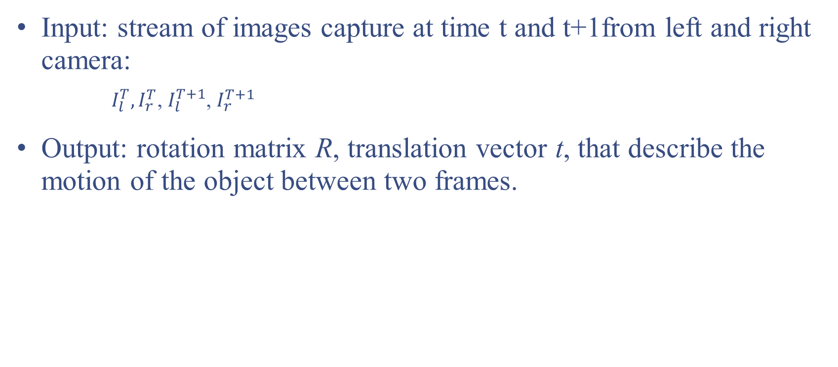
Stereo VO
Input: stream of images capture at time t and t+1from left and right camera:
    $I_{l}^{T},I_{r}^{T}$, $I_{l}^{T+1}$, $I_{r}^{T+1}$
Output: rotation matrix R, translation vector t, that describe the motion of the object between two frames.
Notes:
Stereo VO, when using two or more camera.
translation vector : represent the distance of an object that was moved from one point to another without changing the shape.

Slide 7
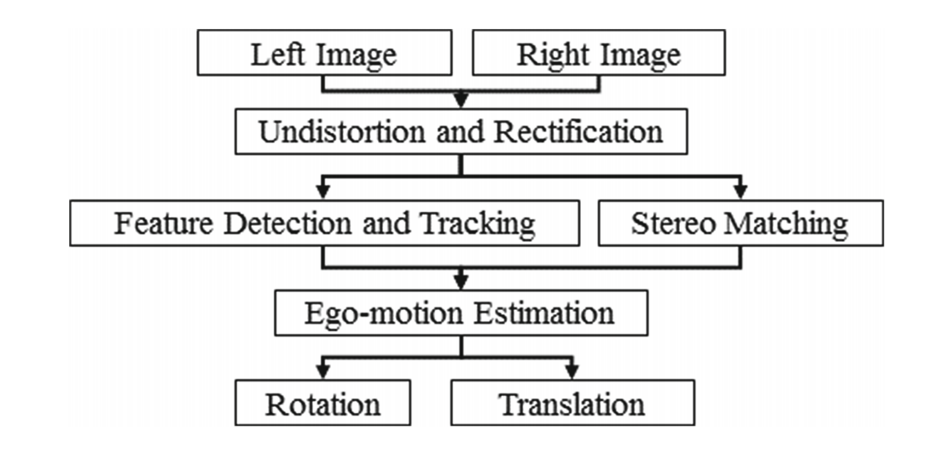
Stereo Visual Odometry
From The paper: Multi-frame Feature Integration for Multi-camera Visual Odometry

Slide 8
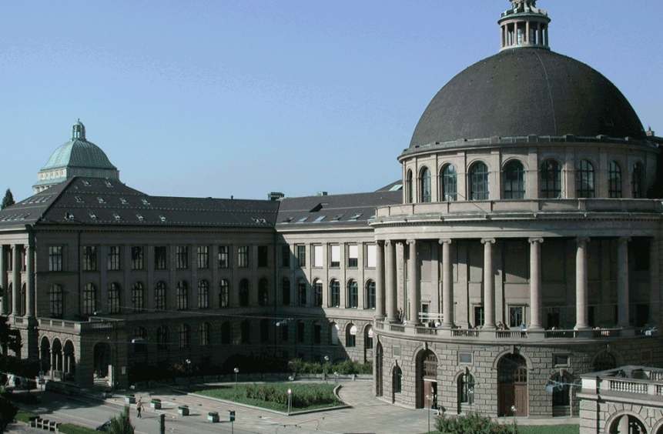
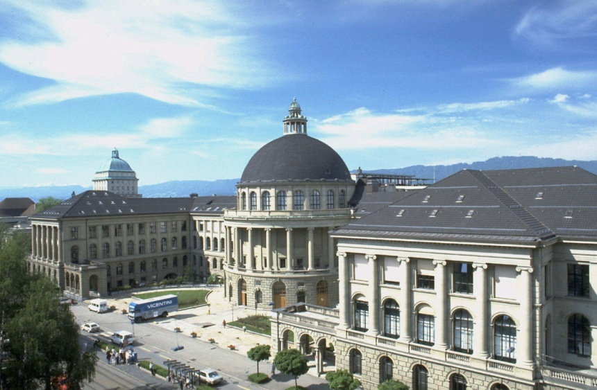

Working Principle
Image 1
Image 2
Notes:
Basically, it looks for feature in the image and try to match and track them in the next frame.

Slide 9
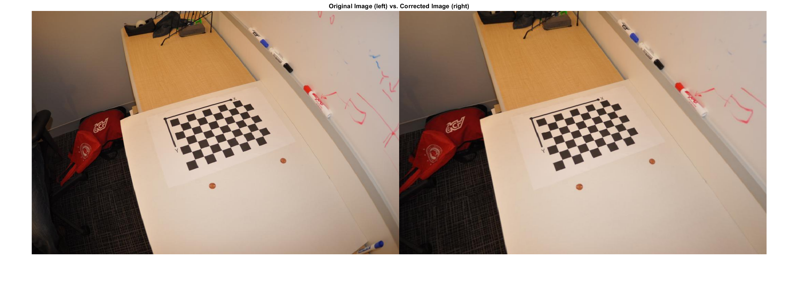
Undistort
Notes:
Left the original and the right without the distortion.
Distortion is the curve that represent in the image.
“straight lines in a scene remain straight in an image” as in Wikipedia.

Slide 10
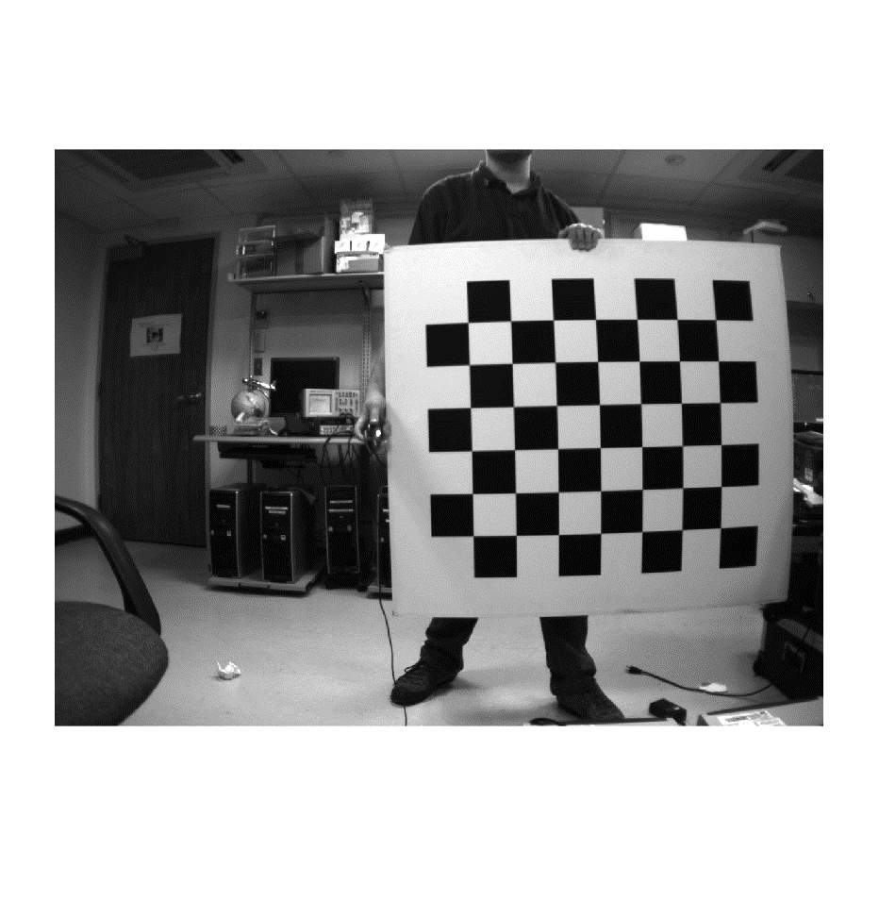
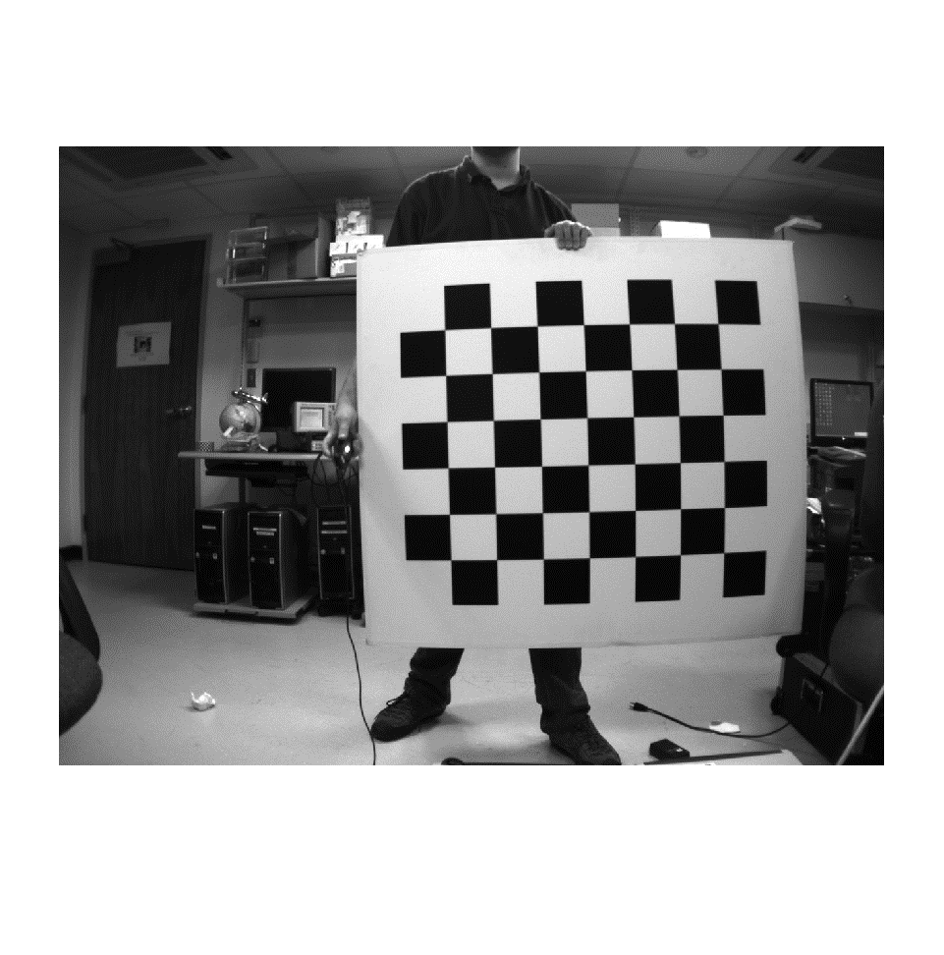
Rectify

Slide 11
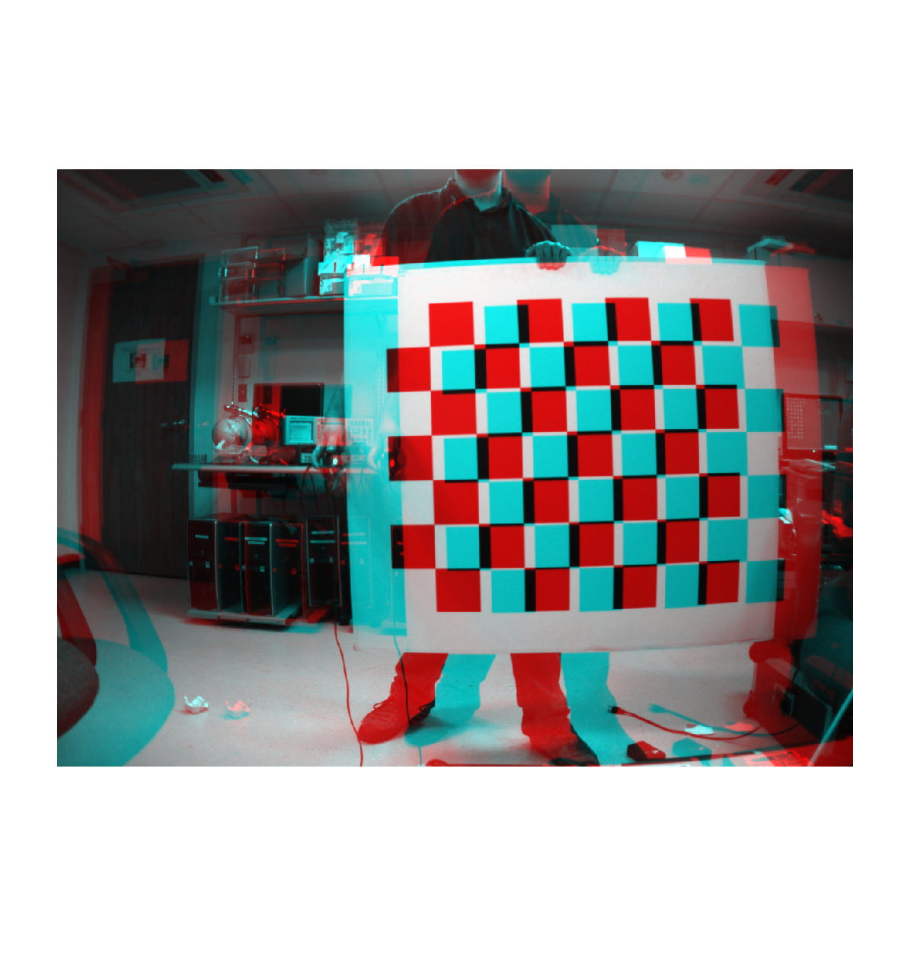
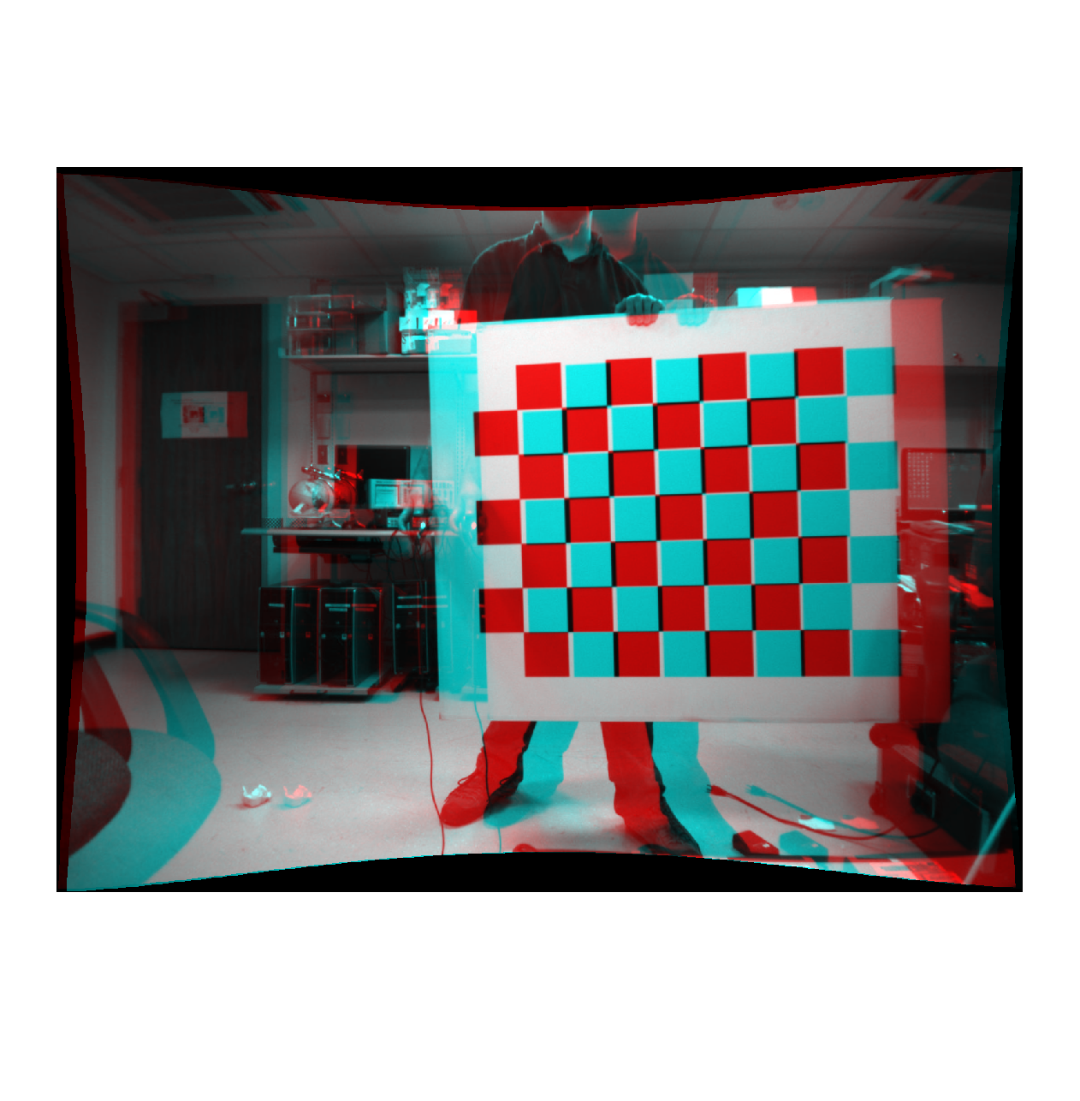
Rectify
Notes:
Rectifying : all the epipolar lines become parallel to the horizontal, and the disparity computation step needs to perform its search for matching blocks only in one direction.
The left side it the combination of the two original images (before rectifying), the right side after the rectifying.
epipolar lines :
https://www8.cs.umu.se/kurser/TDBD19/VT05/epipolar-4.pdf

Slide 12
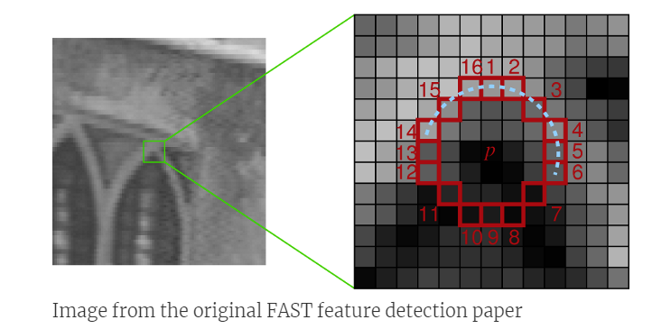
Feature Detection

Slide 13
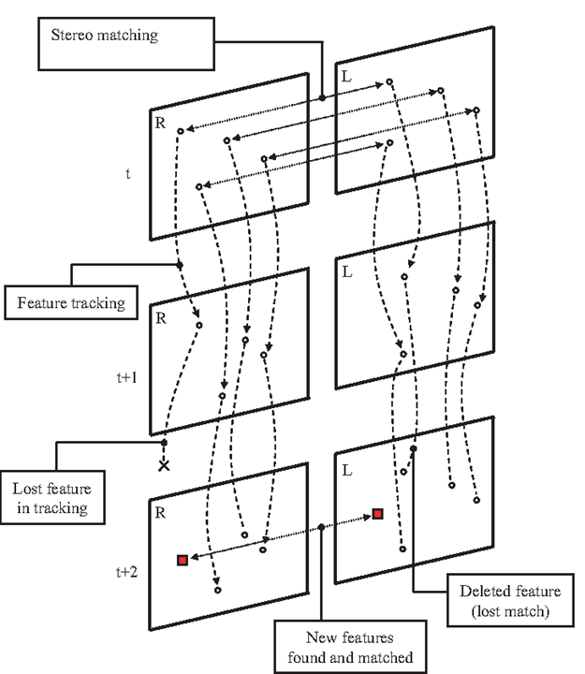
Scheme of the visual odometry algorithm
Modified from the paper: «Stereo vision specific models for particle filter-based SLAM”

Slide 14
Feature Tracking
The matching between two features is performed by applying a p × p pixels cross-correlation on them.
The cross-correlation process is done between each feature in the first frame and a sub-set of features in the second frame.
Those features must be closer than d_{n} pixels from the position of the first frame feature.

Slide 15
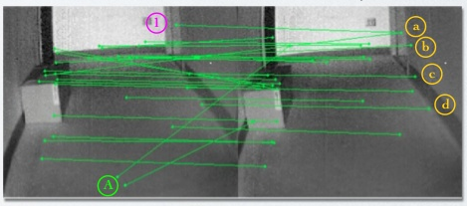
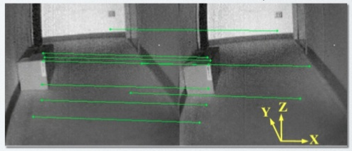
Outlier Rejection
Notes:
Deleting the mismatch point between two images.

Slide 16
Motion Estimation
Estimate a rotation and a translation matrixes that transform the set of points corresponding to the features from the first frame into the set points of their pairs of the second frame.
Video about Visual odometry:
https://www.youtube.com/watch?v=c4LMJJCcSC0
https://www.youtube.com/watch?v=tP1GFapGalQ
Notes:
The goal od VO is to estimation the transformation of an object that move from on position to another.

Slide 17
Structure from Motion (SFM)
SFM is more general than VO and tackles the problem of 3D reconstruction of both the structure and camera poses from unordered image sets
The final structure and camera poses are typically refined with an offline optimization.
https://www.youtube.com/watch?v=sQegEro5Bfo
Modified from slides: “Tutorial on Visual Odometry”, by Davide Scaramuzza
Notes:
This no related to the paper but it kind similar to what the professor mention in a previous class.

Slide 18
Visual Odometry
VO: suffer from several systematic error sources:
  Estimator biases.
  Poor calibration.
  Environmental factors
Notes:
difference between this estimator's expected value and the true value of the parameter being estimated
The orientation of the camera affects the overall position estimates.
When the stereo camera is directed perpendicular to the direction of travel, the overlap between uncertainty ellipsoids corresponding to consecutive measurements of a given landmark decreases. Thus, the combination of measurements should improve landmark localization and, hence, VO accuracy.
Environmental factors
sufficient illumination in the environment
a static scene with enough texture to allow apparent motion to be extracted.
Consecutive frames should have sufficient scene overlapping

Slide 19
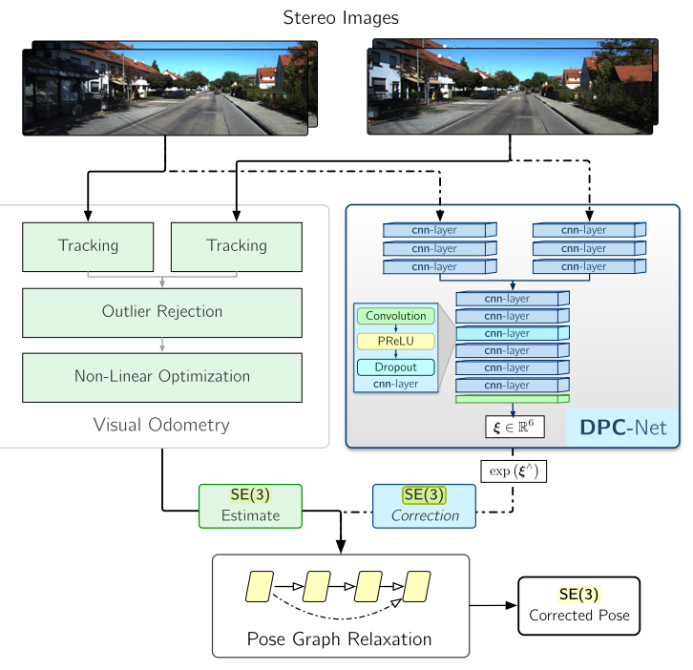
Deep Pose Correction network (DPC-Net)
Notes:
Special Euclidean group SE(n):The set of all displacements is called SE(3), the special Euclidean group of rigid body displacements in three-dimensions.
See the “kinematicsI” in the folder.
Also called “Transformation Matrices” is 4X4 that represent the rotation and translation
where ξ ∈ R6, a vector of Lie algebra coordinates,
Watch for better understand it 3:20
https://www.youtube.com/watch?v=xYQpeKYCfGs
And
https://www.youtube.com/watch?v=HOv2DTaw38U

Slide 20
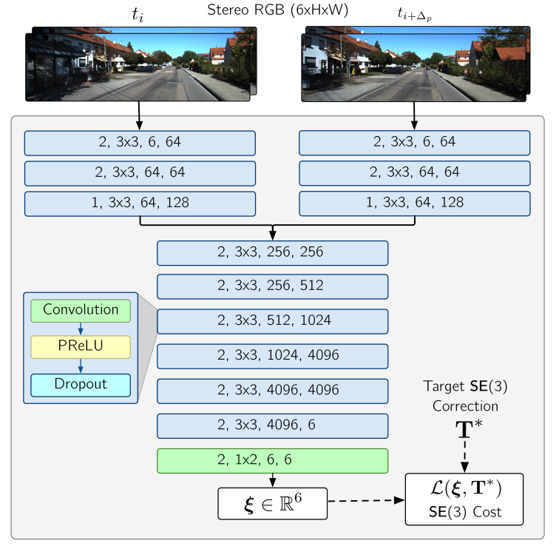

Stride, kernel size, input output channels of for each convolution.
No max pooling to preserve spatial information
ξ is 6-DoF pose vector,
Notes:
Network returns a 6-DoF pose vector which is ξ
where the first three elements correspond to rotation and the last three to translation that transforms one image to the other.
In case of pure rotation, the network predicts a 3×1 vector.
* This information from “gvnn: Neural Network Library for Geometric Computer Vision”

Slide 21
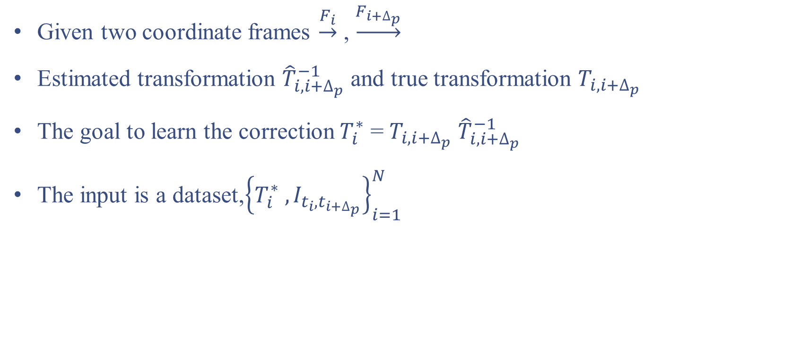
Problem
Given two coordinate frames $\underset{→}{F_{i}}$ , $\underset{→}{F_{i+∆_{p}}}$
Estimated transformation ${\hat{T}}_{i,i+∆_{p}}^{−1}$ and true transformation $T_{i,i+∆_{p}}$
The goal to learn the correction $T_{i}^{∗}$ = $T_{i,i+∆_{p}}$ ${\hat{T}}_{i,i+∆_{p}}^{−1}$
The input is a dataset,${\left\{T_{i}^{∗} ,I_{t_{i},t_{i+∆_{p}}}\right\}}_{i=1}^{N}$

Slide 22
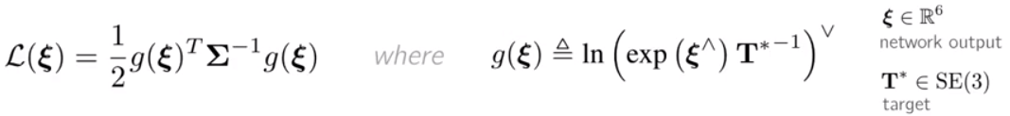

Loss for Corrections
They derived a loos function for learning pose corrections:
Given two stereo image pairs, they use the output of DPC-Net, ξ, to correct the estimator as follows:
Notes:
(·)^, (·)˅ : convert vectors of Lie algebra coordinates to matrix vector space quantities and back, respectively

Slide 23
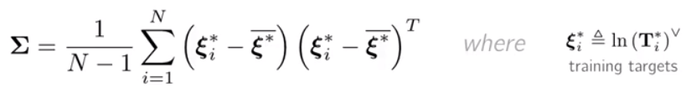

Loss for Corrections
They computed the covariance-based tensor, that balance the rotation and translation loss, from training data:
Where
They derived gradient (“compute Jacobian”), respect to the network output, ξ, for back-propagation:
Notes:
(·)^, (·)˅ : convert vectors of Lie algebra coordinates to matrix vector space quantities and back, respectively
The term Σ balances the rotational and translation loss terms based on their magnitudes in the training set, and accounts for potential correlations.
Jacobian matrix is the matrix of all first-order partial derivatives of a vector-valued function

Slide 24
EXPERIMENTS
They used the KITTI odometry benchmark training set. KITTI
  Consists of 22 stereo sequences, in png forma:
    11 sequences (00-10) with ground truth trajectories for training, and
    11 sequences (11-21) without ground truth for evaluation
They used eight sequences 00,02 and 05-10
For testing and validation, they used the first three sequences (00,02, and 05).
06-10 used for training.

Slide 25
EXPERIMENTS-Training
All images resized to [400, 120] pixels.
Training datasets contained between 35,000 and 52,000 training samples.
They trained all models for 30 epochs using the Adam optimizer, and selected the best epoch based on the lowest validation loss.
Train rotation-only corrections in addition to pose correction.
Notes:
Adam is an optimization algorithm that can used instead of the classical stochastic gradient descent procedure to update network weights iterative based in training data
validation loss:
Training loss is much lower than validation loss then this means the network might be overfitting
If your training/validation loss are about equal then your model is underfitting
Unlike accuracy, loss is not a percentage. It is a summation of the errors made for each example in training or validation sets.

Slide 26
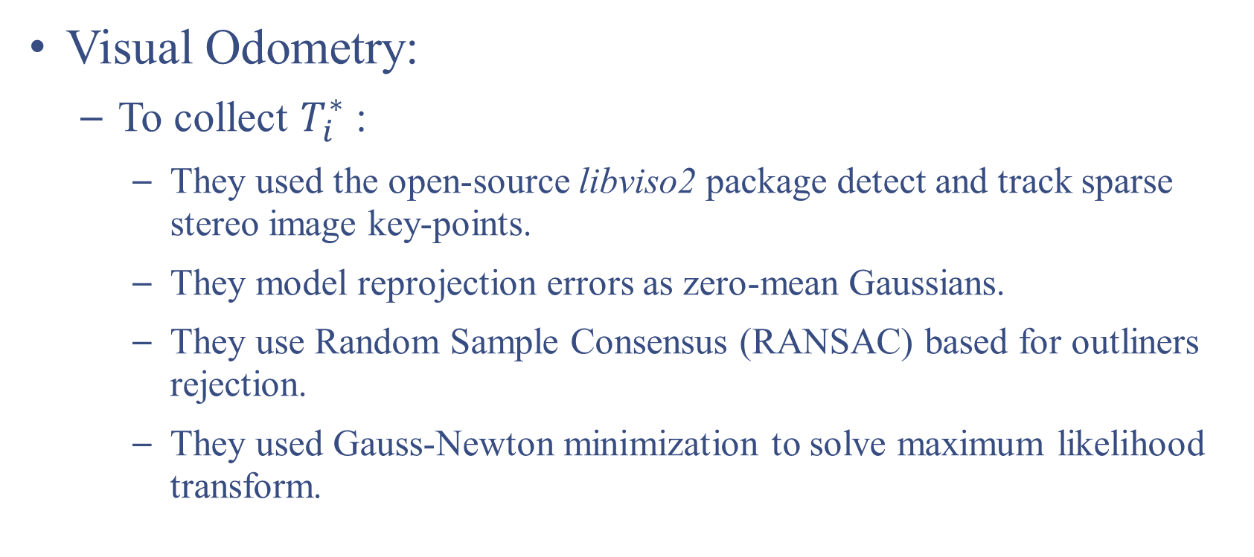
Estimators
Visual Odometry:
  To collect $T_{i}^{∗}$:
    They used the open-source libviso2 package detect and track sparse stereo image key-points.
    They model reprojection errors as zero-mean Gaussians.
    They use Random Sample Consensus (RANSAC) based for outliners rejection.
    They used Gauss-Newton minimization to solve maximum likelihood transform.
Notes:
We model reprojection errors (due to sensor noise and quantization) as zero-mean Gaussians with
Gauss-Newton minimization : To solve non-linear least squares problems. It is a modification of Newton's method for finding a minimum of a function, it can only be used to minimize a sum of squared function values.
The Gauss–Newton algorithm will be used to fit a model to some data by minimizing the sum of squares of errors between the data and model's predictions.

Slide 27
Estimators
Sparse Visual Odometry with Radial Distortion:
  They modified the input images to test with degraded visual data.
  They applied radial distortion to the (rectified) KITTI dataset to simulated a poorly calibrated lens.
  They computed S-VO localization estimates and then trained DPC-Net.

Slide 28
Estimators
Dense (direct) Visual Odometry:
  Pixel intensity values are used for both motion estimation and stereo matching.
  It used for comparation with their proposed method

Slide 29
Evaluation Metrics
They used three error metrics to evaluate the performance of DPC-Net:
  Mean absolute trajectory error.
  Cumulative absolute trajectory error.
  Mean segment error.
Notes:
Mean absolute trajectory error: averages the magnitude of the rotational or translational error of estimated poses with respect to a ground truth trajectory defined within the same navigation frame.
Cumulative absolute trajectory error: cumulative absolute trajectory error sums rotational or translational up to a given point in a trajectory.
Mean segment error: Averages the end-point error for all the possible segments of a given length within a trajectory, and then normalizes by the segment length

Slide 30
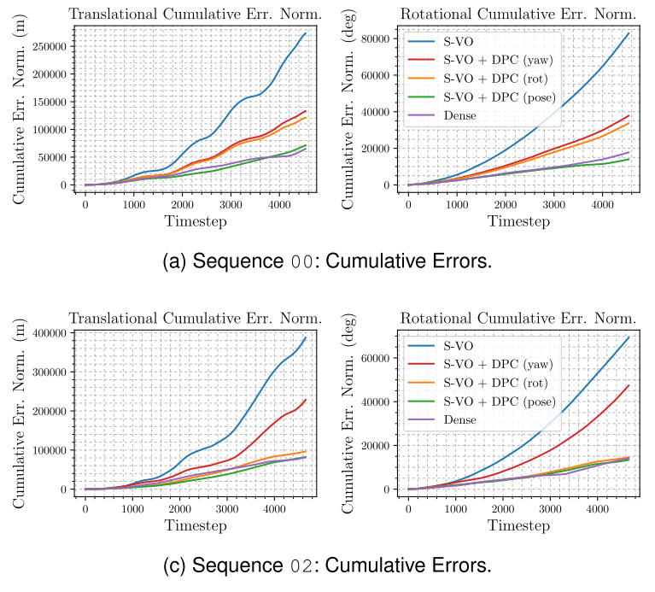

Slide 31
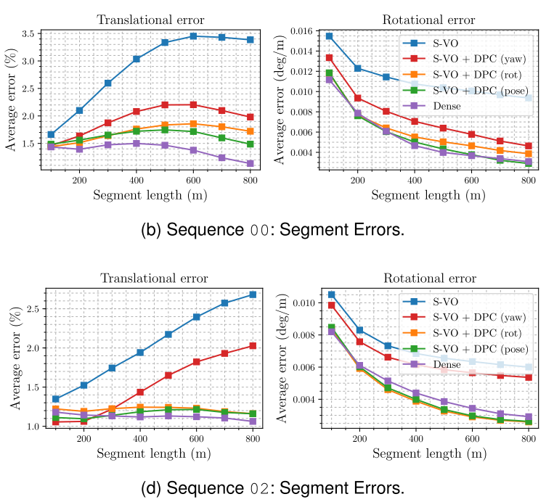
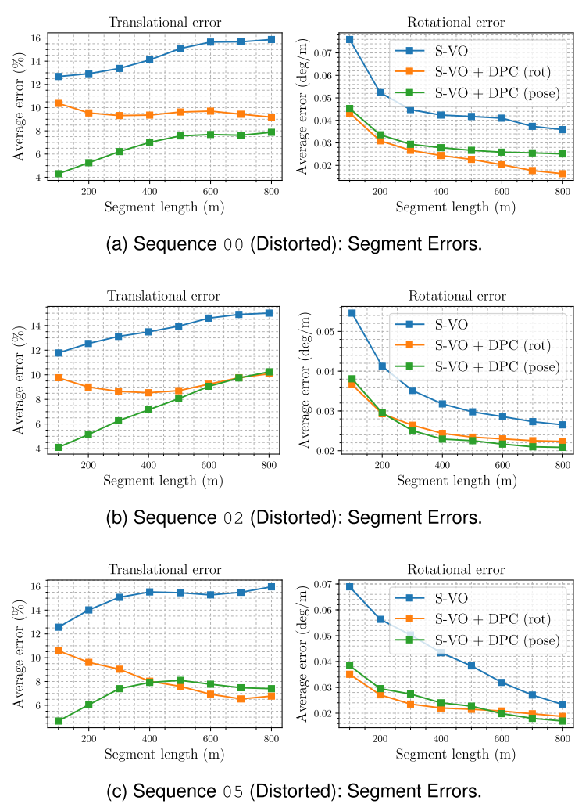

Slide 32
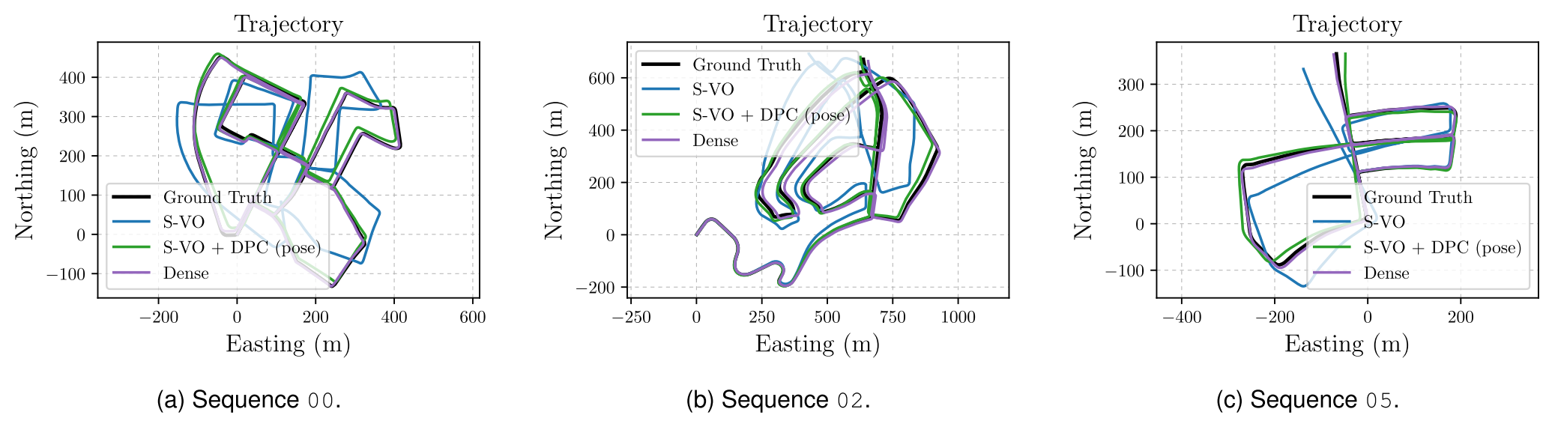
Results

Slide 33
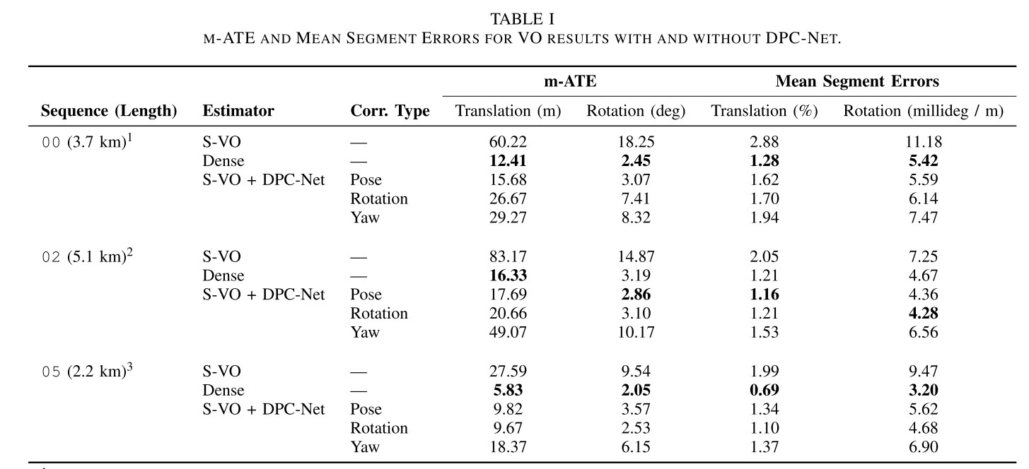
Results

Slide 34
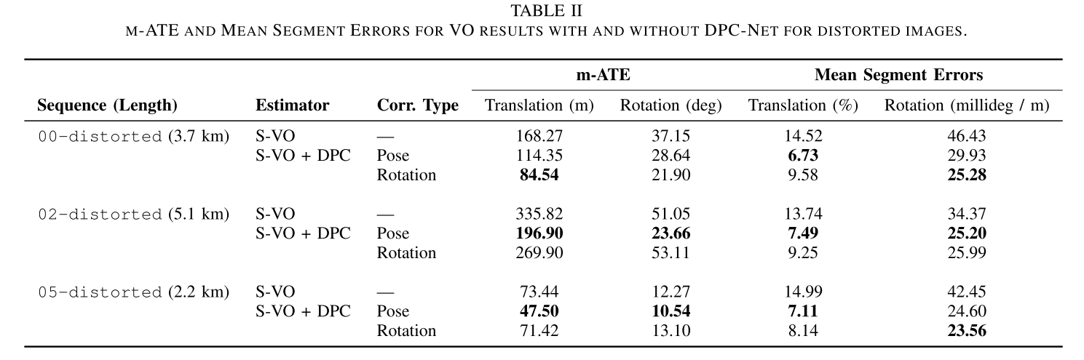
Results
Notes:
They did not compare with Dense method, I do not why…

Slide 35
Reference
Peretroukhin, Valentin and Jonathan Kelly. “DPC-Net: Deep Pose Correction for Visual Localization.” CoRR abs/1709.03128 (2017).
Singh, Avi “Visual Odmetry from scratch - A tutorial for beginners”, May, 2015, https://avisingh599.github.io/vision/visual-odometry-full
Aqel, Mohammad O. A. et al. “Review of Visual Odometry: Types, Approaches, Challenges, and Applications.” SpringerPlus 5.1 (2016): 1897. PMC. Web. 18 Apr. 2018.
Nistér, David, Oleg Naroditsky, and James Bergen. "Visual odometry." Computer Vision and Pattern Recognition, 2004. CVPR 2004. Proceedings of the 2004 IEEE Computer Society Conference on. Vol. 1. Ieee, 2004.
F.A. Moreno, J.L. Blanco, J. Gonzalez, “Stereo vision specific models for particle filter-based SLAM”,Robotics and Autonomous Systems,Volume 57, Issue 9,,2009.
MATLAB Documentations.

Slide 36
Authors video
https://www.youtube.com/watch?v=j9jnLldUAkc

Slide 37
Thank you
Question?

