Slide 1
Human-level control through deep reinforcement learning
Mnih et. al.
Deep Mind

Slide 2
Reinforcement Learning - used to find optimum actions where states/features are well defined.
Deep Learning - learn specific features from high-dimensional data
Reinforcement Learning + Deep Learning = AI (?) - David Silver
Motivation

Slide 3
Motivation Continued...
Deep Reinforcement Learning
Deep Q-network agent
Input - only the pixels and the game score
Achieved a level comparable to that of a professional human games tester across a set of 49 games, using the same algorithm, network architecture and hyperparameters.

Slide 4
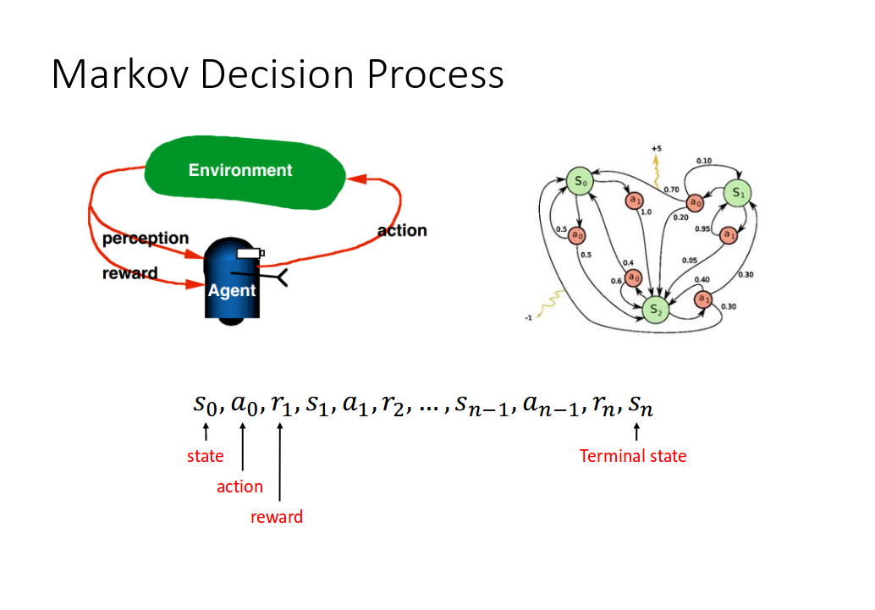
Recap

Slide 5
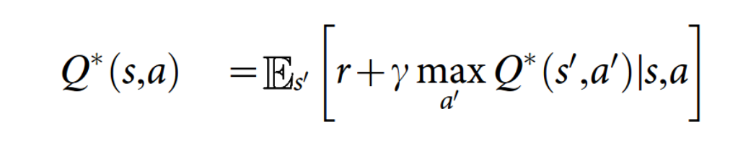
Value-Action (Q or Quality) Function
Goal is to approximate the optimal action-value function
Maximum sum of rewards discounted r_{t} at each time step t, achievable by a behavior policy, after making an observation (s) and taking action (a).

Slide 6
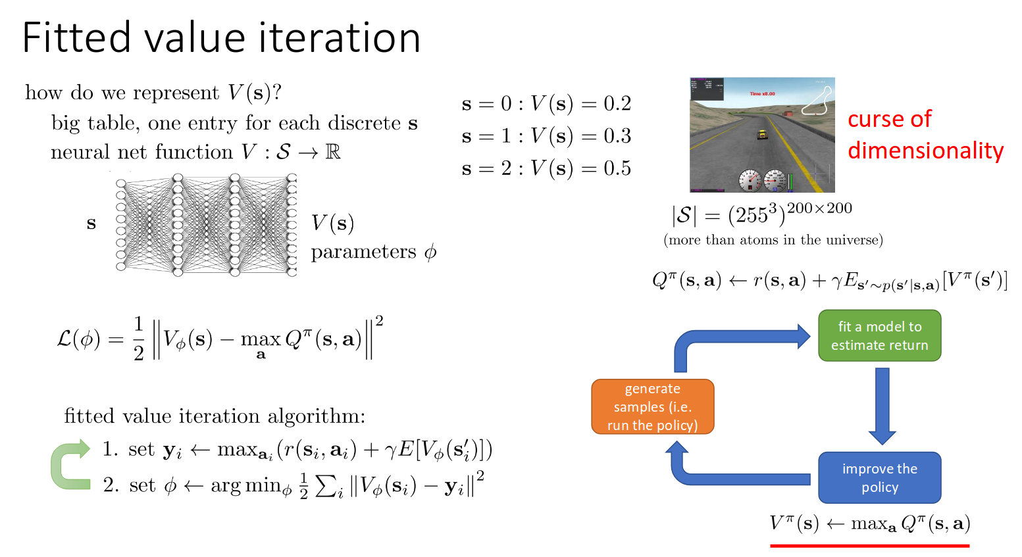

Slide 7
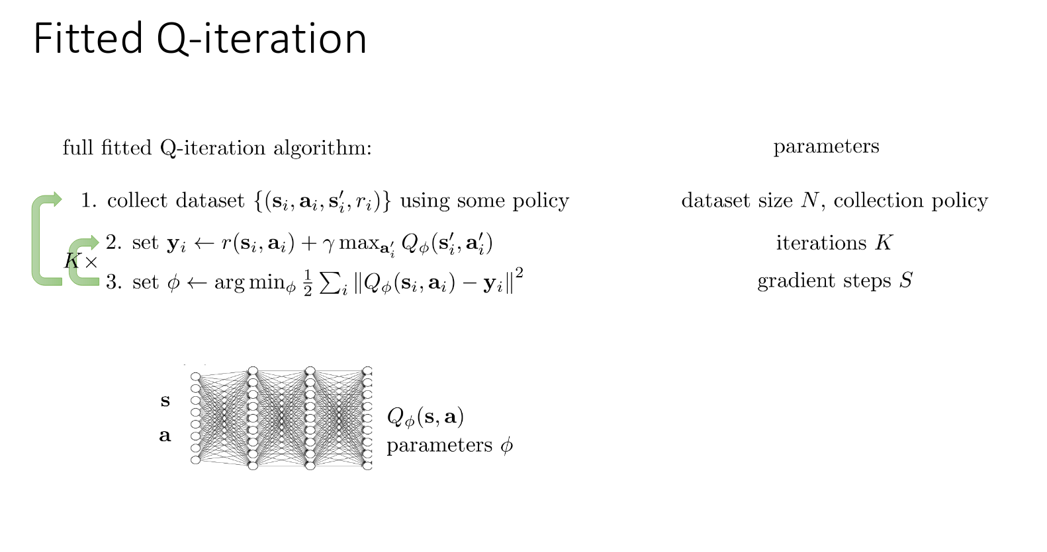

Slide 8
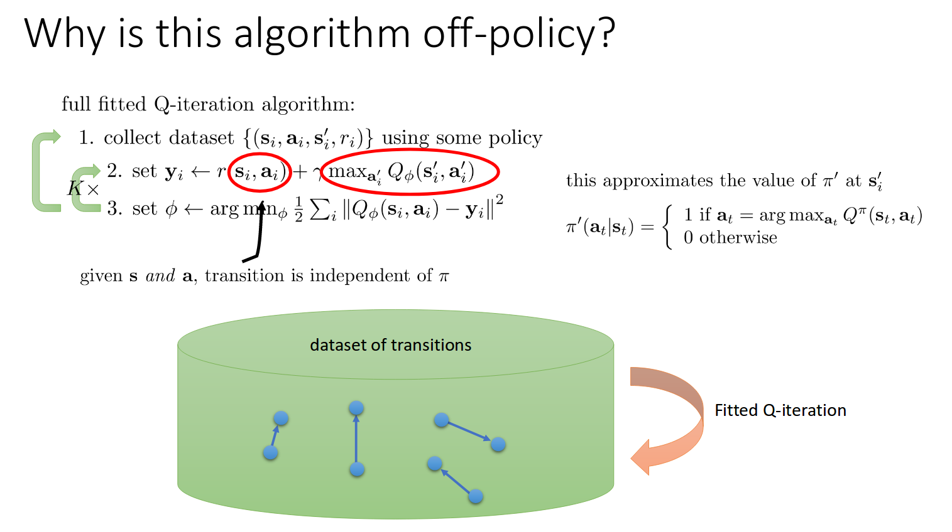

Slide 9
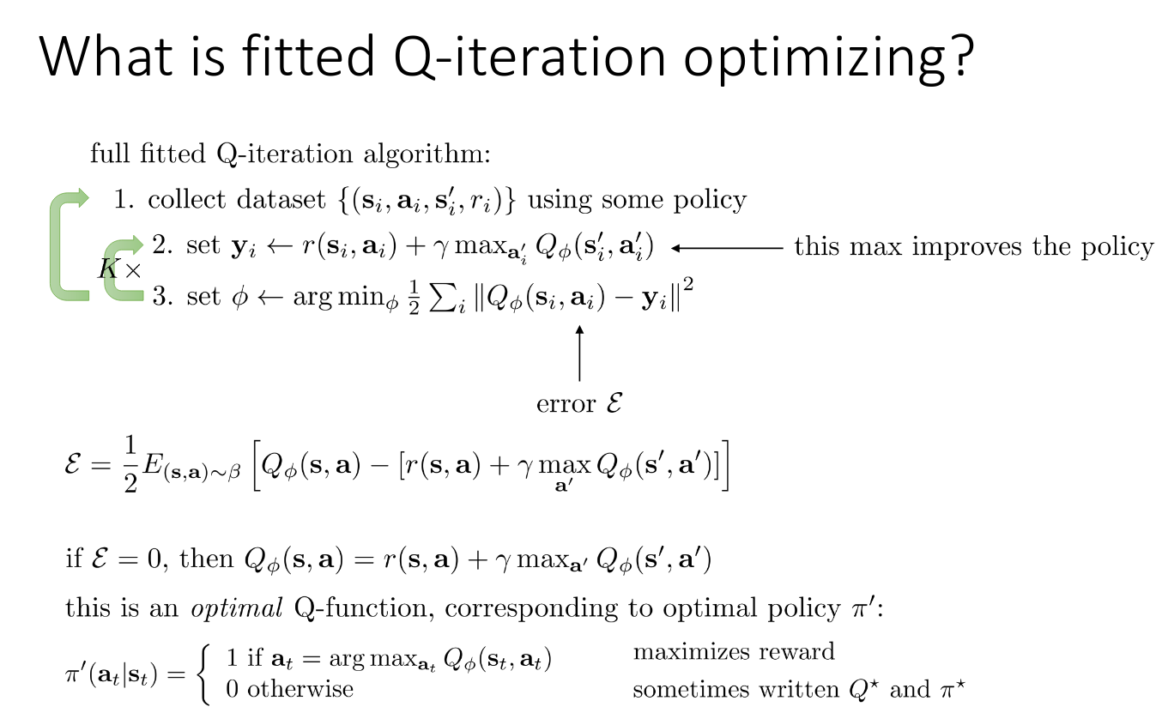

Slide 10
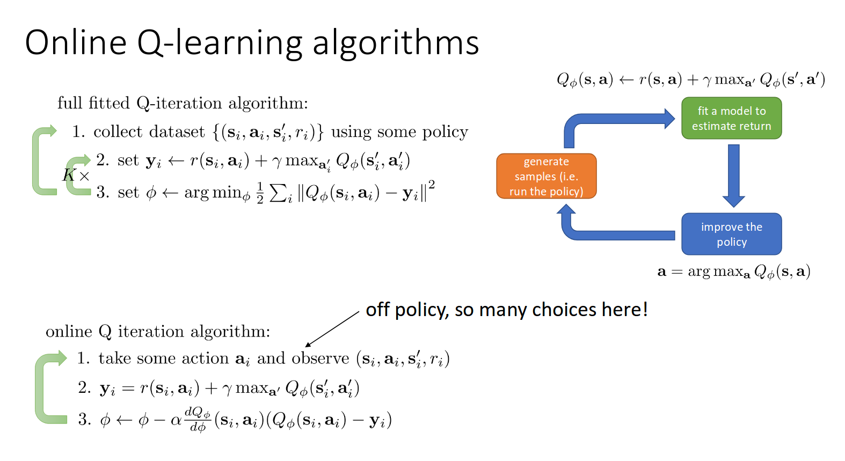

Slide 11
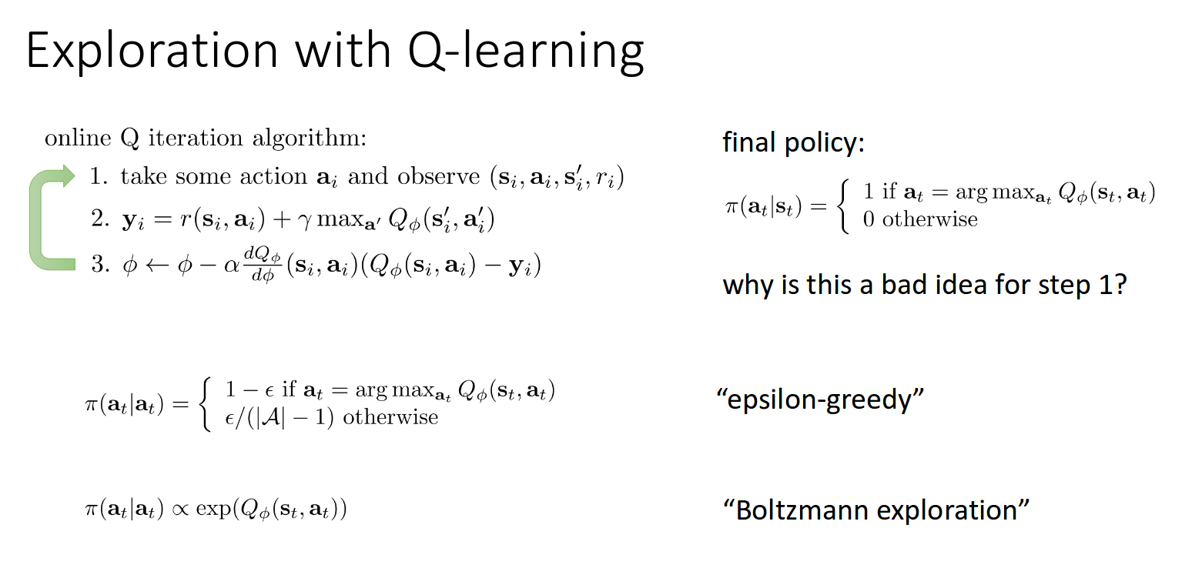

Slide 12
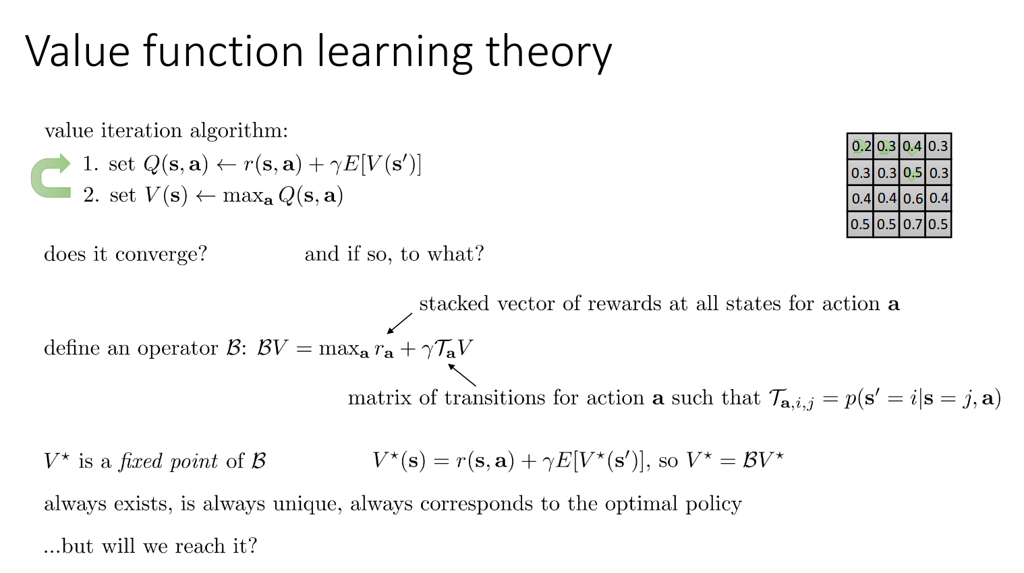

Slide 13
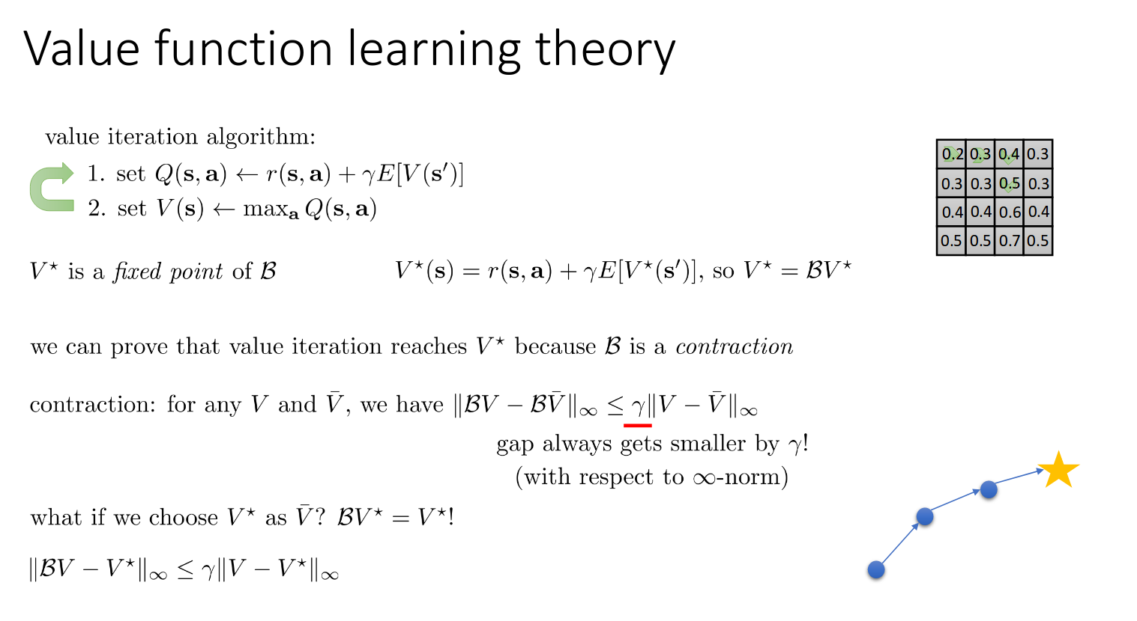

Slide 14
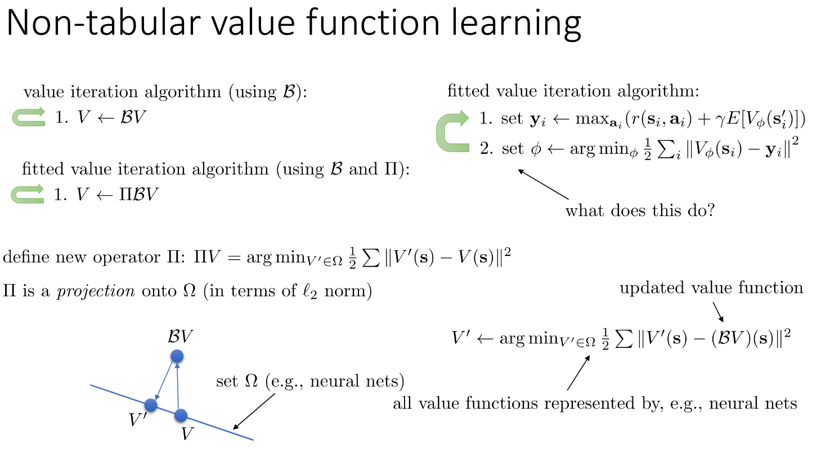

Slide 15
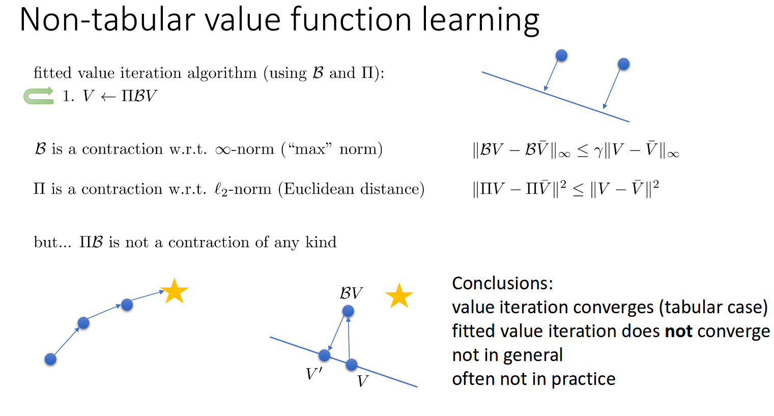

Slide 16
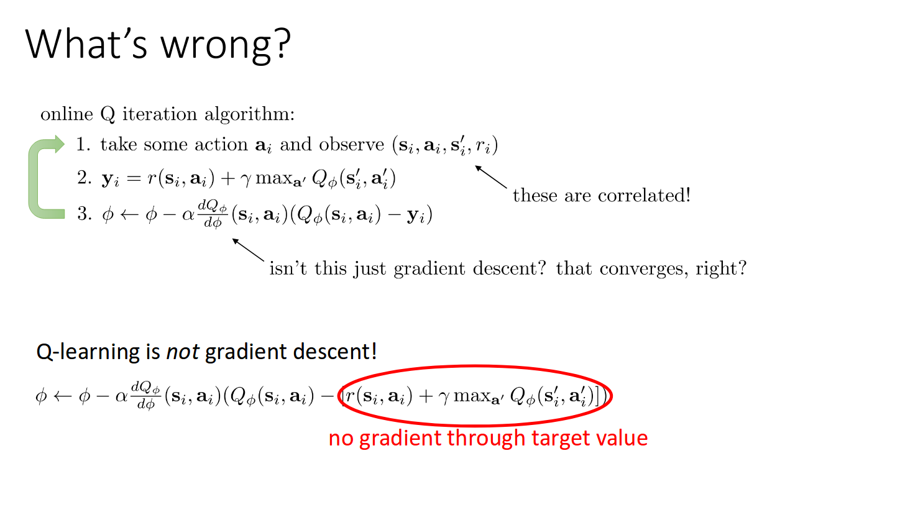

Slide 17
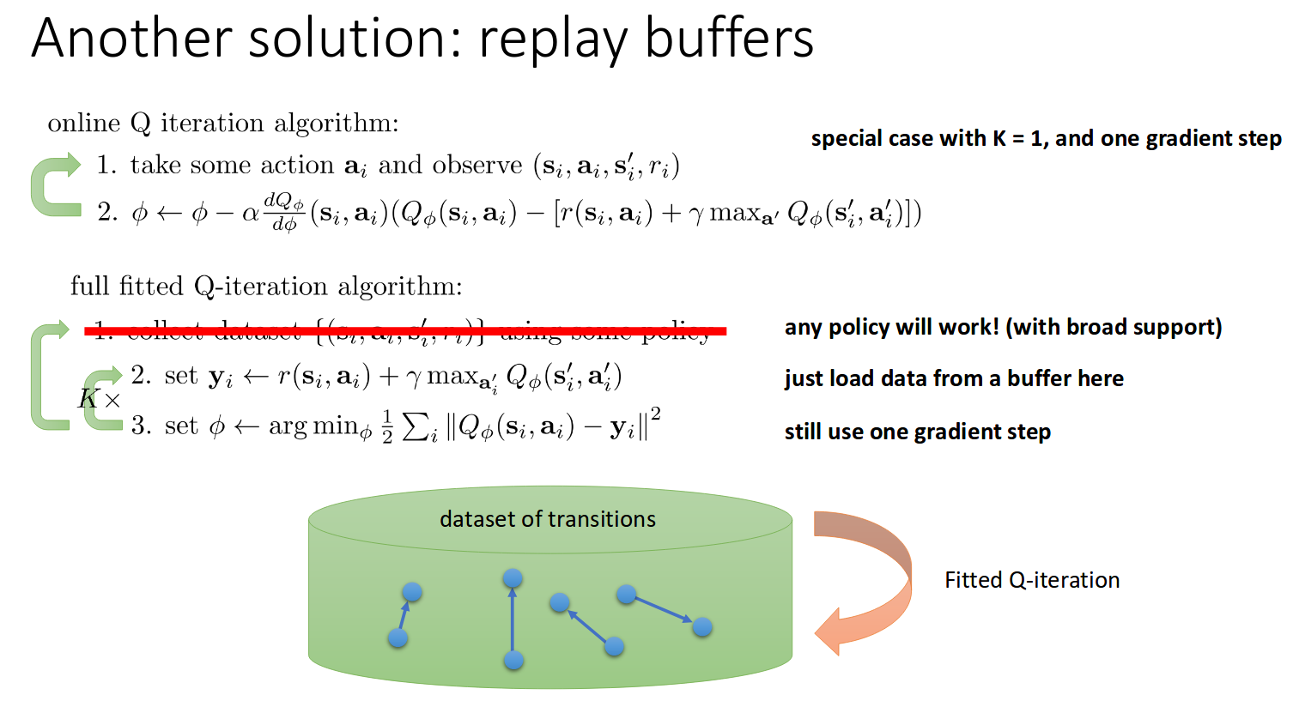
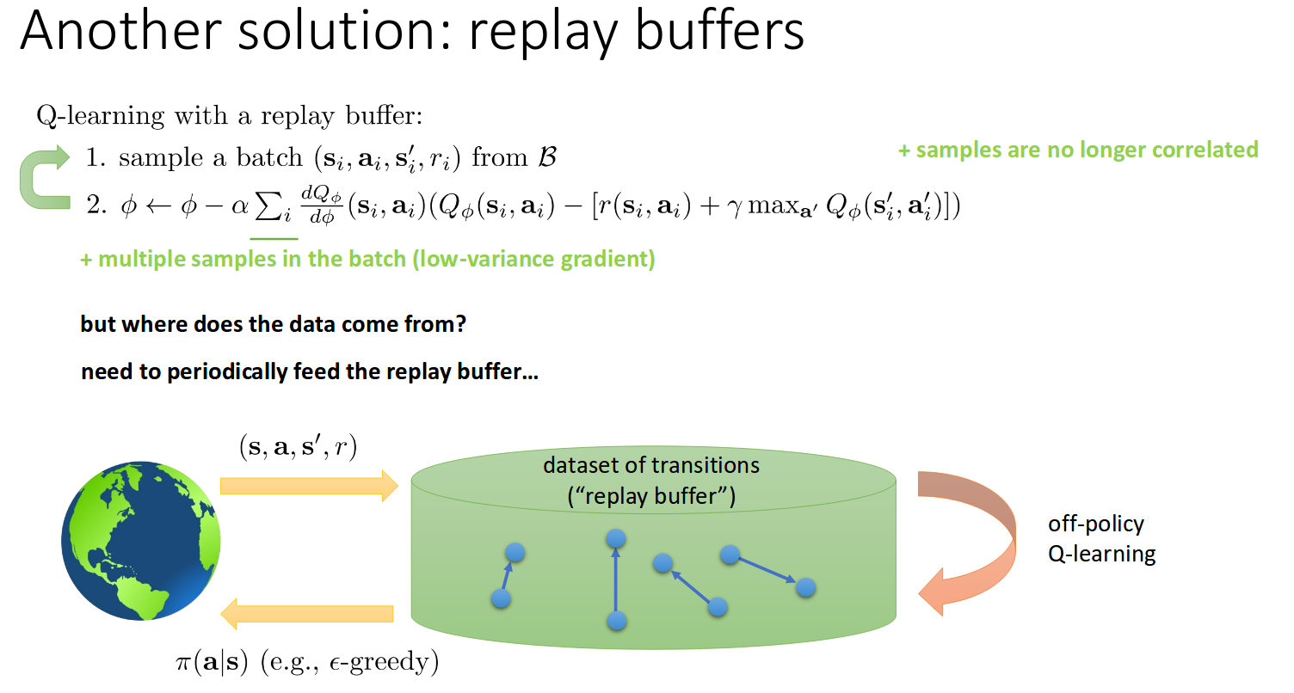

Slide 18
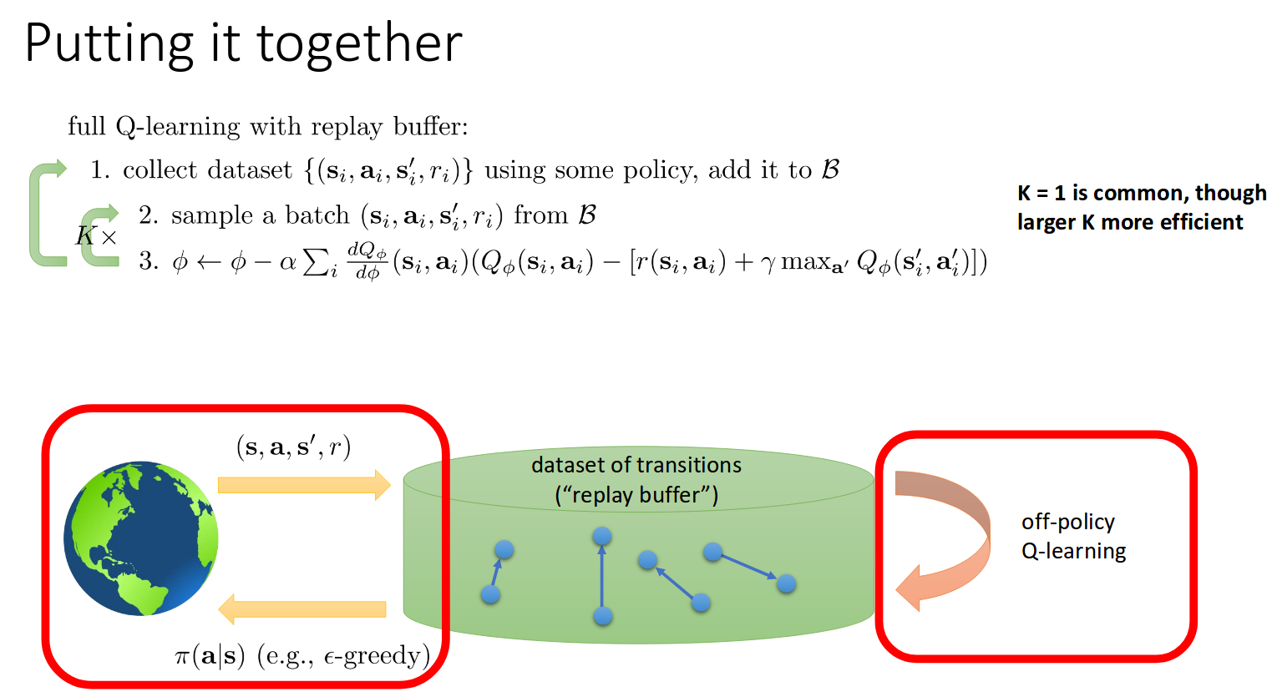

Slide 19
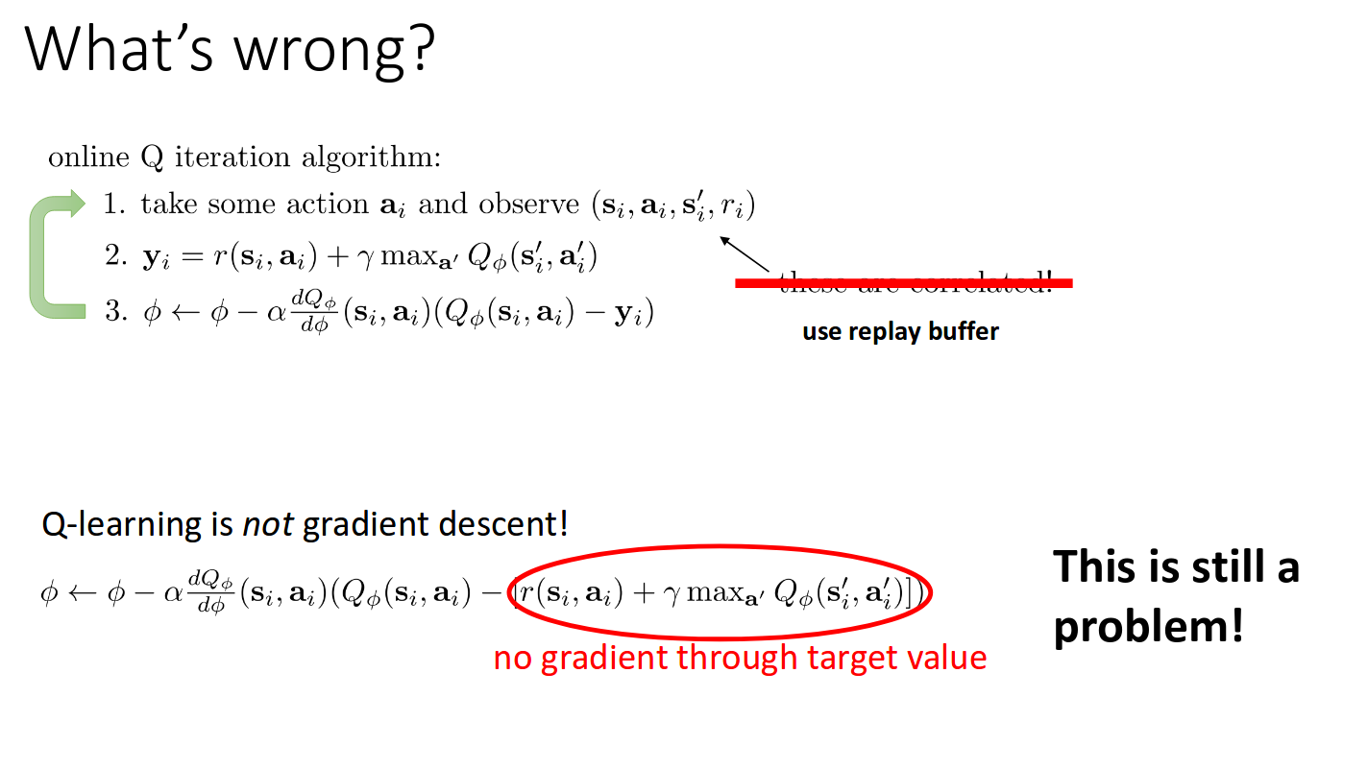

Slide 20
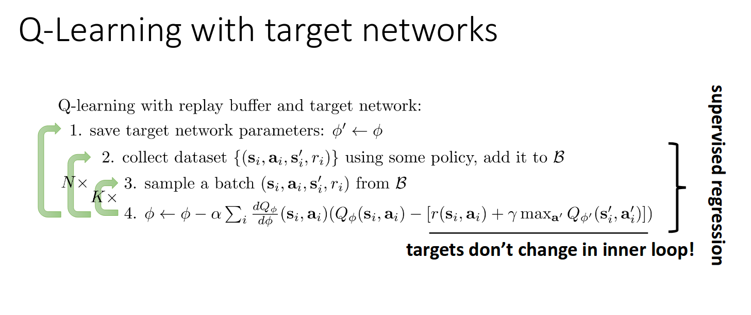

Slide 21
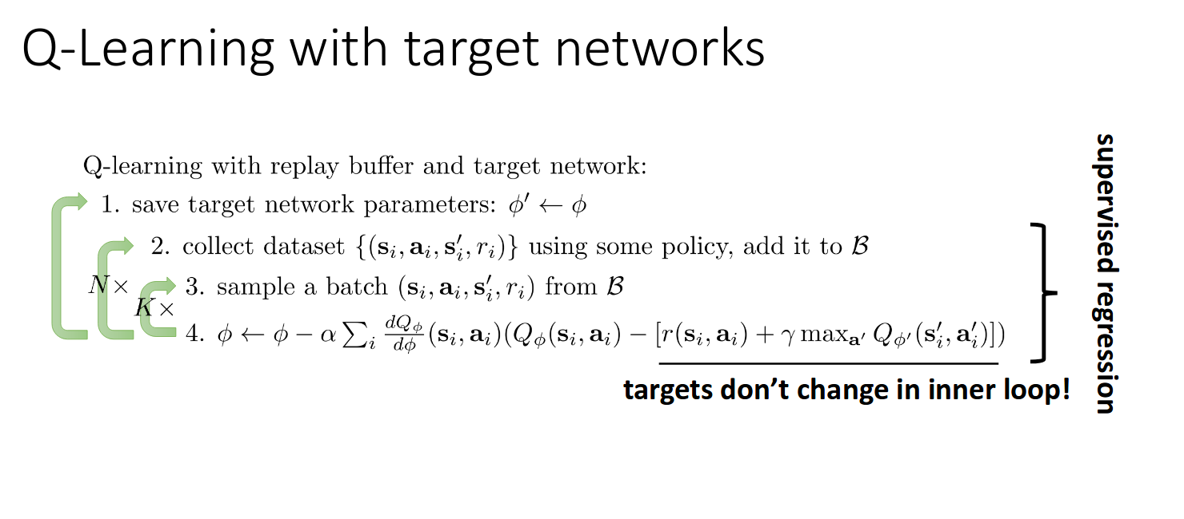

Slide 22
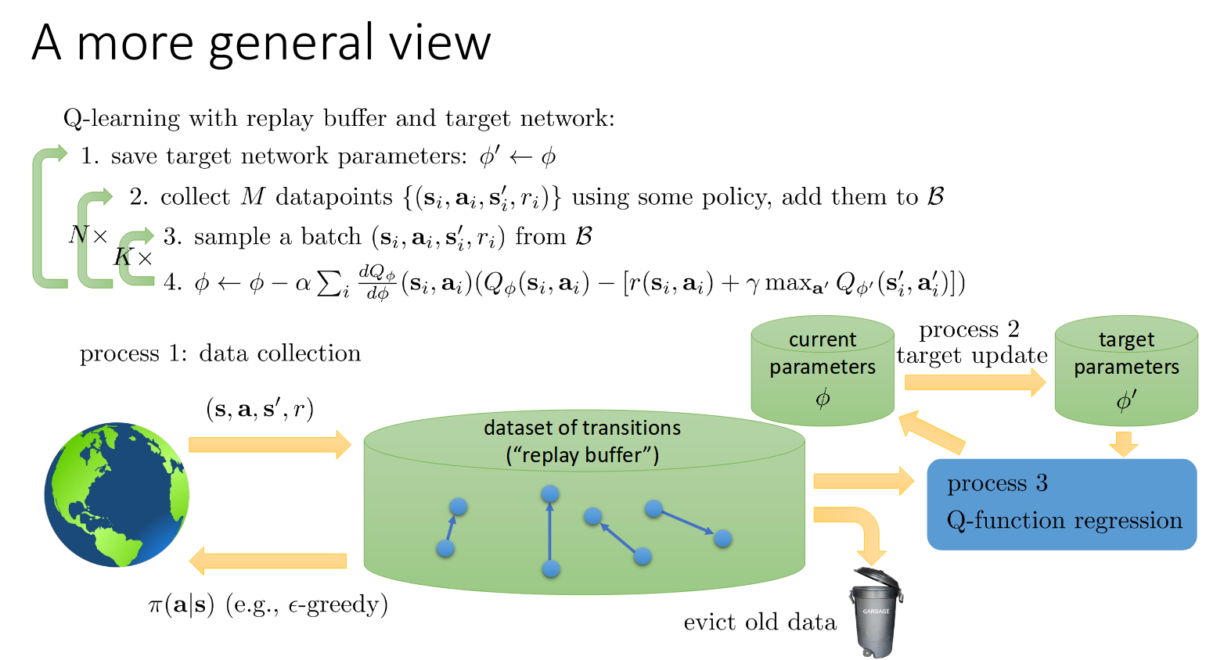
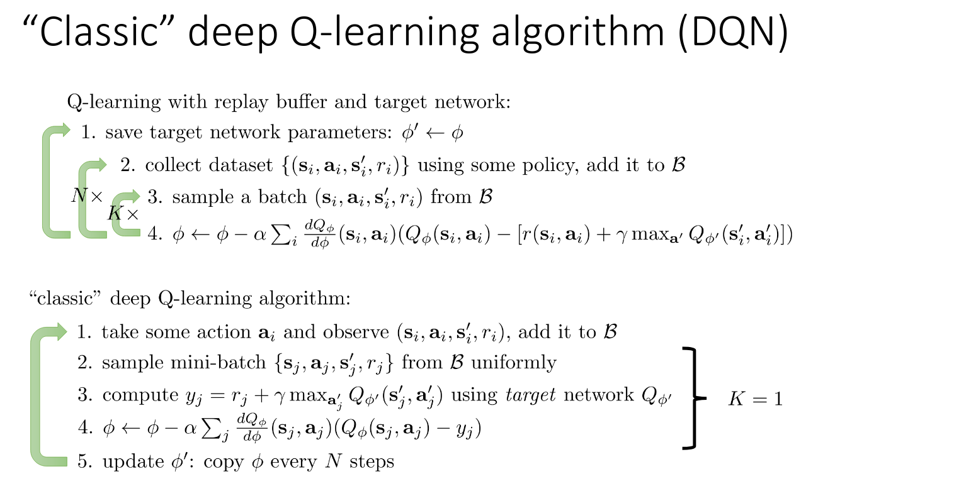

Slide 23
Implementation : First Preprocessing
Raw Input - 210 * 160 pixels with 128-color palette (demanding in terms of computation and memory requirements)
Extracted the Y channel ( luminance ) from RGB and rescale it to 84*84.
Function ∅ applies preprocessing to m recent frames and stacks them to produce input to the Q-function, in which m=4
Real input = 84*84*4

Slide 24
Model Architecture
Input : 84*84*4 images after preprocessing
Hidden Layer: 32 filters 8*8 with stride 4
Another hidden layer: 64 filters of 4*4 with stride 2
Final Fully Connected Layer : 512 rectifier units
Output layer is fully connected linear layer with single output for each valid action
Number of valid actions varied between 4 and 18 based on games
The activation function used in convolutional layer was rectified nonlinearity

Slide 25
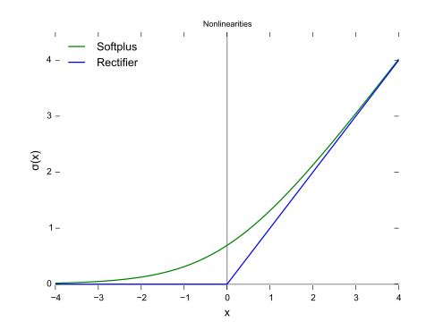


Slide 26
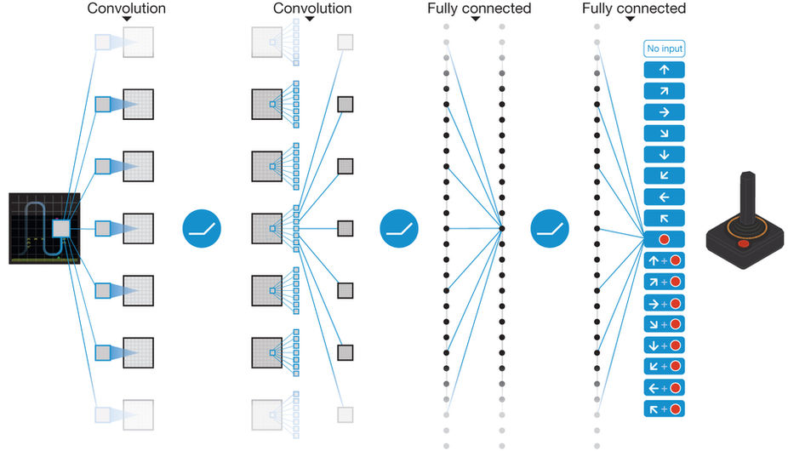

Slide 27
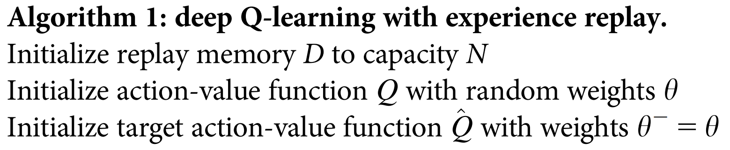
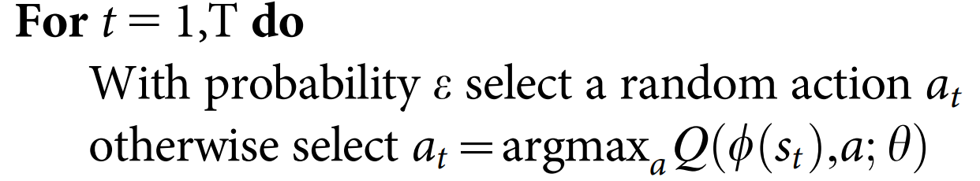

Slide 28
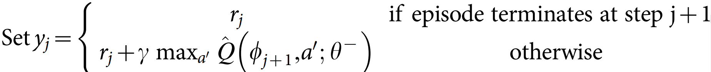
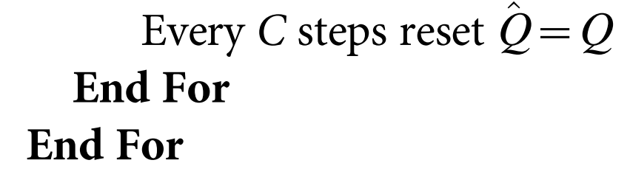

Slide 29
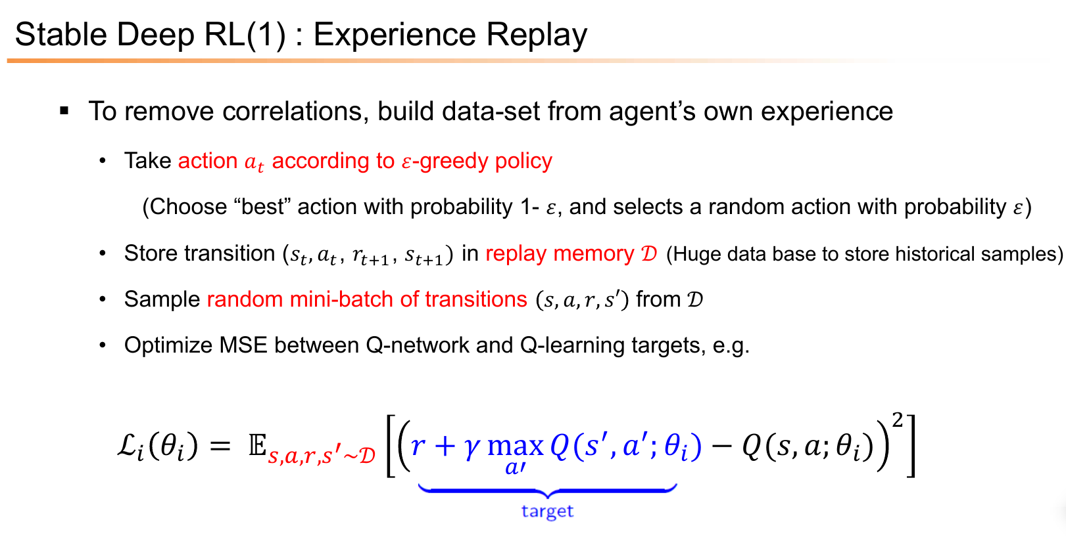

Slide 30
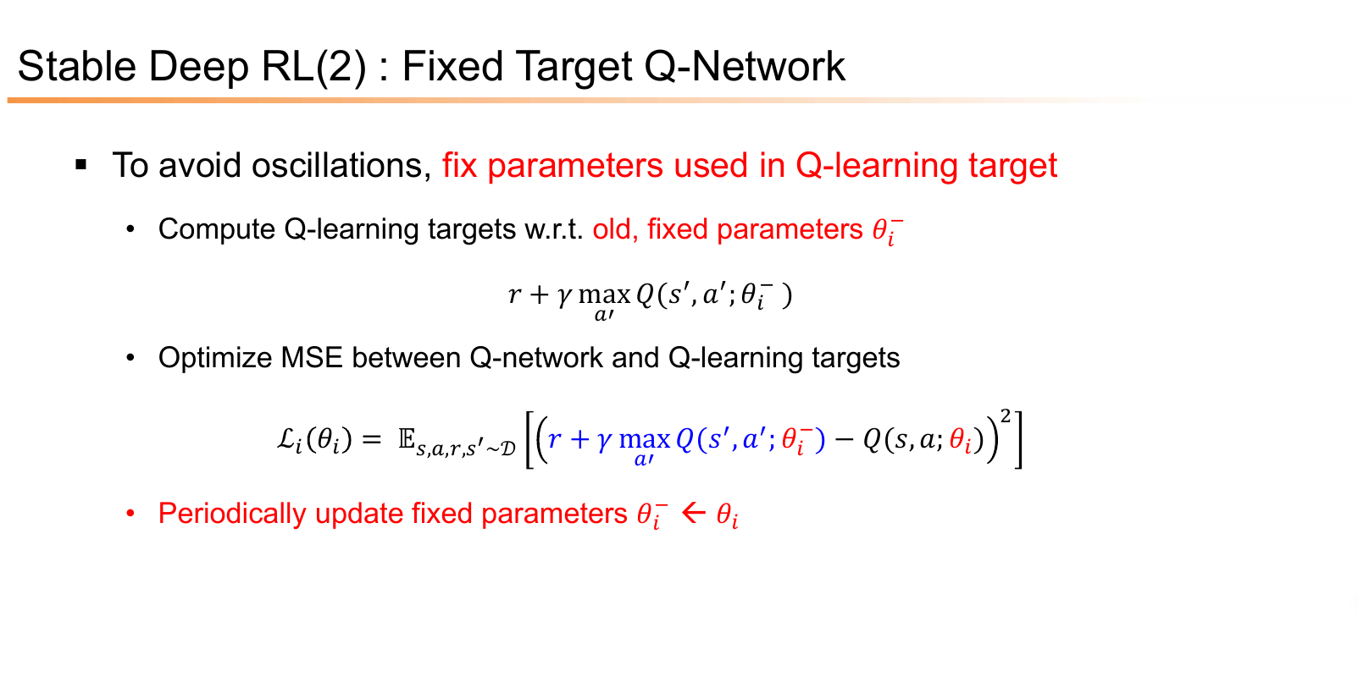

Slide 31
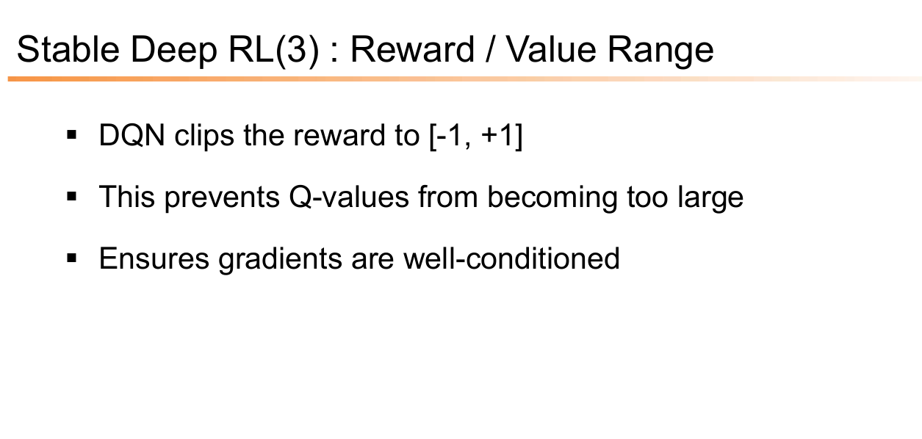

Slide 32
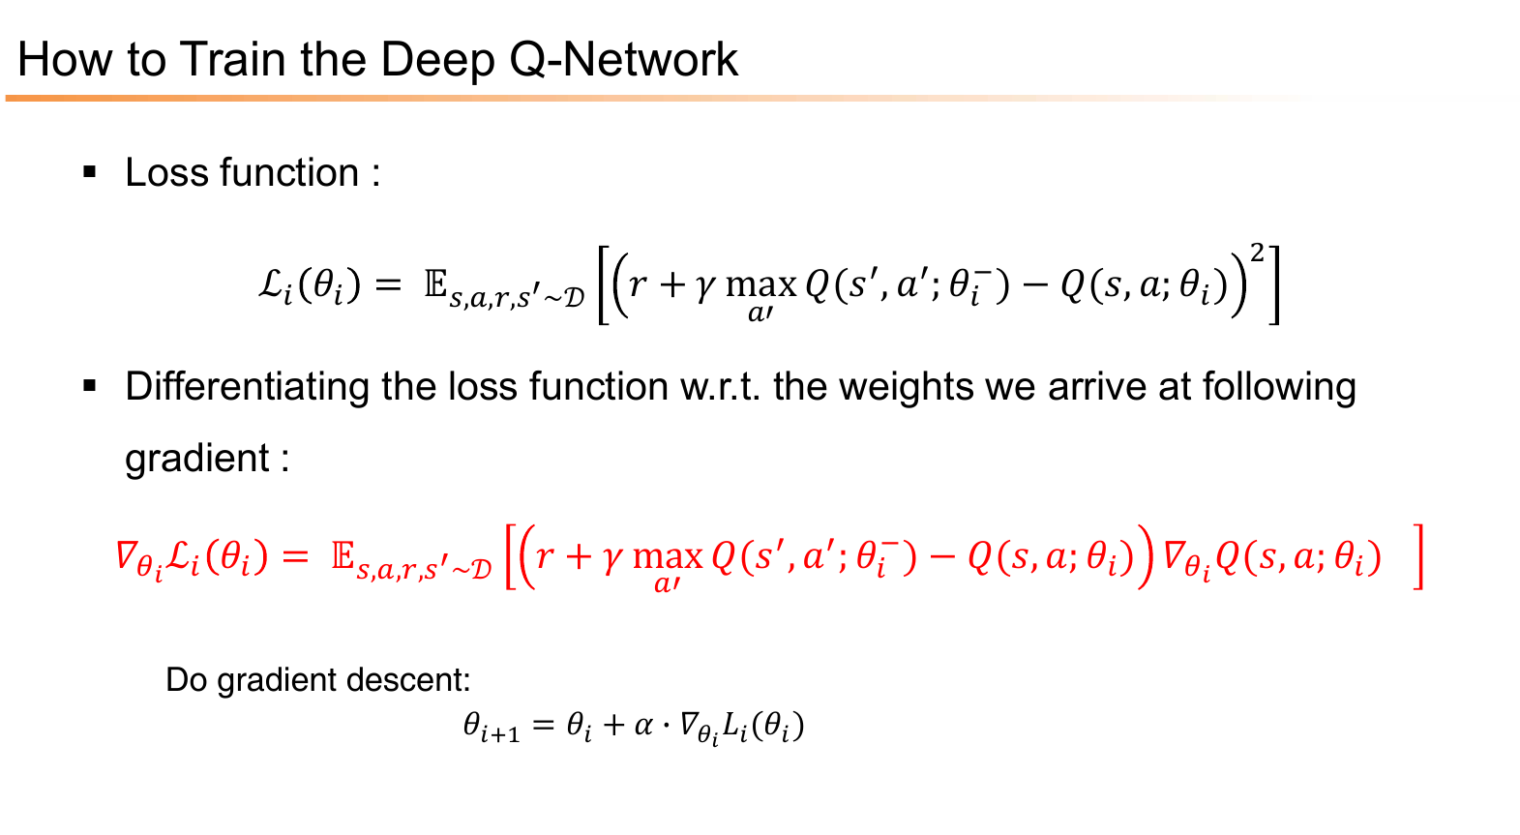

Slide 33
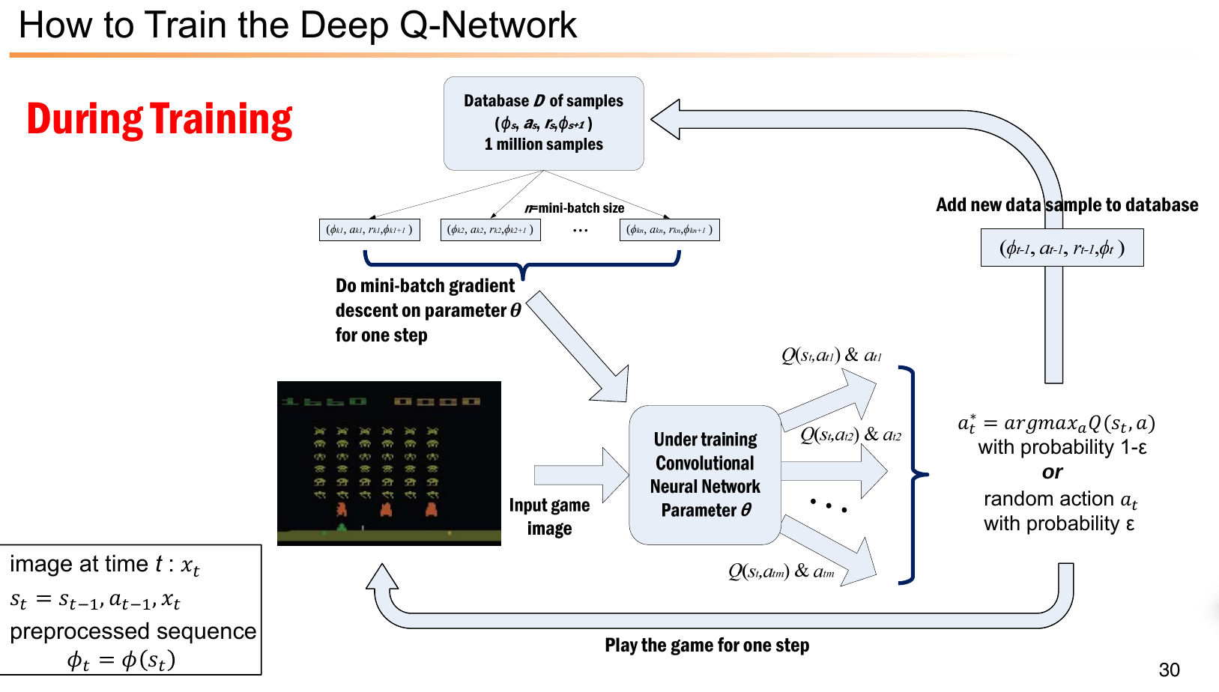

Slide 34
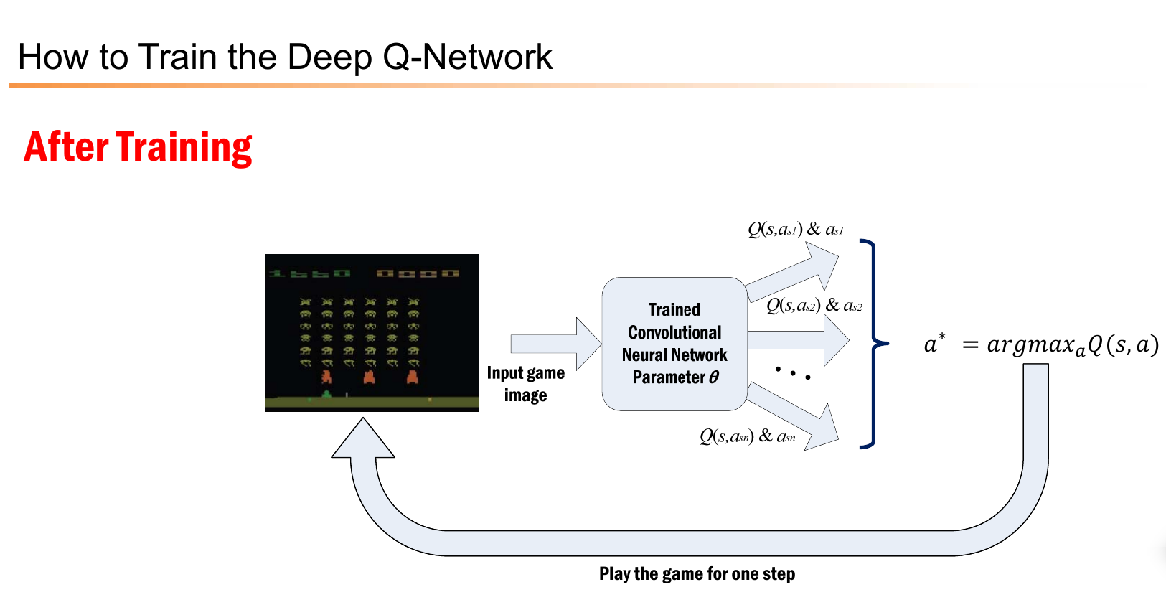

Slide 35
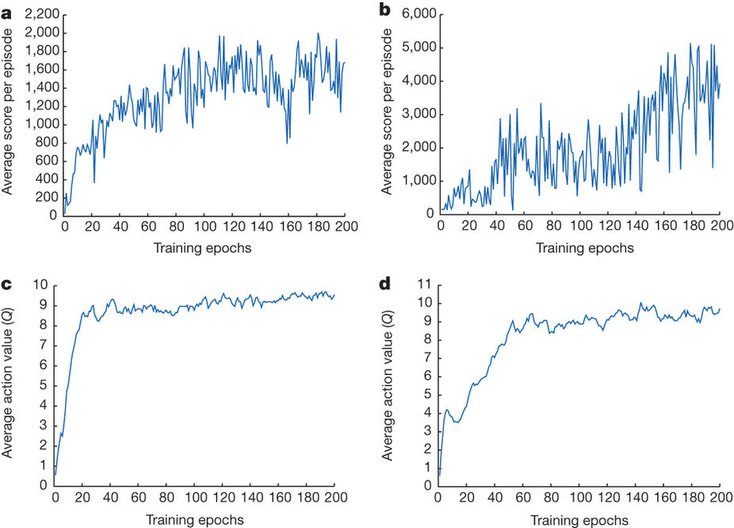

Slide 36
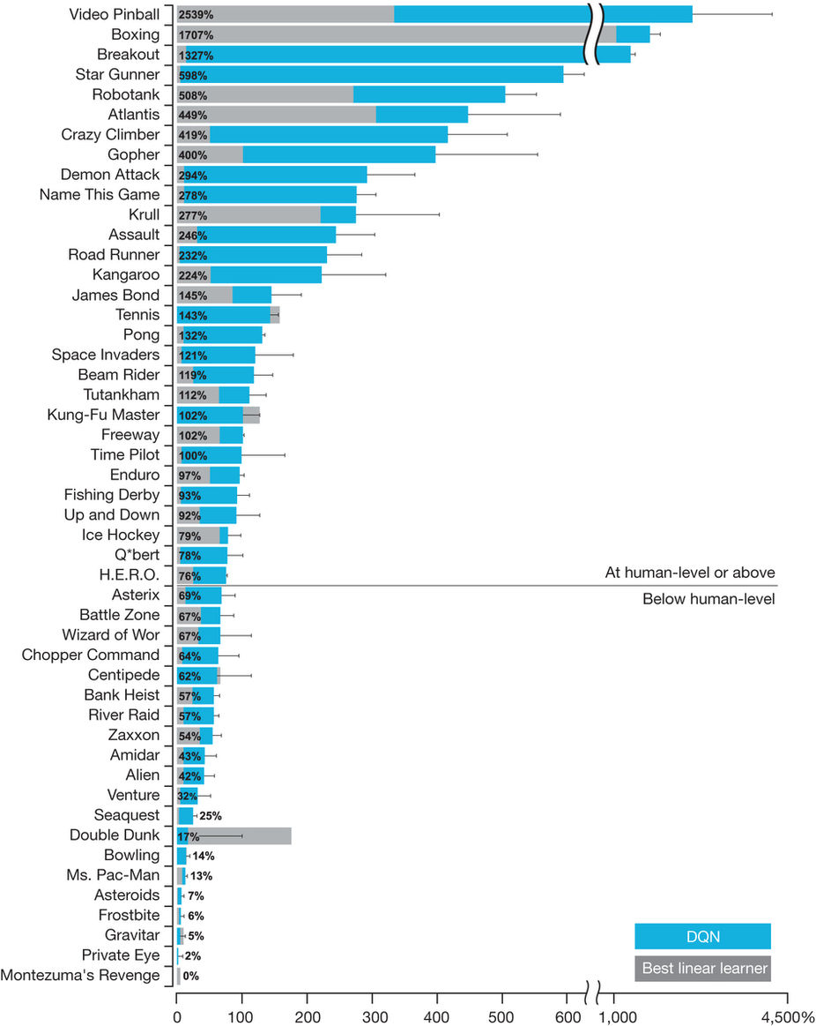
100 * (DQN score - random play score)/ (human score - random play score).

Slide 37
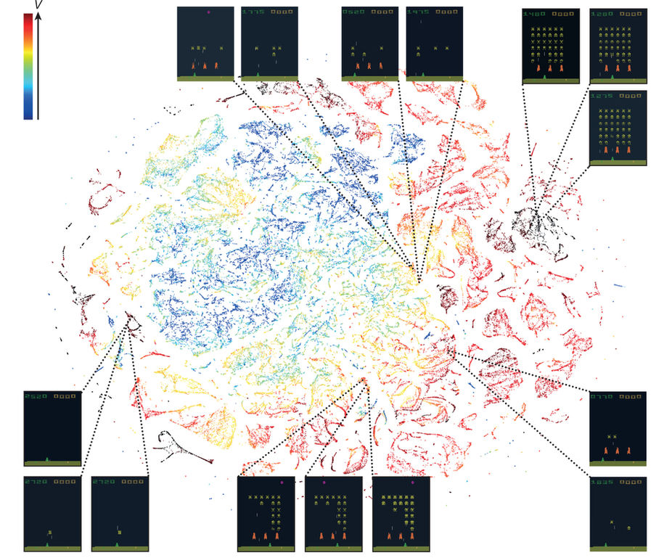
DQN agent play for 2 h of real game time and running the t-SNE algorithm on the last hidden layer representation
The DQN predicts high state values for both full (top right screenshots) and nearly complete screens (bottom left screenshots) because it has learned that completing a screen leads to a new screen full of enemy ships.
Partially completed screens (bottom screenshots) are assigned lower state values because less immediate reward is available.
The screens shown on the bottom right and top left and middle are less perceptually are still mapped to nearby representations and similar values because the orange bunkers do not carry great significance near the end of a level.

Slide 38
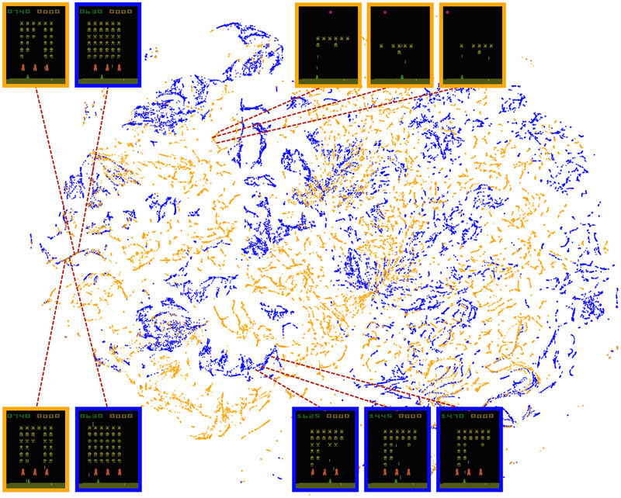
Generated by combination of human and
DQN show similar visualization

Slide 39
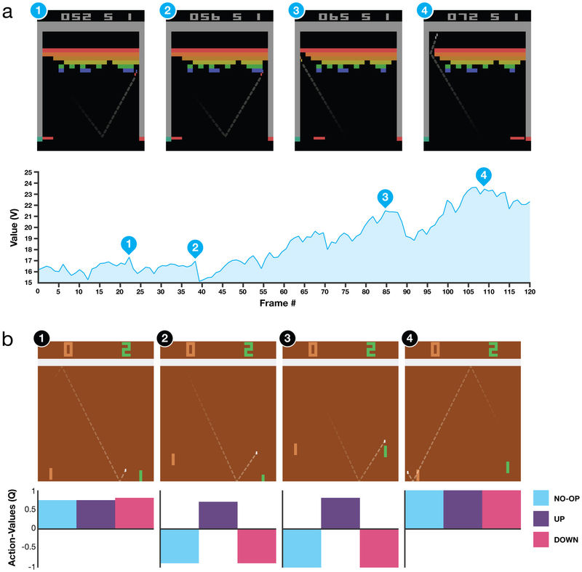

Slide 40
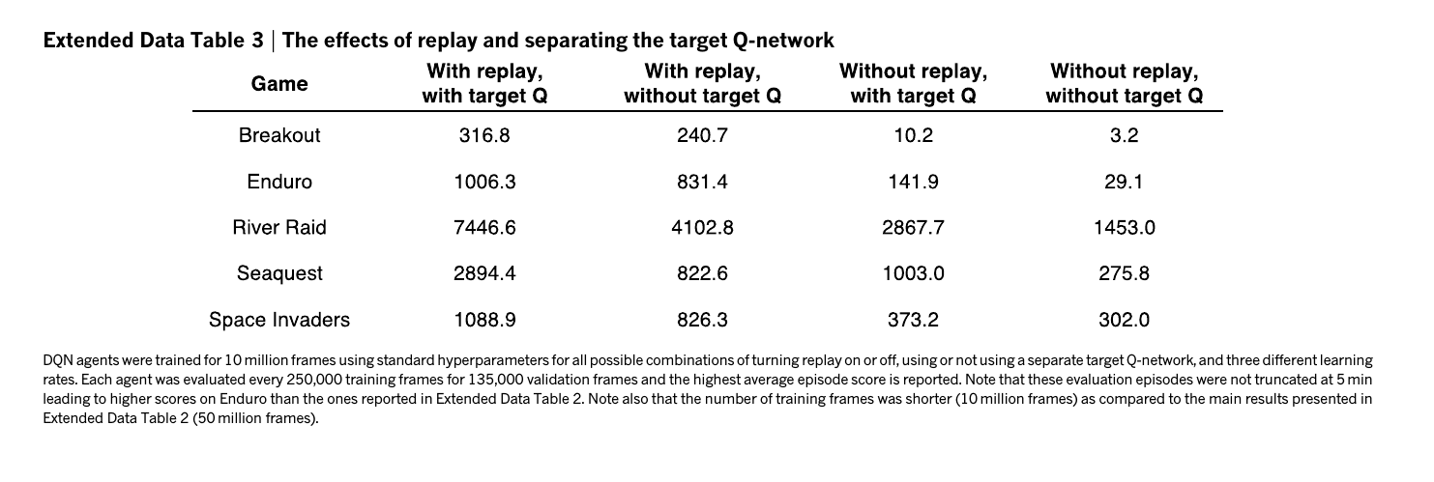

Slide 41
References
Sutton,R. & Barto, A. Reinforcement Learning: An Introduction (MIT Press, 1998)
Deep Reinforcement Learning, Fall 2017, Sergey Levine, University of Berkley
Human-level control through deep reinforcement learning, Mnih et. al., Nature, 2015

