Slide 1
Estimating Uncertain Spatial Relationships in Robotics

Slide 2
Introduction
Need to represent and reason about spatial uncertainty
  Methods such as precision engineering, very accurate sensors, fixtures/calibration points, or multiple low-res sensors have been used to circumvent such issues
However; a problem occurs combining uncertain spatial information which is refereed to as relative information
The paper (and this presentation) presents a general solution to estimating uncertain spatial relationships regardless of the frame where the required information is

Slide 3
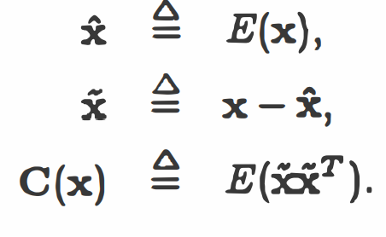
The stochastic Map
What is it?
Estimating Probability
A representation that contains estimates of the special relationships, their uncertainties, and their inter-dependencies.
The first two moments of the probability distribution are estimated and defined as
Spatial Relationship
This will be represented by the vector of its special variables, x
x=[x;y;r]
Interpretation
If spatial relationship is calculated by combining evidence from many independent observations, the central limit theorem indicates that the resulting distribution will tend to be a normal distribution
Probability
A probability density function can represent uncertain spatial relationship by assigning a probability to each combination of x
P(x)=f(x)dx
Notes:
Detailed knowledge of the probability distribution is usually unnecessary
Most measuring devices provide nominal value of the measured relationship
Diagonal – variances of the spatial variables
Off diagonal – covariances between the spatial variables
Not assumed to be normal, only used normal to calculate probability contours

Slide 4
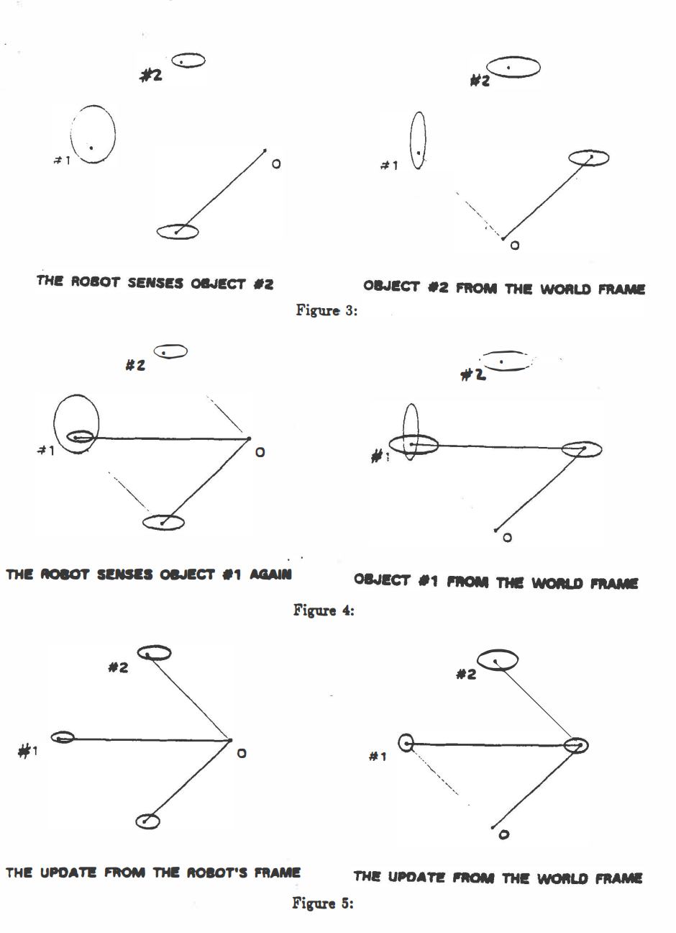
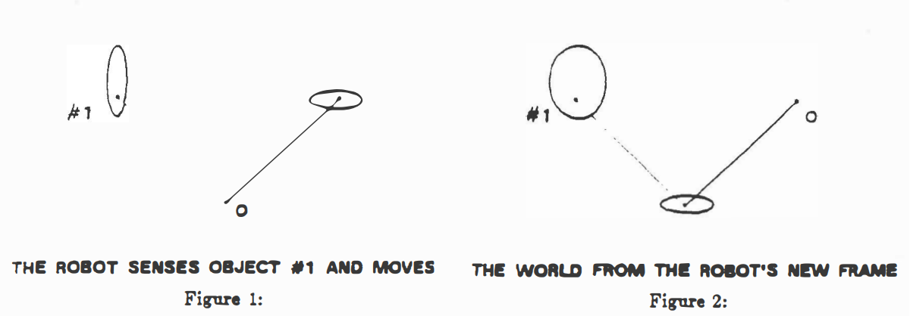
Example

Slide 5
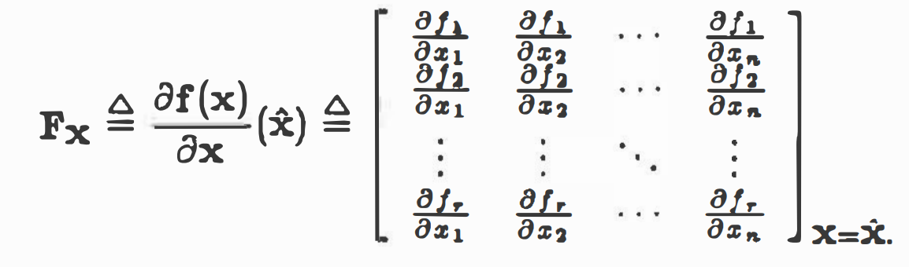
Estimating first 2 moments of unknown multivariate probability distribution
Linear
Non-Linear Relationships
Y=Mx+b
Where x (nX1) is a random vector, M (rXn) is the non-random coefficient matrix, b (rX1) is a constant vector
Since we generally won’t have the probability density function, the best approach is to estimate the non-linear function by a Taylor series expansion about the mean
Y = f(x) + FXx + ….
Covariance
Covariance matrix C(y)=MC(x)M^T
Covariance between Y and Z can be found using the covariance between x and z.
Fx
Fx is the matrix of patrials of f evaluated at x

Slide 6
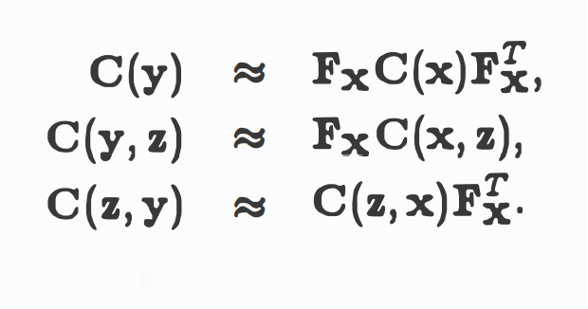
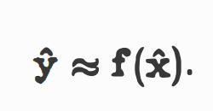
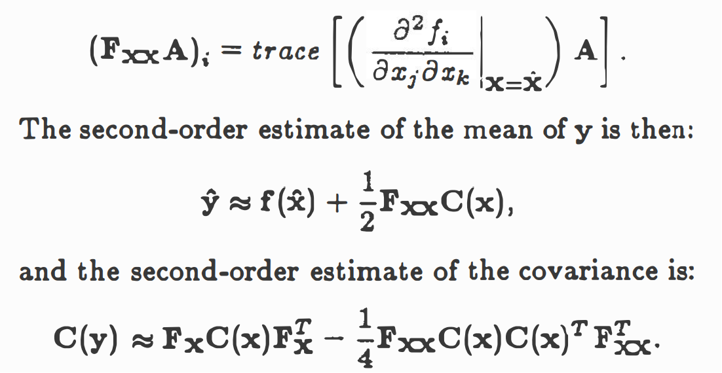

Non-Linear Cont.
Covariance estimates
Estimate for the mean of y
Second order Taylor series improves mean

Slide 7
Spatial Relationships

Slide 8
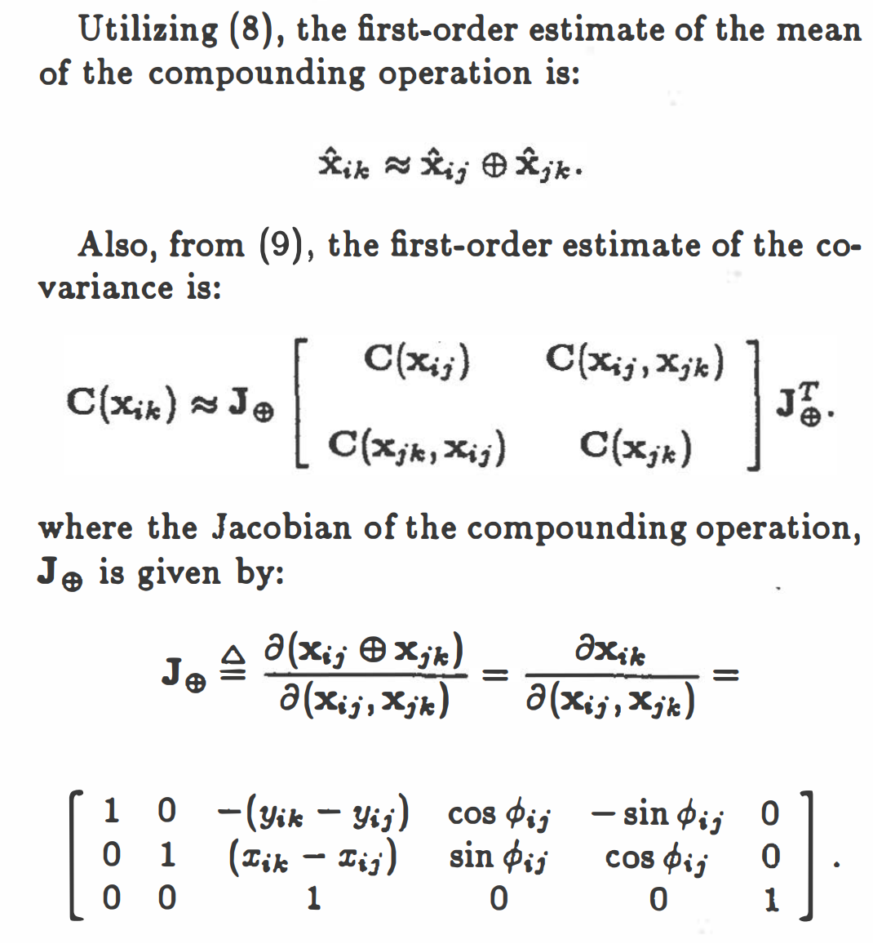
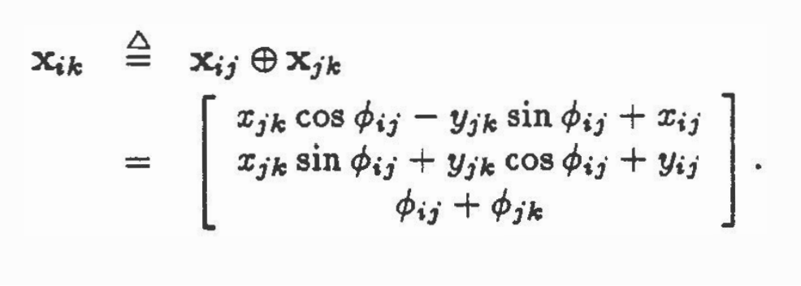
Compounding
Finding Xik
Compunding is used to calculate the resultant relationship from two given relationships
It is used to determine location after movement

Slide 9
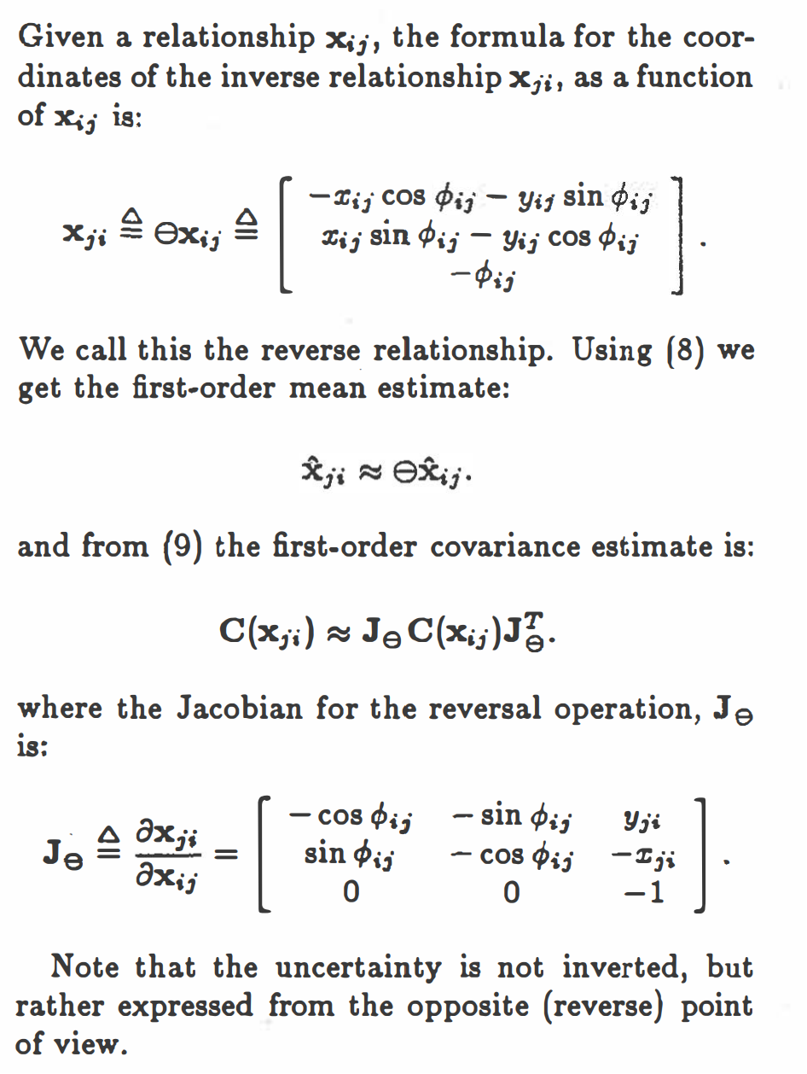
Inverse Relationship

Slide 10
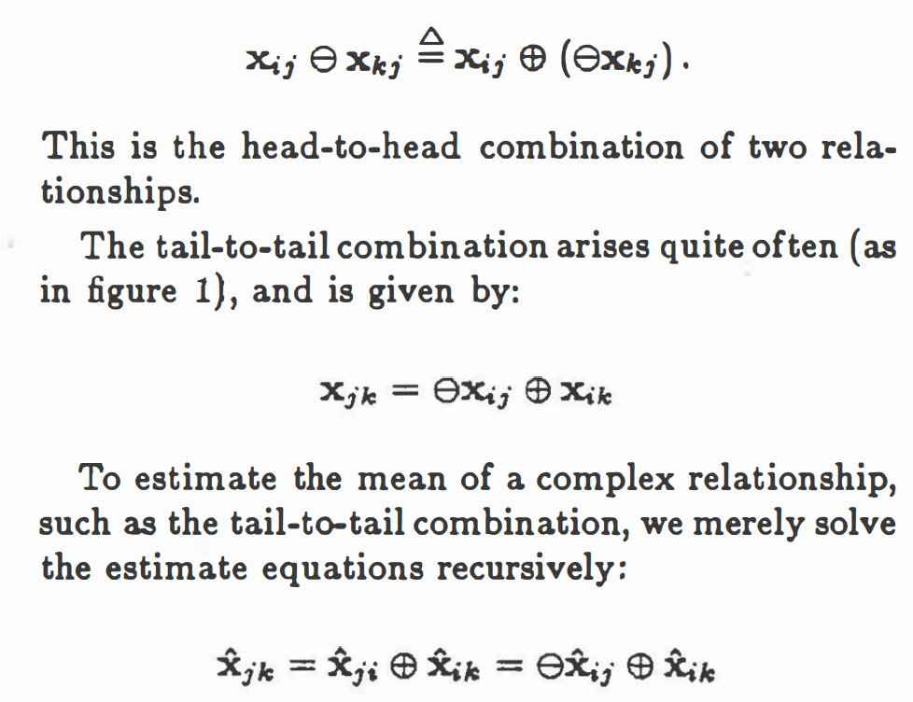
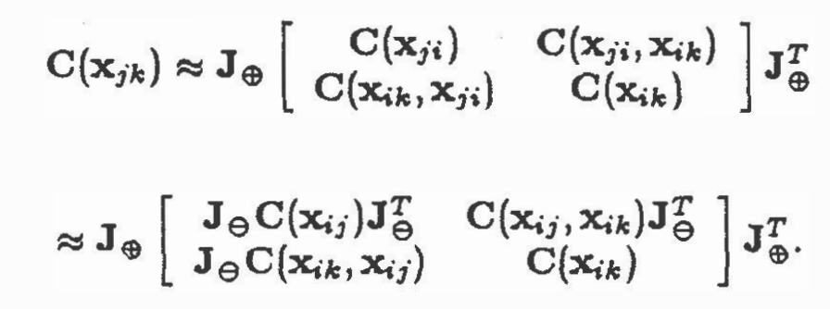
Composite Relationship
With compounding and the ability to reverse relationships, we can calculate the resultant of any sequence of relationships
Covariance can be estimated the same way
FEW
COMPETITORS
Serviceable market

Slide 11
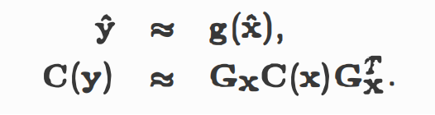

Summary
Y=g(x)
$2B
$1B
General spatial relationship among world locations
Estimated mean and covariance
Estimated relative location of one object with respect to the coordinate from of another object

Slide 12
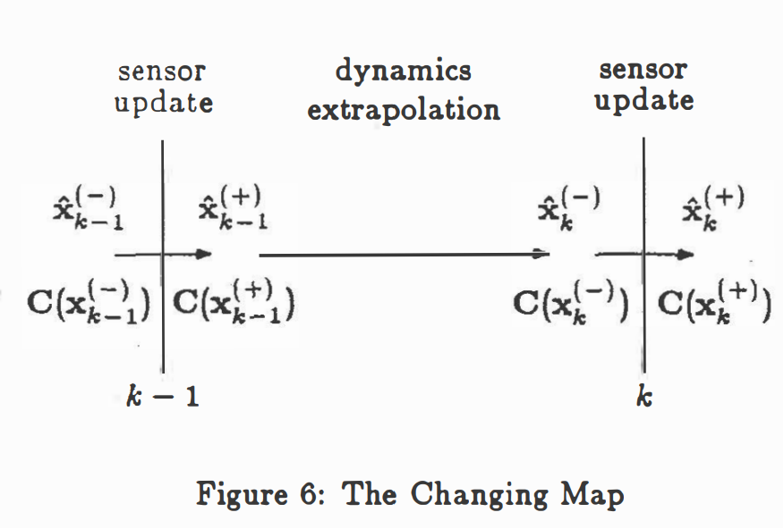
Building the Map

Slide 13
Modifying the map
Entries in map may change for 2 reasons
Changing the map means changing the two componets that define it
Assume new information is obtained in states, k
An object moves
New spatial information is obtained
Updates is considered to be instantaneous and estimates prior to k are denoted by (-) and new information by (+)
Mean
Covariance matric

Slide 14
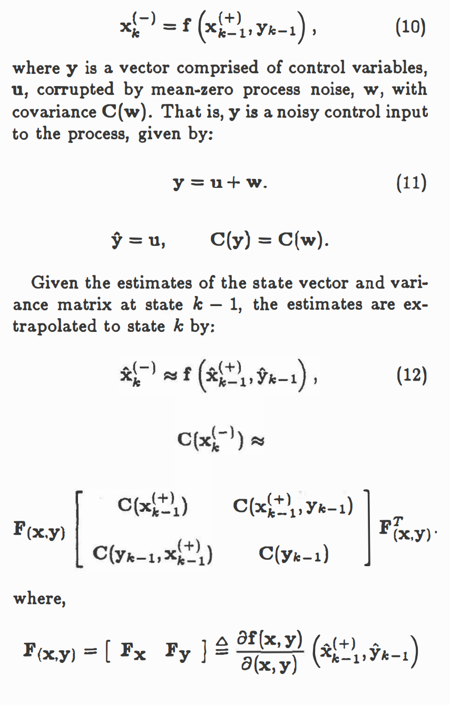
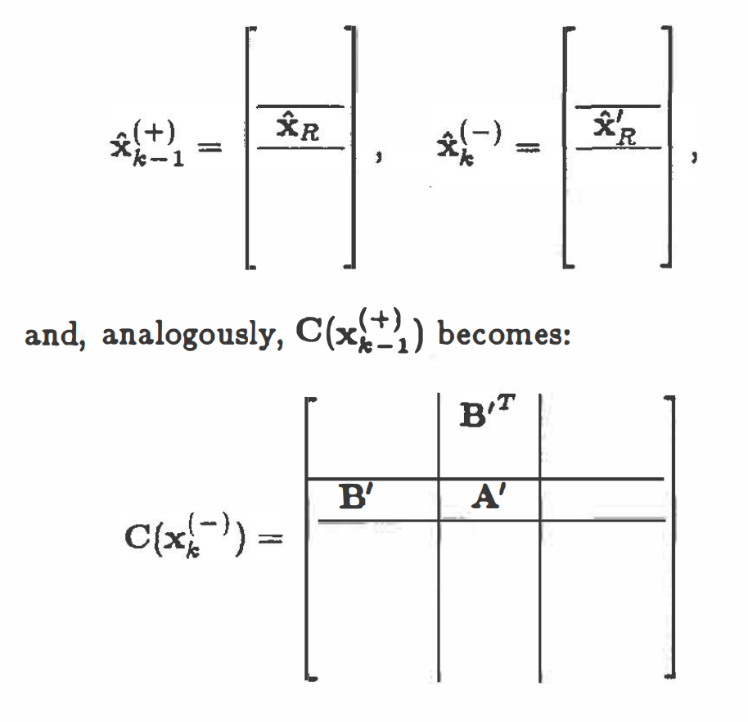
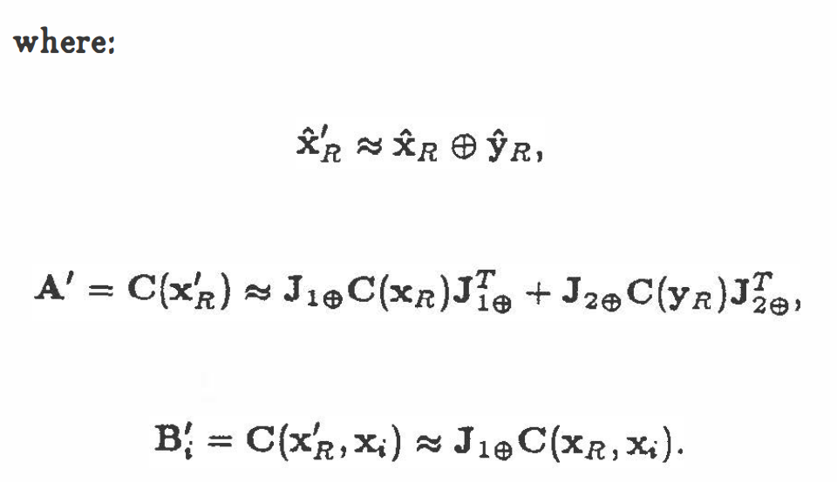
Moving Objects
K-1 to k
Process Model
No measurements of external objects are made
New state is determined by process model, f, as a function of the old state and control variables
Robot Movement
In a system of where the robot is the only dynamic element, the process model only describes its movement
Therefore, only a small part of the map needs to be changed to address this movement

Slide 15
New Spatial Information
There are 2 cases when adding new spatial information about objects
1. A new object is added to the scene
2. A (stochastic) constraint is added between objects already in the scene

Slide 16
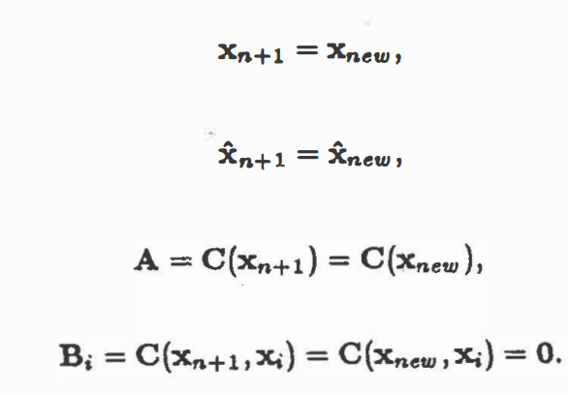
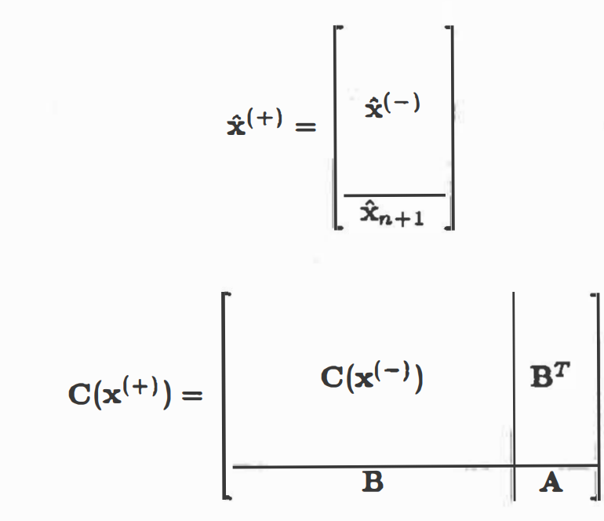
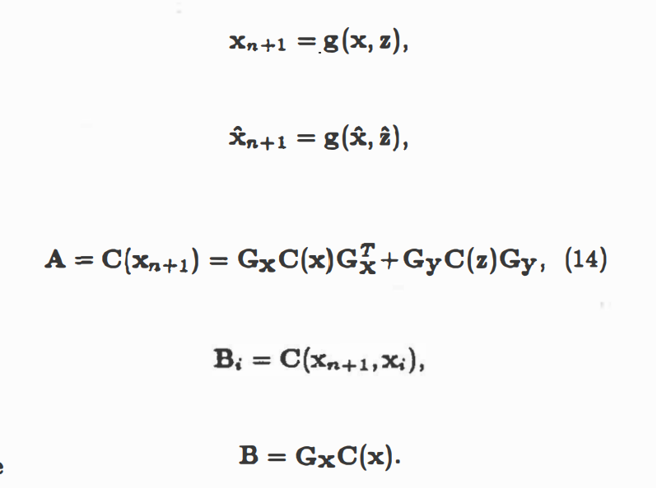
Object is added

Slide 17
Adding Constraints
Measures the relationship of a known landmark to itself
A geometric relationship is given for some set of the object location variables
Here the constraint Is noisy
The constraint could be absolute or could also be given with a tolerance.
Each constraint mathematically is the same
2 estimates in Question
As long as both types of constraints come from measurements by sensors
Current best estimate of the relation
The new sensor information

Slide 18
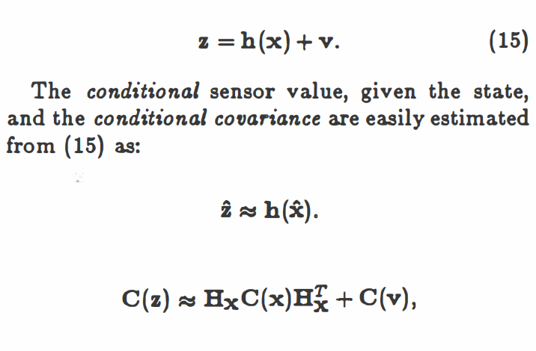
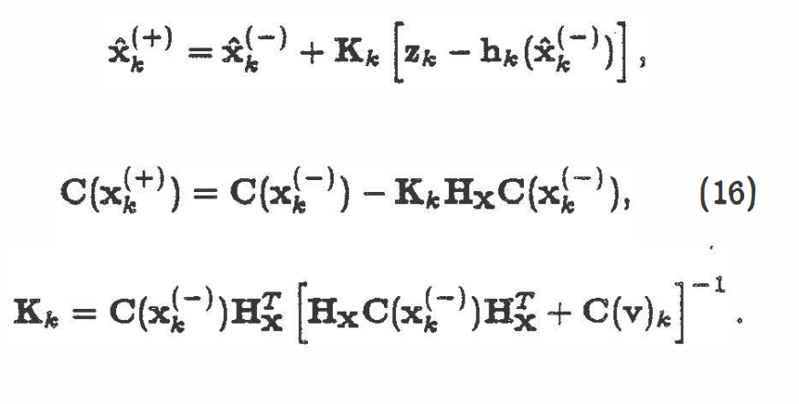
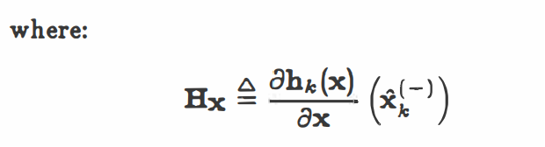
Sensors
Sensor Model
Kalman Filter
Describes how the sensor maps the spatial variables in the state vector into the sensor variables
Given the sensor model, the conditional estimates of the sensor vales and their uncertainties, and an actual sensor measurement, the state estimate can be updated using the Kalman Filter equation
The updated estimate is a weighted average of the two estimates where the weighted factor is proportional to the prior covariance in the state estimate and inversely proportional to the conditional covariance measurement

Slide 19
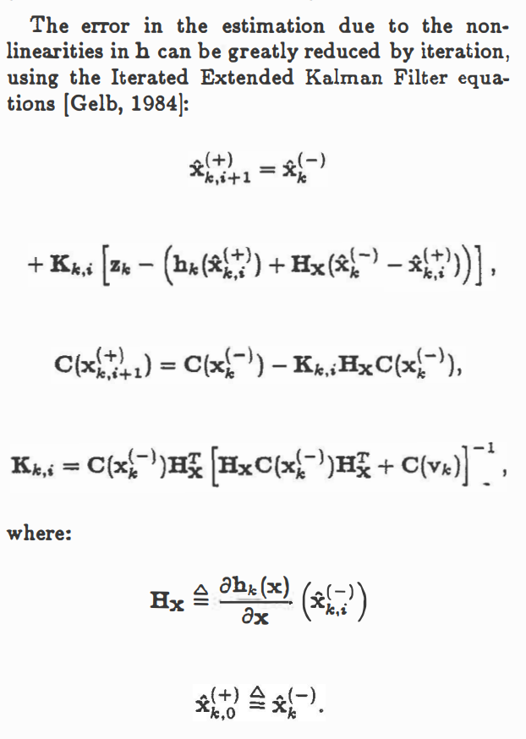
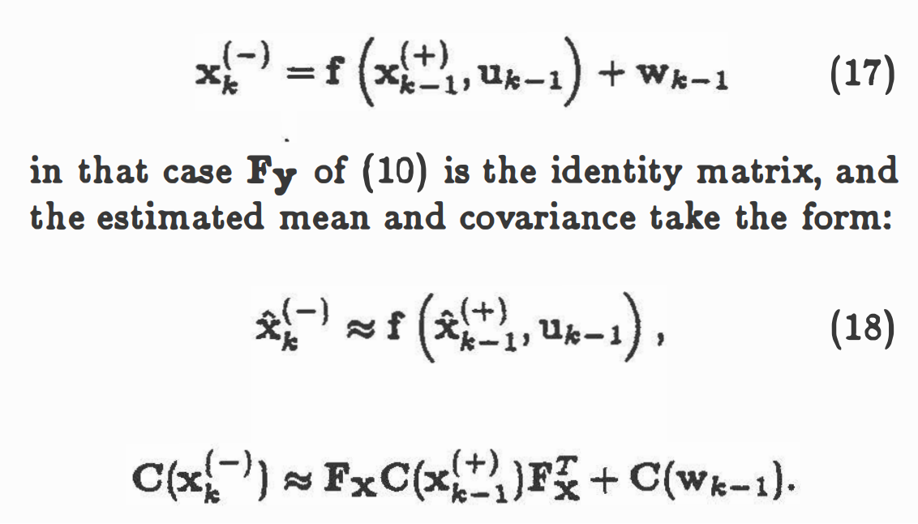
Kalman Filter
The Kalman Filter generally contains a system dynamics model defined less generally than presented in the standard filter equations
If noise does not have a normal distribution, then the Kalman Filter is not optimal but produces the optimal linear estimate
If the function f and h are non-linear in the state variables, then F and H will have to be evaluated. The given formulae then represent the Extended Kalman Filter, a sub-optimal non-linear estimator.

