Slide 1
A Tutorial on GrAPH BASED SLAM
By: Malcolm Peterson
With Authors: Giorgio Grilletti, Rainer Kummerele, Cirillo Stachniss, Wolfram Burgard
Department of Computer Science, University of Freiburg, 79110 Freiburg, Germany

Slide 2
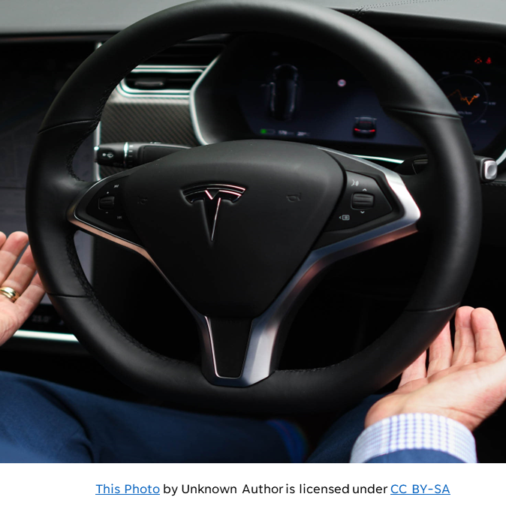
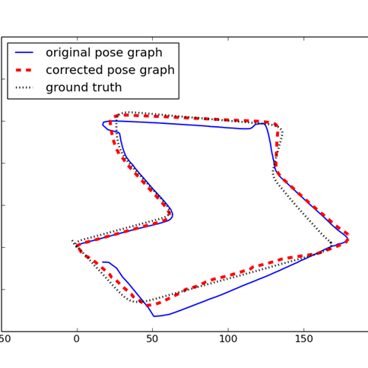
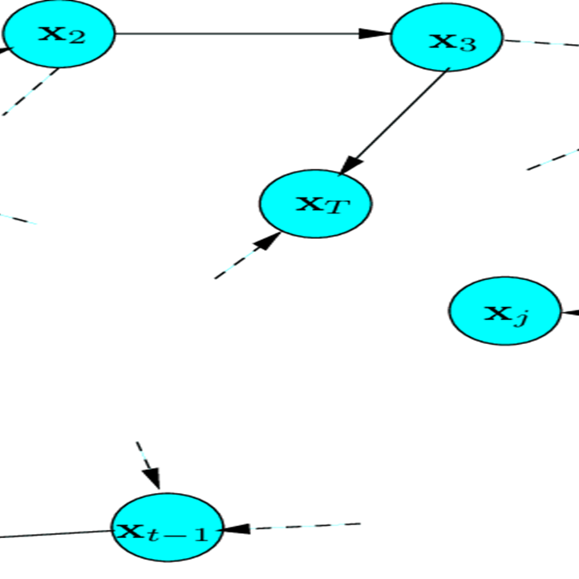
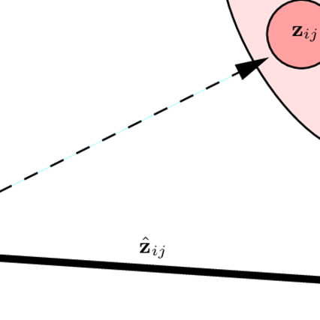
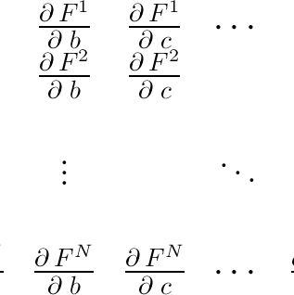
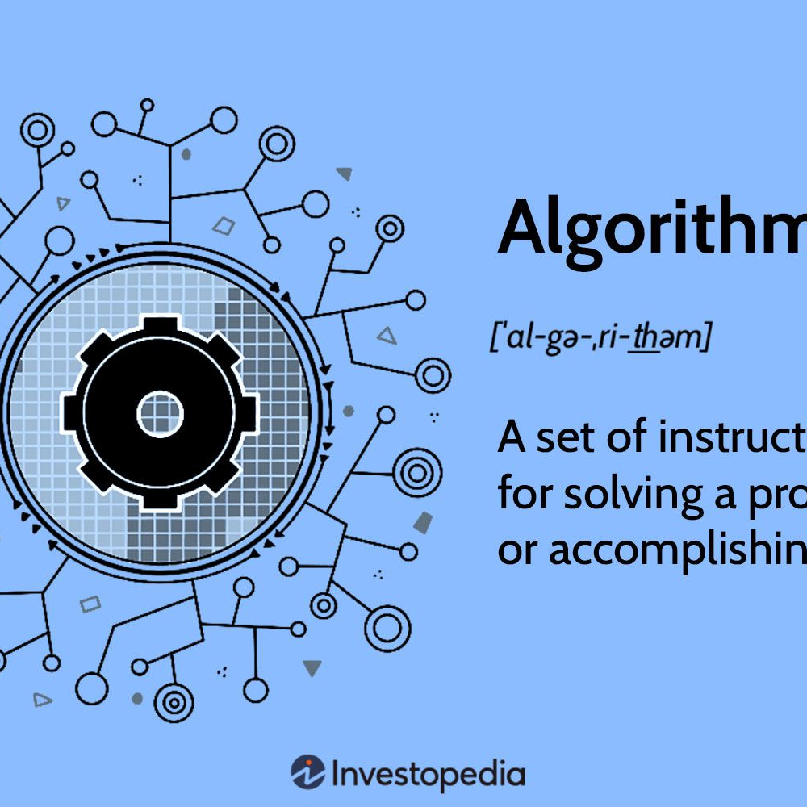
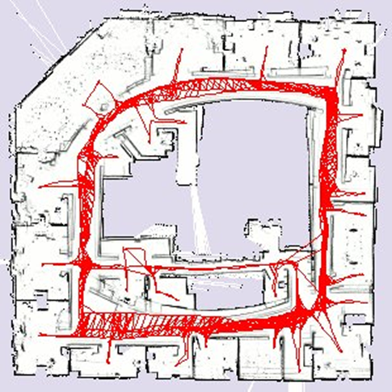
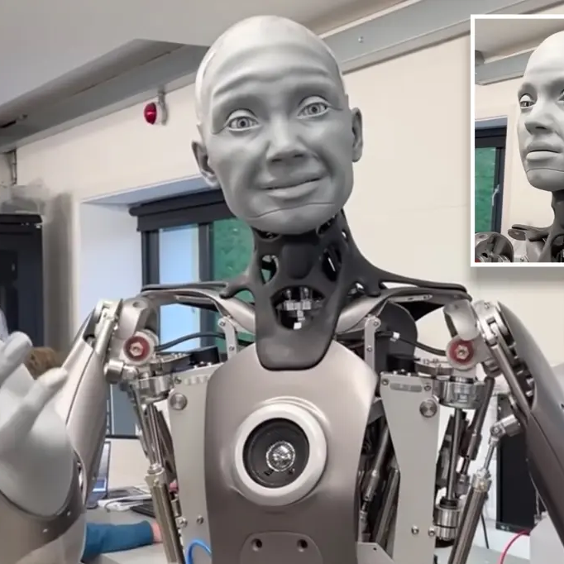
OUTLINE
1. INTRODUCTION
2.PROBABLISTIC FORMULATION OF SLAM
3.RELATED WORK
4.ERROR MINIMIZATION
5. JACOBIAN ERROR ESTIMATION
6. ALGORITHIM OF JACOBIAN ERROR ESTIMATION
7. PRACTICAL APPLICATIONS
8. CLOSE

Slide 3
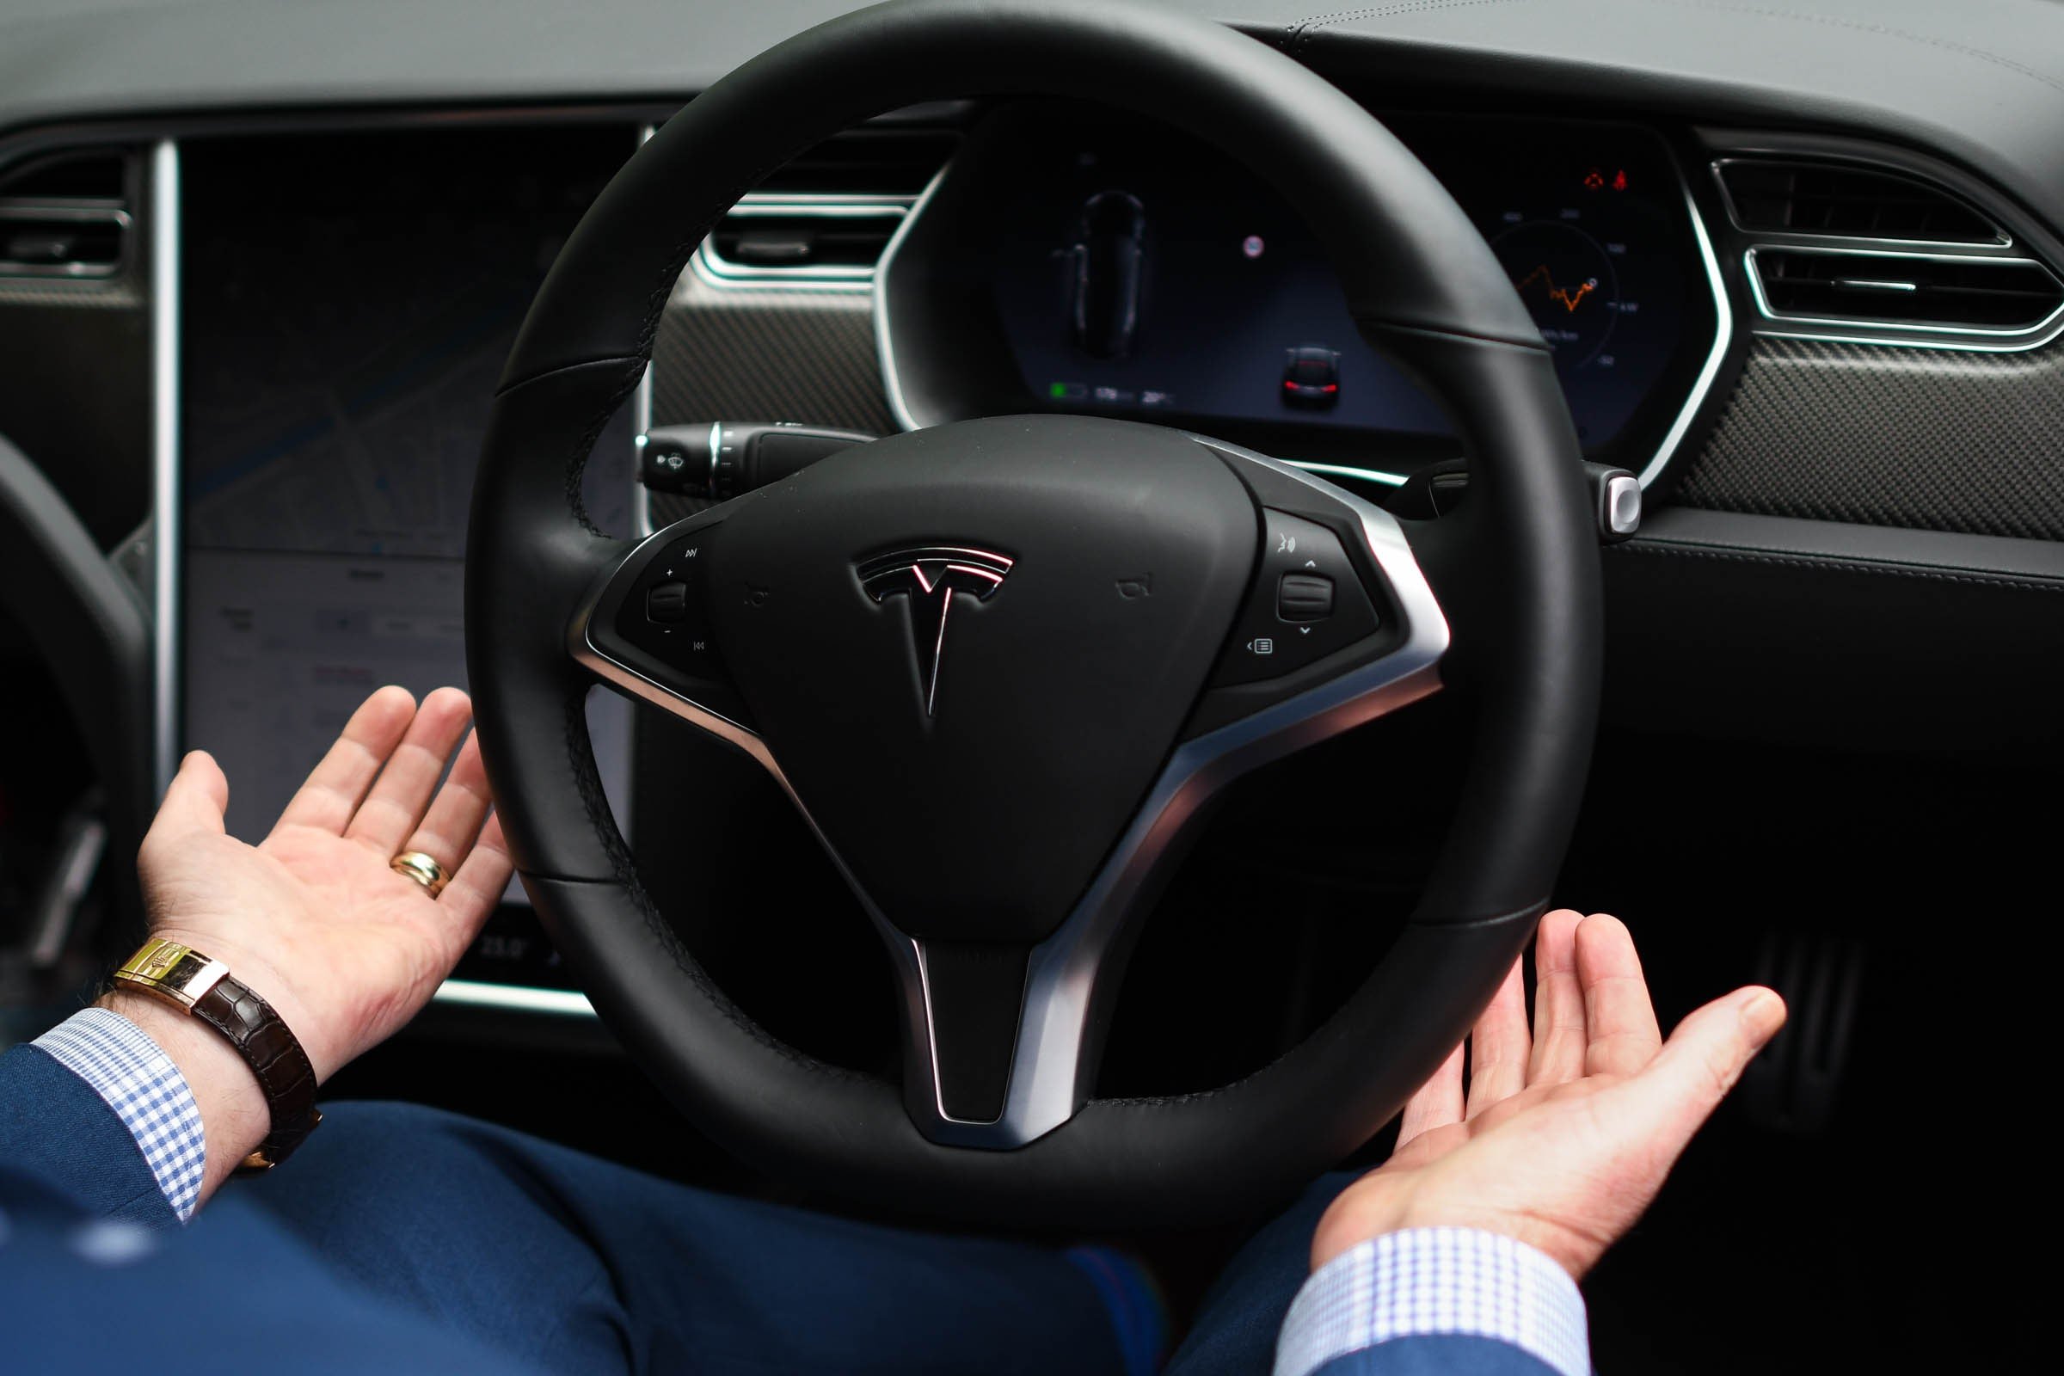
Introduction
Visual Simultaneous Localization and Mapping can be used to solve many tasks to be carried out by actuating mobile robots on a graphical platform.
Transportation, Search and Rescue, Automated Cleaning
Can operate in complex environments
On board sensors w/ no GPS
Uses Kalman filters and mean square error techniques
This Photo by Unknown Author is licensed under CC BY-SA

Slide 4
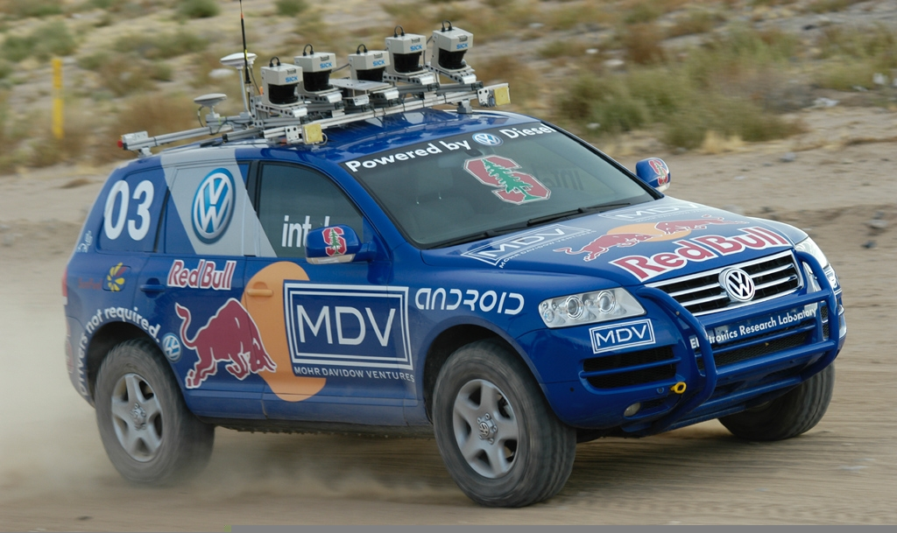
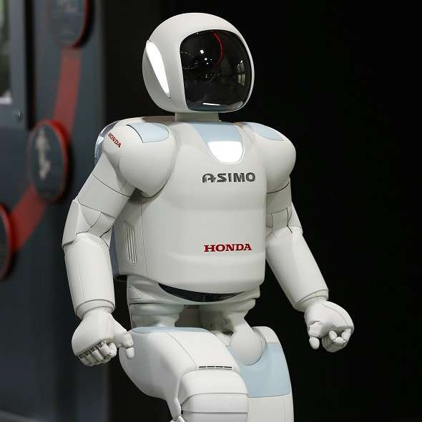
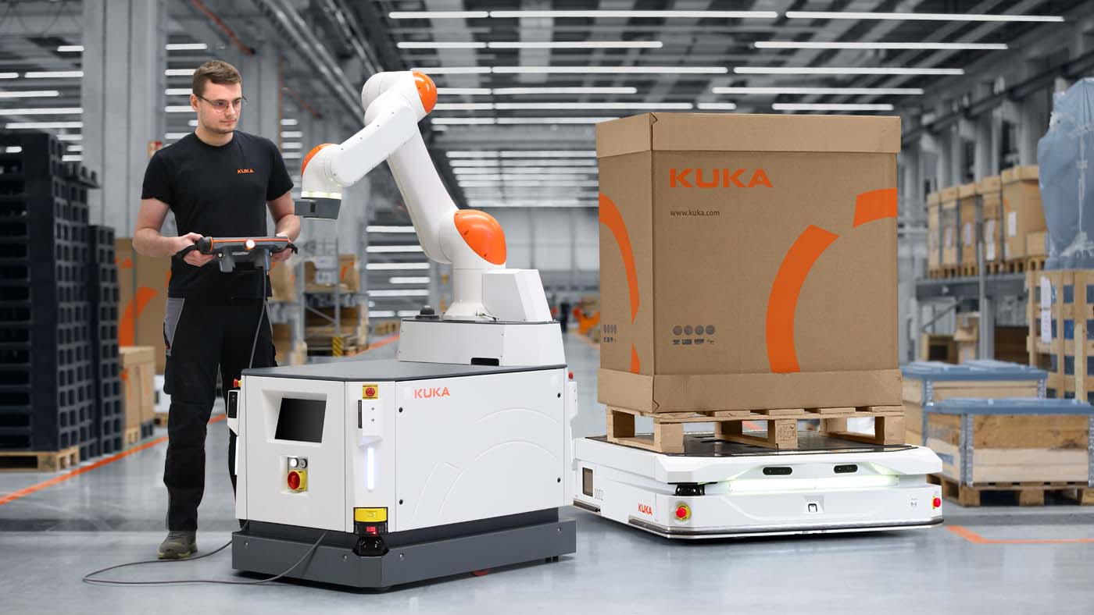

Slide 5
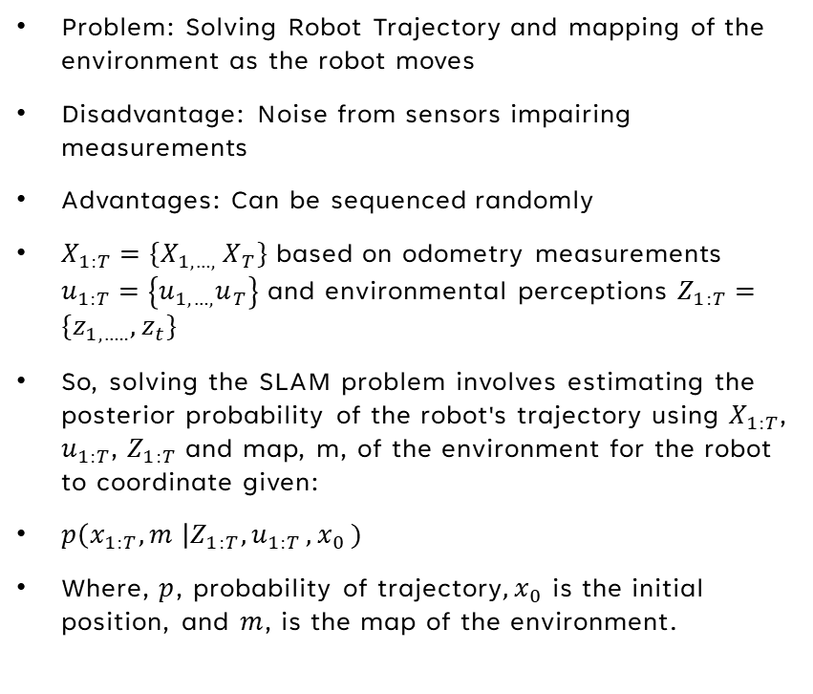
Probabilistic Formulation of SLAM
Problem: Solving Robot Trajectory and mapping of the environment as the robot moves
Disadvantage: Noise from sensors impairing measurements
Advantages: Can be sequenced randomly
$X_{1:T}=\{X_{1,…, }X_{T}\}$ based on odometry measurements $u_{1:T}=\left\{u_{1,…,}u_{T}\right\}$ and environmental perceptions $Z_{1:T}=\{z_{1,…..},z_{t}\}$
So, solving the SLAM problem involves estimating the posterior probability of the robot's trajectory using $X_{1:T}$, $u_{1:T}$, $Z_{1:T}$ and map, m, of the environment for the robot to coordinate given:
$p\left(x_{1:T}, m \right|Z_{1:T}{,u}_{1:T}{,x}_{0})$
Where, $p$, probability of trajectory${,x}_{0}$ is the initial position, and $m$, is the map of the environment.

Slide 6

Pose optimization at $X_{1:T}$ and the odometry of $u_{1:T}$ is represented as a 2D and 3D vectors
Can be used to map specific landmarks and locations
With choosing the correct representation by the sensors involved, the environment, and estimation algorithms
A common way to describe these in SLAM would be through the DBN, or Dynamic Bayesian Network

Slide 7
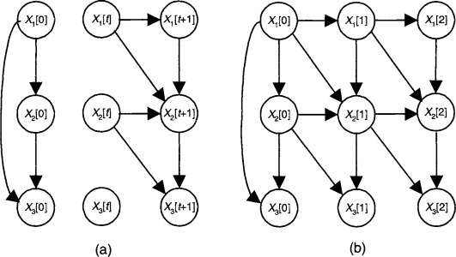
Figure 1: Dynamic Bayesian Network

Slide 8


A Bayesian Network is a graphical model describing a stochastic process using a random node (or arrow).
Randomly Processed variables in path
Hidden variables at $X_{t}$ or the lightly shaded nodes in path aren’t visible because of sensitive trajectories and mapping
Given that you have a time, $t−1$, in $X_{t}$, the robot calculates the probability of the odometry measurement as it moves
Once the graph is constructed, this satisfies the random variable constraints and the robot corrects its estimations.

Slide 9
Related Work
Wide variety of SLAM approaches in robotics
Minimizing error in DBN most effective
Gauss-Seidel, multi-level relaxation at different resolutions
Dellart and Kaess, matrix factorizations
Most SLAM processes that compute the best map are called SLAM back ends
Meanwhile, SLAM front ends uses sensor data to obtain constraints that are excellent optimizers for SLAM methods

Slide 10


Figure 2: A Pose Graph Representation of A SLAM Process Using Edges at $e_{t−1t}$

Slide 11

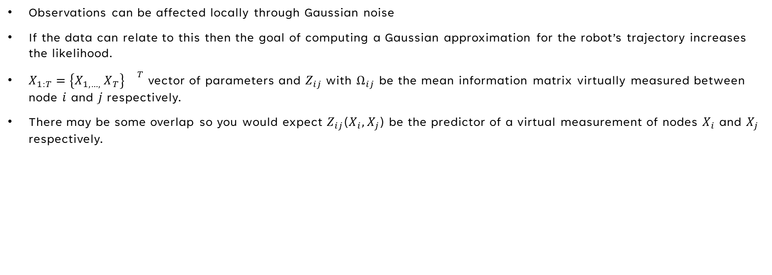
Error Minimization
Observations can be affected locally through Gaussian noise
If the data can relate to this then the goal of computing a Gaussian approximation for the robot’s trajectory increases the likelihood.
$X_{1:T}=\left\{X_{1,…, }X_{T}\right\}{}^{T}$ vector of parameters and $Z_{ij}$with $Ω_{ij}$ be the mean information matrix virtually measured between node $i$ and $j$respectively.
There may be some overlap so you would expect $Z_{ij}$($X_{i},X_{j}$) be the predictor of a virtual measurement of nodes $X_{i}$ and $X_{j}$ respectively.

Slide 12

$I_{ij} ≞[z_{ij}−{\hat{z}}_{ij}\left(X_{i},X_{j}\right)]{}^{T}$ $Ω_{ij}[z_{ij}−{\hat{z}}_{ij}\left(X_{i},X_{j}\right)]$
The matrix H and the vector b are obtained by summing up related sets for every constraint
Let $e\left(x_{i},x_{j},z_{ij}\right)$ be a function that computes a difference between the expected observation ${\hat{z}}_{ij}$ and the real observation $z_{ij}$ gathered by the robot
$e\left(x_{i},x_{j}\right)$ = $z_{ij}−{\hat{z}}_{ij}\left(X_{i},X_{j}\right)$
Maximum likelihood approach where C is the set of pairs of indices for which a constraint, z, exists
$f\left(x\right)=\sum_{(i,j)ες}{e_{ij}^{T}Ω_{ij}e_{ij}}$

Slide 13
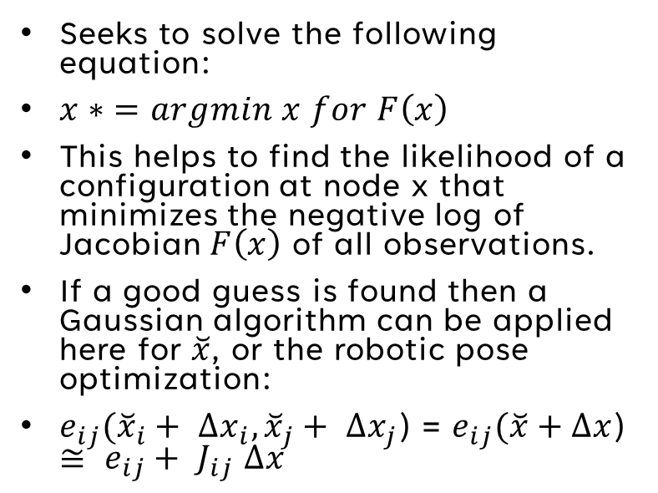
Seeks to solve the following equation:
$x∗ =argmin x for F\left(x\right)$
This helps to find the likelihood of a configuration at node x that minimizes the negative log of Jacobian $F\left(x\right)$ of all observations.
If a good guess is found then a Gaussian algorithm can be applied here for $\breve{x}$, or the robotic pose optimization:
$e_{ij}({\breve{x}}_{i}+ ∆x_{i},{\breve{x}}_{j}+ ∆x_{j}$) = $e_{ij}(\breve{x}+∆x$) $≅ e_{ij}+ { J}_{ij}$ $∆x$

Slide 14
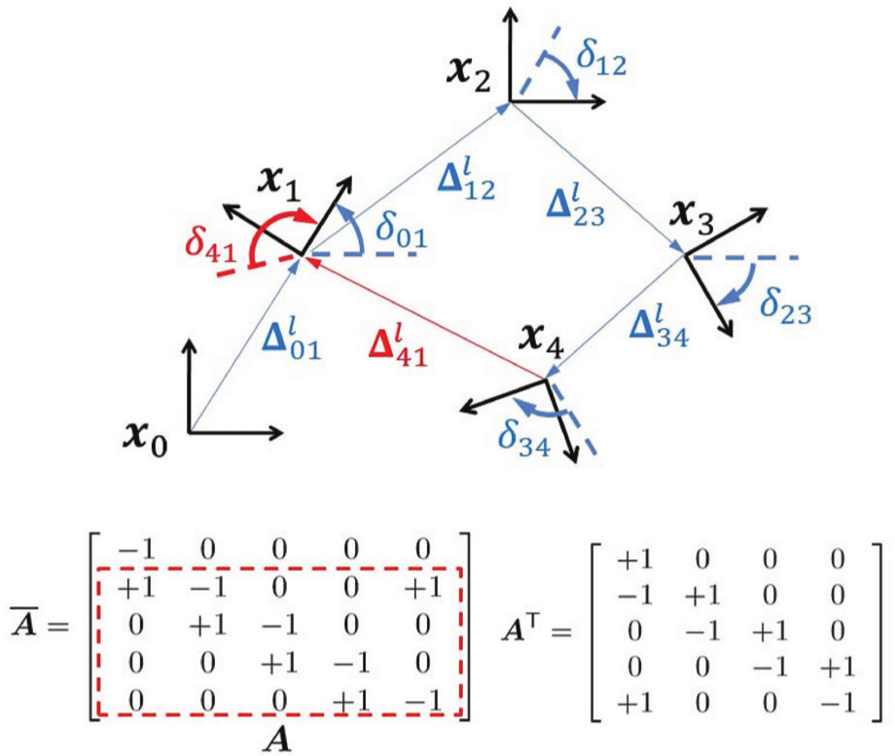

Jacobian Error ESTIMATION
So, supporting the Jacobian approximation for $F\left(x\right)$ we get:
$F_{ij}\left(\breve{x}+∆x\right)=e_{ij}(\breve{x}+∆x\text{)}{}^{T}$ $Ω_{ij}e_{ij}(\breve{x}+∆x\text{)}$
$≅$ $e_{ij}+{ J}_{ij}∆x\text{)}{}^{T}$ $Ω_{ij}$($e_{ij}+$ ${ J}_{ij}∆x$)
= $e_{ij}^{T}Ω_{ij}e_{ij}$($c_{ij}$) + 2 $e_{ij}^{T}Ω_{ij}{ J}_{ij}∆x(b_{ij})+{∆x}^{T}$ $J_{ij}^{T}Ω_{ij}{ J}_{ij}∆x(H_{ij})$

Slide 15
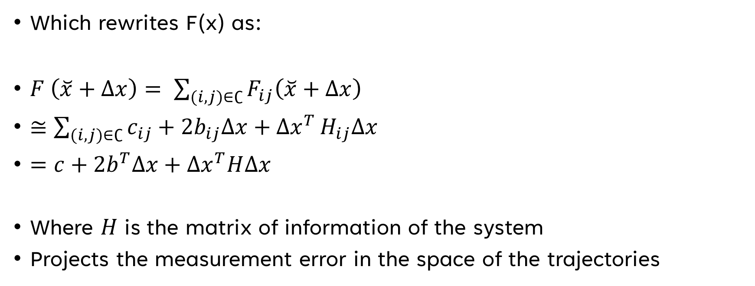
Which rewrites F(x) as:
$F \left(\breve{x}+∆x\right)= \sum_{(i,j)∈∁}{F_{ij}\left(\breve{x}+∆x\right)}$
$≅\sum_{(i,j)∈∁}{c_{ij}+{2b}_{ij}∆x+∆x^{T}}H_{ij}∆x$
$=c+2b^{T}∆x+∆x^{T}H∆x$
Where $H$ is the matrix of information of the system
Projects the measurement error in the space of the trajectories

Slide 16

According to the Jacobian equation, the matrix H and b are obtained by summing up the set of matrices and vectors for each constraint
Structure relies on the Jacobian error function, which further depends on nodes $i$ and $j.$
$J_{ij}=\left(0…0 A_{ij}0…0 B_{ij} 0…0\right)$
$A_{ij}$ and $B_{ij}$ are derivatives of the error function with respect to $X_{i} and X_{j}$ (without non-zeros)
$H_{ij}= \left(\begin{matrix}A_{ij}^{T}Ω_{ij}A_{ij} & ⋯ & A_{ij}^{T}Ω_{ij}B_{ij} \\ ⋮ & ⋱ & ⋮ \\ B_{ij}^{T}Ω_{ij}A_{ij} & ⋯ & B_{ij}^{T}Ω_{ij}B_{ij}\end{matrix}\right)$
$b_{ij}=\left(\begin{matrix}⋮ \\ A_{ij}^{T}Ω_{ij}e_{ij} \\ ⋮\end{matrix}\right)$

Slide 17
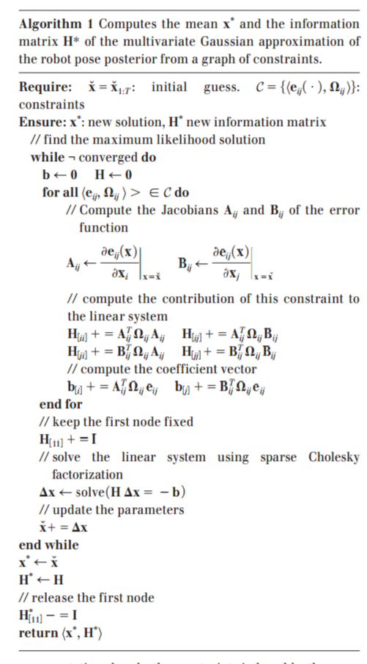

Slide 18
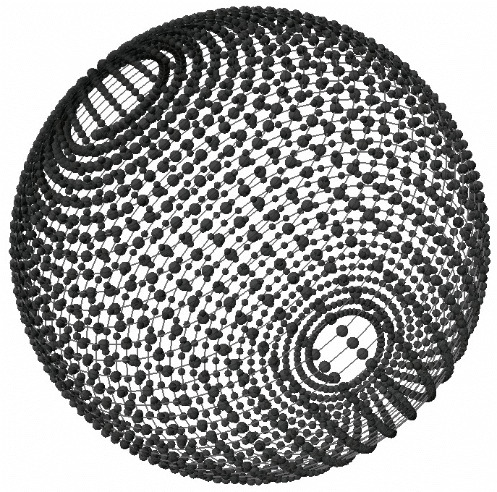
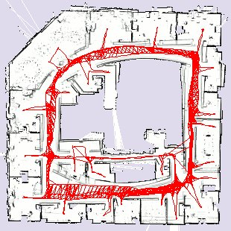
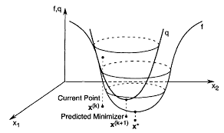
Practical Applications
2D and 3D Laser Based Mapping
Digital Interactivity
Virtual Reality, Oculus Rift, Steam VR, and more

Slide 19
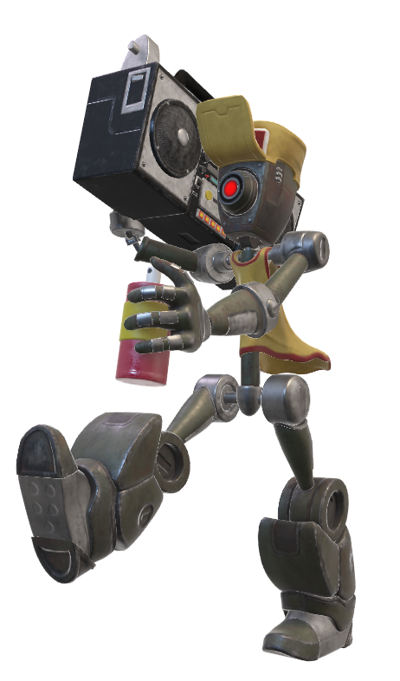
THANK YOU!

