Slide 1
iSAM2: Incremental Smoothing and Mapping Using the Bayes Tree
Michael Kaess, Hordur Johannsson, Richard Roberts, Viorela Ila, John Leonard, and Frank Dellaert

Slide 2
iSAM (Kaess et al., TRO ‘08)
Solving a growing system:
Exact/batch (quickly gets expensive)
Approximations
Incremental Smoothing and Mapping (iSAM)

Slide 3
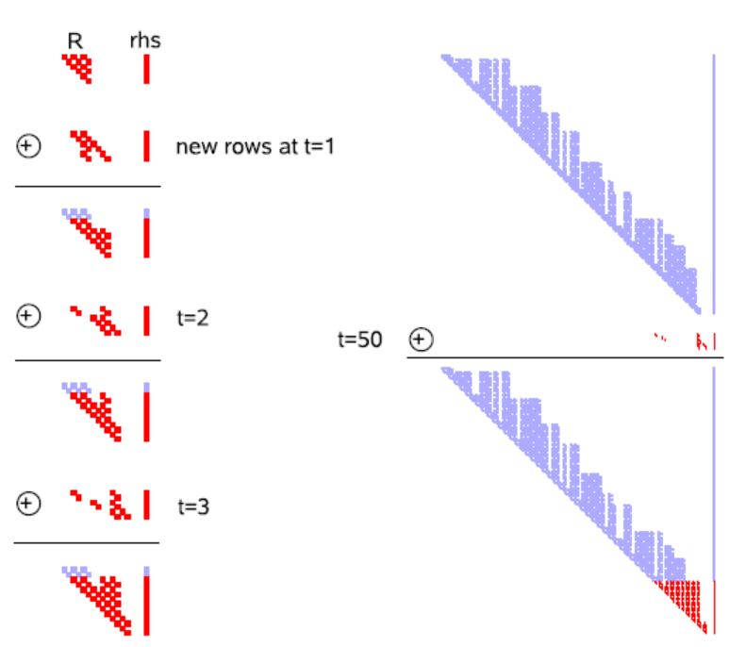
iSAM (Kaess et al., TRO ‘08)
Key Idea:
  Append to existing matrix factorization.
  “Repair” using Givens rotations.
Periodic batch steps for
  Relinearization.
  Variable reordering (to keep sparsity)

Slide 4
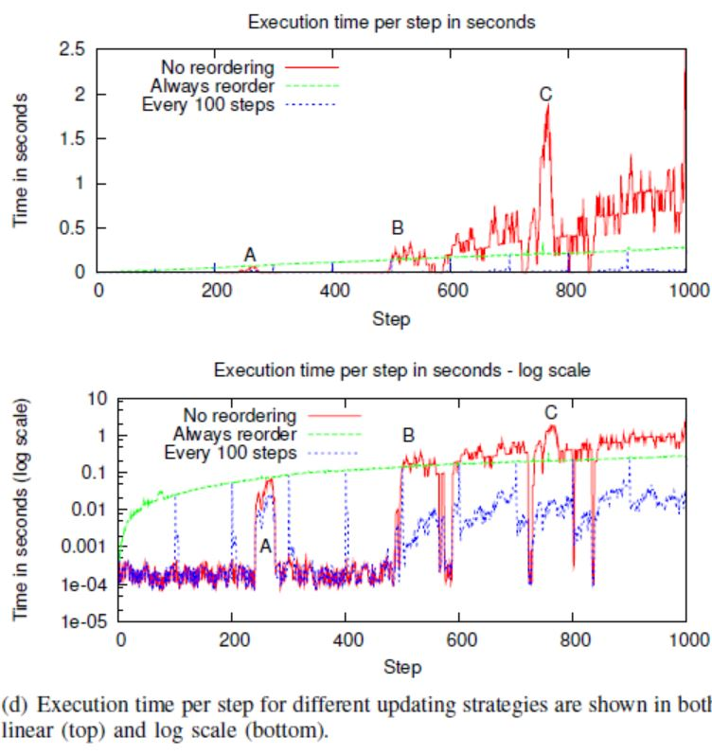

Slide 5
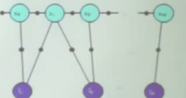
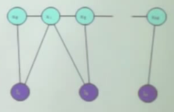
Matrix vs. Graph
Measurement Jacobian
A
Factor Graph
Information Matrix
ATA
Markov Random Field
R
Square Root Inf. Matrix
?

Slide 6
Bayes Tree

Slide 7




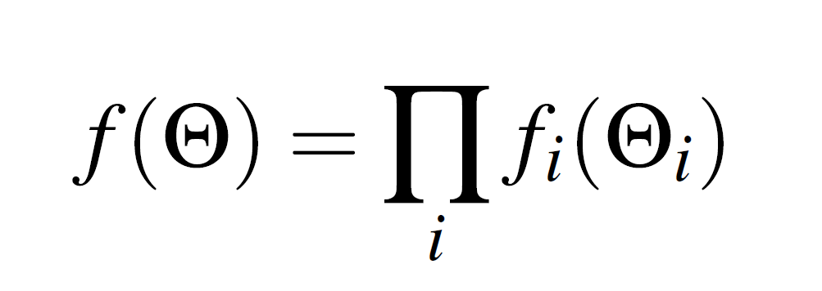
Factor Graph(Kschischang et al., 2001)
A bipartite graph
  Factor nodes
  Variable nodes
Edges are always between factor nodes and variables nodes.
Notes:
where (lhs) is the set of variables (rhs) adjacent to the factor fi, and independence relationships are encoded by the edges ei j:

Slide 8

The goal is to find the variable assignment that maximizes the function before:

Slide 9
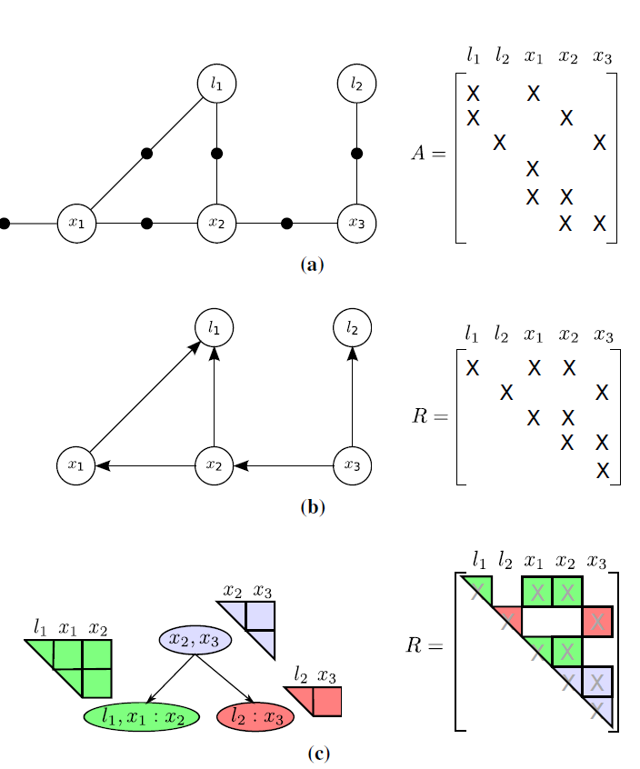
Notes:
(a) The factor graph and the associated Jacobian matrix A for a small SLAM example, where a robot located at successive poses x1, x2, and x3 makes observations on landmarks l1 and l2. In addition there is an absolute measurement on the pose x1. (b) The chordal Bayes net and the associated square root information matrix R resulting from eliminating the factor graph
using the elimination ordering l1, l2, x1, x2, x3. The last variable to be eliminated, here x3, is called the root. (c) The Bayes tree and the associated square root information matrix R describing the clique structure in the chordal Bayes net.

Slide 10
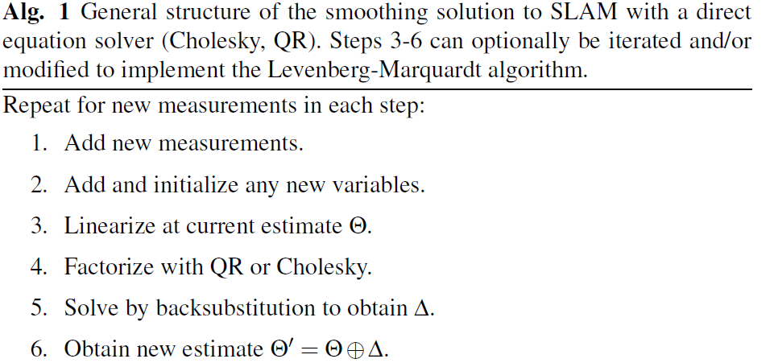

Slide 11
Inference and Elimination
Inference
  Converting the factor graph to a Bayes net using the elimination algorithm
Elimination is done by using bipartite elimination game

Slide 12
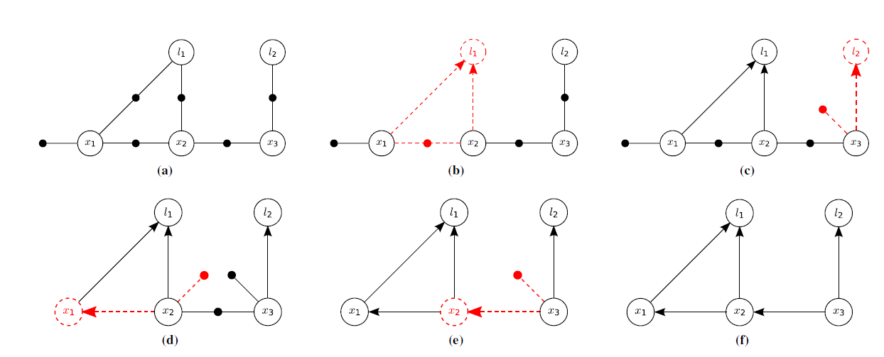
Notes:
Steps in the variable elimination process starting with the factor graph of Fig. 3a and ending with the chordal Bayes net of Fig. 3b. Following Alg. 2,
in each step one variable is eliminated (dashed red circle), and all adjacent factors are combined into a joint distribution. By applying the chain rule, this joint
density is transformed into conditionals (dashed red arrows) and a new factor on the separator (dashed red factor). This new factor represents a prior that
summarizes the effect of the eliminated variables on the separator.

Slide 13
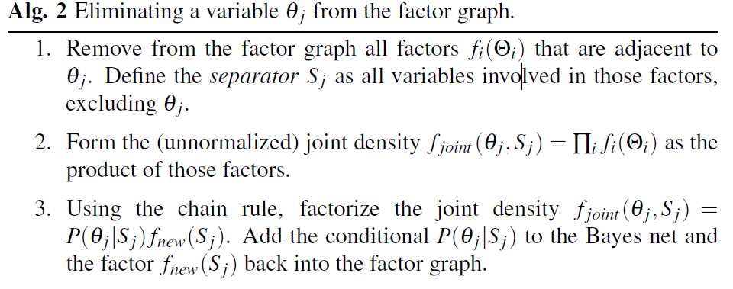

Slide 14
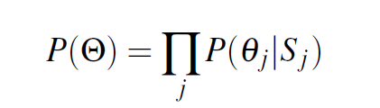


After eliminating all variables, the Bayes net density is defined by the product of the conditionals produced at each step:
Notes:
In terms of math, The factors have been converted into an equivalent product of conditionals.

Slide 15
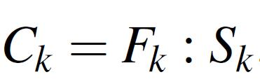
Bayes Tree Definition
A directed graph
Similar to Bayes net as it encodes a factored probability density.
Includes one conditional density per node with separator Sk
Frontal variables Fk as the remaining variables

Slide 16
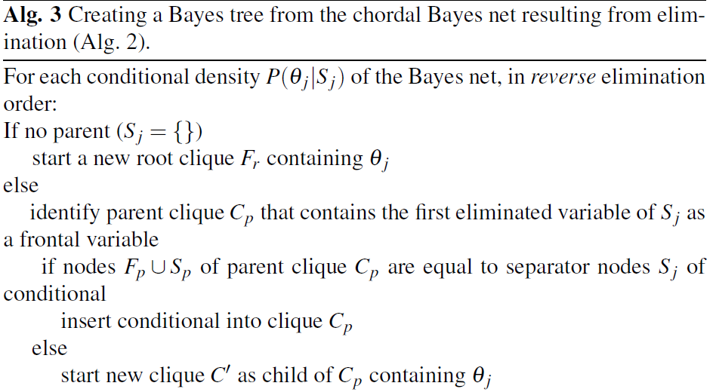
Creating Bayes Tree

Slide 17
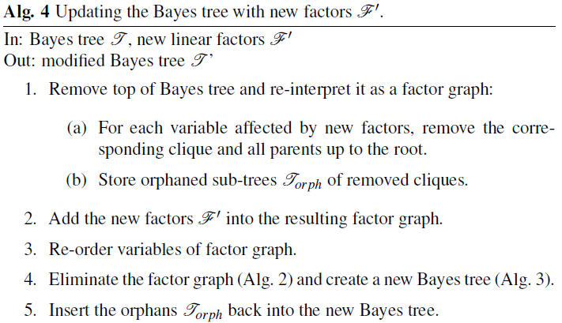
Incremental Inference

Slide 18
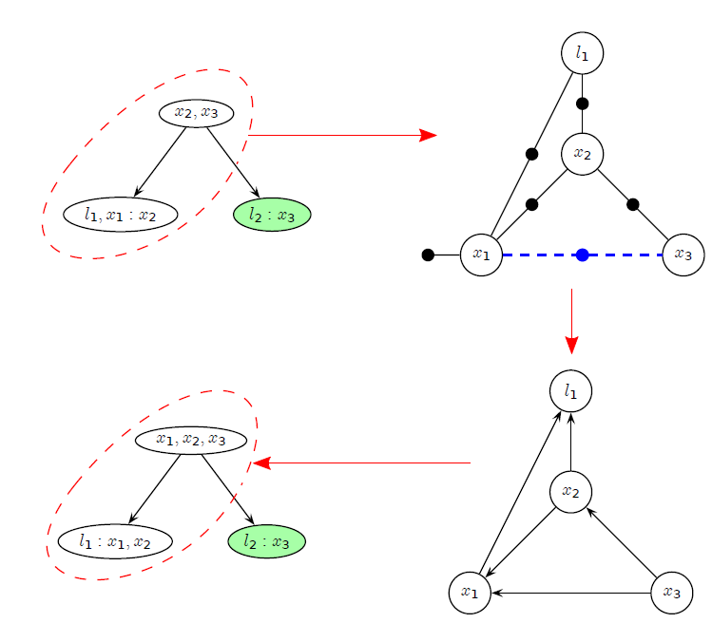
Incremental Inference
Notes:
Updating a Bayes tree with a new factor, based on the example in Fig. 3c. The affected part of the Bayes tree is highlighted for the case of adding a new factor between x1 and x3. Note that the right branch is not affected by the change. (top right) The factor graph generated from the affected part of the Bayes tree with the new factor (dashed blue) inserted. (bottom right) The chordal Bayes net resulting from eliminating the factor graph. (bottom left) The Bayes tree created from the chordal Bayes net, with the unmodified right “orphan” sub-tree from the original Bayes tree added back in.

Slide 19
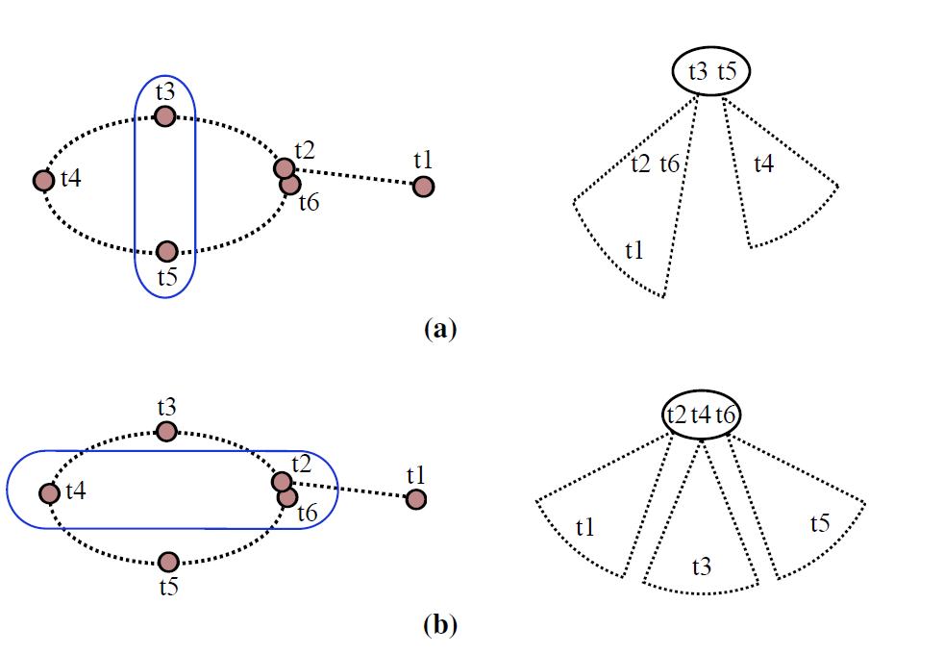
Incremental Variable Ordering
Notes:
7: For a trajectory with loop closing, two different optimal variable orderings based on nested dissection are shown on the left-hand side, with the variables to be eliminated marked in blue. For incremental updates the strategies are not equivalent as can be seen from the corresponding Bayes tree on the right-hand side. Adding factors connected to t6 will affect (a) the left subtree
and the root, (b) only the root. In the latter case incremental updates are therefore expected to be faster.

Slide 20
The iSAM2 Algorithm

Slide 21
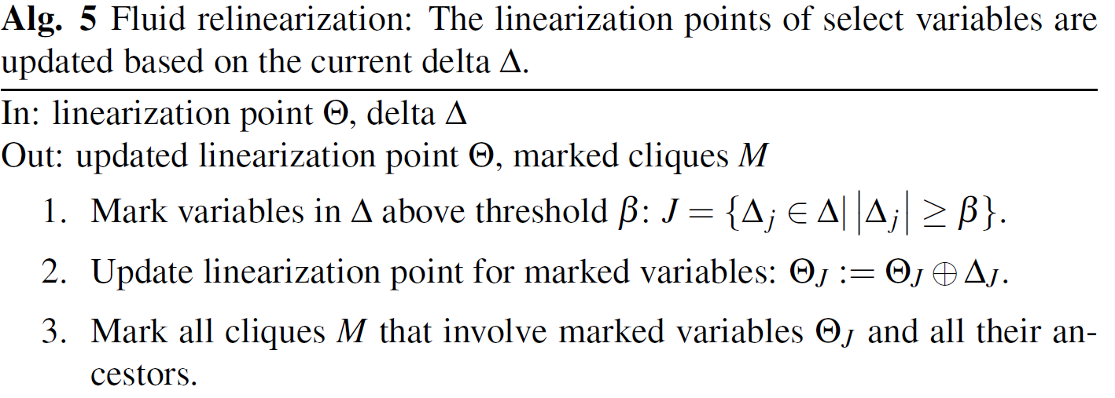
Fluid Relinearization

Slide 22
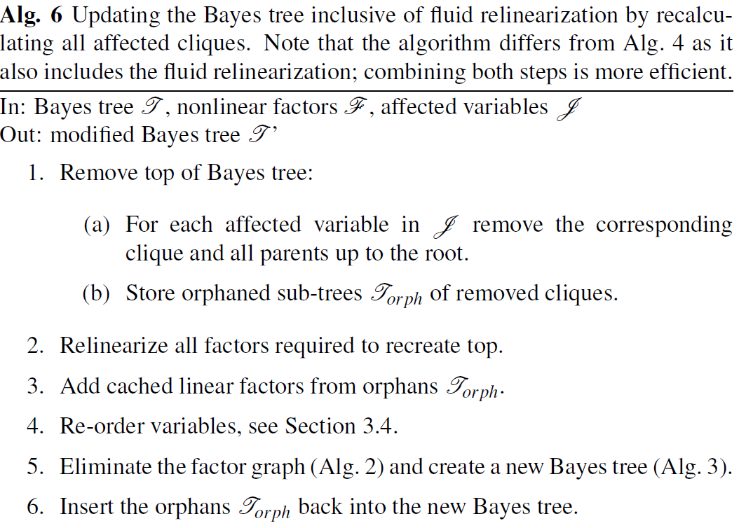

Slide 23
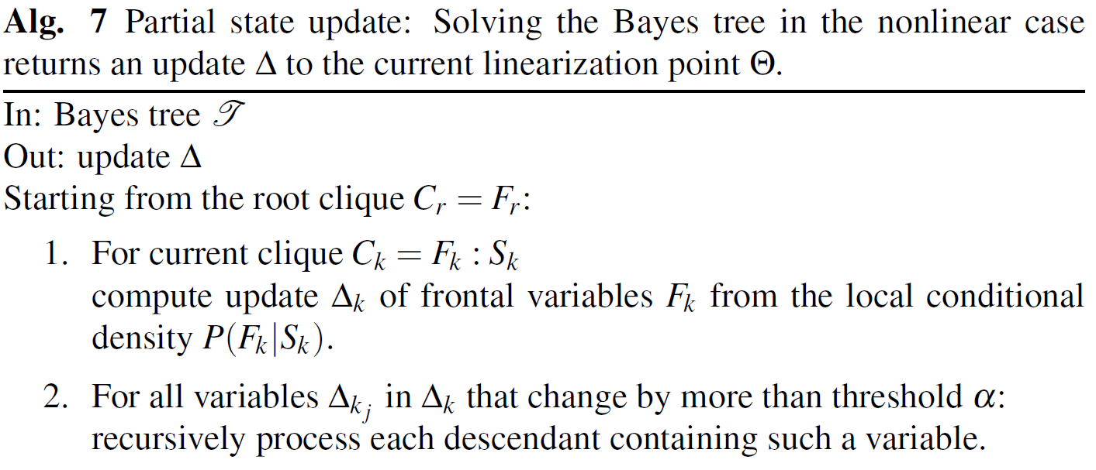
Partial State Updates

Slide 24
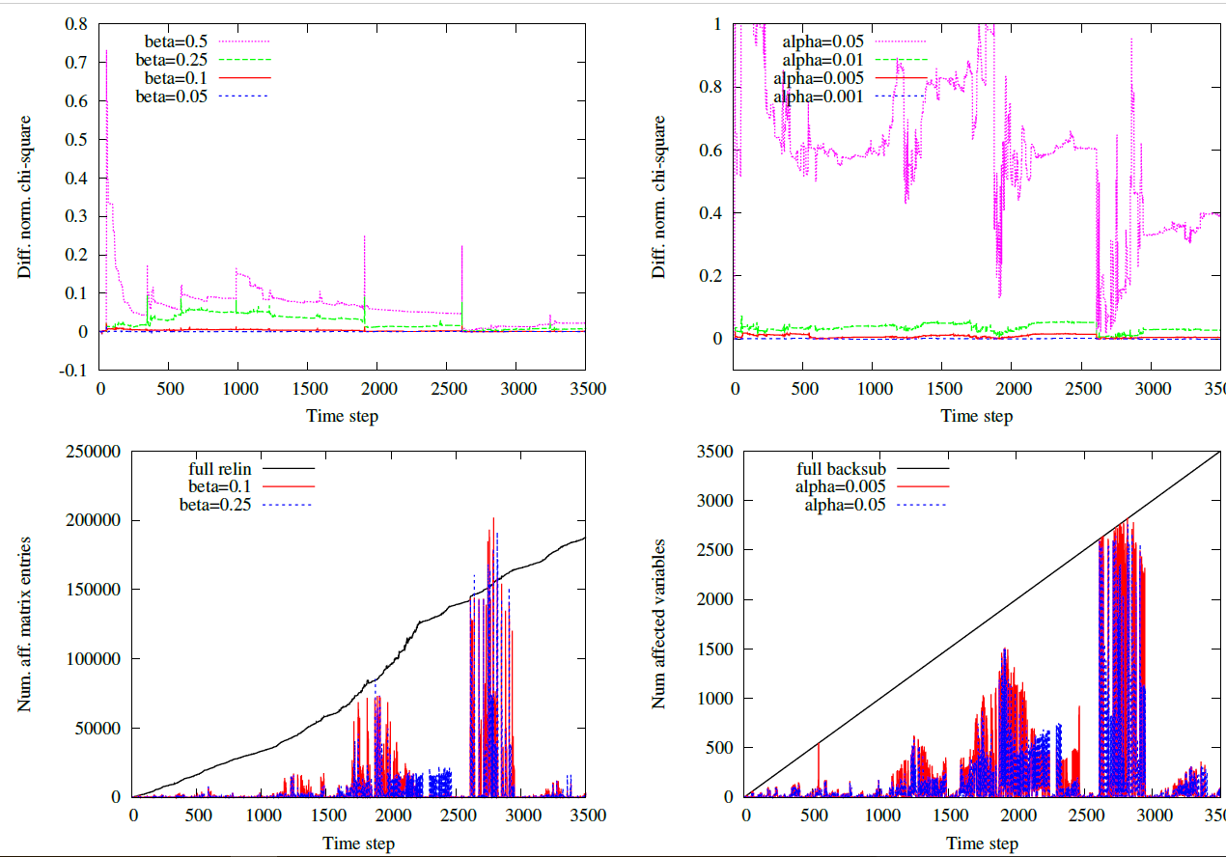

Slide 25
Thank You

