Slide 1

Bundle Adjustment
A Modern Synthesis
Bill Triggs, Philip McLauchlan, Richard Hartley and Andrew Fitzgibbon
Presentation by Marios Xanthidis
5th of No ember 2015

Slide 2
The Bundle Adjustment Problem
“Bundle adjustment is the problem of refining a visual reconstruction and produce a jointly optimal 3D structure and viewing parameters”
  Jointly: The solution is optimal with respect to both the structure and the viewing parameters
  Optimal: The solution is optimal with the meaning that the estimated parameters are found after minimizing some cost function that describe the model fitting error

Slide 3
Bundle Adjustment in Roobotics
The Bundle Adjustment problem is mainly a problem in the field of Computer Vision.
But the solution to that problem includes finding the right viewing parameters (i.e. calibration and pose estimates).
So Bundle Adjustment can be used as solution to the localization problem, since we estimate the pose of the camera that is defined for a robotic system.

Slide 4
Overview of the problem
Bundle adjustment is a large sparse geometric parameter estimation problem that combines 3D feature coordinates, calibrations and camera poses.
The solution tries to minimize some cost functions that describe the reprojection error of the features

Slide 5
Projection Model and Problem Parameterization
The scene is modeled using features X_{p}, p=1…n that are imaged in m shots with camera parameters P_{i}, i=1…m and calibration parameters C_{c}, c=1…k. If for every measurement x_{ip} we have a predictive model x then the feature prediction error is:
Δx_{ip}(C_{c},P_{i},X_{p})= x_{ip}-x(C_{c},P_{i},X_{p})
The cost function f(x), that we will use for the optimization, will be a function of the above error function.
There are no globals parameterizations due to non linearity, so only local parameterizations is used.
Equivalent but different parameterizations can affect differently the efficiency.
Singularities during rotations is a real problem so the use of quaternions is recommended.

Slide 6
Error Modeling(1)
Error modeling is just the choice of an optimal least squares cost function f(x).
We use ML or MAP estimators in order to minimize the probability of the prediction errors.
Treating the observations’ distributions as Gaussians can cause fitting problems for the model.
It is critical to model the noise accurately and use proper noise distributions for a robust ML estimation.

Slide 7


Error Modeling(2)
Generally:
But the above cost function is sensitive to non Gaussian noise. So the robust least square function is recommended:
Where ρ_{i} is a increasing function with ρ_{i}(0) and dρ_{i}(0)=1.
For implicit observation- constraining models techniques as the nuisance parameters and reduction are used

Slide 8
Numerical Optimization
Minimizing a real cost function f(x) is a too complicated task. So an approximation to a local model is needed.
Second order methods are used. And by using the Newton’s method fast convergence is possible.
For more efficiency also the Gauss-Newton approximation is used. (Robustified GNA for radial cost functions).
Using the Sequential Quandratic Programming step is helpful for constraints.

Slide 9
Network Structure(1)
We can model the bundle problem as a graph.
The measurement network can be described by the network graph and the parameter connection graph shows the relations between the parameters and the features.
All bundle methods deal with the scarcity of the J matrix and some advance methods, also with the H matrix.

Slide 10
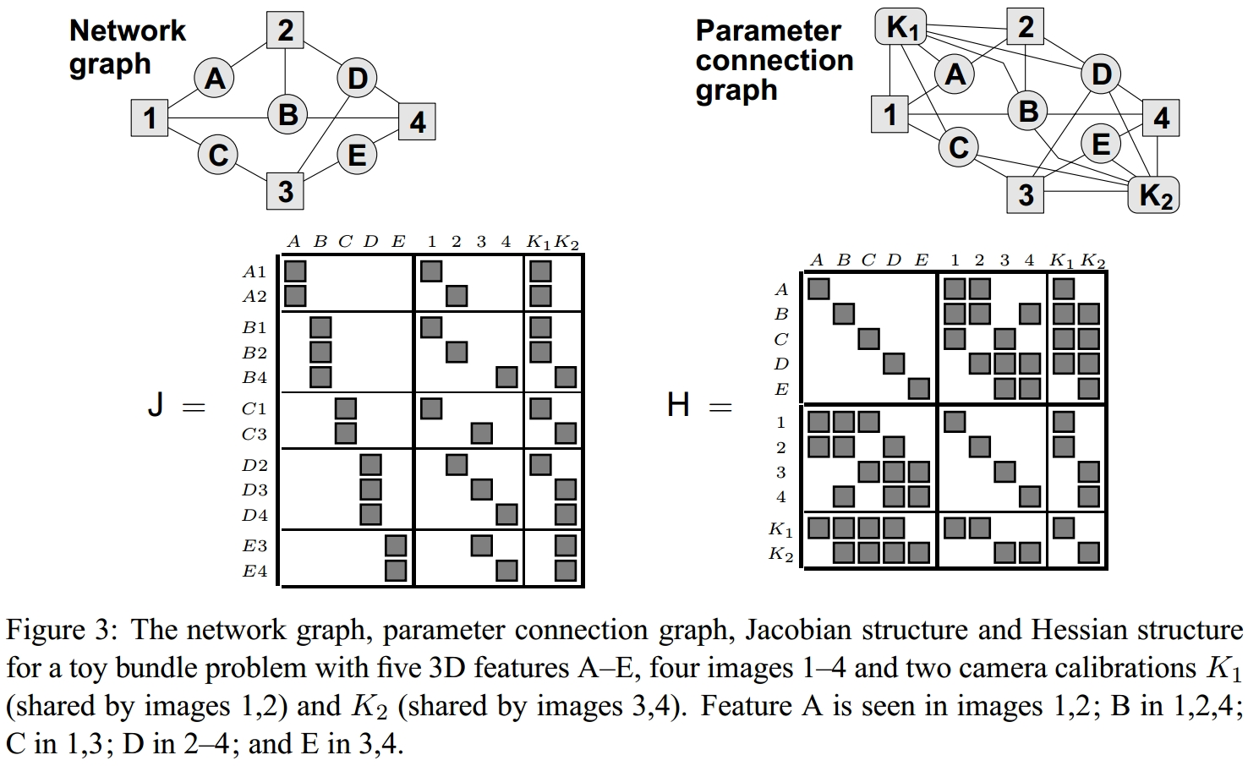
Network Structure(2)

Slide 11
1. Second Order Adjustment Methods
Rapid convergence but with high cost for every iteration.
They deal with the sparsity of the Hessian.
Schur complement is used for factorization.
If needed triangular decompositions can reduce the H matrix. (Cholesky, Bunch-Kaufman method)
Ordering methods are used in order to avoid storing and manipulating zero blocks.

Slide 12
2. First Order Adjustment Methods
Factoring the H matrix to compute the Newton step can be expensive and complex.
More iterations but a much cheaper every iteration but the accuracy is sensitive.
The convergent is often slow due to the need of line search for scale for every step.
Alternation, Krylov subspace or Limited Memory Quasi-Newton methods can improve the above problems.
Not ideal for solving localization problem, since many FOAM ignore the camera blocks of the H.

Slide 13
3. Updating and Recursion
Adding or deleting observations and parameters.
Helpful for real-time applications that need a quick response or for getting preliminary predictions.
The challenge is to update or downdate the Hessian.
Downdating may reduce the accuracy.
We can estimate camera poses with reduction of a sequence of feature correspondences.
The EKF can be used for optimizing filtering and smoothing.

Slide 14
Gauge Freedom
Gauge Freedom is the freedom in the choise of coorbinates fixing rules. The coorbinate system can change anytime without affecting the structure.
Gauge orbits, group, invariants(???)

Slide 15
Quality Control (1)
Quality control is necessary in order to detect outliers and the reliability of the result.
Quality can be defined as the combination of accuracy and reliability.
The number of measurements, the reliability of the system in the face of outliers, small modeling errors and the intelligent use of redundancy increase the quality

Slide 16
Quality Control (2)
“For any sufficiently well behaved cost function, the difference f₊(x₊)-f₋(x₋) is asymptotically an unbiased and accurate estimate”. Where f₊(x₊) and f₋(x₋) are the cost functions with and without the observation included.
So that means that in a good model a single observation won’t make a big difference.
In non robust models there is a need for outlier detection and removal according to a threshold α. An estimation of the effect on the final stage from a single observation is also helpful to determine the outer reliability.
Finally, the sensitivity of the model for every observation should be small for a reliable model.

Slide 17
Model Selection
By freezing some parameters it is possible to produce more specialized models from general models.
Also we can retrieve the unconstraint minimum given by the Newton step from a more specialized model or by applying a prior δf_{prior}(x) peaked at the zero of the specialization constraints c(x).

Slide 18
Any questions?

