Slide 1
Unscented Kalman Filter (UKF)
CSCE 774 – Guest Lecture
Dr. Gabriel Terejanu
Fall 2015

Slide 2
Problem Statement
Process and measurement noise (temporarily uncorrelated)
Initial state statistic summary
Measurements

Slide 3
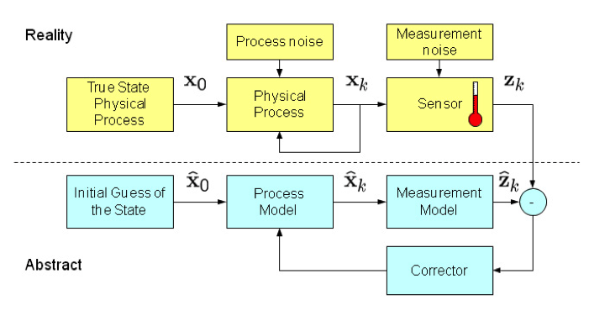
Filtering

Slide 4
Review
Kalman Filter
vs
Extended Kalman Filter
vs
Particle Filter
vs
Unscented Kalman Filter

Slide 5
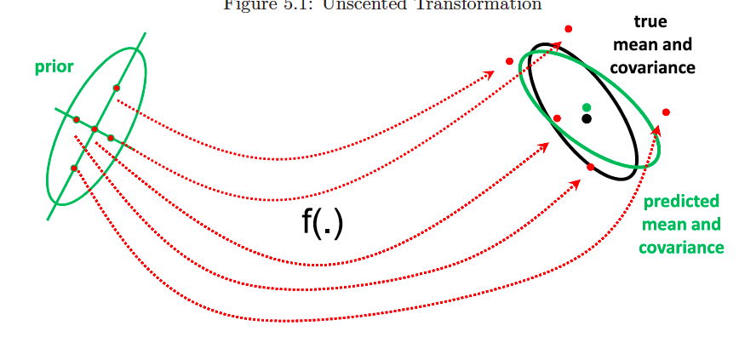
Main idea of Unscented Transformation

Slide 6
Weighted Statistical Linearization (WSL)
WSL provides an alternative linear model to the first-order Taylor series expansion

Slide 7
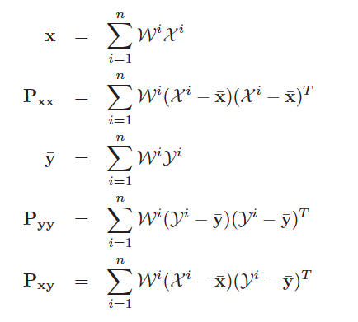
WSL cont.

Slide 8
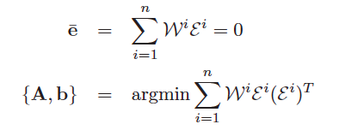
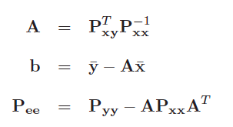
WSL solution

Slide 9
UKF - Sigma Points

Slide 10
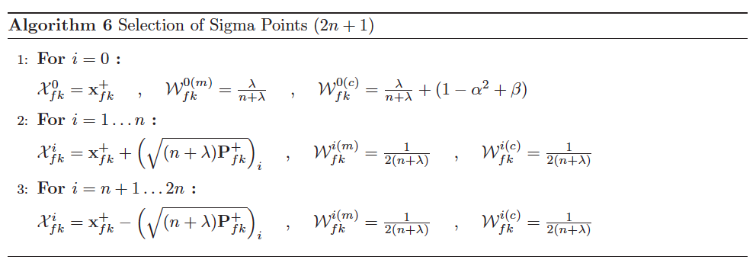
Sigma Points Selection
Sigma points are selected to capture the first and the second order moments of the prior distribution.

Slide 11
Notes

Slide 12
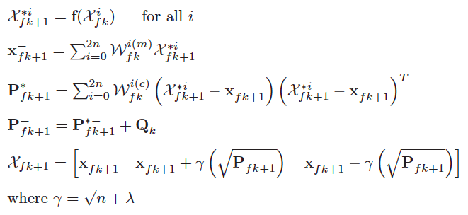
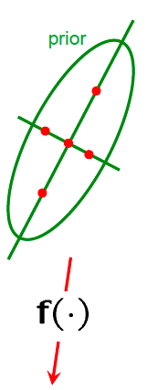
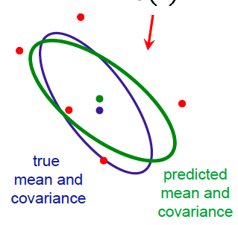
UKF #1 - Propagate sigma-points through process model

Slide 13
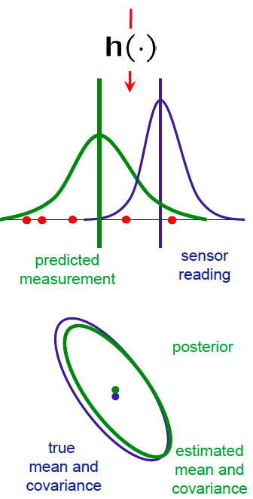
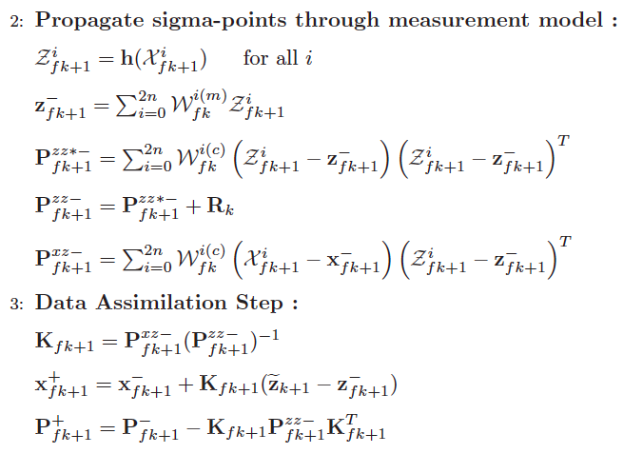
UKF #2/#3 – Propagate through measurement model & Data Assimilation

Slide 14
UKF - Summary
prior
true
mean and
covariance
predicted
mean and
covariance
posterior
Bayes Update
true
mean and
covariance
estimated
mean and
covariance
predicted
measurement
sensor
reading

Slide 15
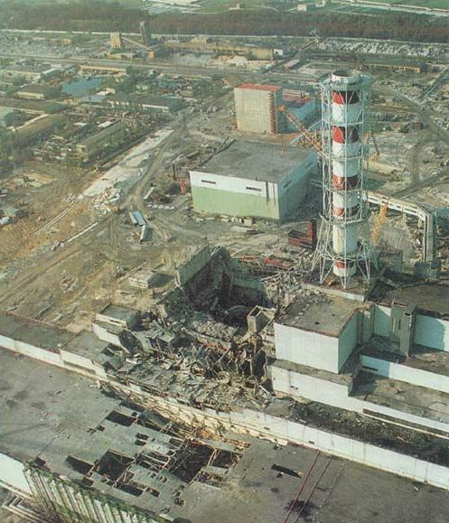
Application – Atmospheric Dispersion
Atmospheric dispersion involves transport (advection) and diffusion of the species released into the atmosphere
Dispersion modeling uses mathematical formulations to characterize the atmospheric processes that disperse a pollutant emitted by a source
Chernobyl, Soviet Union, April, 26, 1986, radioactive particle plume estimated to be responsible for 4000 extra deaths according to IAEA and WHO

Slide 16
Numerical Results – Puff-based Dispersion Model

Slide 17
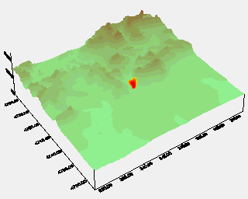
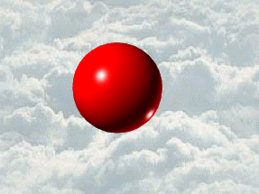
Puff Splitting and Merging
Dispersion over complex terrains
Puff splitting: when an initially small puff is grown to the size comparable with the grid spacing of the flow model
After splitting, the new puffs can set off in individual directions
Puff merging: two puffs, which are sufficiently close to each other, can be merged

Slide 18
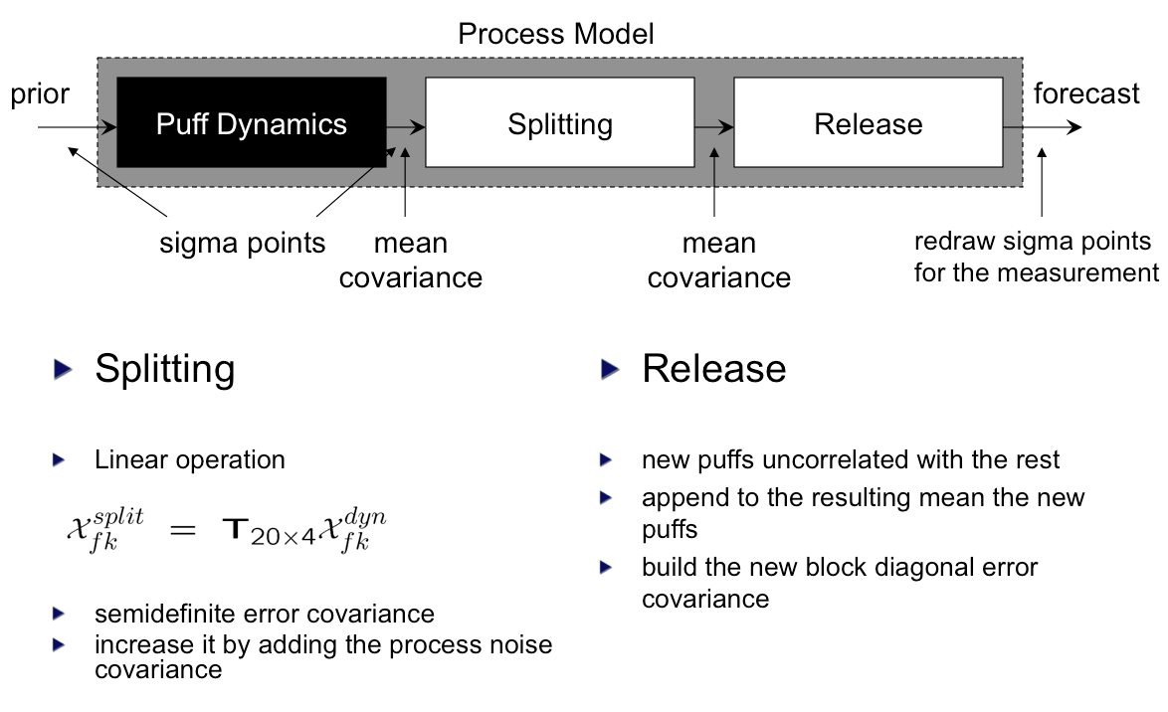
Variable State Dimension

Slide 19
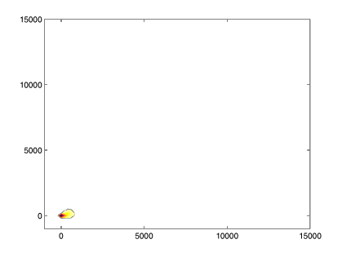
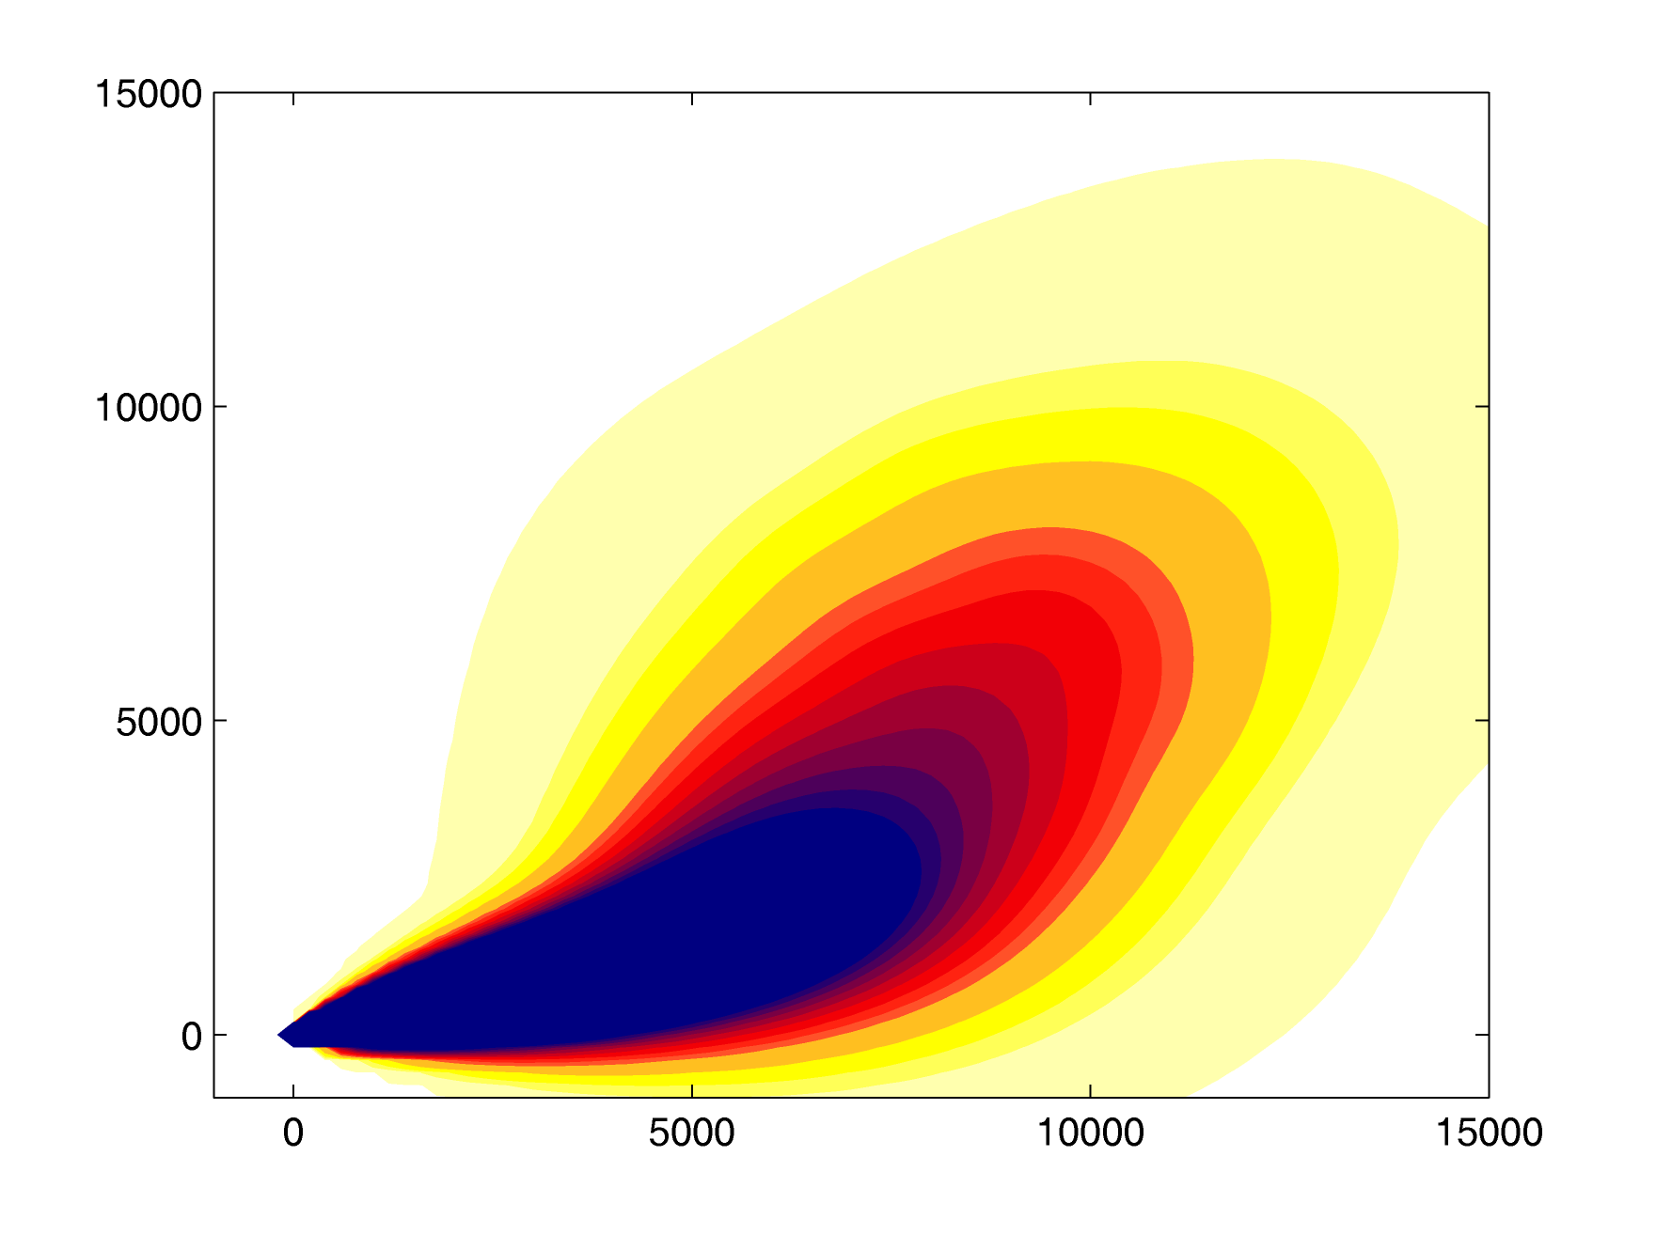
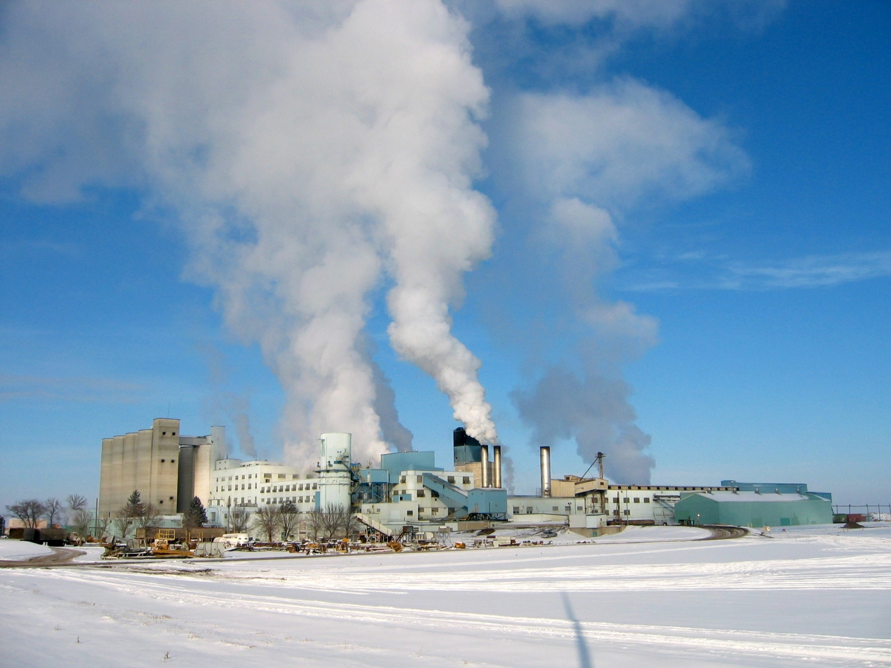
Simulation Environment
Truth model simulation
Dispersion Region 15 x 15 km²
Grid resolution (concentrations) 200 m
Sensors located every 1 km
Square Root implementation
The results have been averaged over 50 runs
Simulation Time: 60 min
The Source releases every 1 min for the first 15 min
Time Step: 20 sec
Wind Speed: 5 m/sec with 20% noise
Wind direction changes from 15 deg to 60 deg after 30 min
Concentration Dosage
Chemical Release Example

Slide 20
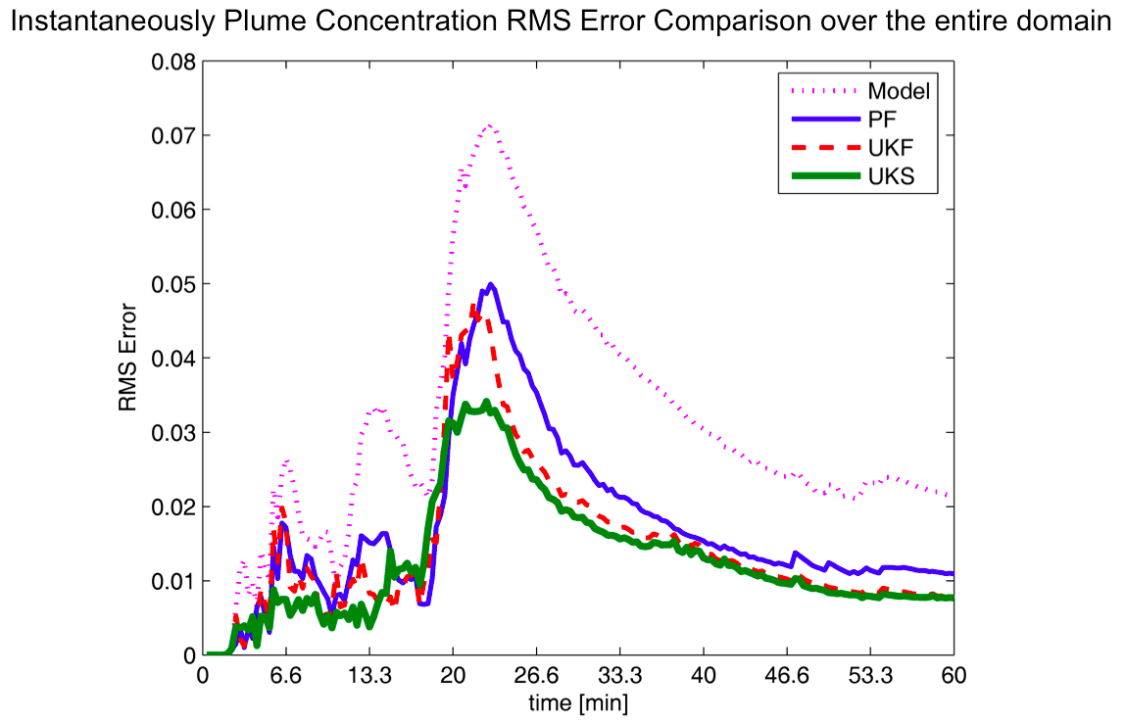
Results – Plume Concentration

Slide 21
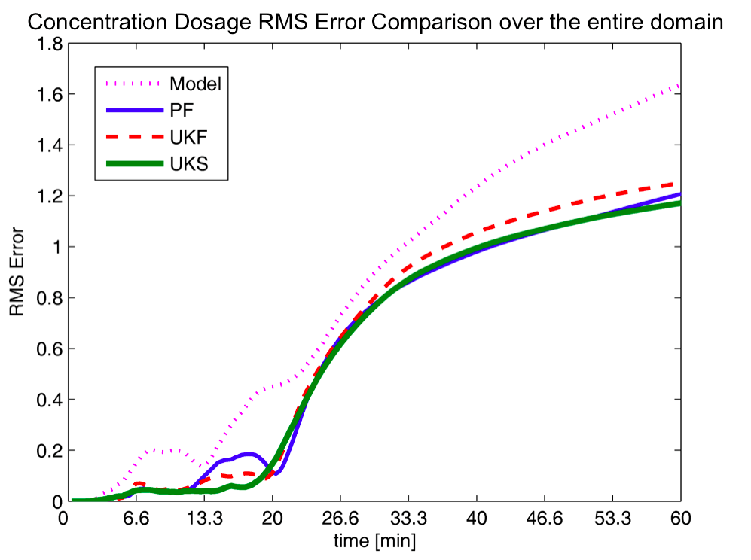
Results - Dosage

Slide 22
Thank you!

