Slide 1
Visual Odometry for Ground Vehicle Applications
David Nistér, Oleg Naroditsky,
and James Bergen
Sarnoff Corporation
CN5300
Princeton, New Jersey 08530

Slide 2
Basic idea
Estimation of motion based on video input alone
No prior knowledge of scene or motion
Real time operation with low delay
Front end: feature tracker
Point features matched between pairs of frames
Can be used in conjunction with other sensors

Slide 3
Introduction
Effective use of video sensors has been a goal for many years
Recent advances have made real-time vision processing practical
Speed and latency constraints

Slide 4
Related works
Moravec’s work in 1970
Stereo visual odometry used on Mars early 2004
Camera motion estimation based on feature tracks
More closely related to Davison; Chiuso,Favaro & Soatto
Notes:
More works are available

Slide 5
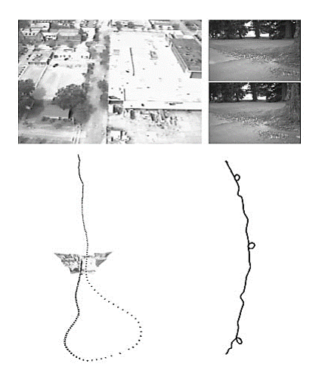
Results obtained using this system
Left: Single camera Right: Stereo pair

Slide 6
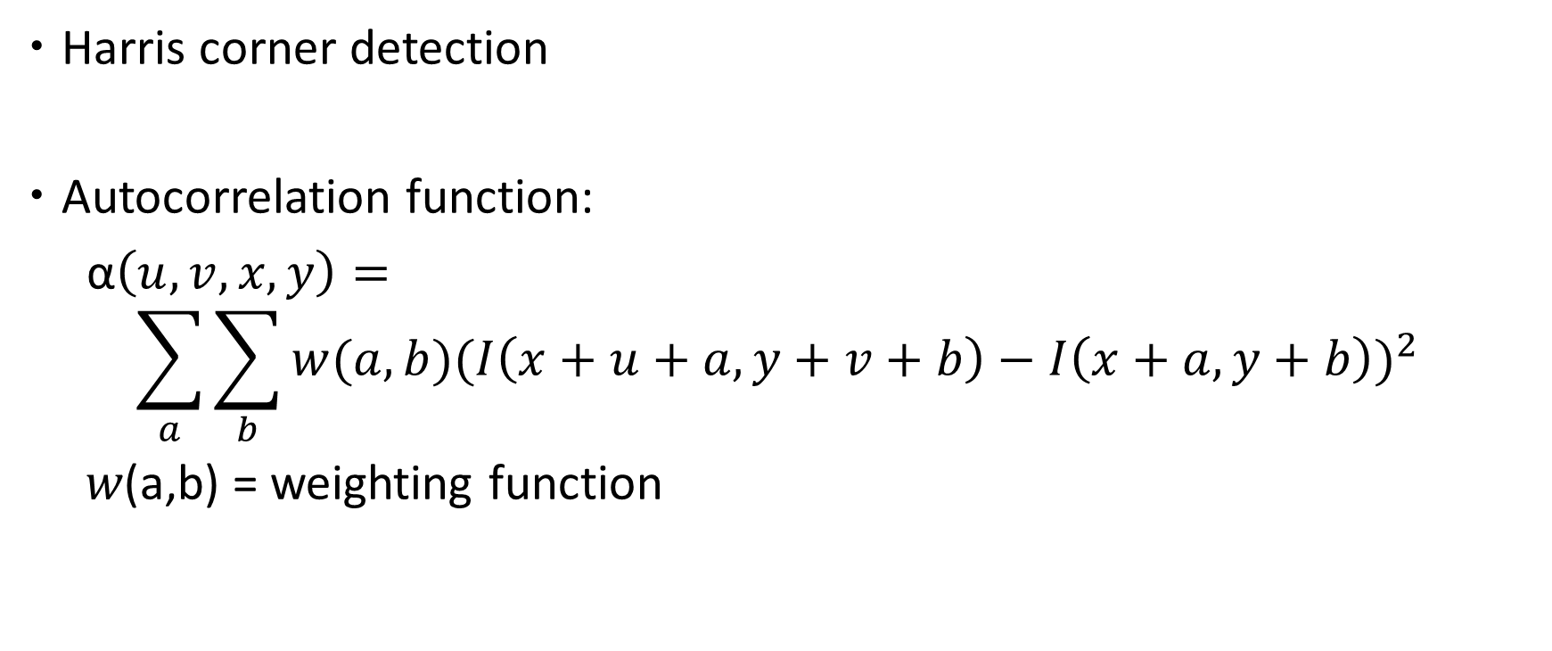
Feature Detection
Harris corner detection
Autocorrelation function:
α$\left(u,v,x,y\right)=$
$$\sum_{a}{\sum_{b}{w(a,b){(I\left(x+u+a,y+v+b\right)−I\left(x+a,y+b\right))}^{2}} }$$
$w$(a,b) = weighting function

Slide 7
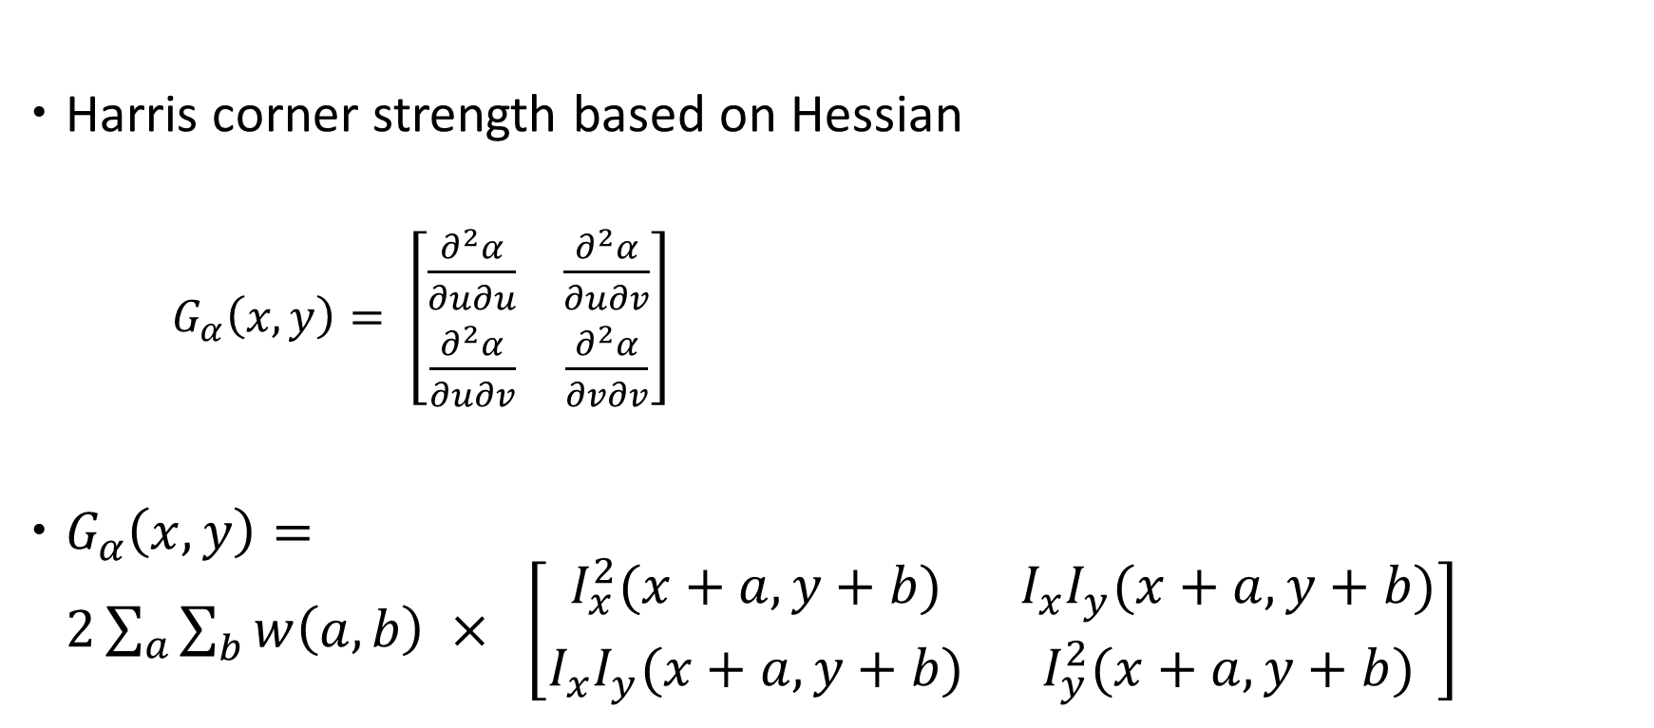
Finding corner strength
Harris corner strength based on Hessian
  $G_{α}\left(x,y\right)= \left[\begin{matrix}\frac{∂^{2}α}{∂u∂u} & \frac{∂^{2}α}{∂u∂v} \\ \frac{∂^{2}α}{∂u∂v} & \frac{∂^{2}α}{∂v∂v}\end{matrix}\right]$
$G_{α}\left(x,y\right)=2\sum_{a}{\sum_{b}{w\left(a,b\right) × \left[\begin{matrix}I_{x}^{2}(x+a,y+b) & I_{x}I_{y}(x+a,y+b) \\ I_{x}I_{y}(x+a,y+b) & I_{y}^{2}(x+a,y+b)\end{matrix}\right]}}$
Notes:
Harris corner detector: http://www.cse.psu.edu/~rtc12/CSE486/lecture06.pdf

Slide 8
Feature Detection
Four Sweeps to Calculate
Compute , by filters and .
Calculate the horizontal sum by filter .
Calculate the vertical sum by filter .
Calculate corner strength .
Notes:
Explain Ix and Iy

Slide 9
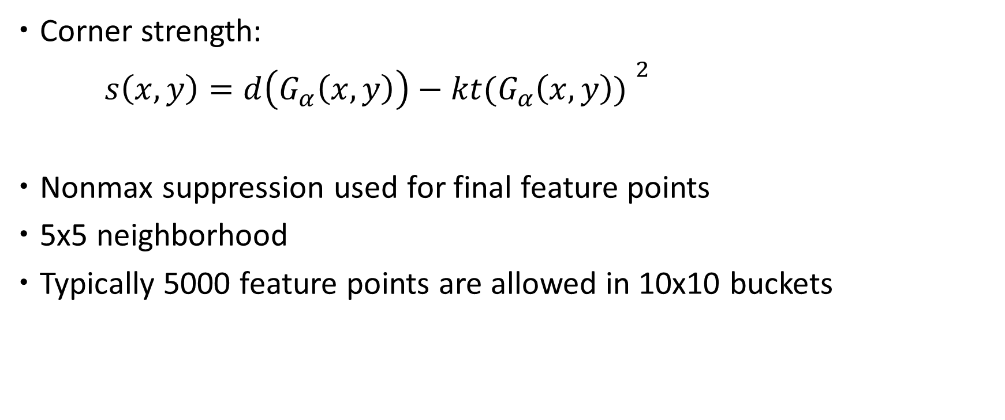
Selecting corner points
Corner strength:
$s\left(x,y\right)=d{\left(G_{α}\left(x,y\right)\right)−kt(G_{α}\left(x,y\right)) }^{2}$
Nonmax suppression used for final feature points
5x5 neighborhood
Typically 5000 feature points are allowed in 10x10 buckets

Slide 10
Feature Detection
Detected Feature Points
Superimposed feature tracks through images

Slide 11
Feature Matching
Two Directional Matching
Calculate the normalized correlation in reign,
where , are two consecutive input images.
Match the feature points in the circular area that have the maximum correlation in two directions.

Slide 12
Robust Estimation
The Monocular Scheme
Separate the matching points into 5-points groups.
Treat each group as a 5-point relative pose problem.
Use RANSAC to select well matched groups.
Estimate camera motion us-
ing the selected groups.
Put the current estimation in to the coordinate of the previ-ous one.
Notes:
RANSAC is the standard used for outlier rejection

Slide 13
Robust Estimation
The Stereo Scheme
Match the feature points in stereo images, then triangulate
them into 3D points.
Estimation the camera motion using RANSAC and the 3D points in consecutive frames.

Slide 14
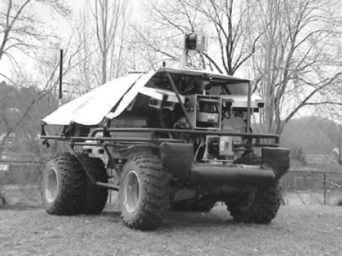
Experiments
Different Platforms

Slide 15
Experiments
Speed and Accuracy

Slide 16
Experiments
Visual Odometry vs. Differential GPS

Slide 17
Experiments
Visual Odometry vs. Inertial Navigation System (INS)

Slide 18
Experiments
Visual Odometry vs. Wheel Recorder

Slide 19
Conclusion and Future Work
Conclusion
A real-time ego motion estimation system.
Work both on monocular camera and stereo head.
Results are accurate and robust.
Future Work
Integrate visual odometry with Kalman filter.
Use sampling methods with multimodal distributions.

