Slide 1
A Multi-State Constraint Kalman Filter for Vision-aided Inertial Navigation
Anastasios I. Mourikis and Stergios I. Roumeliotis

Slide 2
Abstract:
Paper presents an Extended Kalman filter based algorithm for vision-aided inertial navigation.
Main goal is to derive a measurement model.
Computational Complexity – Linear in no. of features.
Capable of accurate pose estimation in large scale real world environment.
The performance of the algorithm is shown in Experimental results.

Slide 3
Related Work
J.W.Langelaan at el, D. Strelow at el, L.L. Ong at el, E. Eade at el, A. Chiuso at el and A.J. Davision at el they proposed algorithms for fusing inertial measurments with visual feature observations that fallow SLAM.
Advantage: SLAM based algorithm consider for correlations that exist between pose of camera and 3D positions of the observed features.
Limitation: Properly treating of correlations are high computationally costly.
S. Roumeliotis at el, D.D. Diel at el, D.S. Bayard at el, S. Soatto at el -1996, S. Soatto at el -1997, R.J Prazenica at el proposed algorithms that estimates the pose of camera only for achieving real time operations.
R. Garcia at el, R. Eustice at el, A.I. Mourikis at el used pairwise constraints in their algorithms that maintain a state vector comprised of multiple camera poses.
M.C.Deans at el proposed an algorithm that maintain a window of camera poses in the variable state dimension filter. Computational complexity of VSDF is quadratic in number of features.

Slide 4
Algorithm:
Propagation: For each IMU measurement received, propagate the filter state and Covariance.
Image registration: Every time a new image is recorded,
1. Augment the state and covariance matrix with a copy of the current camera pose estimate.
2. image processing module begins operation.
Update: When the feature measurements of a given image becomes available, perform EKF update.

Slide 5
Structure of EKF State vectors:
IMU state vector:
IMU error State:
Error in quaternion is given as:
State Vector of EKF when N camera poses are included:

Slide 6
Propagation:
Continuous -time system modeling:
Gyroscope and accelerometer measurements are given by:
Estimates of evolving IMU state is:
Linear continuous time model for IMU error state is:

Slide 7
Discrete time implementation:
-IMU samples the measurements Wm and am with time period T
-used for state propagation in EKF.
-Covariance matrix:
-Propagated Covariance matrix:
--numerical integration of Lyapunov equation:

Slide 8
State Augmentation:
At every new image camera pose estimate is computed from IMU pose estimate.
The camera pose estimate is appended to state vector and covariance matrix of EKF is augmented.
Measurement Model:
The main idea is viewing same feature from multiple camera poses results in constraints involving in all these poses.
Measurement model presented here is considering the case of single feature fj which is observed from Mj camera poses.
Each Mj observation of the feature is given by:

Slide 9
Feature position in camera frame is given by:
By using the estimates of the feature position we can compute the residual:
Estimates:
After linearising the estimates of camera pose and feature positions, residual is given as:
Residual for all Mj measurements of the feature j is given as:
As the above equation is not in the form of defines residual by projecting the rj on the left null space of matrix Hf

Slide 10
covariance matrix of the noise vector:
Update:
EKF is triggered when
1.when features that has been tracked is no longer detected.
2. Every time new image is recorded.
In Order to reduce the computation complexity EKF update QR decomposition is employed on Hx matrix.
Q1 and Q2 are the orthogonal unitary matrices and TH is the upper triangle matrix.

Slide 11
EKF update proceeds by computing kalman gain:
Correction of state is given by vector:
State covariance matrix is updated:
Computational Complexity:
The residual rn and TH matrix are computed in O(r2d) and the above equation involves multiplication of square matrix of dimension and requires operations.Therefore the cost of EKF update is max(O(r2d), ). without QR decomposition computational cost of kalman gain is: where

Slide 12
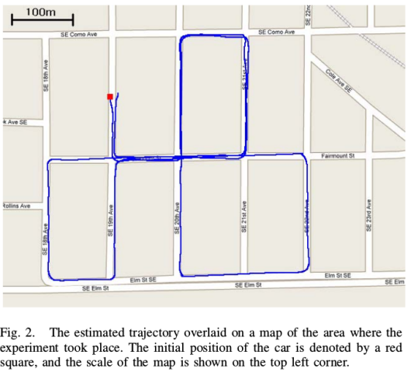
Experimental Results:
The algorithm defined here is tested extensively both in simulation and real data.The experimental setup consists of Camera,IMU placed on top of a car moving on the street.The estimated trajectory is plotted on the map where the experiment took place and it is observed that the trajectory followed the street layout accurately.
The final position estimate expressed with respect to starting pose is Xfinal=[-17.92 13.14 -0.78]T meters. The true final position with respect to the initial position is Xfinal=[0 7 0]T meters and the error is only 10 meter in a trajectory of 3.2 km i.e error is 0.31% of the travelled distance.

