Slide 1
LSD-SLAM: Large-Scale Direct Monocular SLAM
Jacob Engel , Thomas Schops and Daniel Cremers

Slide 2
Key Contribution
A novel direct tracking method which operates on sim(3), thereby explicitly detecting scale-drift.
An elegant probabilistic solution to include the effect of noisy depth values into tracking.

Slide 3
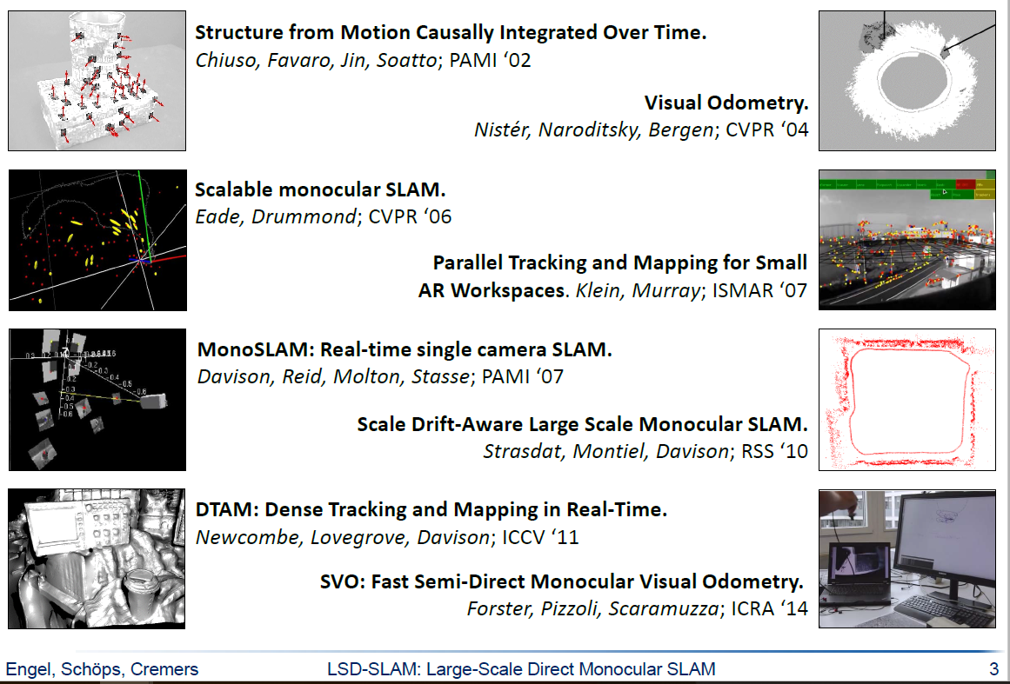
Related Work

Slide 4
LSD-SLAM : What’s New

Slide 5
Preliminaries

Slide 6
Preliminaries

Slide 7
Preliminaries

Slide 8
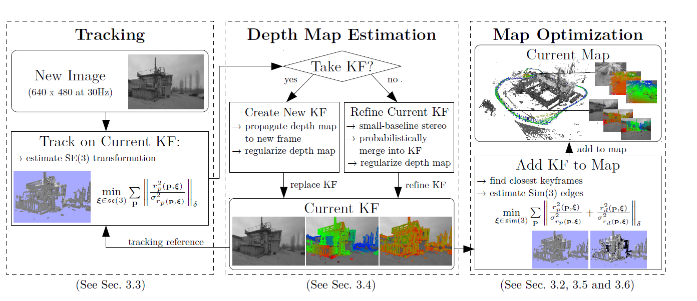
Overview of LSD-SLAM

