Slide 1
iSAM: Incremental Smoothing and Mapping
Michael Kaess (Student Member IEEE)
Ananth Ranganathan(Student Member IEEE)
Frank Dellaert(Member IEEE)

Slide 2
Key Idea
iSAM performs fast incremental updates of the information matrix thus avoiding unnecessary calculations.
Periodic variable reordering prevents unnecessary fill-in in the square root factor.
Online data association, hence relevant estimation uncertainties are retrieved from incrementally updated square root factor exploiting on sparsity of the full covariance matrix.

Slide 3
Related Work
Square root SAM: Simultaneous localization and mapping via square root information smoothing by F. Dellaert and M. Kaess (2006)
Square Root SAM: Simultaneous location and mapping via square root information smoothing by F. Dellaert (2005)
Stochastic Models, Estimation and Control by P. Maybeck (1079)
Factorization method for discrete sequential estimation by G. Bierman (1977)

Slide 4
SAM Exposition
$$P\left(X,L,U,Z\right)∝P(x_{0})\prod_{i=1}^{M}{P(x_{i}|x_{i−1},u_{i})}\prod_{k=1}^{K}{P(z_{k}|x_{ik},l_{jk})}$$

Slide 5
Assumption – Gaussian Measurement Models
$x_{i}=f_{i}\left(x_{i−1},u_{i}\right)+w_{i}$
where $w_{i}$ is process noise as $Ν(0,Λ_{i})$
$z_{k}=h_{k}\left(x_{ik},l_{jk}\right)+ν_{i}$
where $v_{i}$ is process noise as $Ν(0,Γ_{i})$

Slide 6
SLAM as Least Square Problem
maximum a posteriori (MAP) estimate
$$X^{∗}{,L}^{∗}=\underset{X,L}{argmax}{P(X,L,U,Z)}= \underset{X,L}{argmin}{−\log{P(X,L,U,Z)}}$$
In terms of process and measurement models
$$X^{∗}L^{∗}=\underset{X,L}{argmin}{\{\sum_{i=1}^{M}{{∥f}_{i}\left(x_{i−1},u_{i}\right)−x_{i}∥_{Λ_{i}}^{2}}+\sum_{k=1}^{K}{{∥h}_{k}\left(x_{ik},l_{jk}\right)−z_{k}∥_{Γ_{i}}^{2}}\}}$$
Where ${∥e∥}_{Σ}=e^{T}Σ^{−1}e$ for the squared Mahalanobis distance
Linearization of the system : $θ^{∗}=\underset{θ}{argmin}{{∥Aθ−b∥}^{2}}$

Slide 7
QR Factorization
Substitute $A=Q\left[\begin{aligned}R \\ 0\end{aligned}\right]$ in linearized least square problem:
$${\left\|Aθ−b\right\|}^{2}={\left\|Rθ−d\right\|}^{2}+{\left\|e\right\|}^{2}$$
Where ${\left[d,e\right]}^{T}≔ Q^{T}b$ as derived in the paper.
The above is minimum if and only if $Rθ=d$, thus it can be implied that
$$Rθ^{∗}=d$$

Slide 8
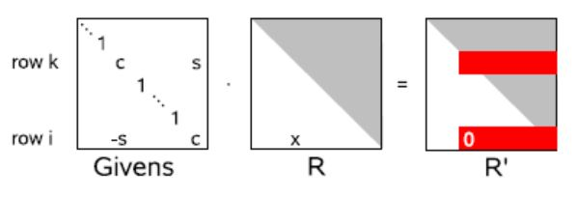
iSAM: Incremental Smoothing and Mapping
Matrix Factorization by Givens Rotations

Slide 9
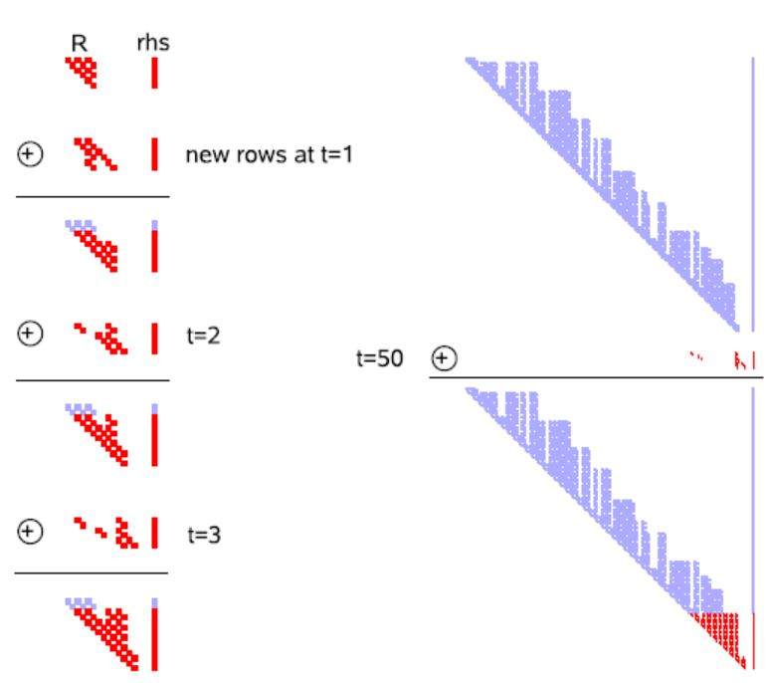
iSAM: Incremental Smoothing and Mapping
Incremental Updating

Slide 10
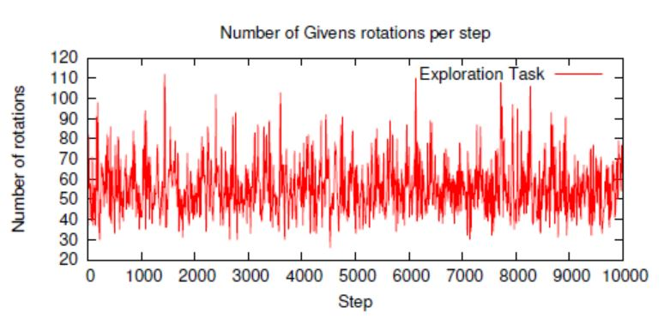
iSAM: Incremental Smoothing and Mapping
Incremental SAM
Maximum number of Givens Rotations needed for adding a new measurement row is $n$. Due to sparsity of R and the new measurement row, constant Givens Rotations are needed in this method.

Slide 11
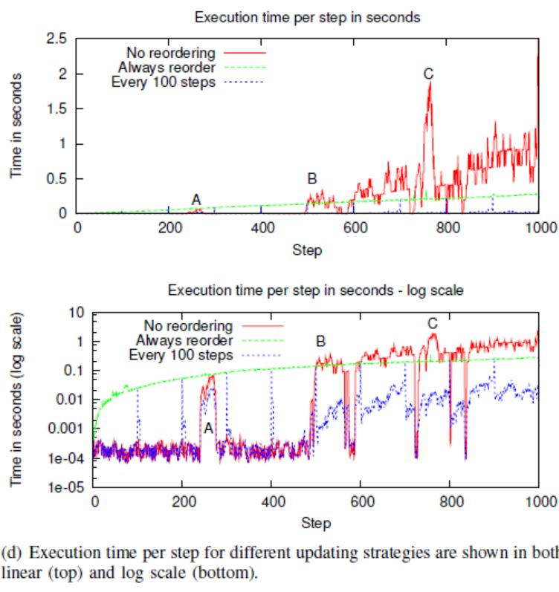
Loops and Periodic Variable Reordering

Slide 12
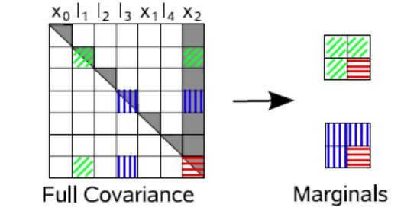
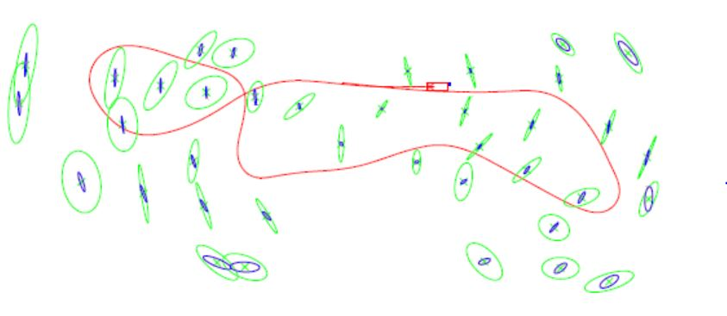
Data Association
Maximum likelihood Data Association (ML)
Marginal Covariances

Slide 13
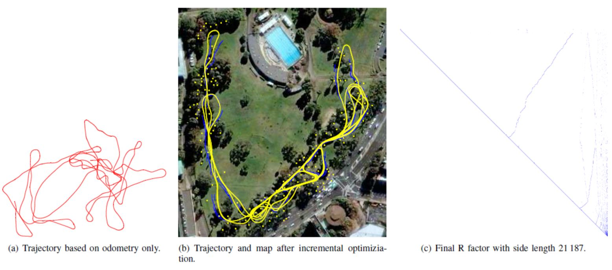
Experimental Results and Discussion
Landmark based iSAM

Slide 14
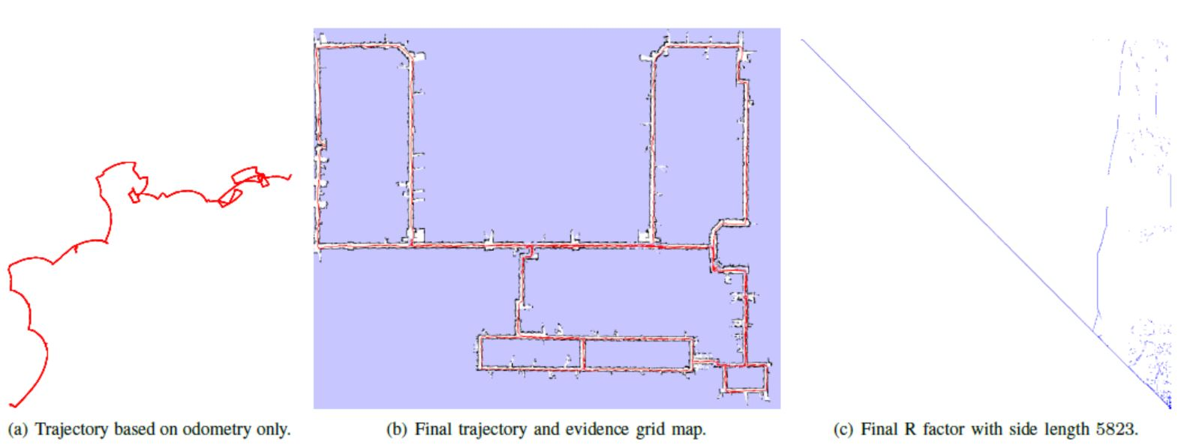
Experimental Results and Discussion
Pose Constraint-based iSAM

Slide 15
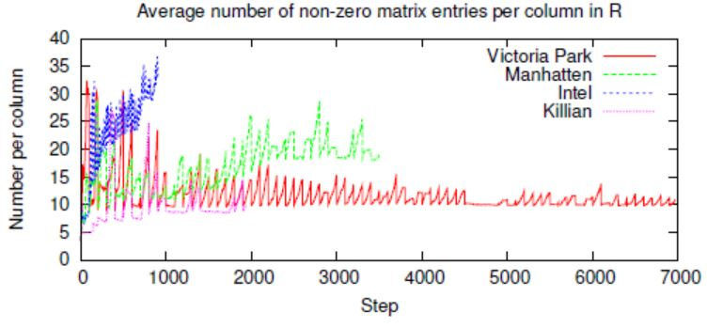
Experimental Results and Discussion
Sparsity of square root factor

Slide 16
Questions?

Slide 17
Thank you!

