Slide 1
GraphSLAM Algorithm with Applications to Large Scale Mapping of Urban Structures
Sebastian Thrun
Michael Montemerlo
Stanford AI Lab at Stanford University

Slide 2
Key Idea Behind GraphSLAM
GraphSLAM extracts from the data a set of soft constraints, represented by a sparse graph.
Then it obtains the map and the robot path by resolving these constraints into a globally consistent estimate.

Slide 3
Related Work
Extensive work in the fields of photogrammetry, computer vision and computer graphics and robotics by various personalities.
Extended Kalman Filter (EKF) mathematically introduced by Cheeseman and Smith(1986) and implemented by Moutarlier and Chatila (1989)
Globally Consistent Range Scan Alignment Algorithm by Lu and Milios (1997)
Incremental Mapping of Large Cyclic Environments by Gumann and Konolige (2000)
Atlas by Bosse et al.(2003, 2004)
Etc..

Slide 4
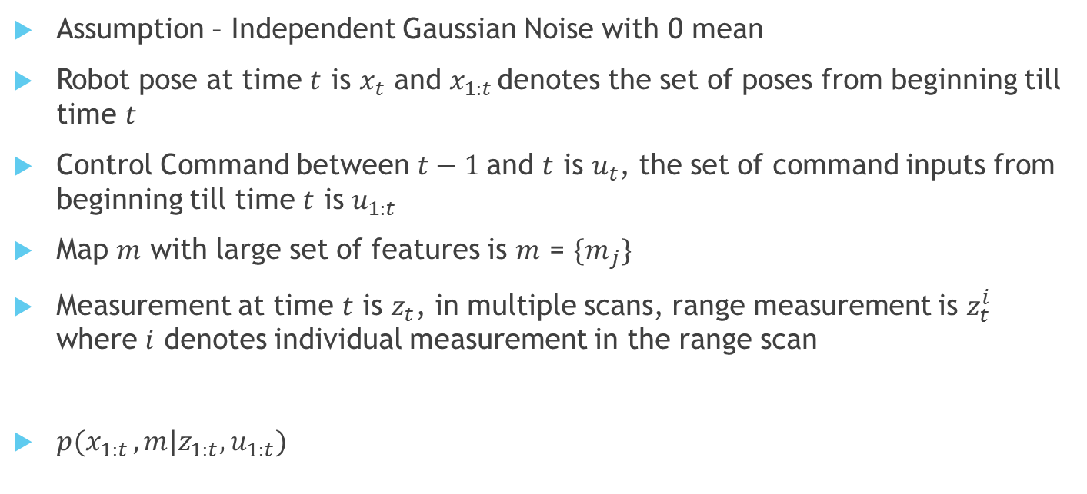
GraphSLAM Exposition
Assumption – Independent Gaussian Noise with 0 mean
Robot pose at time $t$ is $x_{t}$ and $x_{1:t }$denotes the set of poses from beginning till time $t$
Control Command between $t−1$and $t$ is $u_{t}$, the set of command inputs from beginning till time $t$ is $u_{1:t}$
Map $m$ with large set of features is $m$ = ${\{m}_{j}\}$
Measurement at time $t$ is $z_{t}$, in multiple scans, range measurement is $z_{t}^{i}$ where $i$ denotes individual measurement in the range scan
$p(x_{1:t },m|z_{1:t},u_{1:t})$

Slide 5

GraphSLAM Exposition contd..
Measurement $z_{t}^{i}=h\left(x_{t},m_{j},i\right)+ε_{t}^{i}$
or
for a GPS system $z_{t}^{i}=h(x_{t},i)+ε_{t}^{i}$
with $ε_{t}^{i}\sim 𝒩(0,Q_{t})$
Or we can say
$$p(z_{t}^{i}|x_{t},m)=const.exp−\frac{1}{2}(z_{t}^{i}−h(x_{t},m_{j},i))^{T}Q_{t}^{−1}(z_{t}^{i}−h(x_{t},m_{j},i))$$

Slide 6

GraphSLAM Exposition contd..
Robot pose $x_{t}=g(u_{t},x_{t−1})+δ_{t}$
with $δ_{t}\sim 𝒩(0,R_{t})$
Or
$$p(x_{t}|u_{t},x_{t−1})= const.exp−\frac{1}{2}({x_{t}−g(u_{t},x_{t−1}))}^{T}R_{t}^{−1}(x_{t}−g(u_{t},x_{t−1}))$$

Slide 7
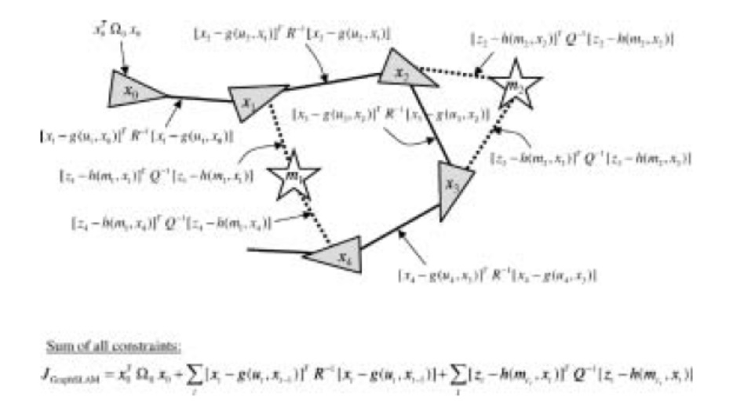
GraphSLAM: Basic Idea

Slide 8
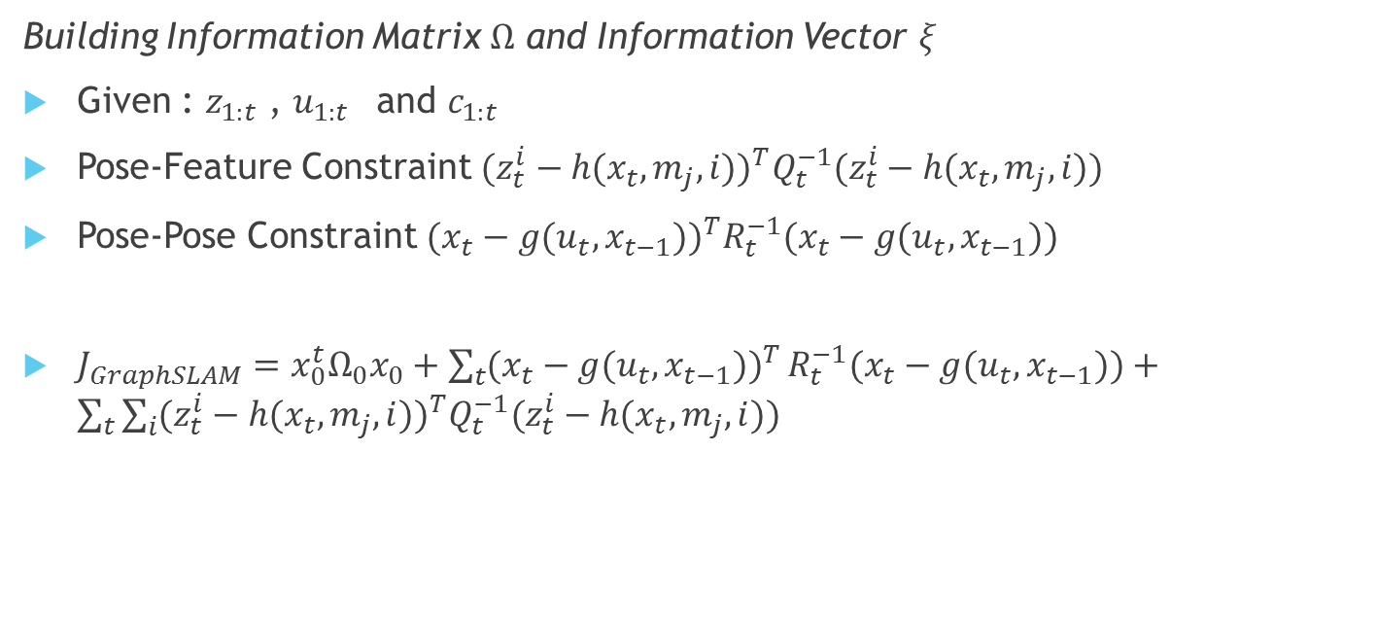
GraphSLAM: Building Graph
Building Information Matrix $Ω$ and Information Vector $ξ$
Given : $z_{1:t}$ , $u_{1:t }$ and $c_{1:t }$
Pose-Feature Constraint $(z_{t}^{i}−h(x_{t},m_{j},i))^{T}Q_{t}^{−1}(z_{t}^{i}−h(x_{t},m_{j},i))$
Pose-Pose Constraint $({x_{t}−g(u_{t},x_{t−1}))}^{T}R_{t}^{−1}(x_{t}−g(u_{t},x_{t−1}))$
$J_{GraphSLAM}=x_{0}^{t}Ω_{0}x_{0}+\sum_{t}{({x_{t}−g(u_{t},x_{t−1}))}^{T}}R_{t}^{−1}(x_{t}−g(u_{t},x_{t−1}))+\sum_{t}{\sum_{i}{(z_{t}^{i}−h(x_{t},m_{j},i))^{T}Q_{t}^{−1}(z_{t}^{i}−h(x_{t},m_{j},i))}}$

Slide 9
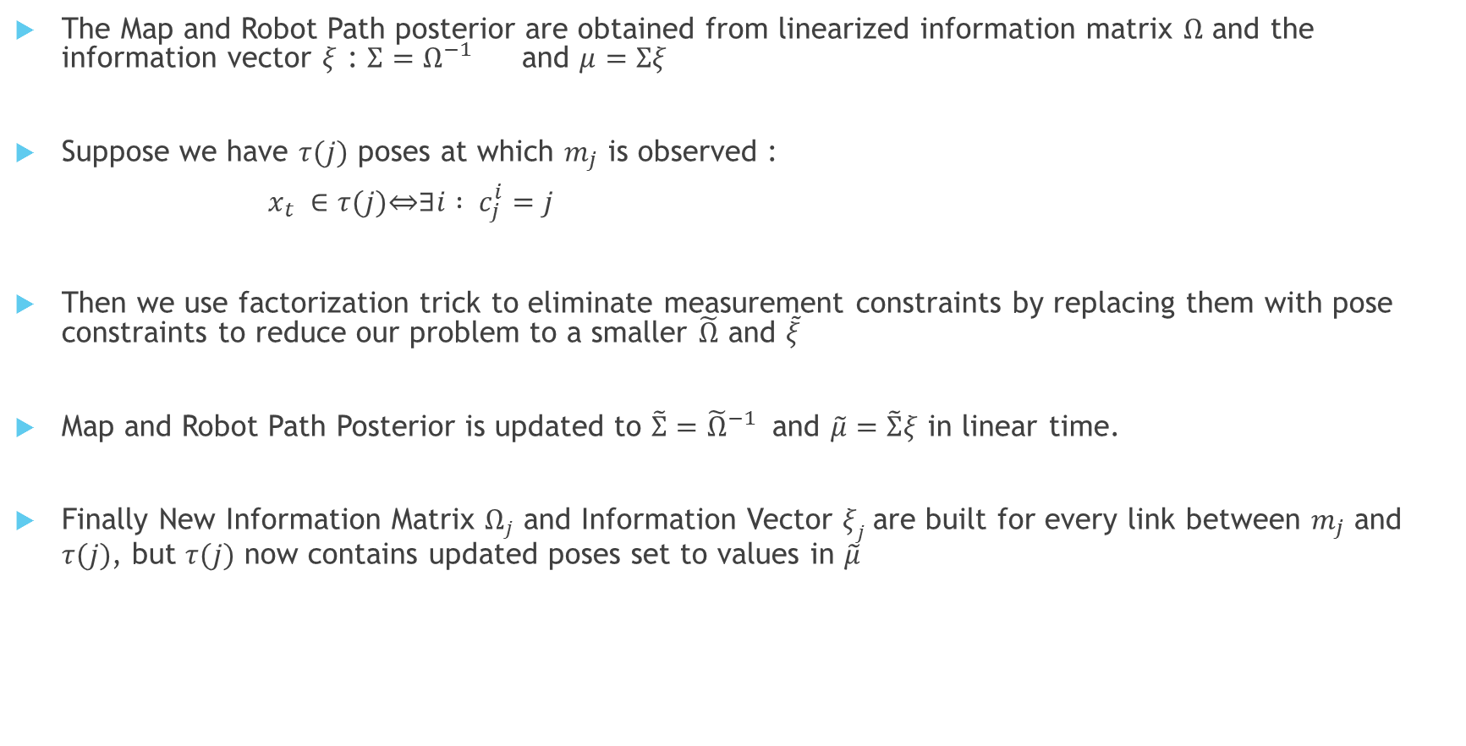
GraphSLAM: Inference
The Map and Robot Path posterior are obtained from linearized information matrix $Ω$ and the information vector $ξ$ : $Σ=Ω^{−1}$ and $μ=Σξ$
Suppose we have $τ(j)$ poses at which $m_{j}$ is observed :
$x_{t} ∈τ(j)\overset{⇔}{}∃i : c_{j}^{i}=j$
Then we use factorization trick to eliminate measurement constraints by replacing them with pose constraints to reduce our problem to a smaller $\tilde{Ω}$ and $\tilde{ξ}$
Map and Robot Path Posterior is updated to $\tilde{Σ}={\tilde{Ω}}^{−1}$ and $\tilde{μ}=\tilde{Σ}ξ$ in linear time.
Finally New Information Matrix $Ω_{j}$ and Information Vector $ξ_{j}$are built for every link between $m_{j}$ and $τ(j)$, but $τ(j)$ now contains updated poses set to values in $\tilde{μ}$

Slide 10
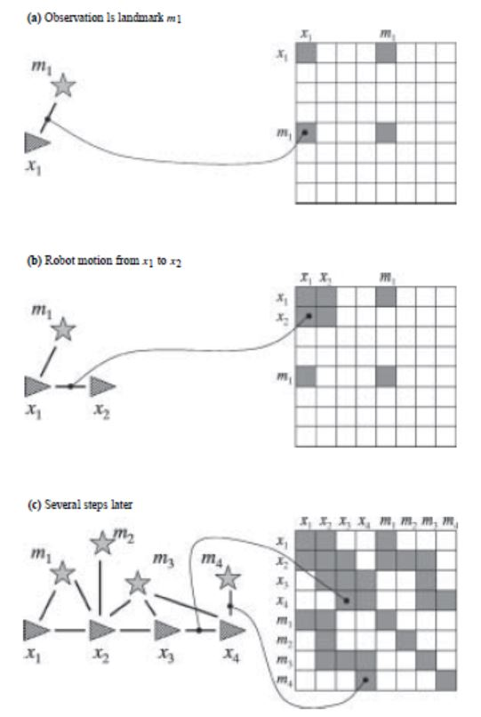
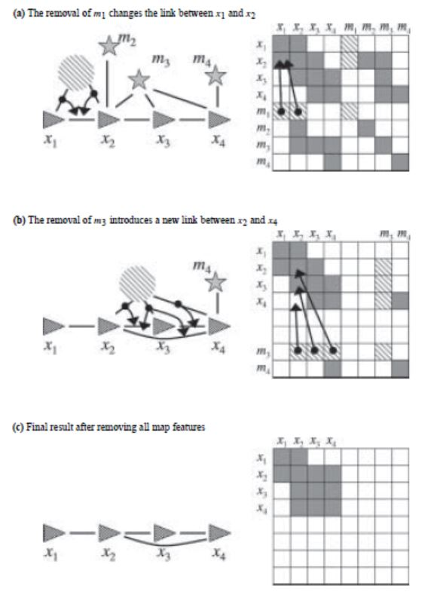
GraphSLAM: Inference Contd..

Slide 11
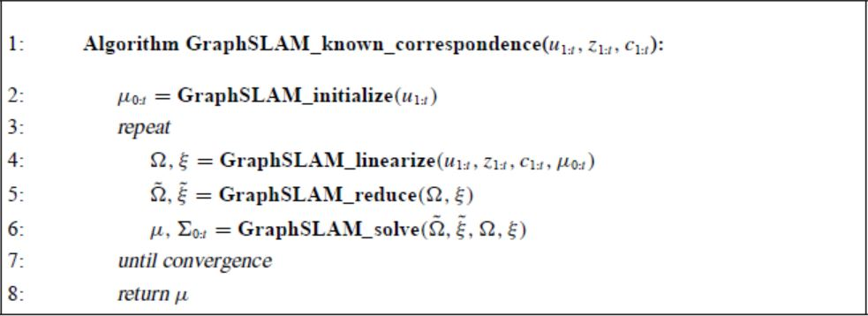
GraphSLAM: Algorithm for Full SLAM problem with Known Correspondence

Slide 12
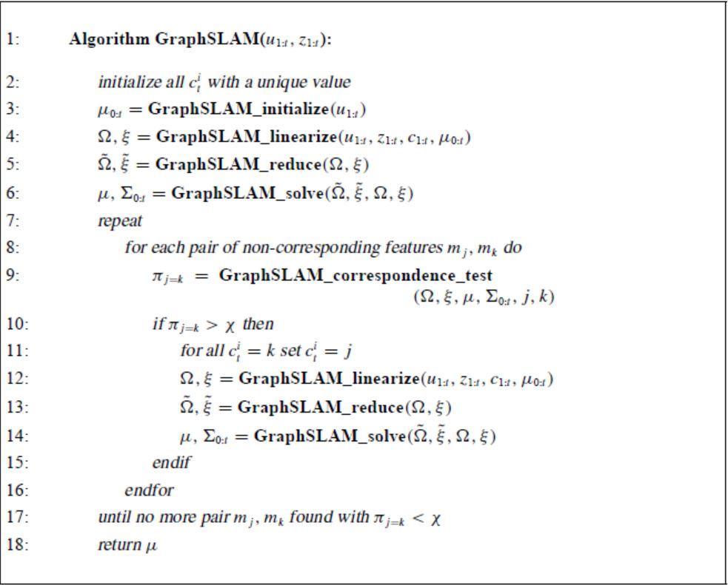
GraphSLAM: Algorithm for Full SLAM problem with Unknown Correspondence

Slide 13
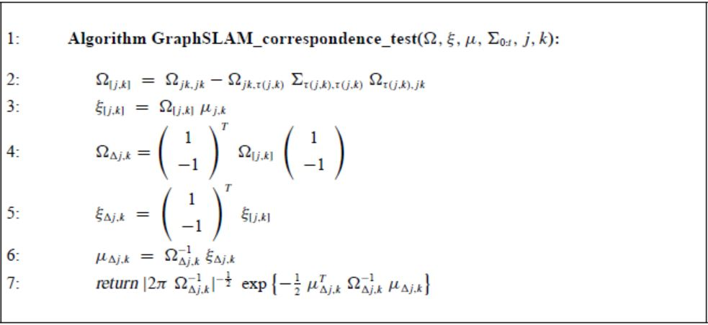
GraphSLAM: Algorithm for Correspondence Test Function

Slide 14
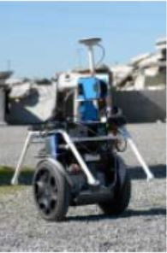
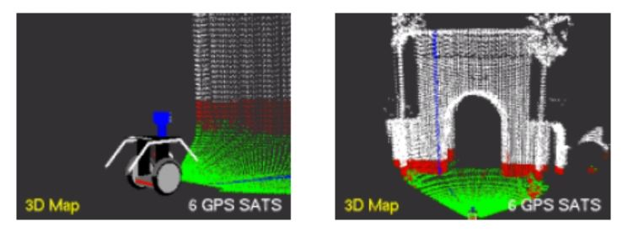
Results

Slide 15
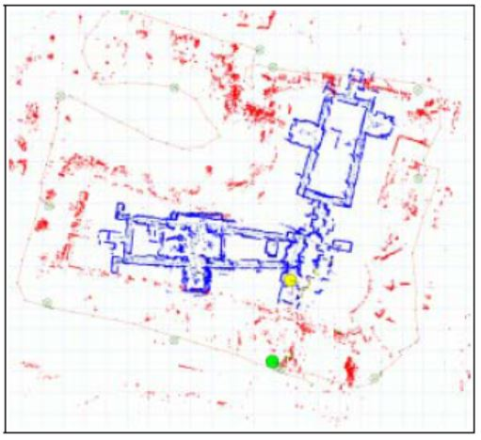
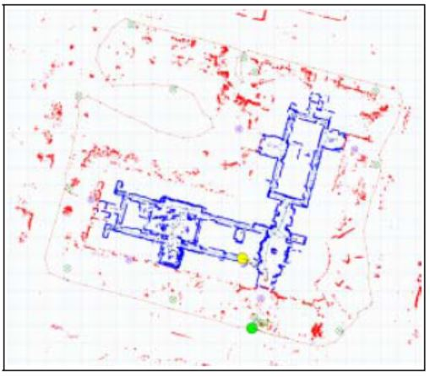
Comparative maps w/o and w GPS data factored in

Slide 16
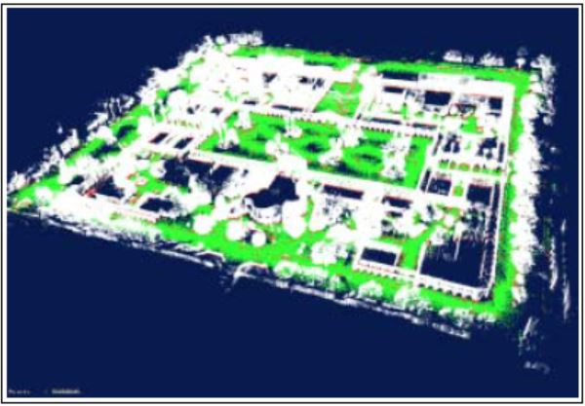
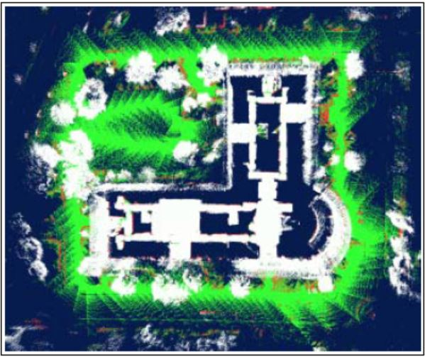
Mapping of Terrain

Slide 17
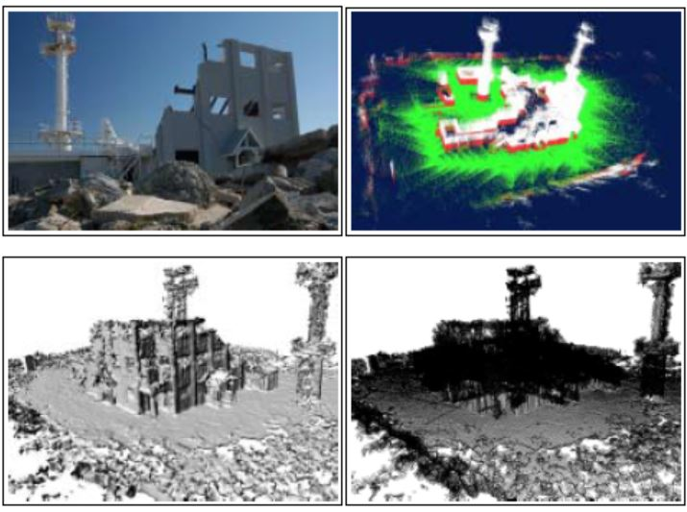
Visualization Using Two Observation Platforms

Slide 18
Discussion
Assumption of Independent Gaussian Noise
Limited Reliance on good initial estimate of map – Initialization Step
Matrix Inversion in GraphSLAM_solve function
Gap between Offline SLAM and Online SLAM
Questions?

Slide 19
Thank you!

