Slide 1
State Estimation of Underwater Robot Using Visual and Inertial Information
Florian Shkurti, Ioannis Rekleitis, Milena Scaccia and Gregory Dudek

Slide 2
Abstract:
This paper discusses vision and inertial-based state estimation algorithm for an underwater robot.
In order to estimate the 6 DOF pose of vehicle it combines information from:
a)IMU (Linear accelerations and Angular velocities).
b) Pressure Sensor(Collects depth measurements)
c)Features from monocular Camera.
3. Validation-- Experimental results are presented on field trials conducted in underwater environment.

Slide 3
Literature Review:
Mourikis and Roumeliotis: Vision aided inertial navigation for estimating the 3DOF pose of vehicle and the results of their work demonstrates estimated trajectories with errors of 0.32% of 3.2 km trajectory.
Jones and Soatto: In his recent work reports an errors of 0.5% of 30 km trajectory with very low drift in IMU for given length of trajectory and another significance of his work is it auto calibrates IMU and camera calibration and also gravity vector--which are sources for bias.
Corke et. al: They used stereo visual odometry and Harris corner features. They used only 10 to 50 features after outlier rejection for stereo reconstruction of 3D trajectory.
Eustice et. al: They used sparse information matrix to combine visual and inertial data to perform for mapping the surface on RMS Titanic.
There are other methods for pose estimation: Doppler or beacon based. The work presented in this paper made use of passive sensors which are energy efficient.

Slide 4
Algorithm:
Propagation: For each IMU measurement received, propagate the filter state and Covariance.
Image registration: Every time a new image is recorded,
1. Augment the state and covariance matrix with a copy of the current camera pose estimate.
2. image processing module begins operation.
Depth Sensor based update: update is done every time before the augmenting camera pose estimate to the state vector.
Vision based Update: When the feature measurements of a given image becomes available, perform EKF update(only when the observed feature is stopped being tracked).

Slide 5
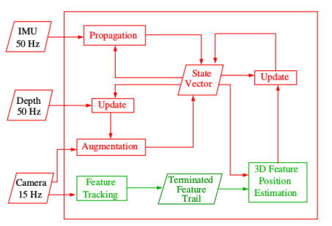
Overview of Algorithm:

Slide 6
EKF State Vector
IMU state vector:
Error in quaternion is given as:
State Vector at time tk:
Propagation
Gyroscope and accelerometer measurements are given by:

Slide 7
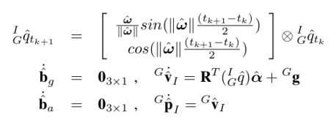
Estimates of linear acceleration and angular velocity:
As the IMU measurements are continuous, in order to use at discrete time steps we have to discretize using 4th order Runge kutta integrator and for quaternion zero order quaternion integrator.

Slide 8
State Augmentation:
At every new image camera pose estimate is computed from IMU pose estimate.
Camera pose estimate is appended to state vector and Covariance matrix is modified.
3D Feature Position Estimation:
Feature f is tracked in n consecutive frames, C1,C2,...,Cn.
Position of feature f with respect to camera frame Ci is:
Measurement model considering the case of single feature f which is observed from set of n camera poses.
Each n observation of the feature is described by the model: =

Slide 9
If the feature f is first appeared in C1 camera frame then the position of feature in Ci frame is given as:
where
By substituting the above equation in measurement model we get:

Slide 10
Given the measurements and estimates of camera poses in state vector we can get the estimates of using nonlinear least square minimisation.
Then, the global feature position is computed by:
Vision Based Update:
After getting the estimated values of we can get an estimate and actual measurement is obtained by tracking features with these two the residual is computed as :
which is in nonlinear form it is linearised by taking its taylor expansion and linearized residual is:
By stacking the residuals of all frames for feature f we get:

Slide 11
As the obtained residual is not in the form used in EKF it is multiplied by transpose of matrix A where A is an orthonormal basis for the null space of Uf matrix i.e Tranpose(A)*Uf=0. Therefore residual becomes
Residuals of all the features are stacked we get
Depth Sensor Update:
Pressure sensor gets the hydrostatic pressure.
Reference point is taken as surface of sea.
Pressure measurements are converted into depth measurements in linear fashion.
Measurement model at time k is:
Difference between initial depth and current depth is calculated :
EKF state estimate for depth is calculated as residual
Covariance matrix of uncertainty in residual:

Slide 12
Kalman gain is computed to correct state vector and covariance matrix.
Correction in state vector=
Update of covariance matrix is:
Correction to quaternion:
Experimental Results:
They collected underwater datasets with ground truth from the waters of the island of Barbados,and performed offline experiments to test their implementation. Two of them are presented here.
Images on both datasets were recorded from the back camera at 15Hz with resolution 870 x 520. The IMU data is coming from a MicroStrain 3DM-GX1 MEMS unit, sampled at 50Hz.

Slide 13
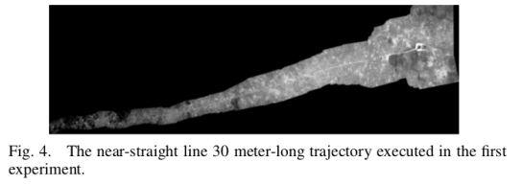
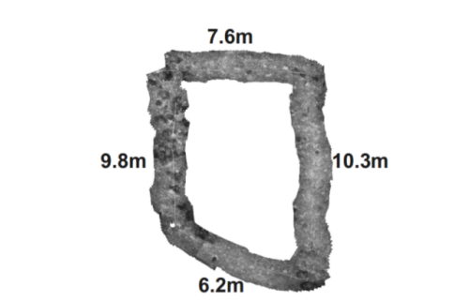
The first dataset, depicted in figure below features a straight 30 meter long trajectory, where the robot moves at approximately 0.2 meters/sec forward, while preserving its depth. The sea bottom is mostly flat, and the robot moves about 2 meters over it. A white 30 meter-long tape has been placed on the bottom, both to provide ground truth for distance travelled, and to facilitate the robot’s guided straight line trajectory.
The second dataset corresponds to an experiment that took place over the same site, and under the same conditions, the shape of the trajectory was a closed loop, as shown in figure above. The total length was approximately 33 meters.

Slide 14
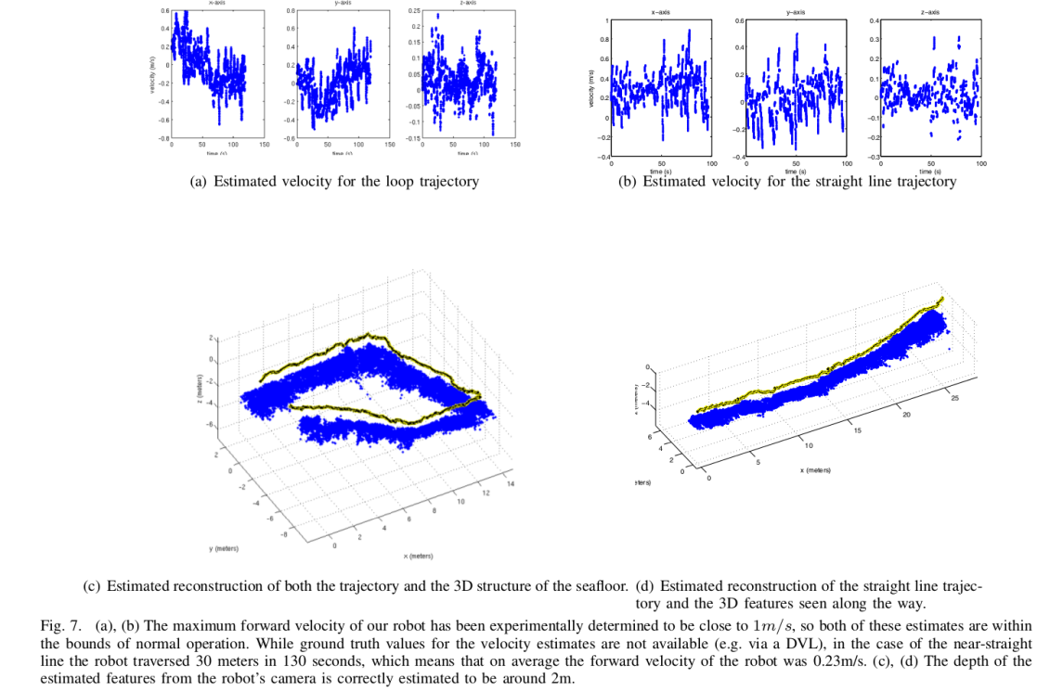
The reconstruction of the straight line trajectory was very accurate with only 1 meter error over a 30 meter-long trajectory.
In case of loop trajectory where the loop closure was approached within 3 meters, mainly due to errors in yaw, which is problematic for the gyroscope sensors in low-cost IMUs. Another factor that contributed to the loop results was the presence of motion blur in both datasets, which makes feature matching susceptible to errors.
The inclusion of the depth sensor measurements improved the estimates of the position’s z-axis,provided that the depth-based updates were given more confidence than the accelerometer’s propagations

