Slide 1
FASTSLAM 2.0:AN IMPROVED PARTICLE FILTERING ALGORITHM FOR SIMULTANEOUS LOCALIZATION AND MAPPING
MICHAEL MONTEMARLO AND SEBASTIAN THRUN
SCHOOL OF COMPUTER SCIENCE
CARNEGIE MELLON UNIVERSITY
DAPHNE KOLLER AND BEN WEGBREIT
COMPUTER SCIENCE DEPARTMENT
STANFORD UNIVERSITY
COMPUTER SCIENCE DEPARTMENT
STANFORD UNIVERSITY

Slide 2
Abstract
This paper describes a modified version of FastSLAM, a algorithm which was originally proposed by Montemerlo et al. ,to overcomes important deficiencies of the original alogorithm. It has also been proven in the paper that the new proposed alogorithm converges for linear SLAM problems.

Slide 3
Related Works
EKF Slam by Smith and Cheeseman
Prior works by Doucet and Colleagues
MCMC techniques for neural network
Parallel works by van der Merwe, using unscented filtering step for generating proposal distribution.

Slide 4
Simultaneous localization and mapping
The posterior distribution is given by:
P (θ, s^{t} |z^{t},u^{t},n^{t})
Where , N landmark locations: θ^{t} = θ₁ , θ_{2 , ………………. ,} θ_{N}
Path of the vehicle: s^{t} = s₁ , s₂ …….. s_{t}
Measurement / Observations : z^{t} = z₁ , z₂ ,……. , z_{t}
Robot Control Inputs : u^{t} = u₁ , u₂ ,…….. ,u_{n}
Data Association variables : n^{t} = n₁ ,n₂ ,…….. ,n_{t}

Slide 5
FastSLAM
In FastSLAM the posterior can be factored as:
p (θ, s^{t} |z^{t},u^{t},n^{t})=p(s^{t} |z^{t},u^{t},n^{t}) ∏ p (θ_{n} |s^{t} ,z^{t},u^{t},n^{t} )
^{n}
Assuming the fact that, if one knew the path of the vehicle , the landmark positions can be estimated independently to each other.

Slide 6
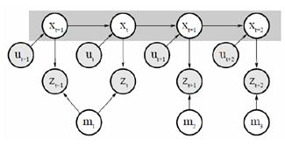
N landmark locations: m^{t} = m₁ , m_{2 , ………………. ,} m_{N}
Path of the vehicle: x^{t} = x₁ , x₂ …….. x_{t}
Measurement / Observations : z^{t} = z₁ , z₂ ,……. , z_{t}
Robot Control Inputs : u^{t} = u₁ , u₂ ,…….. ,u_{n}

Slide 7
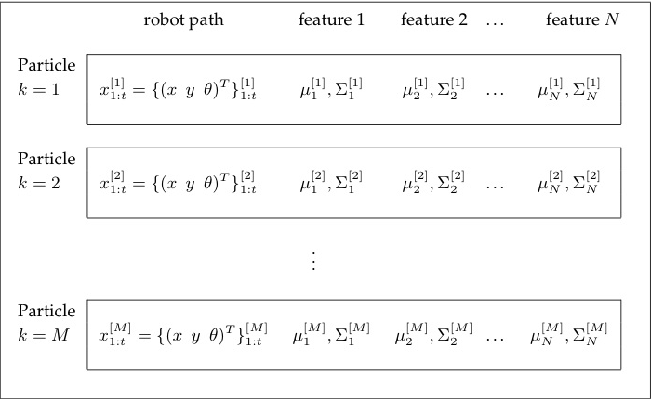
The FastSLAM samples the path using a particle filter thus each particle has its own map, consisting of N extended Kalman filters.

Slide 8
On each update in FastSLAM begins with sampling new poses based on the recent motion command u_{t} .
S _{t}^{[m]} ~ p(s_{t} | s _{t-1}^{[m]} , u_{t} )
target s^{[m]}
The importance Factor w_{t}^{[m]}= ----------------------
proposal s^{[m]}

Slide 9
Importance factor
W_{t}^{[m]} = Ƞ ⌡ p( z_{t} | θ_{n} , s^{[m]}_{t} , n_{t} ) p (θ_{n} | s^{t-1,[m]} ,z^{t-1} ,n^{t-1} )
~ Ɲ (z_{t} ; g(θ_{n} ,s^{[m]}_{t} ),R_{t} ) ~ Ɲ( μ^{[m]}_{n,t-1} ,∑^{[m]}_{n, t-1} )

Slide 10
If data association is unknown ,each particle m in FastSLAM makes its own local data association decision n_{t} by maximizing the measurement likelihood.
n = argmax w^{[m]}_{t} (n_{t} )

Slide 11
Drawbacks of FastSLAM 1.0
The inefficiency of the FastSLAM algorithm arises from its proposal distribution , which only considers the motion command but not the measurement.
This approach is troublesome if the noise in the vehicle motion is large relative to the measurement noise which is typically the case in many real world robot systems.

Slide 12
FastSLAM 2.0
“FastSLAM 2.0 implements a single new idea: poses are sampled under consideration of both the motion u_{t} and the measurement z_{t}”
S _{t}^{[m]} ~ p(s_{t} | s _{t-1}^{[m]} , u_{t} ,z_{t} , n_{t} )

Slide 13
The proposal distribution can be reformulated as:

Slide 14
Approximating by a linear function we get:
=
= denotes predicted measurement,
= denotes the predicted robot pose
= denotes the predicted landmark location
=

Slide 15
Under this EKF style approximation the proposal distribution is Gaussian:
Where the matrix
:
And the Jacobians are given by:
=
=

Slide 16
Updating the observed landmark estimate similarly to the EKF Update

Slide 17
The Importance Weights

Slide 18
Unknown Data Associations
The data association for n_{t} is computed similar to the FastSLAM :

Slide 19
Convergence
Theorem: For Linear SLAM,FastSLAM with M=1particles converges in expectation to the correct map if all features are observed infinitely often and if the location of one feature is known in advance.

Slide 20
Experimental Results
EKF | 7807 sec
Regular FastSLAM,M=50 particles | 403 sec
FastSLAM 2.0,M=1 particle | 140 sec
The Victoria Park Dataset
FastSLAM1.0 vs FastSLAM2.0

Slide 21
Discussion
FastSLAM 2.0 algorithm utilizes a different proposal distribution , making it more efficient in situations where motion noise is higher than measurement noise.
The proof of convergence is the first convergence result for a constant time SLAM algorithm.
FastSLAM2.0 outperforms EKF SLAM approach by a large margin and it successfully generates an accurate map using a single particle on benchmark darta set.

