Slide 1
FAB-MAP: Probabilistic Localization and Mapping
Mark Cummins
Paul Newman
Mobile Robotics Group, University of Oxford, UK

Slide 2
Important features
Not limited to localization
Observations from new or unseen places can be detected
Basic approach inspired by bag-of-words image retrieval systems
Capable of recognizing places having low features
Rejecting false matches even though many features are common
Reasonable computational cost for online operation

Slide 3
Perceptual Aliasing

Slide 4
Related work
Ho and Newman 2007
Methods using global features:
1. Levin and Szeliski (2004); Newman et al. (2006)
2. Ulrich and Nourbakhsh (2000)
3. Torralba et al. (2003)
Methods using local features:
1. Sim and Dudek (1998)
2. Wang et al. (2005)
3. Filliat (2007)

Slide 5
Required fundamentals
Consider a distribution P(Z) with Z = {$z_{1},z_{2},…,z_{n}$}
Space needed to represent P(Z) grows exponential in n
Solution: approximate by another distribution Q(Z)
$D_{KL}\left(P,Q\right)= \sum_{x∈X}{P\left(x\right)\log{\frac{P(x)}{Q(x)}}}$
Kullback-Leibler divergence

Slide 6
Chow Liu Trees
Algorithm approximates discrete distribution by closest tree-structured Bayesian network
Notes:
Lines represent information

Slide 7
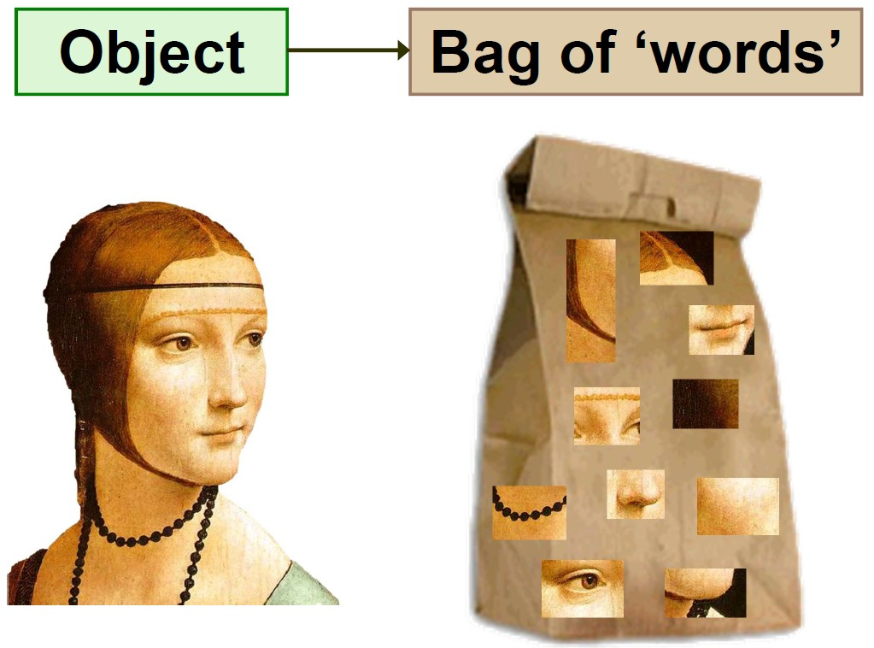
Description of method
Representing appearance : bag-of-words
Representing locations : ${\text{ℒ} }^{k}$ = {$L_{1},…,L_{n_{k}}$}
Ɗ : $\left\{\begin{aligned}p\left(z_{i}=1 | e_{i}=0\right), false positive probability \\ p\left(z_{i}=0 | e_{i}=1\right), false negative probability\end{aligned}\right.$

Slide 8
Typical words in vocabulary
Notes:
Different sets are made

Slide 9
Estimating location via Recursive Bayes
$p\left(L_{i} | Ƶ^{k}\right)=\frac{p\left(Z_{k} | L_{i},Ƶ^{k−1}\right) p\left(L_{i} | Ƶ^{k−1}\right)}{p\left(Ƶ^{k} | Ƶ^{k−1}\right)}$ ……(4)
Observation likelihood
To simplify : assume independence between current and past observations
Make naïve Bayes assumption :
$p\left(Z_{k} | L_{i}\right)≈p\left(z_{n} | L_{i}\right)…p\left(z_{2}|L_{i}\right)p(z_{1}|L_{i})$
Applying our assumptions and simplifying :
$p\left(z_{q}=s_{z_{q}}|e_{q}=s_{e_{q}},z_{p}=s_{z_{p}}\right)={(1+\frac{α}{β})}^{−1}$
Notes:
Check paper for complete derivation

Slide 10
New place or old place?
Requires explicit calculation of $p(Z_{k}|Ƶ^{k−1})$
Divide world into mapped places and unmapped places
$p\left(Z_{k} | Ƶ^{k−1}\right)=\sum_{mεM}{p\left(Z_{k} | L_{m}\right) }p\left(L_{m} | Ƶ^{k−1}\right)+ \sum_{uε\overline{M}}{p\left(Z_{k} | L_{u}\right) p(L_{u}|Ƶ^{k−1})}$
Approximate second summation using sampling
$p\left(Z_{k} | Ƶ^{k−1}\right)≈\sum_{m∈M}{p\left(Z_{k} | L_{m}\right)}p\left(L_{m} | Ƶ^{k−1}\right)+p(L_{new}|Ƶ^{k−1})\sum_{u=1}^{n_{s}}{\frac{p(Z_{k}|L_{u})}{n_{s}}}$

Slide 11
Smoothing
Performance of inference procedure strongly dependent on $p(Z_{k}|Ƶ^{k−1})$
To ameliorate this problem :
$p\left(Z_{k} | L_{i}\right)→σ p\left(Z_{k} | L_{i}\right)+\frac{(1−σ)}{n_{k}}$
$$n_{k}=number of places in the map$$
$$σ=smoothing parameter$$

Slide 12
Results

Slide 13
Robust to repetitive environments

Slide 14
New College Dataset

Slide 15
Questions?

