Slide 1

Chapter 12: File System Implementation

Slide 2
Chapter 12: File System Implementation
File-System Structure
File-System Implementation
Directory Implementation
Allocation Methods
Free-Space Management
Efficiency and Performance
Recovery
NFS

Slide 3
File-System Structure
File structure
  Logical storage unit
  Collection of related information
File system resides on secondary storage (disks)
  Provided user interface to storage, mapping logical to physical
  Provides efficient and convenient access to disk by allowing data to be stored, located retrieved easily
Disk provides in-place rewrite and random access
  I/O transfers performed in blocks of sectors (usually 512 bytes)
File control block – storage structure consisting of information about a file
Device driver controls the physical device
File system organized into layers

Slide 4
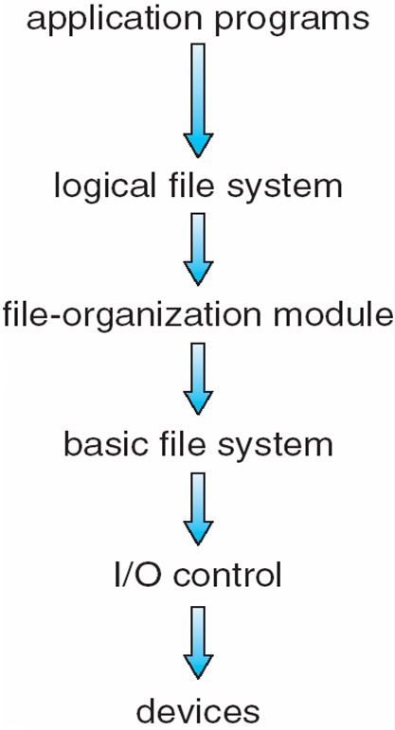
Layered File System

Slide 5
File System Layers
Device drivers manage I/O devices at the I/O control layer
  Given commands like “read drive1, cylinder 72, track 2, sector 10, into memory location 1060” outputs low-level hardware specific commands to hardware controller
Basic file system given command like “retrieve block 123” translates to device driver
    Also manages memory buffers and caches (allocation, freeing, replacement)
      Buffers hold data in transit
      Caches hold frequently used data
File organization module understands files, logical address, and physical blocks
    Translates logical block # to physical block #
    Manages free space, disk allocation

Slide 6
File System Layers (Cont.)
  Logical file system manages metadata information
    Translates file name into file number, file handle, location by maintaining file control blocks (inodes in Unix)
    Directory management
    Protection
  Layering useful for reducing complexity and redundancy, but adds overhead and can decrease performance
  Many file systems, sometimes many within an operating system
    Each with its own format (CD-ROM is ISO 9660; Unix has UFS, FFS; Windows has FAT, FAT32, NTFS as well as floppy, CD, DVD Blu-ray, Linux has more than 40 types, with extended file system ext2 and ext3 leading; plus distributed file systems, etc)
    New ones still arriving – ZFS, GoogleFS, Oracle ASM, FUSE

Slide 7
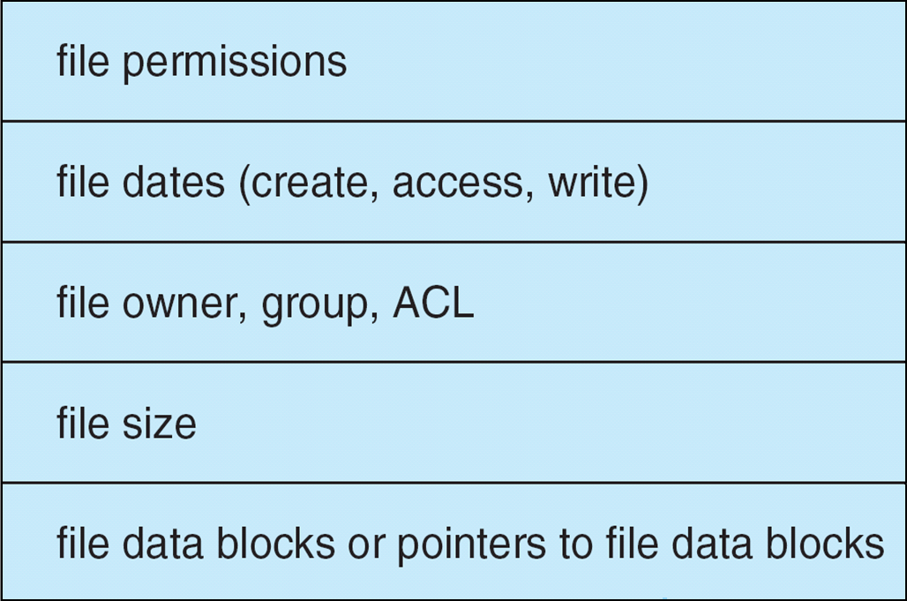
File-System Implementation
We have system calls at the API level, but how do we implement their functions?
  On-disk and in-memory structures
Boot control block contains info needed by system to boot OS from that volume
  Needed if volume contains OS, usually first block of volume
Volume control block (superblock, master file table) contains volume details
  Total # of blocks, # of free blocks, block size, free block pointers or array
Directory structure organizes the files
  Names and inode numbers, master file table
Per-file File Control Block (FCB) contains many details about the file
  inode number, permissions, size, dates
  NFTS stores into in master file table using relational DB structures

Slide 8
In-Memory File System Structures
The following figure illustrates the necessary file system structures provided by the operating systems
Figure 12-3(a) refers to opening a file
  Open returns a file handle for subsequent use
Figure 12-3(b) refers to reading a file
Plus buffers hold data blocks from secondary storage
Data from read eventually copied to specified user process memory address

Slide 9
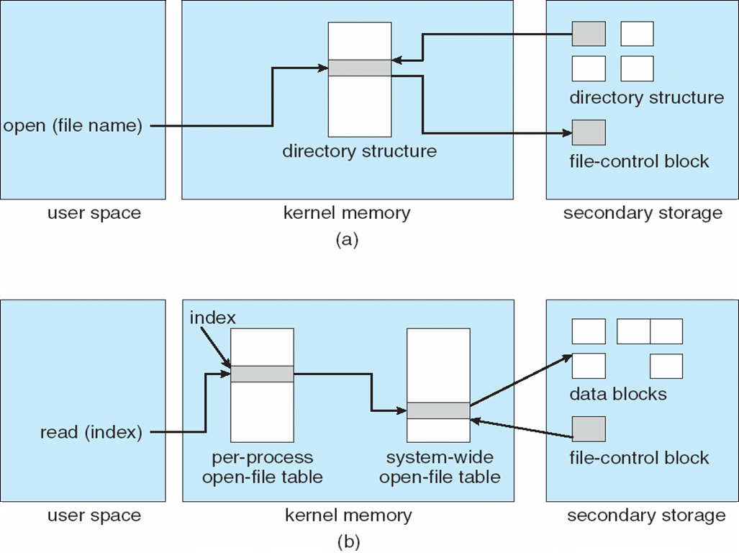

In-Memory File System Structures

Slide 10
Partitions and Mounting
Partitions: Cooked or Raw?
  Cooked - containing a file system
  Raw - sequence of blocks with no file system
Boot block?
  point to boot volume
  Or a boot management program for multi-os booting
Root partition contains the OS, other partitions can hold other Oses, other file systems, or be raw
  Mounted at boot time
  Other partitions can mount automatically or manually
At mount time, file system consistency checked (fsck)
  Is all metadata correct?
    If not, fix it, try again
    If yes, add to mount table, allow access

Slide 11
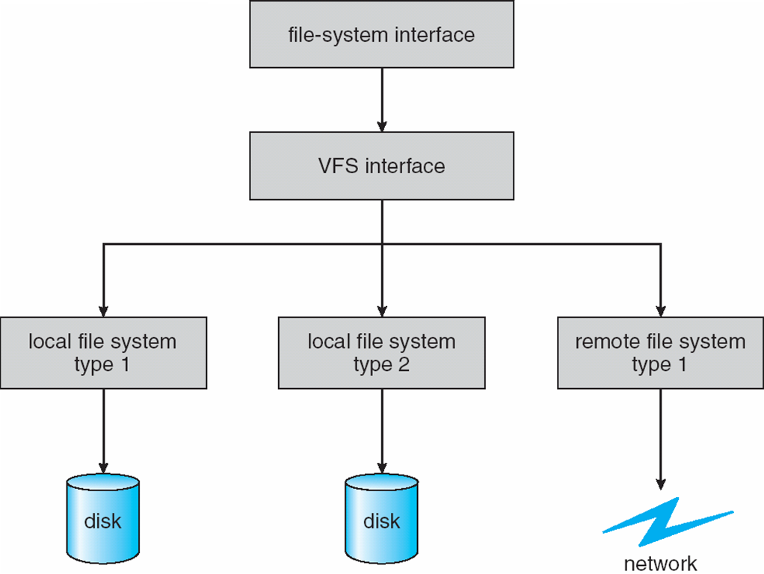

Virtual File Systems
Virtual File Systems (VFS) on Unix provide an object-oriented way of implementing file systems
VFS allows the same system call interface (the API) to be used for different types of file systems
  Separates file-system generic operations from implementation details
  Implementation can be one of many file systems types, or network file system
    Implements vnodes which hold inodes or network file details
  Then dispatches operation to appropriate file system implementation routines
The API is to the VFS interface, rather than any specific type of file system

Slide 12
Virtual File System Implementation
For example, Linux has four object types:
  inode, file, superblock, dentry
VFS defines set of operations on the objects that must be implemented
  Every object has a pointer to a function table
    Function table has addresses of routines to implement that function on that object
    For example of entries in function table:
    • int open(. . .)—Open a file
    • int close(. . .)—Close an already-open file
    • ssize t read(. . .)—Read from a file
    • ssize t write(. . .)—Write to a file
    • int mmap(. . .)—Memory-map a file

Slide 13
Directory Implementation
Linear list of file names with pointer to the data blocks
  Simple to program
  Time-consuming to execute
    Linear search time
    Could keep ordered alphabetically via linked list or use B+ tree
Hash Table – linear list with hash data structure
  Decreases directory search time
  Collisions – situations where two file names hash to the same location
  Only good if entries are fixed size, or use chained-overflow method

Slide 14
Allocation Methods - Contiguous
An allocation method refers to how disk blocks are allocated for files:
Contiguous allocation – each file occupies set of contiguous blocks
  Best performance in most cases
  Simple – only starting location (block #) and length (number of blocks) are required
  Problems include finding space for file, knowing file size, external fragmentation, need for compaction off-line (downtime) or on-line

Slide 15
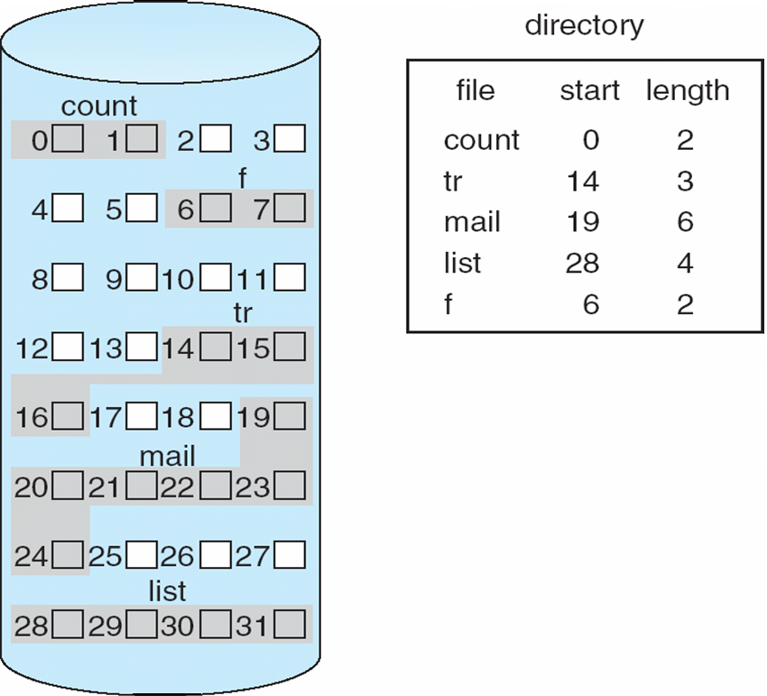
Contiguous Allocation
Mapping from logical to physical
Q
LA/512
R
  Block to be accessed = Q + starting address
  Displacement into block = R

Slide 16
Extent-Based Systems
Many newer file systems (i.e., Veritas File System) use a modified contiguous allocation scheme
Extent-based file systems allocate disk blocks in extents
An extent is a contiguous set of blocks
  Extents are allocated for file allocation
  A file consists of one or more extents

Slide 17
Allocation Methods - Linked
Linked allocation – each file a linked list of blocks
  Each block contains pointer to next block
  File ends at nil pointer
  No external fragmentation
  Free space management system called when new block needed
  Improve efficiency by clustering blocks into groups but increases internal fragmentation
  Reliability can be a problem
  Locating a block can take many I/Os and disk seeks
FAT (File Allocation Table) variation
  Beginning of volume has table, indexed by block number
  Much like a linked list, but faster on disk and cacheable
  New block allocation simple

Slide 18
Linked Allocation
Each file is a linked list of disk blocks: blocks may be scattered anywhere on the disk
block =
pointer

Slide 19
Linked Allocation
Mapping
Q
LA/511
R
  Block to be accessed is the Qth block in the linked chain of blocks representing the file.
  Displacement into block = R + 1

Slide 20
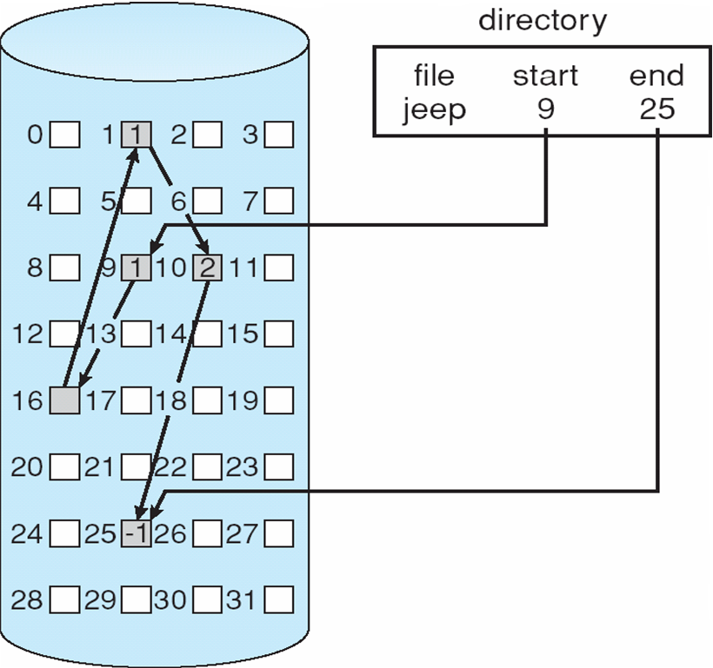
Linked Allocation

Slide 21
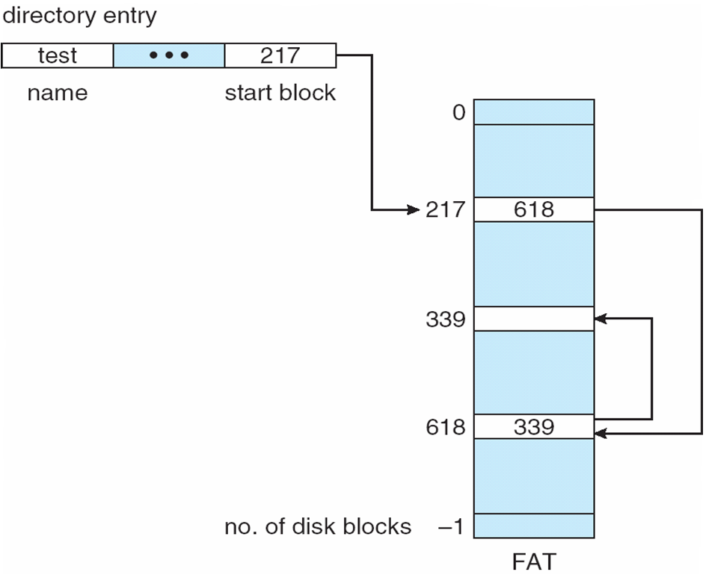
File-Allocation Table

