Slide 1
My Journey in Artificial Intelligence
Marco Valtorta
Department of Computer Science and Engineering
University of South Carolina
November 7, 2019
Notes:
1. Thank you for coming. One of my professors once wrote an article and then a book entitled _Great Ideas in Computer Science_. My hope is to provide you with a few great ideas in Artificial Intelligence, as I came across them in my journey.
2. I should start with a definition of AI, but this will come up only in the 1983 stop

Slide 2
Italy (1956-1975)
The Baby Boom
Languages: Italian (native), English (very fluent), French (basic working proficiency), German (basic), Latin (working proficiency), Ancient Greek (studied)
COBOL Programming

Slide 3
Symbols vs. Numbers
  “The digital computer field defined computers as machines that manipulated numbers. … In contrast, the scientists in AI saw computers that manipulated symbols. … [They] actively promoted the new view, considering the standard one to be a radical misreading of the nature of the computer and one that provided a significant barrier against the view that computers could be intelligent.” [Newell, 1983]

Slide 4
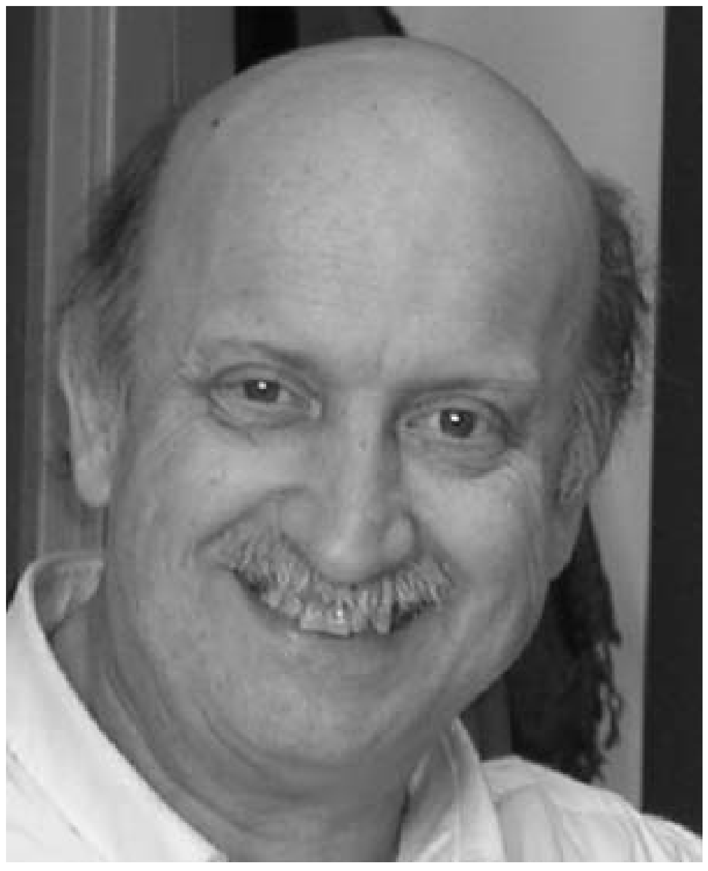
Politecnico di Milano (1975-1980)
Electrical Engineering
Robotics
Actors (agents)
  “Agents are active, persistent
  (software) components that
  perceive, reason, act, and
  communicate” (Huhns and Singh)
Problem-solving Techniques in Artificial Intelligence
The State-Space Approach to Problem Solving
Marco Somalvico
Notes:
Huhns and Singh: “Agents are active, persistent (software) components that perceive, reason, act, and communicate.”
The photo is of Marco Somalvico (1941-2002, from: https://www.researchgate.net/profile/Giuseppina_Gini/publication/220061368_Robotics_Virtual_Reality_and_Agents_and_their_Body_A_Special_Issue_in_Memory_of_Marco_Somalvico/links/58908de8aca272bc14be5182/Robotics-Virtual-Reality-and-Agents-and-their-Body-A-Special-Issue-in-Memory-of-Marco-Somalvico.pdf).

Slide 5
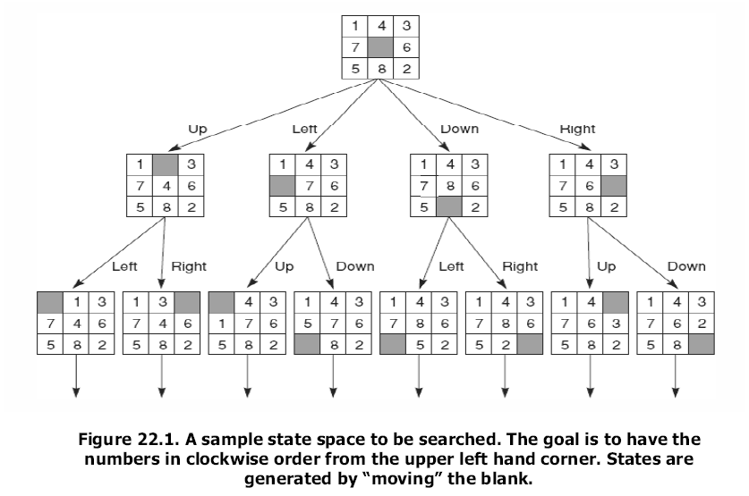
State-Space Search

Slide 6
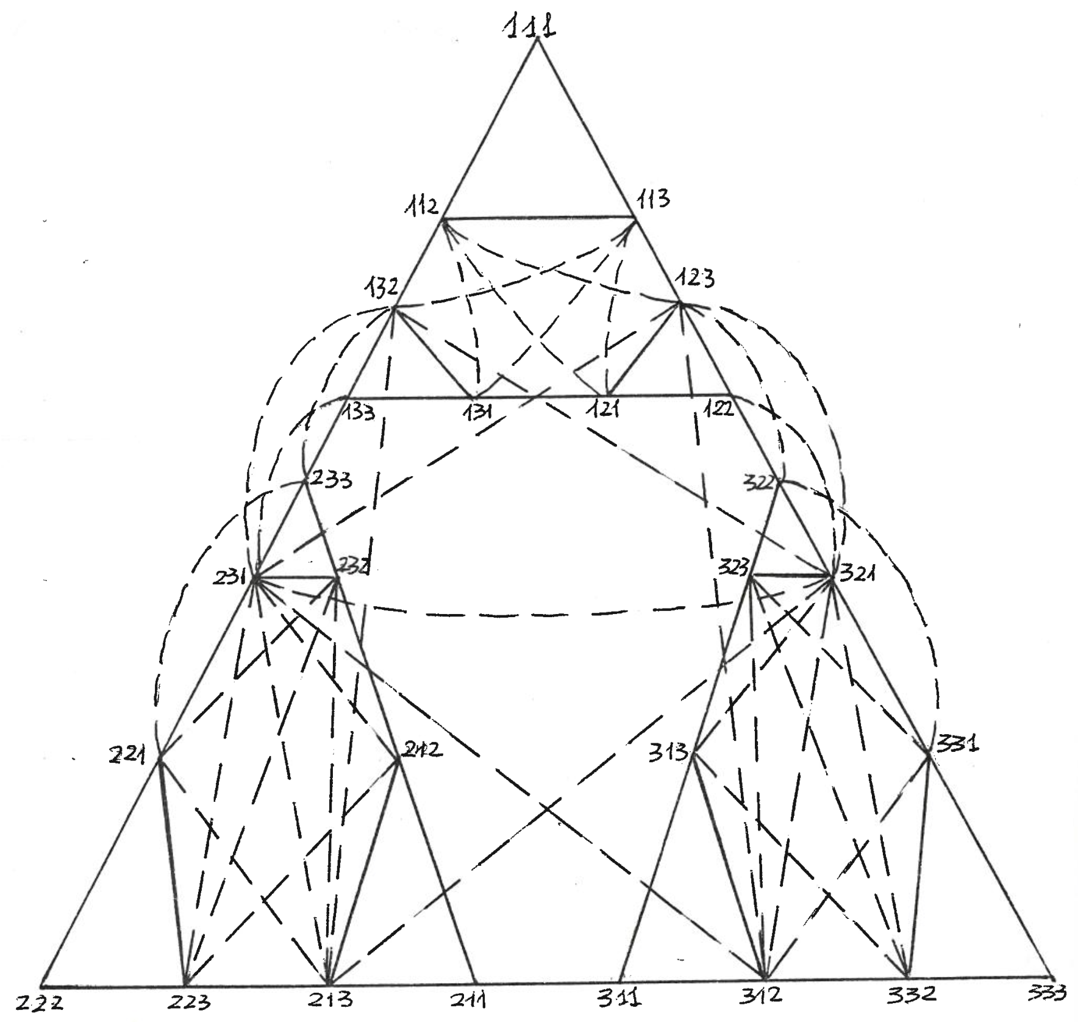
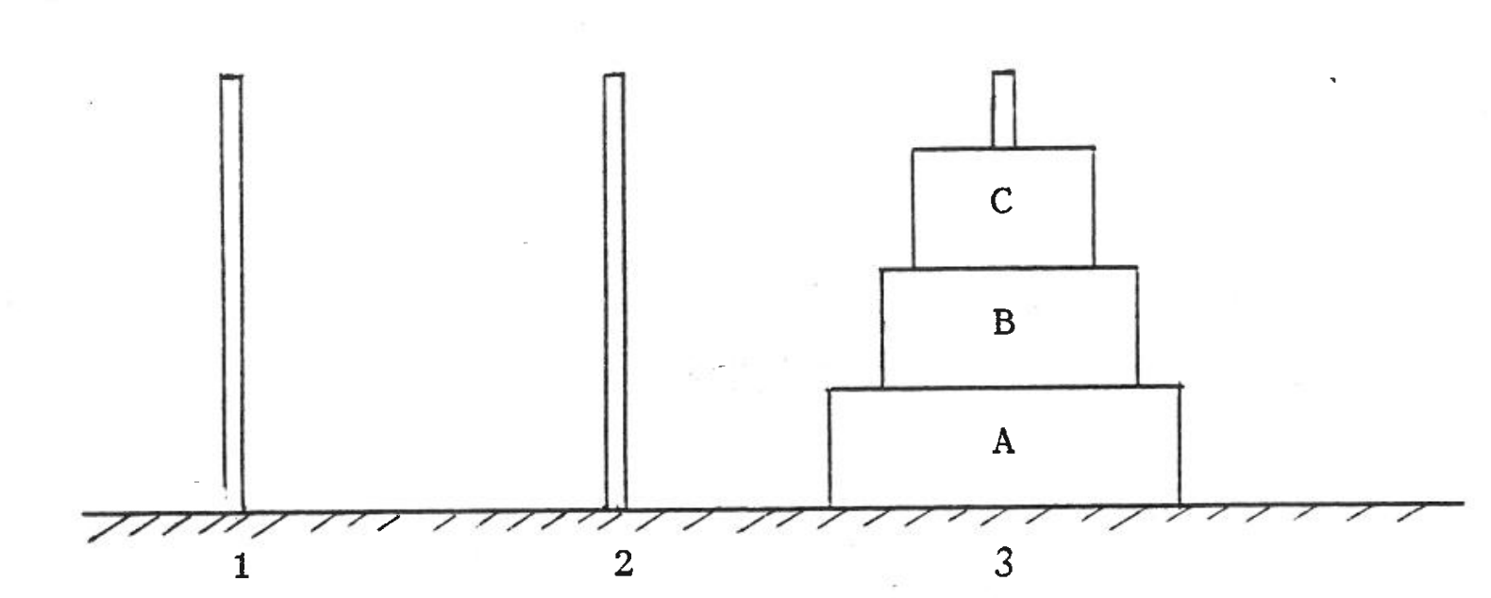
Heuristics
The Towers of Hanoi Puzzle
Notes:
(a,b,c) indicate the pegs where the disks A, B, and C are, respectively. Start state has all disks on the leftmost peg. Goal state is shown.

Slide 7
Summary of IJCAI-83 Survey
Attempt (A) 20.8
to
Build (B) 12.8
Simulate (C) 17.6
Model (D) 17.6
that
Machines (E) 22.4
Human (or People) (F) 60.8
Intelligent (G) 54.4
Behavior (I) 32.0
Processes (H) 24.0
by means of
Computers (L) 38.4
Programs (M) 13.2
Notes:
Massimo Negrotti. “How AI People Think.” Technical Report III/2203/En. Department of Sociology. University of Genoa. 1983. This is Figure 1. Negrotti recognizes the following approaches: robotic (ABECFGI), behavioristic (ACFGILM), and cognitive (ADFGHLM). The report is based on a questionnaire filled by 143 researchers at the 8th International Joint Conference on Artificial Intelligence, which took place in Karlsruhe, Germany, during the summer of 1983. Note the presence of “human” or “people” in all cases. Negrotti states that the numbers are frequencies “per 1000 terms,” but I think they are percentages indicating frequency of occurrence in the definitions given by the researchers who participated in the survey.

Slide 8

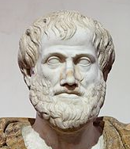
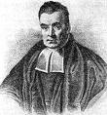
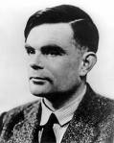
What is AI?
Systems that think like humans “The exciting new effort to make computers think… machines with minds,in the full and literal sense.” (Haugeland, 1985) “[The automation of] activities that we associate with human thinking, activities such as decision-making, problem solving, learning…” (Bellman, 1978) | Systems that think rationally “The study of mental faculties through the use of computational models.” (Charniak and McDermott, 1985) “The study of the computations that make it possible to perceive, reason, and act.” (Winston, 1972)
Systems that act like humans “The art of creating machines that perform functions that require intelligence when performed by people” (Kurzweil, 1990) “The study of how to make computers do things at which, at the moment, people are better (Rich and Knight, 1991) | Systems that act rationally “The branch of computer science that is concerned with the automation of intelligent behavior.” (Luger and Stubblefield, 1993) “Computational intelligence is the study of the design of intelligent agents.” (Poole et al., 1998) “AI… is concerned with intelligent behavior in artifacts.” (Nilsson, 1998)
Richard Bellman (1920-84)
Aristotle (384BC -322BC)
Thomas Bayes (1702-1761)
Alan Turing (1912-1954)
Notes:
[AIMA-2] (Russel and Norvig)

Slide 9
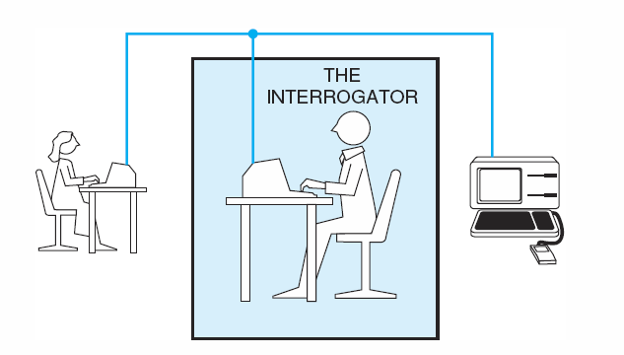
Acting Humanly: the Turing Test
Operational test for intelligent behavior: the Imitation Game
In 1950, Turing
  predicted that by 2000, a machine might have a 30% chance of fooling a lay person for 5 minutes
  Anticipated all major arguments against AI in following 50 years
  Suggested major components of AI: knowledge, reasoning, language understanding, learning
Problem: Turing test is not reproducible, constructive, or amenable to mathematical analysis
Notes:
[AIMA-2]
Turing (1950) “Computing machinery and intelligence“
The original version involved determining the sex of a correspondent; exchanging the man with a computer; comparing the performance of the interrogator in the two different situations. “We now ask the question: “What will happen when a machine takes the part of A [the man] in this game?’ Will the interrogator decide wrongly as often when the game is played like this as he does when the game is played between a man and a woman? These questions replace our original, ‘Can machines think?’”

Slide 10
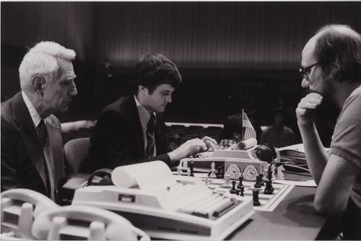
Duke (1980-1985)
Duchess, a chess
program written
in PL/I and Assembly
language running on
an IBM 370/168
under the MVS
operating system
and developed by
graduate students Eric Jensen, Tom Truscott and Bruce Wright, was one of the strongest programs of its time. [Various online sources and recollections]
Notes:
Also: NLP (Biermann)
Duchess: Tom-Truscott; searching in areas of maximum variance. An example of rational behavior and balance of resources at the base and metalevels. Wikipedia
1980; Claude Shannon, Tom Truscott and Ken Thompson, WCCC 1980 https://www.computerhistory.org/chess/stl-430b9bbe2be7f/ Claude Shannon (the founder of information theory)! Ken Thompson (the implementor of Unix)!

Slide 11
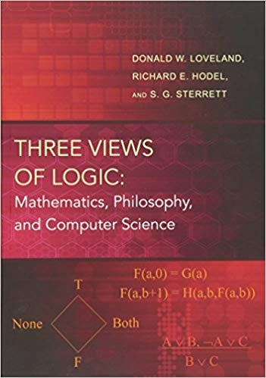
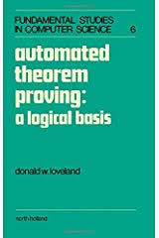

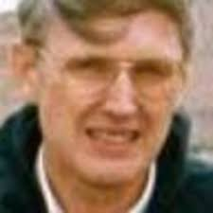
Duke (1980-1985)
Automated Reasoning
Theorem Proving
Logic-based Representation
Prolog
Donald W. Loveland
Notes:
https://www.google.com/imgres?imgurl=https%3A%2F%2Fi1.rgstatic.net%2Fii%2Fprofile.image%2F273728198148097-1442273296100_Q512%2FDonald_Loveland.jpg&imgrefurl=https%3A%2F%2Fwww.researchgate.net%2Fprofile%2FDonald_Loveland&docid=nPnRxd8BlTIGDM&tbnid=Vo_YM2ARXHSz2M%3A&vet=10ahUKEwiM4PbwgtnlAhVMmVkKHTioCuUQMwg8KAAwAA..i&w=512&h=512&client=firefox-b-1-d&bih=679&biw=1009&q=Donald%20W.%20Loveland%20Photo&ved=0ahUKEwiM4PbwgtnlAhVMmVkKHTioCuUQMwg8KAAwAA&iact=mrc&uact=8

Slide 12
Branching Off: Uncertainty in Artificial Intelligence (1984)
Artificial Intelligence (AI)
  [Robotics]
  Automated Reasoning
    [Theorem Proving, Search, etc.]
    Reasoning Under Uncertainty
      [Fuzzy Logic, Possibility Theory, etc.]
      Normative Systems
        Bayesian Networks
        Influence Diagrams (Decision Networks)
Notes:
For my dissertation, rules with certainty factors.

Slide 13
Certainty Factors (1984-1987)
weighted
proposition
several rules with
the same conclusion
integrator
conclusion
conclusion
a rule
a rule
attenuator
attenuator
combinator
combinator
weighted
proposition
weighted
proposition
weighted
proposition
weighted
proposition
Site Visit, 23 January 2008 13 ©2008 University of South Carolina / HNC, Inc. BALER Project
Notes:
A typical combinator is min. A typical attenuator is times. Typical integrators are max and noisy-or (also known as probabilistic sum).
Certainty Factors
Possibility NOTE: Possibility theory is not fully compositional. See: Didier Dubois and Henri Prade. “Possibility theory is not fully compositional!—A comment on a short note by H.J. Greenberg—” ftp://ftp.irit.fr/IRIT/RPDMP/PTFC.pdf, accessed on 2008-01-05.
Fuzzy Logic
Dempster-Shafer Evidential Reasoning
The D-S approach is often used compositionally
It is possible to use D-S extensionally, in which case it becomes the Bayesian network approach
A very thorough analysis of compositional system is in Chapters 6-8 of Hajek, Peter, Tomas Havranek, and Radim Jirousek. _Uncertain Information Processing in Expert Systems_, Academic Press, 1992, and is mainly due to Hajek.

Slide 14
Brussels (1985-1988)
ESPRIT: The European Strategic Program for Research and Development in Information Technologies
Large pre-competitive industry-led multi-state civilian projects with significant academic participation
Approximately 20 projects in Artificial Intelligence in 1987, e.g. in: knowledge engineering, natural language processing, vision, robotics, logic programming, model-based diagnosis, parallel architectures for symbolic processing.
Notes:
A European answer to the Japanese Fifth Generation Computer Project (1982-ca.1990) Also, Alvey. The Lighthill Report.
Source: Special Session on AI at IJCAI-87 (Milan, Italy).

Slide 15
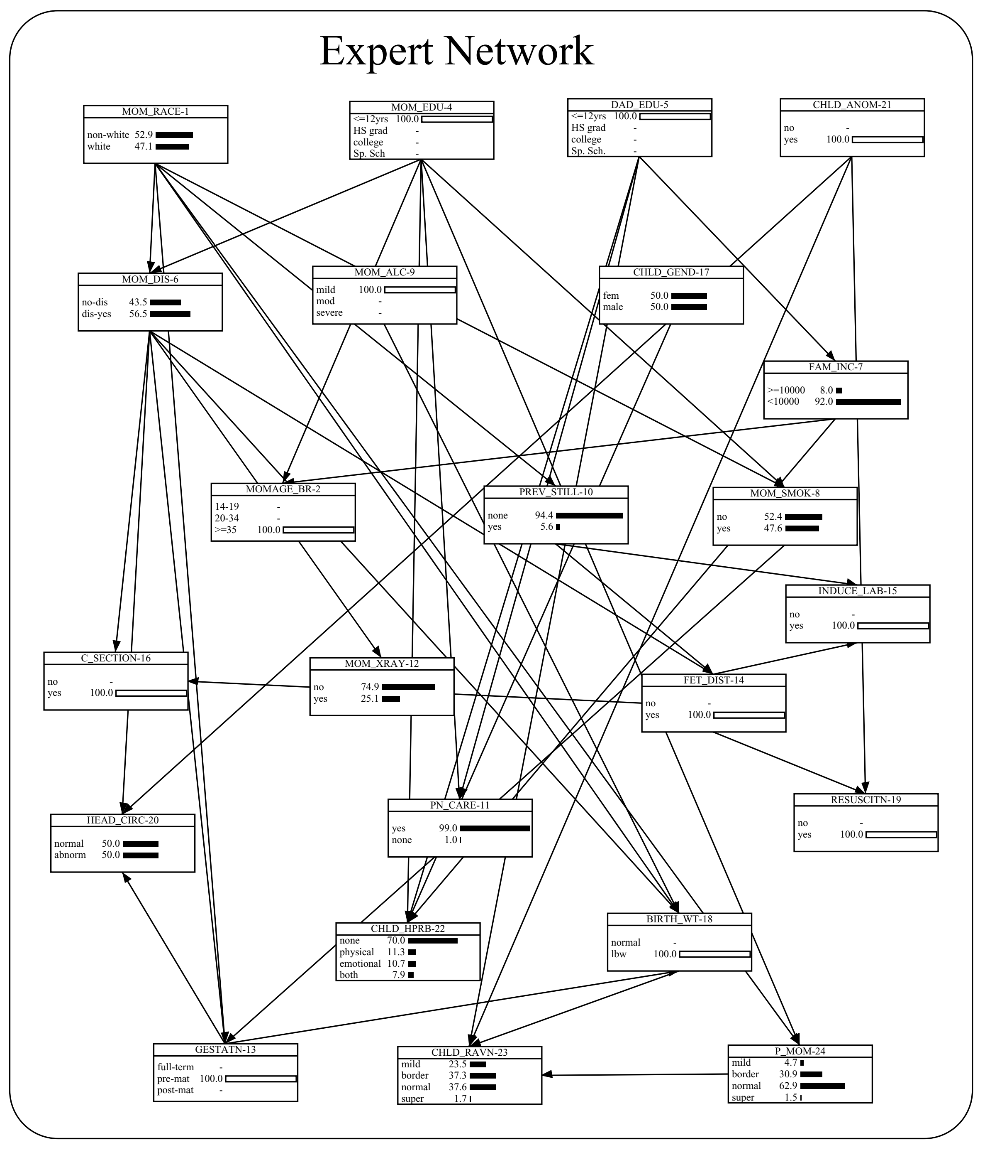
UofSC (1988 - )
Building Bayesian Network Models in Medicine: The MENTOR Experience
Integrating data and knowledge
Learning and validation
Notes:
Main focus: reasoning under uncertainty using probabilistic approaches

Slide 16
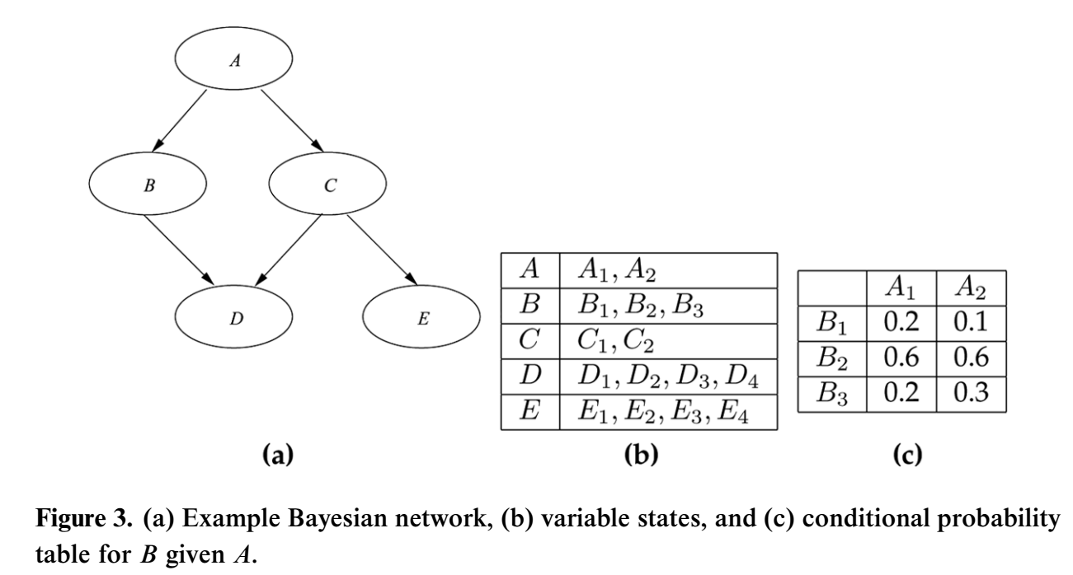
Example Bayesian Network
Notes:
Note what is specified here: DAG and CPTs. This is from the recommended reading: Valtorta and Yimin Huang. IDENTIFIABILITY IN CAUSAL BAYESIAN NETWORKS: A GENTLE INTRODUCTION. Cybernetics and Systems: An International Journal, 39: 425–442. 2008.

Slide 17
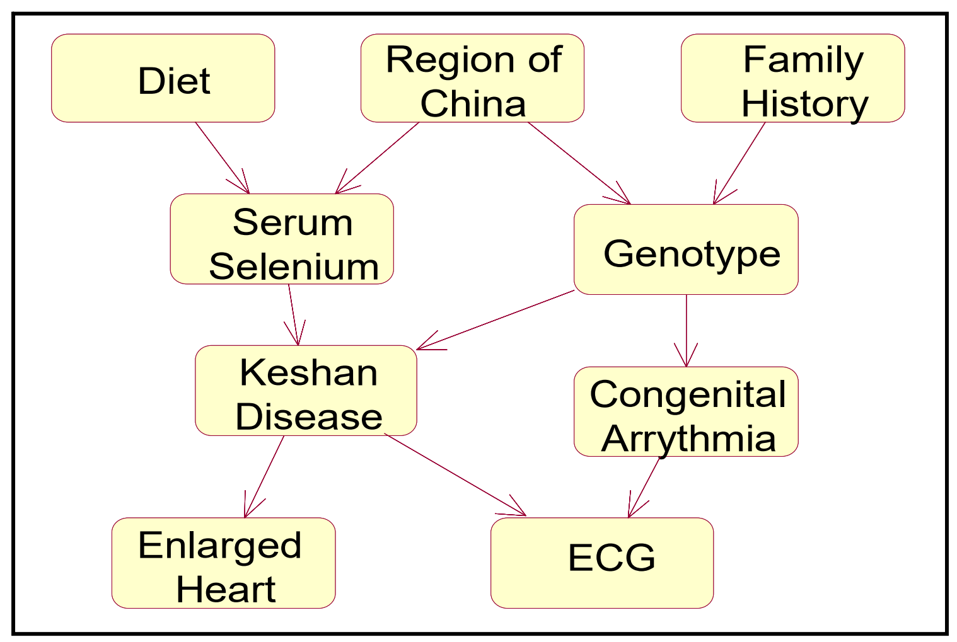
Causal Models and Intervention
In a causal model,
each family of
variables represent
a mechanism
Intervention on a
variable breaks
the mechanism and
cuts off the variable
from its causes
(parents)
Excision semantics capture the meaning of intervention
Notes:
A causal model is useful because it represent many different models:
Each intervention creates a different model (“submodel” or “manipulated graph” [Spirtes et al., 2003])
Our account of causality is based on the notion of intervention. “Manipulated graph” is from [Spirtes 2003], according to [Pearl 2009]
This is a toy esample.

Slide 18
Fisher’s Smoking and Lung Cancer Model
Smoking-lung cancer model with genotype
Genotype (U) is unobservable
Fisher, R.A. “Cancer and Smoking.” Nature 182 (1958 August 30), pp.596-597.
U
X
Y
Notes:
Fisher, R.A. “Cancer and Smoking.” Nature 182 (1958 August 30), pp.596-597.
Also see Spirtes, Glymour and Scheines’s Causation, Prediction, and Search, MIT Press.

Slide 19
Smoking and Lung Cancer Model with an Intermediate Variable
Smoking and lung cancer model with genotype and tar deposits in the lungs
Tar deposits (Z) are observable
U
X
Z
Y

Slide 20
Unidentifiability_2 Example(1)
All the variables are binary.
P(U=0) = 0.5,
P(X=0|U) = (0.6,0.4),
P(Y=0|X,U) =
U
X
Y
Y=0 | X =0 | X= 1
U =0 | 0.7 | 0.2
U=1 | 0.2 | 0.7
Notes:
Fisher, Nature, 1958.

Slide 21
Unidentifiability_2 Example(2)
Note that
We get:
Because of the excision semantics, the link from U to X is removed, and we have:
So, P_{X=0} (Y=0) = (0.7x0.5) + (0.2x0.5) = 0.45
 | X =0 | X= 1
Y =0 | 0.25 (=0.7x0.6x0.5+0.2x0.4x0.5) | 0.25
Y=1 | 0.25 | 0.25

Slide 22
Unidentifiability_2 Example(3)
All the variables are still binary.
P(U=0) = 0.5
P(X=0|U) = (0.7,0.3)
P(Y=0|X,U) =
U
X
Y
Y=0 | X =0 | X= 1
U =0 | 0.65 | 0.15
U=1 | 0.15 | 0.65

Slide 23
Unidentifiability_2 Example(4)
Using
We still get:
From
We have P_{X=0} (Y=0) = (0.65x0.5) + (0.15x 0.5) = 0.4 <> 0.45.
So, P_{X}(Y) is unidentifiable in this model.
 | X =0 | X= 1
Y =0 | 0.25 | 0.25
Y=1 | 0.25 | 0.25

Slide 24

Recommended Reading
Adnan Darwiche. “Human-Level Intelligence or Animal-Like Abilities?”
Communications of the ACM, 61, 10 (October 2018), 56-67.
Judea Pearl. “The Seven Tools of Causal Inference with Reflections on Machine Learning.” Communications of the ACM, 62, 3 (March 2019), 54-60.
These readings complement the “deep learning” or “neural network” view of AI that is prevalent in the popular media.
Notes:
June 2012 and March 2019 cover pages

Slide 25

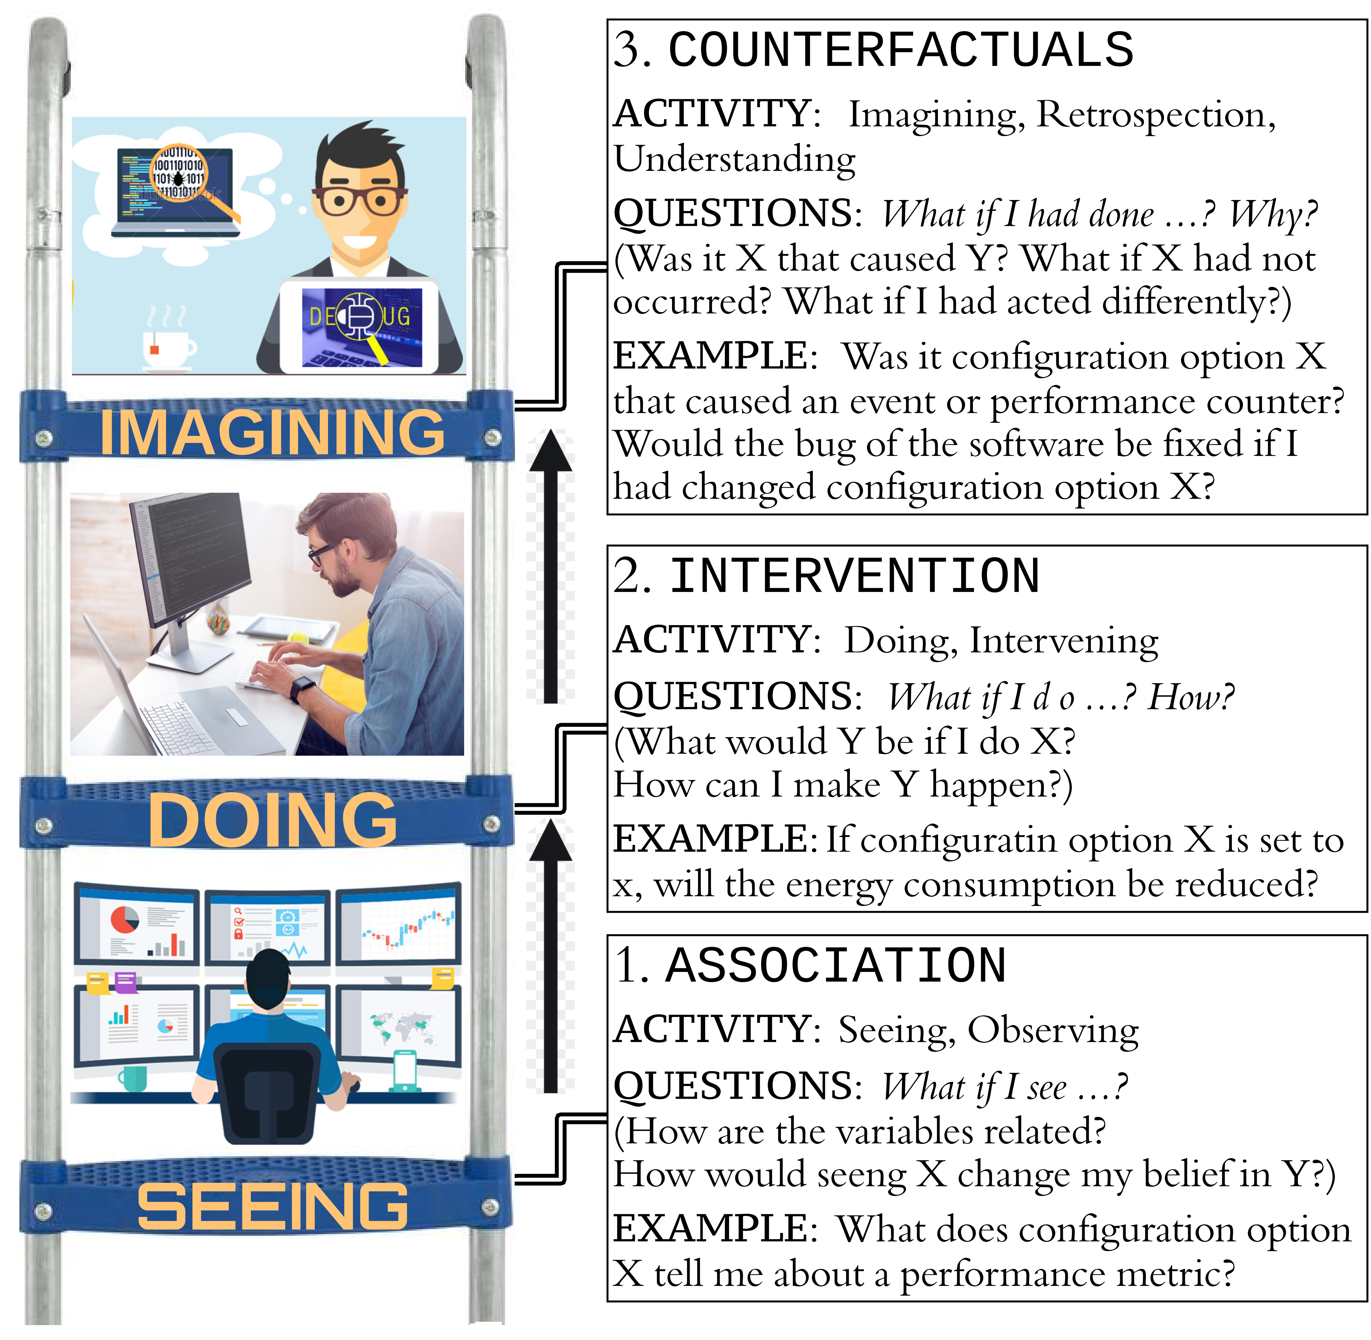
Recommended Reading

Slide 26

Recommended
Reading

Slide 27

Questions?

Slide 28
Identifiability in
Causal Bayesian Networks
Marco Valtorta
Department of Computer Science and Engineering University of South Carolina
Presentation for Amanda Fairchild’s Course
“Big Data, Big Decisions” (SCHC 330)
March 14, 2017
Joint work with:
Mohamed Sharaf and Yimin Huang (USC)
Elizabeth Allman, John Rhodes (Mathematics, U. Fairbanks), and Elena Stanghellini (Statistics, U. Perugia)
Support from AIM is gratefully acknowledged.
Notes:
Original Title: Identifiability of Causal Bayesian Networks with Hidden Variables.

Slide 29
On Artificial Intelligence Research
What is Artificial Intelligence?
Why is it worth one’s time?
AI as a subfield of Computer Science
Now and 40 years ago
Some great people
My personal voice

Slide 30
On University Governance
Why universities?

Slide 31
Contents
Causal Bayesian Networks
Identifiability Problems
Parameterization and Label Swapping
Markov Equivalence and Identifiability
Two Special Models
Results for Small Binary Bayesian Nets
Summary and Conclusion

Slide 32
Causal Bayesian Networks
Causal Bayesian networks are Bayesian networks
  Each variable in the graph is independent of all its non-descendents given its parents
Causal Bayesian networks are causal
  The directed edges in the graph represent causal influences between the corresponding variables
Notes:
Causal Bayesian networks usually include measurable information and a human being’s understanding of the domain being modeled

Slide 33
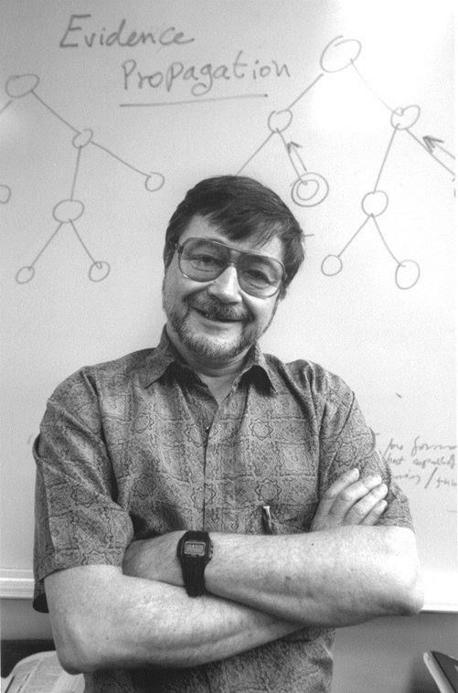
A Key Reference
Judea Pearl. Causality: Models, Reasoning, and Inference, 2nd edition. Cambridge University Press, 2009 (First edition: 2000)

Slide 34
Definition of Bayesian Network
Notes:
Slightly edited from the original---left out the explicit statement of what conditional independence is.
The chain for Bayesian networks follows from the definition.
Use x1 … xn for the variables. Use pa_i for the parents of x_i, for consistency with the truncated factorization formula.
The d-separation criterion follows from the definition.
According to Spirtes [2010; “Introduction to Causal Inference.” Journal of Machine Learning Research 11 (2010) 1643-1662], The local directed Markov condition [used in the definition above], the global directed Markov condition [d-separation implies independence], and factorization [the chain rule for Bayesian networks]
according to a DAG G are all equivalent under mild regularity assumptions (Lauritzen et al., 1990).

Slide 35
Example Bayesian Network
Notes:
Note what is specified here: DAG and CPTs. This is from the recommended reading: Valtorta and Yimin Huang. IDENTIFIABILITY IN CAUSAL BAYESIAN NETWORKS: A GENTLE INTRODUCTION. Cybernetics and Systems: An International Journal, 39: 425–442. 2008.

Slide 36
Visit to Asia Example
Shortness of breath (dyspnoea) may be due to tuberculosis, lung cancer or bronchitis, or none of them, or more than one of them. A recent visit to Asia increases the chances of tuberculosis, while smoking is known to be a risk factor for both lung cancer and bronchitis. The results of a single chest X-ray do not discriminate between lung cancer and tuberculosis, as neither does the presence of dyspnoea [Lauritzen and Spiegelhalter, 1988].
Notes:
Lauritzen and Spiegelhalter, 1988. Dyspnea is spelled in the British way, as “dyspnoea.”

Slide 37
Visit to Asia Example
α (Asia): P(a)=.01 ε (λ or β):P(e|l,t)=1
P(e|l,~t)=1
τ (TB): P(t|a)=.05 P(e|~l,t)=1
P(t|~a)=.01 P(e|~l,~t)=0
σ(Smoking): P(s)=.5 ξ: P(x|e)=.98
P(x|~e)=.05
λ(Lung cancer): P(l|s)=.1
P(l|~s)=.01 δ (Dyspnea): P(d|e,b)=.9
P(d|e,~b)=.7
β(Bronchitis): P(b|s)=.6 P(d|~e.b)=.8
P(b|~s)=.3 P(d|~e,~b)=.1
α
σ
τ
λ
ε
β
ξ
δ
Notes:
Are tau and sigma d-separated given delta? Show computation using the moralized ancestral graph of {tau, sigma, delta}.
Show that the path (chain) tau->epsilon<-lambda<-sigma

Slide 38
Intervention
Causal models are useful because they represent many different models:
  Each (hard) intervention creates a different model (“submodel” or “manipulated graph” [Spirtes et al., 2003])
Excision semantics capture the meaning of intervention
Intervention variables allow for soft intervention
Notes:
Our account of causality is based on the notion of intervention. “Manipulated graph” is from [Spirtes 2003], according to [Pearl 2009]

Slide 39
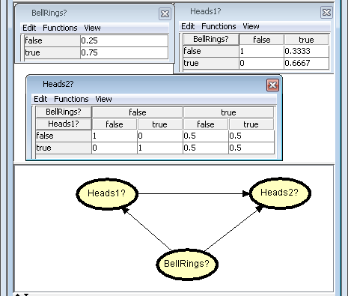
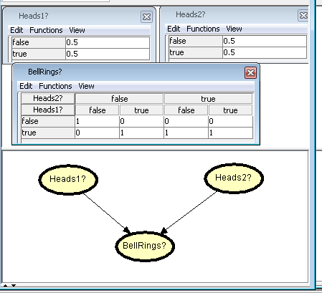
Causality Matters!
Notes:
The model on the left is true under excision semantics; the model on the right is not.
To convince yourself of this, try an intervention in which BellRings? is true.
The model on the left correctly changes to the model in which Heads1? and Heads2? are independent
of BellRings?.
The model on the right does not change at all, which is incorrect, because our belief in the state
of the coins should be unaffected by a direct intervention on the bell.

Slide 40
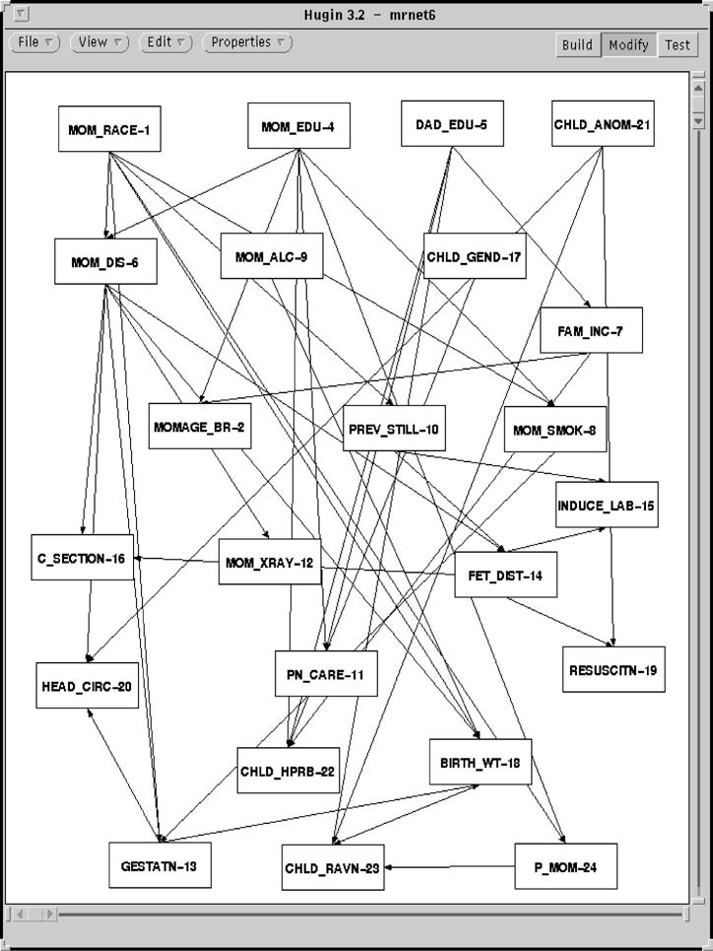
Experts Like Causal Models
Notes:
We defined three rules to characterize the inadequacies
of the generated networks.
6.2.1. Rule of Chronology. Events occurring later in
time cannot be the parents of earlier incidents. For instance
a child health problem cannot be the parent of
maternal disease.
6.2.2. Rule of Common Sense. The directed edges
of the network should not go against common sense.
For instance, Father’s education cannot be a cause of
Mother’s race.
6.2.3. Domain Rule. This rule has been referred as
the Rule of Biological Plausibility in the medical and biological
science literature. This rule states that a causal
explanation is tenable in terms of existing knowledge
level about the variables involved. This level is what we
obtain from an intelligent review of the relevant literature.
The directed edges should not violate established
domain rules. For example, pre-natal care cannot be
put down as a cause of maternal smoking. Mausner and
Kramer strike a note of caution here: “The development
of biological knowledge often introduces new factors
that previous studies have not taken into account.

Slide 41
Visit to Asia Example
Tuberculosis and lung cancer can cause shortness of breath (dyspnea) with equal likelihood. The same is true for a positive chest Xray (i.e., a positive chest Xray is also equally likely given either tuberculosis or lung cancer). Bronchitis is another cause of dyspnea. A recent visit to Asia increases the likelihood of tuberculosis, while smoking is a possible cause of both lung cancer and bronchitis [Neapolitan, 1990].
Notes:
Note the use of “cause” (and the funny spelling of X-ray as Xray). The notion that
causal information can help in building Bayesian networks and that Bayesian networks
represent causal information is not new.

Slide 42
A Simple Smoking and Lung Cancer Model
The simplest model
X: Smoking, Y: Lung cancer
X and Y are observable
X
Y

Slide 43
Fisher’s Smoking and Lung Cancer Model
Smoking-lung cancer model with genotype
Genotype (U) is unobservable
Fisher, R.A. “Cancer and Smoking.” Nature 182 (1958 August 30), pp.596-597.
U
X
Y
Notes:
Fisher, R.A. “Cancer and Smoking.” Nature 182 (1958 August 30), pp.596-597.
Also see Spirtes, Glymour and Scheines’s Causation, Prediction, and Search, MIT Press.

Slide 44
Smoking and Lung Cancer Model with an Intermediate Variable
Smoking and lung cancer model with genotype and tar deposits in the lungs
Tar deposits (Z) are observable
U
X
Z
Y

Slide 45
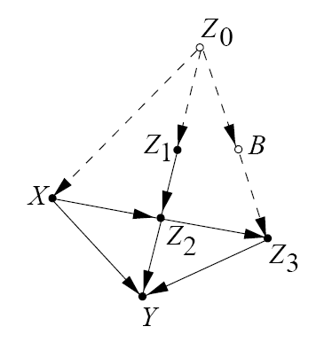
Cochran’s Soil Fumigants Example
X: soil fumigants
Y: oat crop yield
Z₀: last year’s eelworm population (unknown)
Z₁: eelworm populations before treatments
Z₂: eelworm populations after treatments
Z₃: eelworm population at the end of the season
B: population of birds (unknown)
We wish to assess the total effect of the fumigants on crop yield. But controlled randomized experiment are unfeasible, and Z₀ and B are unknown.
Notes:
[Pearl after Cochran]...Consider an experiment in which soil fumigants ($X$) are used to increase oat crop yields ($Y$) by controlling the eelworm population $Z$; the fumigants may also have direct effects (both beneficial and adverse) on yields beside the control of eelworms. We wish to assess the total effect of the fumigants on yields when this typical study is complicated by several factors. First, controlled randomized experiments are infeasible--farmers insist on deciding for themselves which plots are to be fumigated. Second, farmers' choice of treatment depends on last year's eel worm population $Z_0$, an unknown quantity that is strongly correlated with this year's population. Thus we have a classical case of confounding bias that interferes with the assessment of treatment effects regardless of sample size. Fortunately, through laboratory analysis of soil samples, we can determine the eel worm populations before and after the treatment; furthermore, because the fumigants are known to be active for a short period only, we can safely to assume that they do not affect the growth of eelworms surviving the treatment. Instead, eelworms' growth depends on the population of birds (and other predators), which is correlated with last year's eelworm population and hence with the treatment itself.

Slide 46
The Excision Semantics for Intervention
The effect of an intervention that fixes the values of a (subset of the) variable(s) X to x is to remove the links getting into X and force X to have the fixed value(s) x
The deletion of the link(s) into X represents the understanding that, whatever relationship existed between X and its parents prior to the action, that relationship is no longer in effect after we perform the action
Notes:
Pearl 2000

Slide 47
Effect of Interventions
Theorem 3.2.2 (adjustment for direct causes)
Let PA_{i} denote the set of direct causes of variable X_{i}, and let Y be any set of variables disjoint of . The effect of the intervention on Y is given by
where and represent pre-intervention probabilities.
Notes:
Formula numbers and theorem are from Pearl [2009]
Summing (3.12) over all variables except Y U X_i yields Theorem 3.2.2.

Slide 48
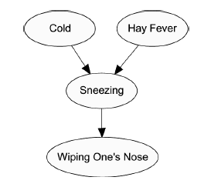
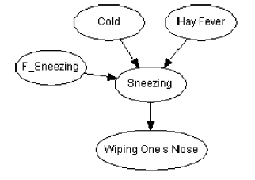
Imperfect Interventions
Notes:
This is also from Valtorta and Huang (recommended reading).

Slide 49
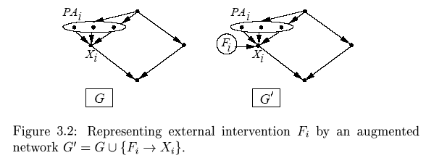
Interventions as Variables
The effect of an atomic intervention do(X_{i}=x_{i}’) is encoded by adding to G a link F_{i} →X_{i}, where F_{i} is a new variable taking values in {do(x_{i}’),idle}, x_{i}’ ranges over the domain of X_{i}, and “idle” represents no intervention. Then we define:
Notes:
Pearl 2000

Slide 50
Contents
Causal Bayesian Networks
Identifiability Problems
Parameterization and Label Swapping
Markov Equivalence and Identifiability
Two Special Models
Results for Small Binary Bayesian Nets
Summary and Conclusion

Slide 51
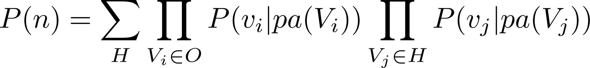
What is Identifiability?
A parameterized statistical model has identifiable parameters if a joint distribution for that model uniquely identifies the parameters that produced that distribution.
The sufficient parameters for discrete Bayesian network with hidden (H) and observable (O) nodes are the conditional probability tables (CPTs) for each family of nodes.

Slide 52
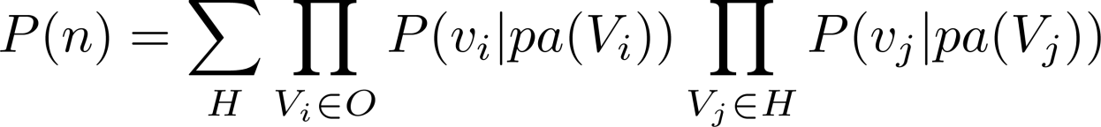
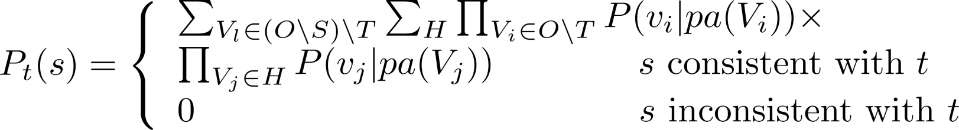
A Space of Identifiability Problems
We concentrate on three dimensions of this space:
  identifiability of all parameters or only some of them;
  identifiability of parameters in their whole range (global identifiability) or with the exception of some subspace of measure zero (generic identifiability);
  identifiability with restrictions on the cardinality of the state space of variables or without them.
We call (simply) identifiability the generic identifiability of all the probabilities in the equation above with appropriate bounds on the state spaces of variables, and identifiability_2 the global identifiability of the causal effect with no bounds on the state space of variables.

Slide 53
Identifiability
Identifiability: The ability to determine whether the CPTs can be computed from observable data alone and, if so, to compute them.
Identifiability_2: The ability to determine whether the causal effect of a set of observable variables on another observable variable in a causal Bayesian network with hidden nodes can be computed from observable data alone, and, if so, to compute it.
  There is a sound and complete algorithm for the (un)identifiability_2 problem.
An example of case 2 follows.
Notes:
Identifiability matches the natural scientist’s perspective
(“find a model of a natural (small) world”).
Identifiability_2 matches the social scientist’s perspective
(“what is the effect of intervention on the world?”).

Slide 54
Unidentifiability_2 Example(1)
All the variables are binary.
P(U=0) = 0.5,
P(X=0|U) = (0.6,0.4),
P(Y=0|X,U) =
U
X
Y
Y=0 | X =0 | X= 1
U =0 | 0.7 | 0.2
U=1 | 0.2 | 0.7
Notes:
Fisher, Nature, 1958.

Slide 55
Unidentifiability_2 Example(2)
Note that
We get:
Because of the excision semantics, the link from U to X is removed, and we have:
So, P_{X=0} (Y=0) = (0.7x0.5) + (0.2x0.5) = 0.45
 | X =0 | X= 1
Y =0 | 0.25 (=0.7x0.6x0.5+0.2x0.4x0.5) | 0.25
Y=1 | 0.25 | 0.25

Slide 56
Unidentifiability_2 Example(3)
All the variables are still binary.
P(U=0) = 0.5
P(X=0|U) = (0.7,0.3)
P(Y=0|X,U) =
U
X
Y
Y=0 | X =0 | X= 1
U =0 | 0.65 | 0.15
U=1 | 0.15 | 0.65

Slide 57
Unidentifiability_2 Example(4)
Using
We still get:
From
We have P_{X=0} (Y=0) = (0.65x0.5) + (0.15x 0.5) = 0.4 <> 0.45.
So, P_{X}(Y) is unidentifiable in this model.
 | X =0 | X= 1
Y =0 | 0.25 | 0.25
Y=1 | 0.25 | 0.25

Slide 58
Unidentifiability_2 Example(1)
All the variables are binary.
P(U=0) = 0.5,
P(X=0|U) = (0.6,0.4),
P(Y=0|X,U) =
U
X
Y
Y=0 | X =0 | X= 1
U =0 | 0.7 | 0.2
U=1 | 0.2 | 0.7
Notes:
Fisher, Nature, 1958.

Slide 59
Unidentifiability_2 Example(2)
Note that
We get:
Because of the excision semantics, the link from U to X is removed, and we have:
So, P_{X=0} (Y=0) = (0.7x0.5) + (0.2x0.5) = 0.45
 | X =0 | X= 1
Y =0 | 0.25 (=0.7x0.6x0.5+0.2x0.4x0.5) | 0.25
Y=1 | 0.25 | 0.25

Slide 60
Unidentifiability_2 Example(3)
All the variables are still binary.
P(U=0) = 0.5
P(X=0|U) = (0.7,0.3)
P(Y=0|X,U) =
U
X
Y
Y=0 | X =0 | X= 1
U =0 | 0.65 | 0.15
U=1 | 0.15 | 0.65

Slide 61
Unidentifiability_2 Example(4)
Using
We still get:
From
We have P_{X=0} (Y=0) = (0.65x0.5) + (0.15x 0.5) = 0.4 <> 0.45.
So, P_{X}(Y) is unidentifiable in this model.
 | X =0 | X= 1
Y =0 | 0.25 | 0.25
Y=1 | 0.25 | 0.25

Slide 62
The Identifiability_2 Problem
For a given causal Bayesian network, decide whether P_{t}(s) (i.e., P(S | do(T)) is identifiable or not.
If P_{t}(s) is identifiable, give a closed-form expression for the value of P_{t}(s) in term of distributions derived from the joint distribution of all observed quantities, P(n).
Notes:
John Rhodes noted on 10-10-05 that

Slide 63
Identifiable Quantities
The quantity P_{t}(s) is identifiable if, given the causal Bayesian network G, the quantity P_{t}(s) can be determined from the distribution of the observed variables P(n) alone
  Alternative notation:
For example, we may want to assess the total effect of the fumigants (t={X}) on yield (s={Y}), denoted P_{t}(s), when we have the graph and P(X,Z₁,Z₂,Z₃,Y)

Slide 64
Identifiability_2 Problem
For a given causal Bayesian network, decide whether P_{t}(s) is identifiable or not
If P_{t}(s) is identifiable, give a closed-form expression for the value of P_{t}(s) in term of distributions derived from the joint distribution of all observed quantities, P(n)
Notes:
John Rhodes noted on 10-10-05 that

Slide 65
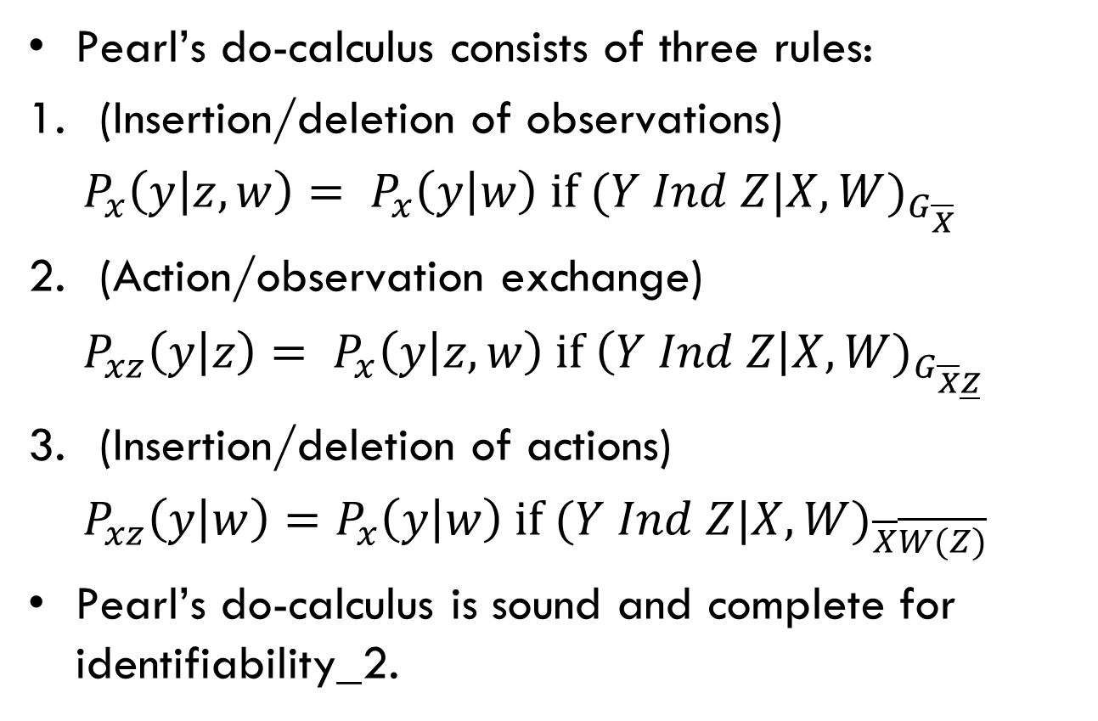
Pearl’s Do-Calculus

Slide 66
Pearl’s Conjecture
Pearl conjectured that P_{t}(s) is identifiable if and only if all terms involving intervention can be replaced by terms involving only observations, by successive application of the three inference rules of the “do calculus”
Notes:
Pearl’s conjecture was also independently proved by Huang & Valtorta and Shpitser & Pearl.
Huang and Shpitser jointly received the “best student paper award” at UAI-06 for work.”
Tian (a former student of Pearl) did a lot of the groundwork.

Slide 67

Completeness of the do-calculus
Various papers by Tian, Shpitser, Pearl, Huang, Valtorta
Yimin Huang and Marco Valtorta. "Pearl’s Calculus of Intervention is Complete." Proceedings of the 22nd Conference on Uncertainty in Artificial Intelligence (UAI-06), Cambridge, MA, July 13-16, 2006, pp. 437-444
Yimin Huang and Marco Valtorta. "Identifiability on Causal Bayesian Networks: A Sound and Complete Algorithm." Proceedings of the Twenty-First National Conference on Artificial Intelligence (AAAI-06), Boston, MA, July 16-20, 2006, pp. 1149-1154.
The paper above extends to general causal Bayesian networks the results in: Yimin Huang and Marco Valtorta. "On the Completeness of an Identifiability Algorithm for Semi-Markovian Models." Annals of Mathematics and Artificial Intelligence, 54, 4, 363-408, 2009
The dates are backwards because of publication delays

Slide 68
Pearl’s Graphical Inference Rules Are Complete
Exploiting the complete Identify algorithm on normal causal Bayesian networks, Huang and Valtorta proved that Pearl’s three inference rules are complete
This result confirms Pearl’s conjecture

Slide 69
Outline of the Proof
The sound and complete algorithm for computing P_{T}(S) is obtained by using lemma 1 and lemma 2
We show that these two lemmas can be obtained by just using the three inference rules and standard probability manipulations. Therefore, the sufficiency of the three rules is proved
Three
inference
rules
Tian & Pearl’s
two lemmas
A sound &
complete
algorithm

Slide 70
Contents
Causal Bayesian Networks
Identifiability Problems
Parameterization and Label Swapping
Markov Equivalence and Identifiability
Two Special Models
Results for Small Binary Bayesian Nets
Summary and Conclusion

Slide 71
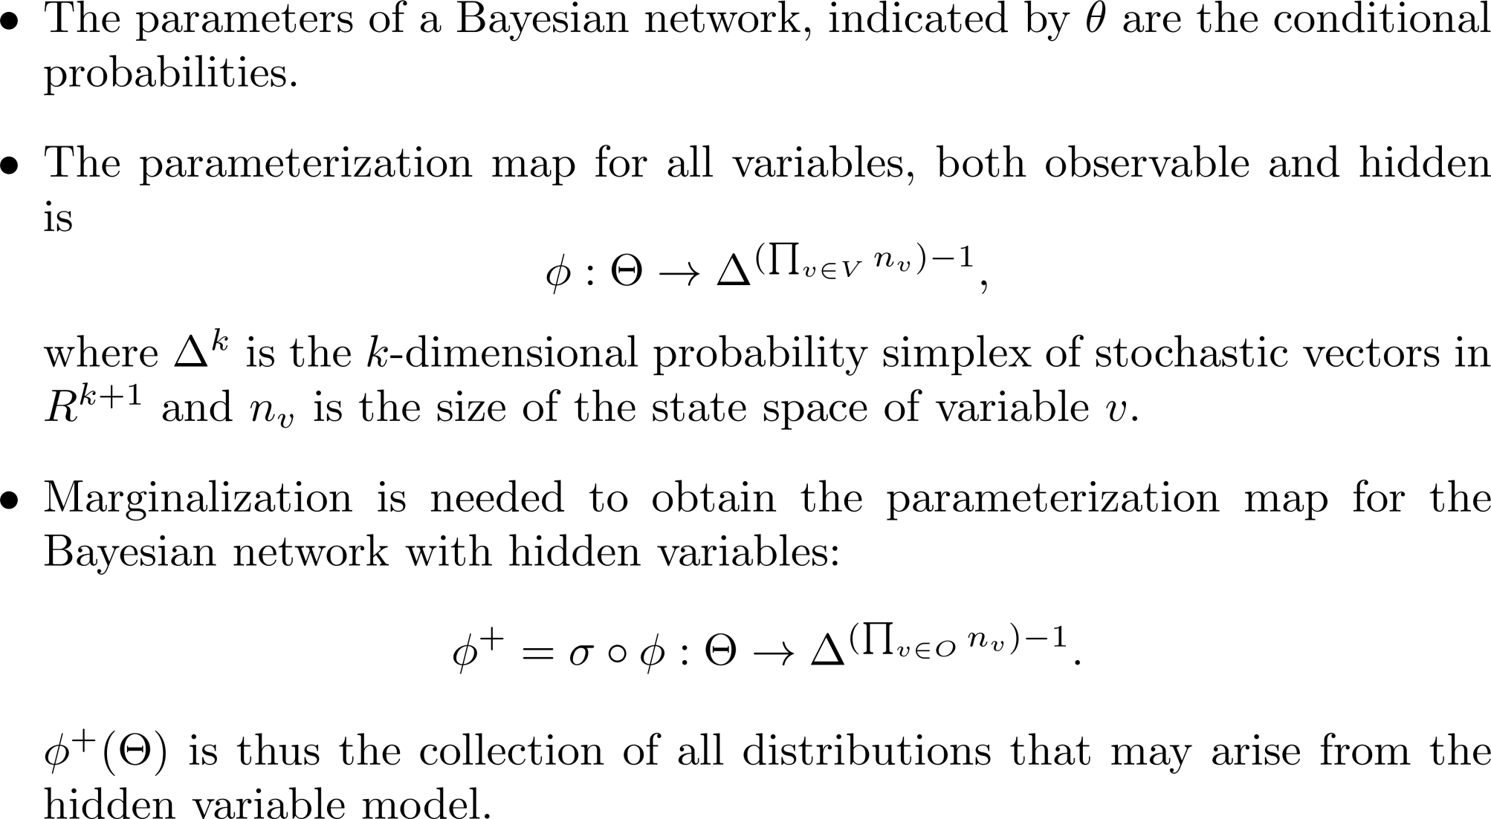
Parameterization
Notes:
The “-1” is an artifact of the definition of the probability symplex

Slide 72
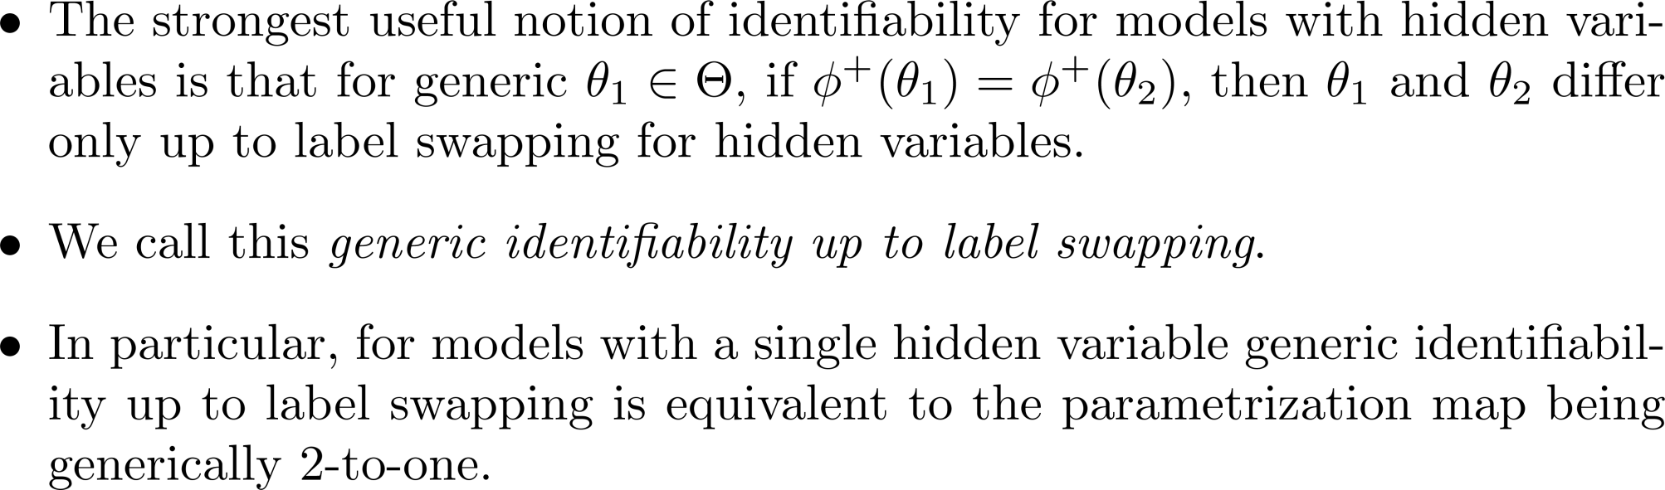
Label Swapping

Slide 73
Contents
Causal Bayesian Networks
Identifiability Problems
Parameterization and Label Swapping
Markov Equivalence and Identifiability
Two Special Models
Results for Small Binary Bayesian Nets
Summary and Conclusion

Slide 74
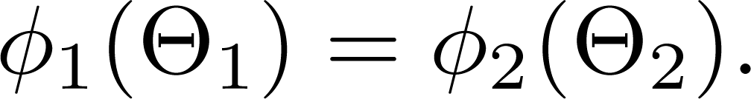
Markov Equivalence
Two DAGs on the same sets of observable and hidden nodes are said to be Markov equivalent if they entail the same conditional independence statements through d-separation. (Note this notion does not distinguish between observable and hidden variables; all are treated as observable.)
Thus for fixed choices of state spaces of the variables, two different but Markov equivalent Bayesian networks, G₁ and G₂, have different parameter spaces , and different parameterization maps, yet

Slide 75
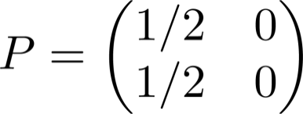
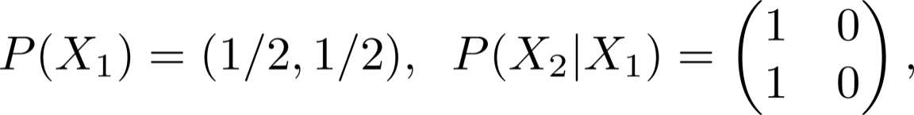
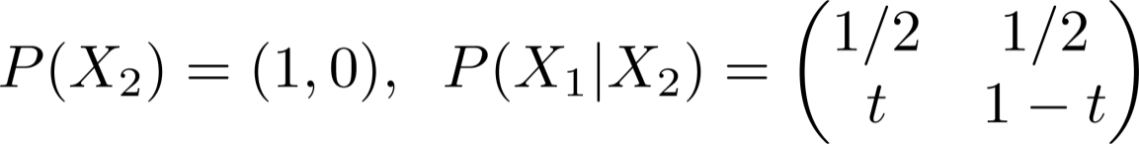
A Simple Example
Consider the Markov Equivalent DAGs 1→2, 1←2.
The particular distribution with
requires parameters on the first DAG to be
while parameters on the second DAG can be
for any t between 0 and 1. (Note that, as in the rest of the presentation, we do not use Hugin order in the CPTs.)
Thus this particular distribution has identifiable parameters for only one of these DAGs.
Notes:
Of course, this probability distribution was a special one, and does not represent
the generic behavior of the models, which both have generically identifiable parameters
(as do all DAG models without hidden variables).
For generic choices of parameters we obtain the theorem on the following slide.

Slide 76
Markov Equivalence and Identifiability
With all variables having finite state spaces, consider two Markov equivalent DAGs, G₁ and G₂, possibly with hidden nodes. If the parameterization map is generically k-to-one, then is also generically k-to-one.
In particular if such a model has parameters that are generically identifiable up to label swapping, so does every Markov equivalent model.

Slide 77
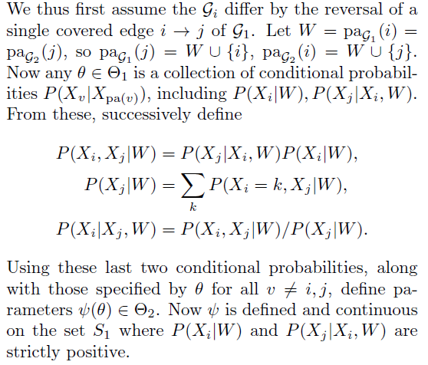
ME and Identifiability: Details
The key observation is due to Chickering (1995): Markov equivalent Bayesian networks differ by applying a sequence of reversals of covered edges.
Notes:
This is lemma 2 in the UAI-13 paper, which is the hard part of theorem 1.

Slide 78
Contents
Causal Bayesian Networks
Identifiability Problems
Parameterization and Label Swapping
Markov Equivalence and Identifiability
Two Special Models
Results for Small Binary Bayesian Nets
Summary and Conclusion

Slide 79
Kruskal’s Theorem
Model with one hidden variable (r states) and three observable variables (s1, s2, s3 states)
Provided that s1, s2, s3 are “large enough” relative to r, the parameters are generically identifiable
In this presentation, we assume that all variables are binary; this is enough.
Kruskal Graph
(3-0 in the paper)
0
1
2
3
Notes:
min(s1,r) + min(s2,r) + min(s3,r) >= 2r+2. See SIS-12 paper.
All variables having the same number of states works (as long as each variable has at least 2 states).
Problems arise when the hidden variable has more states than the observables.

Slide 80
Another Special Model
This model cannot be reduced to the Kruskal one with three observable variables, but it is identifiable (Theorem 4 in the UAI-13 workshop paper)
The non-generic case requires a non-saturated model: a zero interaction between variables X₁, X₂, and X₃
0
2
1
3
4
Graph 4-3b
Notes:
Is it always (for every DAG) the case that the non-generic case requires a non-saturated model?

Slide 81
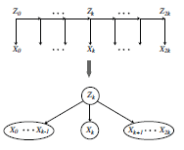
Application of the Special Cases
The special cases can be applied to more complicated graphs:
Clumping several variables (all hidden or all observed) into a single one, with larger state space
Conditioning on the state of an observed variable
Marginalizing over an observed variable (making it hidden)
Operations 2 and 3 are novel in this context
Notes:
The example: HMM, from:
Elizabeth S. Allman, Catherine Matias, and John A. Rhodes
“Identifiability of parameters in latent structure models with many observed variables.”
Annals of Statistics, 37 (2009), 3099-3132.

Slide 82
Contents
Causal Bayesian Networks
Identifiability Problems
Parameterization and Label Swapping
Markov Equivalence and Identifiability
Two Special Models
Results for Small Binary Bayesian Nets
Summary and Conclusion

Slide 83
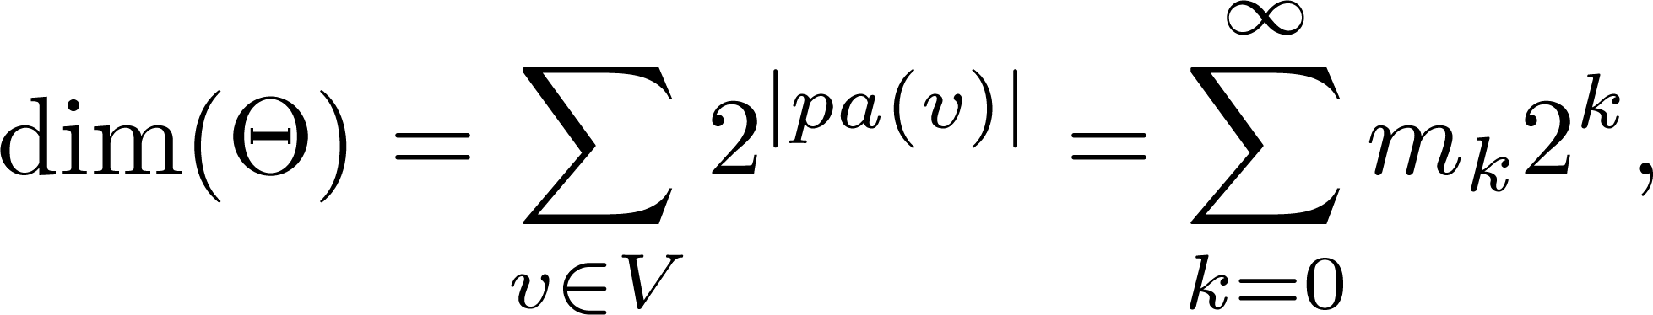
Dimensions
In many models, the dimension of the parameter space, computed by
where m_{k} is the number of nodes with in-degree k, exceeds the dimension of the probability simplex in which the joint distribution of the observed variables lies.
In all these cases, the parameterization map is infinity-to-one
Notes:
Cf. Proposition 5 in the paper.

Slide 84
Two Observable Variables
Neither of the two possible models (up to Markov equivalence) is identifiable
P(S|do(T)) is unidentifiable_2 in the top model
P(S|do(T)) is identifiable_2 in the bottom model
  Effects are independent given their common cause, so when we marginalize out U, the effect of T is eliminated
U
T
S
U
T
S
Graphs 2-B, B≥0
Notes:
The parameter space has size >=5, the probability simplex has size 3.

Slide 85
Three Observed Variables
The model of the original Kruskal Theorem (top) is (obviously) identifiable
The causal effect of any leaf on any other leaf is identifiable_2
If any edges are added, the model becomes unidentifiable, because
P(S | do(T)) is identifiable_2
P(V | do(W)) is unidentifiable_2
3-0
U
3-1a
T
S
U
3-2a
W
V
Notes:
3-Bx for B>=1 has dim >=9 and simplex of size 7.

Slide 86
Four Observed Variables
4-0 is identifiable
  by clumping two observable variables together
  or by marginalizing over any observable
4-1 is identifiable
  by clumping the two observable variables that are connected by an arc,
  or by marginalizing over X2.
4-0
1
2
4-1
Notes:
4-0: dim 9, simpl 15; 4-1: dim 11, simpl 15.

Slide 87
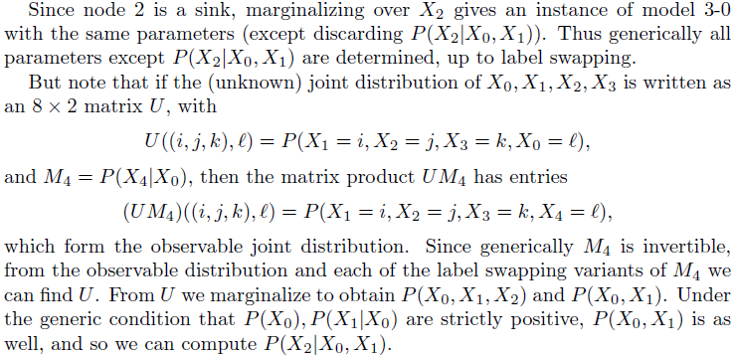
Details for 4-1
0
Identifiable by marginalizing over X2.
1
2
3
4
Notes:
4-1: dim 11, simpl 15. Label swapping here is: label swapping for X0.

Slide 88
Four Observed Variables: 4-2a
This Bayesian network is unidentifiable, because the dimension of is 13, and 11 parameters are sufficient to completely describe the observable joint distribution
P(S | do(T)) is unidentifiable_2, but
P(V | do(T)) is identifiable_2
T
S
V
4-2a
Notes:
Dim 13, simplex 15. So, a simple dimensional argument is not sufficient.
The details are in the paper.

Slide 89
Four Observed Variables (4-2b,c)
The two edges form a directed path
The parameter space is 13 dimensional, and the joint probability distribution of the observed variables is specified by a 2x2x2x2 tensor P
0
0
2
1
3
4
1
2
3
4
4-2c
4-2b
Notes:
These two graphs are M.E.

Slide 90
4-2b, ctd.
0
If all variables are binary, there are
11 free parameters in total:
A vector (t₀, t₁)=(t₀,1-t₀) specifying the distribution of the hidden variable X_{0,} and
Two 2x2 stochastic matrices, M₁, M₄ giving probabilities for X₁, X₄ conditioned on X₀, and
Two 4x2 stochastic matrices, M₂, M₃, giving probabilities for X₂, X₃, s.t. M₂ is conditioned on X₀,X₁, and M₃ is conditioned on X₀, X₂.
1
2
3
4

Slide 91
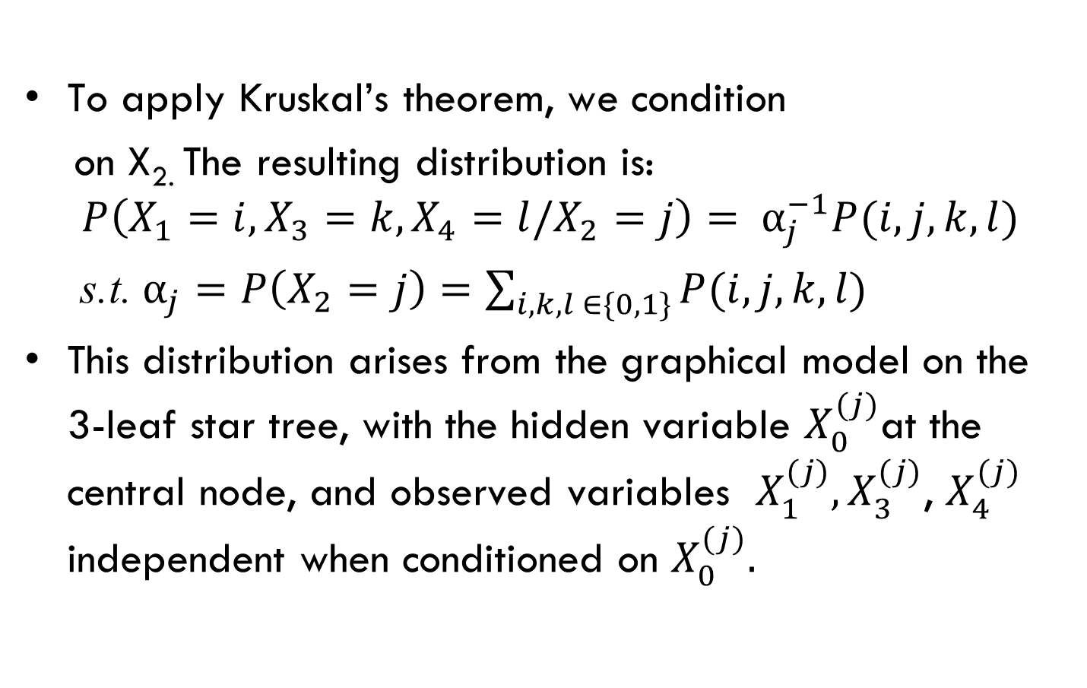
4-2b, ctd.
0
1
2
3
4

Slide 92
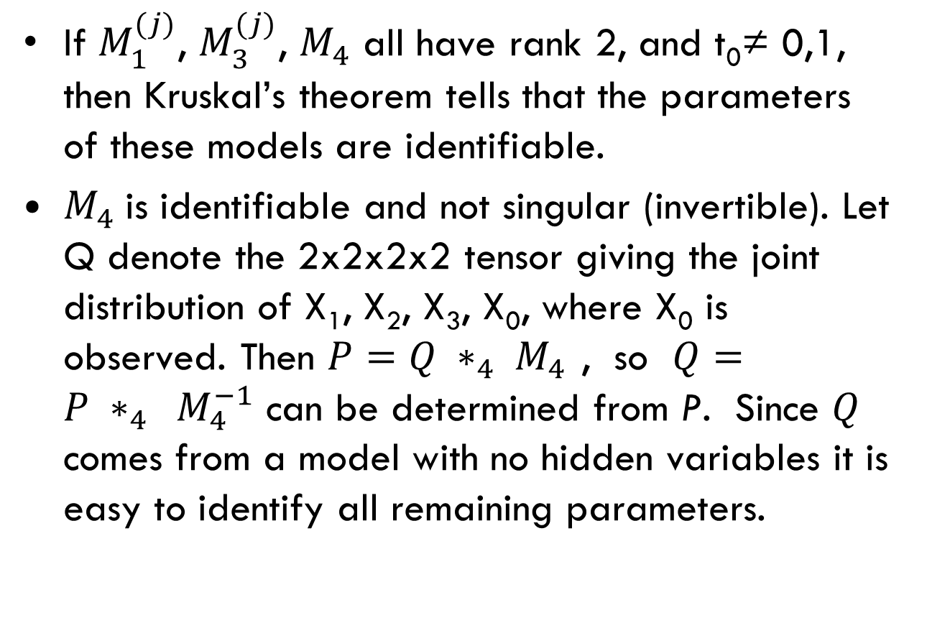
4-2b, ctd.
Notes:
∗_4 𝑚𝑢𝑙𝑡𝑖𝑝𝑙𝑖𝑐𝑎𝑡𝑖𝑜𝑛 𝑖𝑛 𝑡ℎ𝑒 4𝑡ℎ 𝑖𝑛𝑑𝑒𝑥

Slide 93
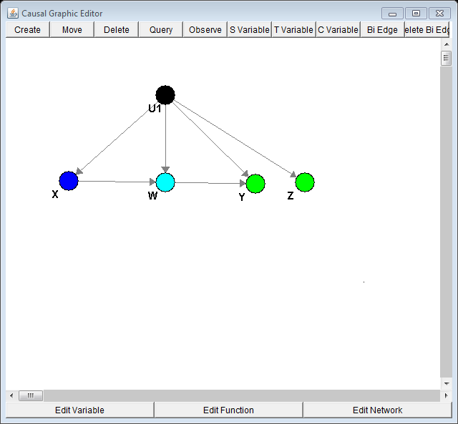
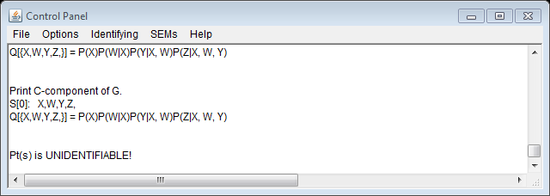
A Surprise Concerning 4-2b
P(W | do(X)) is not identifiable_2!
Jin Tian’s CIBN, available at http://www.cs.iastate.edu/~jtian/Software/CIBN.htm

Slide 94
Four Observed Variables
0
Model 4-3e,f exhibit a 4-1 mapping
2
1
3
4
4-3e
0
1
2
3
4
4-3f
Notes:
4.3e and f are M.E.

Slide 95
4.3(3) exhibits a 4-1 map
0
2
1
3
Condition on X1.
Obtain two Kruskal graphs. In each one, labels for the states of X₀ in P(X₀|X₁=j), j = 1,2, can be set arbitrarily.
Once a choice is made for the labels in those two tables, the other tables are determined precisely.
Note that the edge from X₁ to X₄ is crucial for the existence of a 4-1 map; without this edge, one could recover P(X₄|X₀) without conditioning on X₁, as done for 4.2b
4

Slide 96
Contents
Identifiability Problems
Parameterization and Label Swapping
Markov Equivalence and Identifiability
Two Special Models
Results for Small Binary Bayesian Nets
Summary and Conclusion

Slide 97
Summary and Conclusions
We obtained results for all graphs with four observables
Some heuristics have emerged, e.g., when both conditioning and marginalization lead to a result, marginalization is more efficient
A related algorithm for concentration graphs (Markov networks) based on published criteria (Stanghellini and Vantaggi) has been developed and implemented (Mohamed Sharaf and MV)
An algorithm for the Bayesian net case is a major goal (Mohamed Sharaf’s dissertation is a start)

Slide 98
Summary and Conclusions (ctd.)
In some cases, by assuming a hidden variable is binary, a model may go from unidentifiable to identifiable for generic parameter values
In these cases, it appears that one needs not rational formulas, but algebraic ones, in order to solve for parameter values
It appears that for identifiability_2, one always can obtain rational formulas for parameter values, when they are identifiable

Slide 99
Background References
Elizabeth S. Allman, Catherine Mathias, and John A. Rhodes “Identifiability of parameters in latent structure models with many observed variables.” Annals of Statistics, 37 (2009), 3099-3132.
Yimin Huang and Marco Valtorta. “On the completeness of an identifiability algorithm for semi-Markovian models.” Annals of Mathematics and Artificial Intelligence, 54 (2008), 363-408.
Jin Tian and Ilya Shpitser. “On Identifying Causal Effects.” In: Rina Dechter, Hector Geffner, and Joseph Halpern (eds.) Heuristics, Probability, and Causality: A Tribute to Judea Pearl. College Press (2010), 523-543.
Elena Stanghellini, Barbara Vantaggi “On the identification of discrete graphical models with hidden nodes.” To appear in Bernoulli doi: 10.3150/12-BEJ435 (2013).

Slide 100
Questions?

