Slide 1



New Graduate Students Orientation
Dr. Jijun Tang
On behalf of
Dr. Marco Valtorta, new Graduate Director
MGV@cse.sc.edu

Slide 2
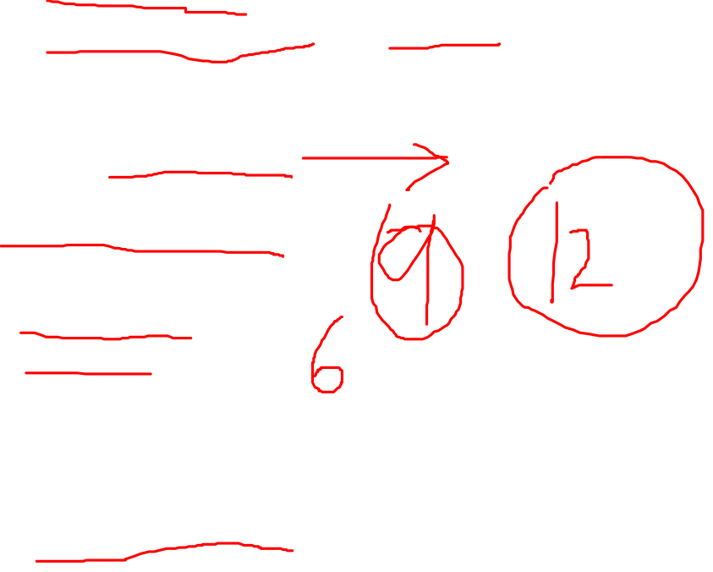
General Tips
Be safe
  Recommended to wear face masks inside rooms
  Do NOT walk at night, call 777-3351 for free late night shuttle
  Tell people about your whereabouts
Check your email
  ***@email.sc.edu
  Mailing list
Balance your load
  Course work
  Teaching duty
  Research
Ask for help
  mgv@cse.sc.edu
  Sri: satti@cse.sc.edu
  Sri @ 777-6959

Slide 3
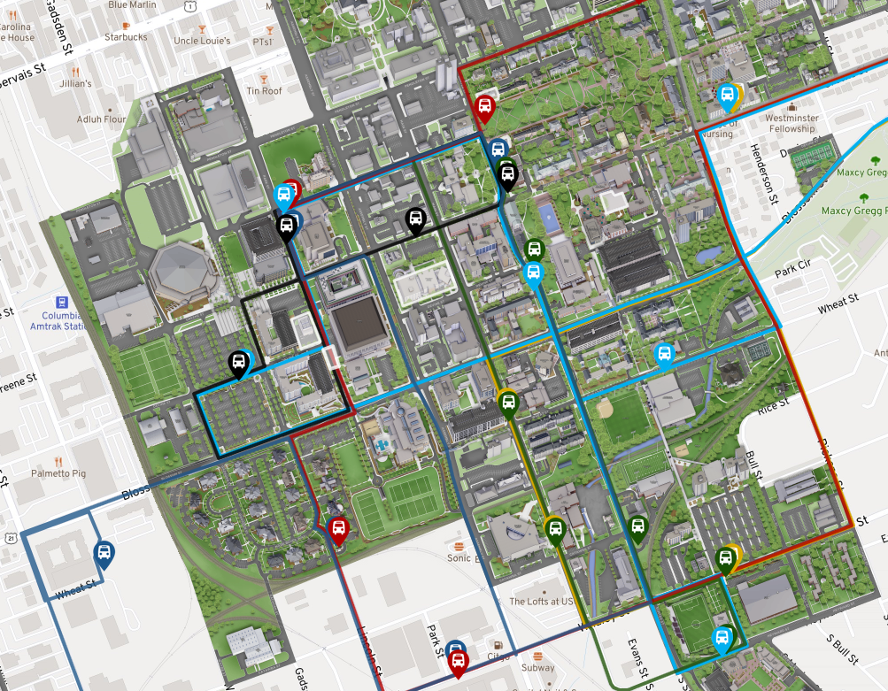
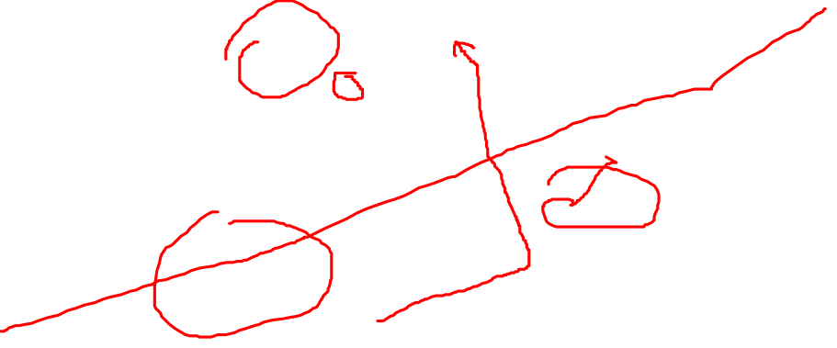
Storey
300 Main
SWGN

Slide 4
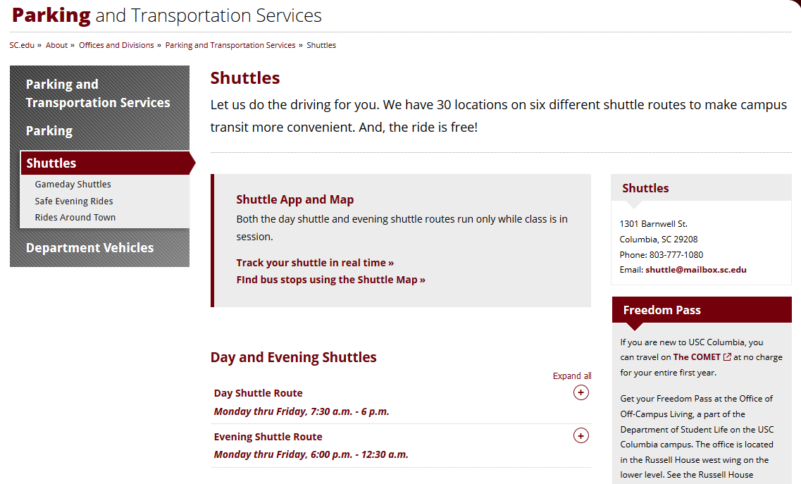


Slide 5
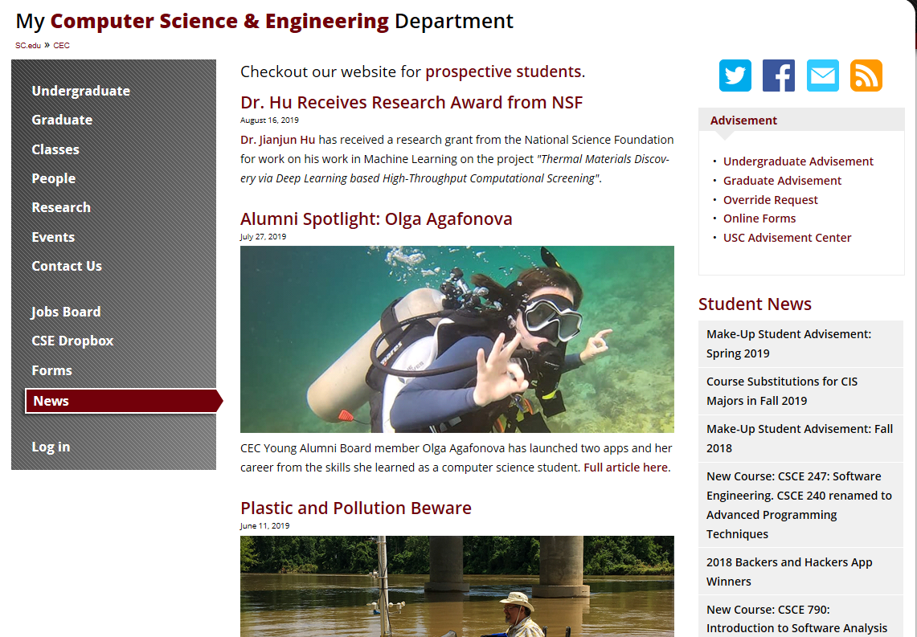
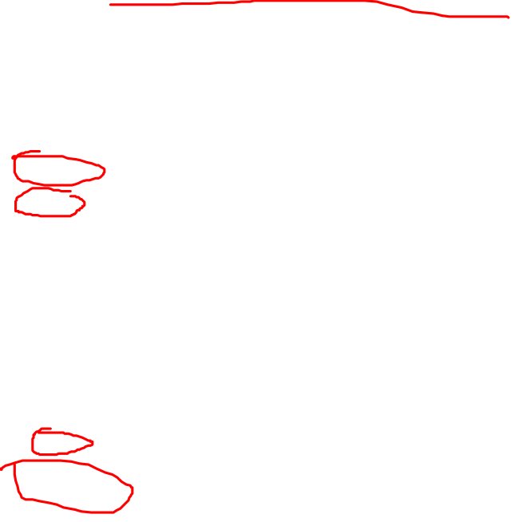
www.cse.sc.edu

Slide 6
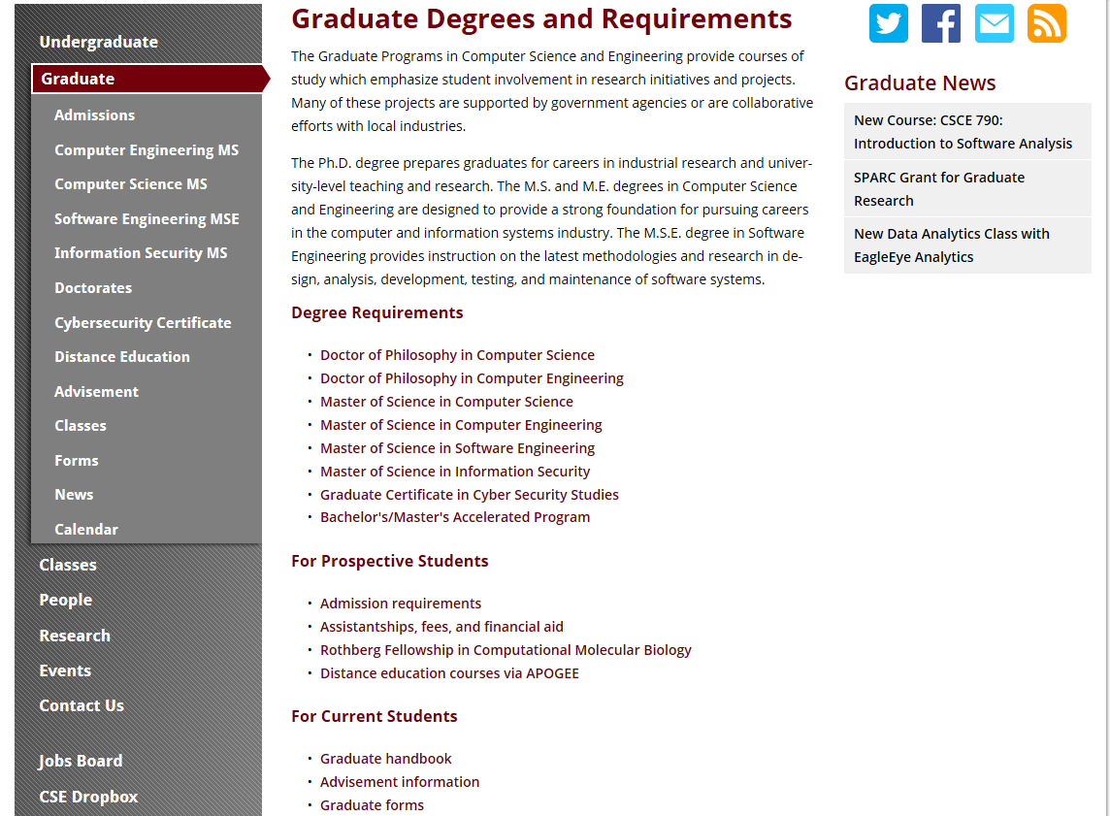
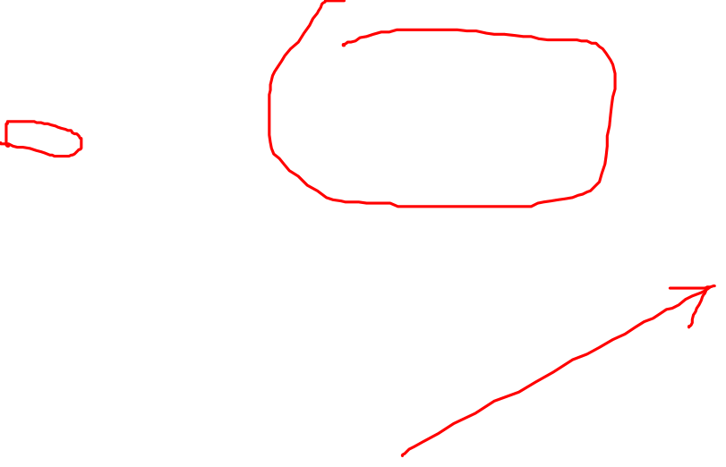
www.cse.sc.edu

Slide 7
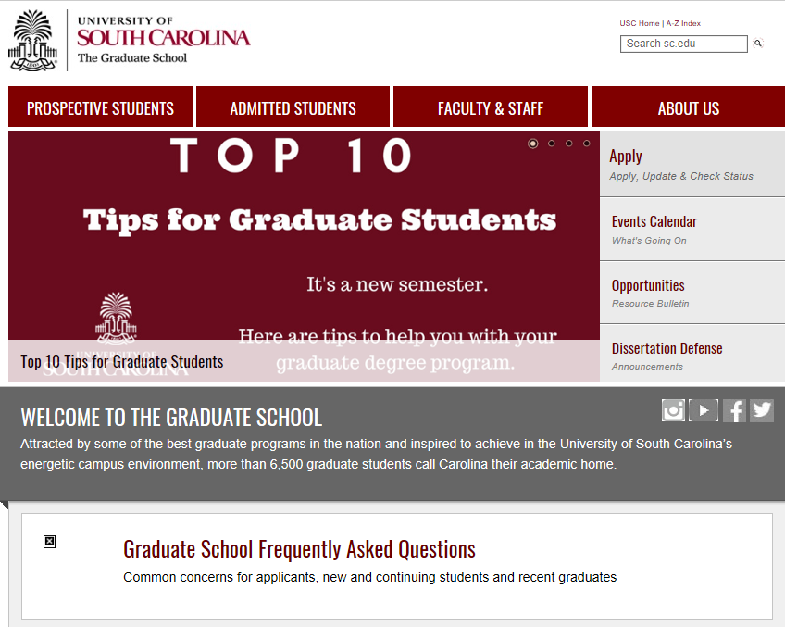
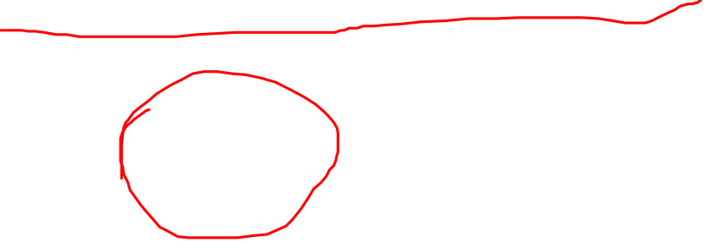
http://gradschool.sc.edu/

Slide 8
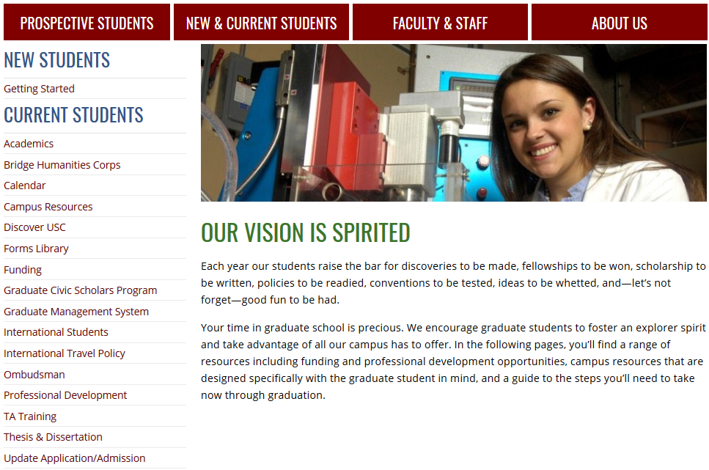

http://gradschool.sc.edu/

Slide 9
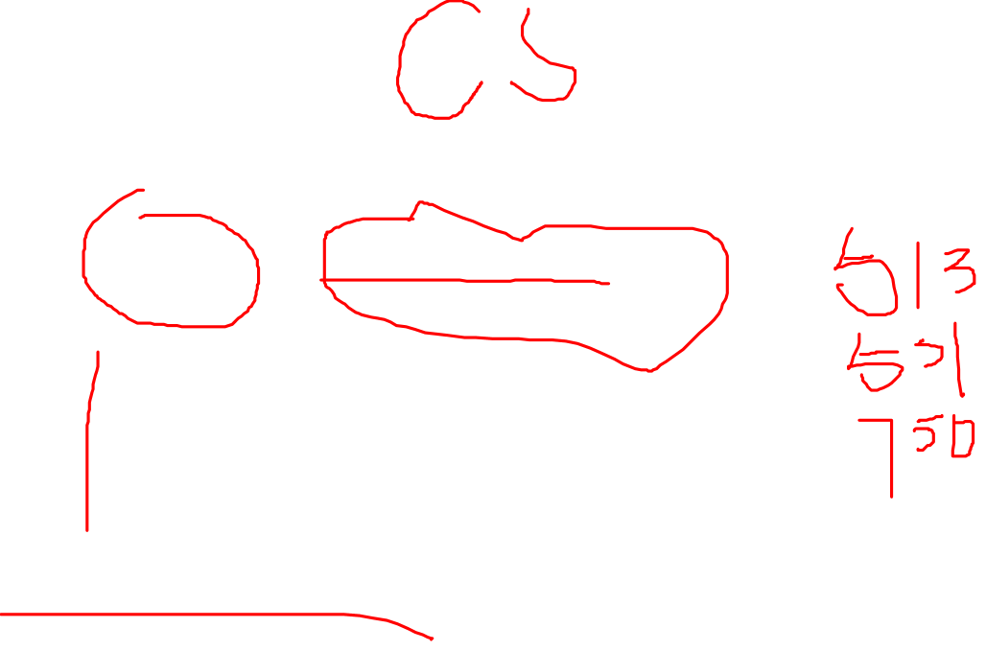
Timeline (Master)
Graduated
Program of studies
Comprehensive Exam
/Thesis defense
Year 1
Year 2

Slide 10
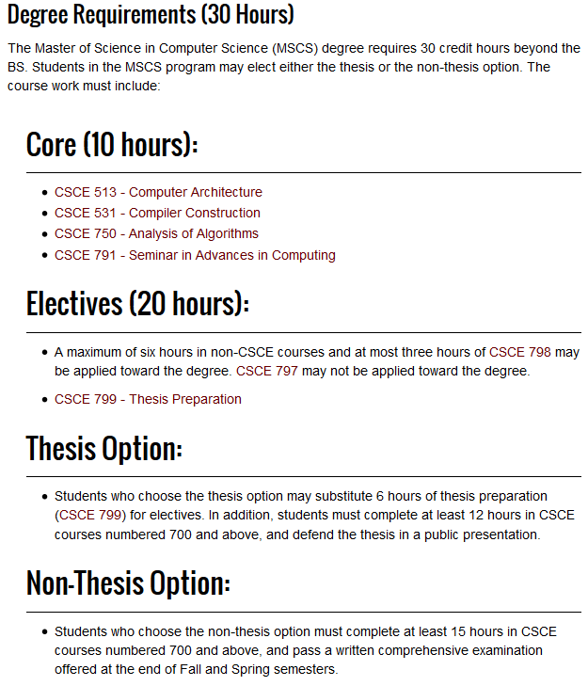
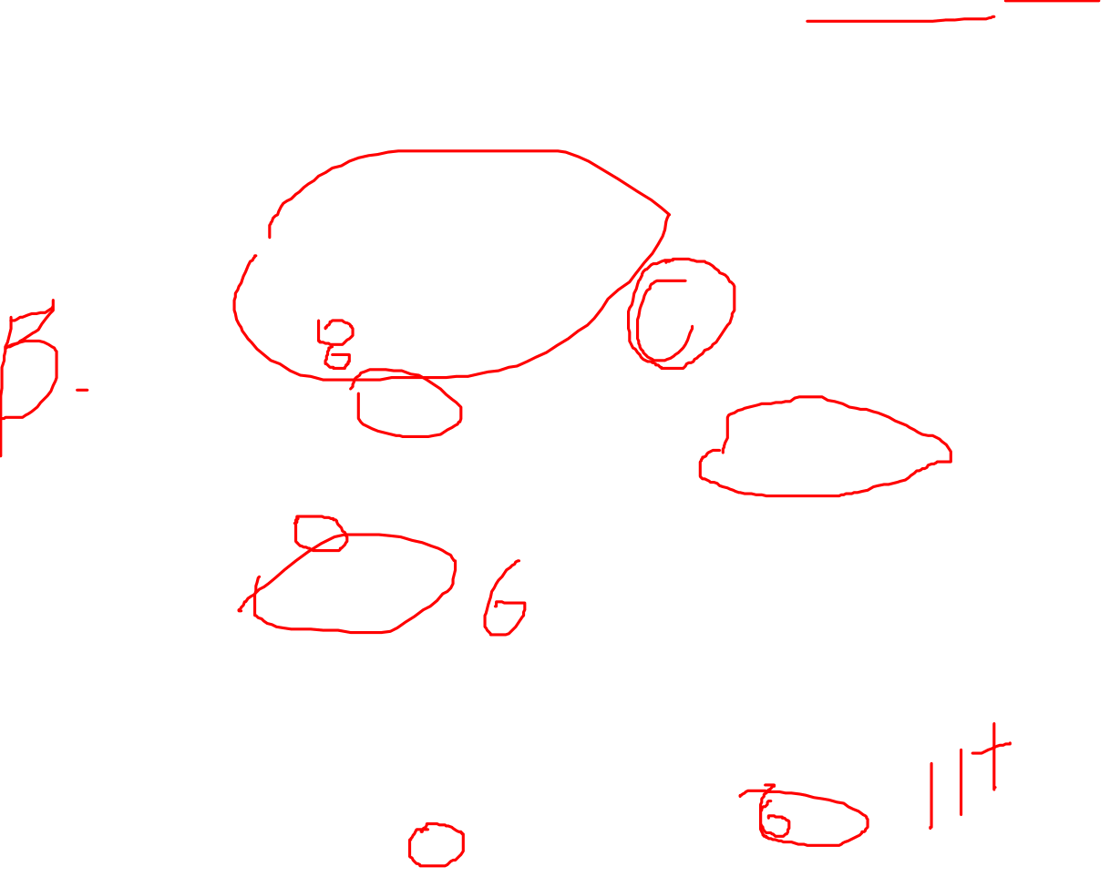
Course Requirement (MS, CS)

Slide 11
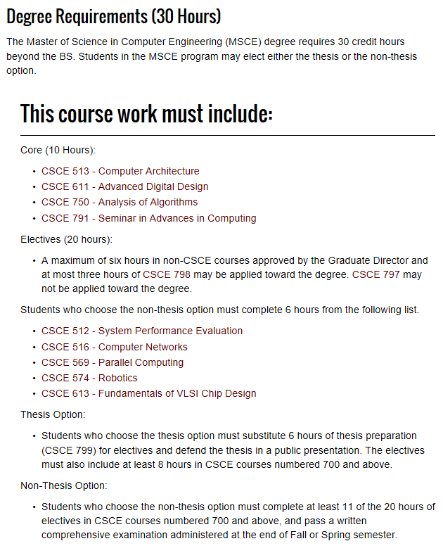

Course Requirement (MS, CE)

Slide 12
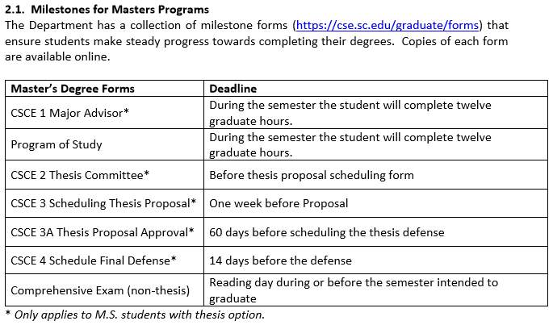
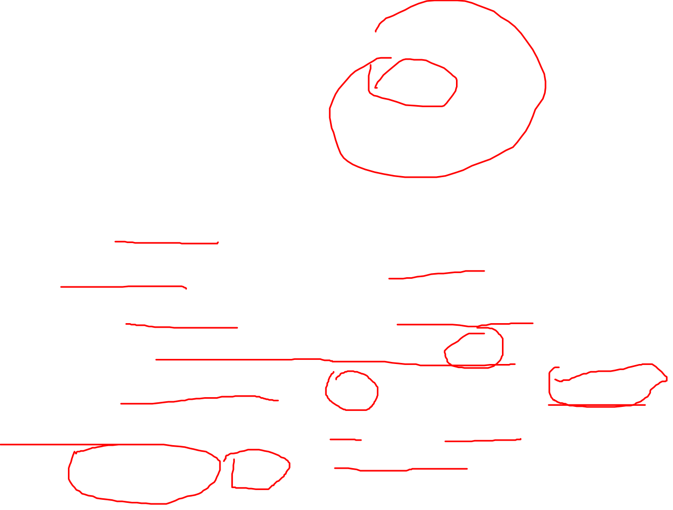
(Thesis option)

Slide 13
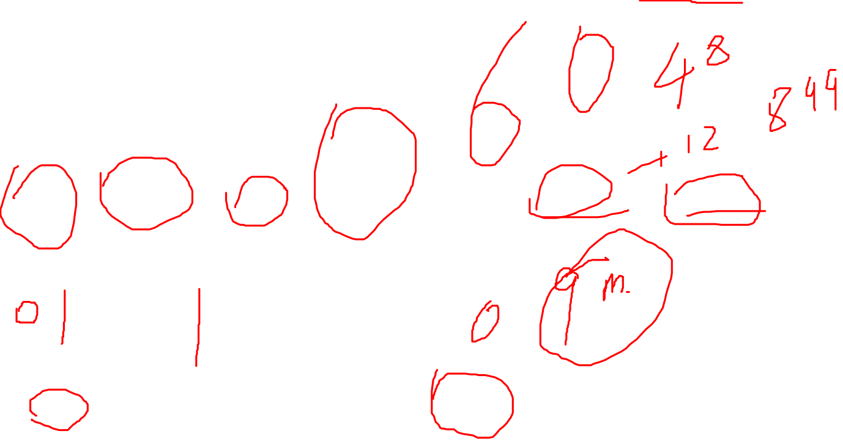
Timeline (Ph.D. without MS)
Starting Publish
Finding advisor
Program of studies
Qualify Exam
Proposal
Graduated
Year 1
Year 2
Year 3
Year 4
Year 5

Slide 14
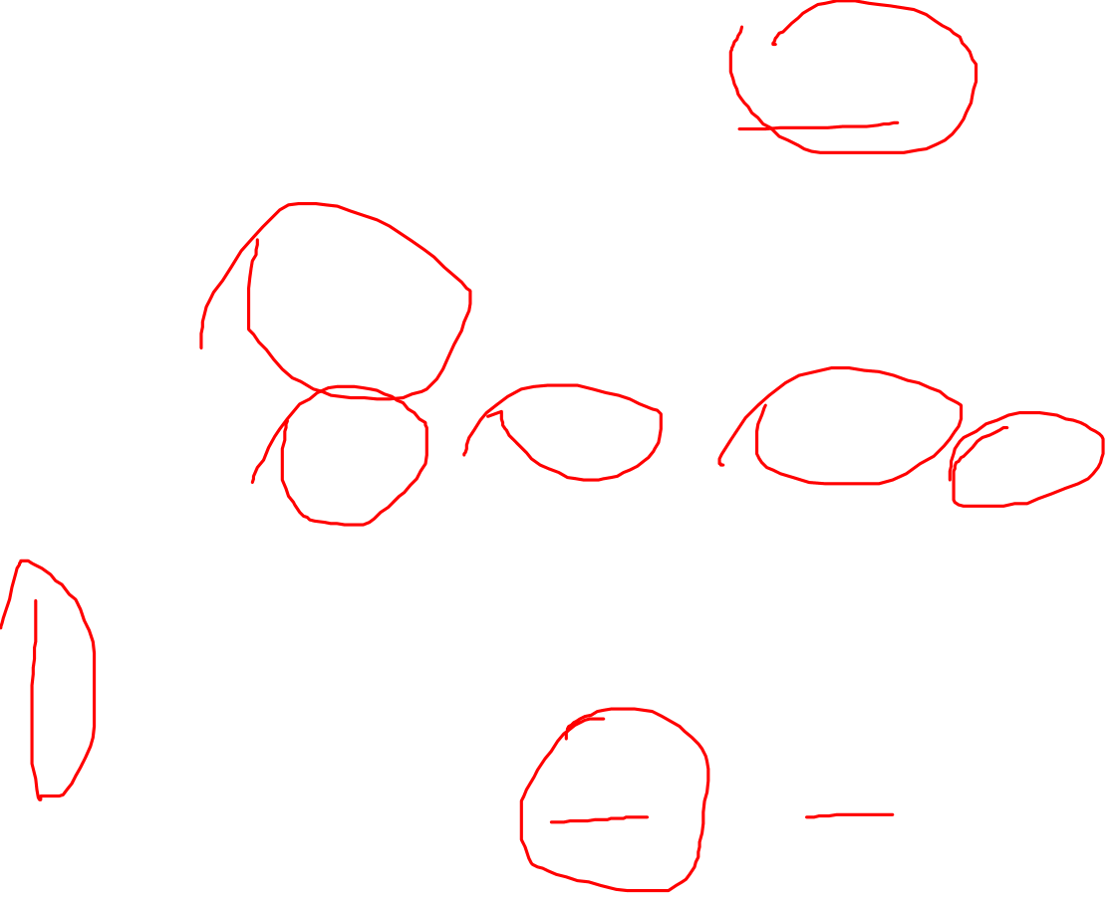
Timeline (Ph.D. with MS)
Starting Publish
Finding advisor
Program of studies
Qualify Exam
Proposal
Graduated
Too late
Year 1
Year 2
Year 3
Year 4
Year 5

Slide 15
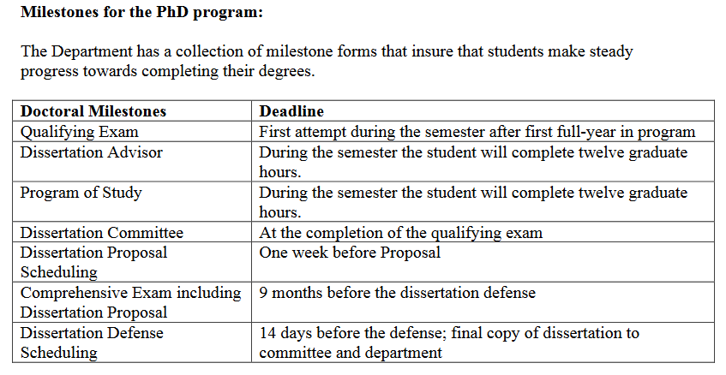
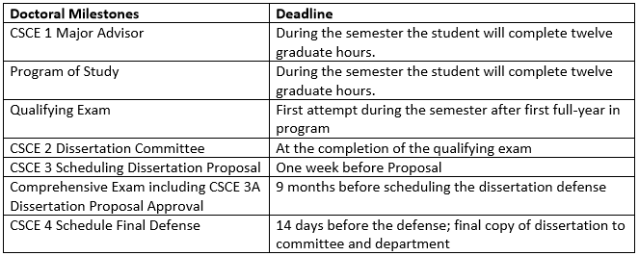
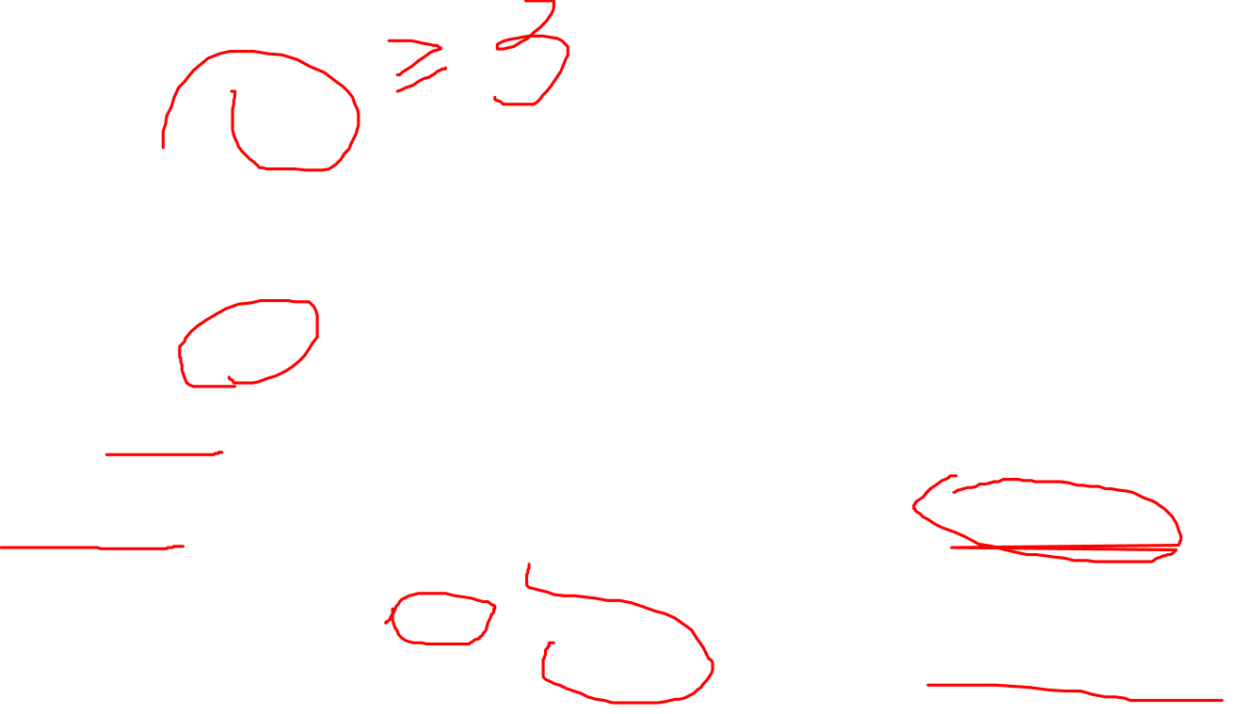

Slide 16
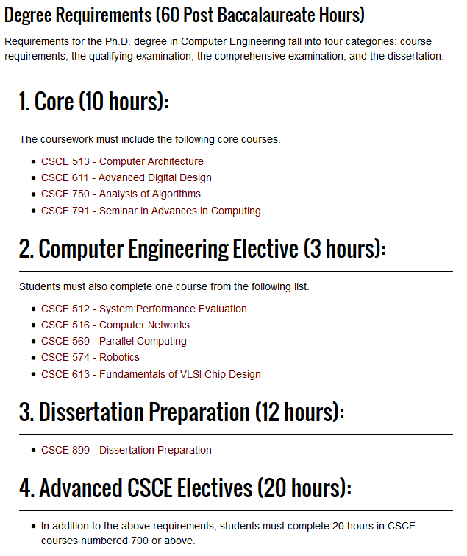
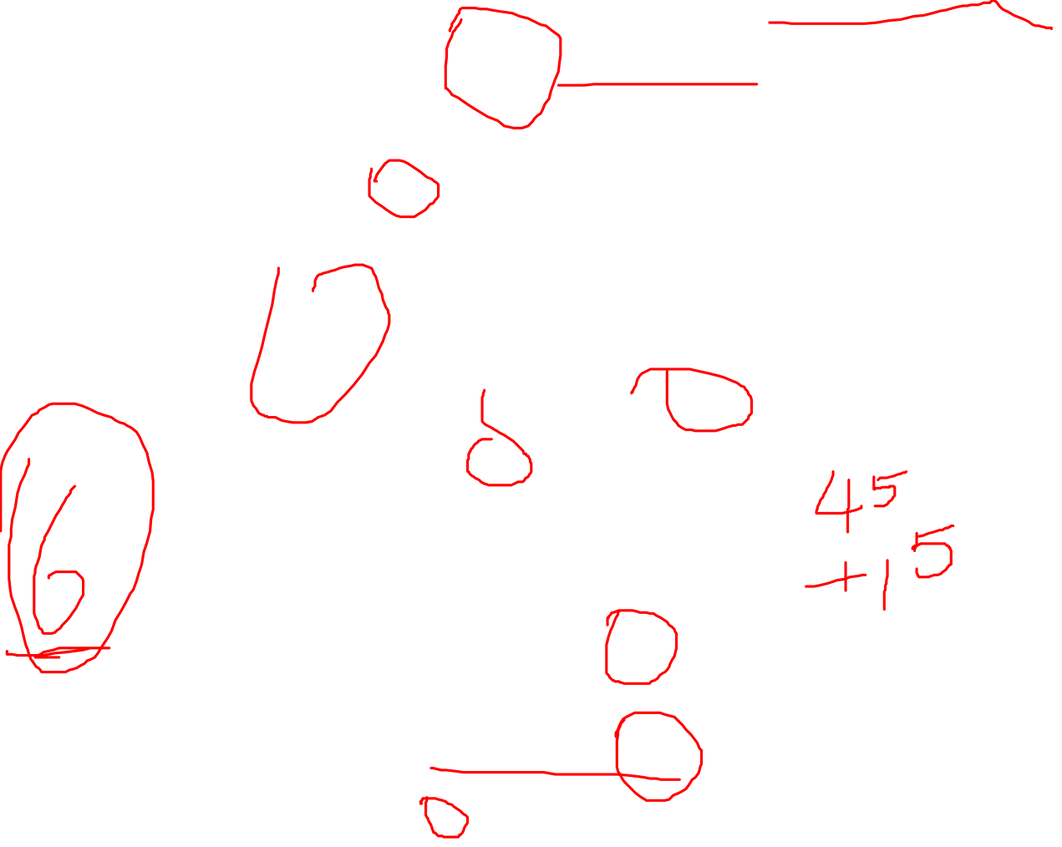
Course Requirement (CE Ph.D.)

Slide 17
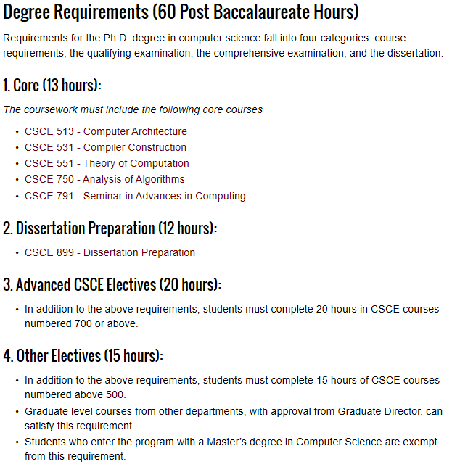
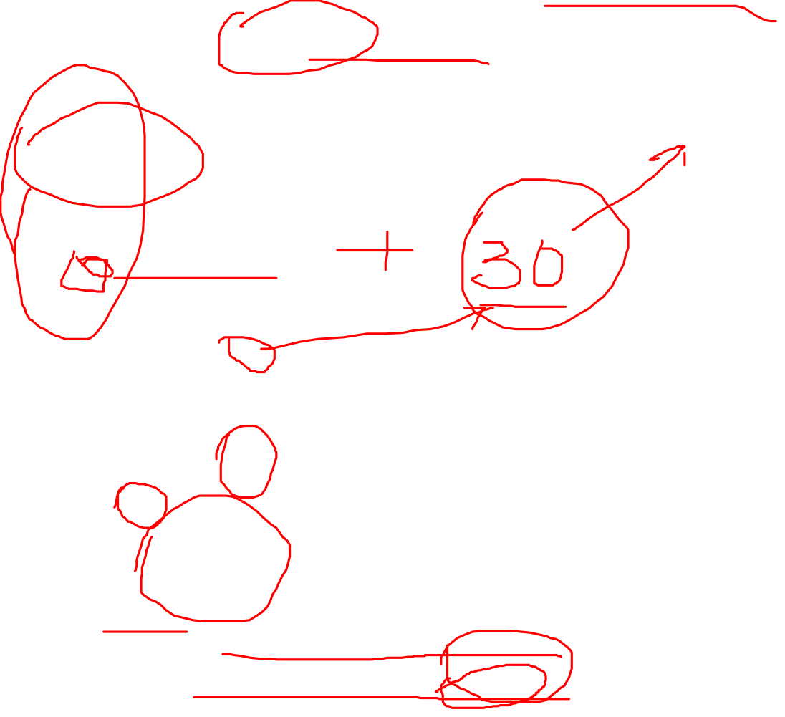
Course Requirement (CS Ph.D.)

Slide 18
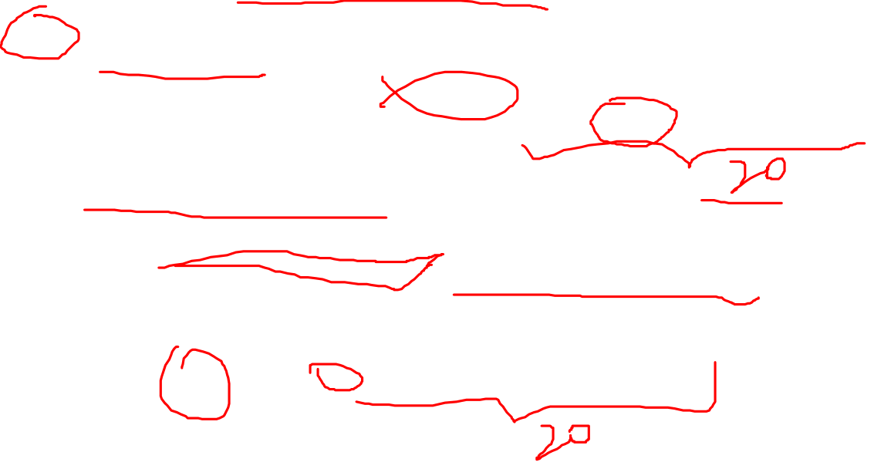
Course Plan (Ph.D., CS)
If you do not have a Master Degree
  60 hours including
    Five core courses (CSCE 513, CSCE 531, CSCE 551, CSCE 750, CSCE 791)
    At least 24 credits of CSCE 700-level
      CSCE 750 (3) + CSCE 791 (1-3) + CSCE 798 (0-9) + other 700 level
    12 hours of dissertation
    15 hours of other electives
If you have a Masters Degree
  Three 500-level core courses (CSCE 513, CSCE 531, CSCE 551)
  Present your transcript to Dr. Tang and evaluate if you need these core courses (MS in CS)
  At least 24 credits of CSCE 700-level
    CSCE 750 (3) + CSCE 791 (1-3) + CSCE 798 (0-9) + other 700 level
  Other courses might be needed
  12 hours of dissertation

Slide 19
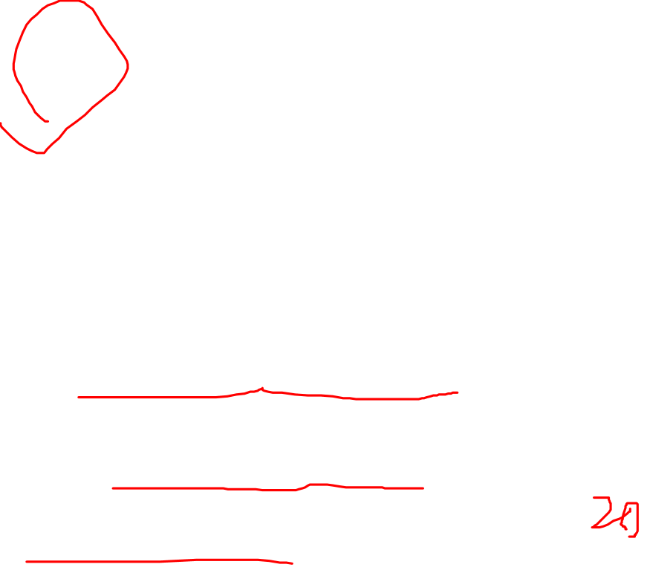
Course Plan (Ph.D., CE)
If you do not have a Master Degree
  60 hours including
    Four core courses (CSCE 513, CSCE 611, CSCE 750, CSCE 791)
    one CE elective
    At least 24 credits of CSCE 700-level
      CSCE 750 (3) + CSCE 791 (1-3) + CSCE 798 (0-9) + other 700 level
    15 hours of other electives
    12 hours of dissertation
If you have a Masters Degree
  Core courses (CSCE 513, CSCE 611)
  Present your transcript to Dr. Tang and evaluate if you need these core courses (MS in CE)
  At least 24 credits of CSCE 700-level
    CSCE 750 (3) + CSCE 791 (1-3) + CSCE 798 (0-9) + other 700 level
  Other courses might be needed
  12 hours of dissertation

Slide 20
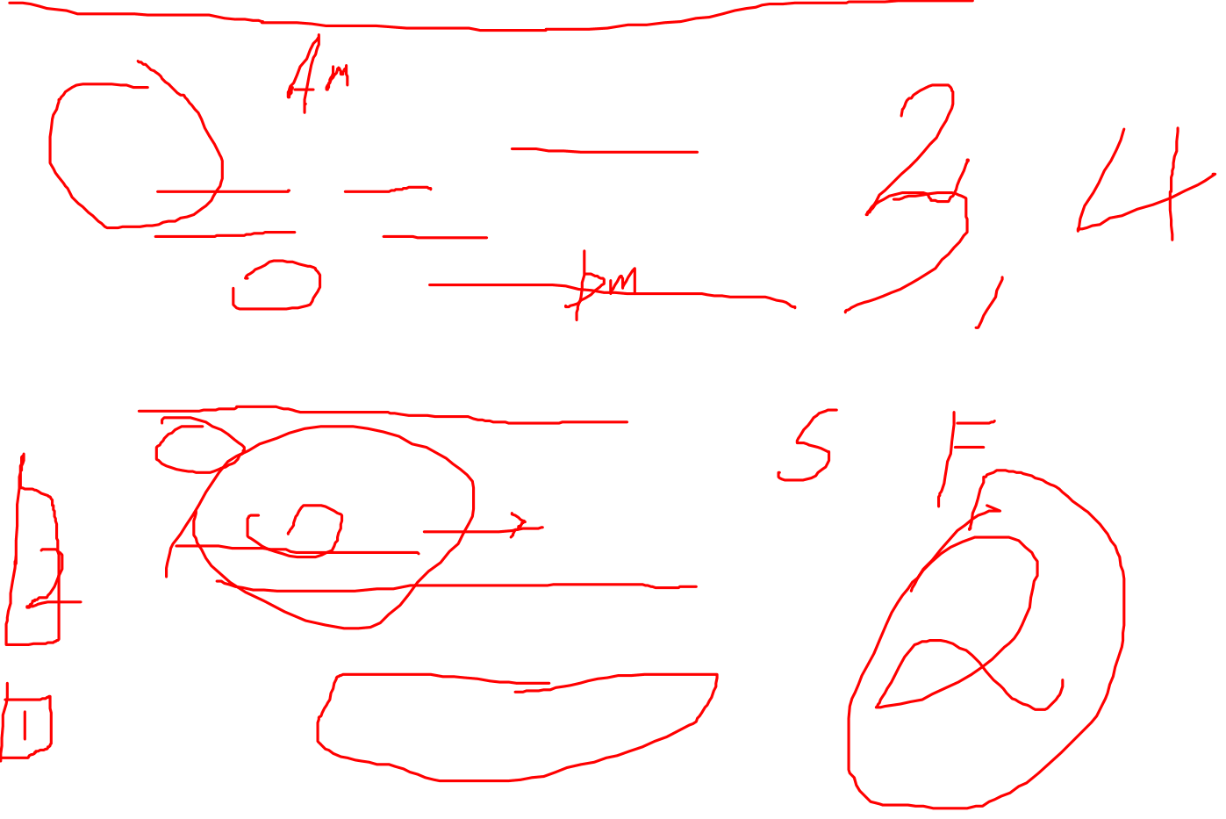
Qualifying Exam (Ph.D.)
Two written exams on core courses
  Algorithms or Theory
  Architecture or Compilers
One written exam on research area of your choice
  Generally on the course close to your research
Time and Q&A sessions
  Beginning of Fall/Spring semester
  Q&A
Constraints
  Only two attempts
  You do not need to take all exams at once
https://cse.sc.edu/~fenner/qexam/index.html

Slide 21
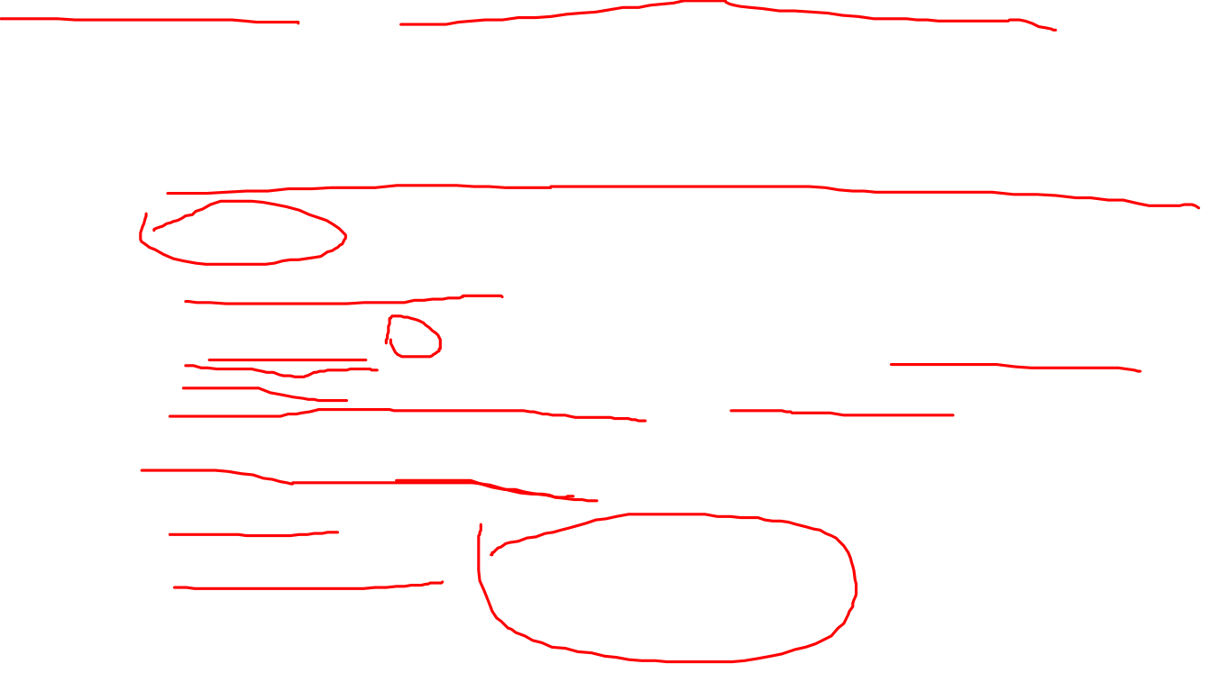
Proposal & Comprehensive Exam (Ph.D.)
Nine month gap between proposal and graduation
Proposal:
  Oral Presentation
  Committee: 5 at least, one must from outside CSE
  40 minutes presentation, followed by Q&A
Comprehensive exam:
  Required
  Written exam – the written proposal

Slide 22
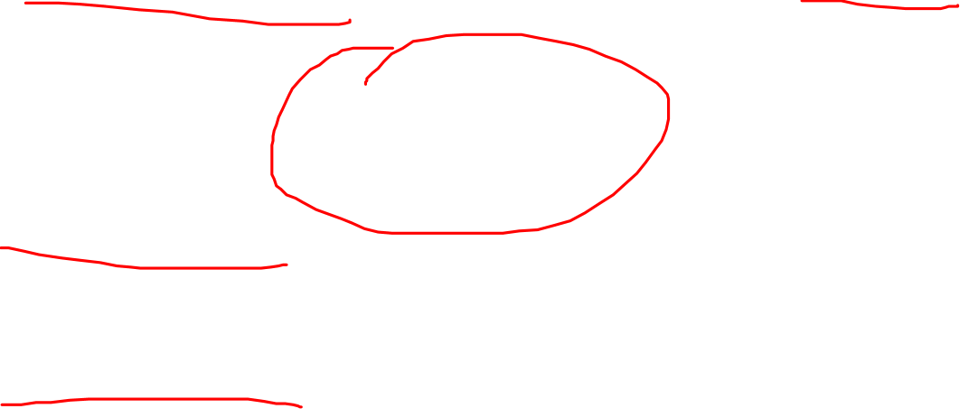
Graduation (Ph.D.)
Expected number of publications: >=3
Where to publish
  http://www.guide2research.com/topconf/
  www.wikicfp.com
Internship
  Encouraged
  Summer

Slide 23

Finding Advisors (Ph.D.)

Slide 24
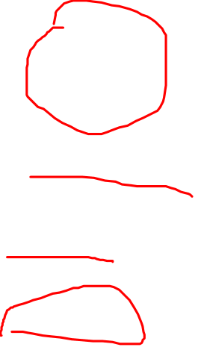
Labs
Areas | Faculty Members | Current Students
Bioinformatics / Computational Biology | Jianjun Hu John Rose Homayoun Valafar
Computer Vision | Yan Tong Song Wang
Robotics | Jason O’Kane Ioannis Rekleitis
Security | Csilla Farkas Chin-tser Huang Lisa Luo Qiang Zeng

Slide 25

Labs – Cont’d
Areas | Faculty Members | Current Students
Software Engineering | Pooyan Jamshidi Qiang Zeng
Network | Srihari Nelakuditi Sur Sanjib
High Performance Computing | Jason Bakos Ramtin Zand
Multi Agent | Jose Vidal
Theory | Steve Fenner Marco Valtorta
AI Institute | Amit Sheth Forest Agostinelli Biplav Srivastava Qi Zhang

Slide 26
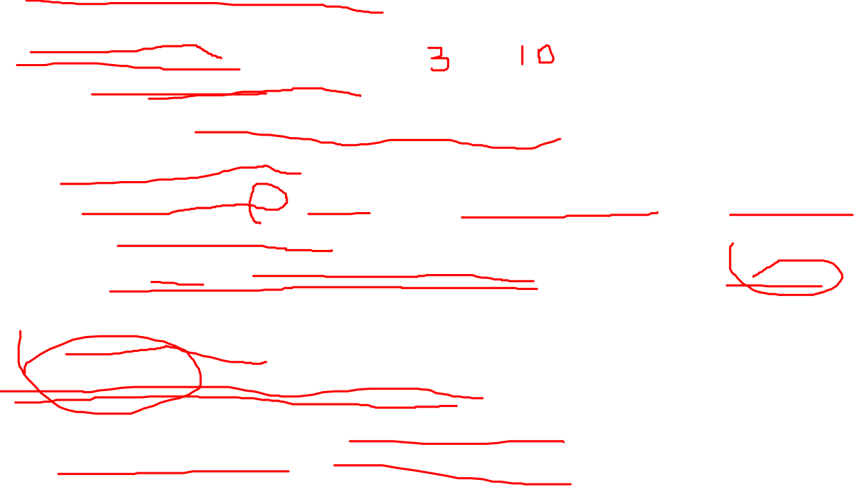
Major Requirements
Residence requirement
Advisement
  Held each semester (mid)
  Must be advised before registering classes
Academic Standing
  GPA Must be >=3.0 overall and for 700-level courses and all courses on the program of study
  If below 3.0 for two consecutive semesters, will result in suspension from the university
  Petition to extend
Application for graduation
  Must apply through the graduate school
  Early in the semester you plan to graduate

Slide 27
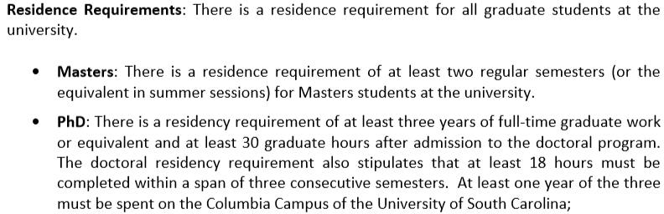
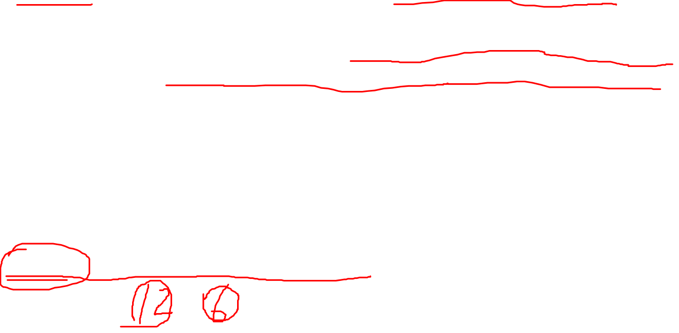
Residence Requirement
1. 3 courses per semester is considered normal/heavy
2. 6 hours required for international students with TA/RA support
3. Ph.D. students suggested 6 hours max per semester if possible
4. Z-status can be obtained (1 hour per semester)

Slide 28
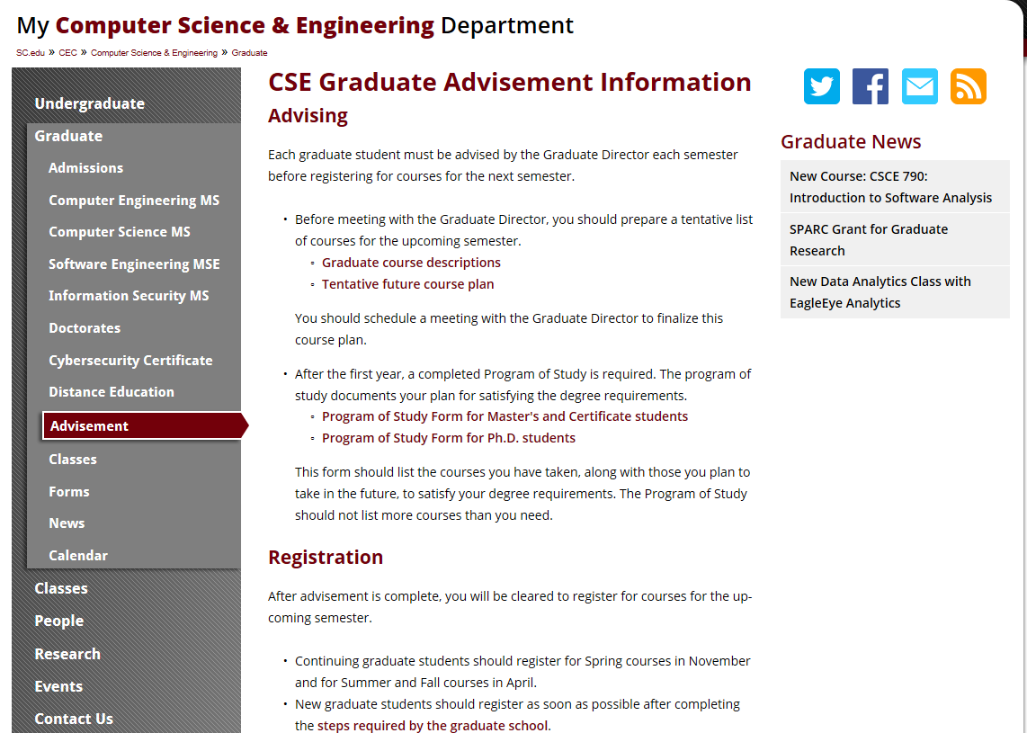
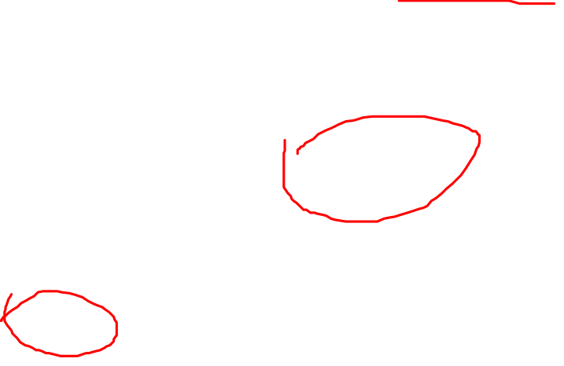
www.cse.sc.edu

Slide 29
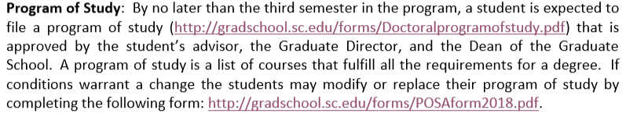

Program of Study

Slide 30
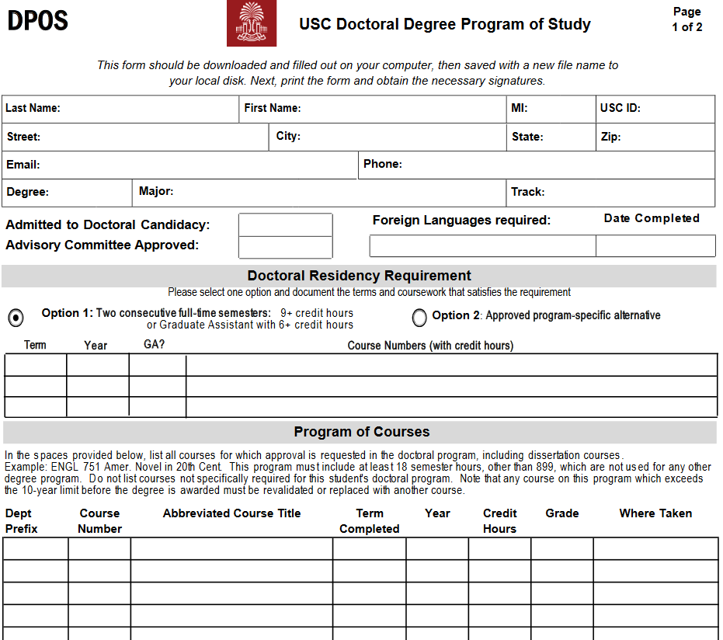
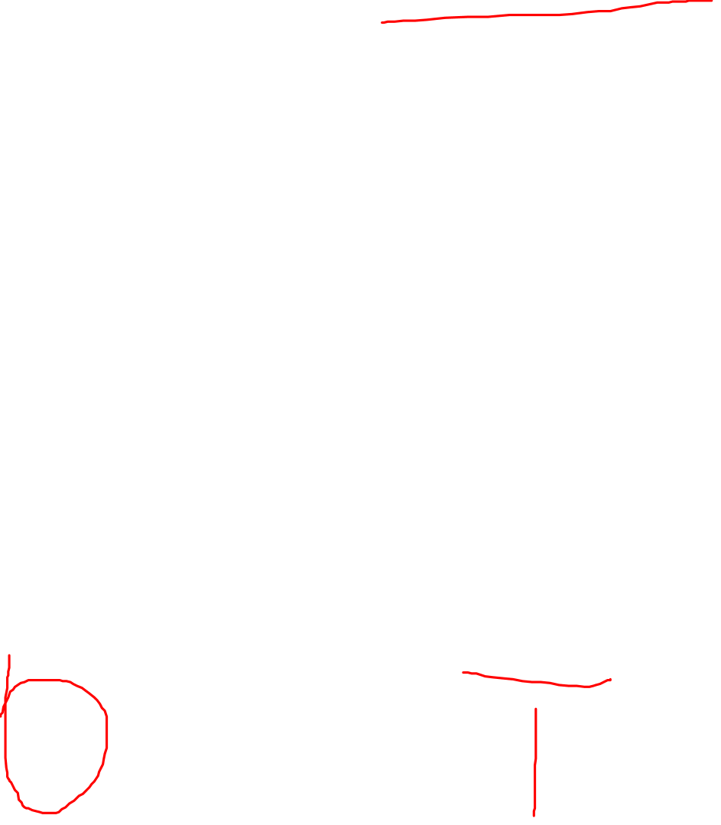

Slide 31
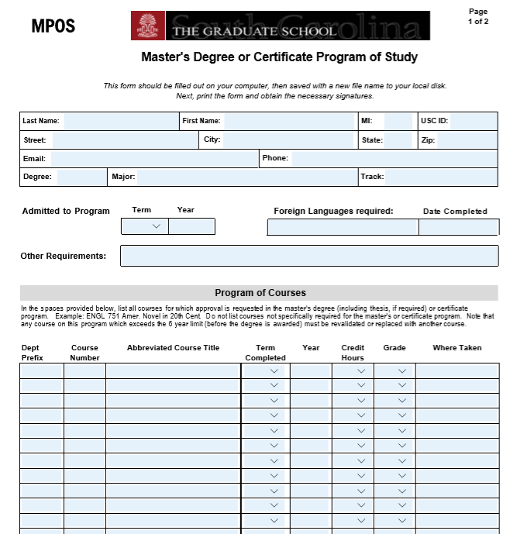
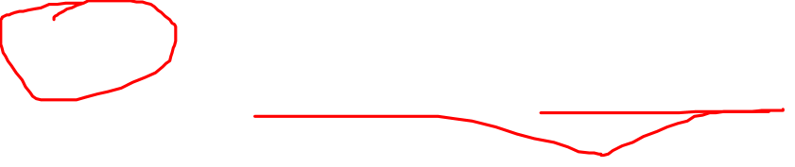

Slide 32
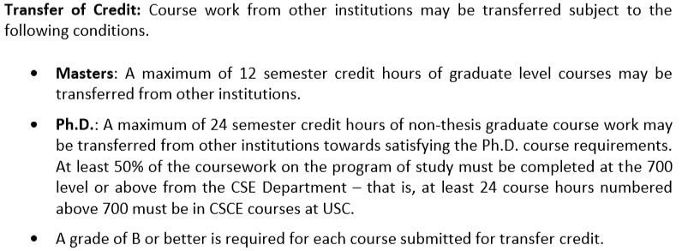
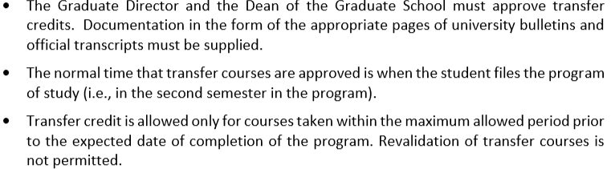
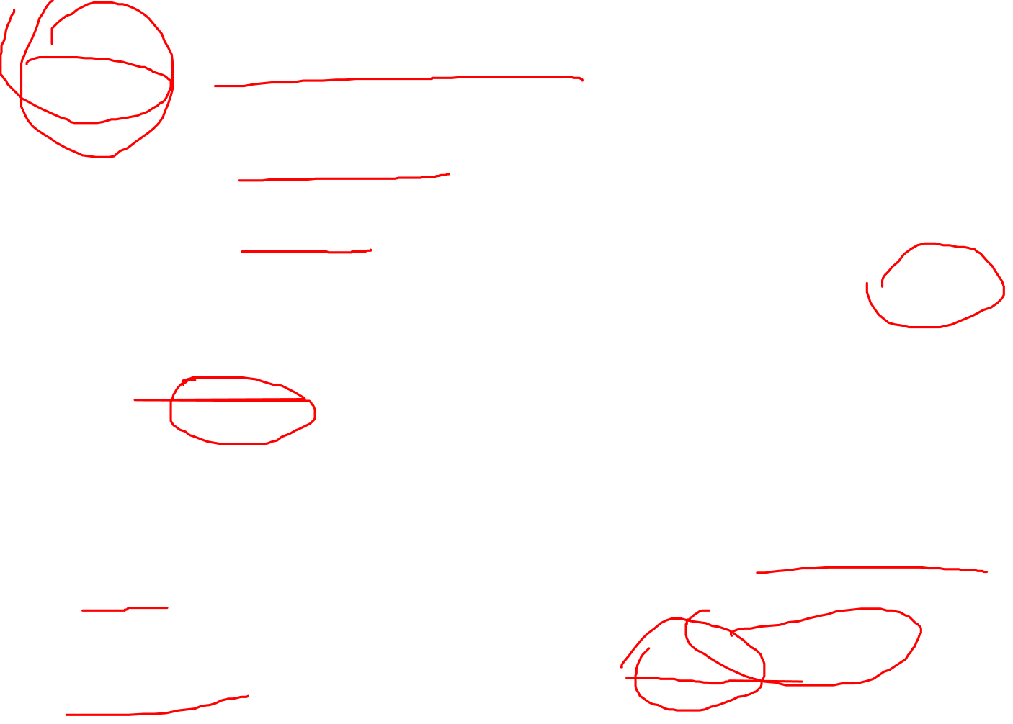

Slide 33
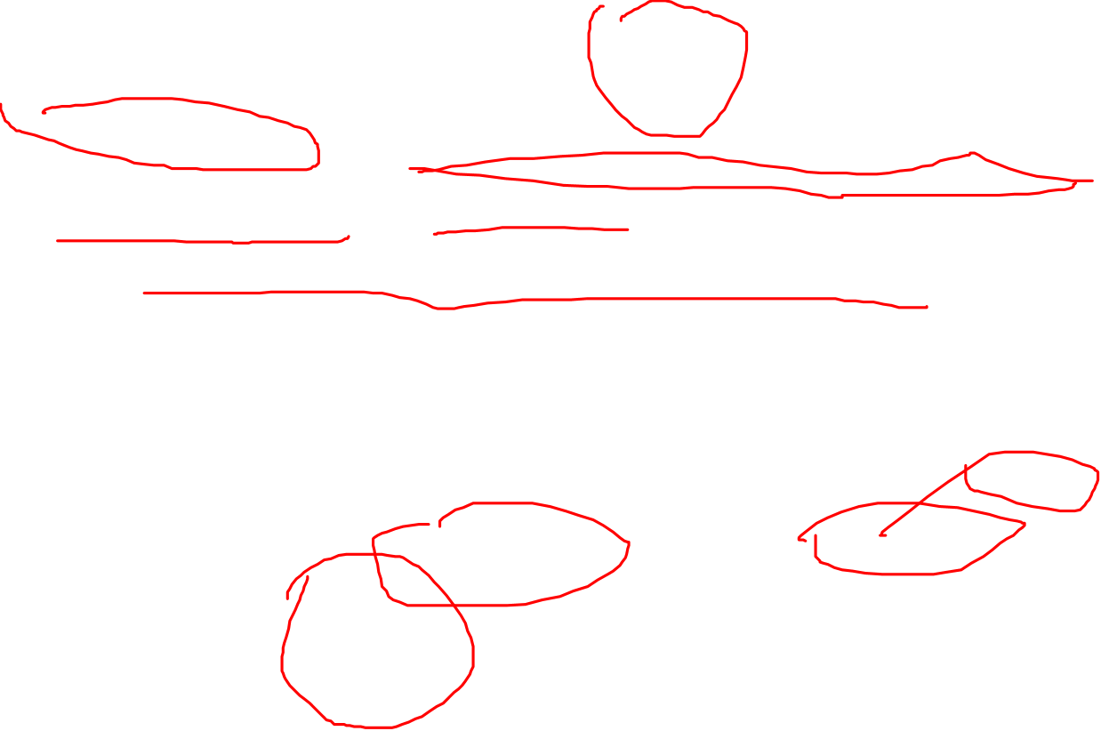
Evaluation for TA Assignment
Limited TA positions. No guarantee for future TA positions.
Enrolled full-time & GPA >=3.0
Graduate Committee performs evaluation on academic performance considering the factors such as
  Number of years in the program
  Number of semesters have previously been supported as a TA
  Status of completing milestones, e.g, having a dissertation advisor, submission of program of study, attempting/passing qualifying exam, passing dissertation proposal
  Number of published papers as first/second/third/fourth author
  Number of submitted papers as first/second author
  Awards
  Evaluation of performance as an RA or TA
Information will be collected during the advisement via the signed advisement form

Slide 34
Questions?

