Slide 1
Probabilistic Networks
Adapted from
Rina Dechter. "Probabilistic Networks." Chapter 14 in Constraint Processing. San Francisco: Morgan Kaufmann, 2003.
Noah Geveke

Slide 2
Probabilistic networks
Also called belief networks or Bayesian networks
Provide a formal way to reason about partial beiefs under conditions of uncertainty

Slide 3
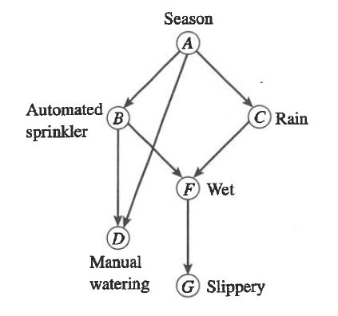
Probabilistic Networks
A directed acyclical graph (DAG)
Each node represents a random variable
Temperature
Gender
Each edge represents a direct causal influence

Slide 4
Three queries
Belief Assessment
Using known information (evidence) compute the posterior probability of each variable not included in the evidence
Finding the most probable explanation
Given some observed variables find a maximum probability assignment for all unobserved variables
Finding the maximum a posteriori hypothesis
Given some observed variables find a probability assignment to a subset of the unobserved variables that maximizes their conditional probability

Slide 5
Methods
These queries become very challenging using multiply connected networks
Algorithms have been developed that solve these problems
Join-tree clustering
Cycle-cutset approach
Variable elimination

Slide 6
Variable Elimination
We have evidence that g=1
Using this evidence compute P(a,g=1)

Slide 7
Variable Elimination Derivation

Slide 8
Variable Elimination Derivation

Slide 9
Variable Elimination Derivation

Slide 10
Elim-Bel Algorithm

Slide 11
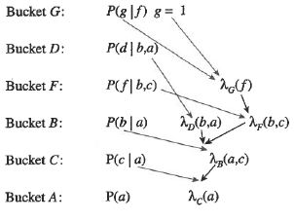
Bucket Diagram

Slide 12
Elim-MPE

Slide 13
Elim-MPE
Similar to the bucket elimination
Requires maximum probability
Final step is to transverse through the bucket order
Calculate argmax of current bucket using previously calculated argmax

Slide 14
Adjusted Induced Width
Used to calculate the complexity of the Elim-BEL and Elim-MPE algorithms

Slide 15
Complexity

Slide 16
Search and Probabilistic Reasoning

Slide 17
Search and Probabilistic Reasoning
Traversing the tree from first variable to last in a depth first manner

Slide 18
Elim-Cond-Bel
Let Y be a subset of conditioned variables of the set X
Let V = X – Y
v is an assignment to V
ý is an assignment to Y

Slide 19
Elim-Cond-Bel

Slide 20
Elim-Cond-Bel algorithm

Slide 21
Complexity of Elim-Cond-Bel

Slide 22
Elim-Cond-Bel-Dy

Slide 23
Cycle Cutset
Set of vertices that when removed will result in a moral graph with no cycles

Slide 24
Cycle Cutset
Set of vertices that when removed will result in a moral graph with no cycles

Slide 25
Cycle Cutset
Leads to Adjusted Induced Width of 1
Elim-Cond-Bel reduces to cycle-cutset Algorithm

Slide 26
Summary
Probabilistic networks represent uncertainty
Bucket Algorithms can be used to update beliefs and find a most probable explaination
Search and other hybrid algorithms can also be used

