Slide 1
Directional Resolution: The Davis-Putnam Procedure, Revisited
Presented by Omar and Walker

Slide 2
Table of Contents
History of Directional Resolution
Definitions and Preliminaries
DP-elimination – Directional Resolution
Tractable Classes
Bounded Directional Resolution
Experimental Evaluation
Related Work and Conclusions
Acknowledgements

Slide 3
History of Directional Resolution
First Introduced in 1960 by Davis and Putnam
  Proved that a restricted amount of resolution performed systematically along with order of the atomic formulas is sufficient for deciding satisfiability.
  Received little attention due to worst-case exponential behavior.
  Overshadowed by The Davis-Putnam Procedure

Slide 4
The Davis-Putnam Procedure
The second algorithm searches through the space of possible truth assignments while performing unit resolution until quiesience at each step.
Is similar to the first algorithm
  The elimination step was replaced with the splitting rule to avoid the memory explosion problem

Slide 5
Elimination vs. Backtracking
We will call DP-Elimination
  Proved that a restricted amount of resolution performed systematically along with order of the atomic formulas is sufficient for deciding satisfiability
We will call DP-Backtracking
  The second algorithm searches through the space of possible truth assignments while performing unit resolution until quiesience at each step.

Slide 6
Elimination vs. Backtracking
DP-Elimination
  Uses the Elimination Rule
DP-Backtracking
  Replaces the Elimination Rule with the Splitting Rule.
  This avoids memory explosion

Slide 7
Purpose
This paper wishes to prove the following:
  That both methods are not the same
  Show the virtues of the DP-Elimination
    It is Satisfiabile (2-cnfs and Horn Clauses)
    Tractable Classes
    Good performance for Chain-like Structures

Slide 8
Definitions and Preliminaries
Variables
  (Uppercase Letters) P,Q,R,…
Propositional Literals
  (Lowercase Letters) p,q,r,…
Disjunctions of Literals
  α, β, …
  Sometimes denoted as a set { … }
  Unit Clause
    A clause of size 1

Slide 9
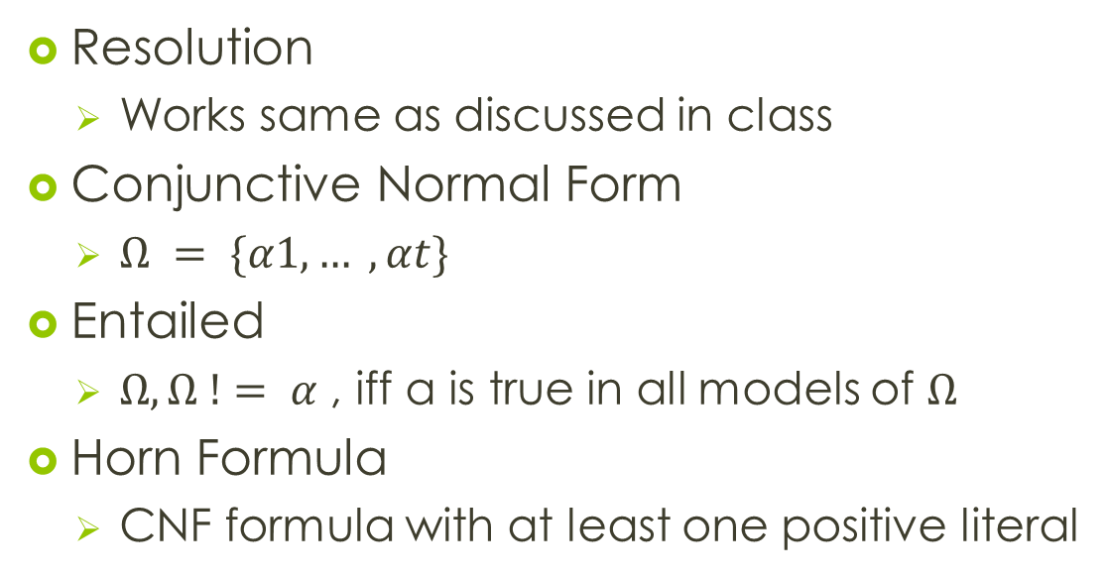
Definitions and Preliminaries
Resolution
  Works same as discussed in class
Conjunctive Normal Form
  $Ω = \{α1, … , αt\}$
Entailed
  $Ω, Ω != α$, iff α is true in all models of $Ω$
Horn Formula
  CNF formula with at least one positive literal

Slide 10
Definitions and Preliminaries
Definite Formula
  A cnf formula that has exactly one positive literal
Positive Formula
  If it only contains positive literals
Negative Formula
  If it only contains negative literals
K-cnf Formula
  Clauses all have length k or less

Slide 11
What is DP-Elimination?
Ordering-based restricted resolution algorithm
  Given Arbitrary ordering
  To each Clause, assign the index of the highest literal in each Clause
  Then resolve only Clauses having the same index.
  This creates a systematic elimination of literals.
  Also remove literals
    only negative
    only positive

Slide 12
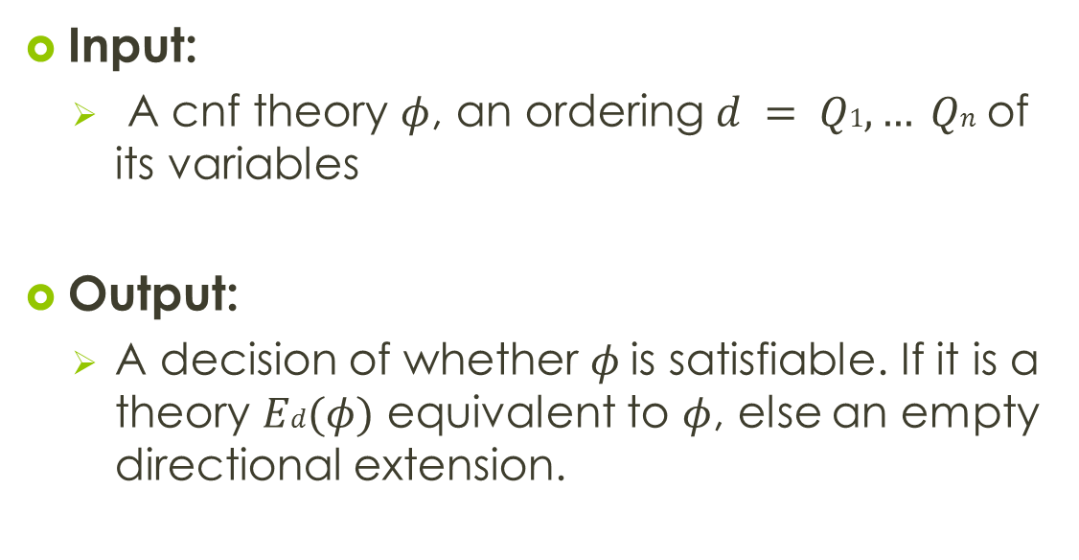
Directional-Resolution
Input:
  A cnf theory $φ$, an ordering $d = Q1, … Qn$of its variables
Output:
  A decision of whether $φ$is satisfiable. If it is a theory $Ed(φ)$ equivalent to $φ$, else an empty directional extension.

Slide 13
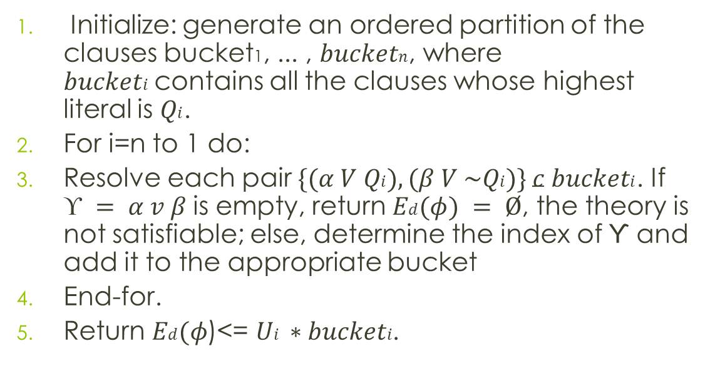
Directional-Resolution
Initialize: generate an ordered partition of the clauses bucket1, ... , $bucketn$, where $bucketi$contains all the clauses whose highest literal is $Qi$.
For i=n to 1 do:
Resolve each pair $\{(α V Qi), (β V \sim Qi)\} c bucketi$. If $ϒ = α v β$is empty, return $Ed(φ) = Ø$, the theory is not satisfiable; else, determine the index of ϒ and add it to the appropriate bucket
End-for.
Return $Ed(φ$)<= $Ui ∗bucketi$.

Slide 14
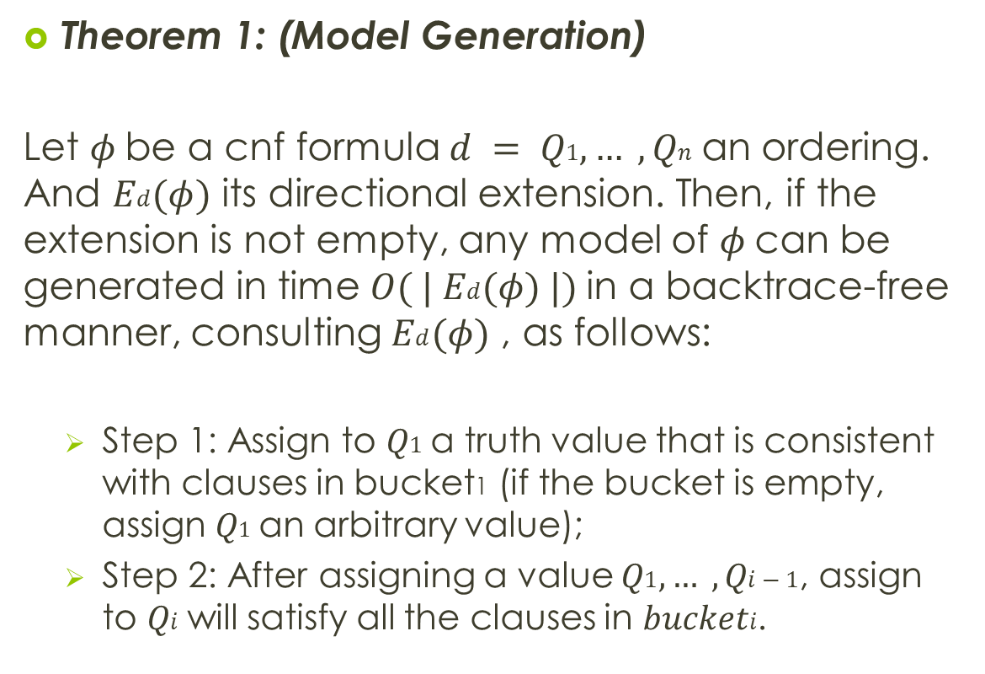
Theorem 1: (Model Generation)
Let $φ$be a cnf formula $d = Q1, … , Qn$an ordering. And $Ed(φ)$ its directional extension. Then, if the extension is not empty, any model of $φ$can be generated in time $O( | Ed(φ) |)$in a backtrace-free manner, consulting $Ed(φ)$ , as follows:
  Step 1: Assign to $Q1$a truth value that is consistent with clauses in bucket1 (if the bucket is empty, assign $Q1$an arbitrary value);
  Step 2: After assigning a value $Q1, … , Qi−1$, assign to $Qi$will satisfy all the clauses in $bucketi$.

Slide 15
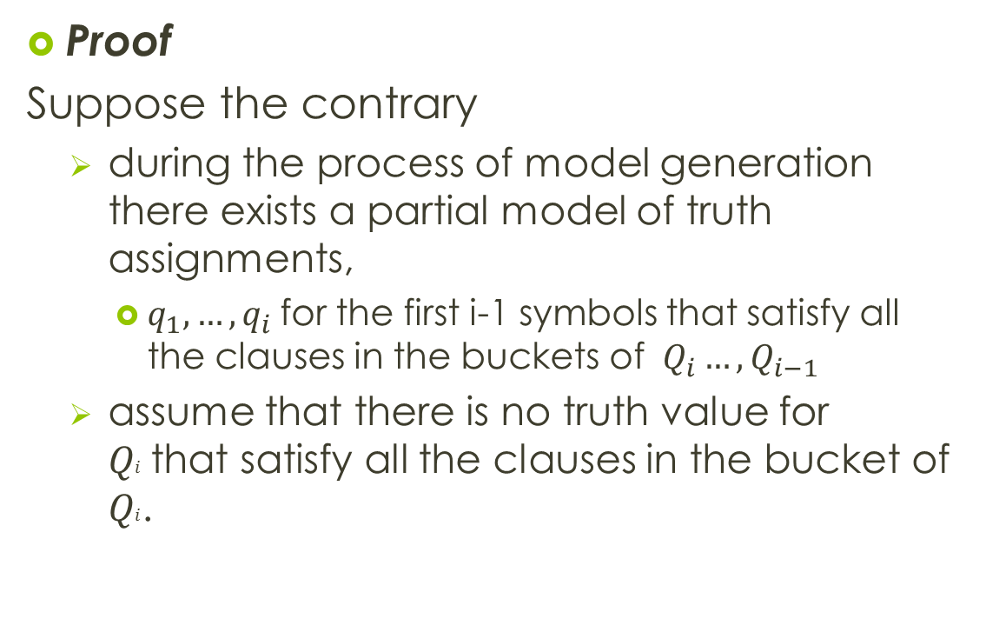
Proof
Suppose the contrary
  during the process of model generation there exists a partial model of truth assignments,
    $q_{1}, …, q_{i}$for the first i-1 symbols that satisfy all the clauses in the buckets of $Q_{i}…, Q_{i−1}$
  assume that there is no truth value for $Qi$that satisfy all the clauses in the bucket of $Qi$.

Slide 16
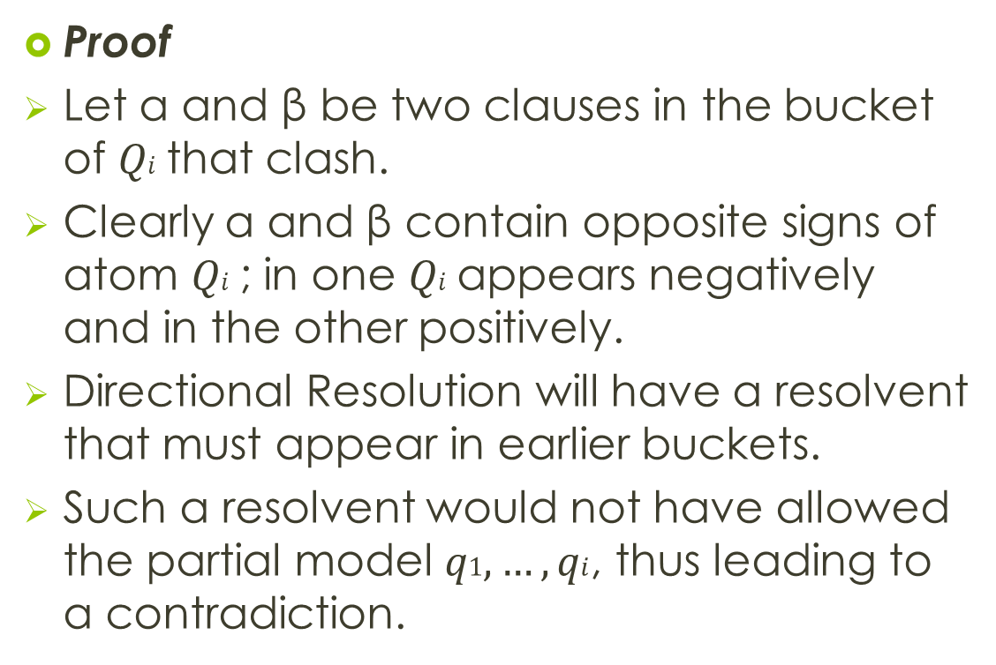
Proof
Let α and β be two clauses in the bucket of $Qi$that clash.
Clearly α and β contain opposite signs of atom $Qi$; in one $Qi$appears negatively and in the other positively.
Directional Resolution will have a resolvent that must appear in earlier buckets.
Such a resolvent would not have allowed the partial model $q1, …, qi$, thus leading to a contradiction.

Slide 17
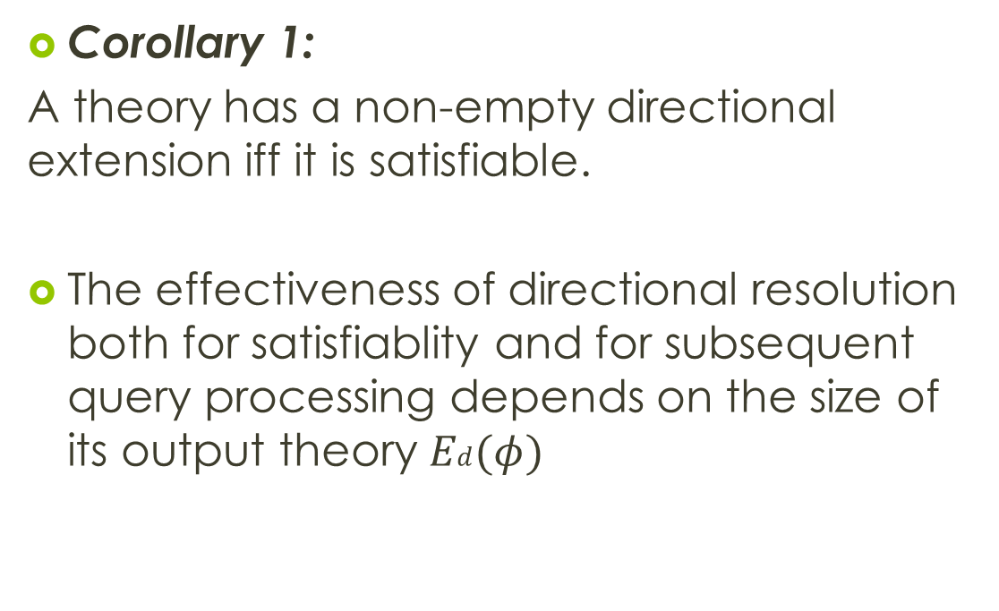
Corollary 1:
A theory has a non-empty directional extension iff it is satisfiable.
The effectiveness of directional resolution both for satisfiablity and for subsequent query processing depends on the size of its output theory $Ed(φ)$

Slide 18
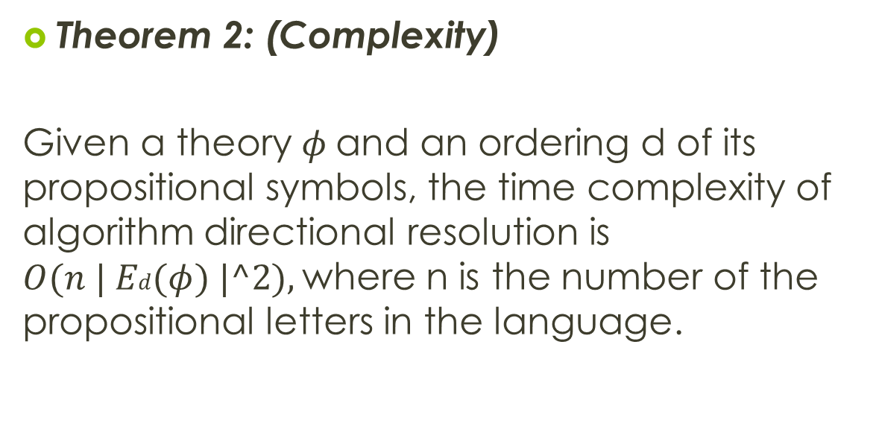
Theorem 2: (Complexity)
Given a theory $φ$and an ordering d of its propositional symbols, the time complexity of algorithm directional resolution is $O(n | Ed(φ) |^2),$where n is the number of the propositional letters in the language.

Slide 19
Proof
There are at most n buckets, each containing no more clauses than the final theory, and resolving pairs of clauses in each bucket is a quadratic operation.
Shows that the algorithm depends on the size of the resulting output.

Slide 20
Entailment
Checking clauses for literals.
  If a literal appears it is a unit clause, it is entailed.
  If no literals, negate and insert the literals
  If empty clause is generated, the literal is entailed.
Arbitrary Clauses
  Add each negated literal to the appropriate buckets
  Restart process with highest bucket.
This suggests that the symbols of the subsets should appear early in the ordering.

Slide 21
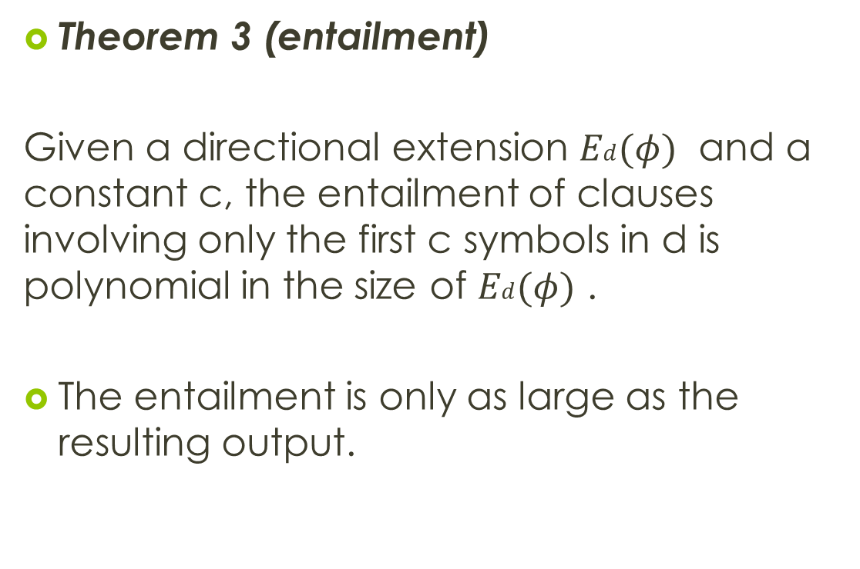
Theorem 3 (entailment)
Given a directional extension $Ed(φ)$ and a constant c, the entailment of clauses involving only the first c symbols in d is polynomial in the size of $Ed(φ)$ .
The entailment is only as large as the resulting output.

Slide 22
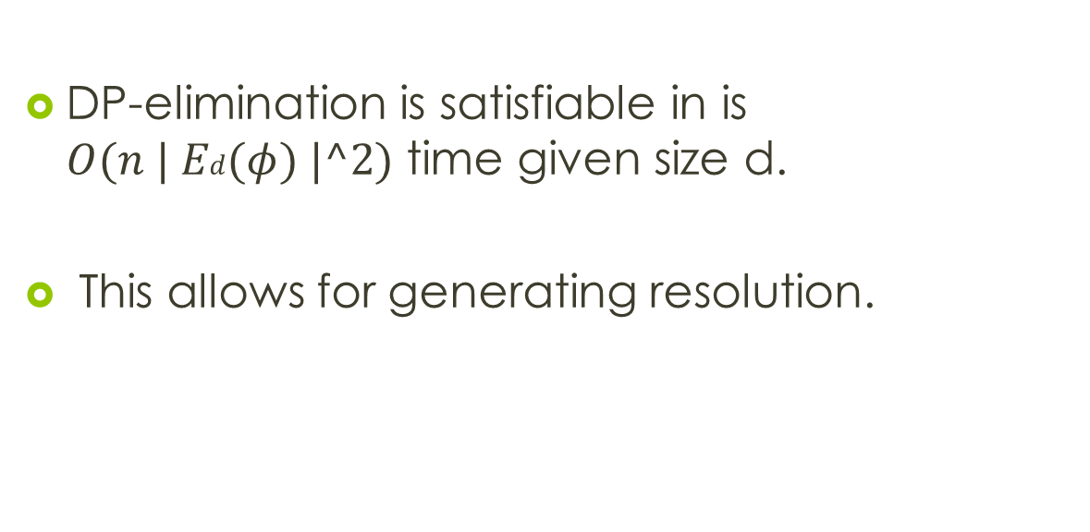
Conclusion thus far
DP-elimination is satisfiable in is $O(n | Ed(φ) |^2)$ time given size d.
This allows for generating resolution.

Slide 23
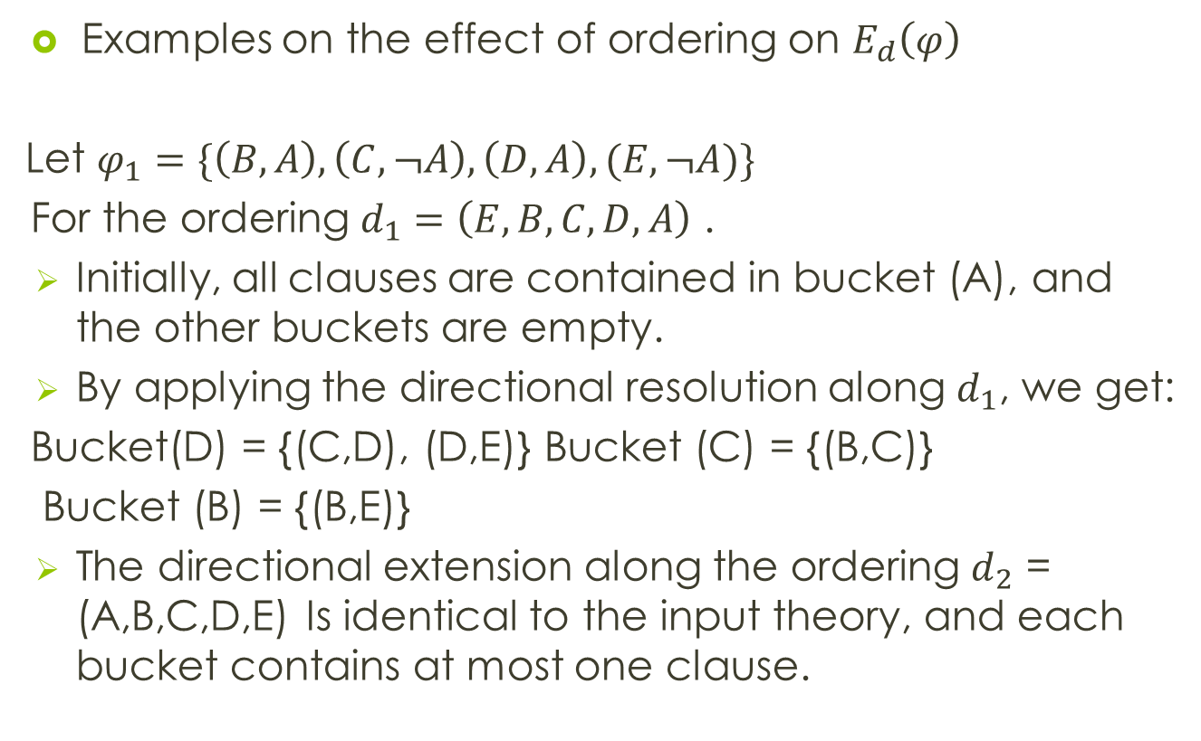
Examples on the effect of ordering on $E_{d}\left(φ\right)$
Let $φ_{1}=\{\left(B,A\right), \left(C,¬A\right),\left(D,A\right), (E,¬A)\}$
For the ordering $d_{1}=\left(E,B,C,D,A\right)$ .
Initially, all clauses are contained in bucket (A), and the other buckets are empty.
By applying the directional resolution along $d_{1}$, we get:
Bucket(D) = {(C,D), (D,E)} Bucket (C) = {(B,C)}
Bucket (B) = {(B,E)}
The directional extension along the ordering $d_{2}$ = (A,B,C,D,E) Is identical to the input theory, and each bucket contains at most one clause.

Slide 24

Note that the interactions among clauses play an important role in the effectiveness of the algorithm, and suggests ordering that yields smaller extensions
Examples on the effect of ordering on $E_{d}\left(φ\right)$
Let $φ_{2}=\{\left(¬A,B\right), \left(A,¬C\right),\left(¬B,D\right), (C,D,E)\}$
The directional extensions of $φ$ along the ordering $d_{1}=\left(A,B,C,D,E\right) and d_{2}=\left(D,E,C,B,A\right)are E_{d1}\left(φ\right)=φ and{ E}_{d2}\left(φ\right)= φ∪\{\left(B,¬C\right),\left(¬C,D\right),\left(E,D\right)\}$

Slide 25
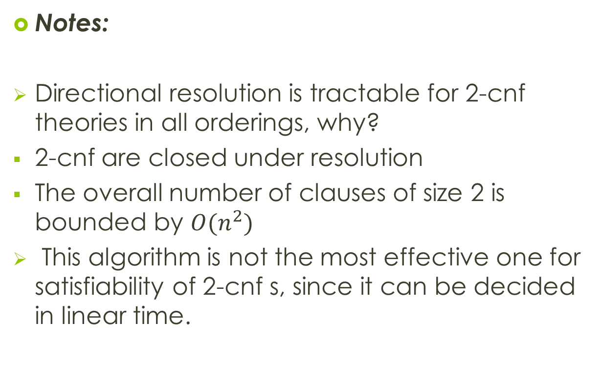
Notes:
Directional resolution is tractable for 2-cnf theories in all orderings, why?
2-cnf are closed under resolution
The overall number of clauses of size 2 is bounded by $O(n^{2})$
This algorithm is not the most effective one for satisfiability of 2-cnf s, since it can be decided in linear time.

Slide 26
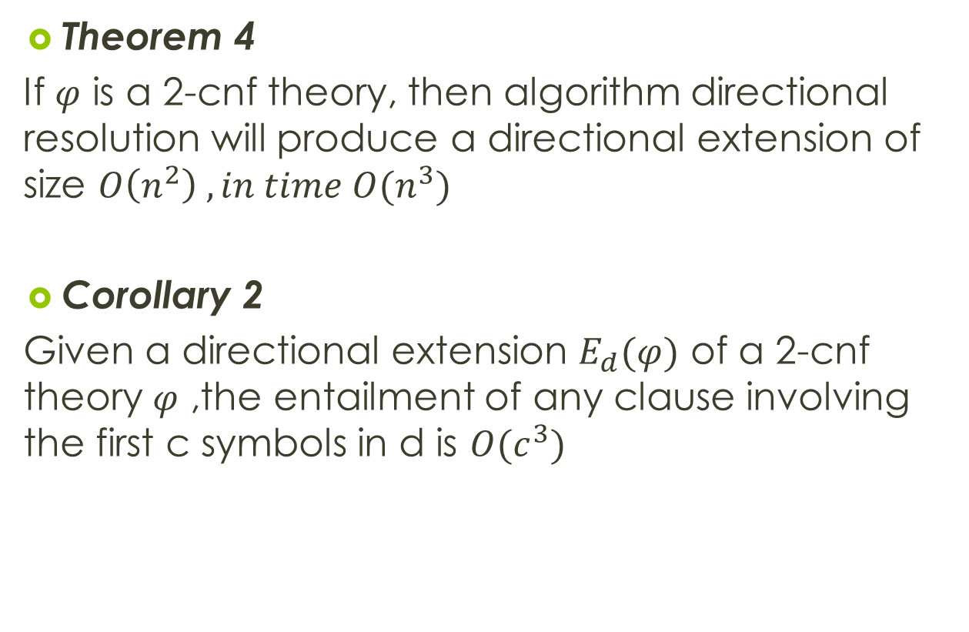
Theorem 4
If $φ$ is a 2-cnf theory, then algorithm directional resolution will produce a directional extension of size $O\left(n^{2}\right) , in time O(n^{3})$
Corollary 2
Given a directional extension $E_{d}(φ)$ of a 2-cnf theory $φ$ ,the entailment of any clause involving the first c symbols in d is $O(c^{3})$

Slide 27

Induced width
Let $φ= φ(Q_{1},…..,Q_{n})$ be a cnf formula defined over the variables $Q_{1},…..,Q_{n}$
The interaction graph of $φ$, denoted $G(φ)$, is an undirected graph that contains one node for each propositional variable and an arc connecting any two nodes whose associated variables appear in the same clause

Slide 28

Example
Let $φ_{2}=\{\left(¬A,B\right), \left(A,¬C\right),\left(¬B,D\right), (C,D,E)\}$
The interaction graph is

Slide 29
Definition 1
Given a graph G and an ordering of its nodes D, the parent set of node A relative to d is the set of nodes connected to A that precede A in the ordering d.
The width of A relative to d: size of this parent set
The width w(d) of an ordering d: the maximum width of nodes along the ordering
The width w of a graph: the minimal width of all its orderings

Slide 30
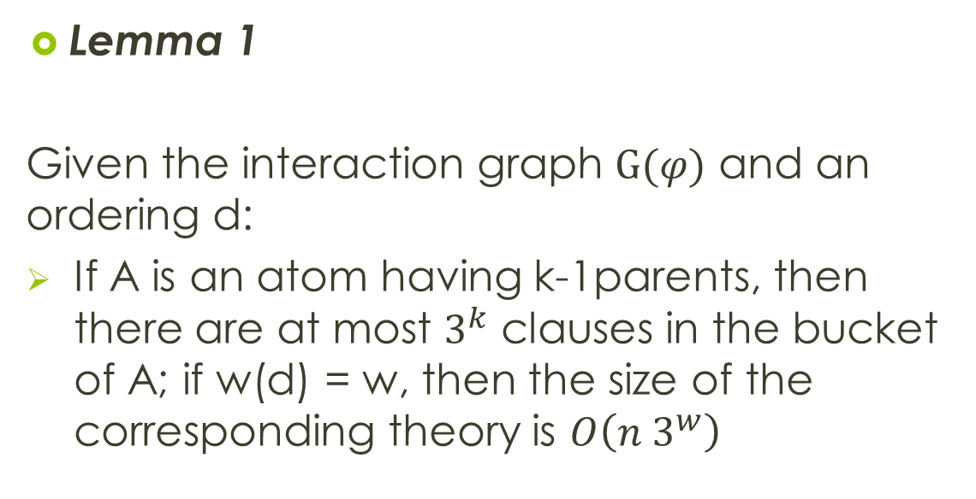
Lemma 1
Given the interaction graph $G(φ)$ and an ordering d:
If A is an atom having k-1parents, then there are at most $3^{k}$ clauses in the bucket of A; if w(d) = w, then the size of the corresponding theory is $O\left(n 3^{w}\right)$

Slide 31
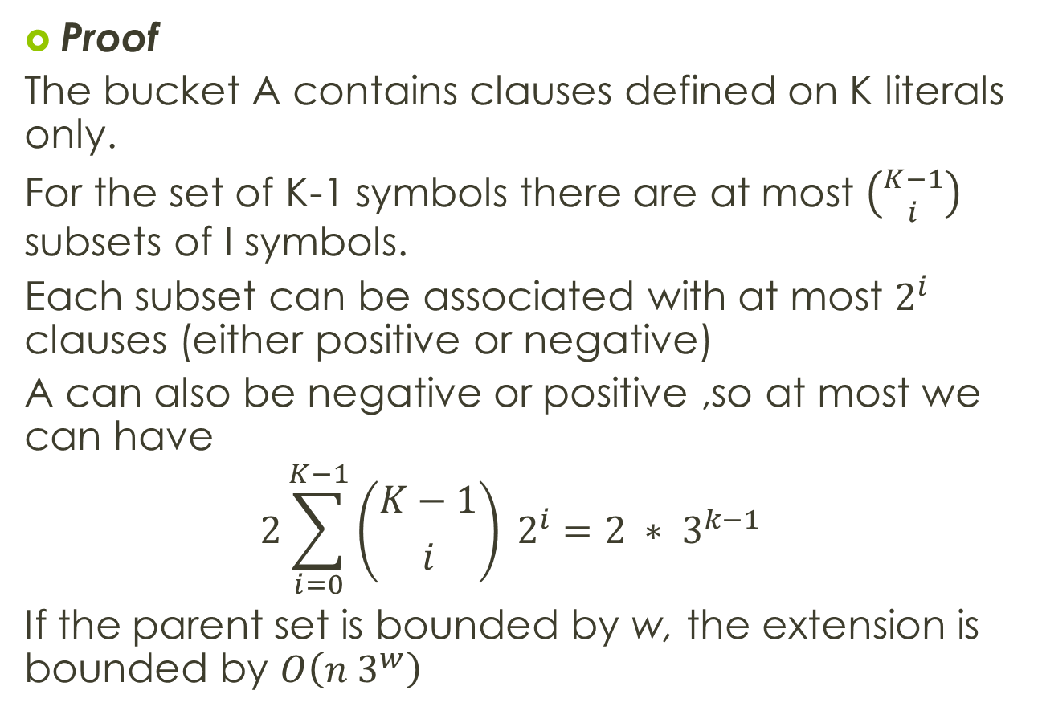
Proof
The bucket A contains clauses defined on K literals only.
For the set of K-1 symbols there are at most $\left({K−1 \atop i}\right)$ subsets of I symbols.
Each subset can be associated with at most $2^{i}$ clauses (either positive or negative)
A can also be negative or positive ,so at most we can have
$$2\sum_{i=0}^{K−1}{\left({K−1 \atop i}\right) 2^{i}=2 ∗ 3^{k−1}}$$
If the parent set is bounded by w, the extension is bounded by $O\left(n 3^{w}\right)$

Slide 32
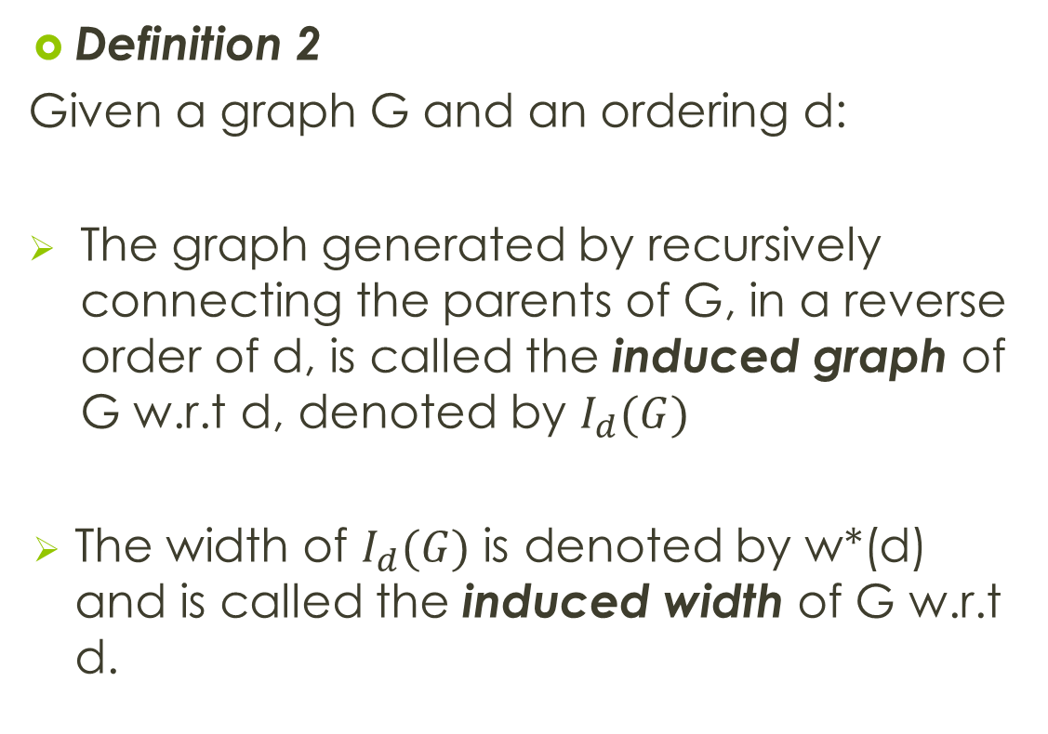
Definition 2
Given a graph G and an ordering d:
The graph generated by recursively connecting the parents of G, in a reverse order of d, is called the induced graph of G w.r.t d, denoted by $I_{d}(G)$
The width of $I_{d}(G)$ is denoted by w*(d) and is called the induced width of G w.r.t d.

Slide 33


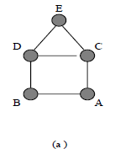
Example
If the ordering is A,B,C,D,E then the width =2
The induced width of G = 2

Slide 34
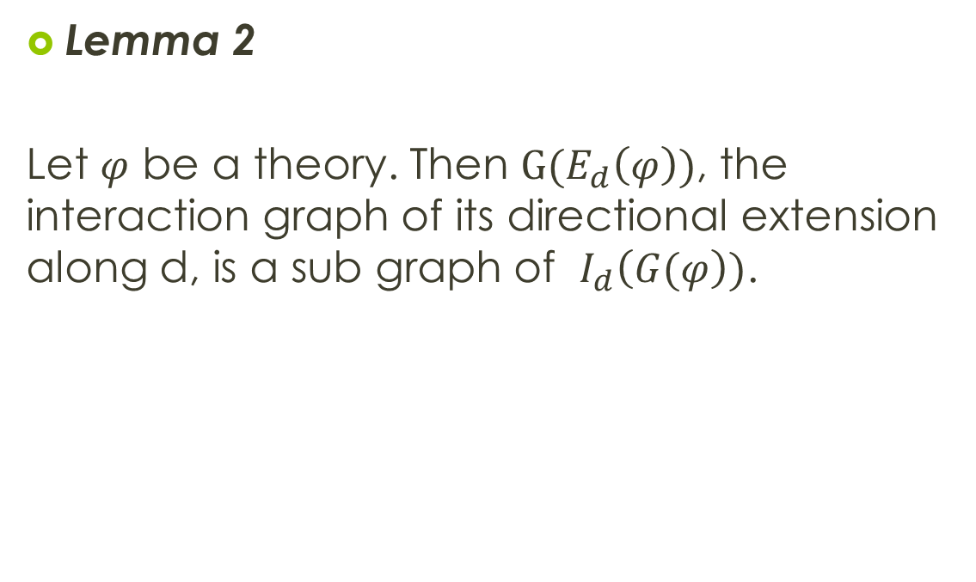
Lemma 2
Let $φ$ be a theory. Then $G(E_{d}\left(φ\right))$, the interaction graph of its directional extension along d, is a sub graph of $I_{d}\left(G(φ\right))$.

Slide 35
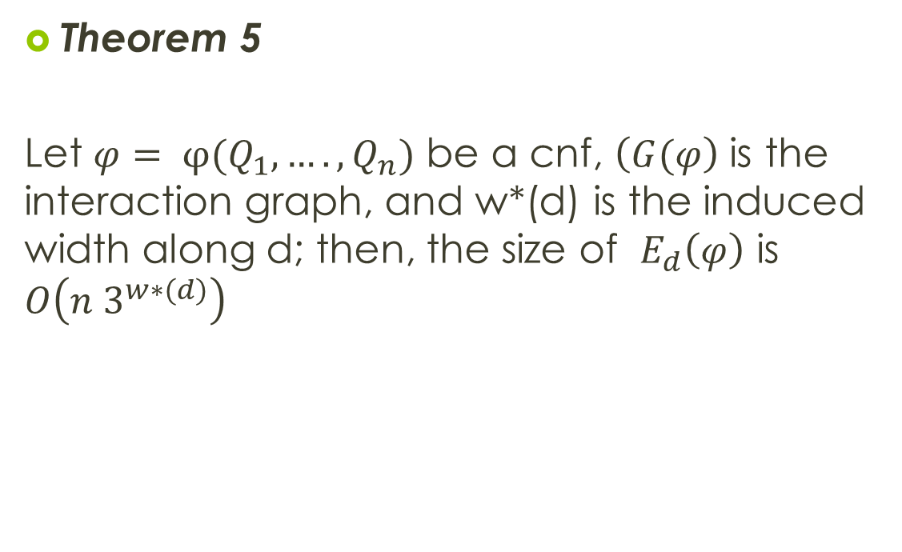
Theorem 5
Let $φ= φ(Q_{1},….,Q_{n})$ be a cnf, $\left(G(φ\right)$ is the interaction graph, and w*(d) is the induced width along d; then, the size of $E_{d}\left(φ\right)$ is $O\left(n 3^{w∗(d)}\right)$

Slide 36
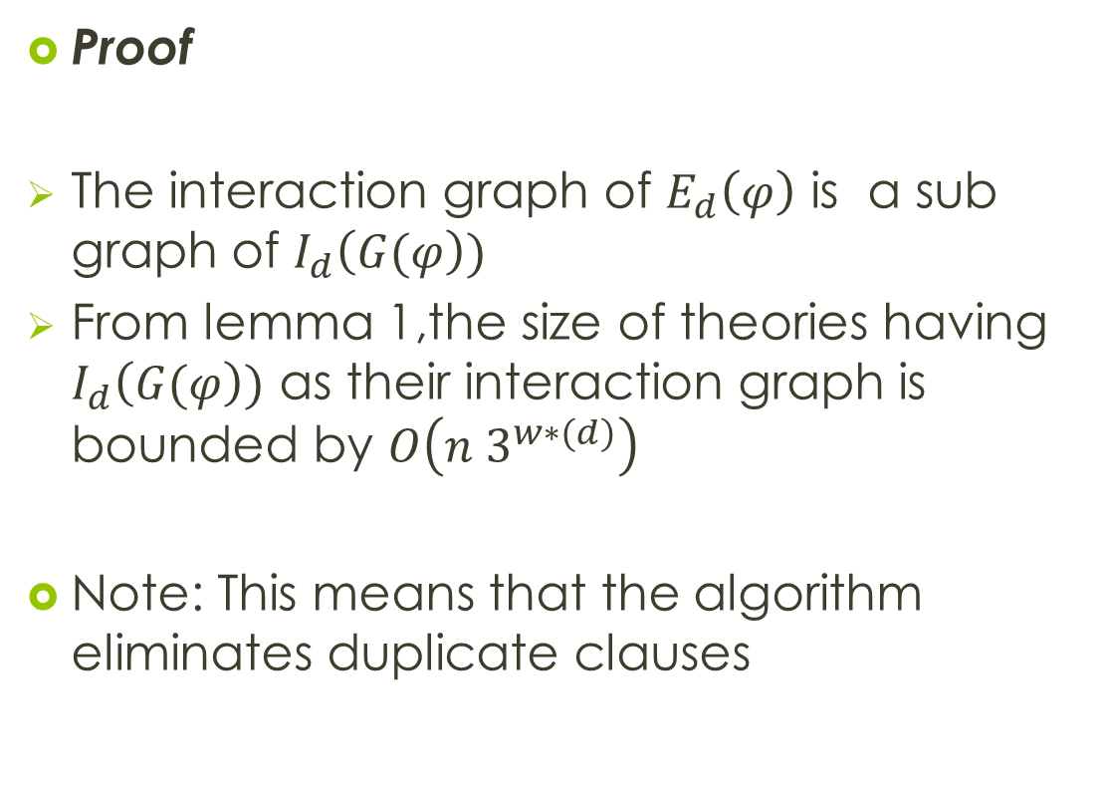
Proof
The interaction graph of $E_{d}\left(φ\right)$ is a sub graph of $I_{d}\left(G(φ\right))$
From lemma 1,the size of theories having $I_{d}\left(G(φ\right))$ as their interaction graph is bounded by $O\left(n 3^{w∗(d)}\right)$
Note: This means that the algorithm eliminates duplicate clauses

Slide 37
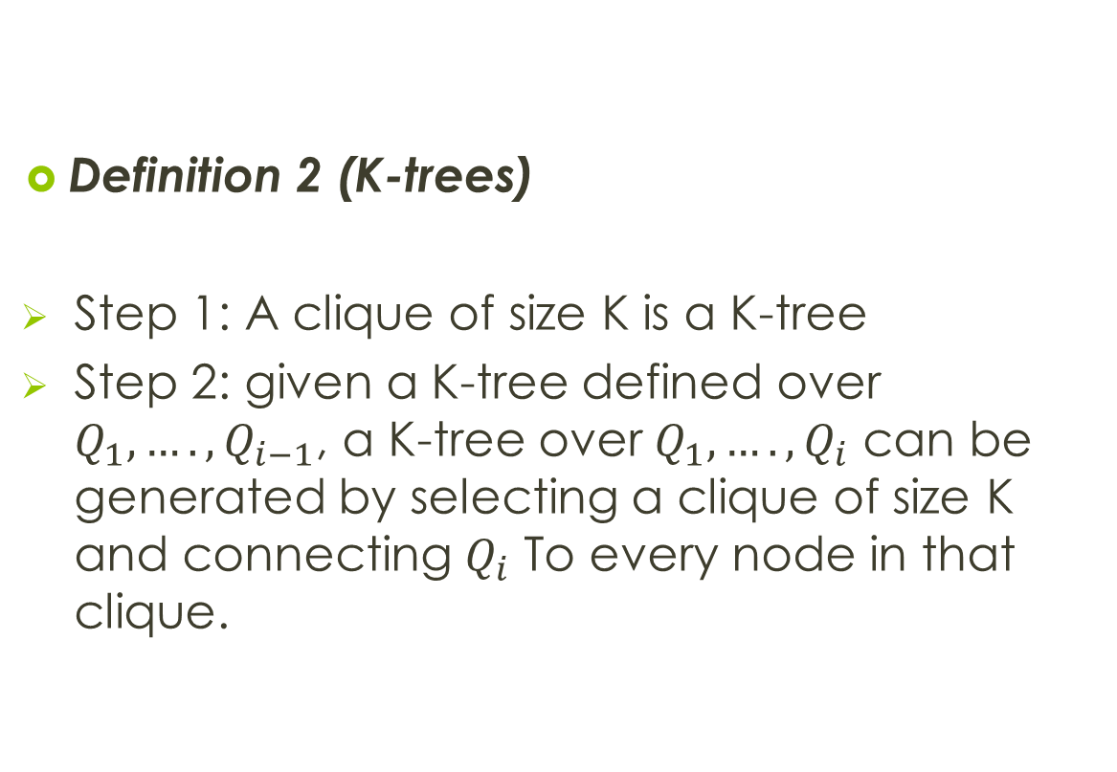
Definition 2 (K-trees)
Step 1: A clique of size K is a K-tree
Step 2: given a K-tree defined over $Q_{1},….,Q_{i−1}$, a K-tree over $Q_{1},….,Q_{i}$ can be generated by selecting a clique of size K and connecting $Q_{i}$ To every node in that clique.

Slide 38
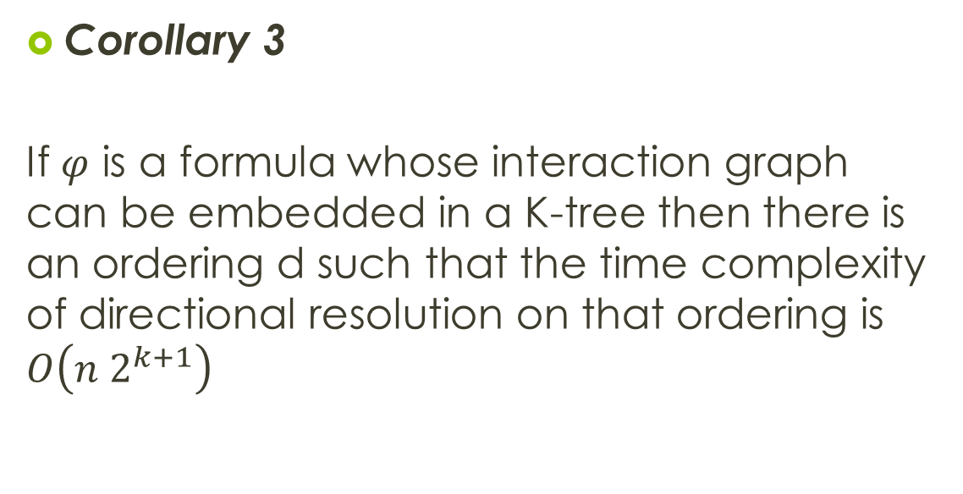
Corollary 3
If $φ$ is a formula whose interaction graph can be embedded in a K-tree then there is an ordering d such that the time complexity of directional resolution on that ordering is $O\left(n 2^{k+1}\right)$

Slide 39
Finding an ordering yielding the smallest induced width of a graph is NP-hard
So, when given a theory and its interaction graph, lets find an ordering that yields the smallest width possible

Slide 40
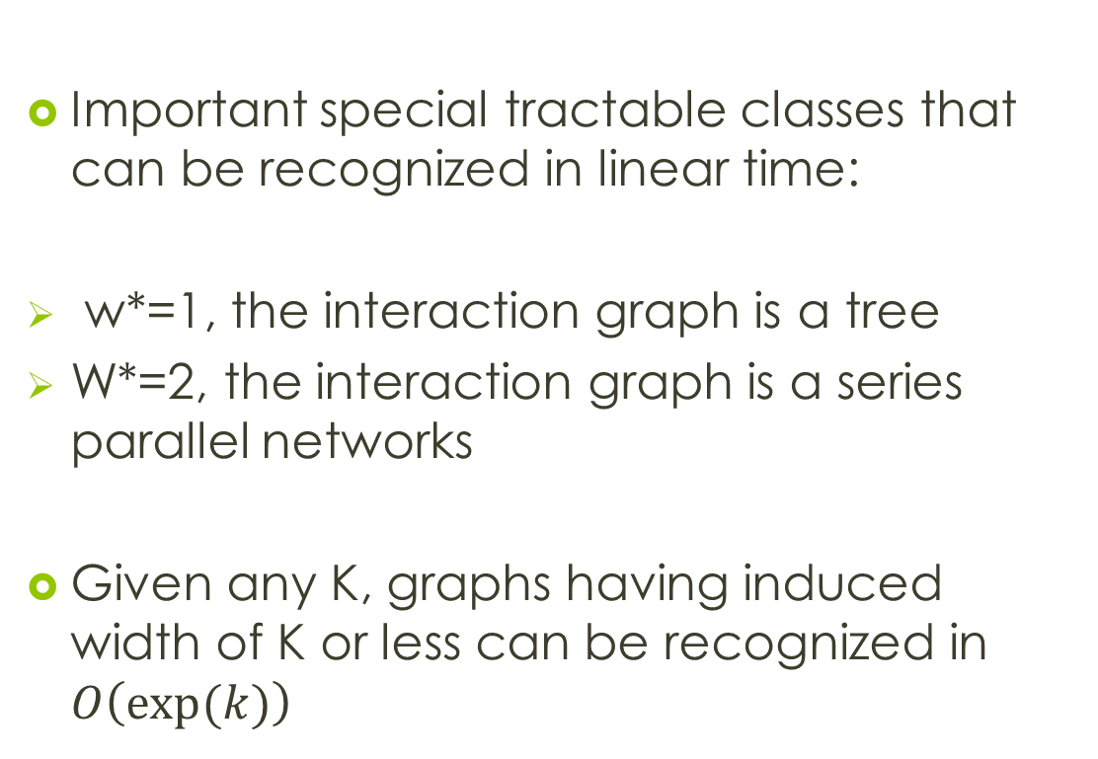
Important special tractable classes that can be recognized in linear time:
w*=1, the interaction graph is a tree
W*=2, the interaction graph is a series parallel networks
Given any K, graphs having induced width of K or less can be recognized in $O\left(exp⁡(k)\right)$

Slide 41
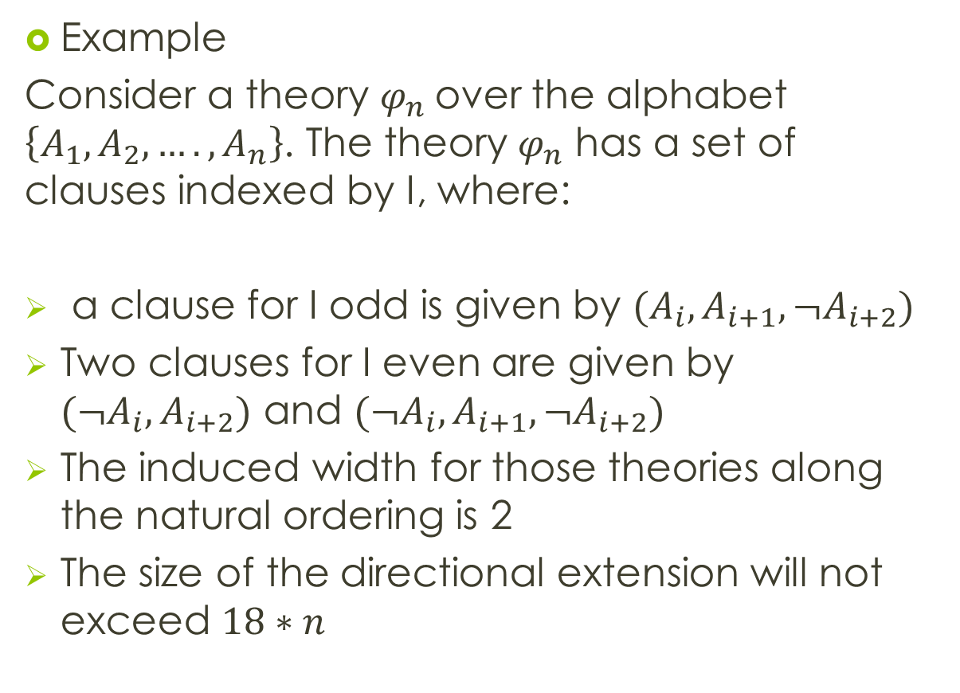
Example
Consider a theory $φ_{n}$over the alphabet $\left\{A_{1},A_{2},….,A_{n}\right\}$. The theory $φ_{n}$ has a set of clauses indexed by I, where:
a clause for I odd is given by $(A_{i},A_{i+1},{¬A}_{i+2})$
Two clauses for I even are given by $({¬A}_{i}, A_{i+2})$ and $({¬A}_{i},A_{i+1},{¬A}_{i+2})$
The induced width for those theories along the natural ordering is 2
The size of the directional extension will not exceed $18∗n$

Slide 42
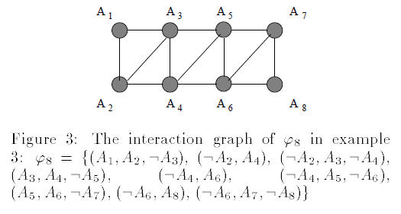

Slide 43
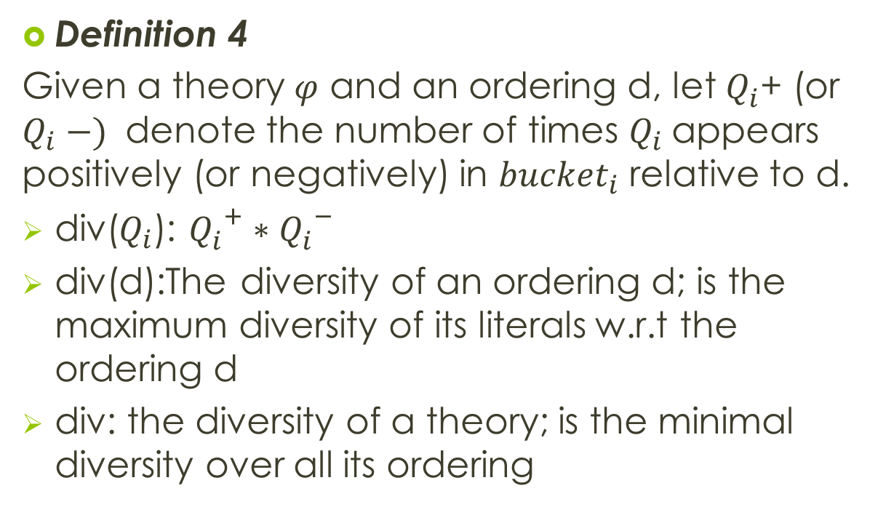
Diversity
Definition 4
Given a theory $φ$ and an ordering d, let $Q_{i}^{}$+ (or $Q_{i} −)$ denote the number of times $Q_{i}$appears positively (or negatively) in ${bucket}_{i}$ relative to d.
div($Q_{i}$): ${Q_{i}^{}}^{+}∗{Q_{i}^{}}^{−}$
div(d):The diversity of an ordering d; is the maximum diversity of its literals w.r.t the ordering d
div: the diversity of a theory; is the minimal diversity over all its ordering

Slide 44
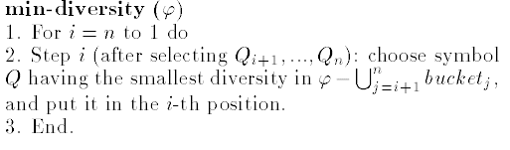
Theorem 6
Algorithm min_diversity generates a minimal diversity ordering of a theory

Slide 45
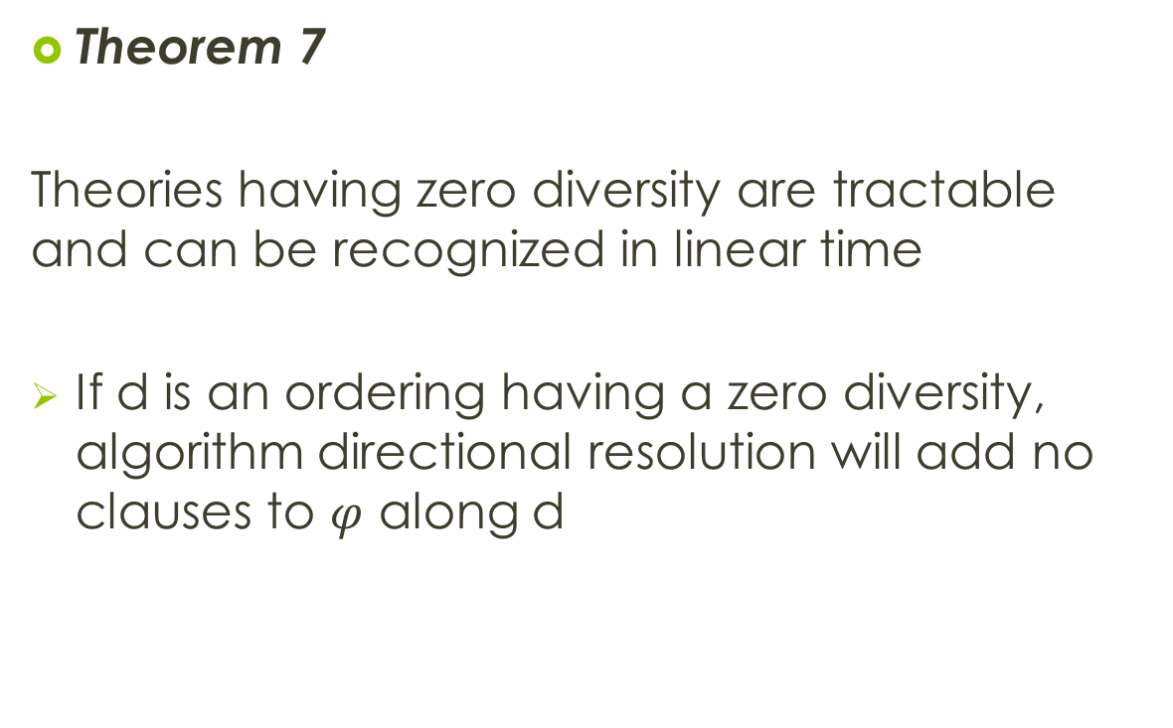
Theorem 7
Theories having zero diversity are tractable and can be recognized in linear time
If d is an ordering having a zero diversity, algorithm directional resolution will add no clauses to $φ$ along d

Slide 46
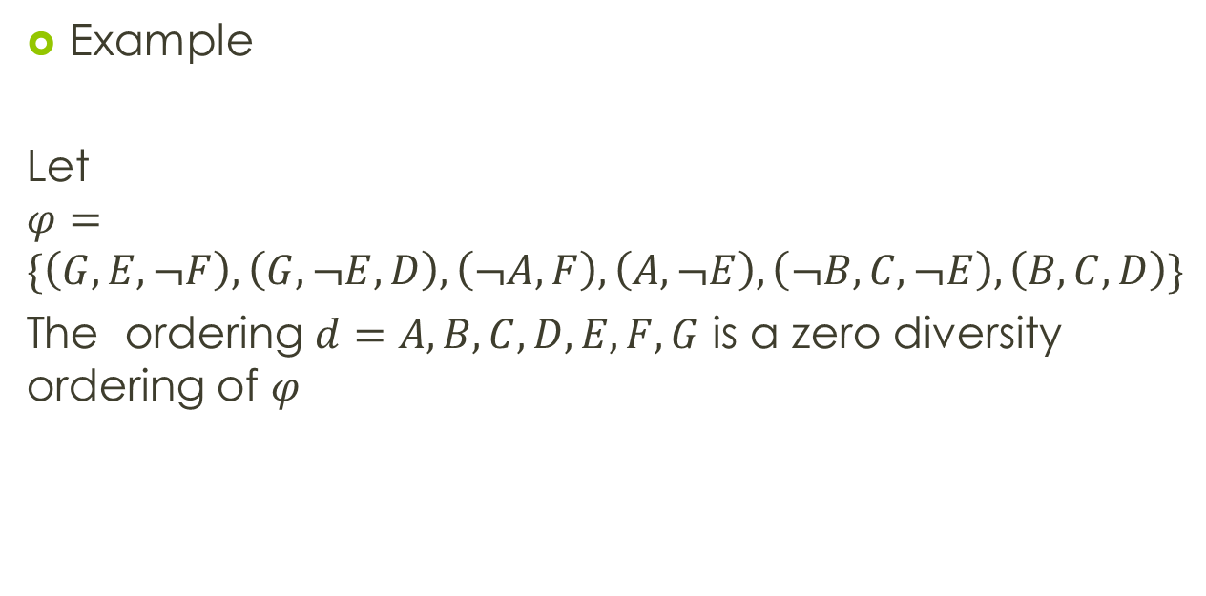
Example
Let $φ=\{\left(G,E,¬F\right),\left(G,¬E,D\right),\left(¬A,F\right),\left(A,¬E\right),\left(¬B,C,¬E\right),\left(B,C,D\right)\}$
The ordering $d=A,B,C,D,E,F,G$ is a zero diversity ordering of $φ$

Slide 47
clausal cnf theory has zero diversity; Theories in cnf forms would correspond to clausal if there is an ordering of the symbols, so that each bucket contains only one clause
The size of the directional-extension is exponentially bounded in the number of literals having only strictly positive diversities

Slide 48
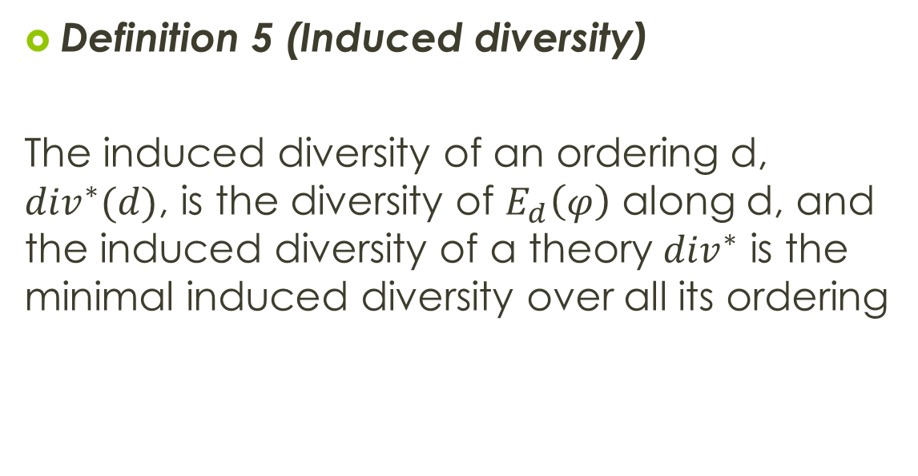
Definition 5 (Induced diversity)
The induced diversity of an ordering d, ${div}^{∗}(d)$, is the diversity of $E_{d}\left(φ\right)$ along d, and the induced diversity of a theory ${div}^{∗}$ is the minimal induced diversity over all its ordering

Slide 49
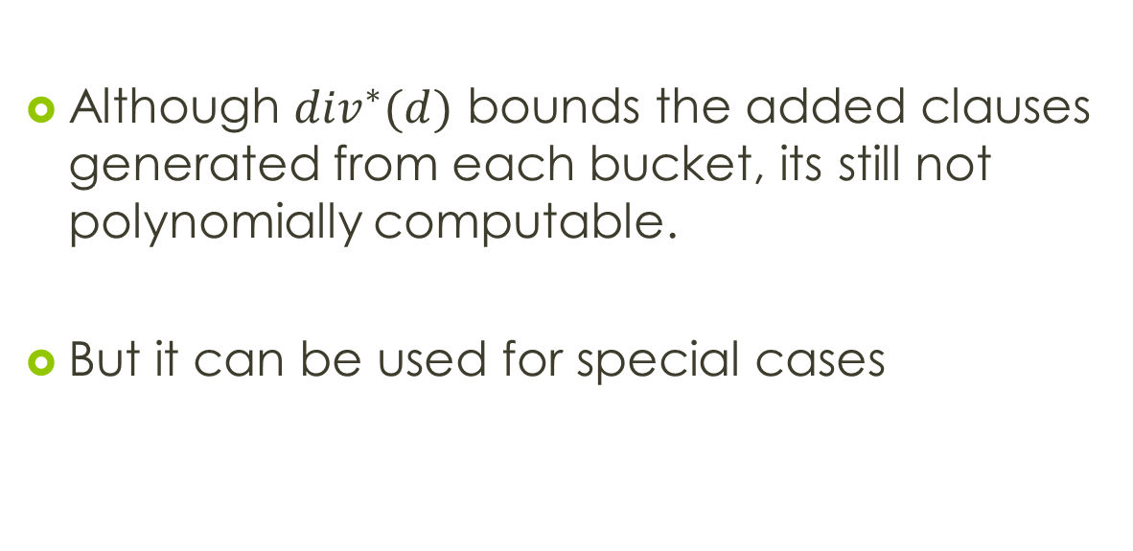
Although ${div}^{∗}(d)$ bounds the added clauses generated from each bucket, its still not polynomially computable.
But it can be used for special cases

Slide 50
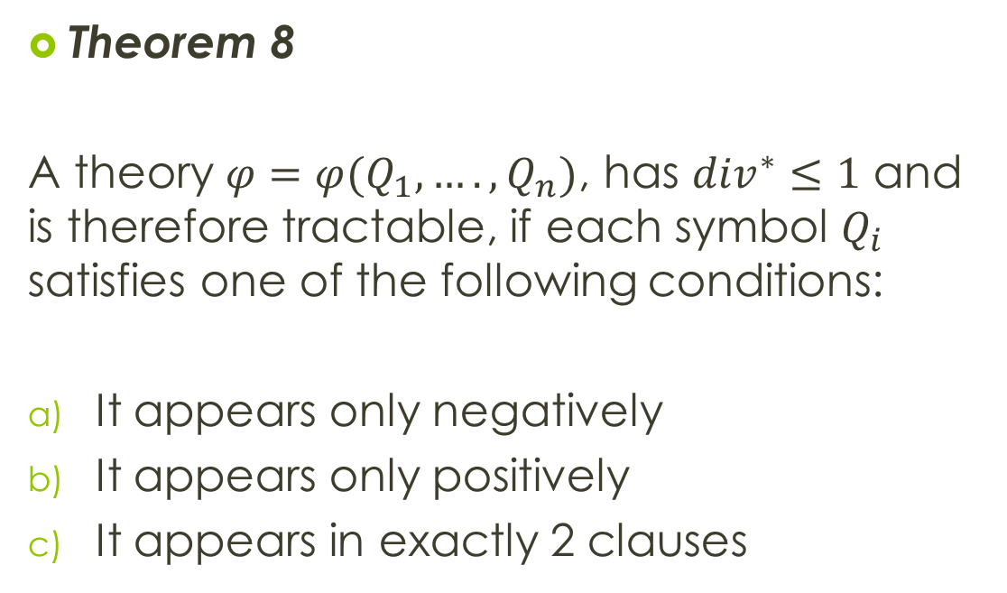
Theorem 8
A theory $φ=φ(Q_{1},….,Q_{n})$, has ${div}^{∗}≤1$ and is therefore tractable, if each symbol $Q_{i}$ satisfies one of the following conditions:
It appears only negatively
It appears only positively
It appears in exactly 2 clauses

Slide 51
Two special nodes labeled true and false are introduced
There is an arc from true to A f A is a positive unit clause
There is an arc from B to false if B is included in any negative clause

Slide 52
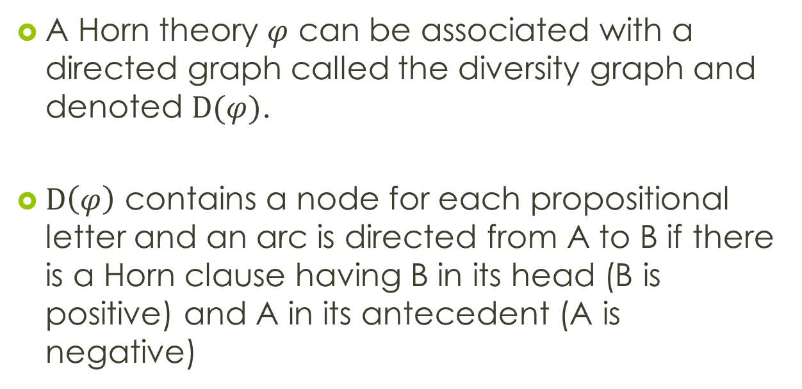
Diversity graph for horn theories
A Horn theory $φ$ can be associated with a directed graph called the diversity graph and denoted $D(φ)$.
$D\left(φ\right)$ contains a node for each propositional letter and an arc is directed from A to B if there is a Horn clause having B in its head (B is positive) and A in its antecedent (A is negative)

Slide 53
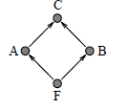
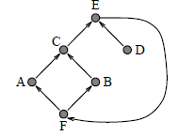
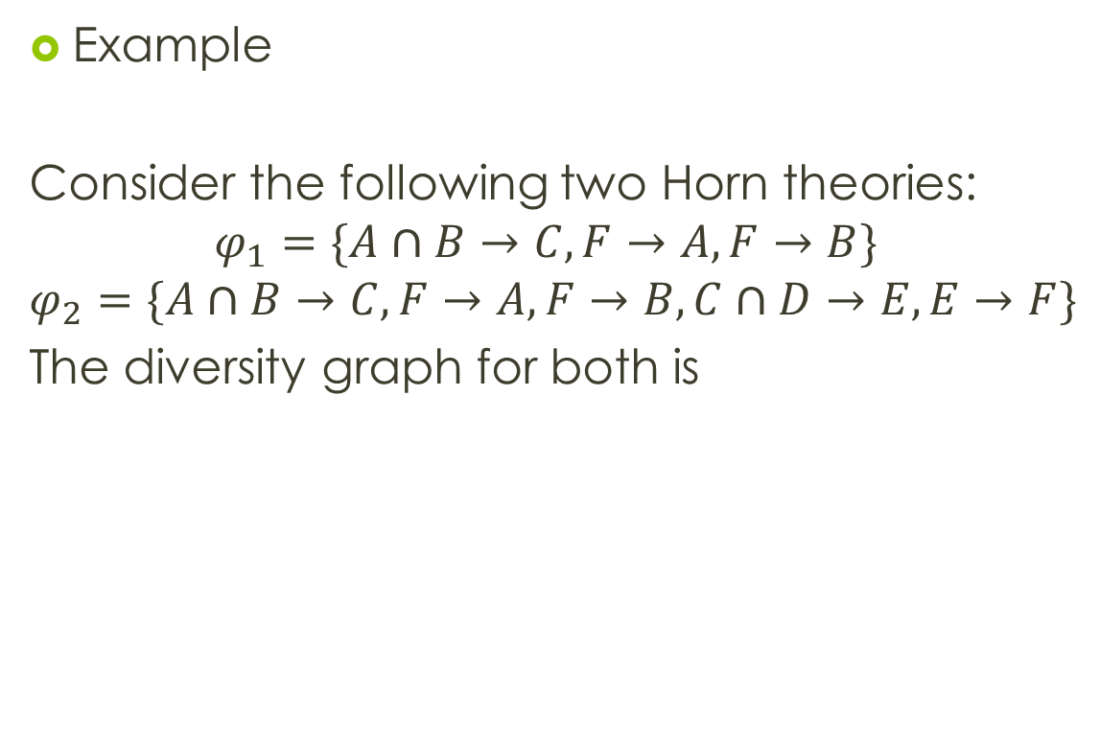
Example
Consider the following two Horn theories:
$$φ_{1}=\{A∩B→C, F→A, F→B\}$$
$$φ_{2}=\{A∩B→C, F→A, F→B, C∩D→E, E→F\}$$
The diversity graph for both is

Slide 54
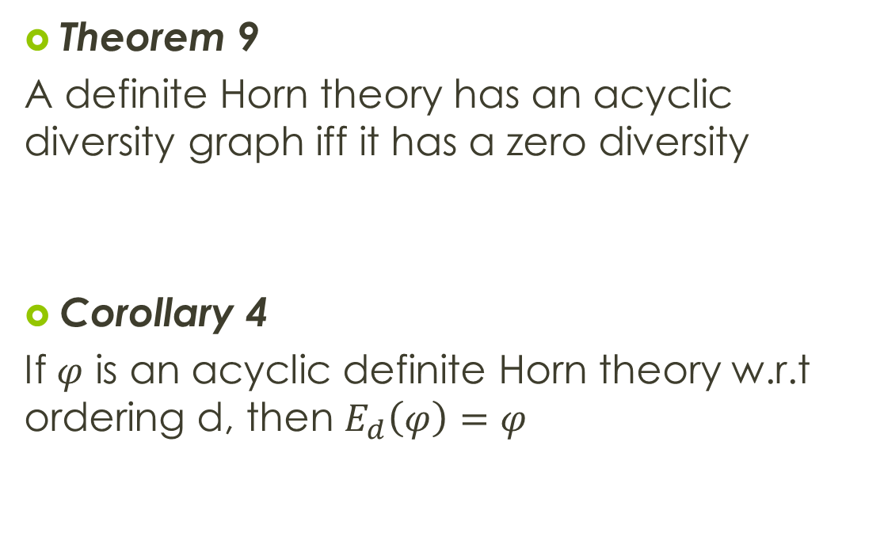
Theorem 9
A definite Horn theory has an acyclic diversity graph iff it has a zero diversity
Corollary 4
If $φ$ is an acyclic definite Horn theory w.r.t ordering d, then $E_{d}\left(φ\right)=φ$

Slide 55
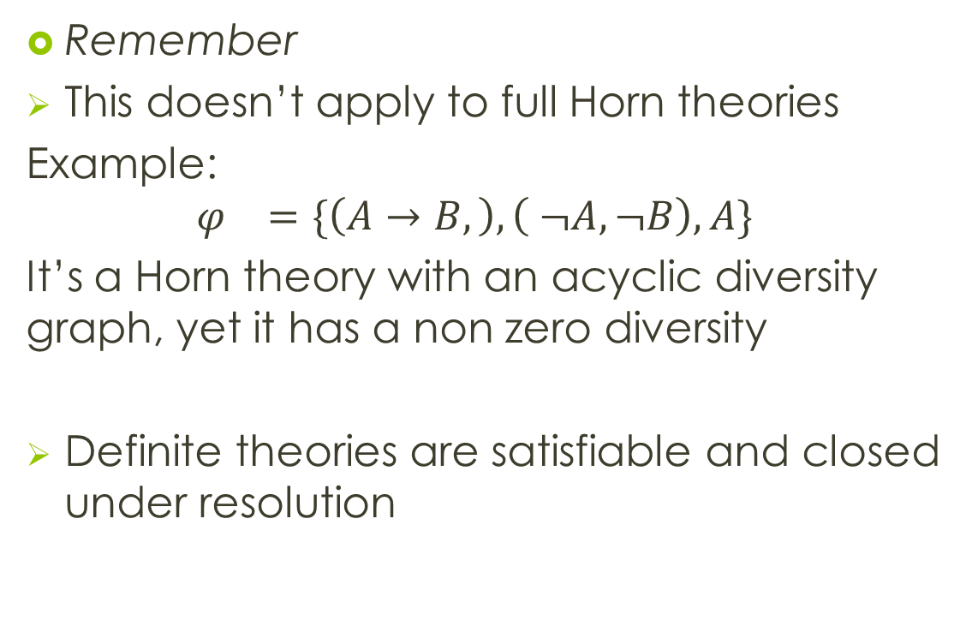
Remember
This doesn’t apply to full Horn theories
Example:
$$φ_{}=\{\left(A→B,\right),\left( ¬A,¬B\right),A\}$$
It’s a Horn theory with an acyclic diversity graph, yet it has a non zero diversity
Definite theories are satisfiable and closed under resolution

Slide 56
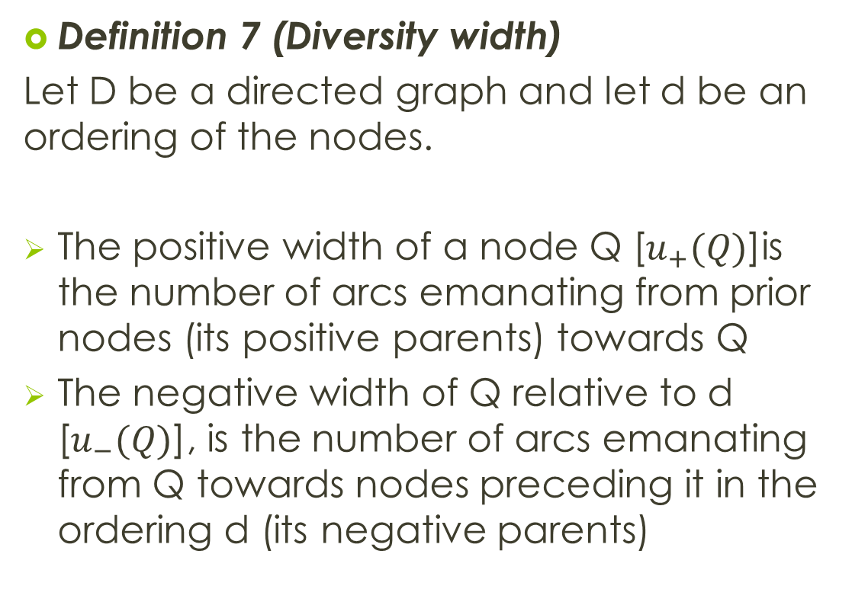
Definition 7 (Diversity width)
Let D be a directed graph and let d be an ordering of the nodes.
The positive width of a node Q [$u_{+}(Q)$]is the number of arcs emanating from prior nodes (its positive parents) towards Q
The negative width of Q relative to d [$u_{−}(Q)$], is the number of arcs emanating from Q towards nodes preceding it in the ordering d (its negative parents)

Slide 57
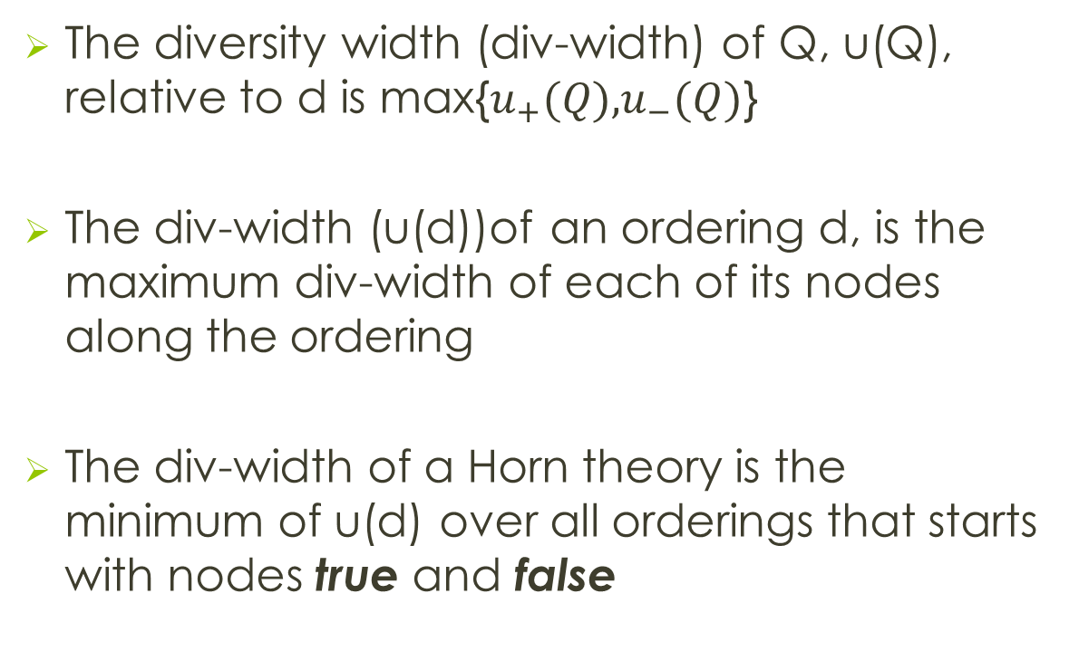
The diversity width (div-width) of Q, u(Q), relative to d is max{$u_{+}(Q)\text{,}u_{−}(Q)$}
The div-width (u(d))of an ordering d, is the maximum div-width of each of its nodes along the ordering
The div-width of a Horn theory is the minimum of u(d) over all orderings that starts with nodes true and false

Slide 58
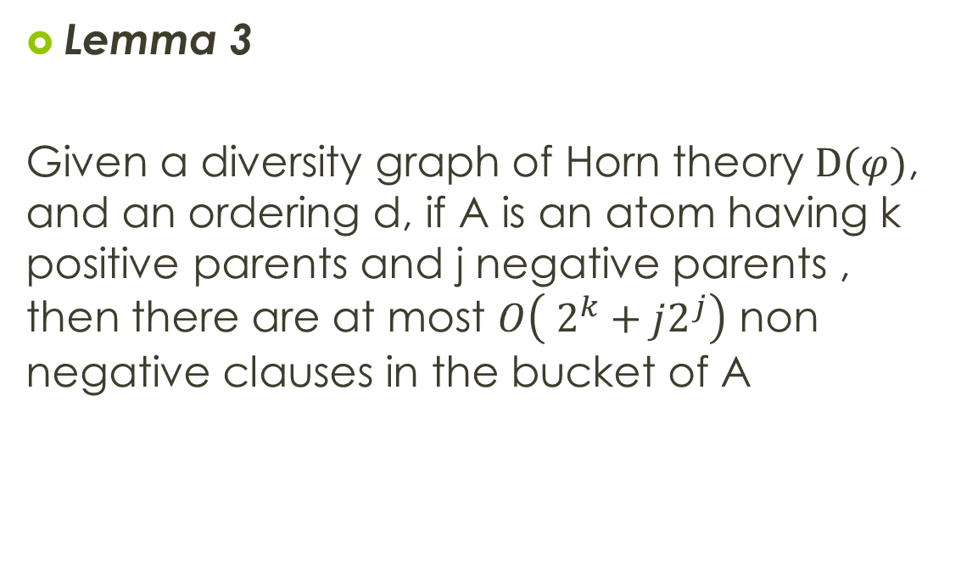
Lemma 3
Given a diversity graph of Horn theory $D(φ)$, and an ordering d, if A is an atom having k positive parents and j negative parents , then there are at most $O\left( 2^{k}+j2^{j}\right)$ non negative clauses in the bucket of A

Slide 59
A minimum div-width of a graph can be computed by a greedy algorithm like the min-diversity algorithm, using div-width criteria for node selection

Slide 60
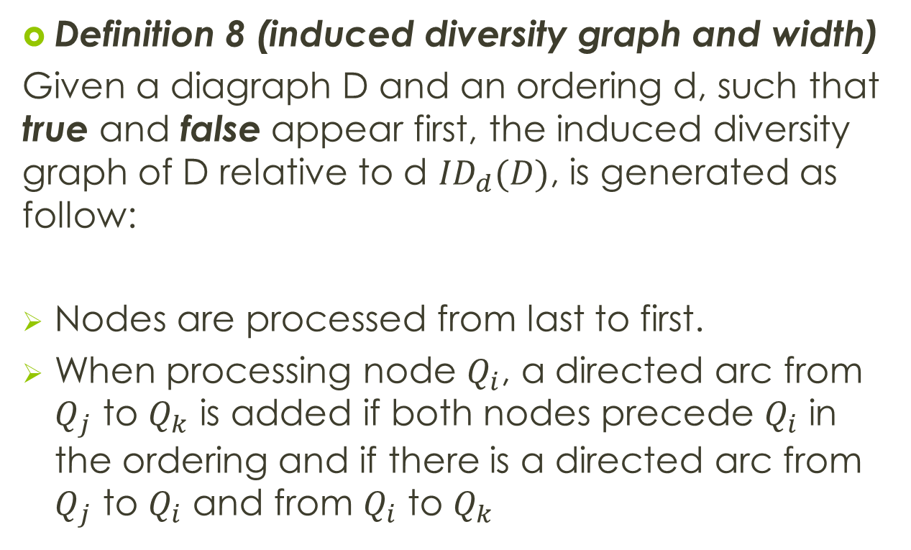
Definition 8 (induced diversity graph and width)
Given a diagraph D and an ordering d, such that true and false appear first, the induced diversity graph of D relative to d ${ID}_{d}(D)$, is generated as follow:
Nodes are processed from last to first.
When processing node $Q_{i}$, a directed arc from $Q_{j}$ to $Q_{k}$ is added if both nodes precede $Q_{i}$ in the ordering and if there is a directed arc from $Q_{j}$ to $Q_{i}$ and from $Q_{i}$ to $Q_{k}$

Slide 61
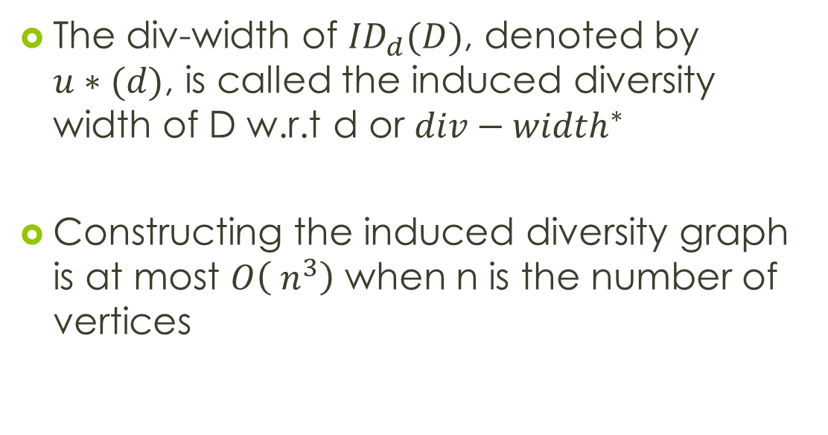
The div-width of ${ID}_{d}(D)$, denoted by $u∗(d)$, is called the induced diversity width of D w.r.t d or ${div−width}^{∗}$
Constructing the induced diversity graph is at most $O\left( n^{3}\right)$ when n is the number of vertices

Slide 62
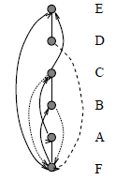
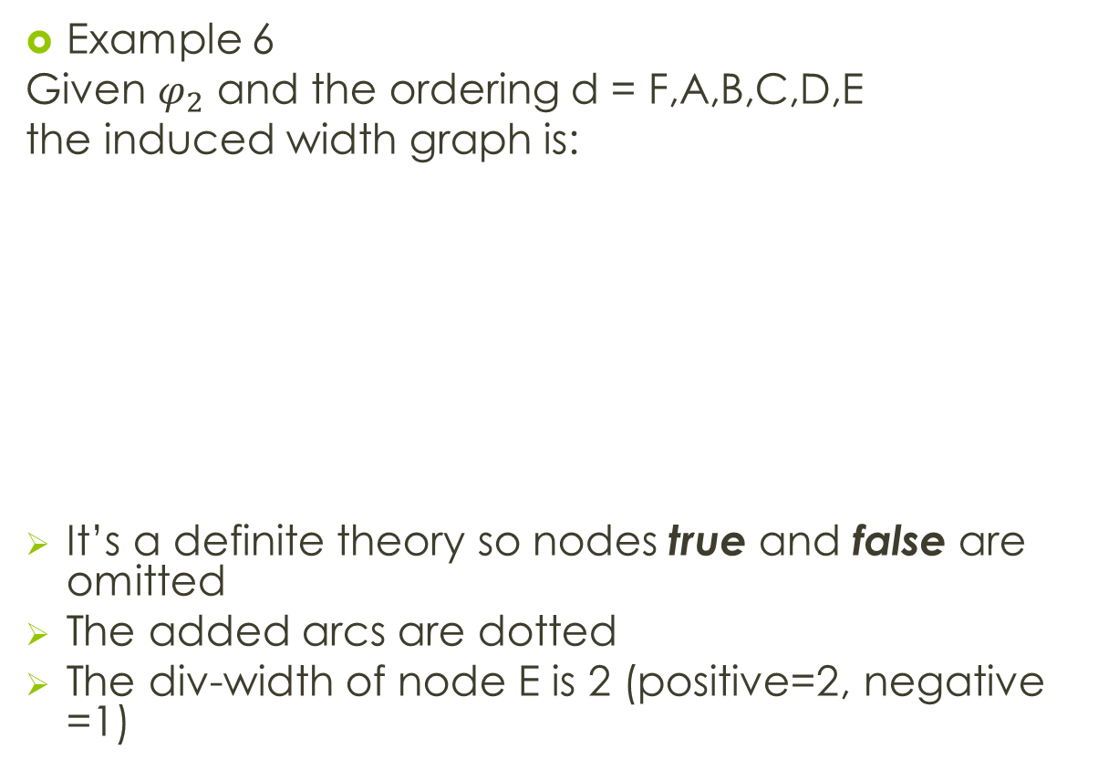
Example 6
Given $φ_{2}$ and the ordering d = F,A,B,C,D,E
the induced width graph is:
It’s a definite theory so nodes true and false are omitted
The added arcs are dotted
The div-width of node E is 2 (positive=2, negative =1)

Slide 63
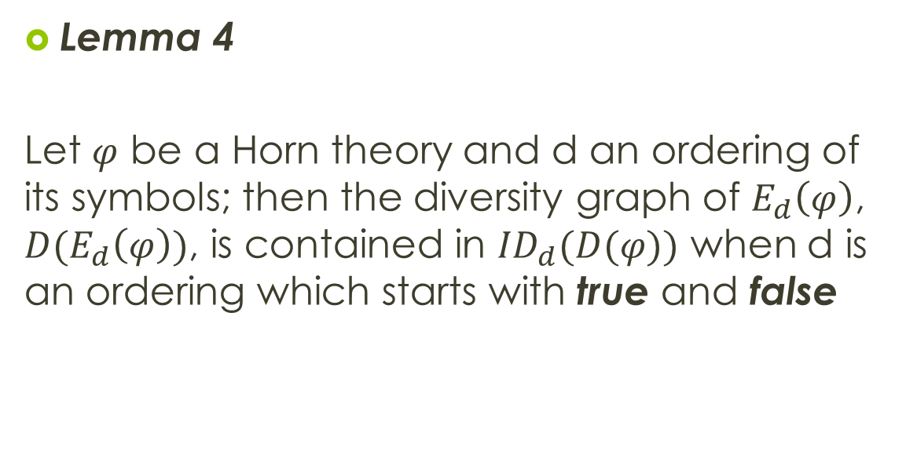
Lemma 4
Let $φ$ be a Horn theory and d an ordering of its symbols; then the diversity graph of $E_{d}\left(φ\right)$, ${D(E}_{d}\left(φ\right))$, is contained in ${ID}_{d}(D(φ))$ when d is an ordering which starts with true and false

Slide 64
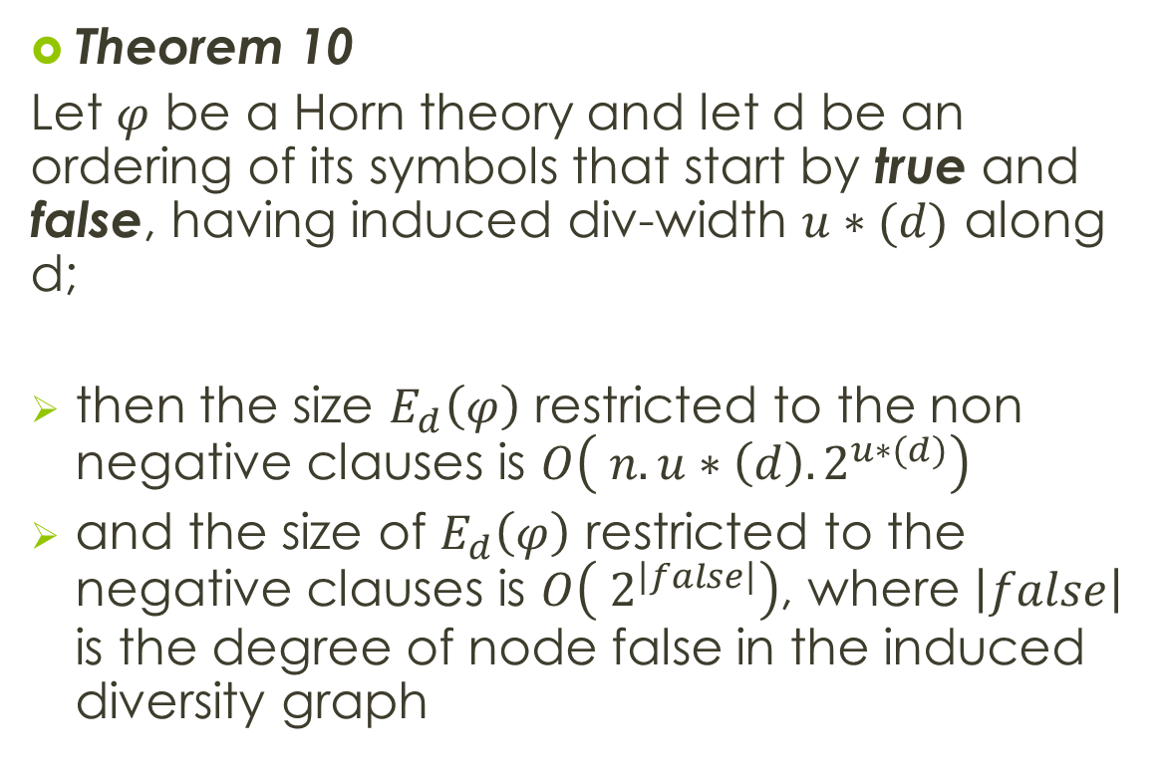
Theorem 10
Let $φ$ be a Horn theory and let d be an ordering of its symbols that start by true and false, having induced div-width $u∗(d)$ along d;
then the size $E_{d}\left(φ\right)$ restricted to the non negative clauses is $O\left( n.u∗\left(d\right).2^{u∗(d)}\right)$
and the size of $E_{d}\left(φ\right)$ restricted to the negative clauses is $O\left( 2^{\left|false\right|}\right)$, where $\left|false\right|$ is the degree of node false in the induced diversity graph

Slide 65
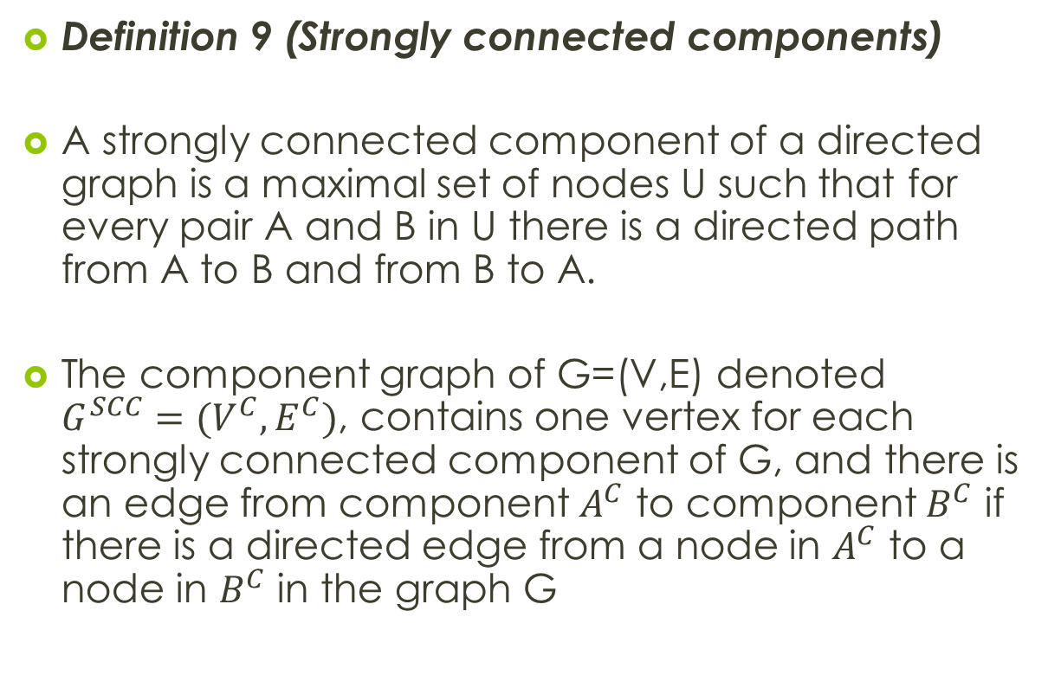
Definition 9 (Strongly connected components)
A strongly connected component of a directed graph is a maximal set of nodes U such that for every pair A and B in U there is a directed path from A to B and from B to A.
The component graph of G=(V,E) denoted $G^{SCC}=(V^{C},E^{C})$, contains one vertex for each strongly connected component of G, and there is an edge from component $A^{C}$ to component $B^{C}$ if there is a directed edge from a node in $A^{C}$ to a node in $B^{C}$ in the graph G

Slide 66

Theorem 11
Let $φ$ be a definite theory having a diversity graph D.
Let $S_{1},….,S_{t}$ be the strongly connected components of G, let $d_{1},d_{2}….,d_{t}$ be orderings of the nodes in each of the strongly connected components, and let d be a concatenation of the orderings ${d= d}_{i1},{….,d}_{ij,}….,d_{it}$, that agrees with the partial acyclic ordering of the components graph

Slide 67

Theorem 11 (cont)
Let $u∗(d_{j})$ be the largest induced div-width of any component
Then the size of $E_{d}\left(φ\right) −φ$ is $O\left( n2^{u∗(d_{j})}\right)$

Slide 68

Example 7
Given $φ_{1}=\{A∩B→C, F→A, F→B\}$
Since the graph is acyclic, the strongly connected components contain only one node, therefore for any admissible ordering d, $u∗\left(d\right)=0$

Slide 69

Example 7 (cont)
Given
$$φ_{2}=\{A∩B→C, F→A, F→B, C∩D→E, E→F\}$$
There are 2 strongly connected components, one including D only, and another including the rest of the variables, For the ordering d = F,A,B,C,E on that component, only the arcs (C,F),(B,F),(A,F) will be added, so that the induced div-width = 2

Slide 70
Conclusion
Finding an optimal width is NP-Hard
Finding an optimal induced div-width is also hard
However good orderings can be generated using various heuristics (min-width, min-diversity, min-div-width)

Slide 71
Directional resolution algorithm is both time and space exponential in the worst case
Instead use an approximate algorithm bounded directional resolution (BDR)

Slide 72
Bounded directional resolution
The algorithm records clauses of size k or less when k is a constant
Consequently, its complexity is polynomial in k

Slide 73
Experimental Evaluation
They implemented DP-Backtracing in C using a 2-literal clause heuristic.

Slide 74


Slide 75
DR vs. DP
DP outperformed DR.

Slide 76


Slide 77


Slide 78


Slide 79


Slide 80
Chain Analysis
DR significantly outperforms DP for instances which DP encountered many deadends.
Almost all hard DP chain problems were unsatisfiable.

Slide 81


Slide 82


Slide 83


Slide 84



Slide 85
Related work and conclusions
Since propositional satisfiability is a special case of constraint satisfaction, the induced-width bound could be obtained by mapping a propositional formula into the relational framework of a constraint satisfaction problem and applying adaptive consistency.

Slide 86
Related work and conclusions
Adaptive consistency and the elimination algorithm does not perform better then Directional Resolution under similar constraints.

Slide 87
Final Conclusions
Revise the pessimistic analysis of DP-elimination by showing that the DR algorithm has merits with tractable classes.
Identify new tractable classes based on diversity.
Show tighter bounds on induced diversity width.

Slide 88
Final Conclusions
While DR is no the most effective algorithm, ideas and concepts should be incorporated into newer, more effective algorithms.
For some structural domains, DR is an effective knowledge compilation procedure.

Slide 89
Thank you

