Slide 1
Consistency-Based vs. Explanation-Based (Abduction) Diagnosis
Andrew Smith
Jhih-Rong Lin
Jeremy Lewis

Slide 2
Overview
Normality and Faults
Normality and Faults in Logic-Based diagnosis, David Poole
Consistency-based vs. Abductive diagnosis
Representing Diagnosis Knowledge, David Poole
Unifying Consistency-based and Abductive diagnosis
Representing Diagnosis Knowledge, David Poole

Slide 3
Normality and Faults in Logic-Based Diagnosis
David Poole
Presented by Andrew Smith

Slide 4
Outline
Normality
Faults
Evolution of faults
Examples of issues

Slide 5
Normality
“A component is normal if it works correctly all the time”
Used by consistency-based diagnoses
A component is normal if it is being produced in a particular case.
Used by abductive diagnoses

Slide 6
Normality
(Consistency-based) Battery example:
Obs: volt(series(b₁,b₂), 1.456)
Hypotheses
~ab(b₁) and ~ab(b₂)
Two diagnoses:
{ab(b₁)}, {ab(b₂)}

Slide 7
Normality
(Abductive) Battery example:
Hypothesis: battOK(B, V), battAB(B, V)
Similar to consistency-based knowledge (so far)
However, diagnosis entails the observation.
Ex: battOK(b₁, 1.403)

Slide 8
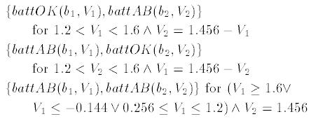
Normality
(Abductive) Battery example
Observation: volt(series(b₁,b₂), 1.456)

Slide 9
Faults
Abductive example extended
Replace abnormalities with fault assumptions
Flat battery
0.3 > V > 1.2
Shorted battery
V = 0
Observation : volt(series(b₁,b₂), 1.517)

Slide 10
Faults
Abductive example extended
Diagnoses:

Slide 11
Faults
Consistency-based example extended
Three choices on what to assume:
Normality
and let faults be concluded as a side effect.
Absence of faults
And let normality be concluded as a side effect.
Both Normality and Absence of faults

Slide 12
Faults
Consistency-based example extended
Same scenario as abductive case
flat(B)
shorted(B)
Assuming b₁ is ok and observing volt(series(b₁,b₂))

Slide 13
Faults
Consistency-based example extended
Assuming both batteries are ok rules out the possibility of both being flat:
Must treat abnormality as a fault!

Slide 14
Faults
Extended battery example
Overcharged battery (1.6 < V < 2.0)
Abductive case
Both batteries are OK, or one is overcharged and one is flat
Consistency-based case
Same, but interpreted differently
Can compare diagnoses by using explanations in the abductive case that assumes less.
Notes:
Consistency based diagnoses (ok(b1) and ok(b2)) could mean that anything could be wrong (1st def.) or that we need to appeal to “parsimony” (2nd def.).

Slide 15
Evolution of faults
Evolving from normality- to fault-based
Over time, systems evolve as more information is gained.
Consistency-based
Assuming abnormalities and faults
Restricts the number of abnormalities by implying a strict number of faults.
No fault information
Treats abnormality (vague) as a fault.

Slide 16
Evolution of faults
New faults
Adding small batteries to abductive knowledge-base
Consistency-based is much more difficult due to the assumption of complete knowledge!

Slide 17
Evolution of faults
New faults in consistency-based KBs
Replace flat(B) rule with:
Replace the complete knowledge assumption with:

Slide 18
Examples of issues
Observations
Suppose lhs(d, 4, t₀) and rhs(d, 16, t₁)
Two different observations
Consistency-based (1st form)
Abductive-based (2nd form)

Slide 19
Examples of issues
Noise (handling errors)
Consistency-based diagnosis
Abductive diagnosis

Slide 20
Examples of issues
Hierarchial Reasoning
Both abductive and consistency models can handle hierarchial models.
These are models that have levels of abstraction embedded within them (i.e. the batteries being complex power stations).

Slide 21
Examples of issues
Epistemological Assumptions
Consistency-based
Requires complete knowledge assumption, though this usually is false.
Unanticipated observations are ignored.
Abductive
Does not require this assumption.
Unanticipated observations result in no diagnosis.

Slide 22
Examples of issues
Efficiency
Consistency-based
Forward chaining from observations until a contradiction occurs.
Abductive
Backward chaining from observations collecting assumptions to prove a goal.
Same search space (essentially) for both.

Slide 23
Representing Diagnosis Knowledge: Consistency-based vs. Abductive diagnosis
David Poole
Presented by Jhih-Rong Lin
Notes:
How to represent knowledge in the context of diagnosis
My presentation is based on the first part of the paper, the second part will be presented by Jeremy.

Slide 24
Outline
The knowledge representation problem
The frameworks of representing diagnosis knowledge
An Example to compare abductive and consistent-based diagnosis.
Notes:
The argument of this paper is that under certain constraints, we can find a way to represent knowledge so that consistency-based and abductive diagnosis will give the same(or similar) answers to the problem.

Slide 25
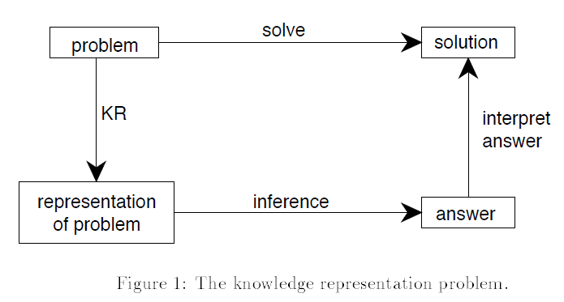
The Knowledge Representation Problem (KR)
Notes:
Bottom up, top down

Slide 26
Review of the two diagnosis
{influenza, nonsmoker} ->
wheezing ^ fever
The differences: Consistency-based diagnosis is defined in terms of normality assumptions
rather than in terms of fault(cause/symptom) models. Abductive diagnosis
is conceptualised in term of fault models.
Notes:
In another words. Minimal explanation of the observations

Slide 27
How to incorporate fault models into consistency-based diagnosis
The consistency-based diagnosis is to minimize its negation assumed and maximize assumed.
=>To assume the negation of a fault assumption as possible hypothesis. (which has similar meaning of finding mimimal explanation)

Slide 28
Definition of Knowledge Base
Theorist [15] defined a knowledge base KB is a pair <F,H>, such that F is a set of closed formulae (called the facts) and H is a set of open formulae (called the possible hypotheses).

Slide 29
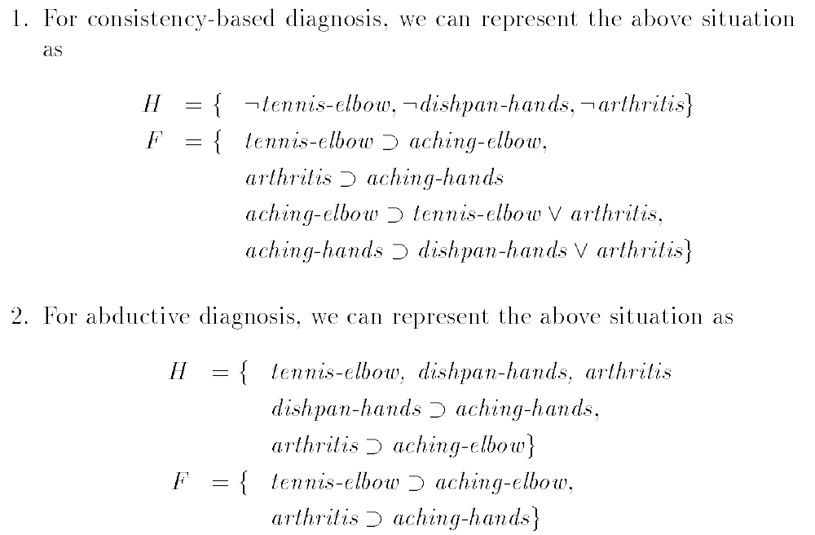
An Example to compare abductive and consistent-based diagnosis.
Notes:
For abductive: F: cause -> symptom (always)
For consistent-based: F: cause -> symptom, symptom->c1 v c2 v c3…

Slide 30
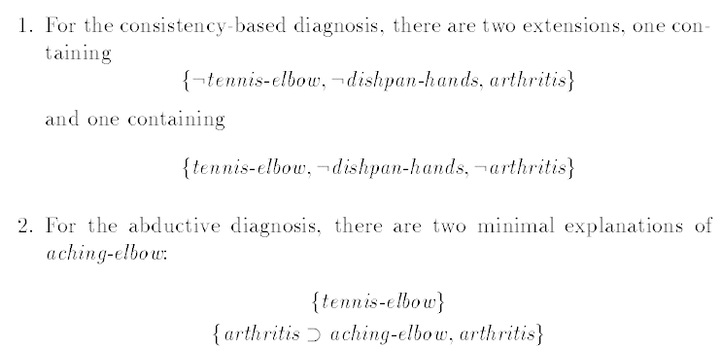
The observation: aching-elbow

Slide 31
Representing Diagnosis Knowledge: Unifying Consistency-based & Abductive diagnosis
David Poole
Presented by Jeremy Lewis

Slide 32
Outline
Theorem 3.2
Theorem 3.2 Proof: Inductive Base
Theorem 3.2 Proof: Inductive Step 1 of 2
Theorem 3.2 Proof: Inductive Step 2 of 2
Theorem 3.2 Example 1
Theorem 3.2 Example 2
Clark’s completion
Pearl’s example 1 of 2
Pearl’s example 2 of 2

Slide 33
Theorem 3.2
Theorem 3.2: Given a set of symptoms, the base causes in the diagnoses using abductive diagnosis from KB_A are identical to the diagnoses using consistency-based diagnosis from KB_CB.

Slide 34
Theorem 3.2 Proof: Inductive Base
Knowledge base is given in clausal form, A1 ∧ · · · ∧ AM ⊃ B, where B is a either a single variable or variables in conjunctive form.
The structure is ordered as follows: aj ∧ · · · ∧ aj+k ⊃ bj+k+l , k ≥ 0 and l > 0
Base case for induction given a pair i, n , where i is the largest index in the observation and n is the number of elements with that index, then:
x_n = 0 implies an empty diagnosis, equivalent in both systems
x_i = 0 implies observation is conjunction of base clauses. This means
that if C ∪ {b}, where b = b_1 ∧ · · · ∧ b_n , is consistent, then in both systems diagnosis is b.

Slide 35
Theorem 3.2 Proof: Inductive Step 1 of 2
Inductive Step: consider the symptoms s_1 ∧ · · · ∧ s_n , for each s_i it is either a base case or there will exist a set of rules c_i ⊃ s_i . By substitution we have c_i ∧ · · · ∧ s_n , a set of symptoms with a lower maximal index, i. For each i let D_1 , . . . , D_k^i be this simpler query. Now, by the induction base, both systems of diagnosis are identical.

Slide 36
Theorem 3.2 Proof: Inductive Step 2 of 2
To convert from abduction to consistency-based diagnosis, the following
must be derived from KB_CB :
KB_CB |= s1 ⊃ \bigvee c_i ,
KB_CB |= s1 ∧ · · · ∧ sn ⊃ \bigvee_i ci ∧ s2 ∧ · · · ∧ sn , and
KB_CB |= s1 ∧ · · · ∧ sn ⊃ \bigvee_i \bigvee_j D^i_j s2 ∧ · · · ∧ sn .

Slide 37
Theorem 3.2 Example 1
When there are no causes of a symptom, abductive diagnosis cannot explain the symptom and consistency-based diagnosis would not have the symptom occur.
Consider the following Dj as defined above:
KB_A = {c_2 ⊃ ¬s}, {c_2 , c_3 , c_2 ⊃ c_1 , c_3 ⊃ c_1 , c_1 ⊃ s}
KB_CB = {c_2 ⊃ ¬s, s ⊃ c_1 , c_1 ⊃ c_2 ∨ c_3 }, {¬c_2 , ¬c_3 }}
Both systems provide the two diagnoses of c1 , {c_2 } and {c_3 }. However, they provide only one diagnosis of s, {c_3 }.

Slide 38
Theorem 3.2 Example 2
The author does point out a difference between the two diagnosis systems.
Consider a system with c_1 ∨ c_2 , both are base causes with no supporting observations. Note this violates constraint that base causes should not imply each other.
Abduction will provide diagnosis {∅} if KB_A is consistent, while KB_CB will provide diagnoses, ({c_1 }and{c_2}).
The author makes no claim on what this difference implies or what ways it may be exploited to provide preference to abduction or consistency-based diagnosis.

Slide 39
Clark’s completion
Consider rules, b_1 ⊃ a, ...b_n ⊃ a and true ⊃ a. For this to be consistent, at least one b_i must be true and thus, a ⊃ b_1 ∨ · · · ∨ b_n. Since the rules can be rewritten to b_1 ∨ . . . ∨ b_n ⊃ a, then a ≡ b_1 ∨ · · · ∨ b_n must be true. This equivalence is very close to Clark’s completion for propositions and inference. However, three important differences exist:
If b_i is a base case, do not complete it. Even if b_i has no implication, it should not be false as in a full completion
Because a ⊃ b_1 ∨ · · · ∨ b_n is included whether each b_i actually causes and implications must be considered for both facts and hypotheses, a biconditional does not typically result.
Negation is used in diagnosis for pruning (i.e. reducing set of explanations) and not just for failure

Slide 40
Pearl’s example 1 of 2
Author, Judea Pearl a researcher in inference argued that a distinction should exist between causal rules and evidential rules. Poole provides the following example of the way in which Pearl’s problem doesn’t occur in consistency-based or abductive diagnosis.
Consistency-based:
F = {grass-is-wet ≡ sprinkler-was-on ∨ rained-last-night,
grass-is-wet ≡ grass-is-cold-and-shiny,
grass-is-wet ≡ shoes-are-wet}
H = { ¬rained-last-night, ¬sprinkler-was-on }
Abductive:
F = {rained-last-night ⊃ grass-is-wet,
sprinkler-was-on ⊃ grass-is-wet,
grass-is-wet ⊃ grass-is-cold-and-shiny ∧ shoes-are-wet}
H = {rain-last-night, sprinkler-was-on}

Slide 41
Pearl’s example 2 of 2
In this example, observation of the rained-last-night, can be used to prove causal case, grass is cold, wet, and my shoes are wet.
Observing that the grass is cold and shiny, leads to proving that it must have rained or the sprinklers must have ran, the evidentia

Slide 42
Conclusion
No one true way to represent logic-based diagnosis
Both consistency-based and abductive based models require different representations of the world.
Both are equally powerful in diagnosis and preference of one over the other would be domain-specific.

