Slide 1
CSCE 590
Programming Language Paradigms
Marco Valtorta
Fall 2021
mgv@cse.sc.edu
Notes:
(This lecture was originally designed for CSCE 190 f19.) Why this lecture? You will not learn about other programming languages until CSCE 330, if you are a CS major; if you are a CE or CIS major, you are not required to take a Comparative Programming Languages course at all!

Slide 2
Language Families
Imperative (or Procedural, or Assignment-Based)
Functional (or Applicative)
Logic (or Declarative)

Slide 3
Imperative Languages
Mostly influenced by the von Neumann computer architecture
Variables model memory cells, can be assigned to, and act differently from mathematical variables
Destructive assignment, which mimics the movement of data from memory to CPU and back
Iteration as a means of repetition is faster than the more natural recursion, because instructions to be repeated are stored in adjacent memory cells

Slide 4
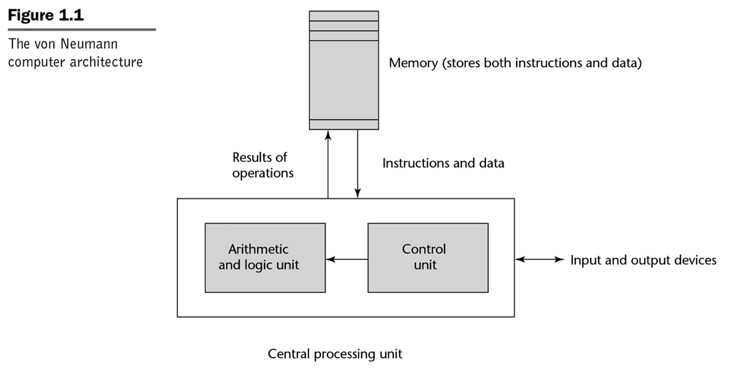
The Von Neumann Computer Architecture
Notes:
[Sebesta]

Slide 5
GCD (Euclid’s Algorithm) in C
To compute the gcd of a and b, check to see if a and b are equal. If so, print one of them and stop. Otherwise, replace the larger one by their difference and repeat.
#include <stdio.h>
int gcd(int a, int b) {
while (a != b) {
if (a > b) a = a - b;
else b = b - a;
}
return a;
}
Notes:
[S] Also:
int main()
{
int i, j;
scanf("%d %d", &i, &j);
printf("%d\n", gcd(i, j));
}

Slide 6
Functional Languages
Model of computation is the lambda calculus (of function application)
No variables or write-once variables
No destructive assignment
Program computes by applying a functional form to an argument
Program are built by composing simple functions into progressively more complicated ones
Recursion is the preferred means of repetition

Slide 7
GCD (Euclid’s Algorithm) in Scheme
The gcd of a and b is defined to be (1) a when a and b are equal, (2) the gcd of b and a-b when a > b and (3) the gcd of a and b-a when b > a. To compute the gcd of a given pair of numbers, expand and simplify this definition until it terminates
(define gcd2 ; 'gcd' is built-in to R5RS
(lambda (a b)
(cond ((= a b) a)
((> a b) (gcd2 (- a b) b))
(else (gcd2 (- b a) a)))))
Notes:
Show the algorithm in Haskell too (20151124_190.hs in csce330f09/hutton/chapterPrograms)

Slide 8
GCD (Euclid’s Algorithm) in OCaml
The gcd of a and b is defined to be (1) a when a and b are equal, (2) the gcd of b and a-b when a > b and (3) the gcd of a and b-a when b > a. To compute the gcd of a given pair of numbers, expand and simplify this definition until it terminates
let rec gcd a b =
if a = b then a
else if a > b then gcd b (a – b)
else gcd a (b – a)
Notes:
[S], Fourth Edition (2016)

Slide 9
GCD (Euclid’s Algorithm) in Haskell
The gcd of a and b is defined to be (1) a when a and b are equal, (2) the gcd of b and a-b when a > b and (3) the gcd of a and b-a when b > a. To compute the gcd of a given pair of numbers, expand and simplify this definition until it terminates
-- GCD (Euclid's Algorithm) in Haskell; requires non-negative
-- arguments.
gcd' :: Integral a => a -> a -> a
gcd' m n | m == n = m
| otherwise = if m > n then gcd' (m - n) n
else gcd' m (n - m)
Notes:
Show the algorithm in Haskell too (20151124_190.hs in csce330f09/hutton/chapterPrograms); also in the csce190f17 directory. May also show the binary string transmitter (transmit.hs) in C:\Users\mgv\courses_D_Fujitsu161013\csce330f09\hutton\huttonPrograms2016\Code

Slide 10
Logic Languages
Model of computation is the Post production system
Write-once variables
Rule-based programming
Related to Horn logic, a subset of first-order logic
AND and OR non-determinism can be exploited in parallel execution
Almost unbelievably simple semantics
Prolog is a compromise language: not a pure logic language

Slide 11
GCD (Euclid’s Algorithm) in Prolog
The proposition gcd(a,b,g) is true if (a) a,b, and g are equal; (2) a is greater than b and there exists a number c such that c is a-b and gcd(c,g,b) is true; or (3) a is less than b and there exists a number c such that c is b-a and gcd(c,a,g) is true. To compute the gcd of a given pair of numbers, search for a number g (and various numbers c) for which these rules allow one to prove that gcd(a,b,g) is true
gcd(A,B,G) :- A = B, G = A.
gcd(A,B,G) :- A > B, C is A-B, gcd(C,B,G).
gcd(A,B,G) :- B > A, C is B-A, gcd(C,A,G).
Notes:
Show gcd program in Prolog (gcd_190_20151124.pl in csce330f12/levesque/TCFiles). Also gcd_and_family.pl in csce190f18.pl.

Slide 12
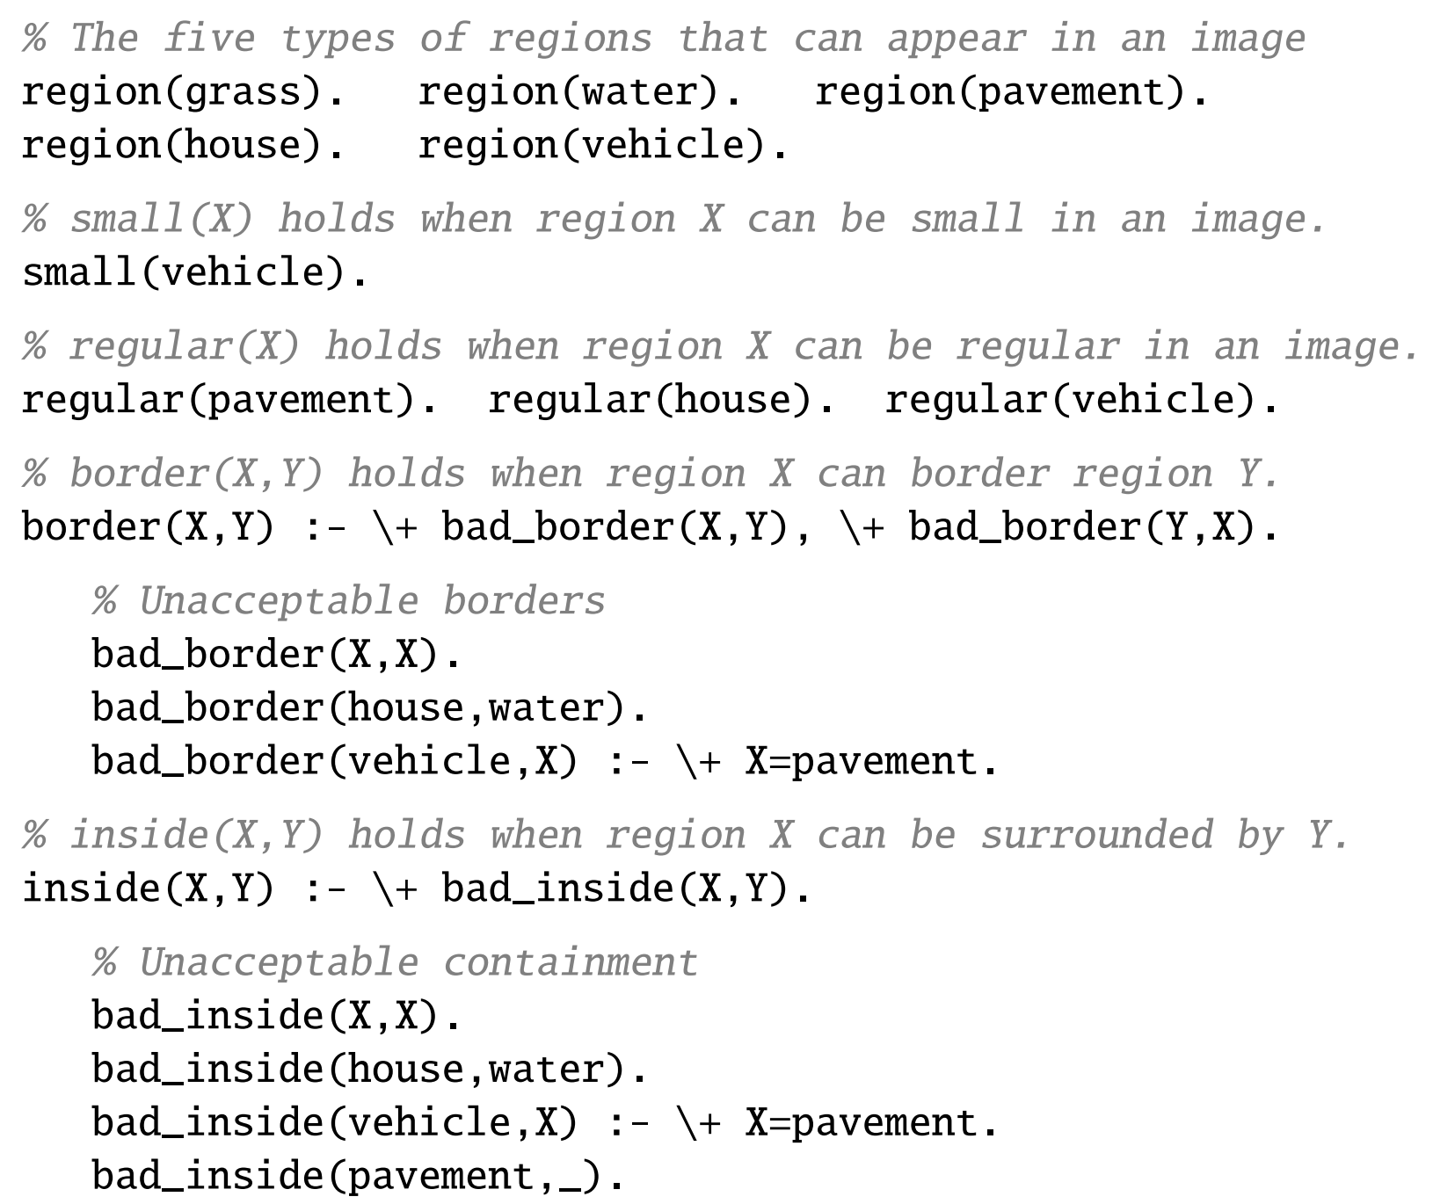
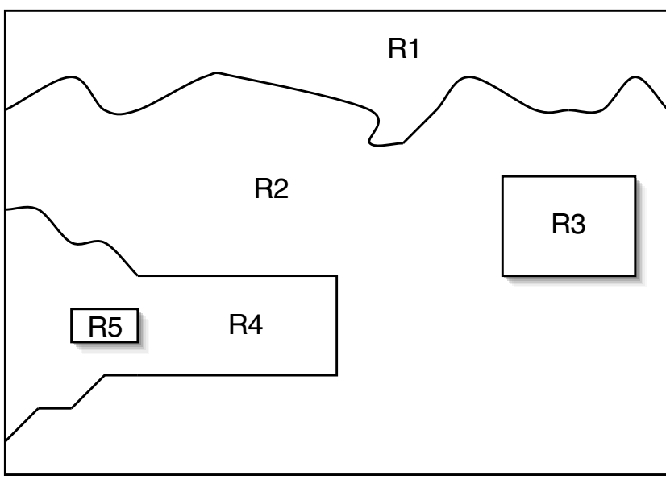
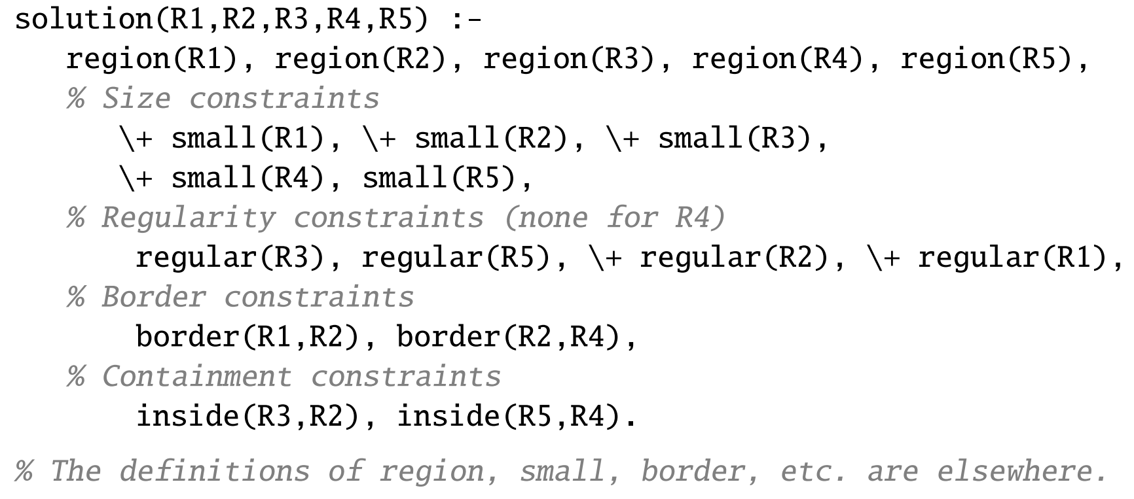
An Example: Aerial Sketch Interpretation as a Logic Program
Notes:
These are Prolog programs taught in CSCE 330.
Source: Slides by the H.L. for: Hector J. Levesque. Thinking as Computation: A First Course. MIT Press, 2012.

Slide 13
Some Historical Perspective
“Every programmer knows there is one true programming language. A new one every week.”
  Brian Hayes, “The Semicolon Wars.” American Scientist, July-August 2006, pp.299-303
  http://www.americanscientist.org/template/AssetDetail/assetid/51982#52116
Language families
Evolution and Design

Slide 14
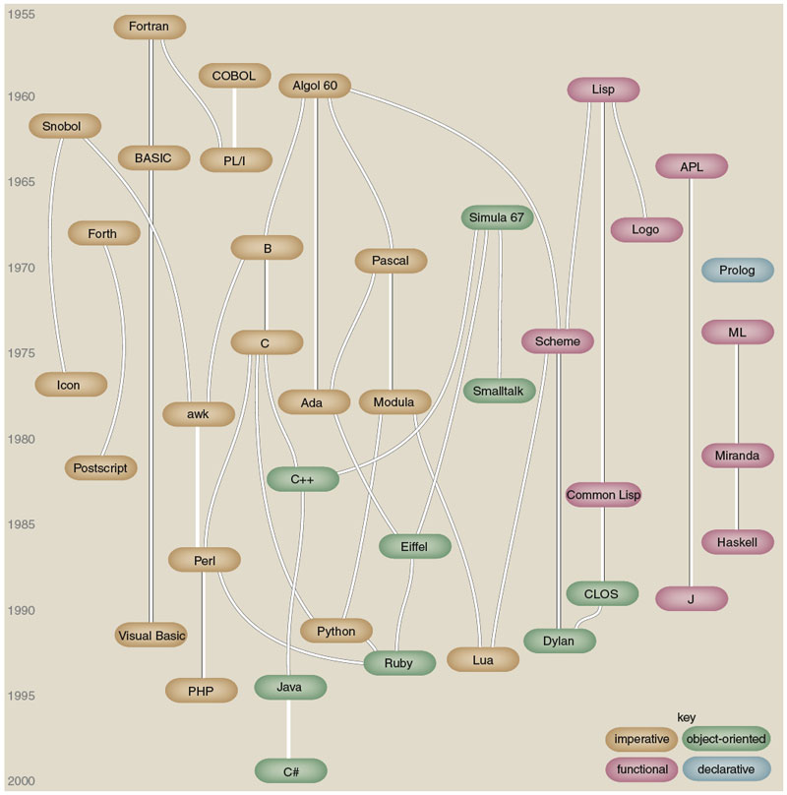
Figure by Brian Hayes
(who credits, in part, Éric Lévénez and Pascal Rigaux):
Brian Hayes, “The Semicolon Wars.” American Scientist, July-August 2006, pp.299-303
Notes:
Also see figure A.1 in [S], p.820.

Slide 15
Some Historical Perspective
Plankalkül (Konrad Zuse, 1943-1945)
FORTRAN (John Backus, 1956)
LISP (John McCarthy, 1960)
ALGOL 60 (Transatlantic Committee, 1960)
COBOL (US DoD Committee, 1960)
APL (Iverson, 1962)
BASIC (Kemeny and Kurz, 1964)
PL/I (IBM, 1964)
SIMULA 67 (Nygaard and Dahl, 1967)
ALGOL 68 (Committee, 1968)
Pascal (Niklaus Wirth, 1971)
C (Dennis Ritchie, 1972)
Prolog (Alain Colmerauer, 1972)
Smalltalk (Alan Kay, 1972)
FP (Backus, 1978)
Ada (UD DoD and Jean Ichbiah, 1983)
C++ (Stroustrup, 1983)
Modula-2 (Wirth, 1985)
Delphi (Borland, 1988?)
Modula-3 (Cardelli, 1989)
ML (Robin Milner, 1978)
Haskell (Committee, 1990)
Eiffel (Bertrand Meyer, 1992)
Java (Sun and James Gosling, 1993?)
C# (Microsoft, 2001?)
Scripting languages such as Perl, etc.
Etc.

Slide 16


Alain Colmerauer and John Backus
Alain Colmerauer (1941-2017), the creator of Prolog
John Backus (1924-2007), the creator of FP
Notes:
http://alain.colmerauer.free.fr/, accessed 2010-08-17
http://en.wikipedia.org/wiki/John_Backus and http://www.nytimes.com/2007/03/20/business/20backus.html?_r=2&hp&oref=slogin accessed 2010-08017, accessed 2010-08-17

Slide 17
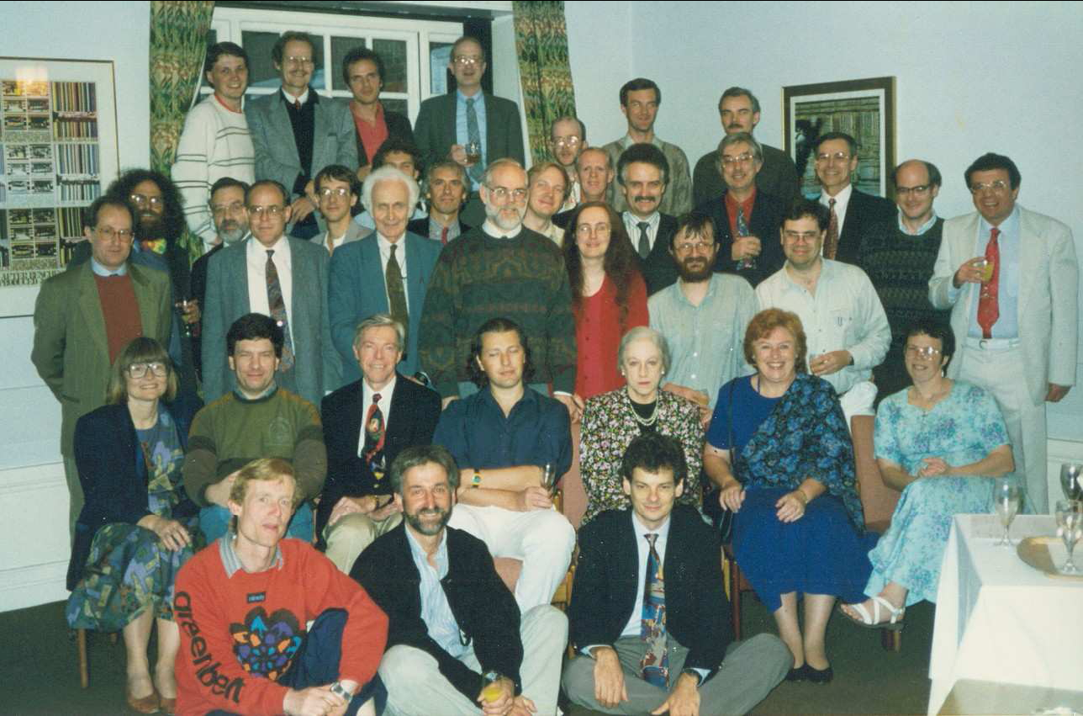
Haskell committee, 1992---history from www.haskell.org
Notes:
From the History of Haskell paper in the csce330f15 folder (p.6).

Slide 18
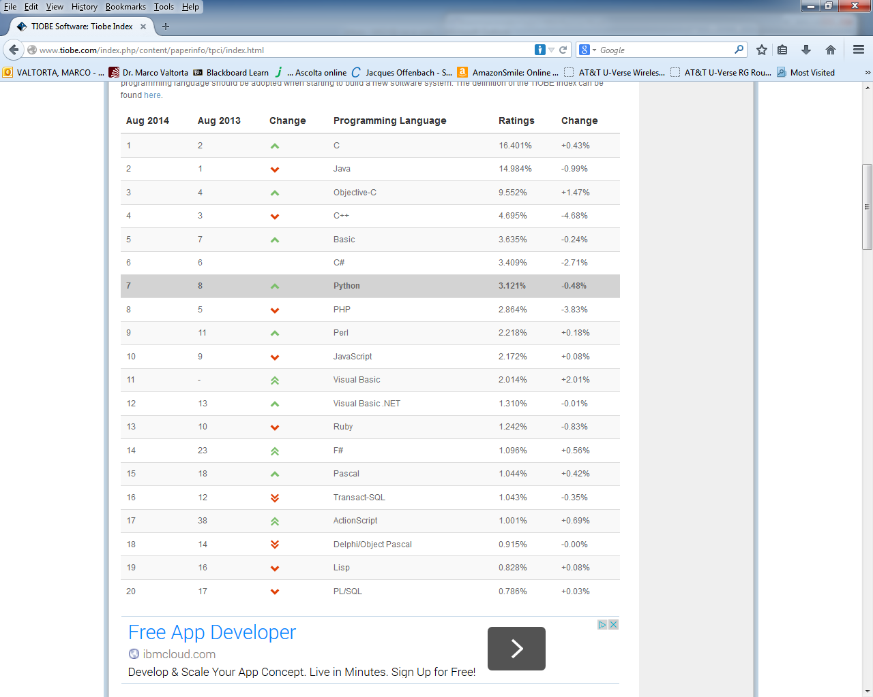
August 2014 Tiobe PL Index
Notes:
Accessed 2014-08-21. Haskell is #40 (was #34 in August 2013 and 2012), Prolog is #46 (was #36 in August 2013, #31 in August 2012), Fortran is #34, and ML is #25.

Slide 19
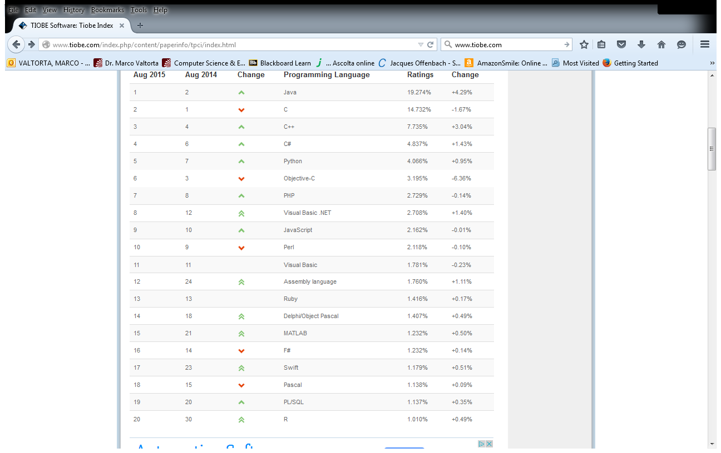
August 2015 Tiobe PL Index
Notes:
Accessed 2014-08-18. Haskell is #41 (was #40 in August 2014, #34 in August 2013 and 2012), Prolog is #32 (was #46 in August 2014, #36 in August 2013, #31 in August 2012), Fortran is #24 (was #34 in August 2014), and ML is #46.

Slide 20
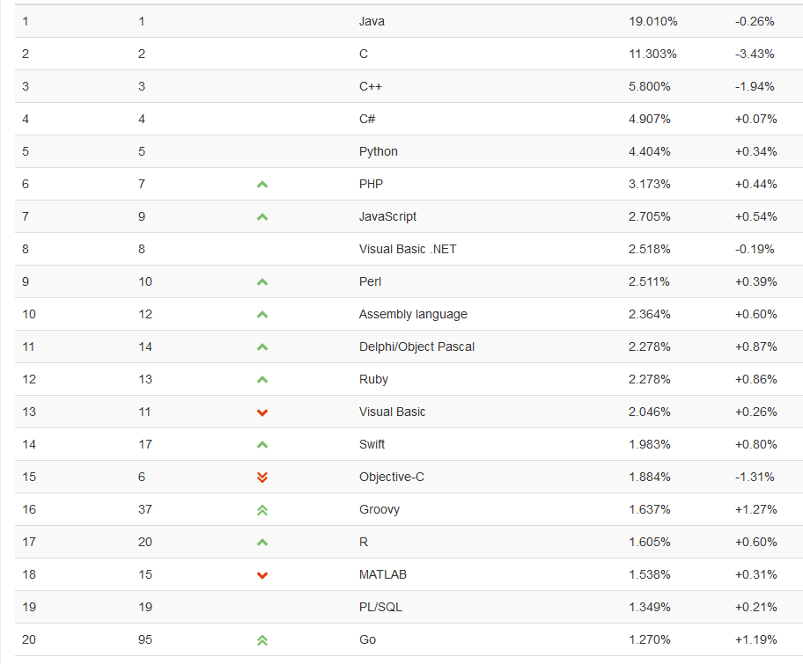
August 2016 Tiobe PL Index
Notes:
Accessed 2016-08-17. Haskell is #39 (was #41 in August 2015, #40 in August 2014, #34 in August 2013 and 2012), Prolog is #33 (was #32 in August 2015, #46 in August 2014, #36 in August 2013, #31 in August 2012), Fortran is #28 (was #24 in August 2015, #34 in August 2014), and ML is in the 51-100 range (was #46 in August 2015).

Slide 21
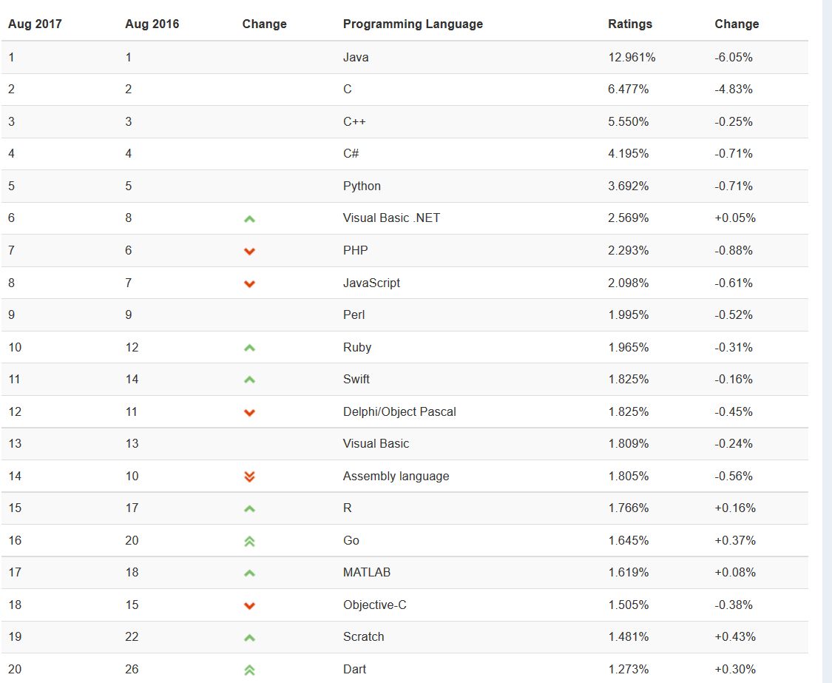
August 2017 Tiobe PL Index
Notes:
Accessed 2018-12-04. Haskell is #38 (was #47 in August 2017, was #39 in August 2016, #41 in August 2015, #40 in August 2014, #34 in August 2013 and 2012), Prolog is# 31 (was #30 in August 2017 was #33 in August 2016, #32 in August 2015, #46 in August 2014, #36 in August 2013, #31 in August 2012), Fortran is #35 (was #28 in August 2016, #24 in August 2015, #34 in August 2014), and ML is in the 51-100 range (was in that range in August 2016, #46 in August 2015).

Slide 22
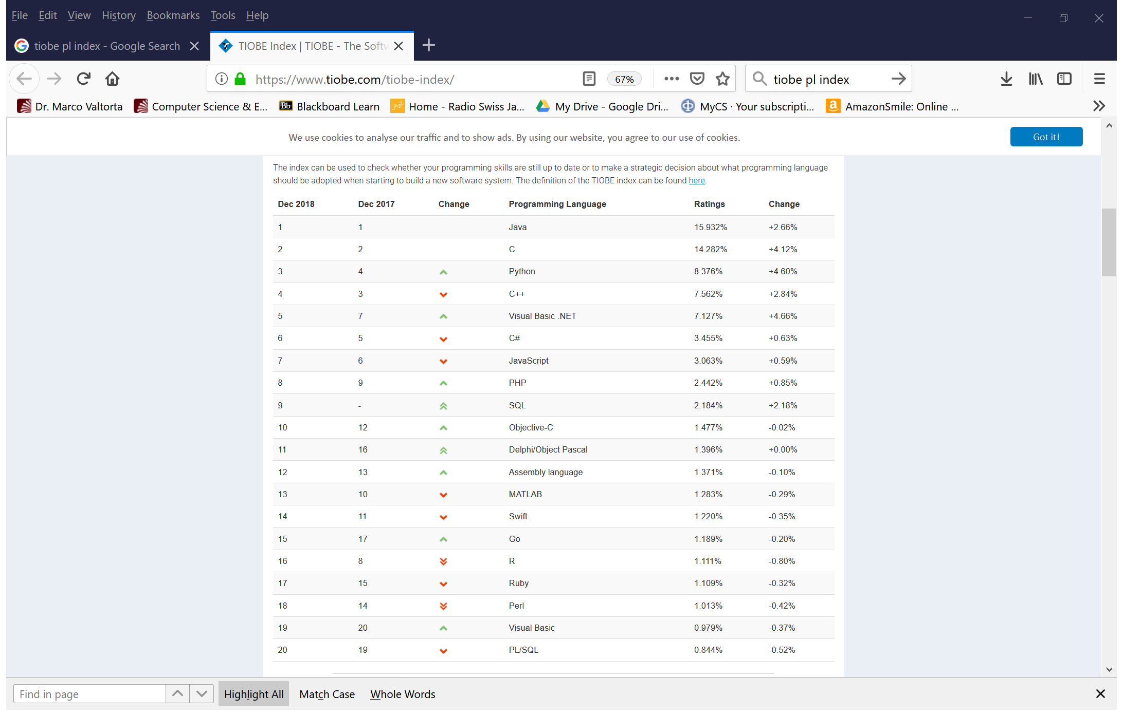
December 2018 Tiobe PL Index
Notes:
Accessed 2017-08-23. Haskell is #47 (was #39 in August 2016, #41 in August 2015, #40 in August 2014, #34 in August 2013 and 2012), Prolog is #30 (was #33 in August 2016, #32 in August 2015, #46 in August 2014, #36 in August 2013, #31 in August 2012), Fortran is #27 (was #35 in August 2017, #28 in August 2016, #24 in August 2015, #34 in August 2014), and ML is in the 51-100 range (Ocaml and Standard ML are both in this range; was in that range in August 2017, August 2016, #46 in August 2015).

Slide 23
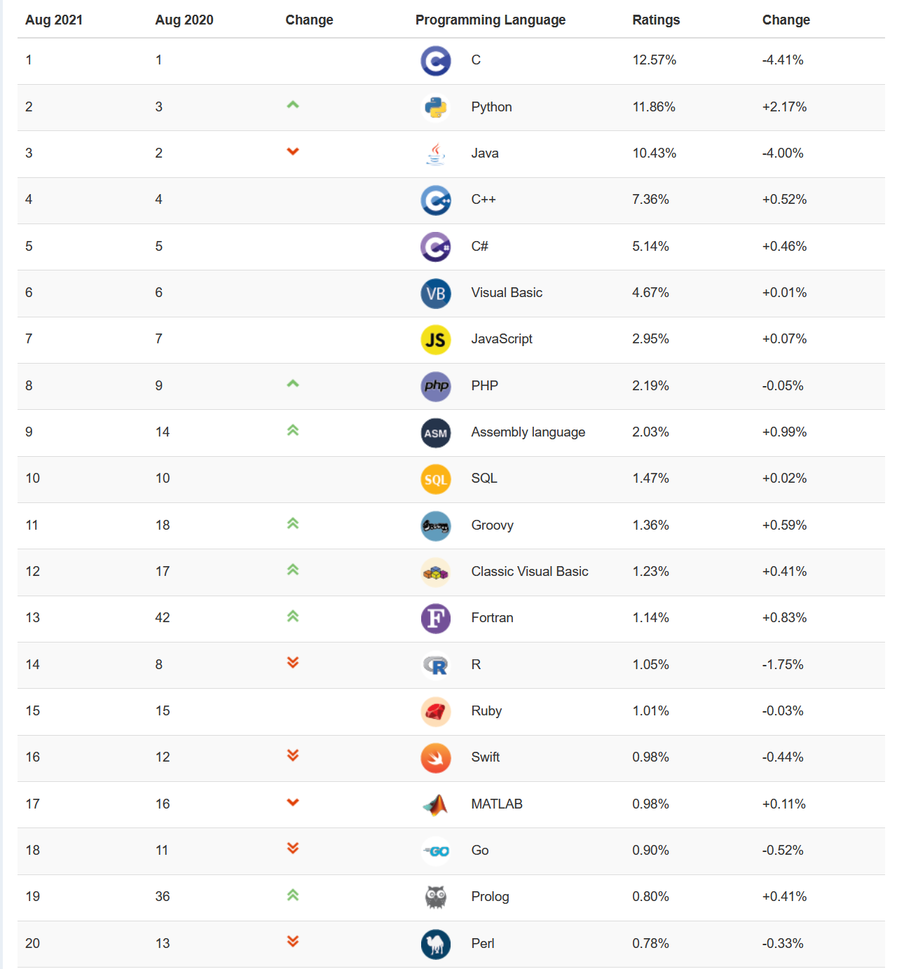
August 2021Tiobe PL Index
Notes:
Accessed 2021-08-24. Haskell is in the 51-100 range (was #47 in December 2017, #39 in August 2016, #41 in August 2015, #40 in August 2014, #34 in August 2013 and 2012), Prolog was #30 in December 2017, #33 in August 2016, #32 in August 2015, #46 in August 2014, #36 in August 2013, #31 in August 2012), Fortran was #27 in December 2017, #35 in August 2017, #28 in August 2016, #24 in August 2015, #34 in August 2014), and ML is in the 51-100 range (Ocaml and Standard ML are both in this range; was in that range in August 2017, August 2016, #46 in August 2015).

Slide 24
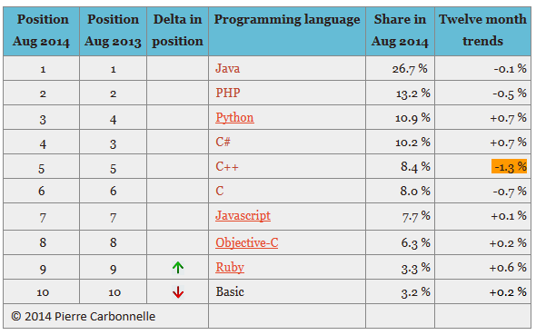
August 2014 PYPL Index
Notes:
PYPL is a competing (with respect to Tiobe) PL popularity index. This chart and the commentary below were downloaded on 2014-08-19 from https://sites.google.com/site/pydatalog/pypl/PyPL-PopularitY-of-Programming-Language.
The PYPL PopularitY of Programming Language index is created by analyzing how often language tutorials are searched on Google : the more a specific language tutorial is searched, the more popular the language is assumed to be. It is a leading indicator. The raw data comes from Google Trends, so that anyone can verify it, or make the analysis for his own country.

Slide 25
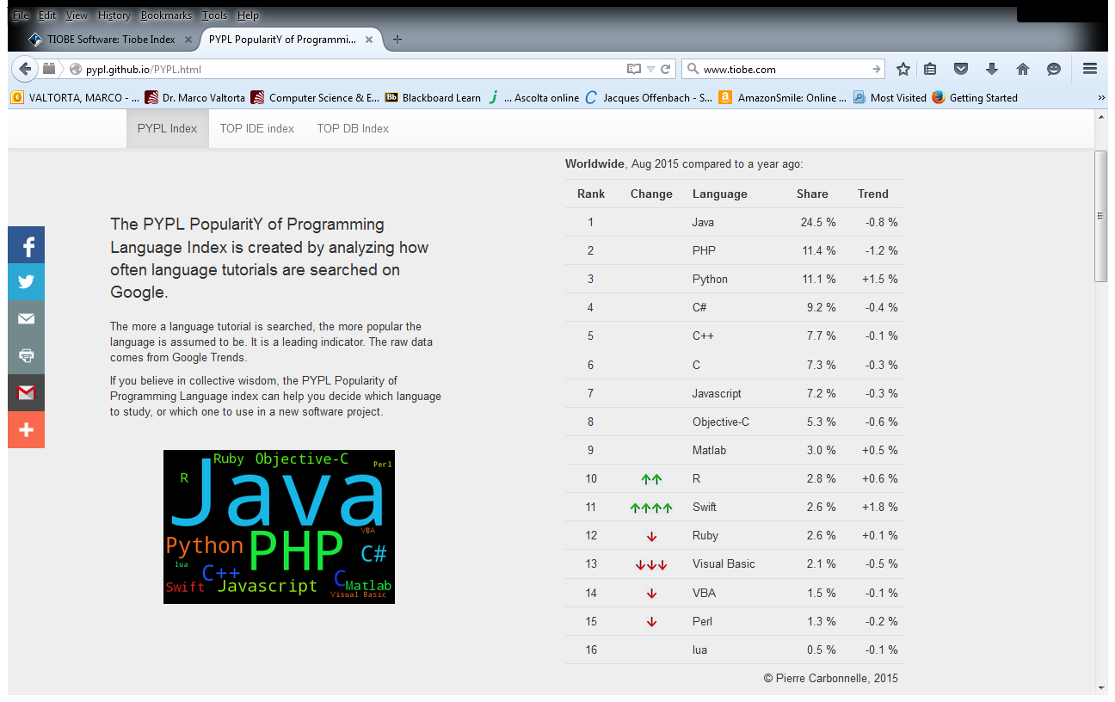
August 2015 PYPL Index
Notes:
PYPL is a competing (with respect to Tiobe) PL popularity index. This chart and the commentary below were downloaded on 2015-08-18 from http://pypl.github.io/PYPL.html. The site includes a custom search engine to construct charts and graphs for specific languages and geographic regions. The PYPL PopularitY of Programming Language index is created by analyzing how often language tutorials are searched on Google : the more a specific language tutorial is searched, the more popular the language is assumed to be. It is a leading indicator. The raw data comes from Google Trends, so that anyone can verify it, or make the analysis for his own country.

Slide 26
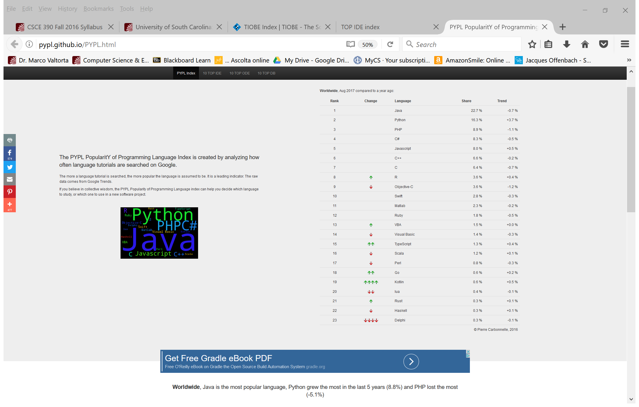
August 2017 PYPL Index
Notes:
PYPL is a competing (with respect to Tiobe) PL popularity index. This chart and the commentary below were downloaded on 2017-08-23 from http://pypl.github.io/PYPL.html. The site includes a custom search engine to construct charts and graphs for specific languages and geographic regions. The PYPL PopularitY of Programming Language index is created by analyzing how often language tutorials are searched on Google : the more a specific language tutorial is searched, the more popular the language is assumed to be. It is a leading indicator. The raw data comes from Google Trends, so that anyone can verify it, or make the analysis for his own country.

Slide 27
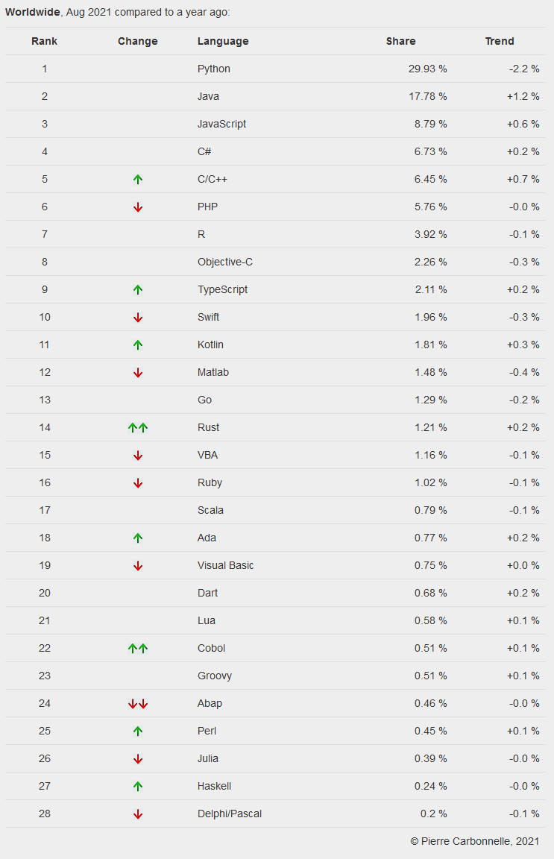
August 2021 PYPL Index
Notes:
PYPL is a competing (with respect to Tiobe) PL popularity index. This chart and the commentary below were downloaded on 2021-08-24 from http://pypl.github.io/PYPL.html. The site includes a custom search engine to construct charts and graphs for specific languages and geographic regions. The PYPL PopularitY of Programming Language index is created by analyzing how often language tutorials are searched on Google : the more a specific language tutorial is searched, the more popular the language is assumed to be. It is a leading indicator. The raw data comes from Google Trends, so that anyone can verify it, or make the analysis for his own country.

Slide 28
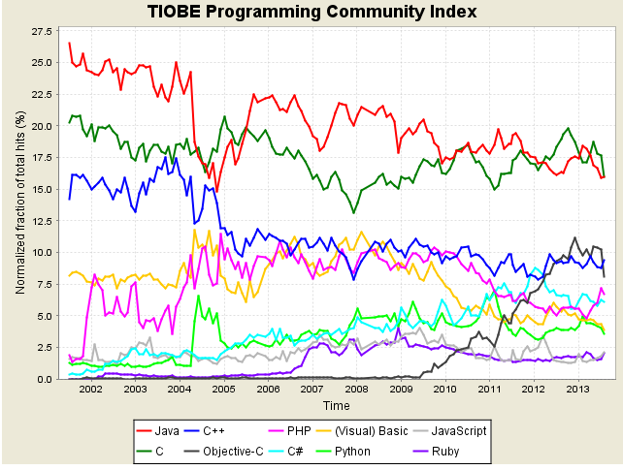
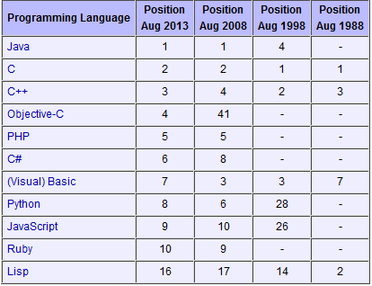
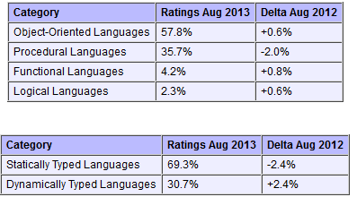
Tiobe Index Long Term Trends, August 2013
Notes:
http://www.tiobe.com/index.php/content/paperinfo/tpci/index.html, accessed 2013-08-20. The end of 2004 drop for Java is due to a change in Google. See http://www.tiobe.com/index.htm?tiobe_index, accessed on 2007-08-23.
Static vs. Dynamic Typing will be explained in a later lecture.

Slide 29
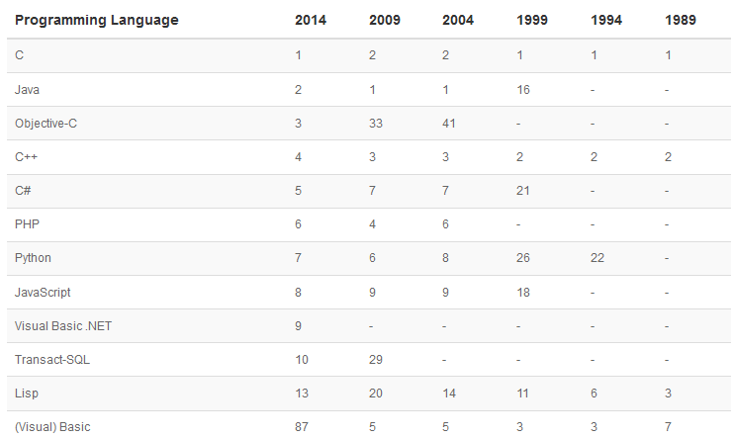
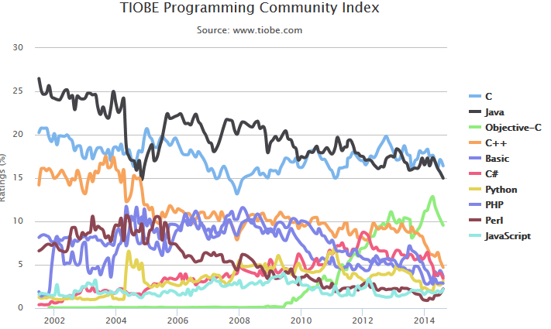
Tiobe Index Long Term Trends, August 2014
Notes:
http://www.tiobe.com/index.php/content/paperinfo/tpci/index.html, accessed 2014-08-19. The end of 2004 drop for Java is due to a change in Google. See http://www.tiobe.com/index.htm?tiobe_index, accessed on 2007-08-23. Apparently, Tiobe no longer provides “category” tables.
Static vs. Dynamic Typing will be explained in a later lecture.

Slide 30
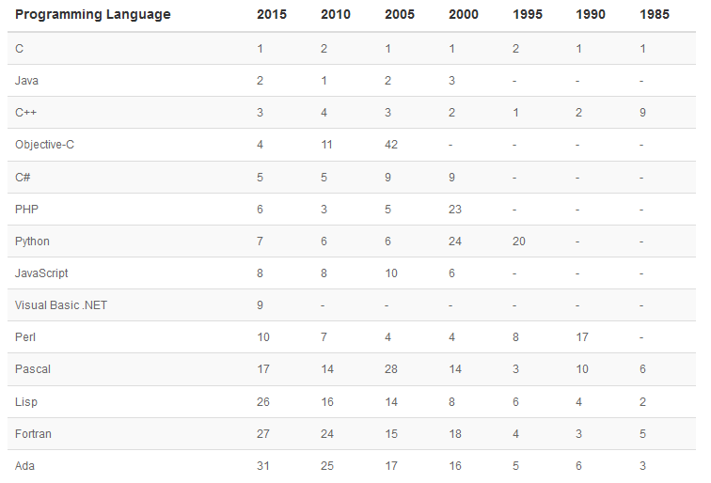
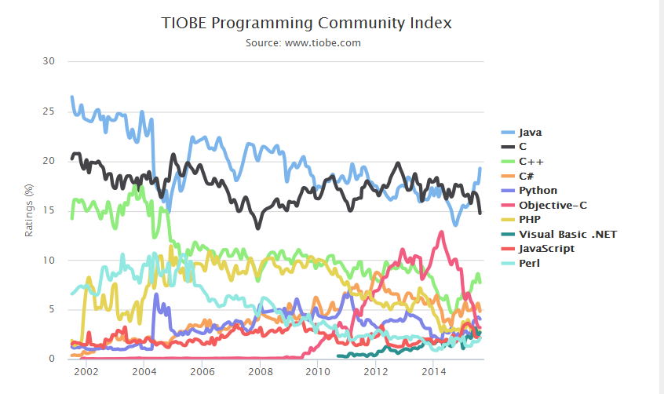
Tiobe Index Long Term Trends, August 2015
Notes:
http://www.tiobe.com/index.php/content/paperinfo/tpci/index.html, accessed 2015-08-18. The end of 2004 drop for Java is due to a change in Google. See http://www.tiobe.com/index.htm?tiobe_index, accessed on 2007-08-23. Apparently, Tiobe no longer provides “category” tables.
Static vs. Dynamic Typing will be explained in a later lecture.

Slide 31
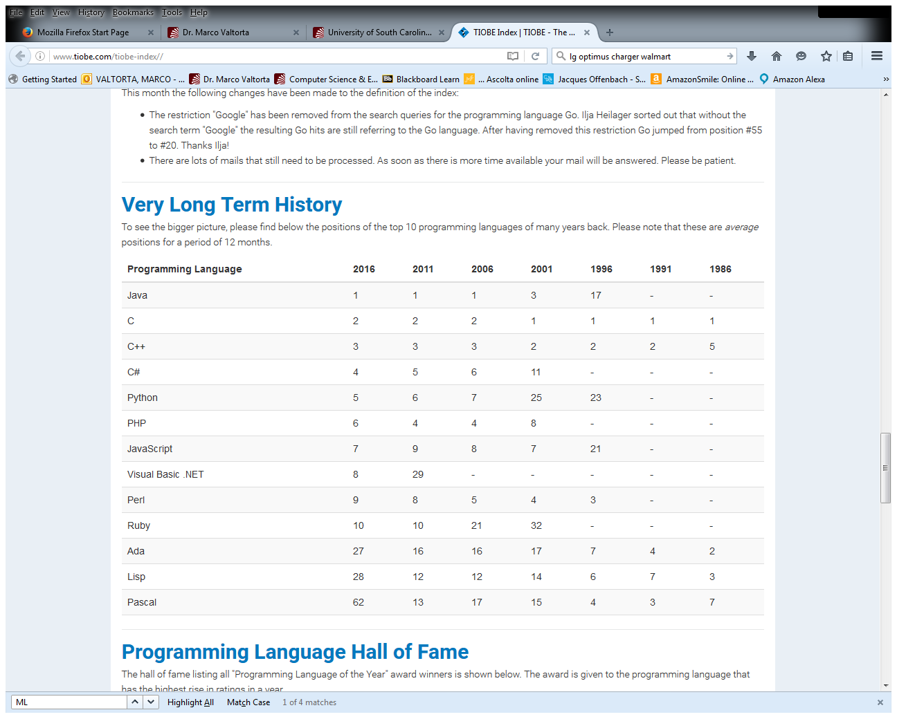
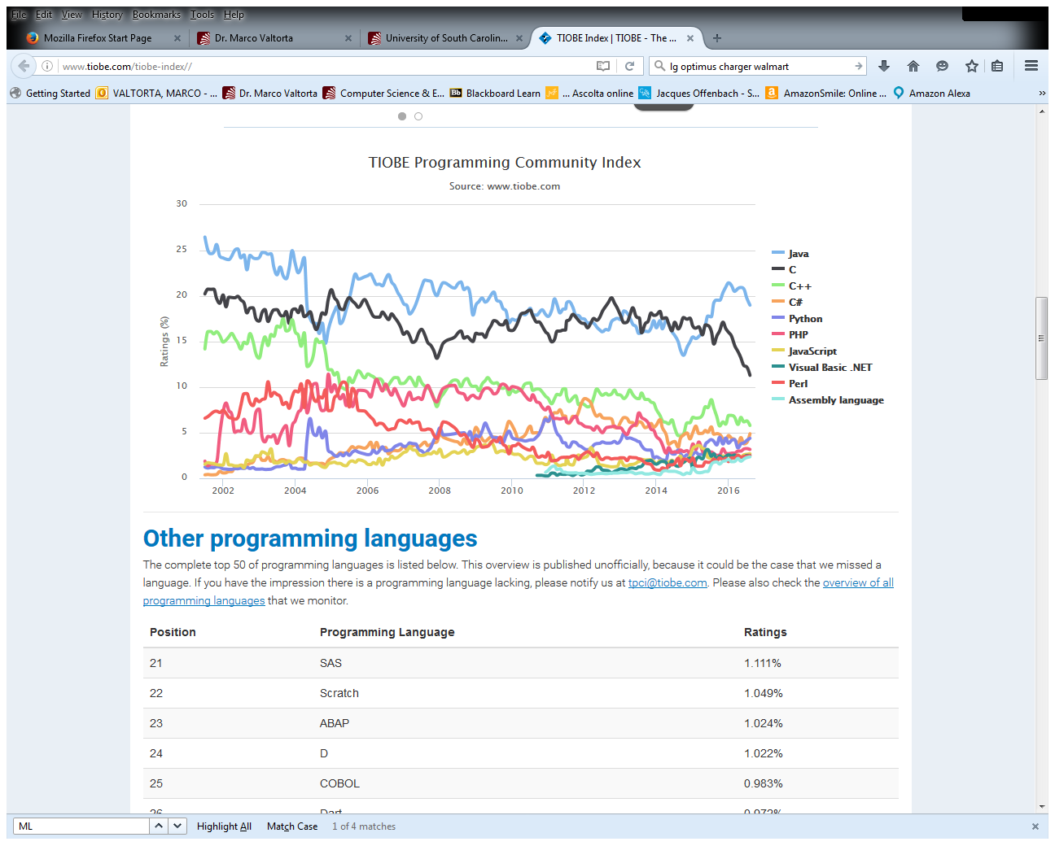
Tiobe Index Long Term Trends, August 2016
Notes:
http://www.tiobe.com/index.php/content/paperinfo/tpci/index.html, accessed 2016-08-17. The end of 2004 drop for Java is due to a change in Google. See http://www.tiobe.com/index.htm?tiobe_index, accessed on 2007-08-23. Apparently, Tiobe no longer provides “category” tables.
Static vs. Dynamic Typing will be explained in a later lecture.

Slide 32
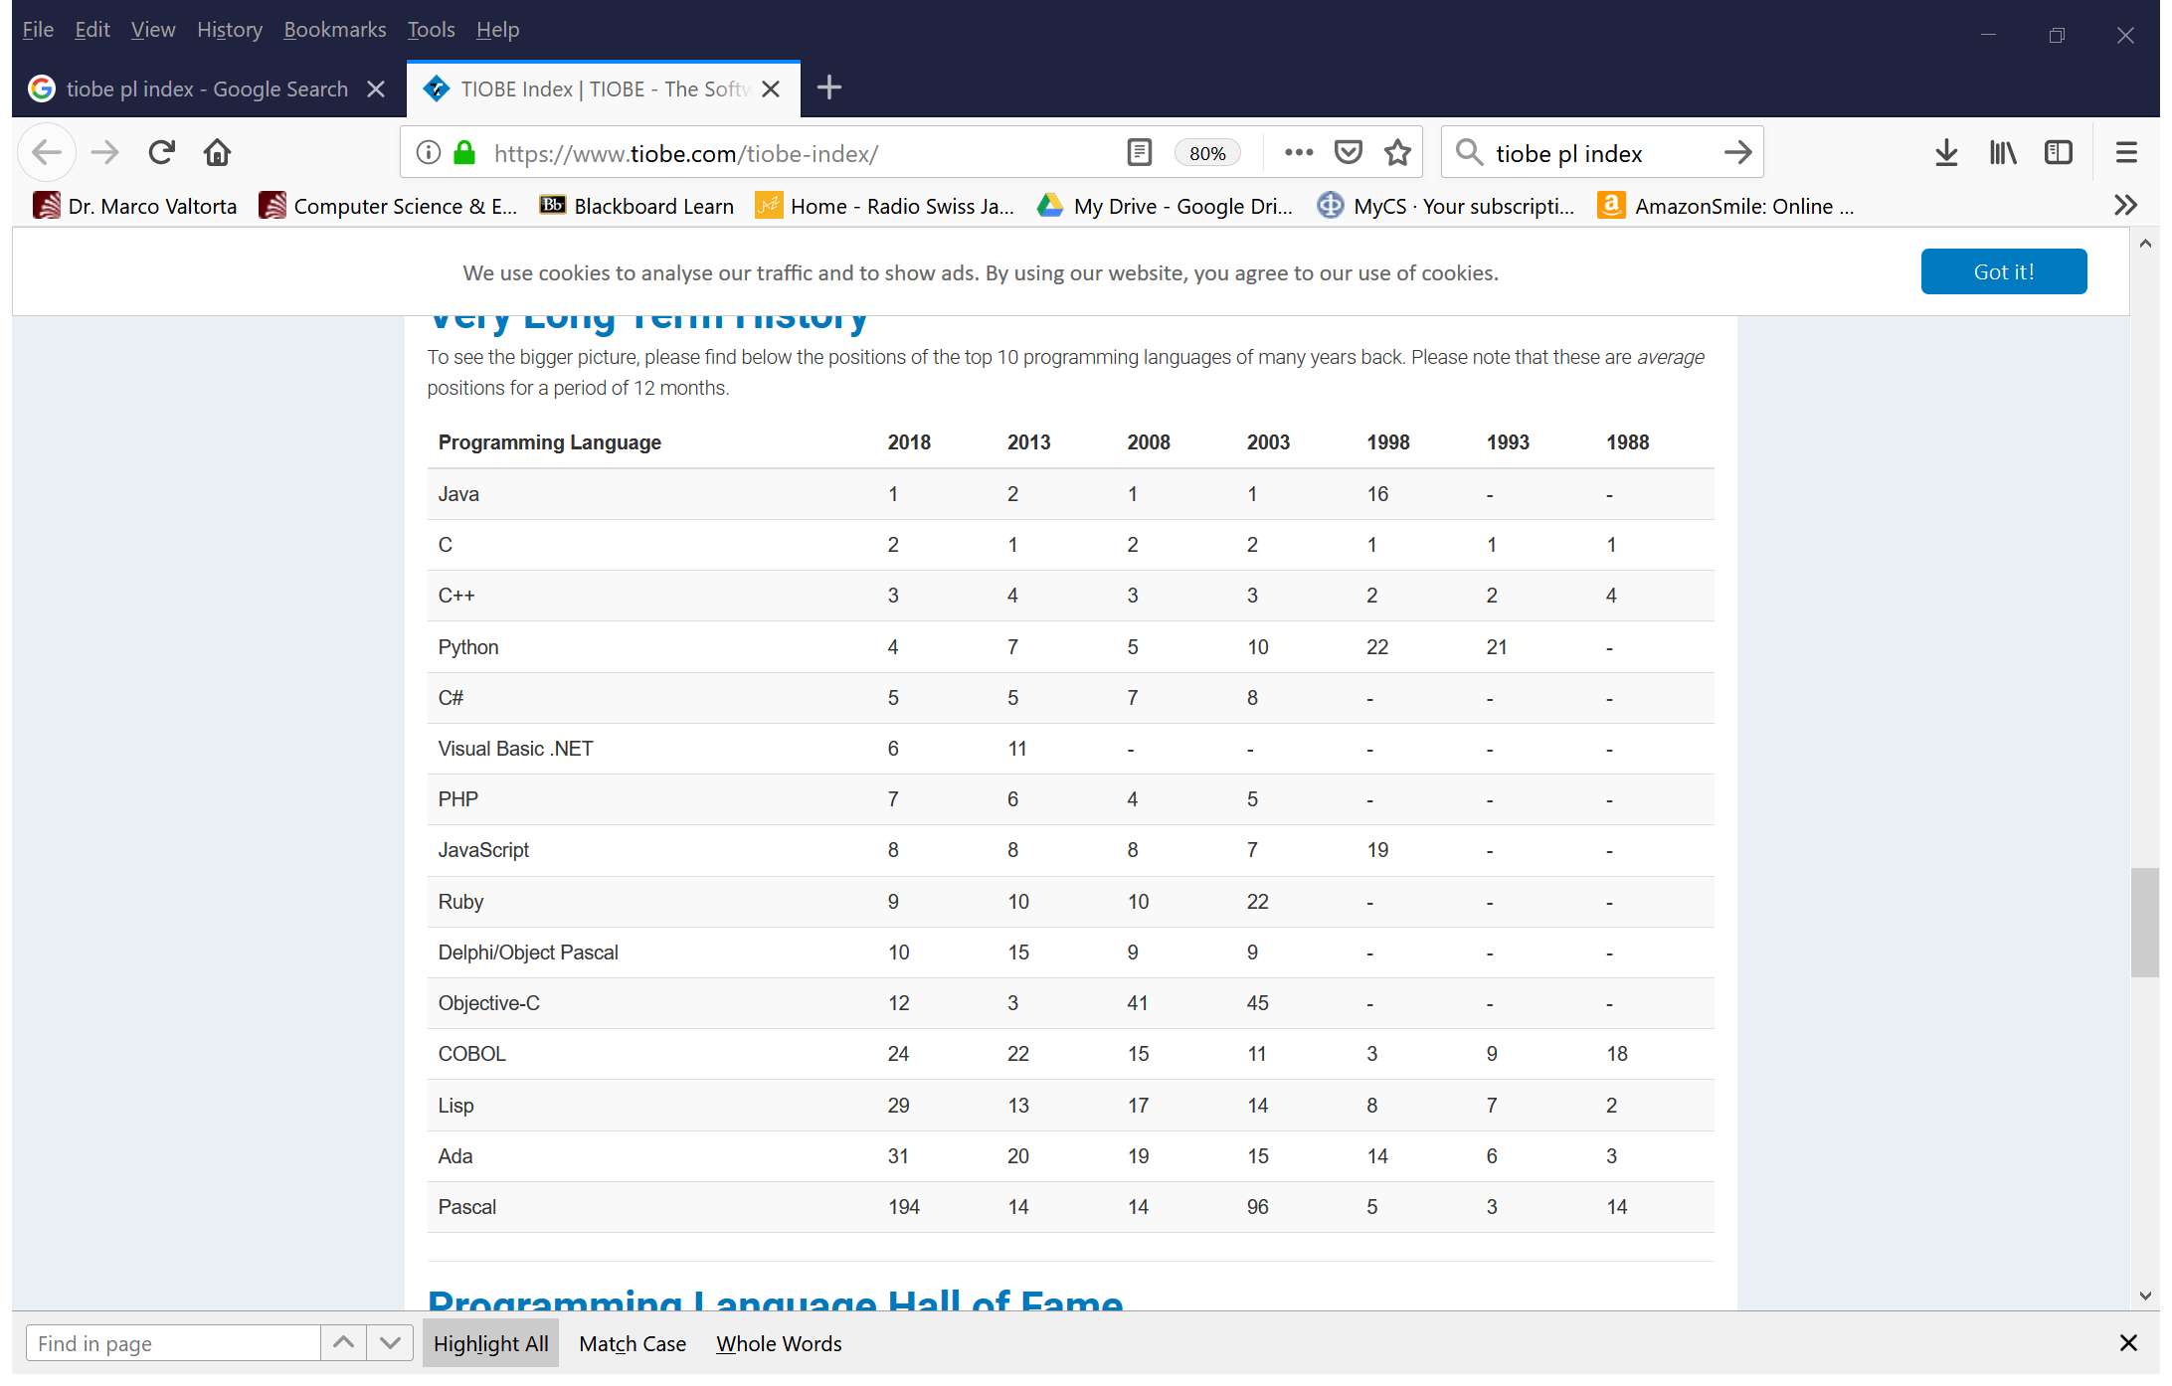
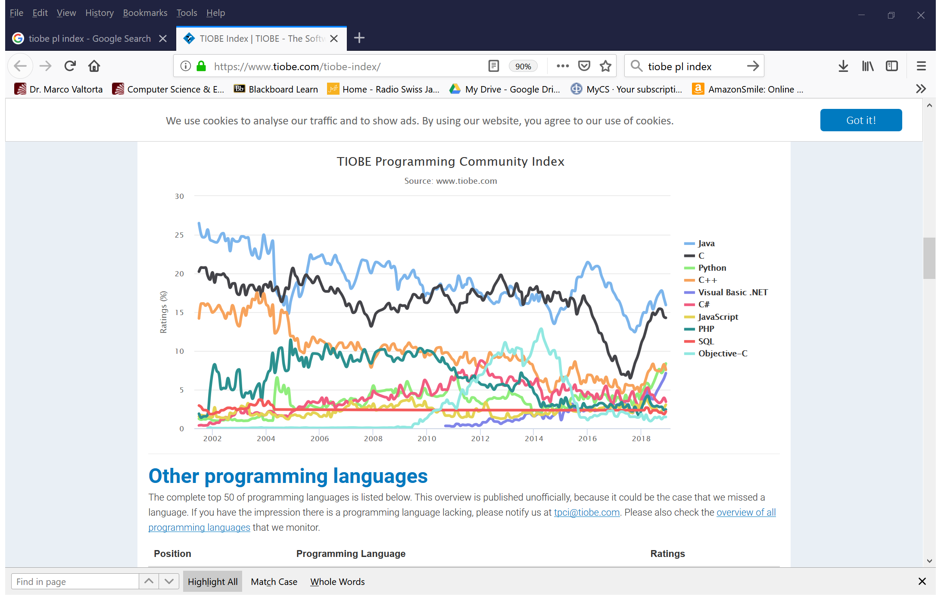
Tiobe Index Long Term Trends, December 2018
Notes:
http://www.tiobe.com/index.php/content/paperinfo/tpci/index.html, accessed 2018-12-04. The end of 2004 drop for Java is due to a change in Google. Apparently, Tiobe no longer provides “category” tables. Static vs. Dynamic Typing will be explained in CSCE 330.

Slide 33
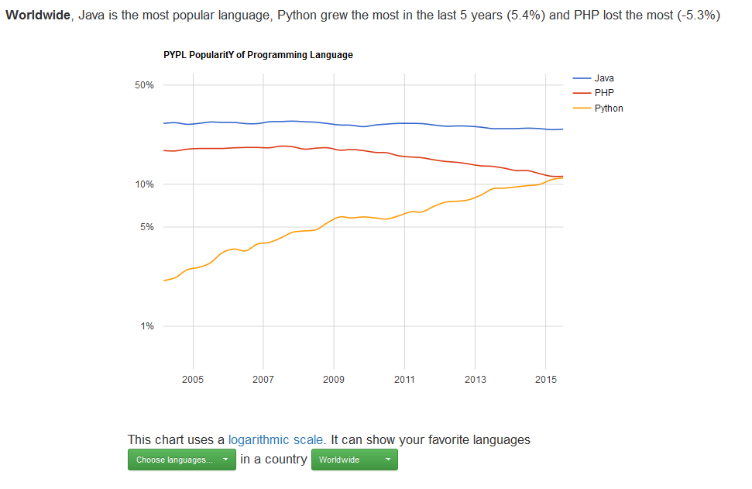
August 2015 PYPL Long-Term Index
Notes:
PYPL is a competing (with respect to Tiobe) PL popularity index. This chart and the commentary below were downloaded on 2015-08-18 from http://pypl.github.io/PYPL.html. The site includes a custom search engine to construct charts and graphs for specific languages and geographic regions. The PYPL PopularitY of Programming Language index is created by analyzing how often language tutorials are searched on Google : the more a specific language tutorial is searched, the more popular the language is assumed to be. It is a leading indicator. The raw data comes from Google Trends, so that anyone can verify it, or make the analysis for his own country.

Slide 34
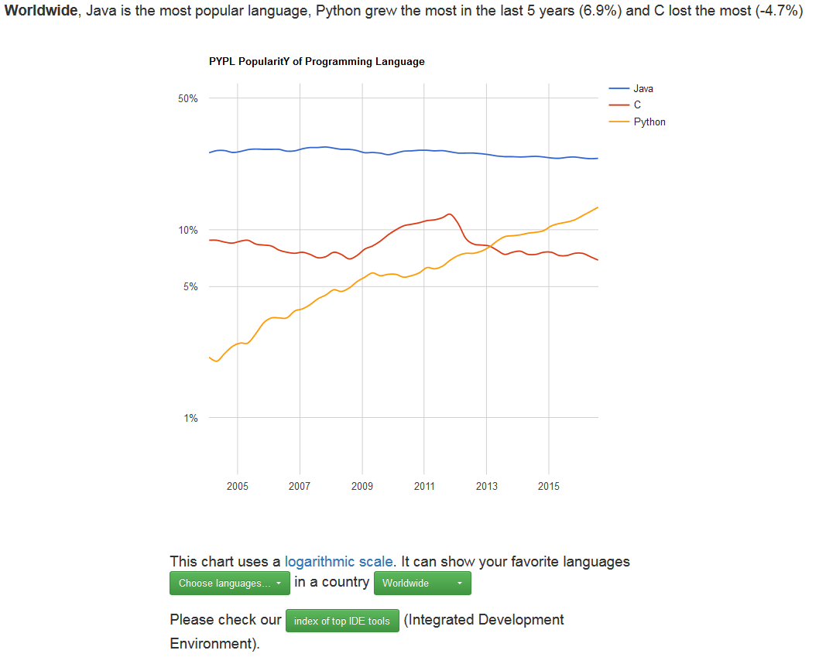
August 2016 PYPL Long-Term Index
Notes:
PYPL is a competing (with respect to Tiobe) PL popularity index. This chart and the commentary below were downloaded on 2016-08-17 from http://pypl.github.io/PYPL.html. The site includes a custom search engine to construct charts and graphs for specific languages and geographic regions. The PYPL PopularitY of Programming Language index is created by analyzing how often language tutorials are searched on Google : the more a specific language tutorial is searched, the more popular the language is assumed to be. It is a leading indicator. The raw data comes from Google Trends, so that anyone can verify it, or make the analysis for his own country. The table is covered by the Creative Commons Attribution 3.0 Unported License (https://creativecommons.org/licenses/by/3.0/).

Slide 35
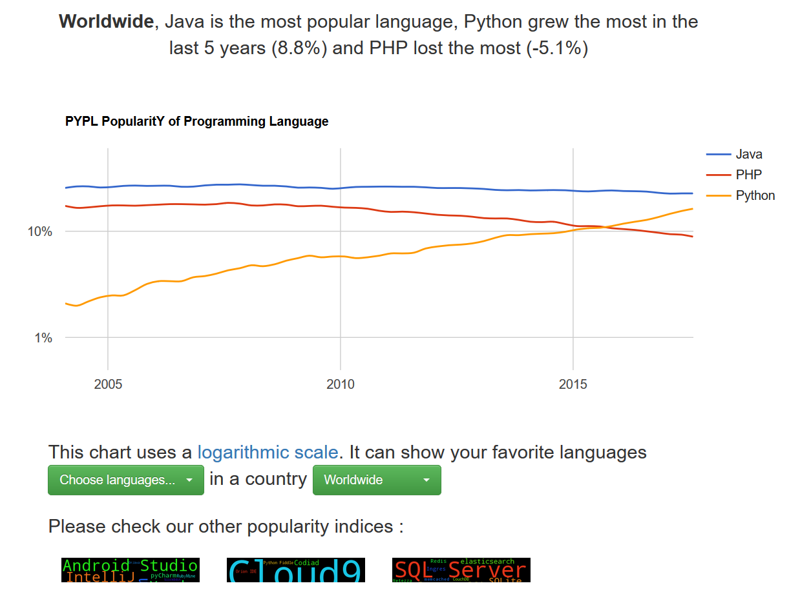
August 2017 PYPL Long-Term Index
Notes:
PYPL is a competing (with respect to Tiobe) PL popularity index. This chart and the commentary below were downloaded on 2017-08-23 from http://pypl.github.io/PYPL.html. The site includes a custom search engine to construct charts and graphs for specific languages and geographic regions. The PYPL PopularitY of Programming Language index is created by analyzing how often language tutorials are searched on Google : the more a specific language tutorial is searched, the more popular the language is assumed to be. It is a leading indicator. The raw data comes from Google Trends, so that anyone can verify it, or make the analysis for his own country. The table is covered by the Creative Commons Attribution 3.0 Unported License (https://creativecommons.org/licenses/by/3.0/).

Slide 36
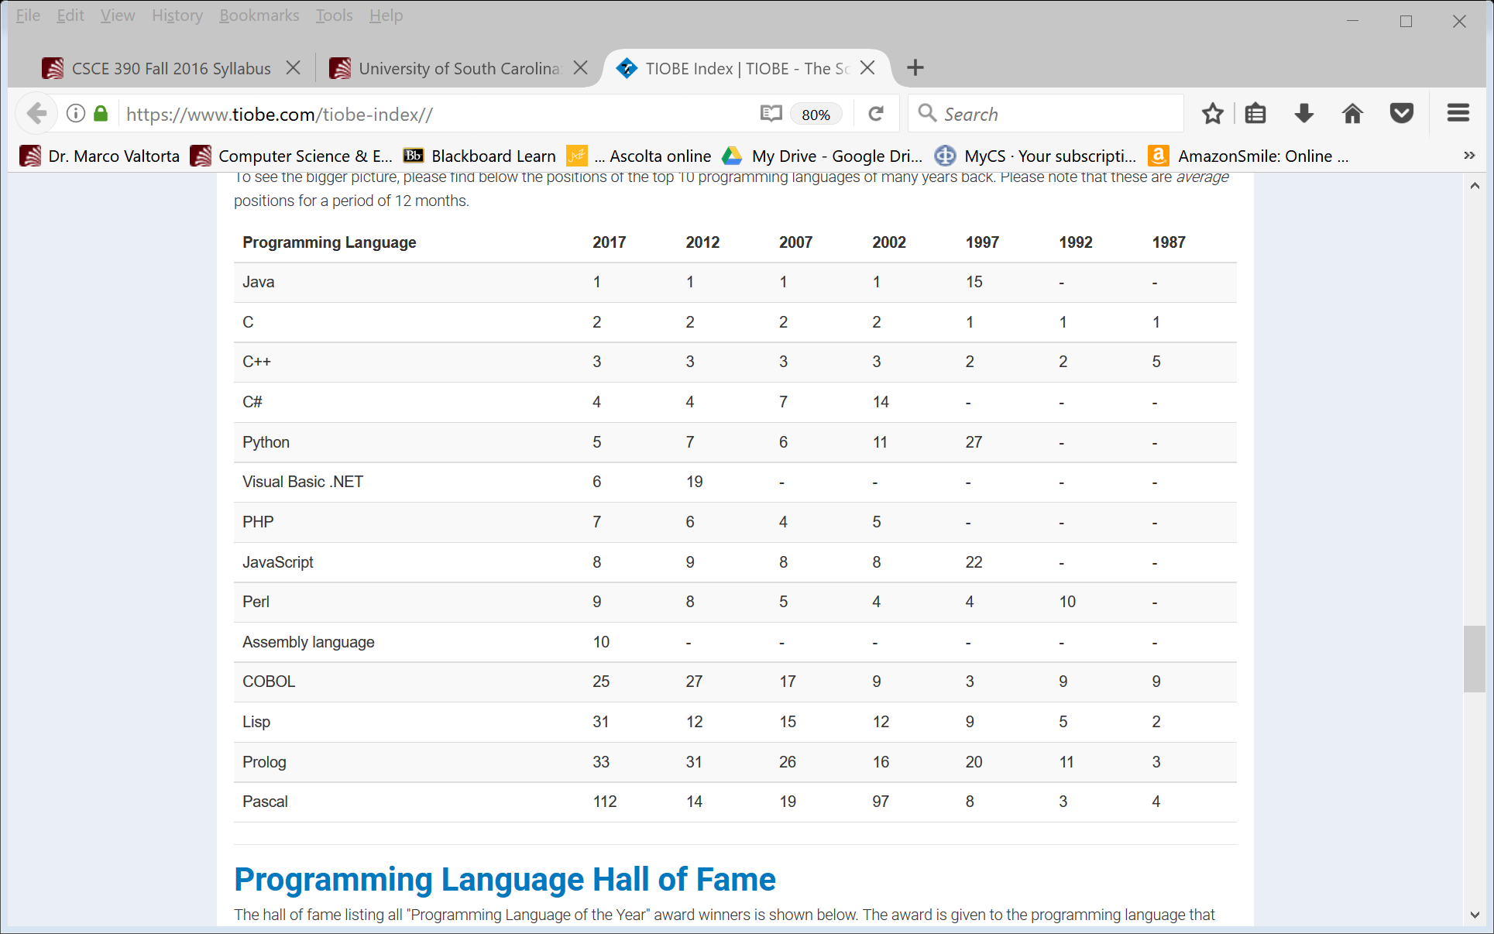
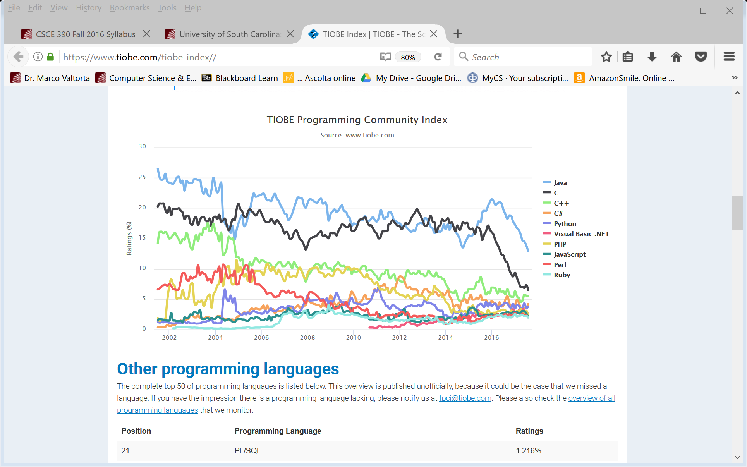
Tiobe Index Long Term Trends, August 2017
Notes:
http://www.tiobe.com/index.php/content/paperinfo/tpci/index.html, accessed 2017-08-23. The end of 2004 drop for Java is due to a change in Google. See http://www.tiobe.com/index.htm?tiobe_index, accessed on 2007-08-23. Apparently, Tiobe no longer provides “category” tables.
Static vs. Dynamic Typing will be explained in a later lecture.

Slide 37
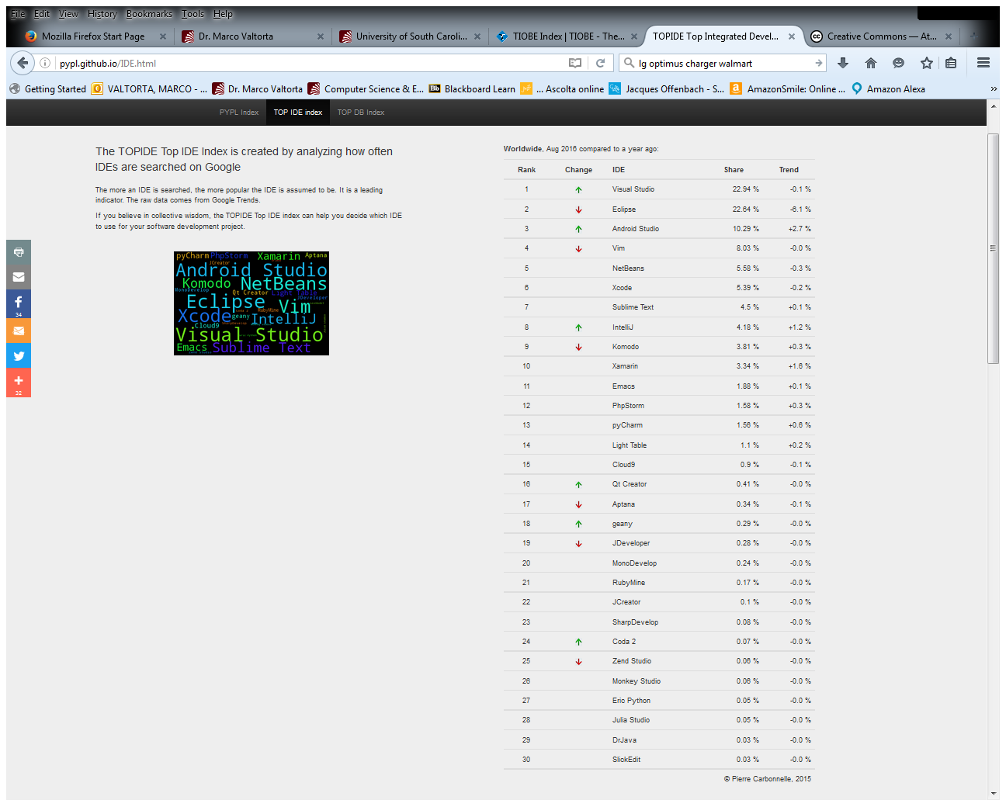
TOPIDE Top IDE Index, August 2016
Notes:
http://pypl.github.io/IDE.html, accessed 2016-08-17.

Slide 38
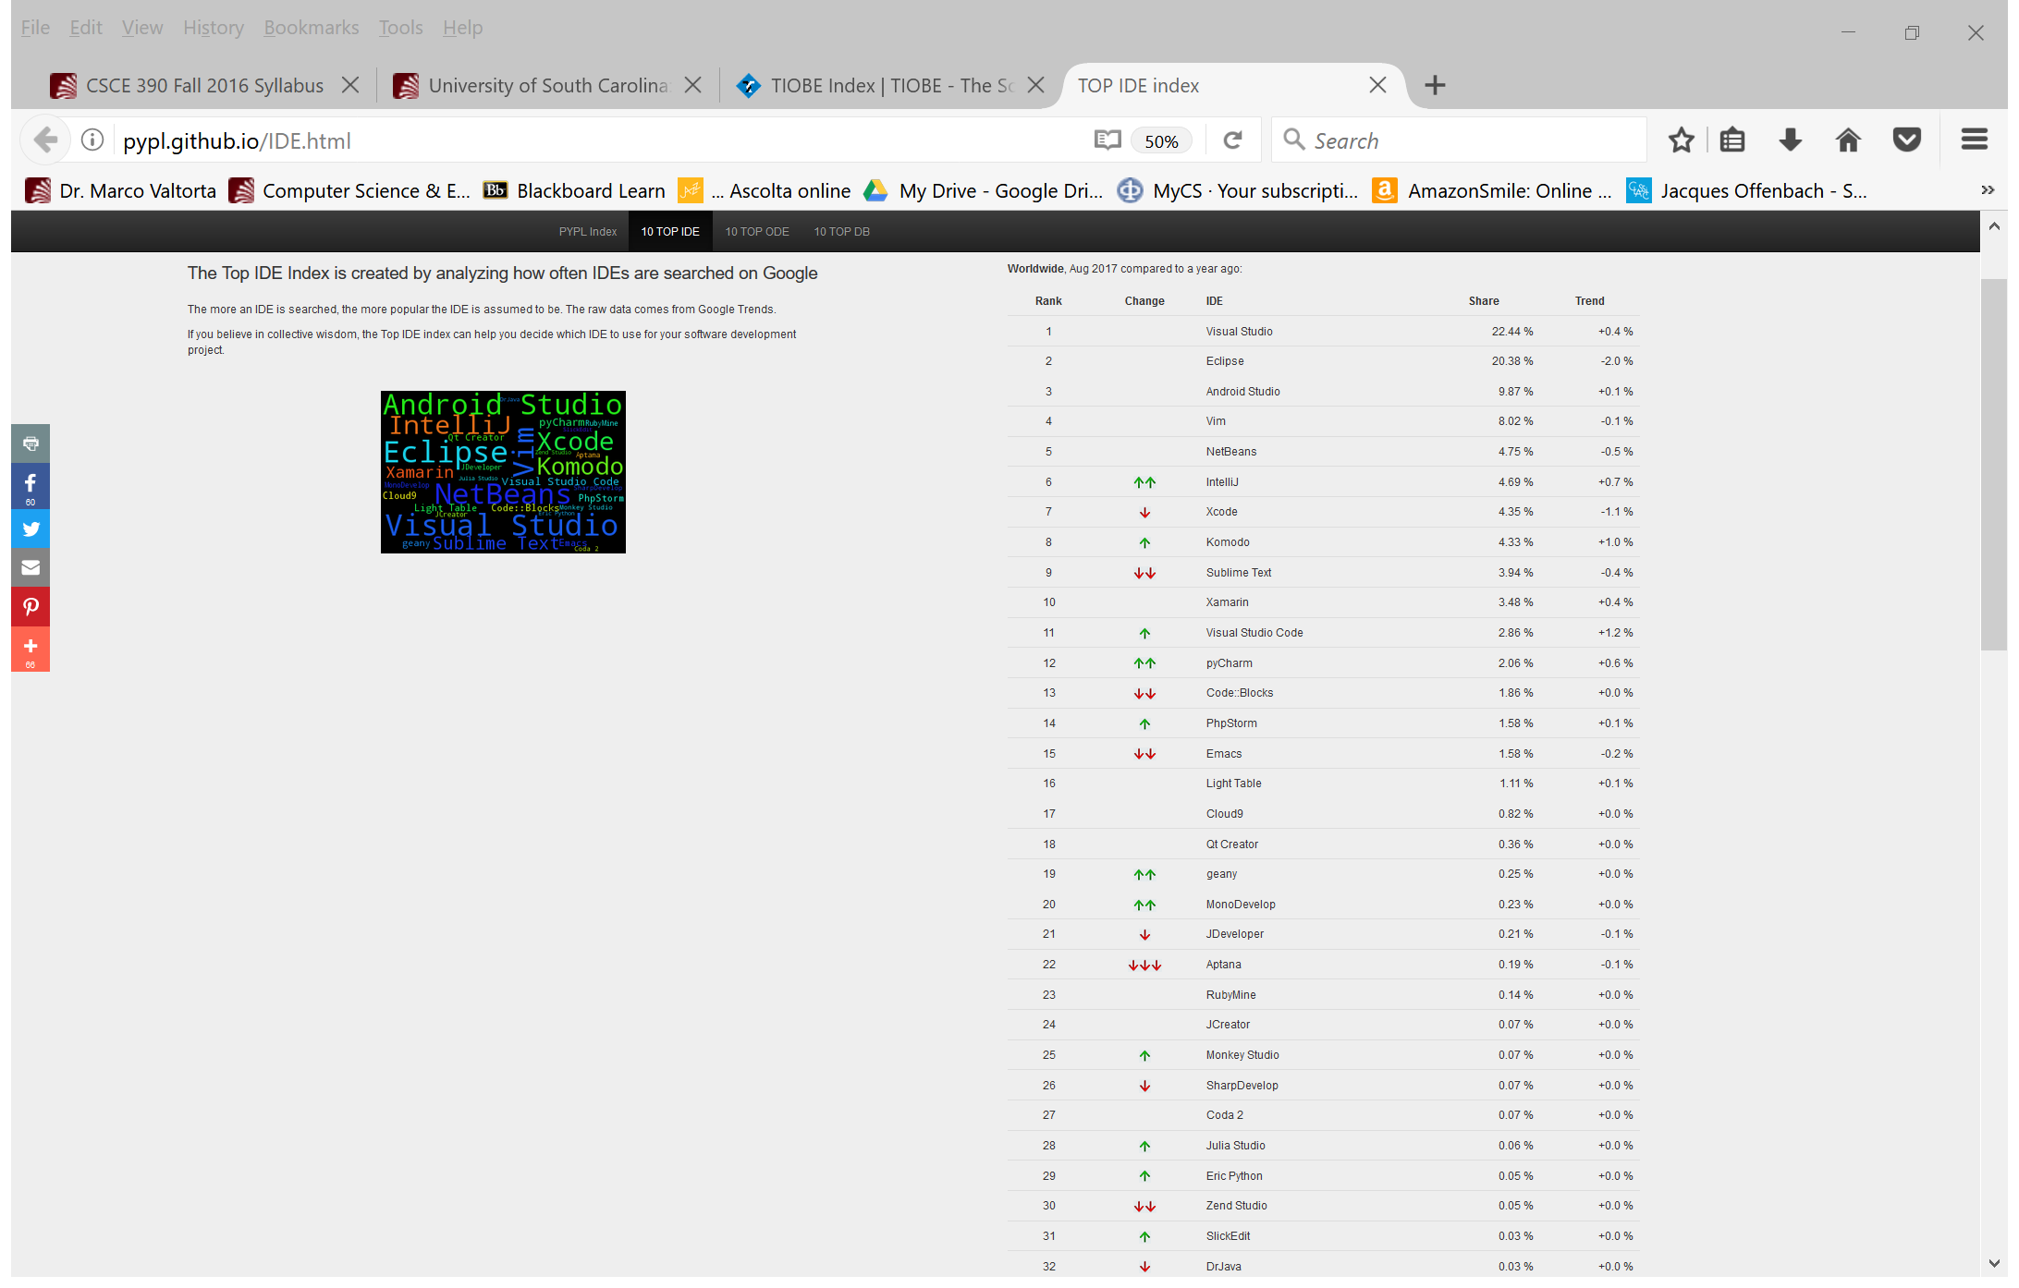
TOPIDE Top IDE Index, August 2017
Notes:
http://pypl.github.io/IDE.html, accessed 2016-08-17.

