Slide 1
An Introduction to
Bayesian Networks
January 11, 2022
Marco Valtorta
INNOVA 1400
mgv@cse.sc.edu
Notes:
The slides contain parts of a presentation written by Bezuglov and Goradia for CSCE 582, F02.

Slide 2
Purpose of the Introductory Slides
Introduce the area of uncertainty in Artificial Intelligence
Introduce some examples of plausible reasoning
Introduce some patterns of plausible reasoning
Introduce some requirements for calculi of plausible reasoning
Review the axioms of probability (Kolmogorov’s axioms)
Review models of the axioms
Define Bayesian networks
Introduce some algorithms

Slide 3
Uncertainty in Artificial Intelligence
Artificial Intelligence (AI)
  [Robotics]
  Automated Reasoning
    [Theorem Proving, Search, etc.]
    Reasoning Under Uncertainty
      [Fuzzy Logic, Possibility Theory, etc.]
      Normative Systems
        Bayesian Networks
        Influence Diagrams (Decision Networks)

Slide 4
Plausible Reasoning
Examples:
  Icy Roads
  Earthquake
  Holmes’s Lawn
  Car Start
Patterns of Plausible Reasoning
  Serial (head-to-tail), diverging (tail-to-tail) and converging (head-to-head) connections
  D-separation
  The graphoid axioms

Slide 5
Requirements
Handling of bidirectional inference
  Evidential and causal inference
  Inter-causal reasoning
Locality (“regardless of anything else”) and detachment (“regardless of how it was derived”) do not hold in plausible reasoning
  Compositional (rule-based, truth-functional approaches) are inadequate
  Example: Chernobyl
Notes:
Pearl, 1988, sections 1.2 and 1.3; Hajek, Havranek, and Jirousek, 1992, chs. 6-8.
The naïve fuzzy calculus of degrees of truth for fuzzy proposition, is compositional (using min, max (or probabilistic sum), complement to 1)
Possibility theory is not fully compositional. See: Didier Dubois and Henri Prade. “Possibility theory is not fully compositional!—A comment on a short note by H.J. Greenberg—” ftp://ftp.irit.fr/IRIT/RPDMP/PTFC.pdf, accessed on 2008-01-05.

Slide 6
Why Probability for Representing Uncertainty? Compositional Approaches
weighted
proposition
several rules with
the same conclusion
integrator
conclusion
conclusion
a rule
a rule
attenuator
attenuator
combinator
combinator
weighted
proposition
weighted
proposition
weighted
proposition
weighted
proposition
Site Visit, 23 January 2008 6 ©2008 University of South Carolina / HNC, Inc. BALER Project
Notes:
A typical combinator is min. A typical attenuator is times. Typical integrators are max and noisy-or (also known as probabilistic sum).
Certainty Factors
Possibility NOTE: Possibility theory is not fully compositional. See: Didier Dubois and Henri Prade. “Possibility theory is not fully compositional!—A comment on a short note by H.J. Greenberg—” ftp://ftp.irit.fr/IRIT/RPDMP/PTFC.pdf, accessed on 2008-01-05.
Fuzzy Logic
Dempster-Shafer Evidential Reasoning
The D-S approach is often used compositionally
It is possible to use D-S extensionally, in which case it becomes the Bayesian network approach
A very thorough analysis of compositional system is in Chapters 6-8 of Hajek, Peter, Tomas Havranek, and Radim Jirousek. _Uncertain Information Processing in Expert Systems_, Academic Press, 1992, and is mainly due to Hajek.

Slide 7
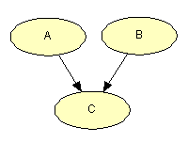
Problems with Compositionality
Lack of Support for Bidirectional Inference
  Reasoning from effect to cause and from cause to effect should be supported
Unwarranted Modularity
  Synergistic and antagonistic effects need to be accounted for
Intercausal Effects
  Knowledge of effect and one of its possible causes affects the likelihood of other possible causes
Unwarranted Reliance on Transitivity
  A makes C more likely, C makes B more likely, but A does not make B more likely if A and B are both possible causes of C. The connection between nontransitive and induced dependencies is a built-in feature of probability theory
Mishandling of Rumors
  Multiple reasoning paths from evidence to hypotheses might not lead to confirmation of hypotheses if the evidence is correlated
Site Visit, 23 January 2008 7 ©2008 University of South Carolina / HNC, Inc. BALER Project
Notes:
Some of these ideas come from Judea Pearl, especially in _Probabilistic Reasoning for Intelligent Systems_, Morgan-Kaufman, 1988.

Slide 8
An Example: Quality of Information
Notes:
This is not a Bayesian network, but a diagram showing flow of information.

Slide 9
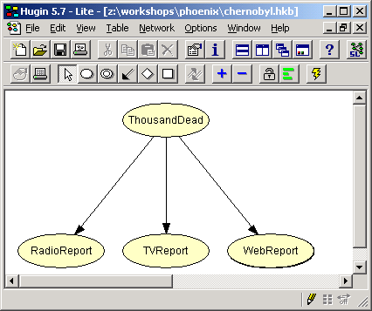
A Naïve Bayes Model

Slide 10
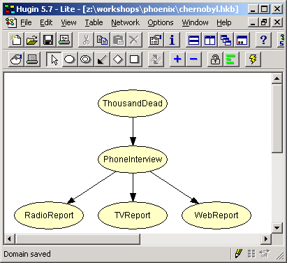
A Bayesian Network Model

Slide 11
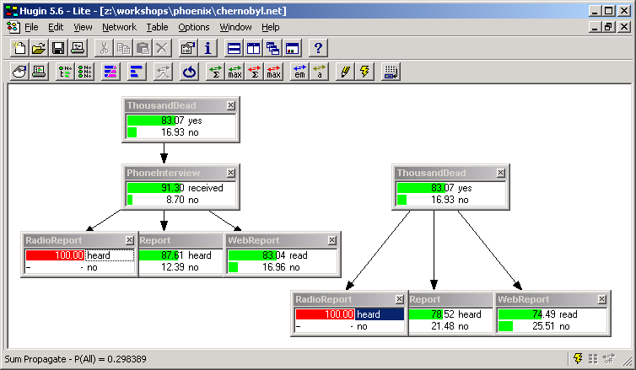
Numerical Parameters

Slide 12
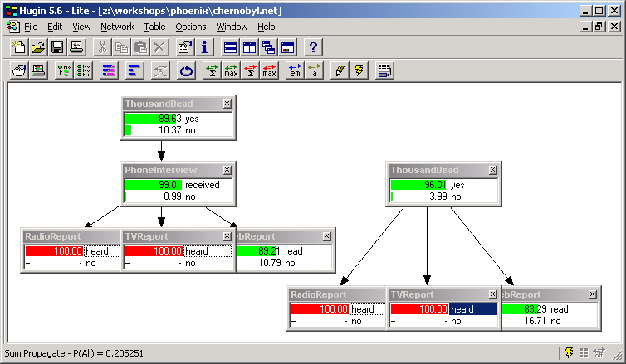
Rumors

Slide 13
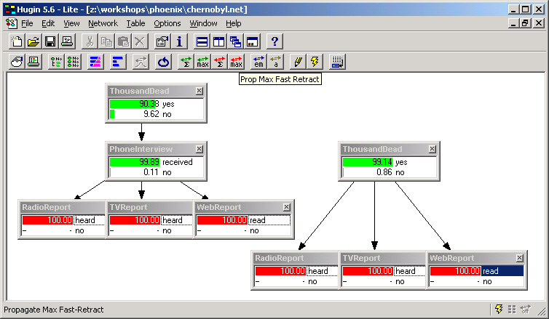
Reliability of Information

Slide 14
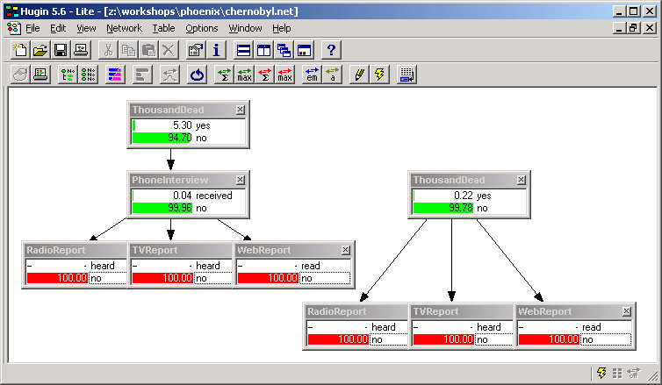
Selectivity of Media Reports

Slide 15
Dependencies
In the better model, ThousandDead is independent of the Reports given PhoneInterview. We can safely ignore the reports, if we know the outcome of the interview.
In the naïve Bayes model, RadioReport is necessarily independent of TVReport, given ThousandDead. This is not true in the better model.
Therefore, the naïve Bayes model cannot simulate the better model.

Slide 16
Probabilities
A set of events is a set of subsets of the set of sample points Ω s.t:
  Ω is an event,
  If E₁ and E₂ are events, then E₁ U E₂ is an event,
  If E is an event, then its complement is an event
Let Ω be a set of sample points (outcomes), F be a set of events relative to Ω, and P a function that assigns a unique real number to each E in F . Suppose that
  P(E) >= 0 for all E in F
  P(Ω) = 1
  If E₁ and E₂ are disjoint subsets of F , then P(E₁ V E₂) = P(E₁) + P(E₂)
Then, the triple (Ω, F ,P) is called a probability space, and P is called a probability measure on F
Notes:
A set of events is a set of subsets of the sample points with three properties: (1) Omega is an event, (2) If E1 and E2 are events, then E1 U E2 is an event, (3) if E is an event, then its complement is an event.
The three properties of probability in the second half of the space are called the axioms of Kolmogorov.

Slide 17
Conditional probabilities
Let (Ω, F ,P) be a probability space and E₁ in F such that P(E₁) > 0. Then for E₂ in F , the conditional probability of E₂ given E₁, which is denoted by P(E₂| E₁), is defined as follows:
Notes:
This should be considered a fourth axiom (besides the three axioms of Kolmogorov) that needs to be shows true in every (proper) model of probability.

Slide 18
Models of the Axioms
There are three major models (i.e., interpretations in which the axioms are true) of the axioms of Kolmogorov and of the definition of conditional probability.
The classical approach
The limiting frequency approach
The subjective (Bayesian) approach

Slide 19
Derivation of Kolmogorov’s Axioms in the Classical Approach
Let n be the number of equipossible outcomes in Ω
If m is the number of equipossible outcomes in E, then P(E) = m/n ≥0
P(Ω) = n/n = 1
Let E1 and E2 be disjoint events, with m equipossible outcomes in E1 and k equipossible outcomes in E2. Since E1 and E2 are disjoint, there are k+m equipossible outcomes in E1 V E2, and:
P(E1)+P(E2) = m/n + k/n = (k+m)/n = P(E1 V E2)

Slide 20
Conditional Probability in the Classical Approach
Let n, m, k be the number of sample points in Ω, E1, and E1&E2. Assuming that the alternatives in E1 remain equipossible when it is known that E1 has occurred, the probability of E2 given that E1 has occurred, P(E2|E1), is:
k/m = (k/n)/(m/n) = P(E1&E2)/P(E1)
This is a theorem that relates unconditional probability to conditional probability.

Slide 21
The Subjective Approach
The probability P(E) of an event E is the fraction of a whole unit value which one would feel is the fair amount to exchange for the promise that one would receive a whole unit of value if E turns out to be true and zero units if E turns out to be false
The probability P(E) of an event E is the fraction of red balls in an urn containing red and brown balls such that one would feel indifferent between the statement "E will occur" and "a red ball would be extracted from the urn."
Notes:
Neapolitan, after De Finetti (first definition)
I believe that the second definition is due to Dennis V. Lindley

Slide 22
The Subjective Approach II
If there are n mutually exclusive and exhaustive events E_{i}, and a person assigned probability P(E_{i}) to each of them respectively, then he would agree that all n exchanges are fair and therefore agree that it is fair to exchange the sum of the probabilities of all events for 1 unit. Thus if the sum of the probabilities of the whole sample space were not one, the probabilities would be incoherent.
De Finetti derived Kolmogorov’s axioms and the definition of conditional probability from the first definition on the previous slide and the assumption of coherency.
Notes:
Neapolitan, p.56. This is De Finetti’s Dutch Book theorem

Slide 23
Definition of Conditional
Probability in the Subjective Approach
Let E and H be events. The conditional probability of E given H, denoted P(E|H), is defined as follows: Once it is learned that H occurs for certain, P(E|H) is the fair amount one would exchange for the promise that one would receive a whole unit value if E turns out to be true and zero units if E turns out to be false. [Neapolitan, 1990]
Note that this is a conditional definition: we do not care about what happens when H is false.
Notes:
Neapolitan, 1990, p.57

Slide 24
Derivation of Conditional Probability
One would exchange P(H) units for the promise to receive 1 unit if H occurs, 0 units otherwise; therefore, by multiplication of payoffs:
One would exchange P(H)P(E|H) units for the promise to receive P(E|H) units if H occurs, 0 units if H does not occur (bet 1); furthermore, by definition of P(E|H), if H does occur:
One would exchange P(E|H) units for the promise to receive 1 unit if E occurs, and 0 units if E does not occur (bet 2)
Therefore, one would exchange P(H)P(E|H) units for the promise to receive 1 unit if both H and E occur, and 0 units otherwise (bet 3).
But bet 3 is the same that one would accept for P(E&H), i.e. one would exchange P(E&H) units for the promise to receive 1 unit if both H and E occur, and 0 otherwise, and therefore P(H)P(E|H)=P(E&H).
Notes:
The derivation of P(H)P(E|H) = P(E & H) in the subjective approach given above is on p.57 of [Neapolitan, 1990]

Slide 25
Probability Theory as a Logic of Plausible Inference
Formal Justification:
  Bayesian networks admit d-separation
  Cox’s Theorem
  Dutch Books
  Dawid’s Theorem
  Exchangeability
Growing Body of Successful Applications

Slide 26
Definition of Bayesian Network

Slide 27
Visit to Asia Example
Shortness of breath (dyspnoea) may be due to tuberculosis, lung cancer or bronchitis, or none of them, or more than one of them. A recent visit to Asia increases the chances of tuberculosis, while smoking is known to be a risk factor for both lung cancer and bronchitis. The results of a single chest X-ray do not discriminate between lung cancer and tuberculosis, as neither does the presence of dyspnoea [Lauritzen and Spiegelhalter, 1988].
Notes:
Lauritzen and Spiegelhalter, 1988. Dyspnea is spelled in the British way, as “dyspnoea.”

Slide 28
Visit to Asia Example
Tuberculosis and lung cancer can cause shortness of breath (dyspnea) with equal likelihood. The same is true for a positive chest Xray (i.e., a positive chest Xray is also equally likely given either tuberculosis or lung cancer). Bronchitis is another cause of dyspnea. A recent visit to Asia increases the likelihood of tuberculosis, while smoking is a possible cause of both lung cancer and bronchitis [Neapolitan, 1990].
Notes:
Note the use of “cause” (and the funny spelling of X-ray as Xray).

Slide 29
Visit to Asia Example
α (Asia): P(a)=.01 ε (λ or β):P(e|l,t)=1
P(e|l,~t)=1
τ (TB): P(t|a)=.05 P(e|~l,t)=1
P(t|~a)=.01 P(e|~l,~t)=0
σ(Smoking): P(s)=.5 ξ: P(x|e)=.98
P(x|~e)=.05
λ(Lung cancer): P(l|s)=.1
P(l|~s)=.01 δ (Dyspnea): P(d|e,b)=.9
P(d|e,~b)=.7
β(Bronchitis): P(b|s)=.6 P(d|~e.b)=.8
P(b|~s)=.3 P(d|~e,~b)=.1
α
σ
τ
λ
ε
β
ξ
δ

Slide 30
Three Computational Problems
For a Bayesian network, we present algorithms for
  Belief Assessment
  Most Probable Explanation (MPE)
  Maximum a posteriori Hypothesis (MAP)
Notes:
Over the years a lot of work has been done on processing Bayesian networks; there is a lot of material available in the literature on this. Some of the ideas are translations of each other, others involve combinations of existing ideas, others are extensions. It can get very taxing on a newcomer to sort out the relationships among the various approaches. The paper by Dr. Dechter presents a purely algorithmic view of the core ideas behind the main approach to probabilistic reasoning.
In a Bayesian network, we would mainly be interested in solving the following problems: belief assessment, most probable explanation and maximum aposteriori hypothesis. The paper presents the algorithms for solving these problems.
All of these problems fall in the category of NSDP problems, and hence they can all be solved by eliminating variables one by one while computing the effect of each eliminated variable on the remainder of the problem. These algorithms are called bucket elimination algorithms.

Slide 31
Belief Assessment
Definition
  The belief assessment task of X_{k} = x_{k} is to find
In the Visit to Asia example, the belief assessment problem answers questions like
  What is the probability that a person has tuberculosis, given that he/she has dyspnea and has visited Asia recently ?
  where k – normalizing constant
Notes:
The belief assessment problem is to summarize the function . For the atomic proposition Xi = xi, the problem is to assess and later update the belief in xi given evidence e.

Slide 32
Most Probable Explanation (MPE)
Definition
  The MPE task is to find an assignment xº = (xº₁, …, xº_{n}) such that
In the Visit to Asia example, the MPE problem answers questions like
  What are the most probable values for all variables such that a person doesn’t catch dyspnea ?

Slide 33
Maximum A posteriori Hypothesis (MAP)
Definition
  Given a set of hypothesized variables A = {A₁, …, A_{k}},
  , the MAP task is to find an assignment
  aº = (aº₁, …, aº_{k}) such that
In the Visit to Asia example, the MAP problem answers questions like
  What are the most probable values for a person having both lung cancer and bronchitis, given that he/she has dyspnea and that his/her X-ray is positive?

Slide 34
Axioms for Local Computation
Notes:
Madsen’s dissertation (section 3.1.1) after Shenoy and Shafer. The axioms are maybe best described in Shenoy, Prakash P. “Valuation-Based Systems for Discrete Optimization.” Uncertainty in Artificial Intelligence, 6 (P.P. Bonissone, M. Henrion, L.N. Kanal, eds.), pp.385-400. The first axioms is written in quite a different form in that reference, but Shenoy notes that his axiom “can be interpreted as saying that the order in which we delete the variables does not matter,” “if we regards marginalization as a reduction of a valuation by deleting variables.” This seems to be what Madsen emphasizes in his axiom 1.
Another key reference, with an abstract algebraic treatment is made, is S. Bistarelli, U. Montanari, and F. Rossi. “Semiring-Based Constraint Satisfaction and Optimization,” Journal of the ACM 44, 2 (March 1997), pp.201-236. The authors explicitly mention Shenoy’s axioms as a special case in section 5, where they also discuss the solution of the secondary problem of Non-Serial Dynamic Programming [Bertelè and Brioschi, 1972]. Finally, an alternative algebraic generalization is in: S.L. Lauritzen and F.V. Jensen, “Local Computations with Valuations from a Commutative Semigroup,” Annals of Mathematics and Artificial Intelligence 21 (1997), pp.51-69.

Slide 35
Comments on the Axioms (part I)
Presentation of the axioms is from Madsen’s dissertation (section 3.1.1) after Shenoy and Shafer
The best description of the axioms is in: Shenoy, Prakash P. “Valuation-Based Systems for Discrete Optimization.” Uncertainty in Artificial Intelligence, 6 (P.P. Bonissone, M. Henrion, L.N. Kanal, eds.), pp.385-400.
The first axioms is written in quite a different form in that reference, but Shenoy notes that his axiom “can be interpreted as saying that the order in which we delete the variables does not matter,” “if we regard marginalization as a reduction of a valuation by deleting variables.” This seems to be what Madsen emphasizes in his axiom 1.

Slide 36
Comments on the Axioms (part I)
Another key reference is: S. Bistarelli, U. Montanari, and F. Rossi. “Semiring-Based Constraint Satisfaction and Optimization,” Journal of the ACM 44, 2 (March 1997), pp.201-236.
  This is an abstract algebraic treatment
  The authors explicitly mention Shenoy’s axioms as a special case in section 5, where they also discuss the solution of the secondary problem of Non-Serial Dynamic Programming, as introduced in: Bertelè and Brioschi, Non-Serial Dynamic Programming, Academic Press,1972.
An alternative algebraic generalization is in: S.L. Lauritzen and F.V. Jensen, “Local Computations with Valuations from a Commutative Semigroup,” Annals of Mathematics and Artificial Intelligence 21 (1997), pp.51-69.

Slide 37
Some Algorithms for Belief Update
Construct joint first (not based on local computation)
Stochastic Simulation (not based on local computation)
Conditioning (not based on local computation)
Direct Computation
  Variable elimination
    Bucket elimination (described next), variable elimination proper, peeling
  Combination of potentials
    SPI, factor trees
Junction trees
    L&S, Shafer-Shenoy, Hugin, Lazy propagation
Polynomials
    Castillo et al., Darwiche
Notes:
Anders Madsen’s dissertation describes several of these methods

Slide 38
Ordering the Variables
Method 1 (Minimum deficiency)
Begin elimination with the node which
adds the fewest number of edges
1. α, ξ, δ (nothing added)
2. τ (nothing added)
3. σ, λ, ε, β (one edge added)
α
σ
τ
λ
β
ε
Method 2 (Minimum degree)
Begin elimination with the node which has
the lowest degree
1. α, ξ (degree = 1)
2. τ, σ, δ (degree = 2)
3. λ, ε, β (degree = 2)
ξ
δ

Slide 39
Elimination Algorithm for Belief Assessment
P(τ| α=“yes”, δ=“yes”) = ∑_{X\ {τ}} (P(ξ|ε)* P(τ|α)* P(ε|τ,λ)* P(δ|ε,β)* P(α)*P(λ|σ)*P(β|σ)*P(σ))
Bucket α:
P(τ|α)*P(α), α=“yes”
H_{n}(u)=∑_{xn}П^{j}_{i=1}C_{i}(x_{n},u_{si})
Bucket ξ:
P(ξ|ε)
Bucket δ:
P(δ|ε,β), δ=“yes”
Bucket ε:
P(ε|τ,λ)
H_{δ}(ε,β)
H_{ξ}(ε)
Bucket λ:
P(λ|σ)
H_{ε}(τ,λ,β)
Bucket σ:
P(β|σ)*P(σ)
H_{λ}(τ,β,σ)
Bucket β:
H_{σ}(τ,β)
Bucket τ:
H_{α}(τ)
H_{β}(τ)
k-normalizing constant
*k
P(τ| α=“yes”, δ=“yes”)

Slide 40
Elimination Algorithm for Most Probable Explanation
Finding MPE = max _{ξ,ε,τ,α,λ,δ,β,σ} P(ξ,ε,τ,α,λ,δ,β,σ)
MPE= MAX_{{ξ,ε,τ,α,λ,δ,β,σ}} (P(ξ|ε)* P(τ|α)* P(ε|τ,λ)* P(δ|ε,β)* P(α)*P(λ|σ)*P(β|σ)*P(σ))
Bucket α:
P(τ|α)*P(α)
H_{n}(u)=max_{xn} ( П_{xn∈Fn}C(x_{n}|x_{pa}))
Bucket ξ:
P(ξ|ε)
Bucket δ:
P(δ|ε,β), δ=“no”
Bucket ε:
P(ε|τ,λ)
H_{δ}(ε,β)
H_{ξ}(ε)
Bucket λ:
P(λ|σ)
H_{ε}(τ,λ,β)
Bucket σ:
P(β|σ)*P(σ)
H_{λ}(τ,β,σ)
Bucket β:
H_{σ}(τ,β)
Bucket τ:
H_{α}(τ)
H_{β}(τ)
MPE probability

Slide 41
Elimination Algorithm for Most Probable Explanation
Forward part
Bucket α:
P(τ|α)*P(α)
α’ = arg max_{α} P(τ’|α)*P(α)
Bucket ξ:
P(ξ|ε)
ξ’ = arg max_{ξ} P(ξ|ε’)
Bucket δ:
P(δ|ε,β), δ=“no”
δ’ = “no”
Bucket ε:
P(ε|τ,λ)
H_{δ}(ε,β)
H_{ξ}(ε)
ε’ = arg max_{ε} P(ε|τ’,λ’)*H_{δ}(ε,β’)*H_{ξ}(ε)
Bucket λ:
P(λ|σ)
H_{ε}(τ,λ,β)
λ’ = arg max_{λ} P(λ|σ’)*H_{ε}(τ’,λ,β’)
Bucket σ:
P(β|σ)*P(σ)
H_{λ}(τ,β,σ)
σ’ = arg max_{σ} P(β’|σ)*P(σ)* H_{λ}(τ’,β’,σ)
Bucket β:
H_{σ}(τ,β)
β’ = arg max_{β} H_{σ}(τ’,β)
Bucket τ:
H_{α}(τ)
H_{β}(τ)
τ’ = arg max_{τ} H_{α}(τ)* H_{β}(τ)
Return: (τ’, β’, σ’, λ’, ε’, δ’, ξ’, α’)

Slide 42
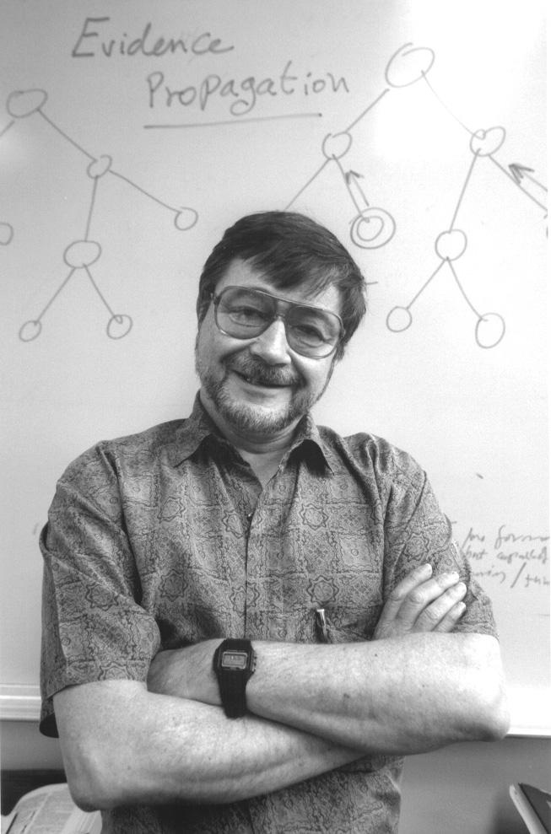
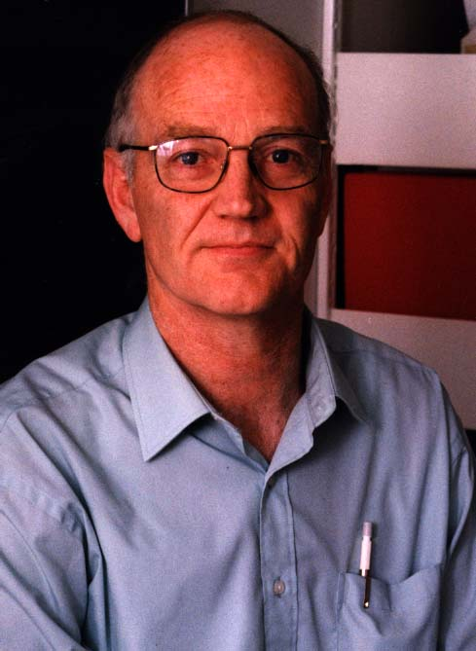
Judea Pearl and Finn V.Jensen
Notes:
Finn Jensen retired in June 2013.

Slide 43

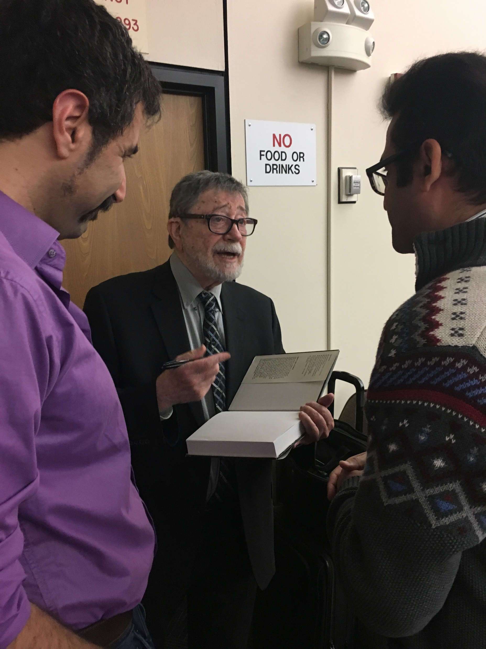
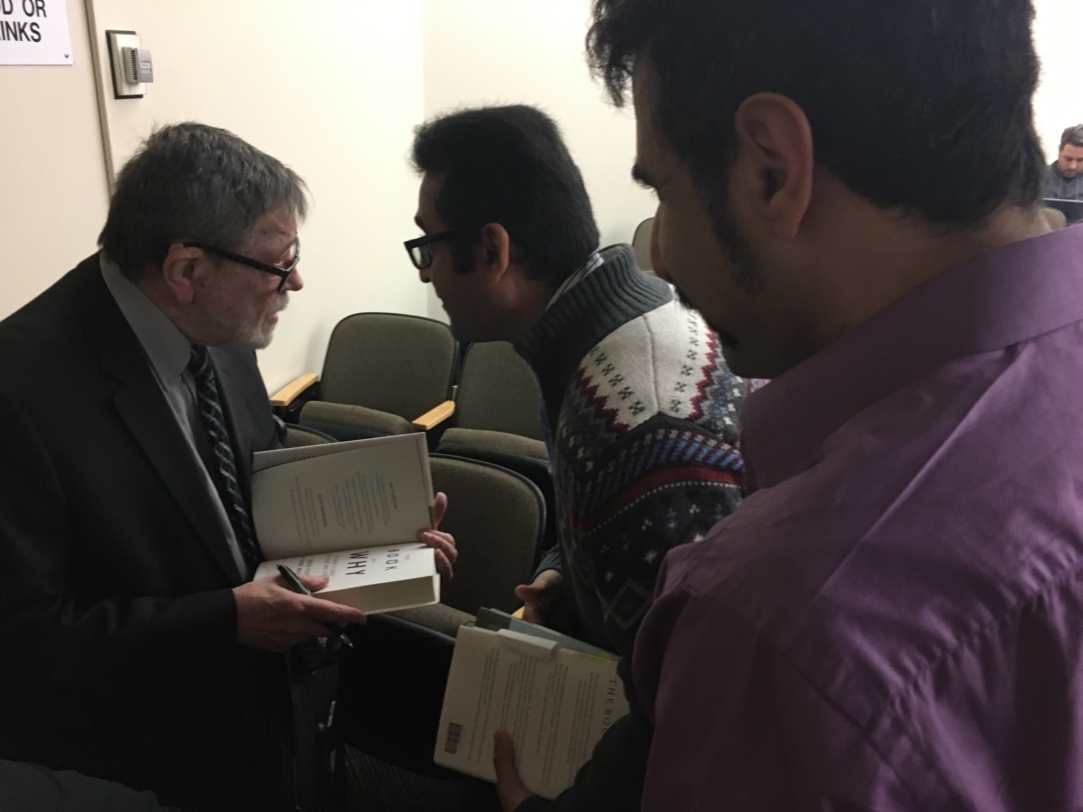
Judea Pearl with Pooyan Jamshidi and Mohammad Ali Javidian
Notes:
At WHY-19.
Mohammad Ali Javidian, Pooyan Jamshidi, and Marco Valtorta. "Transfer Learning for Performance Modeling of Configurable Systems: A Causal Analysis." AAAI Spring 2019 Symposium: "Beyond Curve Fitting--Causation, Counterfactuals, and Imagination-Based AI" (WHY-19), Palo Alto, CA, March 2019, seven pages. (Locally published proceedings; available at https://why19.causalai.net/papers.html.)
Zhiyu Wang, Mohammad Ali Javidian, Linyuan Lu, and Marco Valtorta. "The Causal Interpretation of Bayesian Hypergraphs." AAAI Spring 2019 Symposium: "Beyond Curve Fitting--Causation, Counterfactuals, and Imagination-Based AI" (WHY-19), Palo Alto, CA, March 2019, seven pages. (Locally published proceedings; available at https://why19.causalai.net/papers.html.)

