Slide 1
CSCE 582
Two Example Bayesian Networks
January 14, 2020
Marco Valtorta
mgv@cse.sc.edu

Slide 2
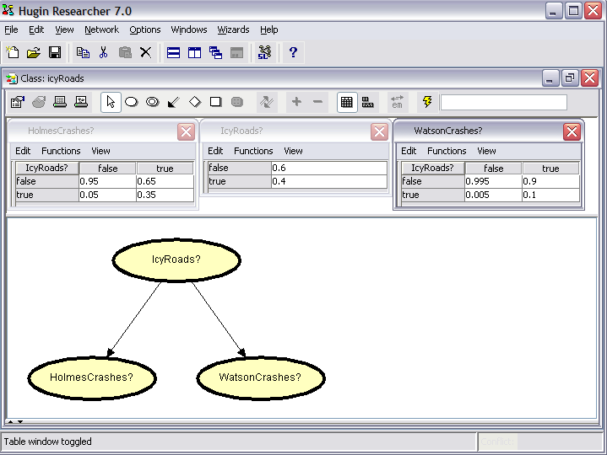
Icy Roads, Model
Source: Judea Pearl via Finn V. Jensen; Hugin Screen Shot

Slide 3
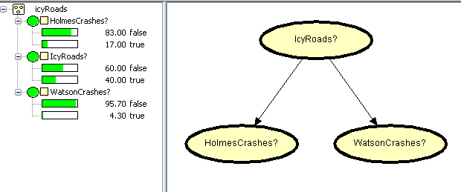
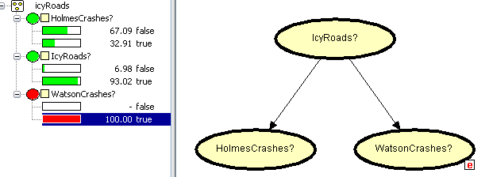
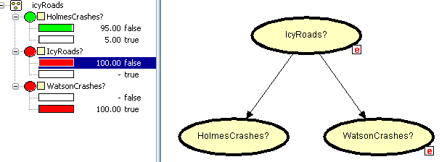
Icy Roads, Example of Use
Source: Judea Pearl via Finn V. Jensen; Hugin Screen Shots

Slide 4
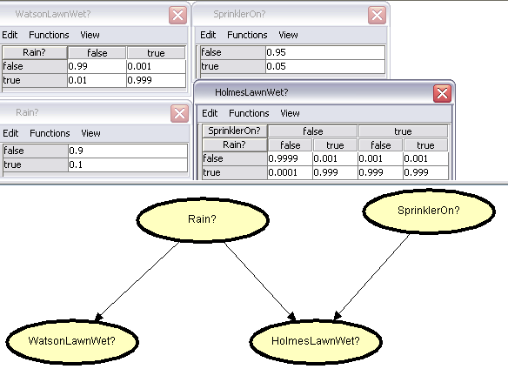
Wet Lawn, Model
Judea Pearl via Finn V. Jensen; Hugin Screen Shot

Slide 5
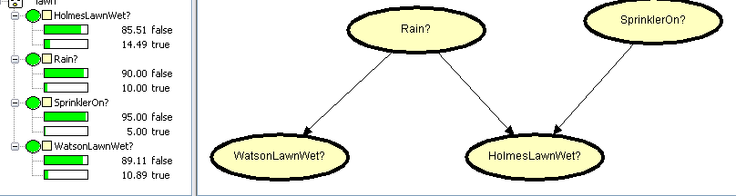
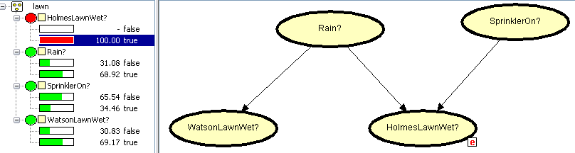
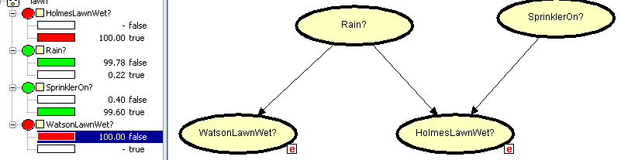
Wet Lawn, Example of Use
Judea Pearl via Finn V. Jensen; Hugin Screen Shot

