Slide 1
Prediction and assessment of student behavior in open
and distance education in computers using Bayesian networks
Michalis Xenos
Presented BY:
Asif Jamil Chowdhury
AHMED SHEHAB KHAN
(4/21/2016)

Slide 2
Problem Description:
Modelling Student Behavior in distance educational system.
Prediction of Student Behavior based on the model
Progressively update the model based on past experience.
Assessment of individual student’s progress beforehand to decrease potential dropouts.
Identify the dropout causes based on automated model.

Slide 3
Motivation:
Number of students in distance learning is very high.
It is very hard for a single coordinator to have an overall idea of the student’s progress.
It is not feasible to appoint many coordinator for a single course.
It is impossible the account for the uncertainty involved in the whole process manually, so a probabilistic model is necessary.
Large number of students makes it almost impossible for the coordinator
to evaluate all student data without the use of a model that will enable the automation of certain measurements and estimates and will aid in decision-making

Slide 4
Case Description:
Applied in the Informatics course of the School of Sciences and Technology of the Hellenic Open University (HOU)
It is a 4- year course, that comprises 12 modules. Each module is equivalent to 3-4 university level course
The particularities and the nature of studies in the field of information technology, combined with the use of web-based material in the particular course, provided good conditions for the application of the model

Slide 5
Case Description:
The modelling of student data from the 1st-year module, INF10, is presented to demonstrate the effectiveness of the discussed method.
Currently about 800 students are attending the INF10 module.
These students are distributed in 28 groups, each comprising
around 30 students.
Each student group communicates with a single tutor and uses a variety of
educational material either sent to the students or made available on the Web.
A faculty member of the HOU serves as the coordinator of all tutors and all students.

Slide 6
Case Description:
Each student attending the INF10 module has to reach six important milestones with regard to his/her academic progress.
These include the results of each of the four written assignments
that will determine if the student is allowed to participate in the final face-to-face examinations and the two examinations themselves.
Naturally, a number of individual milestones affecting student performance also have to be taken into account such as important changes at work, changes in the student’s family status, health problems, family problems, financial problems, etc.
These kinds of differences influence not only each student’s progress, but also their perception of the course’s difficulty and in many cases determine the successful or unsuccessful completion of the course

Slide 7
Proposed Method and Model:
A Bayesian Network based method was proposed to model the problem.
The model has been implemented using the Microsoft MSBNx Authoring and Evaluation Tool version 1.4.2.
The initial data of the probability tables was based on analyses of previous data
collected from the course from past 3 years.

Slide 8
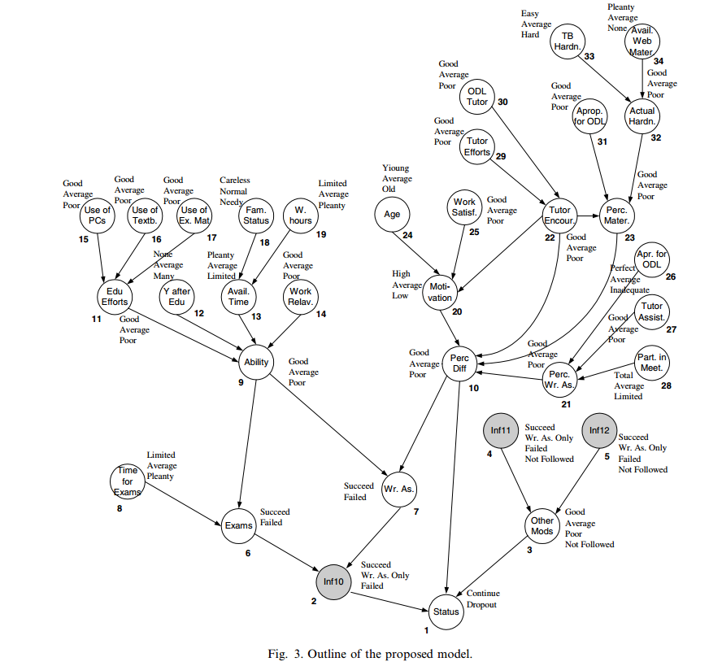
Proposed Method and Model:

Slide 9
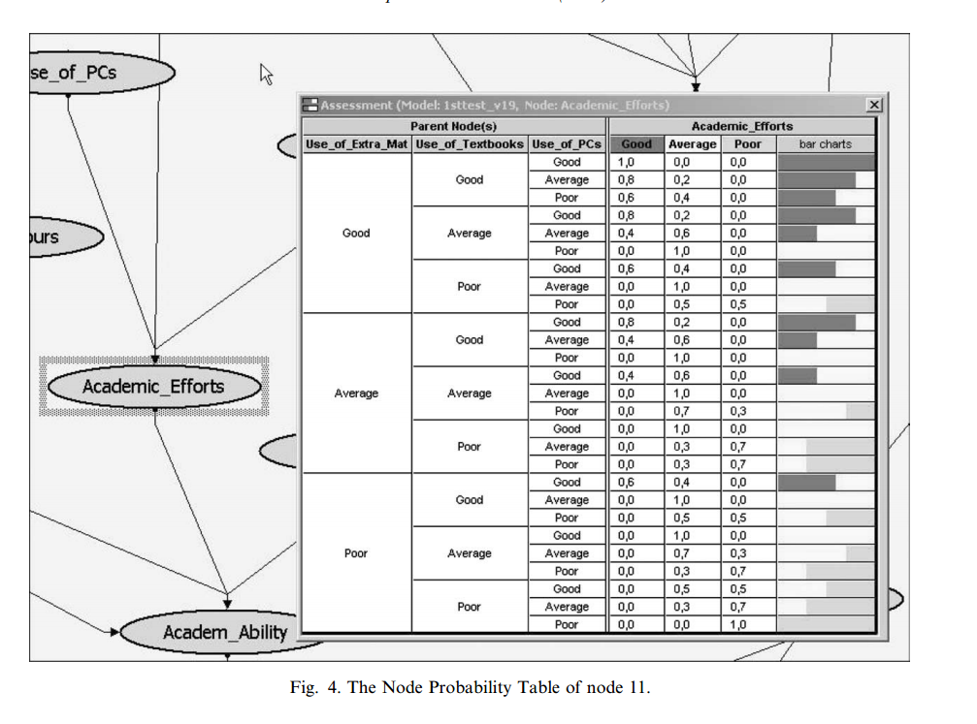
Proposed Method and Model:

Slide 10
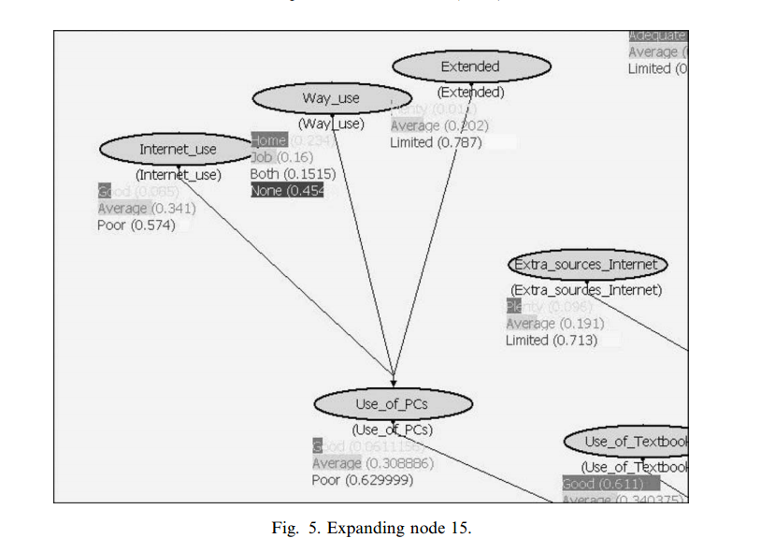
Proposed Method and Model:

Slide 11
Application of the Model:
The application of the model is based on entering evidence for certain nodes.
The import of evidence in the model activates the probabilities in the NPT of each relevant node and as result some parent estimations and correspondingly the final estimation change. This type of model usage is called forward.
Entering evidence on the child nodes changes the NPT of some parent nodes. This type of usage is called backward assessment.

Slide 12
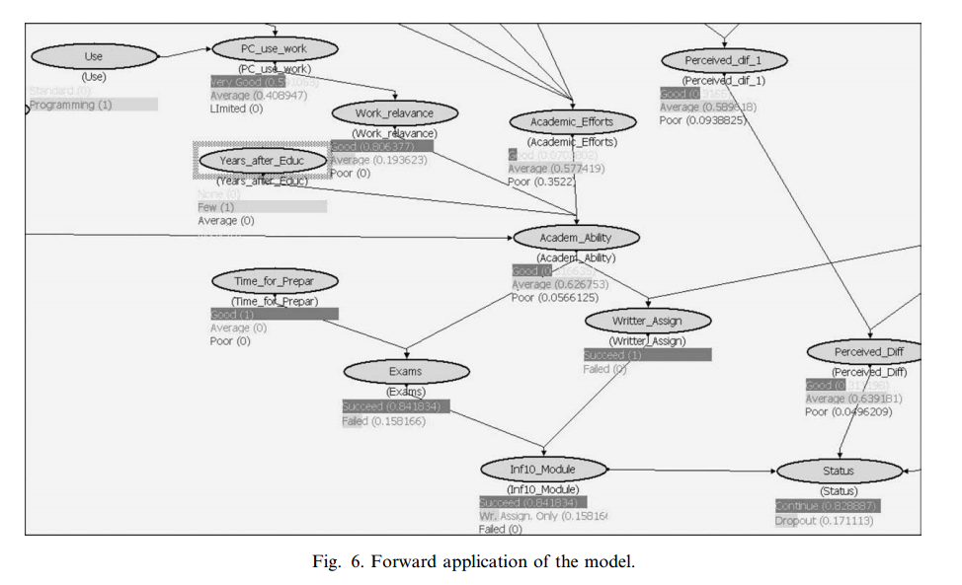
Application of the Model:

Slide 13
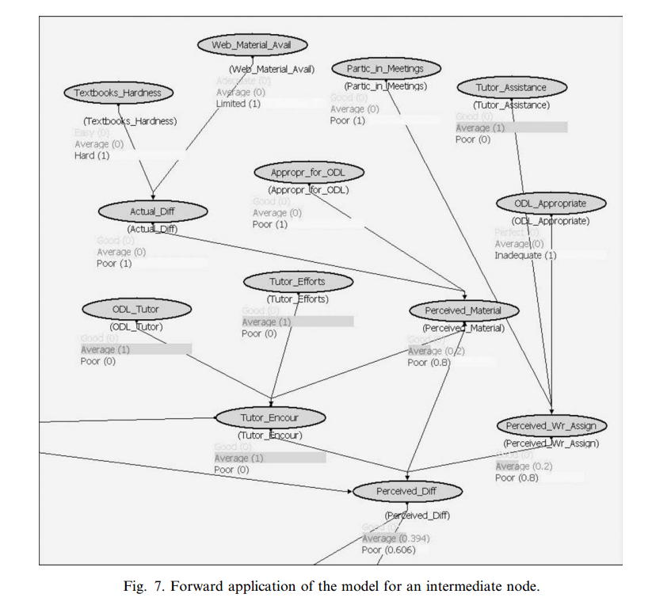
Application of the Model::

Slide 14
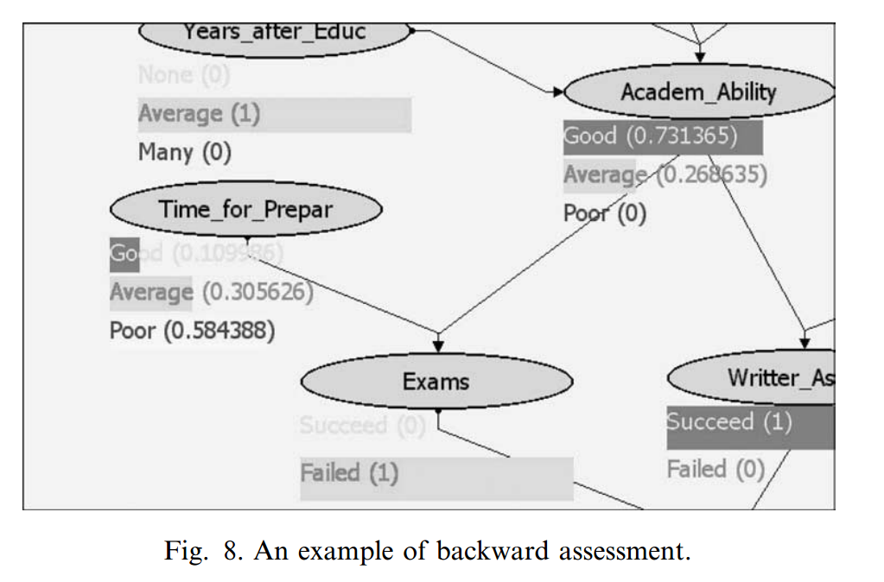
Application of the Model:

Slide 15
Conclusion:
The effectiveness of the model is closely related to the quality of the BN design and accuracy of values entered in the probability tables.
The goal was to develop a method for modelling the educational experience of its designer and exploiting the past data or data resulting from its use.
Furthermore, the model can prove to be a valuable tool assisting
in decision making in conditions of uncertainty, especially when a large number of parameters is involved.
Finally, it must be noted that the main advantage of the proposed model is its modularity. This means that a limited network can be built and tested for a small part of a problem and then the same network can be expanded to include more parts of the same problem, while exploiting results from its use to improve the values in the tables of probabilities.

Slide 16
THANK YOU

