Slide 1
Evaluating Bayesian networks’ precision for detecting students’ learning styles
Andrew Smith
Mikhail Simin

Slide 2
Introduction
Learning styles
Seeing and hearing; reflecting and acting; etc.
Web-based courses
Ability to customize content for different students
But how?
Surveys?
Bayesian Networks!

Slide 3
Learning Styles
Dimensions of Felder’s learning styles
Perception | Sensitive Intuitive
Input | Visual Verbal
Organization | Inductive Deductive
Processing | Active Reflective
Understanding | Sequential Global

Slide 4
Learning Styles
Sensitive vs. intuitive
Sensors => facts, data, experimentation
Intuitors => principles, theory
Visual vs. verbal
Visual learners => picture, diagrams, etc.
Verbal learners => hear, read and say
Inductive vs. deductive
Inductive learners => natural human learning style, from particulars to generalities (most engineers)
Deductive learners => opposite (NOT considered)

Slide 5
Learning Styles
Active vs. reflective
Active learners => learn most when involved
Reflective learners => learn most when given time to think about information
Sequential vs. global
Sequential learners => linear reasoning, can understand material superficially
Global learners => intuitive leaps; can solve problems unexplainably

Slide 6
Learning Styles
Dimensions of Felder’s learning styles
Perception | Sensitive Intuitive
Input | Visual Verbal
Organization | Inductive Deductive
Processing | Active Reflective
Understanding | Sequential Global

Slide 7
Setting Up the Problem
Fedler’s Framework:
Preception
Processing
Understanding
(more)

Slide 8
Setting Up the Problem
Bayesian Network
Choose Variables (nodes)
Variable Relationship (edges)
Probabilistic Analysis

Slide 9
Perception
Sensory
Revises Exercises, Exams etc
Uses many examples
Concrete Material (application related)
Intuitive
Less Revision
One or Two examples
Abstract / Theoretical texts

Slide 10
Processing
Active
Working in Groups
Forums
Chats
Mail list
Reflective
Working Alone
Forum
Begin/reply to/read discussions

Slide 11
Understanding
Global
Jumps around the content
Does not read every chapter
And still scores well on exams
Sequential
Reads continuously

Slide 12
Dimensions
(4) Forum: posts messages; replies messages; reads messages; no participation.
(3) Chat: participates; listens; no participation.
(2) Mail: uses; does not use.
(2) Information access: in fits and starts; continuous.
(2) Reading material: concrete; abstract.
(3) Exam Revision: t < 10%; 10% < t < 20%; 20% < t.
(3) Exam Delivery Time: t< 50%; 50% < t <75%; 75% < t.
(3) Exercises: many (more than 75%); few (between 25% and 75%); none.
(3) Changes: many (more than 50%); few (between 20% and 50%); none.
(3) Access to Examples: many (more than 75%); few (between 25% and 75%); none.
(3) Exam Results: high (more than 7 in a 1–10 scale); medium (between 4 and 7); low (below 4).
TOTAL OF 11 VARIABLES
4*3*2*2*2*3*3*3*3*3*3
*3
= 209,952

Slide 13
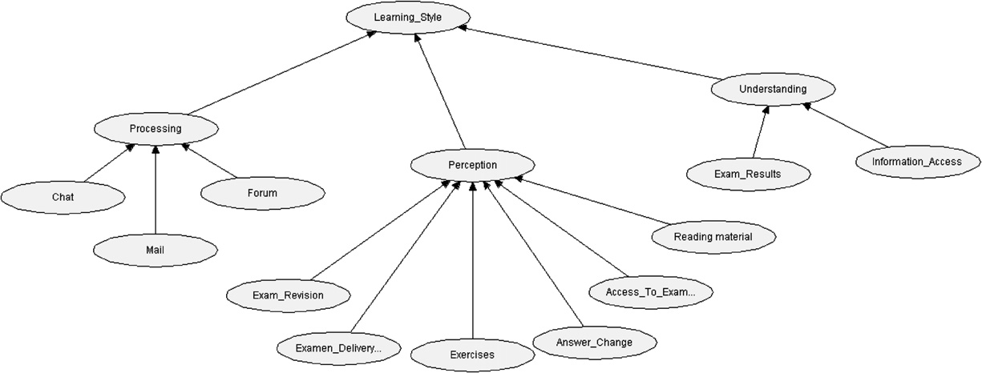
Bad Marriage Calls for…
4*3*2*2 + 2*3*3*3*3*3*2 + 2*3*2 + 2*2*2*3
= 1,056
Notes:
The probability functions associated with the independent nodes are gradually obtained by
observing the student interaction with the system.
Initially, probability values for independent nodes are assigned equal values. Then, the values are updated as the system gathers information about the student behavior.
The probability functions attached to the independent nodes are adjusted to represent the new observations or experiences
Convergence: Eventually, at a certain point in the interaction, the probabilities reach equilibrium.
The values obtained at this point represent the students behavior.

Slide 14
Example: Understanding
Notes:
the second cell in the first (numbered) column indicates that if the student
reads in “fits and starts” AND gets “high” marks
global learner is 100%.

Slide 15
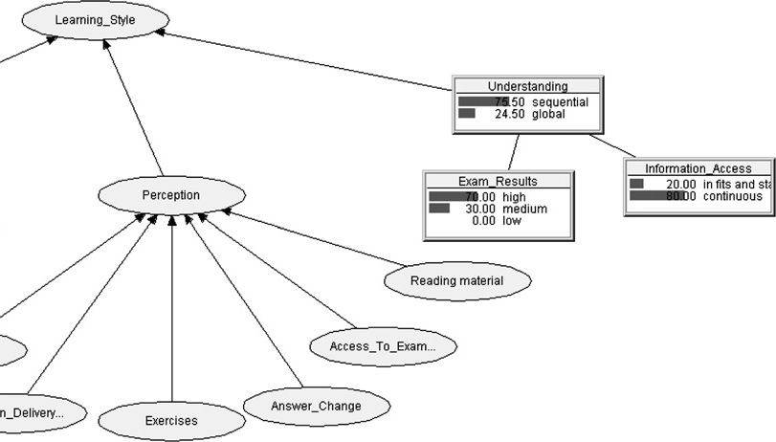
Example: Understanding
Notes:
75.5 > 24.5 Therefore understanding is “Sequential” not both

Slide 16
Results
27 CSE Students
No a priori knowledge of subject (AI)
Web-based course to collect data
Observations grouped by topics and averaged over all topics
Multiple Examples, Excercises
One Final Exam

Slide 17
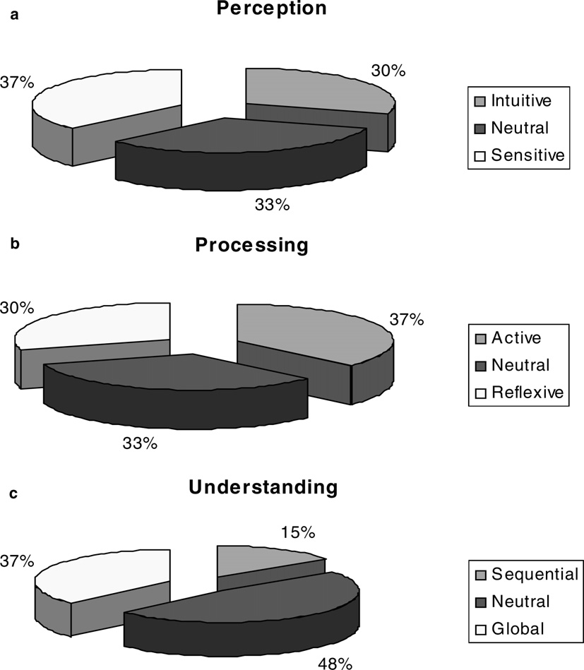
Notes:
27 students,
0.30 – 8
0.48 – 13
Only 14% have used web-courses before.

Slide 18
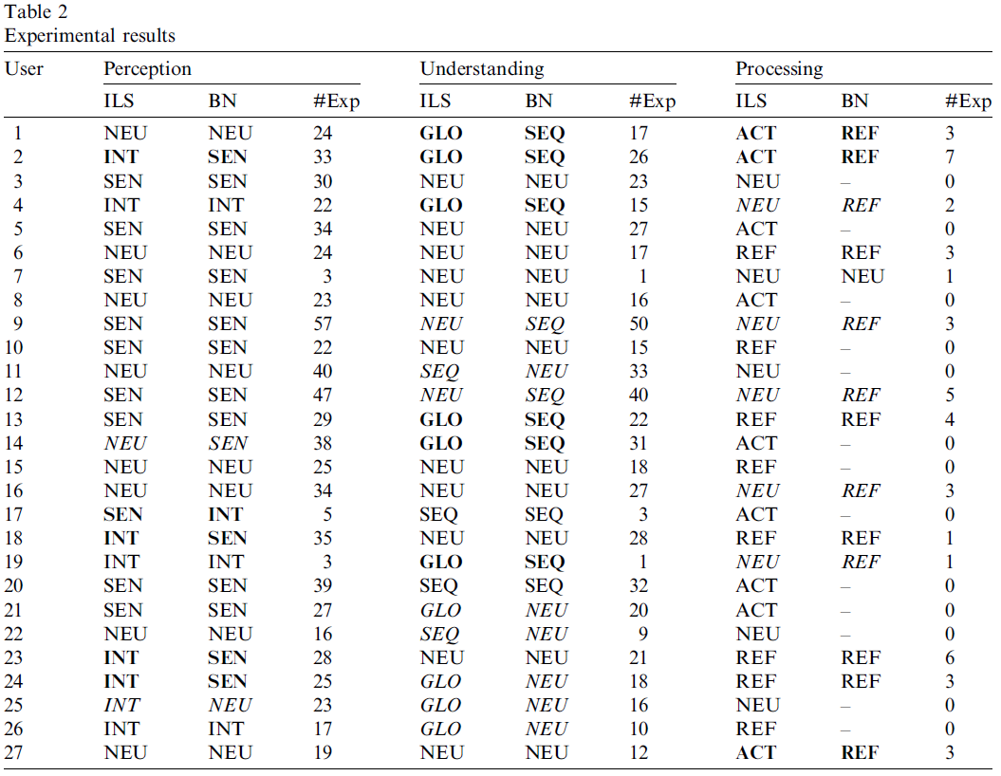
Notes:
We found that most students made little use (or no use) of the chat, mail and
forum facilities. 79% of the students did not use it at all.

Slide 19
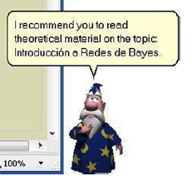
Additional Work
eTeacher
Use the Bayesian network as a teaching aid

Slide 20
eTeacher Recommendations
Dimension | Value | Assistance
Perception | Sensitive Intuitive | More exercises about topic X. Study more examples of topic X. Carefully revise the exam before submitting it. Read theoretical explanations of topic X. Read the suggested bibliography of topic X.
Processing | Active Reflective | Participate in the debate about topic X Take some minutes to think about topic X.
Understanding | Sequential Global | Study topic X before studying topic Y. Read the introduction and summary of this topic first.

Slide 21
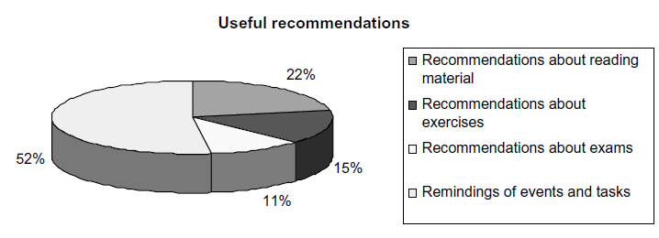
eTeacher Results
30% found eTeacher’s recommendations useless.

Slide 22
Bibliography
Patricio Garcia, Analia Amandi, Silvia Schiaffino, Marcelo Campo. "Evaluating Bayesian networks' precision for detecting students' learning styles,” Computers and Education, Volume 49, Issue 3, November 2007, Pages 794-808.
Silvia Schiaffino, Patricio Garcia, Analia Amandi. "eTeacher: Providing personalized assistance to e-learning students," Computers and Education, Computers & Education, Volume 51, Issue 4, December 2008, Pages 1744-1754.

