Slide 1
A Summary of “Bayesian Networks in Educational Testing” by Jiri Vomlel
Bernardo Quibiana
Shamik Roy Chowdhury
CSCE 582 – Fall 2010
October 18, 2010

Slide 2
Objective
Diagnosis of person’s skills → obtained faster my modeling dependence between skills → can be done with Bayesian Networks.
We are concerned with the findings: whether a person has or lacks specific skills and to inform that person.( eg: whether he has necessary prerequisites for enrolling in a course).
Can be achieved with CAT (Computer Adaptive Tests) or Paper based tests → each question tests some necessary skills.
Test Designer specifies a set of tested skills, abilities, misconceptions S = { S₁, S₂, …. S_{k} } and bank of questions, tasks X = {X₁, X₂, …. X_{m} }. Also specifies which skills are directly related to each question

Slide 3
Objective
Whole systems aim is to maximize information after the test
( ie: reduce uncertainty about presence or absence of skills represented by the probability distribution over the skills).

Slide 4
Theoretical Background for CAT – its Advantages
Available all year around → reduce student number taking the test at a time.
Available at many locations ( and presented through internet )
Better tailored to ability level of each student.
Scores available immediately after the test.
Gives more precise information about student’s abilities than paper test.
Number of asked questions reduced hence saves time.
Reduces examinee frustration ( low ability examinees not forced to take test items constructed for high-ability testees and vice versa)
Each result recorded and easily reused later for various purposes.
Improves variability of the test ( it includes an entire item bank rather than merely 20 or 40 items that make up the examinee’s test)
Can include graphics, photos, audio records and full motion video clips.

Slide 5
Advantages
Does not require examinee to be a computer specialist for answering the test. Only basic computer skills are sufficient.
Possible to compare CAT results of students, since all test questions are rated before student takes it.

Slide 6
Theoretical Background for CAT – its Disadvantages
Computer needed for every student taking the test at a time – might be a difficulty when large number of students present.
Might be hard to concentrate for the test sitting in front of a computer – for a paper test a student realizes it is something important.
Some people are afraid of computers and get nervous during the test thinking they might not be able to manage it.

Slide 7
Theoretical Background for CAT: An Example of an Adaptive Test
Goal of project: construct computerized adaptive test of student’s skills we wish to measure using an item bank.

Slide 8
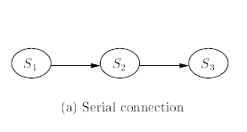
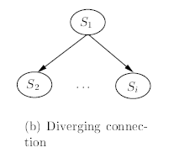
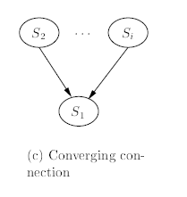
Theoretical Background for CAT: Building a Student Model
First step in construction of CAT : Create Bayesian Network for a Student Model(SM) & Evidence Model(EM)
Student Model(SM): Bayesian Network which describes relations among students skills measured by random variables
S = (S_{i}) _{i€[1, N]} and a probability distribution P(S) = P(S₁, ….. , S_{n}) which represents knowledge about a student.
Student Model built combining the basic connections shown (right →) and according to the rules of
d-separation. ( this rule can indicate whether any pair of skill variables are independent given evidence )

Slide 9
Theoretical Background for CAT: Building a Student Model
For converging connections different types of relations can be defined
whether one of parent variables
(S_{2,} … S_{i} ) can have a greater impact on S₁ than other parents.
whether all the parents (S_{2,} … S_{i} ) have an equal impact on S_{i}
Special kinds of relations are:
logical
logical or
logical and
Right( → ) :
Logical relations of S₃ to S₁ , S₂ described by P(S₃| S₁ , S₂ )
encoding of connections into conditional probability tables

Slide 10
Theoretical Background for CAT: Building an Evidence Model (EMd)
Describes relations among skill variables and an Item from item bank
S_{i} → i-th skill variable
X_{i,l} → l-th item from i-th group of item.
In EMd:
each item X_{i,l} can have one skill variable as a parent.
In case of 2 or more parents intermediate node created.
Each item has 5-6 possible answers. 1 correct and few correspond to misconceptions
Item Bank: collection of items (tasks, exercises) grouped according to skill variables. Each item in a group of same type and have same conditional probabilities.
Evidence on a variable is an information about the state of the variable – Evidence can only be transmitted to the SM through an EMds.
P(X_{i} | S_{i} ) →
0.2 → Guessing probability without having the ‘imagination’ skill.

Slide 11
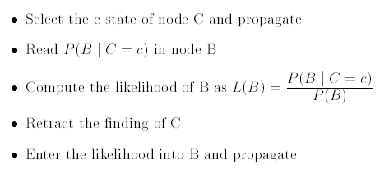
Theoretical Background for CAT: Soft Evidential Update – Update through entering Likelihood
Big Circle :
-- subnetwork of Bayesian network containing nodes ( A₁, A₂, … A_{n}, B)
-- Node C connected to network via Node B.
-- Node C’s state will be selected
-- Node B can have output or input arrows to any node in the subnetwork.
-- There can be any edges between (A₁, A₂, … A_{n}, B) provided they construct a directed acyclic graph.

Slide 12
Theoretical Background for CAT: Next Best Item Selection
Myopically Optimal Test:
Each question minimizes expected value of entropy after question answered. ( ie decrease in the uncertainty about the presence or absence of the skills represented by probability distribution over the skills)
Entropy H(P) of probability distribution P(S) defined as:
In CAT this information function used as:
Stopping criteria for the test ( ie: test stopped after certain value of entropy reached )
In ‘Best Next Item Selection’ Algorithm
Best Next Item Selection Algorithm

Slide 13
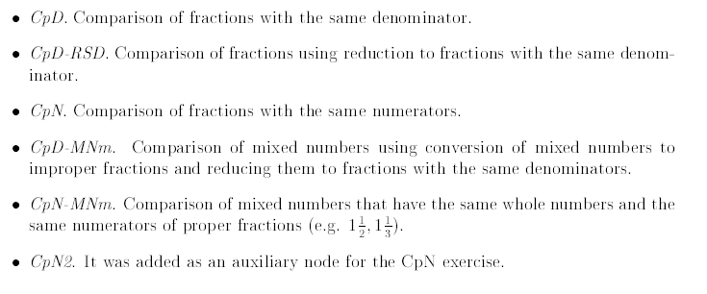
Structure of Student Model – Types of Nodes
6 Types of Nodes :
Skill Nodes
Skill Nodes grouped according to operations to which the skill belongs.
Each skill belongs to one of the groups:
Misconception Nodes
Task Nodes ( Student Model is a model without Task Nodes )
Auxiliary Nodes ( for combining influence of a skill and misconception)
Logical AND and OR nodes
Logical NOT AND nodes

Slide 14
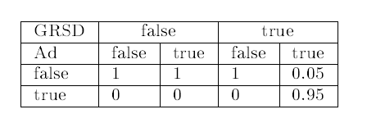
Structure of Student Model – Skill Nodes
Nodes of the group are connected and they constitute a hierarchy.
Skills required to solve an AD_RSD (2/3 + 1/5) exercise:
Ad ( 7/15 + 3/15)
RSD ( reducing fractions to fractions with same denominator )
UN_RSD ( understanding of RSD)
GRSD =>
RSD ( Logical AND ) UN_RSD
P(Ad_RSD = true | Ad = true, GRSD = true ) = 0.95
Not 1 since the student might make a mistake in spite of having the specified skills to solve the exercise.
Skills nodes have :
Experience Tables
Prior Probabilities
Notes:
Error: AD_RSD (2/3 + 1/5) -> Ad ( 7/15 + 3/15)
Corrected: AD_RSD (2/3 + 1/5) -> Ad ( 10/15 + 3/15)

Slide 15
Structure of Student Model – Misconception Nodes
Misconception Nodes begin with a symbol “-”.
Have same features as skill nodes
Have experience and prior probability tables.
Probabilities updated using penalized EM Algorithm.
Do not have any hierarchy

Slide 16
Structure of Student Model – Task Nodes
Name begins with letter ‘T’.
It’s a task item and a task node from evidence model.
Task nodes are separated and student model is a model without task nodes.
These nodes attached to the model dynamically and evidence obtained by the student is transmitted to these nodes and after propagation the evidence transmitted to the evidence model

Slide 17
Structure of Student Model – Task Nodes
Table correspond to a multichoice exercise for the TMAd node.
1 correct choice
1 misconception choice ( ADA in model)
3 false choices
Student has skill Ad
P(TMAd = true | Ad = true ) = 0.95
P(TMAd = false | Ad = true ) = 0.038
P(TMAd = ADA | Ad = true ) = 0.012
Student has Misconception
P(TMAd = ADA | Ad = ADA ) = 0.95
Student does not have skill Ad (he guesses)
P(TMAd = false | Ad = false ) = 0.6
Every answer chosen with a probability of 0.2
Notes:
Error: P(TMAd = ADA | Ad = true ) = 0.12 (in the CPT)
Corrected: P(TMAd = ADA | Ad = true ) = 0.012

Slide 18
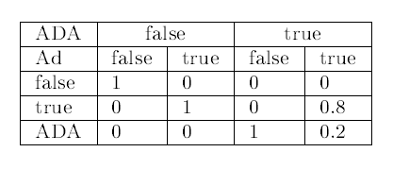
Structure of Student Model – Auxiliary nodes for combining influence of a skill and misconception
Combine skill nodes and misconception nodes so each task node has just one parent.
Helps to minimize table size for task nodes.
Student cannot have both – a skill and a misconception
Thus P(MAd | ADA=true , Ad=true ) is irrelevant
In Model it is forbidden with a ‘logical NOT AND’ nodes

Slide 19
Structure of Student Model – Logical AND nodes
Combine parent nodes by AND operation.
Minimizes number of arrows in the network.
GRSD = RSD (Logical AND) UN_RSD
P(GRSD | RSD, UN_RSD )
Table for the GRSD Table
RSD
UN_RSD
RSD | False |  | True
UN_RSD | False | True | False | True
True | 0 | 0 | 0 | 1
False | 1 | 1 | 1 | 0

Slide 20
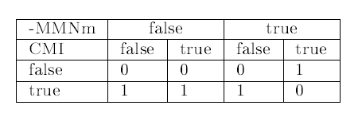
Structure of Student Model – Logical NOT AND nodes
Student cannot have a skill and misconception at the same time -- !NAND nodes used to avoid such situations.
-MMNm
CMI

Slide 21
CAT IMPLEMENTATION OF FRACTIONS – SYSTEM ARCHITECTURE

Slide 22
CAT IMPLEMENTATION OF FRACTIONS – CLASS DIAGRAMS AND DESCRIPTION OF MAIN CLASSES
class CATest
Controls execution of the whole program.
Provides user interface and responses to user’s selection of answers
Main Methods :
initTest()
Initializes Test, loads student model and creates Item Bank
randomizeItemBank()
Mixes ordering of Items in each ItemGroup
proceedWithNewItem()
Finds most informative item using Entropy object and gives it to student
userResponse()
Handles user response and passes evidence to the NetworkControl Object

Slide 23
CAT IMPLEMENTATION OF FRACTIONS – CLASS DIAGRAMS AND DESCRIPTION OF MAIN CLASSES
Interface ItemControl
General interface for the item selection procedure.
Main Methods :
ItemGroup selectBestNewItem(Vector ItemBank)
Returns next item in the test
boolean toStop(Vector itemBank)
Returns true if test should be finished

Slide 24
CAT IMPLEMENTATION OF FRACTIONS – CLASS DIAGRAMS AND DESCRIPTION OF MAIN CLASSES
Class Entropy :
Handles mathematical calculations and finds item to proceed next.
Main Methods :
ItemGroup selectBestNewItem(Vector itemBank)
Returns next item in the test
Boolean toStop(Vector itemBank)
Returns true if test over
Double entropyValue()
Calculates entropy of the probability distribution of the Student Model

Slide 25
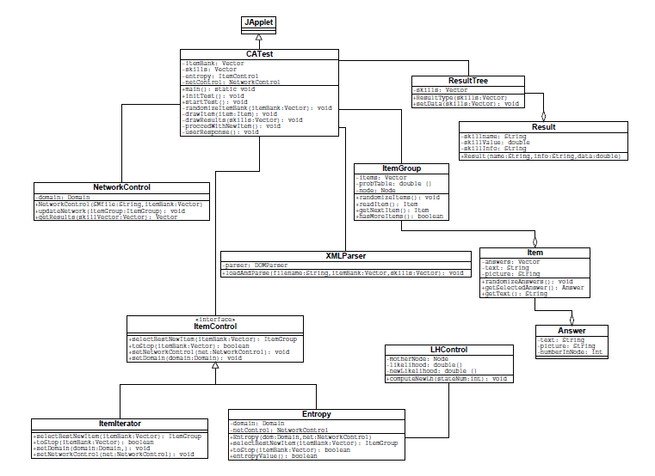
CAT IMPLEMENTATION OF FRACTIONS – CLASS DIAGRAMS AND DESCRIPTION OF MAIN CLASSES
Class ItemIterator
Go through all items in ItemBank
Used as a tool to find errors in ItemBank
Main Methods:
ItemGroup selectBestNewItem(Vector itemBank)
Returns item from itemGroup item by item
Boolean toStop(Vector itemBank)
Returns true if no more items left in itemBank

Slide 26
CAT IMPLEMENTATION OF FRACTIONS – CLASS DIAGRAMS AND DESCRIPTION OF MAIN CLASSES
Class NetworkControl
Loads student model, builds evidence model and updates network
It parses the Bayesian Network “.hkb” file, and loads network into domain → student model built.
Since item nodes in evidence model not taken into consideration when entropy value calculated , it records cliques and intersections in the student model and stores in 2 Vectors.
It builds Evidence Model, and reads the information for each item node from Class Item. Information includes parent nodes’ names of each item, the number of its states, the conditional probability table. All Hugin nodes are created and attached to student model → Initialization part ends.
During the test, Class NetworkControl will modify and update the network by the requests from other parts of the program.

Slide 27
CAT IMPLEMENTATION OF FRACTIONS – CLASS DIAGRAMS AND DESCRIPTION OF MAIN CLASSES
Main Methods :
NetworkControl(String SMfile, Vector itemBank)
This is the constructor. Created domain object, loads student model from “.hkb” file and builds evidence models using data of the itemBank.
Void upDateNetwork(Vector itemBank)
Updates network by soft evidential update. Hard evidential update is performed during soft evidential update but is retracted once updated values are read.
Goal: Keep a skill node updated by outcomes of all answered children nodes.
Vector getResults(Vector skills)
Read current beliefs from the student model.
Also called after test finish

Slide 28
CAT IMPLEMENTATION OF FRACTIONS – CLASS DIAGRAMS AND DESCRIPTION OF MAIN CLASSES
Class ItemGroup
Storage class for items of the same type.
Items of same type have same parent and same probability table.
Main Methods:
Item readItem()
reads current available item from item group
Item getNextItem()
Reads next item from item group which becomes current item
Void randomizedItems()
Mixes ordering items in the ItemGroup.
Initial ordering in XML file.
Class Item
Stores information related to one test item.
Main Methods:
String getTest()
Returns question of an item
Answer getSelectedAnswer()
After student selects one possible answer for an item, the selected answer is provided by this method
void randomizeAnswers()
Mixes ordering items in the ItemGroup.
Initial ordering in XML file.

Slide 29
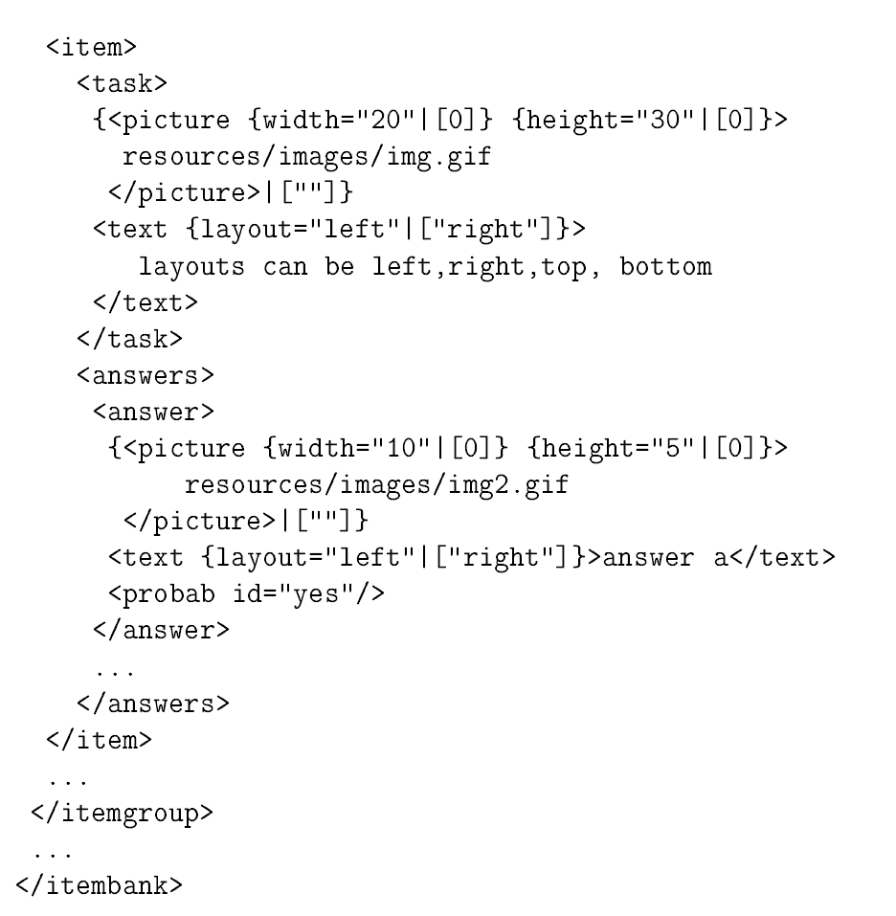
CAT IMPLEMENTATION OF FRACTIONS – CLASS DIAGRAMS AND DESCRIPTION OF MAIN CLASSES
Class XMLParser
Loads itemBank and description of skills from the xml file
Main Methods:
Void loadAndParse(String fileName, Vector itemBank, Vector skills)
Reads the file with a name fileName and fills the data from this file into 2 Vectors.

Slide 30
PERFORMANCE OF ITEM SELECTION PROCEDURE

Slide 31
Review
Diagnosis of person’s skills
Tests vs. Skills
Testing
Fixed Tests
Adaptive Tests
Bayesian Networks
$P\left(S,X\right)=P\left(S\right)∗\prod_{X_{j}∈X}{P(X_{j}|S_{j})}$
S: set of tested skills (skills, abilities, misconceptions, etc.)
X: bank of tests (questions, tasks, etc.)
Student Models
$P(S)$
Evidence Models
$P(X_{j}|S_{j})$

Slide 32
Finding the Student Model
Structural Learning Algorithms
Score-based
Conditional log-likelihood
$CLL\left(P | D\right)= \sum_{i=1}^{n}{\log{P(s_{i}|x_{i})}}$
where P: model, D: data
Constraint-based
Hugin PC Algorithm (under assumption of infinite data sets, perfect tests and DAG faithfulness)
Statistical tests for conditional independence for all pairs of variables
Undirected links between each pair of conditionally dependent variables
Identify colliders (e.g. A , C : A -> B <-C)
Derive directed links from statistics and colliders
Random directed as long as a DAG is obtained

Slide 33
Building Models
Structural Learning
Hugin PC Algorithm
Domain experts
Maximum Information
Decrease uncertainty of the hypothesis (skills)
Most informative test with least number of questions
Value Function: Entropy
$H\left(P\left(S\right)\right)=− \sum_{s∈S}{P\left(S=s\right)∗\log{P(S=s)}}$
Minimal entropy Maximum Information
Myopic Approximation
Minimize the expected value of the entropy with each answer

Slide 34
Algorithm for an Optimal Fixed Test

Slide 35
The Experiment
Basic Fraction Skills
Elementary skills
Operational skills
Application skills
Students from Aalborg University prepared two paper tests, each with 10 groups of exercises
149 (15 years old) students from Brønderslev High School solved the tests

Slide 36
Basic Fractions Skills Assessed
Skills and Abilities
Example
Elementary Skills
Comparison
Addition
Subtraction
Multiplication
Operational Skills
Finding common denominator
Cancelling out
Conversion to mixed numbers
Conversion to improper numbers
Application Skills
Finding common denominator
Cancelling out
Conversion to mixed numbers
Conversion to improper numbers

Slide 37
Common Misconceptions

Slide 38
Student Model - $P(S)$

Slide 39
Evidence Model - $P(X_{j}|S_{j})$

Slide 40
The Original Model

Slide 41
Comparison of Models
The Original Overall Model
Vomlel’s Student Model

Slide 42
Results
Nine models created through different constraints
Result of tests using a leave-one-out cross-validation procedure on each model

Slide 43
Results: Predictive Accuracy – Cont.
Pairwise comparisons of models based on paired t-tests , t(148)=1.97601
Comparisons of question predictive accuracy

Slide 44
Results: Comparison of Test Design Methods
Test Design Methods
Comparison of predictive accuracy
Same order as the paper test
Ascending
Reverser order of the paper test
Descending
Fixed test based on the proposed algorithm
Average
Myopically optimal adaptive test using model (b)
Adaptive

Slide 45
Results: Test Design Methods– Cont.
Comparison of change in entropy with number of questions answered
Comparison of predictive accuracy based on number of questions answered

Slide 46
Conclusion
Predictive Accuracy
Adaptive Tests > Fixed Tests (> Descending >>> Ascending)
Adaptive Tests
Bayesian Networks
Computerized Adaptive Tests
Most informative test with least number of questions
Fixed Tests
New algorithm
Improved predictive accuracy

Slide 47
Questions
?

Slide 48
References
Jiří Vomlet. Bayesian networks in Educational testing. http://utia.cas.cz/vomlel.
Linas Būtenas, Agnė Brilingaite, Alminas Čivilis, Xuepeng Yin, and Nora Zokaitė. Computerized adaptive test based on Bayesian network for basic operations with fractions. Student project report, Aalborg University, 2001. http://www.cs.auc.dk/library.

