Slide 1
Bayesian Networks for Student Model Engineering
Bridgette Parsons
Megan Tarter
Eva Millan, Tomasz Loboda, Jose Luis Perez-de-la-Cruz

Slide 2
Introduction
Purpose: provide education practitioners with background and examples to understand Bayesian networks
Be able to use them to design and implement student models
Student model - it stores all the information about the student so the tutoring system can use this information to provide personalized instruction

Slide 3
Student Model
A student model is a component of the architecture for Intelligent Tutoring Systems(ITSs)
Keeps track of progress
Prototypes based on:
  How will the student model be initialized and updated?
  How will the student model be used?

Slide 4
Student Model
Classifications of Attributes and Aptitudes
  Cognitive
    Student has “good visual analogical intelligence”
  Conative
    Student is “reflective” rather than “impulsive”
  Affective
    Attributes related to values and emotions

Slide 5
Student Model
There are many reasons for the increasing interest in using Bayesian networks in modeling
  A theoretically sound framework
  More powerful computers
  Presence of Bayesian libraries

Slide 6
Student Model
Types of Student Models
  Overlay Model
  Differential Model
  Perturbation Model
  Constraint-Based Model
  Knowledge Tracing vs. Model Tracing

Slide 7
Overlay Model
Student’s knowledge is subset of entire domain
Differences in behavior of student compared to behavior of one with perfect knowledge=> gaps
Works well when goal is is to move knowledge from system to student
Difficulty is the student may have incorrect beliefs

Slide 8
Differential Model
Variation of the Overlay Model
Domain Knowledge split into necessary and unnecessary (or optional)
Defined over a subset of the domain knowledge

Slide 9
Perturbation Model
Student’s knowledge is split into correct and incorrect
Overlay model over an increased set of knowledge items
Incorrect knowledge is divided into misconceptions and bugs
Better explanation for student’s behavior
More costly to build and maintain
Most common

Slide 10
Constraint-Based Model
Domain knowledge is represented by a set of constraints over the problem state
The set of constraints identifies correct solutions and the student model is an overlay model over this set
Advantage is unless a solution violates at least one constraint is is considered correct.
Allows the student to find new ways of problem-solving that were not foreseen

Slide 11
Student Model
Two types of student models
  Knowledge tracing
    Attempts to determine what a student knows, including misconceptions
    Useful as an evaluation tool and a decision aid
  Model tracing
    Attempts to understand how the student solves a given problem
    Useful in systems that provide guidance when the student is stuck
Bayesian networks can be used to implement all the approaches

Slide 12
Student Model Building
Target Variables
  Represent features a system will use to customize the guidance of or assistance to the student
  Examples
    Knowledge
    Cognitive Features
    Affective Attributes
Evidence variables
  Directly observable features of student’s behavior
  Examples
    Answers
    Conscious behavior
    Unconscious behavior

Slide 13
Student Model Building
Factor variables
  Factors the student was or is in that affect other variables
  Could be a target variable
Global vs. Local Variables
  Global variables linked to a large number of other nodes
  Local variables linked to a modest number of target variables
Static vs. Dynamic Variables
  Static variables remain unchanged by situation
  Dynamic variables address the change in the student’s state as a result of interaction with the system

Slide 14
Student Model Building
Prerequisite Relationships
  Define the order in which learning material is believed to be mastered
  Useful because they can speed up inference
Refinement Relationships
  Define the level of detail
Granularity Relationships
  Describes how the domain is broken up into its components
    Coarse-grained or Fine-grained

Slide 15
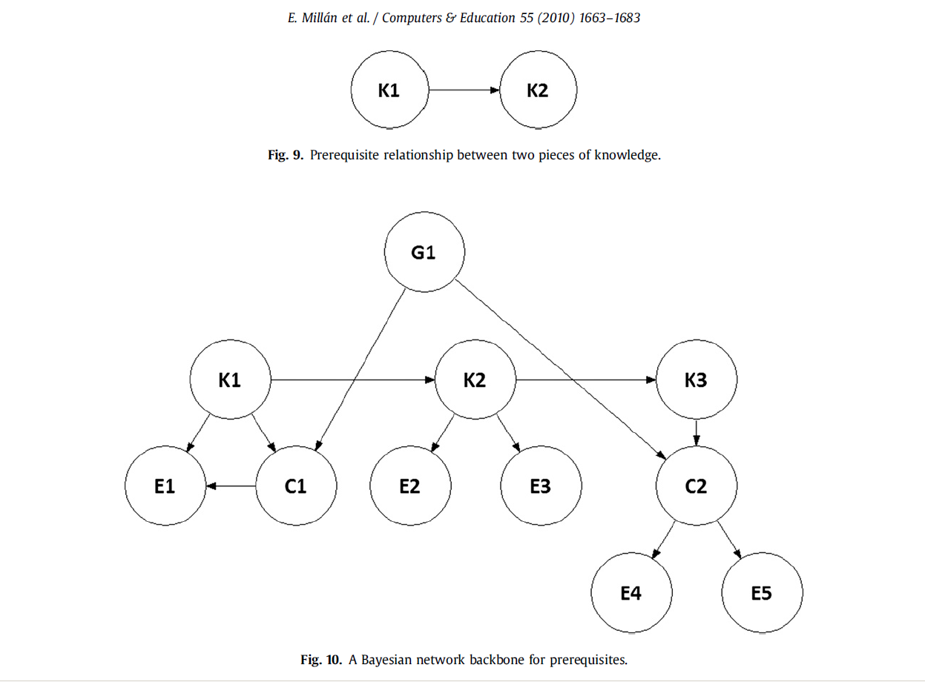
Student Model Building

Slide 16
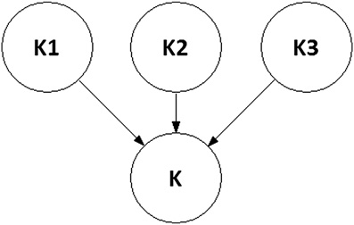
Student Model Building
Fig. 12. A Bayesian network modeling granularity relationships

Slide 17
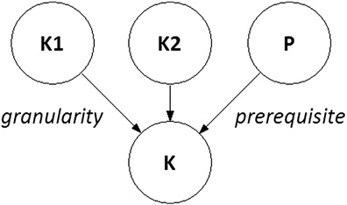
Student Model Building
Fig. 13. A Bayesian network modeling granularity and prerequisite relationships simultaneously

Slide 18
Student Model Building
Time Factor
  Dynamic Bayesian networks
    Alternative for modeling relationships between knowledge and evidential variables
    Time is discrete, needing separate networks for each time-slice
Machine learning techniques
  Define a DAG
    Eliminate links between observable variables
    Set causal direction between hidden and observable variable
    Select the more intuitive casual direction for every correlation between hidden variables
    Eliminate cycles by removing the weakest links

Slide 19
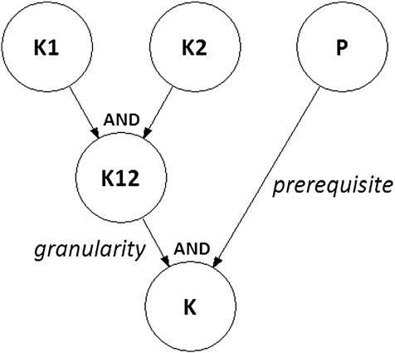
Student Model Building
Fig. 14. A Bayesian network modeling granularity and prerequisite relationships simultaneously – with intermediate variable introduced

Slide 20
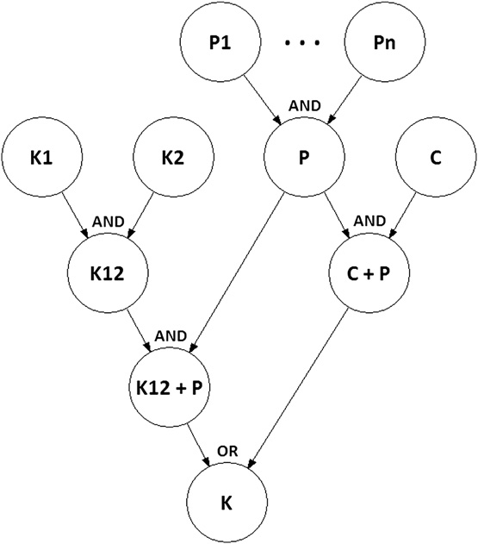
Student Model Building
Fig. 15. A Bayesian network modeling two ways of a learner’s knowledge acquisition

Slide 21
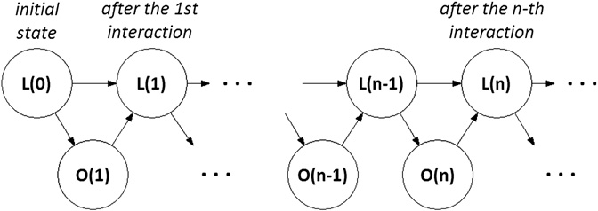
Student Model Building
More Complex Models
  such as problem solving, metacognitive skills, and emotional state and affect
Fig. 16. A dynamic Bayesian network for student modeling

Slide 22
Student Model Building
Example of problem solving process in physics tutor ANDES
Kinds of Assessment
  Plan recognition
  Prediction of student’s goals and actions
  Long-time assessment of student’s knowledge
Variables
    Knowledge variables
    Goal variables
    Strategy variables
    Rule application variables

Slide 23
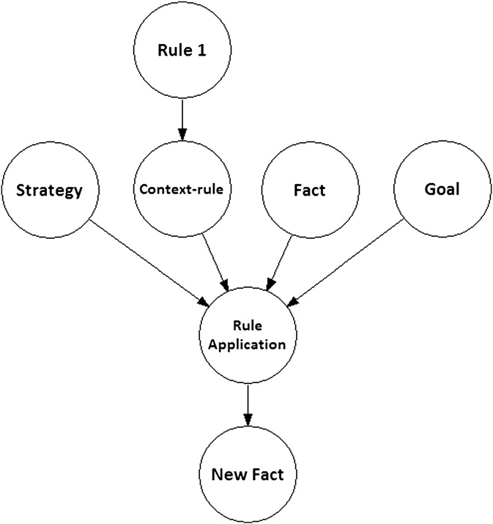
Student Model Building
Fig. 17. Basic structure of ANDES BNs

Slide 24
Student Model Building
Metacognitive Skills - How to learn
  Min-analogy
    Try problems on their own then look at solutions
    More effective
  Max-analogy
    Copy solutions
Explanation Based Learning of Correctness (EBLC)
  Copy variables
  Similarity variables
  Analogy-tend variables
  EBLC variables
  EBLC-tend variables

Slide 25
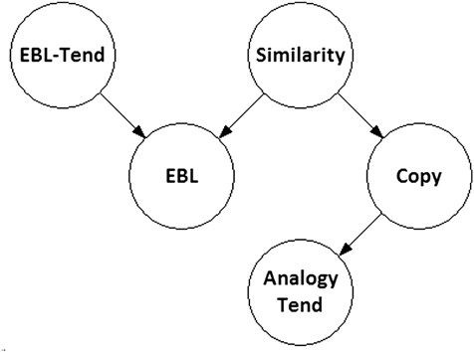
Student Model Building
Fig. 18. A BN supporting the Explanation Based Learning of Correctness (EBLC).

Slide 26
Student Model Building
Emotions-User’s characteristics accounted for by computer applications
  Prime Climb
    Goal Variables
    Action Variables
    Goal Satisfaction Variables
    Emotion Variables
      Joy/distress (user state)
      Pride/shame (user state)
      Admiration/Reproach (AI state)

Slide 27
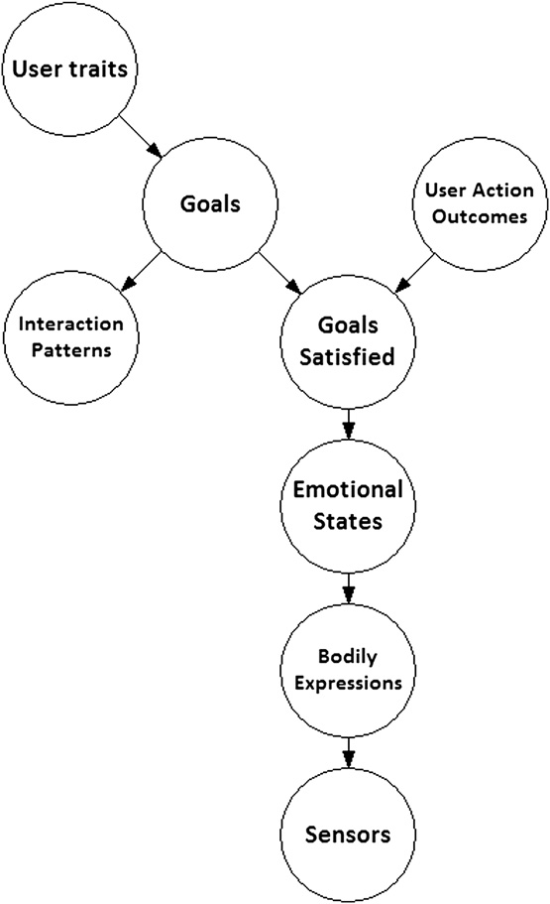
Student Model Building
Linear Programming Example
Fig. 19. A Bayesian network for the Prime Climb game

Slide 28
Student Model Building
Evidential problem nodes
Dedicated questions or problems
Relationships between questions and ability are all logical AND
Relationships between ability and problem and between skills and questions are 1 or 0 with a minor adjustment for lucky guesses/slips

Slide 29
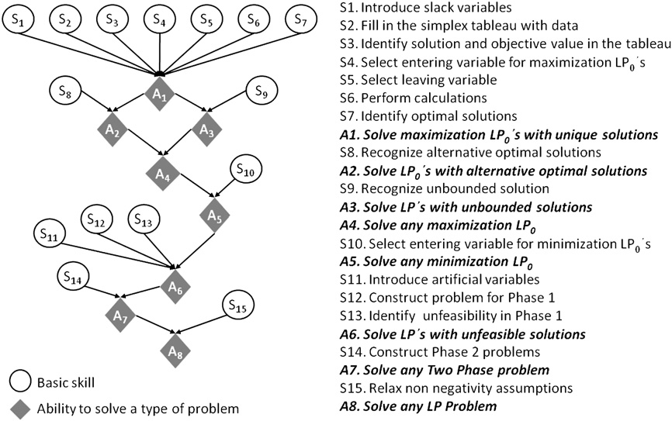
Student Model Building
Fig. 20. A learning strategy for the simplex algorithm

Slide 30
Propositional Variables
A1 = 1 if the student has all skills 1–7: 0 otherwise
A2 = 1 if the student has ability A1 and skill 8: 0 otherwise
A3 = 1 if the student has ability A1 and skill 9: 0 otherwise
A4 = 1 if the student has abilities A2 and A3: 0 otherwise
A5 = 1 if the student has ability A4 and skill 10: 0 otherwise
A6 = 1 if the student has ability A5 and skills 11, 12, 13: 0 otherwise
A7 = 1 if the student has ability A6 and skill 14: 0 otherwise
A8 = 1 if the student has ability A7 and skill 15: 0 otherwise

Slide 31
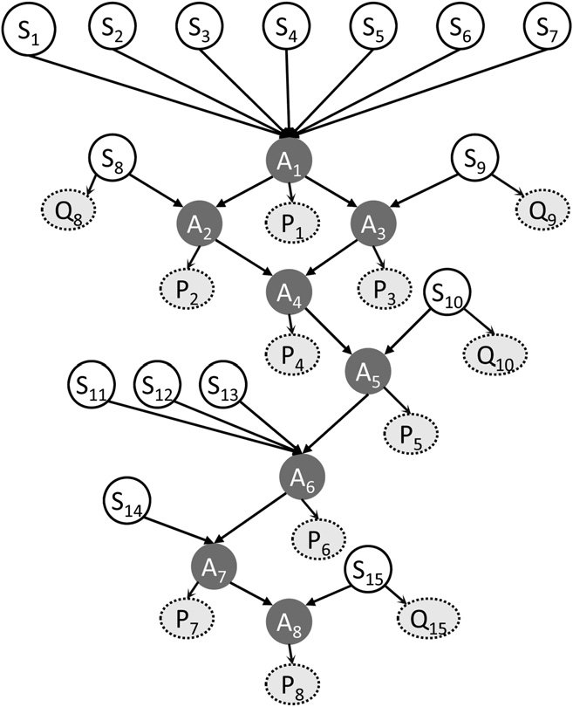
Student Model Building
Fig. 21. A Bayesian student model for the Simplex algorithm.

Slide 32
Conclusions
User models are useful in education.
Bayesian networks are a powerful tool for student modeling.
This paper introduced concepts and techniques relevant to Bayesian networks and argued that Bayesian networks can represent a wide range of student features.

