Slide 1
Dijkstra’s Algorithm
Run by hand Dijkstra's Algorithm (as stated in slide 68 at http://www.cse.sc.edu/~mgv/csce580sp15/notes/580Ch3AIMA.ppt) on the example of Figure 3.2 [P] (also on slide 6 at http://www.cse.sc.edu/~mgv/csce580sp15/notes/580Ch3.ppt); show the OPEN and CLOSED lists with the g values of the nodes on those lists for each iteration of lines 2-6 from beginning to end.

Slide 2
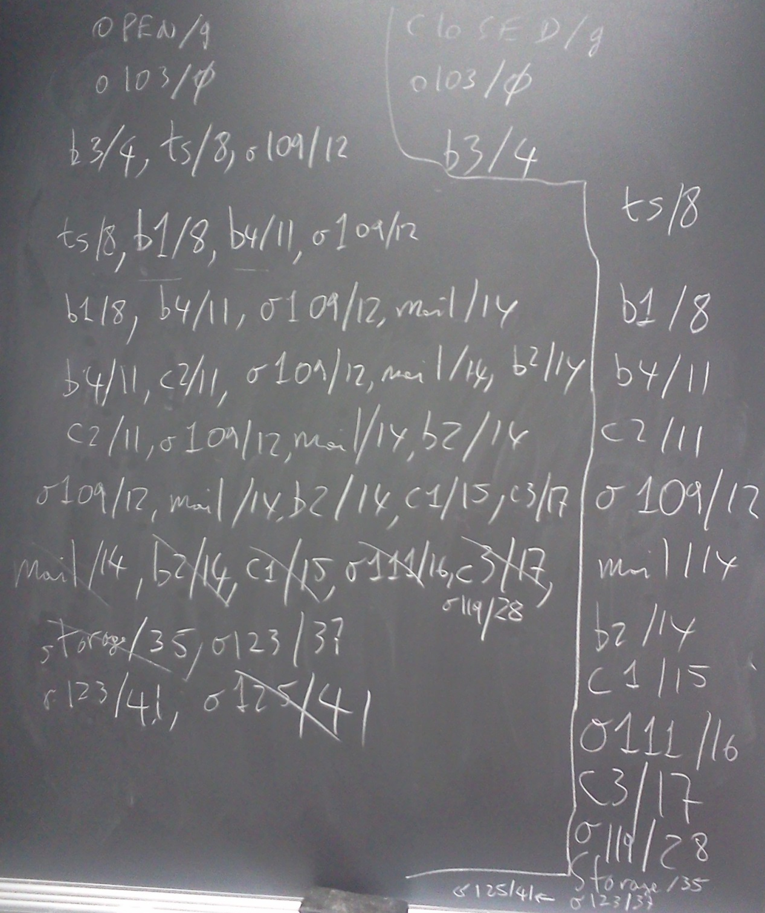

Slide 3
1. Put the start node s in OPEN. Set g(s) to 0
2. If OPEN is empty, exit with failure
3. Remove from OPEN and place in CLOSED a node n for which g(n) is minimum
4. If n is a goal node, exit with the solution obtained by tracing back pointers from n to s
5. Expand n, generating all of its successors. For each successor n' of n:
  a. compute g'(n')=g(n)+c(n,n')
  b. if n' is already on OPEN, and g'(n')<g(n'), let g(n')=g'(n’) and redirect the pointer from n' to n
  c. if n' is neither on OPEN or on CLOSED, let g(n')=g'(n'), attach a pointer from n' to n, and place n' on OPEN
6. Go to 2
Notes:
Dijkstra’s algorithm using OPEN and CLOSED lists.

