Slide 1
CSCE 580
Artificial Intelligence
Ch.4: Features and Constraints
Spring 2017
Marco Valtorta
mgv@cse.sc.edu
Every task involves constraint,
Solve the thing without complaint;
There are magic links and chains
Forged to loose our rigid brains.
Structures, strictures, though they bind,
Strangely liberate the mind.
—James Falen

Slide 2
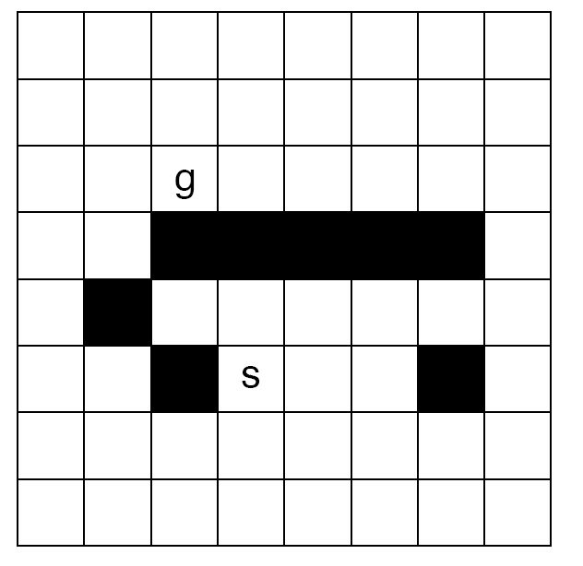

Slide 3
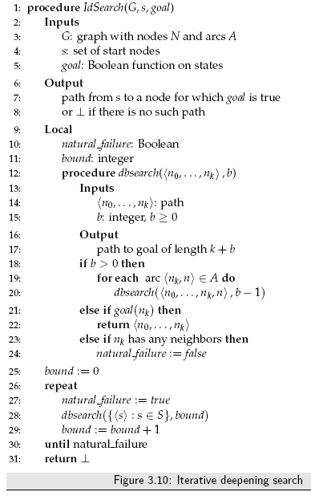
Iterative-deepening-A* (IDA*) works as follows: At each iteration, perform a
depth-first search, cutting off a branch when its total cost (g + h) exceeds a
given threshold. This threshold starts at the estimate of the cost of the initial
state, and increases for each iteration of the algorithm. At each iteration, the
threshold used for the next iteration is the minimum cost of all values that
exceeded the current threshold.
Richard Korf. “Depth-First Iterative-Deepening: An Optimal Admissible Tree Search.” Artificial Intelligence, 27 (1985), 97-109.
Notes:
IDA* Pseudocode from Stuart Russell ``Efficient Memory-Bounded Search Methods.'' In Proceedings of the Tenth European Conference on Artificial Intelligence, Vienna: Wiley, 1992.

Slide 5
Notes:
Not used in 2012.

Slide 6
Acknowledgment
The slides are based on the textbook [P] and other sources, including other fine textbooks
  [AIMA-2]
  David Poole, Alan Mackworth, and Randy Goebel. Computational Intelligence: A Logical Approach. Oxford, 1998
  Ivan Bratko. Prolog Programming for Artificial Intelligence, Third Edition. Addison-Wesley, 2001
    The fourth edition is under development
  George F. Luger. Artificial Intelligence: Structures and Strategies for Complex Problem Solving, Sixth Edition. Addison-Welsey, 2009
Notes:
From: David Poole [poole@cs.ubc.ca]
Sent: Wednesday, August 06, 2008 8:47 PM
To: Valtorta, Marco
Cc: Alan Mackworth
Subject: Re: New edition of your textbook
Hi Marco,
You can point the students to
http://www.cs.ubc.ca/~poole/aibook/

Slide 7
Features and States
States can be defined in terms of features: a state can be defined as an assignment of a value to each feature
Features can be defined in terms of states: the states can be primitive and a feature is a function on states. Given a state, the function returns the values of the feature in that state.
Each feature has a domain, which is the set of values it can take. The domain of a feature is the range of the function on the states in the previous bullet.

Slide 8
Example 4.1 (features and states)
In the electrical environment of Figure 1.8 (page 34; on this slide), there may be a feature for the position of each switch that specifies whether the switch is up or down. There may be a feature for each light that specifies whether the light is lit or not. There may be a feature for each component specifying whether it is working properly or if it is broken. A state consists of the position of every switch, the status of every device, and so on.
If the features are primitive, a state is an assignment of a value to each feature. For example, a state may be described as switch 1 is up, switch 2 is down, fuse 1 is okay, wire 3 is broken, and so on.
If the states are primitive, the functions may be, for example, the position of switch 1. The position is a function of the state, and it may be up in some states and down in other states.

Slide 9
Possible Worlds, Variables, and Constraints
A possible world is a possible way the world (the real world or some imaginary world) could be. When time is not involved, states and possible worlds correspond to the same thing.
Possible worlds are described by algebraic variables. An algebraic variable is a symbol used to denote features of possible worlds. Algebraic variables will be written starting with an upper-case letter. Each algebraic variable V has an associated domain, dom(V), which is the set of values the variable can take on.
Possible worlds are roughly equivalent to states
A variable is a symbol used to denote a feature of possible worlds
Variables can be primitive and a possible world corresponds to a total assignment of a value to each variable.
Worlds can be primitive and a variable is a function from possible worlds into the domain of the variable; given a possible world, the function returns the value of that variable in that possible world.
Notes:
Time is not considered explicitly in this chapter. Algebraic variable is simply called variable in this chapter.

Slide 10
Example 4.4 (possible worlds, variables, and features)
A classic example of a constraint satisfaction problem is a crossword puzzle. There are two different representations of crossword puzzles in terms of variables:
(a) In one representation, the variables are the numbered squares with the direction of the word (down or across), and the domains are the set of possible words that can be put in. A possible world corresponds to an assignment of a word for each of the variables.
(b) In another representation of a crossword, the variables are the individual squares and the domain of each variable is the set of letters in the alphabet. A possible world corresponds to an assignment of a letter to each square.

Slide 11
Example 4.5 (variables and possible worlds)
If there are two variables, A with domain {0, 1, 2} and B with domain {true, false}, there are six possible worlds, which you can name w0, . . .w5.
One possible arrangement of variables and possible worlds is:
w0 : A = 0 and B = true
w1 : A = 0 and B = false
w2 : A = 1 and B = true
w3 : A = 1 and B = false
w4 : A = 2 and B = true
w5 : A = 2 and B = false

Slide 12
Constraint Satisfaction Problems
Given a set of variables, each with a set of possible values (a domain), assign a value to each variable that either
  satisfies some set of constraints
    satisfiability problems
    hard constraints
  minimizes some cost function, where each assignment of values to variables has some cost
    optimization problems
    soft constraints
Many problems are a mix of hard and soft constraints.
Notes:
[P]

Slide 13
Relationship to Search
The path to a goal isn't important, only the solution is
Many algorithms exploit the multi-dimensional nature of the
problems
There are no predefined starting nodes
Often these problems are huge, with thousands of variables, so systematically searching the space is infeasible
For optimization problems, there are no well-defined goal nodes
Notes:
[P]

Slide 14
Constraint Satisfaction Problems
A CSP is characterized by
A set of variables V₁, V₂, …,V_{n}
Each variable V_{i} has an associated domain D_{Vi} of possible values
For satisfiability problems, there are constraint relations on various subsets of the variables which give legal combinations of values for these variables
A solution to the CSP is an n-tuple of values for the variables that satisfies all the constraint relations
Notes:
[P]

Slide 15
Extensional vs. intensional representation of constraints
Extensional representation Intensional representation
(Example 4.7 [P])
There is an error: 112 satisfies the formula.
Notes:
(Example 4.7 [P]) Point out error to authors! (112 is not in the table but satisfies

Slide 16
Examples 4.4 and 4.9 (Crossword Puzzle)
Example 4.4 A classic example of a constraint satisfaction problem is a crossword puzzle. There are two different representations of crossword puzzles in terms of variables:
In one representation, the variables are the numbered squares with the direction of the word (down or across), and the domains are the set of possible words that can be put in. A possible world corresponds to an assignment of a word for each of the (numbered square, direction) pairs.
In another representation of a crossword, the variables are the individual squares and the domain of each variable is the set of letters in the alphabet. A possible world corresponds to an assignment of a letter to each square.

Slide 17
Examples 4.4 and 4.9 (Crossword Puzzle)
Consider the constraints for the two representations of crossword puzzles of Example 4.4 (page 115); see previous slide.
For the case where the domains are words, each constraint is that the letters where a pair of words intersect must be the same. This is a binary constraint.
For the representation where the domains are the letters, each constraint is that contiguous sequences of letters have to form legal words. For a word of length n, this is an n-ary constraint.

Slide 18
Example 4.8 [P]: Scheduling Activities
Notes:
[P]

Slide 19
Generate-and-Test (4.3)
The assignment space, D, is the set of assignments of values to all of the variables; it corresponds to the set of all possible worlds. Each element of D is a total assignment of a value to each variable. The algorithm returns those assignments that satisfy all of the constraints.
The generate-and-test algorithm is as follows: check each total assignment in turn; if an assignment is found that satisfies all of the constraints, return that assignment.

Slide 20
CSP as Graph Searching
A CSP can be represented as a graph-search problem:
A node is an assignment of values to some of the variables
Suppose node N is the assignment X₁ = v₁, …, X_{k} = v_{k}
  Select a variable Y that isn't assigned in N
  For each value y_{i} in dom(Y ) there is a neighbor
  X₁ = v₁,…, X_{k} = v_{k}, Y = y_{i} if this assignment is consistent with the constraints on these variables.
The start node is the empty assignment.
A goal node is a total assignment that satisfies the constraints
Notes:
[P]

Slide 21
Backtracking Algorithms
Systematically explore the search space by instantiating the variables one at a time
Evaluate each constraint predicate as soon as all its variables are bound
Any partial assignment that doesn't satisfy the constraint can be pruned
Example: Assignment A = 1& B = 1 is inconsistent with constraint A != B regardless of the value of the other variables.
Therefore, backtracking is more efficient than generate and test, as shown in the following example.
Notes:
[P]

Slide 22
Backtracking Search Example (4.13)
Suppose you have a CSP with the variables A, B, C, each with domain {1, 2, 3, 4}. Suppose the constraints are A < B and B < C.
The size of the search tree, and thus the efficiency of the algorithm, depends on which variable is selected at each time.
In this example, there would be 4³ = 64 assignments tested in generate-and-test. For the search method, there are 22 assignments generated. Generate-and-test always reaches the leaves of the search tree.

Slide 23
Consistency Algorithms
Idea: prune the domains as much as possible before selecting values from them
In the example of the previous slide, the variables A and B are related by the constraint A<B. The assignment A=4 is inconsistent with each of the possible assignments to B since dom(B) = {1, 2, 3, 4}. In the course of the backtracking search this fact is rediscovered for different assignments to B and C. This inefficiency can be avoided by the simple expedient of deleting 4 from dom(A), once and for all. This idea is the basis for the consistency algorithms.
A variable is domain consistent if no value of the domain of the node is ruled impossible by any of the constraints
Notes:
[P]

Slide 24
Constraint Network
There is an oval-shaped node for each variable
There is a rectangular node for each constraint relation
There is a domain of values associated with each variable node
There is an arc from variable X to each constraint relation that involves X
Notes:
[P]

Slide 25
Constraint Network for Example 4.15
There are three variables A, B, C, each with domain {1, 2, 3, 4}. The constraints are A < B and B < C. In the constraint network, shown above (Fig. 4.2) there are 4 arcs: <A, A < B>, <B, A < B>, <B, B < C>, <C, B < C>
None of the arcs are arc consistent. The first arc is not arc consistent because for A = 4 there is no corresponding value for B, for which A < B.

Slide 26
Constraint Networks for Example 4.16
The constraint X 6= 4 has one arc: (X, X <>4)
The constraint X + Y = Z has three arcs:
(X, X + Y = Z)
(Y, X + Y = Z)
(Z, X + Y = Z)
X
X <> 4
Y
X
X +Y=Z
Z

Slide 27
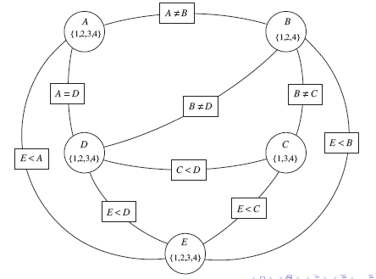
Example Constraint Network: Fig 4.4
For this example (delivery robot Example 4.8): D_{B} = {1, 2, 3, 4} is not domain consistent as B = 3 violates the constraint B != 3. We did not represent the unary constraint B != 3 and just reduced the domain of B.
Notes:
[P]

Slide 28
Arc Consistency
An arc <X, r (X, Y )> is arc consistent if, for each value x in dom(X), there is some value y in dom(Y ) such that r(x, y) is satisfied
A network is arc consistent if all its arcs are arc consistent
If an arc <X, r (X, Y )> is not arc consistent, all values of X in dom(X) for which there is no corresponding value in dom(Y ) may be deleted from dom(X) to make the arc <X, r (X,Y)> consistent
Notes:
[P]

Slide 29
Arc Consistency Algorithm
The arcs can be considered in turn making each arc consistent.
An arc <X, r (X, Y )> needs to be revisited if the domain of one of the Y 's is reduced.
Three possible outcomes (when all arcs are arc consistent):
  One domain is empty => no solution
  Each domain has a single value => unique solution
  Some domains have more than one value => there may or may not be a solution
If each variable domain is of size d and there are e constraints to be tested then the algorithm GAC does O(ed³) consistency checks. For some CSPs, for example, if the constraint graph is a tree, GAC alone solves the CSP and does it in time linear in the number of variables.
Notes:
[P]

Slide 30
Generalized Arc Consistency Algorithm

Slide 31
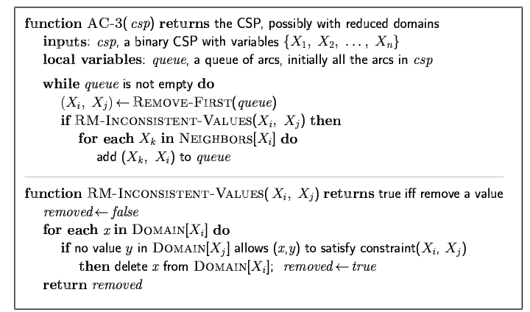
Arc consistency algorithm AC-3
Time complexity: O(n²d³), where n is the number of variables and d is the maximum variable domain size, because:
  At most O(n²) arcs
  Each arc can be inserted into the agenda (TDA set) at most d times
  Checking consistency of each arc can be done in O(d²) time
Notes:
AC-3 from [AIMA-3]

Slide 32
Generalized Arc Consistency Algorithm
Three possible outcomes:
  One domain is empty => no solution
  Each domain has a single value => unique solution
  Some domains have more than one value => there may or may not be a solution
If the problem has a unique solution, GAC may end in state (2) or (3); otherwise, we would have a polynomial-time algorithm to solve UNIQUE-SAT
UNIQUE-SAT or USAT is the problem of determining whether a formula known to have either zero or one satisfying assignments has zero or has one. Although this problem seems easier than general SAT, if there is a practical algorithm to solve this problem, then all problems in NP can be solved just as easily [Wikipedia; L.G. Valiant and V.V. Vazirani, NP is as Easy as Detecting Unique Solutions. Theoretical Computer Science, 47(1986), 85-94.]
Thanks to Amber McKenzie for asking a question about this!
Notes:
L.G. Valiant and V.V. Vazirani, NP is as Easy as Detecting Unique Solutions. Theoretical Computer Science, 47(1986), 85-94.

Slide 33
Finding Solutions when AC Finishes
If some domains have more than one element => search
Split a domain, then recursively solve each half
We only need to revisit arcs affected by the split
It is often best to split a domain in half
Notes:
[P]

Slide 34
Domain Splitting: Examples 4.15, 4.19, 4.22
Suppose it first selects the arc (A,A < B). For A = 4, there is no value of B that satisfies the constraint. Thus 4 is pruned from the domain of A. Nothing is added to TDA as there is no other arc currently outside TDA.
Suppose that (B, A < B) is selected next. The value 1 can be pruned from the domain of B. Again no element is added to TDA.
Suppose that (B, B < C) is selected next. The value 4 can be removed from the domain of B. As the domain of B has been reduced, the arc (A,A < B) must be added back into the TDA set because potentially the domain of A could be reduced further now that the domain of B is smaller.
If the arc (A,A < B) is selected next, the value A = 3 can be pruned from the domain of A.
The remaining arc on TDA is (C, B < C). The values 1 and 2 can be removed from the domain of C. No arcs are added to TDA and TDA becomes empty.
The algorithm then terminates with D_{A} = {1, 2}, D_{B} = {2, 3}, D_{C} = {3, 4}. While this has not fully solved the problem, it has greatly simplified it.

Slide 35
Domain Splitting: Examples 4.15, 4.19, 4.22
After arc consistency had completed, there are multiple elements in the domains. Suppose B is split. There are two cases:
  B = 2. In this case A = 2 is pruned. Splitting on C produces two of the answers.
  B = 3. In this case C = 3 is pruned. Splitting on A produces the other two answers.
This search tree should be contrasted with the search tree of Figure 4.1 (page 120). The search space with arc consistency is much smaller and not as sensitive to the selection of variable orderings. (Figure 4.1 (page 120) would be much bigger with different variable orderings).

Slide 36
Exploiting Propositional Structure
A Boolean variables is a symbol denoting a binary feature; it can be considered a 2-partition of the event space; it has (conventionally) the domain {true, false}
A CNF expression (aka CNF theory) is a conjunction of (disjunctive) clauses, where a clause is a disjunction of literals, and a literal is either a Boolean variable or a negated Boolean variable; a literal can also be considered an assignment of a value to a Boolean variable
Notes:
Section 4.6.1 [P]

Slide 37
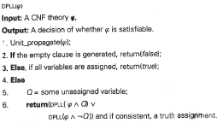
DPLL
The Davis-Putnam, Logemann, and Loveland procedure is the basis of some the most efficient propositional logic theorem provers. This presentation is due to Rina Dechter.
Notes:
Dechter’s book, section 5.4.

Slide 38
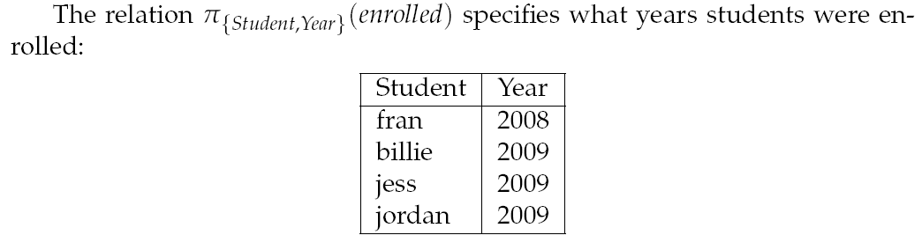
Variable Elimination: Preliminaries
The enrolled relation
Notes:
[P], Appendix 3

Slide 39
Variable Elimination: Join

Slide 40
Variable Elimination: Example

Slide 41
Variable Elimination Algorithm

Slide 42
Davis-Putnam (DP) Algorithm
Notes:
Irina Rish and Rina Dechter. “Resolution Versus Search: Two Strategies for SAT.” Report R-80, Department of Information and Computer Science, University of California, Irvine, undated. Published under the same title in: Journal of Automated Reasoning. Volume 24, Issue 1/2 (special issue on SAT), pp. 225-275, January, 2000. Most of the material appears in various places (especially, pp. 152-153, 228-229, 272-273) in: Rina Dechter. Constraint Processing. Morgan-Kauffman, 2003.

Slide 43
Davis-Putnam (DP) Algorithm
Notes:
Irina Rish and Rina Dechter. “Resolution Versus Search: Two Strategies for SAT.” Report R-80, Department of Information and Computer Science, University of California, Irvine, undated. Published under the same title in: Journal of Automated Reasoning. Volume 24, Issue 1/2 (special issue on SAT), pp. 225-275, January, 2000. Most of the material appears in various places (especially, pp. 152-153, 228-229, 272-273) in: Rina Dechter. Constraint Processing. Morgan-Kauffman, 2003.

Slide 44
Local Search
Local Search:
Maintain an assignment of a value to each variable
At each step, select a neighbor of the current assignment (usually, that improves some heuristic value)
Stop when a satisfying assignment is found, or return the best assignment found
Requires:
What is a neighbor?
Which neighbor should be selected?
(Some methods maintain multiple assignments.)

Slide 45
Local Search for CSPs
For loop:
  Random initialization
  Try: random restart
While loop:
  Local search (Walk)
Two special cases of the algorithm:
  Random sampling
  Random walk

Slide 46
Local Search for CSPs
Aim is to find an assignment with zero unsatisfied relations
Given an assignment of a value to each variable, a conflict is an unsatisfied constraint
The goal is an assignment with zero conflicts
Heuristic function to be minimized: the number of conflicts

Slide 47
Iterative Best Improvement [4.8.1 P]

Slide 48
Greedy Descent Variants
Find the variable-value pair that minimizes the number of conflicts at every step
Select a variable that participates in the most conflicts. Select a value that minimizes the number of conflicts
Select a variable that appears in any conflict. Select a value that minimizes the number of conflicts
Select a variable at random. Select a value that minimizes the number of conflicts
Select a variable and value at random; accept this change if it does not increase the number of conflicts.
Notes:
[P]

Slide 49
Selecting Neighbors in Local Search
When the domains are small or unordered, the neighbors of an assignment can correspond to choosing another value for one of the variables.
When the domains are large and ordered, the neighbors of an assignment are the adjacent values for one of the variables.
If the domains are continuous, Gradient descent changes each variable proportionally to the gradient of the heuristic function in that direction. The value of variable X_{i} goes from v_{i} to
Gradient ascent: go uphill; v_{i} becomes
Notes:
[P]

Slide 50
Problems with Hill Climbing
Notes:
[P]

Slide 51
Randomized Algorithms
Consider two methods to find a maximum value:
  Hill climbing, starting from some position, keep moving uphill and report maximum value found
  Pick values at random and report maximum value found
Which do you expect to work better to find a maximum?
Can a mix work better?
Notes:
[P]

Slide 52
Randomized Hill Climbing
As well as uphill steps we can allow for:
Random steps: move to a random neighbor
Random restart: reassign random values to all variables
Which is more expensive computationally?
Notes:
[P]

Slide 53
1-Dimensional Ordered Examples
Two --dimensional search spaces; step right or left:
Which method would most easily find the maximum?
What happens in hundreds or thousands of dimensions?
What if different parts of the search space have different structure?
Notes:
[P]

Slide 54
Random Walk
Variants of random walk:
When choosing the best variable-value pair, randomly sometimes choose a random variable-value pair
When selecting a variable then a value:
  Sometimes choose any variable that participates in the most conflicts
  Sometimes choose any variable that participates in any conflict (a red node)
  Sometimes choose any variable.
Sometimes choose the best value and sometimes choose a random value
Notes:
[P]

Slide 55
Comparing Stochastic Algorithm
How can you compare three algorithms when
  one solves the problem 30% of the time very quickly but doesn't halt for the other 70% of the cases
  one solves 60% of the cases reasonably quickly but doesn't solve the rest
  one solves the problem in 100% of the cases, but slowly?
Summary statistics, such as mean run time, median run time, and mode run time don't make much sense
Notes:
[P]

Slide 56
Runtime Distribution
Plots runtime (or number of steps) and the proportion (or number) of the runs that are solved within that runtime
Notes:
[P]

Slide 57
Runtime Distribution [Fig.4.9P]

Slide 58
Variant: Simulated Annealing
Pick a variable at random and a new value at random
If it is an improvement, adopt it
If it isn't an improvement, adopt it probabilistically depending on a temperature parameter, T.
  With current assignment n and proposed assignment n’ we move to n’ with probability
Temperature can be reduced
Probability of accepting a change:
Notes:
[P]

Slide 59
Tabu Lists
To prevent cycling we can maintain a tabu list of the k last assignments
Don't allow an assignment that is already on the tabu list
If k = 1, we don't allow an assignment of the same value to the variable chosen
We can implement it more efficiently than as a list of complete assignments
It can be expensive if k is large

Slide 60
Parallel Search
A total assignment is called an individual
Idea: maintain a population of k individuals instead of one
At every stage, update each individual in the population
Whenever an individual is a solution, it can be reported
Like k restarts, but uses k times the minimum number of steps
Notes:
[P]

Slide 61
Beam Search
Like parallel search, with k individuals, but choose the k best out of all of the neighbors
When k = 1, it is hill climbing
When k = infinity, it is breadth-first search
The value of k lets us limit space and parallelism
Notes:
[P]

Slide 62
Stochastic Beam Search
Like beam search, but it probabilistically chooses the k individuals at the next generation
The probability that a neighbor is chosen is proportional to its heuristic value
This maintains diversity amongst the individuals
The heuristic value reflects the fitness of the individual
Like asexual reproduction: each individual mutates and the fittest ones survive

Slide 63
Genetic Algorithms
Like stochastic beam search, but pairs of individuals are combined to create the offspring
For each generation:
  Randomly choose pairs of individuals where the fittest individuals are more likely to be chosen
  For each pair, perform a cross-over: form two offspring each taking different parts of their parents
  Mutate some values
Stop when a solution is found
Notes:
[P]

Slide 64
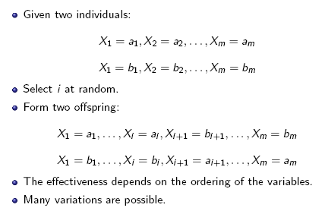
Crossover
Notes:
[P]

Slide 65
Example: Crossword Puzzle
Notes:
This is sample crossword 2 in AISpace.

Slide 66
Constraint satisfaction problems (CSPs)
Standard search problem:
  state is a "black box“ – any data structure that supports successor function, heuristic function, and goal test
CSP:
  state is defined by variables X_{i} with values from domain D_{i}
  goal test is a set of constraints specifying allowable combinations of values for subsets of variables
Simple example of a formal representation language
Allows useful general-purpose algorithms with more power than standard search algorithms
Notes:
[AIMA-2]

Slide 67
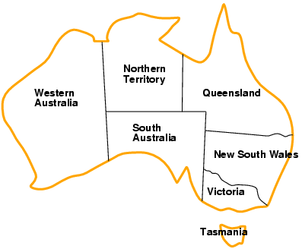
Example: Map-Coloring
Variables WA, NT, Q, NSW, V, SA, T
Domains D_{i} = {red,green,blue}
Constraints: adjacent regions must have different colors
e.g., WA ≠ NT, or (WA,NT) in {(red,green),(red,blue),(green,red), (green,blue),(blue,red),(blue,green)}
Notes:
[AIMA]

Slide 68
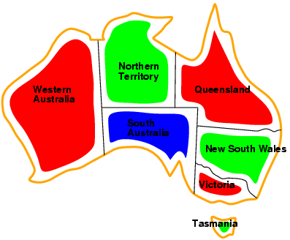
Example: Map-Coloring
Solutions are complete and consistent assignments, e.g., WA = red, NT = green,Q = red,NSW = green,V = red,SA = blue,T = green
Notes:
[AIMA]

Slide 69
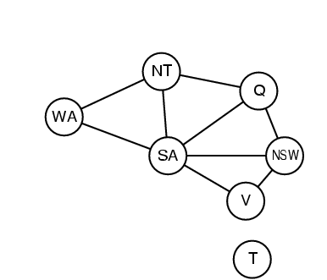
Constraint graph
Binary CSP: each constraint relates two variables
Constraint graph: nodes are variables, arcs are constraints
Notes:
[AIMA]

Slide 70
Varieties of CSPs
Discrete variables
  finite domains:
    n variables, domain size d → O(d^{n}) complete assignments
    e.g., Boolean CSPs, incl.~Boolean satisfiability (NP-complete)
  infinite domains:
    integers, strings, etc.
    e.g., job scheduling, variables are start/end days for each job
    need a constraint language, e.g., StartJob₁ + 5 ≤ StartJob₃
Continuous variables
  e.g., start/end times for Hubble Space Telescope observations
  linear constraints solvable in polynomial time by linear programming
Notes:
[AIMA]

Slide 71
Varieties of constraints
Unary constraints involve a single variable,
  e.g., SA ≠ green
Binary constraints involve pairs of variables,
  e.g., SA ≠ WA
Higher-order constraints involve 3 or more variables,
  e.g., cryptarithmetic column constraints
Notes:
[AIMA]

Slide 72
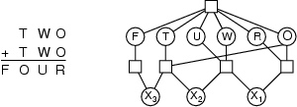
Example: Cryptarithmetic
Variables: F T U W
R O X₁ X₂ X₃
Domains: {0,1,2,3,4,5,6,7,8,9}
Constraints: Alldiff (F,T,U,W,R,O)
  O + O = R + 10 · X₁
  X₁ + W + W = U + 10 · X₂
  X₂ + T + T = O + 10 · X₃
  X₃ = F, T ≠ 0, F ≠ 0
Notes:
[AIMA]

Slide 73
Real-world CSPs
Assignment problems
  e.g., who teaches what class
Timetabling problems
  e.g., which class is offered when and where?
Transportation scheduling
Factory scheduling
Notice that many real-world problems involve real-valued variables
Notes:
[AIMA]

Slide 74
Standard search formulation (incremental)
Let's start with the straightforward approach, then fix it
States are defined by the values assigned so far
Initial state: the empty assignment { }
Successor function: assign a value to an unassigned variable that does not conflict with current assignment
  → fail if no legal assignments
Goal test: the current assignment is complete
This is the same for all CSPs
Every solution appears at depth n with n variables
→ use depth-first search
Path is irrelevant, so can also use complete-state formulation
b = (n – l)d at depth l, hence n! · d^{n} leaves
The result in (4) is grossly pessimistic, because the order in which values are assigned to variables does not matter. There are only d^{n} assignments.
Notes:
[AIMA]

Slide 75
Backtracking search
Variable assignments are commutative}, i.e.,
[ WA = red then NT = green ] same as [ NT = green then WA = red ]
Only need to consider assignments to a single variable at each node
  → b = d and there are d^{n} leaves
Depth-first search for CSPs with single-variable assignments is called backtracking search
Backtracking search is the basic uninformed algorithm for CSPs
Can solve n-queens for n ≈ 25
Notes:
[AIMA]

Slide 76
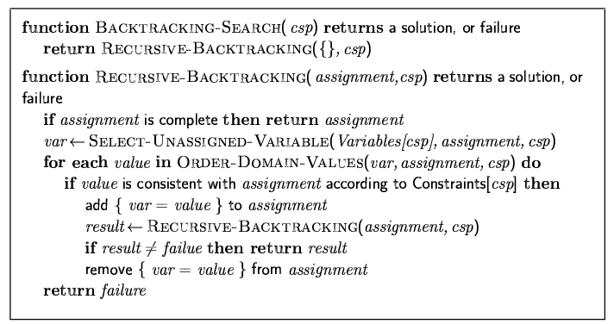
Backtracking search
Notes:
[AIMA]

Slide 77

Backtracking example
Notes:
[AIMA]

Slide 78
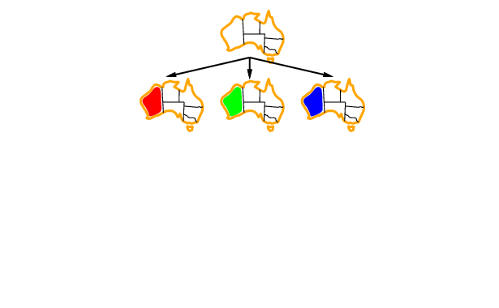
Backtracking example
Notes:
[AIMA]

Slide 79
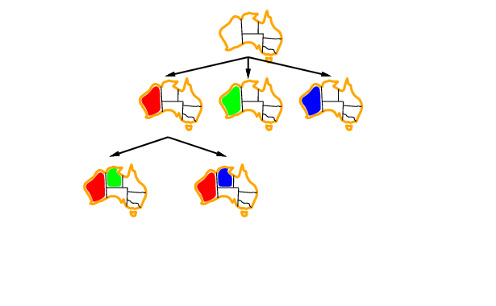
Backtracking example

Slide 80
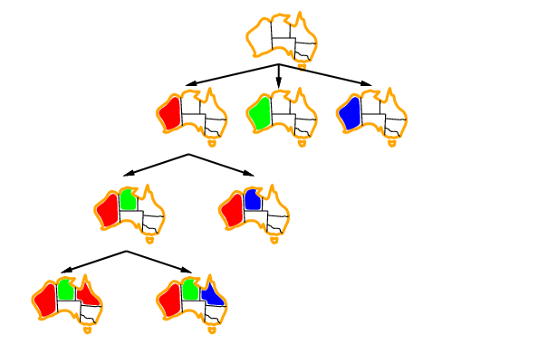
Backtracking example

Slide 81
Improving backtracking efficiency
General-purpose methods can give huge gains in speed:
  Which variable should be assigned next?
  In what order should its values be tried?
  Can we detect inevitable failure early?

Slide 82

Most constrained variable
Most constrained variable:
  choose the variable with the fewest legal values
a.k.a. minimum remaining values (MRV) heuristic

Slide 83

Most constraining variable
Tie-breaker among most constrained variables
Most constraining variable:
  choose the variable with the most constraints on remaining variables

Slide 84
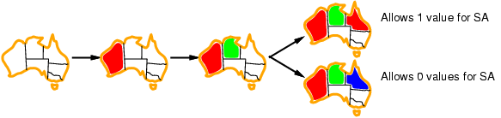
Least constraining value
Given a variable, choose the least constraining value:
  the one that rules out the fewest values in the remaining variables
Combining these heuristics makes 1000 queens feasible

Slide 85
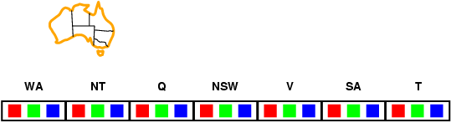
Forward checking
Idea:
  Keep track of remaining legal values for unassigned variables
  Terminate search when any variable has no legal values

Slide 86
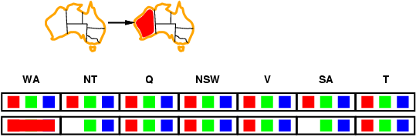
Forward checking
Idea:
  Keep track of remaining legal values for unassigned variables
  Terminate search when any variable has no legal values

Slide 87
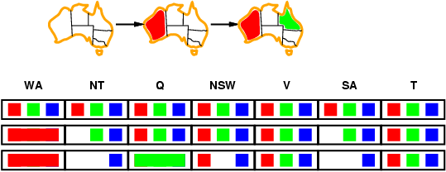
Forward checking
Idea:
  Keep track of remaining legal values for unassigned variables
  Terminate search when any variable has no legal values

Slide 88
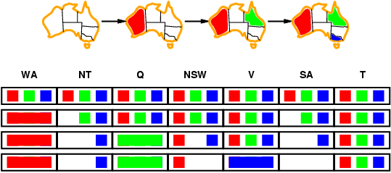
Forward checking
Idea:
  Keep track of remaining legal values for unassigned variables
  Terminate search when any variable has no legal values

Slide 89
Constraint propagation
Forward checking propagates information from assigned to unassigned variables, but doesn't provide early detection for all failures:
NT and SA cannot both be blue!
Constraint propagation repeatedly enforces constraints locally

Slide 90
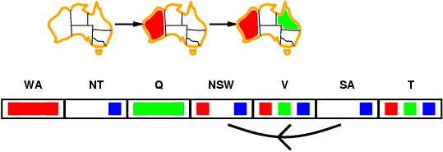
Arc consistency
Simplest form of propagation makes each arc consistent
X →Y is consistent iff
  for every value x of X there is some allowed y

Slide 91
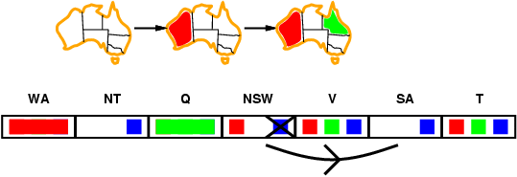
Arc consistency
Simplest form of propagation makes each arc consistent
X →Y is consistent iff
  for every value x of X there is some allowed y

Slide 92
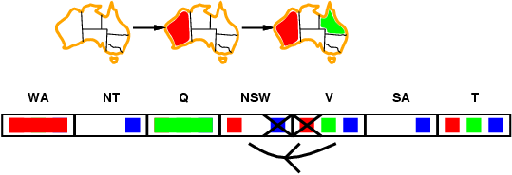
Arc consistency
Simplest form of propagation makes each arc consistent
X →Y is consistent iff
  for every value x of X there is some allowed y
If X loses a value, neighbors of X need to be rechecked

Slide 93
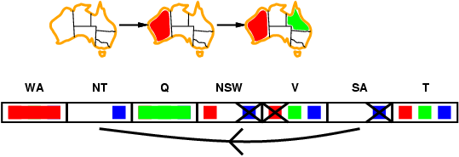
Arc consistency
Simplest form of propagation makes each arc consistent
X →Y is consistent iff
  for every value x of X there is some allowed y
If X loses a value, neighbors of X need to be rechecked
Arc consistency detects failure earlier than forward checking
Can be run as a preprocessor or after each assignment

Slide 94
Arc consistency algorithm AC-3
Time complexity: O(n²d³), where n is the number of variables and d is the maximum variable domain size, because:
  At most O(n²) arcs
  Each arc can be inserted into the agenda (TDA set) at most d times
  Checking consistency of each arc can be done in O(d²) time

Slide 95
Generalized Arc Consistency Algorithm
Three possible outcomes:
  One domain is empty => no solution
  Each domain has a single value => unique solution
  Some domains have more than one value => there may or may not be a solution
If the problem has a unique solution, GAC may end in state (2) or (3); otherwise, we would have a polynomial-time algorithm to solve UNIQUE-SAT
UNIQUE-SAT or USAT is the problem of determining whether a formula known to have either zero or one satisfying assignments has zero or has one. Although this problem seems easier than general SAT, if there is a practical algorithm to solve this problem, then all problems in NP can be solved just as easily [Wikipedia; L.G. Valiant and V.V. Vazirani, NP is as Easy as Detecting Unique Solutions. Theoretical Computer Science, 47(1986), 85-94.]
Thanks to Amber McKenzie for asking a question about this!
Notes:
L.G. Valiant and V.V. Vazirani, NP is as Easy as Detecting Unique Solutions. Theoretical Computer Science, 47(1986), 85-94.

Slide 96
Local search for CSPs
Hill-climbing, simulated annealing typically work with "complete" states, i.e., all variables assigned
To apply to CSPs:
  allow states with unsatisfied constraints
  operators reassign variable values
Variable selection: randomly select any conflicted variable
Value selection by min-conflicts heuristic:
  choose value that violates the fewest constraints
  i.e., hill-climb with h(n) = total number of violated constraints

Slide 97
Local search for CSP
function MIN-CONFLICTS(csp, max_steps) return solution or failure
inputs: csp, a constraint satisfaction problem
max_steps, the number of steps allowed before giving up
current ← an initial complete assignment for csp
for i = 1 to max_steps do
if current is a solution for csp then return current
var ← a randomly chosen, conflicted variable from VARIABLES[csp]
value ← the value v for var that minimize CONFLICTS(var,v,current,csp)
set var = value in current
return failure

Slide 98
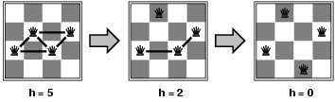
Example: 4-Queens
States: 4 queens in 4 columns (4⁴ = 256 states)
Actions: move queen in column
Goal test: no attacks
Evaluation: h(n) = number of attacks
Given random initial state, can solve n-queens in almost constant time for arbitrary n with high probability (e.g., n = 10,000,000)

Slide 99
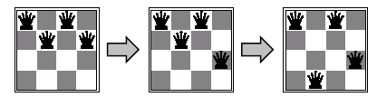
Min-conflicts example 2
h=5
h=3
h=1
Use of min-conflicts heuristic in hill-climbing

Slide 100
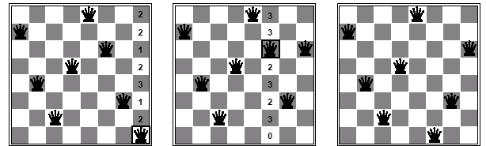
Min-conflicts example 3
A two-step solution for an 8-queens problem using min-conflicts heuristic
At each stage a queen is chosen for reassignment in its column
The algorithm moves the queen to the min-conflict square breaking ties randomly

Slide 101
Advantages of local search
The runtime of min-conflicts is roughly independent of problem size.
  Solving the millions-queen problem in roughly 50 steps.
Local search can be used in an online setting.
  Backtrack search requires more time

Slide 102
Summary
CSPs are a special kind of problem:
  states defined by values of a fixed set of variables
  goal test defined by constraints on variable values
Backtracking = depth-first search with one variable assigned per node
Variable ordering and value selection heuristics help significantly
Forward checking prevents assignments that guarantee later failure
Constraint propagation (e.g., arc consistency) does additional work to constrain values and detect inconsistencies
Iterative min-conflicts is usually effective in practice

Slide 103
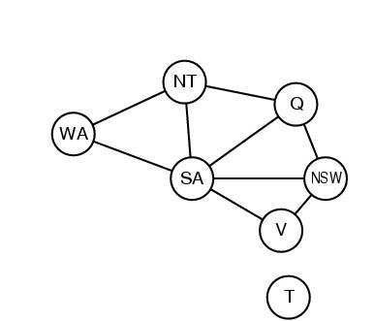
Problem structure
How can the problem structure help to find a solution quickly?
Subproblem identification is important:
  Coloring Tasmania and mainland are independent subproblems
  Identifiable as connected components of constrained graph.
Improves performance

Slide 104
Problem structure
Suppose each problem has c variables out of a total of n.
Worst case solution cost is O(n/c d^{c}), i.e. linear in n
  Instead of O(d ^{n}), exponential in n
E.g. n= 80, c= 20, d=2
  2⁸⁰ = 4 billion years at 1 million nodes/sec.
  4 * 2²⁰= .4 second at 1 million nodes/sec

Slide 105
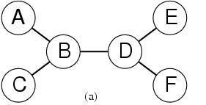
Tree-structured CSPs
Theorem: if the constraint graph has no loops then CSP can be solved in O(nd ²) time
Compare difference with general CSP, where worst case is O(d ^{n})

Slide 106
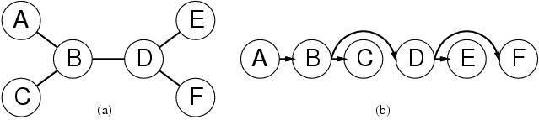
Tree-structured CSPs
In most cases subproblems of a CSP are connected as a tree
Any tree-structured CSP can be solved in time linear in the number of variables.
  Choose a variable as root, order variables from root to leaves such that every node’s parent precedes it in the ordering. (label var from X₁ to X_{n})
  For j from n down to 2, apply REMOVE-INCONSISTENT-VALUES(Parent(X_{j}),X_{j})
  For j from 1 to n assign X_{j} consistently with Parent(X_{j} )

Slide 107
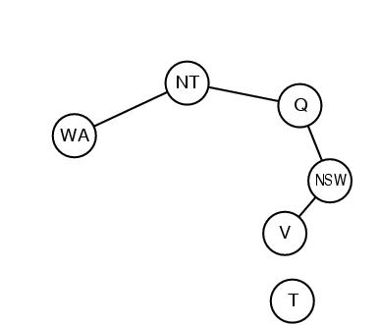
Nearly tree-structured CSPs
Can more general constraint graphs be reduced to trees?
Two approaches:
  Remove certain nodes
  Collapse certain nodes

Slide 108
Nearly tree-structured CSPs
Idea: assign values to some variables so that the remaining variables form a tree.
Assume that we assign {SA=x} ← cycle cutset
  And remove any values from the other variables that are inconsistent.
  The selected value for SA could be the wrong one so we have to try all of them

Slide 109
Nearly tree-structured CSPs
This approach is worthwhile if cycle cutset is small.
Finding the smallest cycle cutset is NP-hard
  Approximation algorithms exist
This approach is called cutset conditioning.

Slide 110
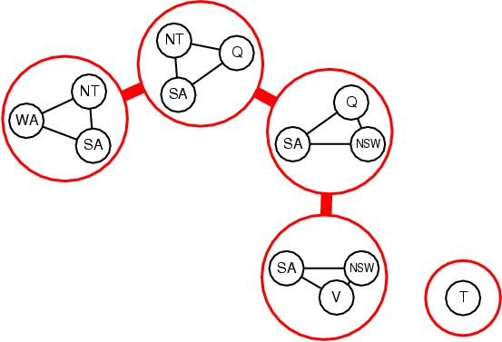
Nearly tree-structured CSPs
Tree decomposition of the constraint graph in a set of connected subproblems.
Each subproblem is solved independently
Resulting solutions are combined.
Necessary requirements:
  Every variable appears in at least one of the subproblems
  If two variables are connected in the original problem, they must appear together in at least one subproblem
  If a variable appears in two subproblems, it must appear in each node on the path

Slide 111
Summary
CSPs are a special kind of problem: states defined by values of a fixed set of variables, goal test defined by constraints on variable values
Backtracking=depth-first search with one variable assigned per node
Variable ordering and value selection heuristics help significantly
Forward checking prevents assignments that lead to failure.
Constraint propagation does additional work to constrain values and detect inconsistencies.
The CSP representation allows analysis of problem structure.
Tree structured CSPs can be solved in linear time.
Iterative min-conflicts is usually effective in practice.

Slide 112
Dynamic Programming
Dynamic programming is a problem solving method which is especially useful to solve the problems to which Bellman’s Principle of Optimality applies:
“An optimal policy has the property that whatever the initial state and the initial decision are, the remaining decisions constitute an optimal policy with respect to the state resulting from the initial decision.”
The shortest path problem in a directed staged network is an example of such a problem

Slide 113
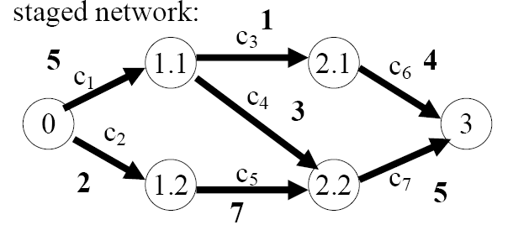
Shortest-Path in a Staged Network
The principle of optimality can be stated as follows:
If the shortest path from 0 to 3 goes through X, then:
  1. that part from 0 to X is the shortest path from 0 to X, and
  2. that part from X to 3 is the shortest path from X to 3
The previous statement leads to a forward algorithm and a backward algorithm for finding the shortest path in a directed staged network

Slide 114
Non-Serial Dynamic Programming
The statement of the nonserial (NSPD) unconstrained dynamic programming problem is:
where X = {x₁, x₂, …, x_{n}} is a set of discrete variables, being the
definition set of the variable x_{i} ( | | = ),
T = {1, 2, …, t}, and
The function f(x) is called the objective function, and the functions f_{i}(X^{i}) are the components of the objective function.

Slide 115
Reasoning Tasks Solved by NSDP
Reference: K. Kask, R. Dechter, J. Larrosa and F. Cozman, “Bucket-Tree Elimination for Automated Reasoning”, ICS Technical Report, 2001 (http://www.ics.uci.edu/~csp/r92.pdf)

Slide 116
Reasoning Tasks Solved by NSDP
Deciding consistency of a CSP requires determining if a constraint satisfaction problem has a solution and, if so, to find all its solutions. Here the combination operator is join and the marginalization operator is projection
Max-CSP problems seek to find a solution that minimizes the number of constraints violated. Combinatorial optimization assumes real cost functions in F. Both tasks can be formalized using the combination operator sum and the marginalization operator minimization over full tuples. (The constraints can be expressed as cost functions of cost 0, or 1.)
Reference: K. Kask, R. Dechter, J. Larrosa and F. Cozman, “Bucket-Tree Elimination for Automated Reasoning”, ICS Technical Report, 2001 (http://www.ics.uci.edu/~csp/r92.pdf)

Slide 117
Reasoning Tasks Solved by NSDP
Belief-updating is the task of computing belief in variable y in Bayesian networks. For this task, the combination operator is product and the marginalization operator is probability marginalization
Most probable explanation requires computing the most probable tuple in a given Bayesian network. Here the combination operator is product and marginalization operator is maximization over all full tuples
Reference: K. Kask, R. Dechter, J. Larrosa and F. Cozman, “Bucket-Tree Elimination for Automated Reasoning”, ICS Technical Report, 2001 (http://www.ics.uci.edu/~csp/r92.pdf)

Slide 118
Davis-Putnam
The original DP applied non-serial dynamic programming to satisfiability
* for every variable in the formula
** for every clause c containing the variable and every clause n containing the negation of the variable
*** resolve c and n and add the resolvent to the formula
** remove all original clauses containing the variable or its negation
DPLL is a backtracking version
Source: http://trainingo2.net/wapipedia/mobiletopic.php?s=Davis-Putnam+algorithm; Dechter (ref to be completed). Wikipedia; Davis, Martin; Putnam, Hillary (1960). “A Computing Procedure for Quantification Theory.” Journal of the ACM 7 (1): 201–215.

Slide 119
Davis-Putnam-Logeman-Loveland
function DPLL(Φ)
if Φ is a consistent set of literals
then return true;
if Φ contains an empty clause
then return false;
for every unit clause l in Φ
Φ=unit-propagate(l, Φ);
for every literal l that occurs pure in Φ
Φ=pure-literal-assign(l, Φ);
l := choose-literal(Φ);
return DPLL(ΦΛl) OR DPLL(ΦΛnot(l))
Source: Wikipedia; Davis, Martin; Logemann, George, and Loveland, Donald (1962). “A Machine Program for Theorem Proving.” Communications of the ACM 5 (7): 394–397

Slide 120
Constraint Networks for Example 4.16
X
X <> 4
Y
X
X +Y=Z
Z

