Slide 1
Limitations of Front-to-End Bidirectional Heuristic Search
Joseph K Barker and Richard E Korf
Presented by Xiaoyi Sun and Madushan Abeysinghe
CSCE 580

Slide 2
Outline
Background
Analysis
Explanatory Theory
A Pathological Case
Experiments
Summary and conclusions

Slide 3
Background: Front-To-End Bidirectional Search
Bidirectional search
Simultaneous forward and reverse searches.
The reverse search is done from the goal to the start, using the reverse of the standard operators.
Both search directions have a frontier of the deepest nodes generated,
A path has been found from the start to the end whenever the frontiers intersect
Bidirectional heuristic search algorithm
Both directions of search can be explored using a heuristic.
Earliest bidirectional heuristic search algorithm: Bidirectional Heuristic Path Algorithm(BHPA, Pohl 1971), which does A* searches in both directions
Search continues until a solution has been proven optimal.
Search can stop under two conditions
The minimum f cost in either frontier is at least the cost of the best solution found so far
The sum of the minimum g costs of both frontiers is at least the cost of the best solution found so far
A front-to-end heuristic evaluation is done from a node to either the start or goal node, depending on the direction of search

Slide 4
Background: Former Study
Kaindl and Kainz (1997)
Performed one of the first analyses of bidirectional heuristic search, focusing specifically on BHPA
Proved that the best-case performance of BHPA is only slightly better than the best-case performance of unidirectional A*.
Found that bidirectional heuristic search algorithms find optimal solutions early, and spend most of their time proving solution optimality. (Proved to be wrong in experimental part)
Edelkamp and Schr¨odl 2011
Hypothesize that bidirectional heuristic search performs poorly because the mean depth of nodes generated in heuristic search tends to be near the solution midpoint
Illustration of their hypothesis was performed with a graph of nodes generated at each search depth in one 15-puzzle problem using the Manhattan distance heuristic.
The distribution of these nodes is indeed roughly centered on the solution midpoint
The premise of this hypothesis proved to be incorrect in paper’s experimental part.

Slide 5
Analysis: Explanatory Theory
Unidirectional heuristic search considered to be weak if it expands the majority of its nodes deeper than the solution midpoint, otherwise considered to be strong
A balanced bidirectional brute-force search expands no nodes deeper than the solution midpoint.
In an unbalanced search, as long as one direction of search does not expand significantly more nodes than the other, search will meet near the solution midpoint will not expand any deep nodes.
Adding a weak heuristic to a bidirectional brute force search cannot prevent it from expanding additional nodes.
$f=g+h$
With a consistent heuristic, $f$ costs are monotonically non-decreasing with increasing $g$ cost (Pearl 1984). As a result, nodes whose expansion is prevented by a heuristic—those with f cost greater than C*—tend to have high g cost. With a sufficiently weak heuristic, the only nodes whose expansion is prevented have depth greater than the solution midpoint, none of which are expanded in a bidirectional brute-force search.

Slide 6
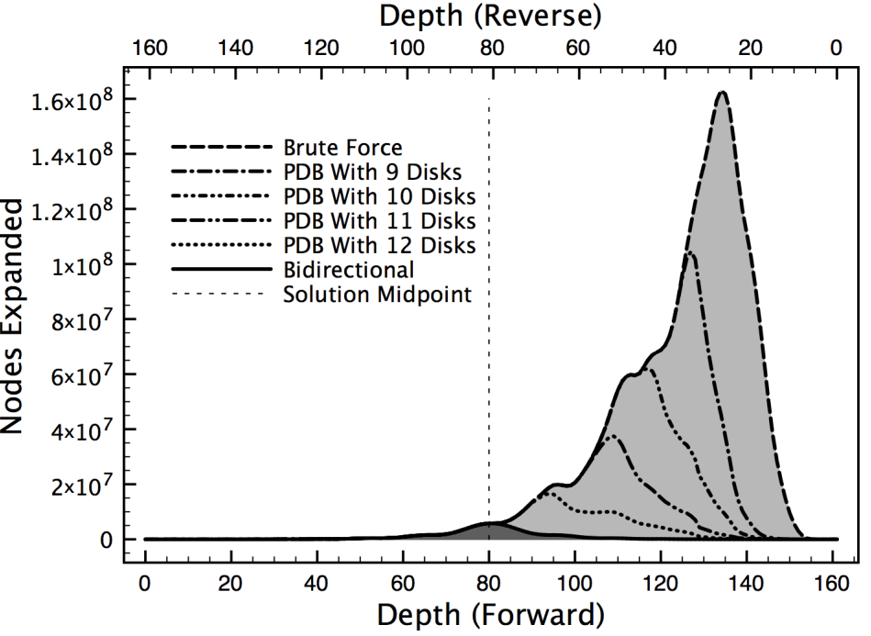
Analysis: Towers of Hanoi Example
All of which nodes expanded in searches are deeper than the solution midpoint.
It shows increasingly strong unidirectional heuristic searches on a Towers Of Hanoi instance, drawn with dashed lines.
The algorithm used is breadth-first heuristic search (BFHS) (Zhou and Hansen 2006)
The cutoff is set to the optimal solution cost.
Fewer nodes are expanded with successively stronger heuristics, and the nodes not expanded are the deepest. The nodes whose expansion is prevented by these weak heuristics are not expanded in the bidirectional brute-force search, either.
Fig.1 Depths of nodes expanded in searches of a Towers of Hanoi instance. Dashed lines are unidirectional searches with heuristics of varying strengths. Nodes expanded in a unidirectional brute-force search are light gray. Nodes expanded in a bidirectional brute-force search are dark gray.

Slide 7
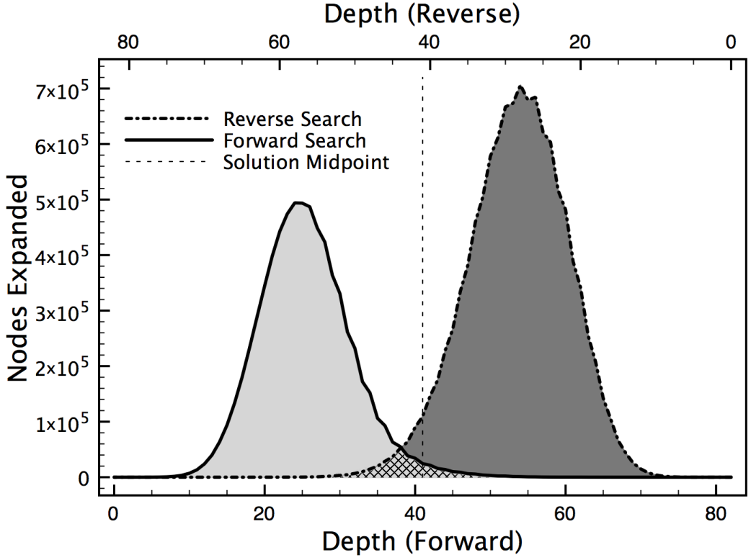
Analysis: 24-Puzzle Example
PDBs (Korf and Felner 2002) are used
The light gray nodes are expanded in a forward search and the dark gray nodes are expanded in a reverse search; the hashed region is expanded in both. A bidirectional heuristic search expands both regions, while a unidirectional heuristic search expands only one.
With a strong heuristic, a bidirectional heuristic search expands more nodes than a unidirectional heuristic search.
With a heuristic that is neither strong nor weak, approximately half of all nodes expanded in a unidirectional heuristic search are shallower than the midpoint.
A bidirectional heuristic search expands no fewer nodes than a unidirectional heuristic search.
Fig.2 Depths of nodes expanded in forward and reverse searches on a 24-Puzzle instance.

Slide 8
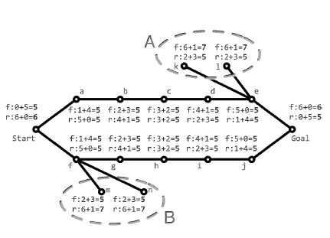
Analysis: A Pathological Case
A start-to-goal unidirectional heuristic search expands all nodes with f cost less than the optimal solution cost of six, of which there are 13 nodes
Bidirectional brute force search expands all nodes up to depth two in both directions, at which point an intersection would be generated at depth three and proved optimal with 14 such nodes
Bidirectional heuristic search expands fewer nodes if it explores children in left-to-right order and breaks f cost ties in favor of lower h cost, it will expand only 12 nodes.
Fig 3: A pathological graph where bidirectional heuristic search outperforms both unidirectional heuristic and bidirectional brute-force search. Nodes are labeled with g-cost + h-cost = f -cost, in the forward (f) and reverse (r) direction.

Slide 9
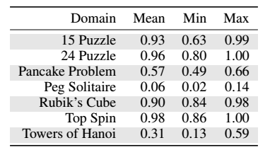
Experiments
Each column shows the fraction of nodes expanded shallower than the midpoint.
In Peg Solitaire and Towers Of Hanoi, a mean of 6% and 31% of the nodes expanded have shallower depth than the midpoint, respectively
So we expect a bidirectional brute-force search to outperform a unidirectional heuristic search for Peg Solitaire and Towers of Hanoi.
But for Peg Solitaire Bidirectional heuristic search gives the best results.
Tab.1: Fraction of nodes expanded with depth less than or equal to the solution midpoint for many instances of several search domains

Slide 10
Experiments
They implemented a bidirectional heuristic search algorithm (BS*) to compare 15 Puzzle, Pancake Problem and Rubik’s Cube with unidirectional heuristic search (A*).
In all three domains A* expands fewer nodes on average.
BS* wins on some instances; importantly, though, BS*always expands at least as many nodes as A* with f cost less than C*
Tab.2: A8 vs BS* in 3 domains

Slide 11
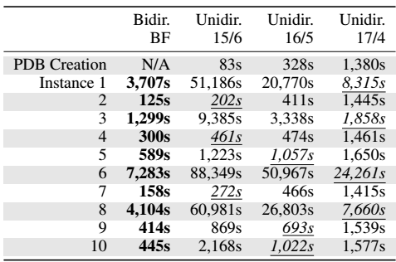
Experiments
They compared the Four Peg Towers of Hanoi with unidirectional heuristic search (BFHS with C* as cutoff) and bidirectional brute force search (brute force breadth first search).
Tab.2: A8 vs BS* in 3 domains

Slide 12
Experiments
Finally they refute a statement from (Kaindl and Kainz 1997) that is often used to explain the ineffectiveness of bidirectional heuristic search: that front-to-end algorithms tend to find optimal solutions very early and spend a long time proving optimality.
In fact, in their bidirectional experiments, the optimal solution was found very late: on average after 90% of the nodes had been generated in the 15 Puzzle, after 86% had been generated in the Pancake Problem, and after 96% had been generated in Rubik’s Cube.

Slide 13
Conclusions
They presented an intuitive explanation for the limited effectiveness of front-to-end bidirectional heuristic search.
Bidirectional brute-force and unidirectional heuristic search both prevent expansion of nodes with high g cost so they’re better than bidirectional heuristic search.
Finally, we found that an often-repeated claim explaining the poor performance of bidirectional heuristic search—that most of its time is spent proving solution optimality—is not true in general, in particular when using strong heuristics.

Slide 14
Thank you!

