Slide 1
Multi-Heuristic A*
Sandip Aine, Siddharth Swaminathan, Venkatraman Narayanan, Victor Hwang and Maxim Likhachev. International Journal of Robotics Research, 35 (1-3), 224-243, 2016.
Presented By: Ahmed Shehab Khan

Slide 2
Background
For High-Dimensional planning problem, Heuristic search algorithms like (A*) suffers from the curse of dimensionality.
This problem is usually addressed by trading off solution quality for faster computation time.
Specifically, bounded sub-optimal versions of A* such as Weighted A* (WA*) (Pohl, 1970) and its anytime variants (Likhachev et al., 2004; Zhou and Hansen, 2002) have been used quite effectively for high-dimensional search problems.
WA*’s performance is very sensitive to the accuracy of the heuristic function, and can degrade severely in the presence of heuristic depression regions.

Slide 4
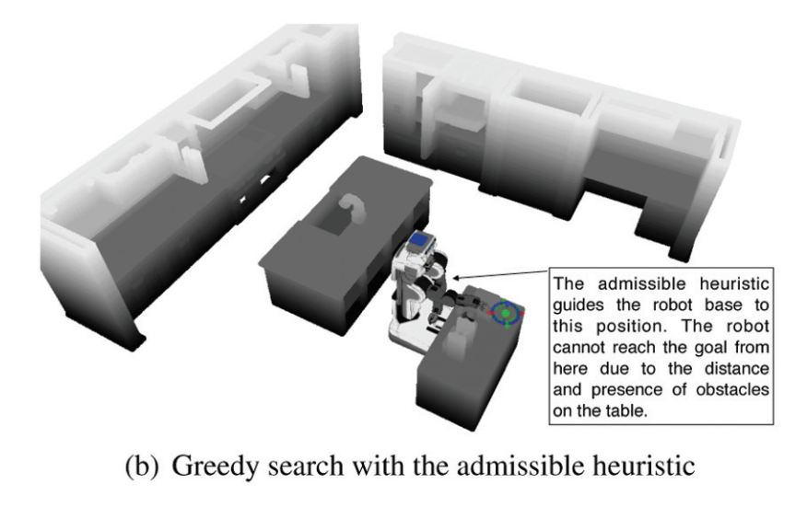

Slide 5
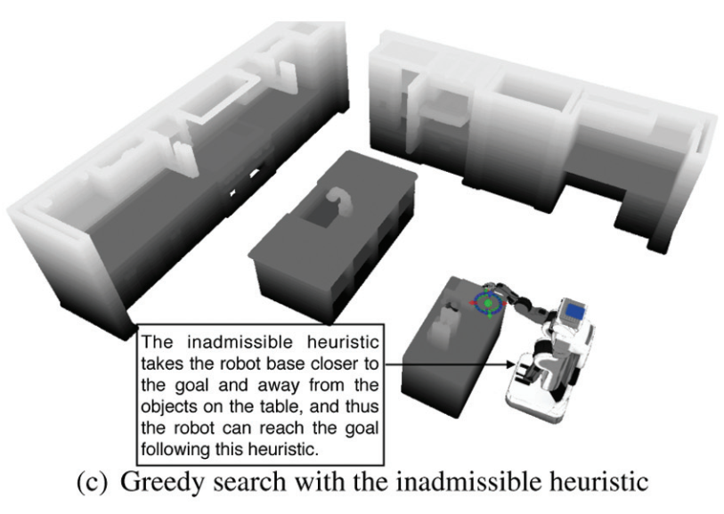

Slide 6
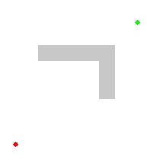
A* and WA*
Source: https://en.wikipedia.org/wiki/A*_search_algorithm

Slide 7
Contribution
Proposed an algorithmic framework, called Multi-Heuristic A* (MHA*)
MHA* works by running multiple searches with different inadmissible heuristics in a manner that preserves completeness and guarantees on the sub-optimality bounds.
Two variants of MHA* proposed:
Independent Multi-Heuristic A* (IMHA*)
Shared Multi-Heuristic A* (SMHA*)

Slide 8
Methodology

Slide 9
Notations

Slide 10
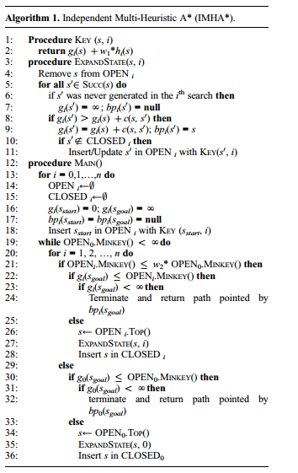
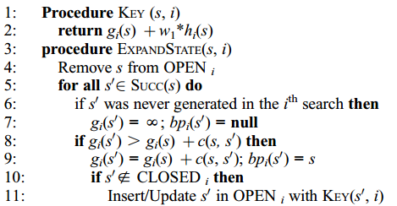
Independent Multi-Heuristic A* (IMHA*)

Slide 11
Independent Multi-Heuristic A* (IMHA*)

Slide 12
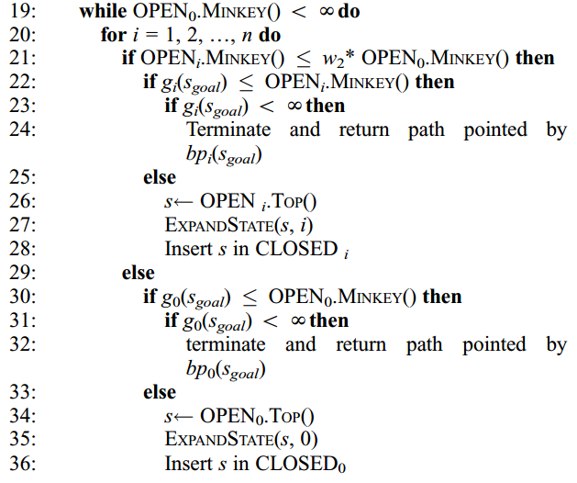
Independent Multi-Heuristic A* (IMHA*)

Slide 13
Theorems proved on IMHA*

Slide 14
Theorems proved on IMHA*

Slide 15
Theorems proved on IMHA*

Slide 16
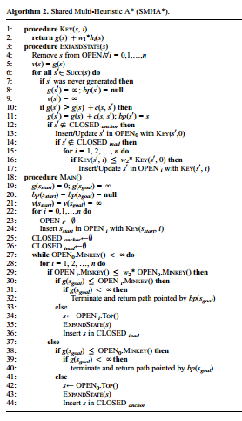
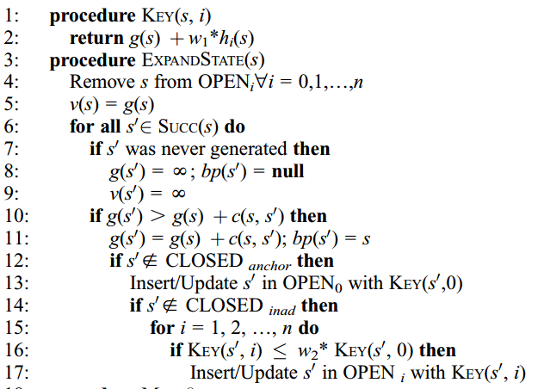
Shared Multi-Heuristic A* (SMHA*)

Slide 17
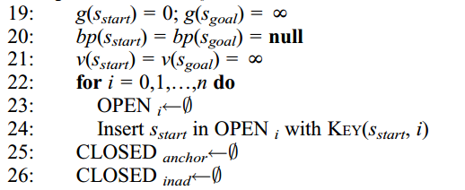
Shared Multi-Heuristic A* (SMHA*)

Slide 18
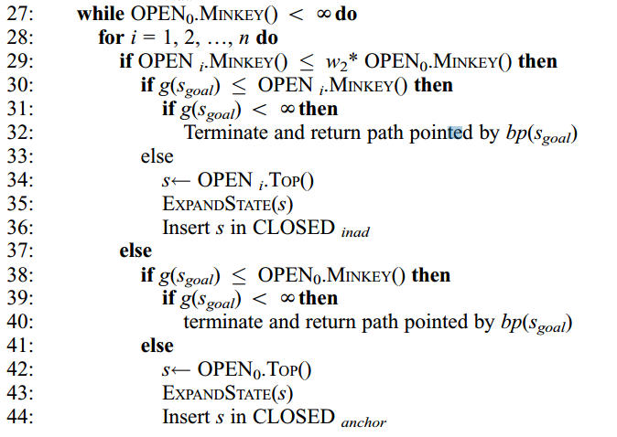
Shared Multi-Heuristic A* (SMHA*)

Slide 19
Theorems proved on SMHA*

Slide 20
Theorems proved on SMHA*

Slide 21
Theorems proved on SMHA*

Slide 22
Experimental Results

Slide 23
Domains of Experiments
12-dimensional mobile manipulation planning for the PR2 robot
3-dimensional (x, y, orientation) navigation for single and multiple goal domains
sliding tile puzzles

Slide 24
Mobile manipulation planning for the PR2 (12-dimensional)

Slide 25
Mobile manipulation planning for the PR2 (12-dimensional)

Slide 26
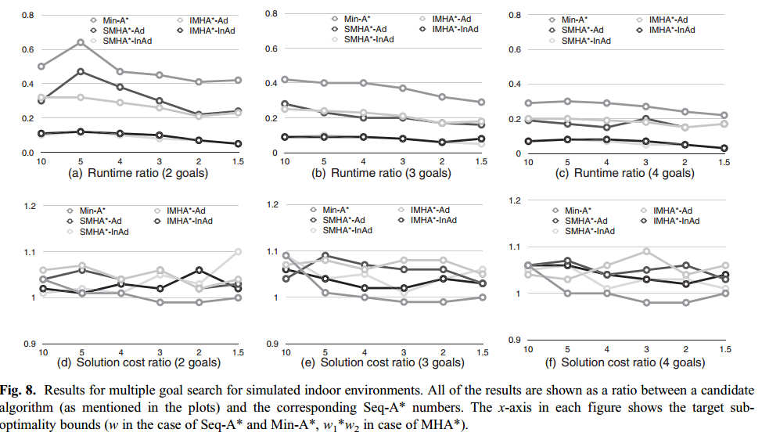
Multiple Goal Path Planning

Slide 27
Multiple Goal Path Planning

Slide 28
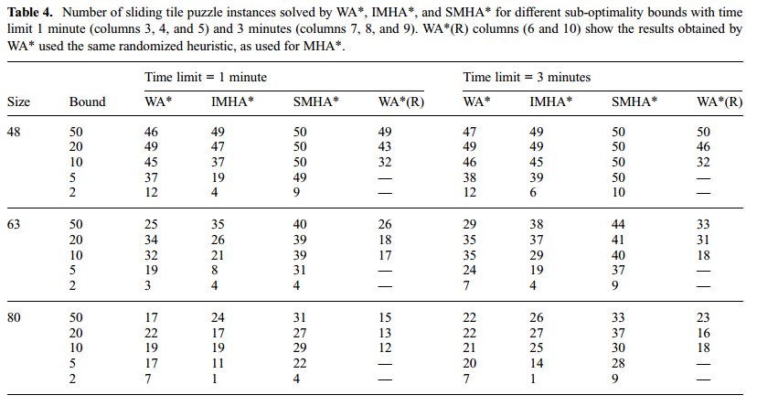
Sliding tile puzzle

Slide 29
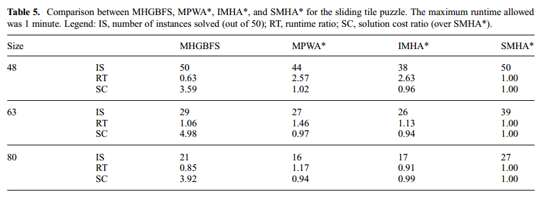
Sliding tile puzzle

