Slide 1
A Guaranteed Bidirectional Search
Presented by Allen Bates and Daniel Ruegamer

Slide 2
Before we begin, here are the authors
Bidirectional Search That Is Guaranteed to Meet in the Middle is written by:
Robert C. Holte from the Computing Science Department of the University of Alberta
Ariel Felner from the ISE Department of the Ben-Gurion University
Guni Sharon from the ISE Department of the Ben-Gurion University
Nathan R. Sturtevant from the Computer Science Department of the University of Denver

Slide 3
Meeting in the Middle
MM is the first bidirectional heuristic search algorithm whose forward and backward searches are guaranteed to never expand a node beyond the solution midpoint, under all circumstances.
MM never expands a node whose f-value exceeds C*.
MM returns C*
If there exists a path from start to goal and MM’s heuristics are consistent MM never expands a state twice.

Slide 4
Corollary 14
Forward search never expands a node n with f_{F}(n) > C* or g_{F}(n) > C* / 2
Backward search never expands a node n with f_{B}(n) > C* or g_{B}(n) > C* / 2
If a path doesn’t exist from start to goal, then C* will have a value of infinity.
If there is a path, the forward search will never expand a node when C > C*
The priority node pr(n) determines the node that is chosen to expand in a search
If a node is expanded in the forward search, pr_{F}(n) <= C*.
pr_{F}(n) = max(f_{F}(n), 2*g_{F}(n)), therefore both f_{F}(n) and 2*g_{F}(n) <= C*

Slide 5
Lemma 4
For any finite state-space S with non-negative edge weights MM halts for any start and goal states in S. Since MM never expands a node in the same path twice, and since there aren’t any negative-cost cycles, MM will never expand a node in a path containing a cycle. Therefore, each state can only be expanded until that path is permanently closed. Since each iteration expand a a node in one of the search paths, after a finite number of iterations, MM will permanently close all the nodes reachable.
If there is no path from start to goal, MM returns infinity. Our algorithm checks to see if a node in the Open Set for Backward Search. If there is no path from start to goal, then there will be no node within this set. Therefore, our cheapest solution will never be updated and maintain its initial cost of infinity

Slide 6
Theorem 16
If there exists a path from start to goal MM returns U = C*
MM will never terminate if both the Open and Closed Set are empty
MM cannot terminate if C < C* since U cannot be smaller than C*
Therefore, MM will reach an iteration where C >= C*
If C > C*, MM will return U = C*
If C=C*, then U <= C=C* so U = C* is returned
If a path does exist from start to goal, then that means that the Open and Closed sets must contain elements for presenting that path. MM will find this path.

Slide 7
Theorem 23
Suppose MM’s heuristics are consistent and MM does not re-open closed nodes. There if there exists a path from start to goal, then MM never expands a state twice.
MM will not expand a state twice because once a state becomes closed, it is permanently closed. The only way a state is expanded twice is when that state is expanded once in the forward direction and once in the backward direction.
However, if a node is in the open lists for the Forward and Backward Search, U will equal C*, the cost of the path of the node. The algorithm will then check if U <= C* and terminate before expanding the node for a second time.

Slide 8
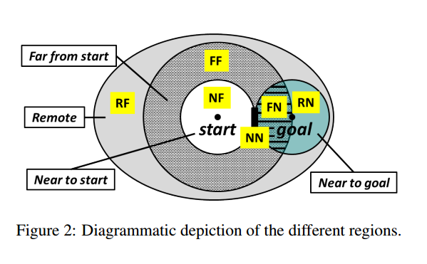
Definitions
1st letter is the distance from the start, the 2nd letter is the distance from the goal
N is Near, F is Far, R is Remote
State s is ‘near to goal’ if d(s, goal) <= C* / 2
State s is ‘remote’ if d(start, s) > C*
State s is ‘far from goal’ otherwise

Slide 9
Definitions
A* < MM indicates that A* expands less nodes than MM
N’ indicates that MM might not expand all the nodes that are near to start. N’F < NF
N’FU is the unpruned part of N’F. The heuristic, h, splits each region into two parts: pruned states and unpruned states.
FN’B has the same implication as FN’U except that B is based on h_{B} the heuristic of MM’s backward search.

Slide 10
Comparisons : MM vs A*
MM’s equation : MM = N’FU + N’N’U + FN’B + RN’B
A* equation : NFU + NNU + FNU + FFU
By definition, N’FU <= NFU and N’N’U <= NN, therefore MM has an advantage in NF and NN
For the FN region, A* uses a forward search heuristic that estimates a small distance of, at most, C* / 2. However, MM’s uses a backward search heuristic that estimates a distance larger than C* /2. A* has an advantage in FN
FFU vs RNB : If RN is smaller than FF but h_{F} is accurate enough to make FFU smaller than MM_{o}’s RN’, then h_{B} is accurate enough to prune in RN. Therefore, FFU > RNB whenever RN is much smaller than FF. Therefore, MM will have an advantage in this case.

Slide 11
Comparisons : MM vs MM₀
MM’s equation : MM = N’FU + N’N’U + FN’B + RN’B
MM₀ ‘s equation : MM₀ = N’F + N’N’ + FN’ + RN’
MM₀ can expand strictly fewer nodes than MM with a consistent, non-zero heuristic.

Slide 12
Definitions
Problem instances are pairs (start, goal) of states in a state space in which all edge weights are non-negative
A state is an immutable element of a state-space, with a fixed distance to start and goal
D(u,v) is the distance (cost of least-cost path) from node u to node v
F(n) = g(n) + h(n) where n is the last node
G(n) is the cost to n from the start node
H(n) is the heuristic value for node n
C* is the cost of the optimal solution path
C is the minimum priority of all the nodes in both Open lists and n_{F} Є Open_{F}
U is the cost of the cheapest solution found so far.

Slide 13
Definitions
A node is a mutable element created and updated by a search algorithm, representing a path (or paths) in the state-space
Forward Search is subscripted with F
Backward Search is subscripted with B
Each search direction uses an admissible (it doesn’t overestimate the cost from a node to the goal, i.e. h(n) <= actual cost)

Slide 14
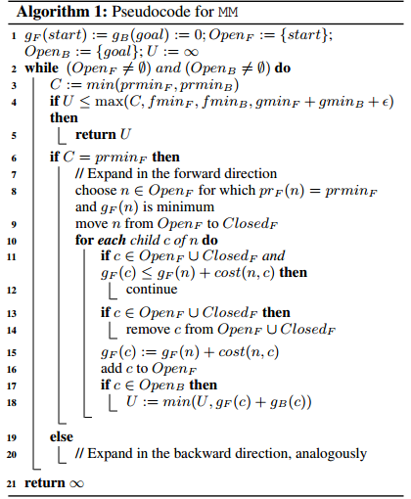
Pseudocode

Slide 15
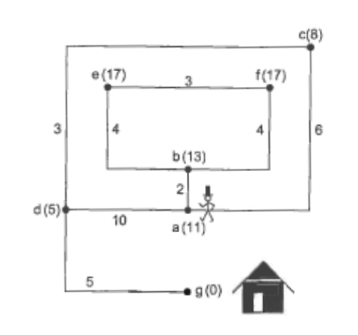
Example

Slide 16
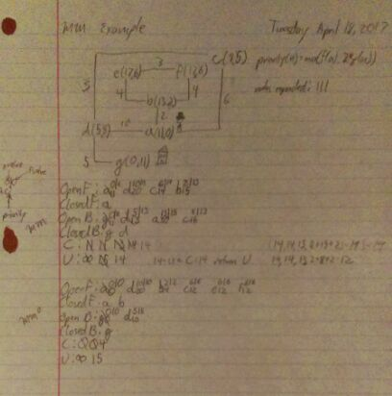
Example

Slide 17
Questions and Answering

Slide 18
References
Robert C. Holte, Ariel Felner, Guni Sharon, and Nathan R. Sturtevant. "Bidirectional Search that is Guaranteed to Meet in the Middle." Proceedings of the 30th AAAI Conference on Artificial Intelligence. 2016

