Slide 1
A* with Pattern Databases
Li Wang
Haorui Wu
University of South Carolina
04/02/2015

Slide 2
Background - Efforts on improving A*
Improvements to the search efficiency can take the range from general algorithm enhancements to problem-specific heuristics
Iterative deepening A* (IDA*) – used to reduce storage requirements
General search space properties – using different graph representation to remove duplicate nodes
Branch selection – could save efficiency in some special cases, application dependent
Symmetry reduction – many problems have inherent symmetries that can be removed, application dependent
Solution database – the states near to the goal nodes can be pre-computed by a backwards search
An application-independent search enhancement is rare but necessary.

Slide 3
New Approach – Pattern Database
Notations:
A pattern is the partial specification of a permutation (or state)
A target pattern is a partial specification of the goal state.
A pattern database (PDB) is the set of all patterns that can be obtained by permutations of a target pattern.
First choose k elements from the goal state, a database is formed by the permutation of these k elements. Given any permutation, the pattern can be looked up in the pattern database to find the minimal number of operations required to place these k elements in correction position.

Slide 4
(n²-1)-Puzzle Problem
States in (n²-1)-Puzzle problem: (n²)!/2
181,440 possible states for 8-Puzzle
1.05  10¹³ possible states for 15-Puzzle
7 | 2 | 4
5 |  | 6
8 | 3 | 1
 | 1 | 2
3 | 4 | 5
6 | 7 | 8
1 | 2 | 3 | 4
5 | 6 | 7 | 8
9 | 10 | 11 | 12
13 | 14 | 15
Start State
Goal State
8-Puzzle
15-Puzzle
the number of misplaced tiles, h1 = 8
the sum of the distances of the tiles from their goal positions (Manhattan distance heuristic), h2 = 18

Slide 5
PDB in 15-Puzzle Problem
Target patterns
 | 1 | 2 | 3
4 | 5 | 6 | 7
8 | 9 | 10 | 11
12 | 13 | 14 | 15
 |  |  | 3
 |  |  | 7
 |  |  | 11
12 | 13 | 14 | 15
8 | 9 | 10
12 | 13 | 14 | 15
After this, a smaller size problem need to be solved only
Fringe
Corner
For each pattern in a database, we compute the distance (minimum number of moves) to the target pattern using retrograde analysis. This distance is the cost of the pattern.
Size of database: 16!/8! = 5.2  10⁸

Slide 6
Tight Lower Bound?
 |  |  | 3
 |  |  | 7
 |  |  | 11
12 | 13 | 14 | 10
 |  |  | 3
 |  |  | 7
 |  | 10 | 11
12 | 13 | 14 | 15
 |  |  | 3
 |  | 15 | 7
 |  | 11 | 10
12 | 13 | 14
 |  |  | 3
 |  | 15 | 7
 | 11 | 10
12 | 13 | 14
 |  |  | 3
 | 11 | 15 | 7
 | 10
12 | 13 | 14

Slide 7
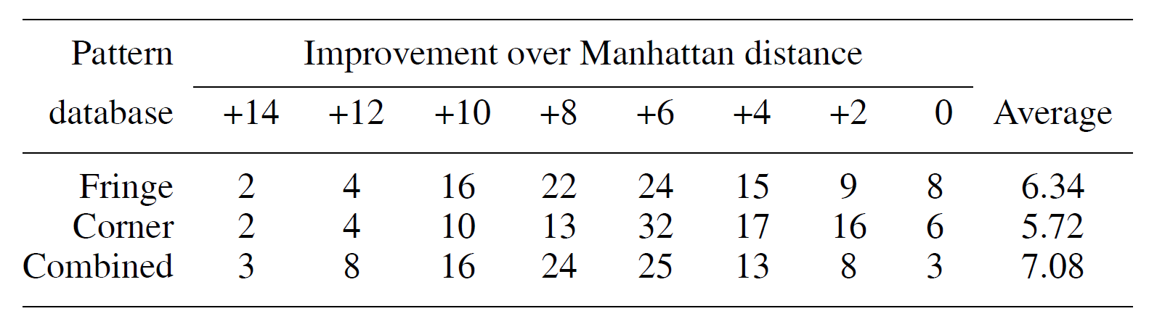
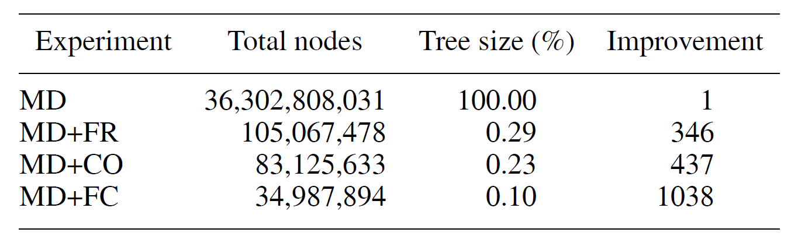
Improvement over Manhattan
In general, the larger the values of an admissible heuristic, the better the corresponding database should be judged.
100 tests
Heuristic value increases
Number of nodes decreases

Slide 8
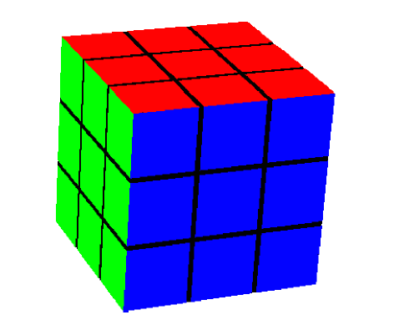
Rubik’s Cube
27 cubies: 26 visible
8 corners: 3 color
12 edges: 2 color
Number of States: 8!3⁸12!2¹²/12  4.310¹⁹
3 operations:
90° clockwise
90° counterclockwise
180°

Slide 9
Expanding Nodes for Rubik’s Cube
﻿Depth Nodes
1 18
2 243
3 3,240
4 43,254
5 577,368
6 7,706,988
7 102,876,480
8 1,373,243,544
9 18,330,699,168
10 244,686,773,808
11 3,266,193,870,720
12 43,598,688,377,184
13 581,975,750,199,168
14 7,768,485,393,179,328
15 103,697,388,221,736,960
16 1,384,201,395,738,071,424
17 18,476,969,736,848,122,368
18 246,639,261,965,462,754,048
Branching Factor
b = 3  6 Faces = 18
After first move, the second step cannot be on the same face
b = 15
Forbid move that twist two faces in a row in opposite order
b = 13.35
number of nodes 2.4710²⁰
> 4.310¹⁹
Nodes in search tree as a function of depth

Slide 10
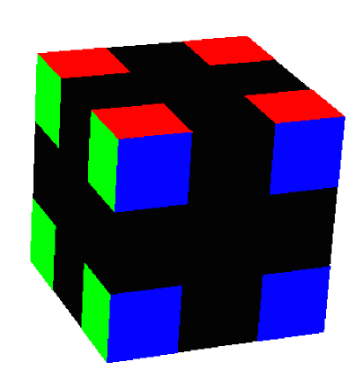
3D Manhattan vs. PDB
3D version of the Manhattan distance
Single Cubie Move: sum of all moves / 8
Corner Cubie Move: 3
Edge Cubie Move: 5.5
Take maximum
Pattern Database
8 corner cubies: 8!  3⁷ = 88,179,840 possible combinations, require 44,089,920 bytes of memory (42 megabytes) – improved heuristic to 8.764
6 of 12 edge cubies: 12!/6!  2⁶ = 42,577,920 states, require 21,288,960 bytes (20 megabytes) – improved heuristic to 7.668
Combine 8 corner and two groups of 6 edge cubies require a memory of 82 megabytes – improved heuristic to 8.878
Notes:
For each cubie, compute the minimum number of moves required to correctly position and orient it, and sum these values over all cubies. Unfortunately, to be admissible, this value has to be divided by eight, since every twist moves four corner and four edge cubies. This result can be rounded up. A better heuristic is to take the maximum of the sum of the manhattan distances of the corner cubies, and the edge cubies, each divided by four. The expected value of the manhattan distance of the edge cubies is 5.5, while the expected value of the manhattan distance of the corner cubies is only about 3.

Slide 11
Reduction of Nodes using PDB
Ten solvable instances of Rubik's Cube, by making 100 random moves each, starting from the goal state.
﻿No. Depth Nodes Generated Cost Time
1 16 3,720,885,493 4 hours
2 17 11,485,155,726
3 17 64,837,508,623
4 17 126,005,368,381 2 days
5 18 262,228,269,081
6 18 344,770,394,346
7 18 502,417,601,953
8 18 562,494,969,937
9 18 626,785,460,346
10 18 1,021,814,815,051 4 weeks

Slide 12
More improvements of PDB
Multiple Pattern Databases
Disjoint Pattern Databases

Slide 13
Multiple Pattern Databases
Mapping different states into smaller patterns
Break the large pattern database into different smaller ones
Manhattan distance
Pattern Databases
Multiple Pattern Databases

Slide 14
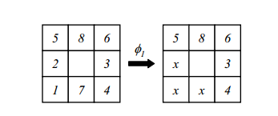
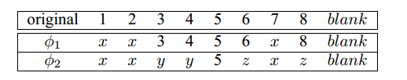
Definitions
Abstracting a state makes a pattern
Original domain
Abstract
domain
Granularity: A vector indication how many constants in the original domain are mapped to each constant in the abstract domain
The granularity of φ₁ is <3,1,1,1,1,1,1>
The granularity of φ₂ is <3,2,2,1,1>

Slide 15
Multiple Pattern Databases
Using n pattern databases of size m/n instead of one pattern database of size m improves search performance.
The use of multiple smaller pattern databases reduces the number of nodes generated by IDA*

Slide 16
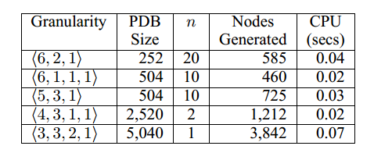
Experiment
8 puzzle:
m = 5040
Taking tow or smaller pattern databases results in very significant reductions in nodes over using a single large pattern database.
Using n = 10 reduces the number of nodes generated almost an order of magnitude over a single pattern database.

Slide 17
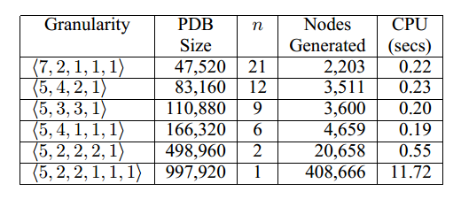
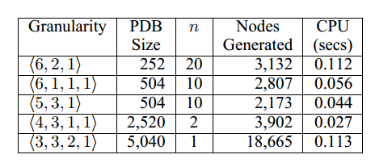
Experiment
(3X4) sliding tile puzzle
m = 997920
9 pancake puzzle
m = 5040

Slide 18
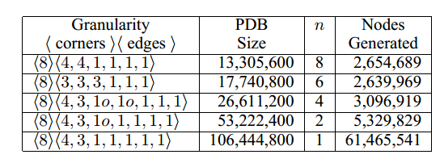
Rubik’s Cube
Enormous state space over 4 * 10¹⁹

Slide 19
Why performance is improved by multiple pattern databases
Proposition 1: Maxing smaller pattern databases could replace small h-values by larger ones, and substantially reduce the number of patterns with very small h-values
Proposition 2: Eliminating low h-values is more important for improving search performance than retaining large h-values.
Multiple Pattern Databases, R. C. Holte, etc. ICAPS 2004,

Slide 20
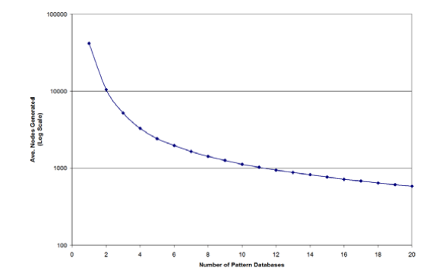
Discussion
Making the pattern databases too small has a negative impact on performance.
9 pancake puzzle
m = 5040

Slide 21
Disjoint Pattern Databases
Pattern databases: Combining heuristics from different pattern databases by taking the maximum of their values.
Disjoint pattern databases: Partition the set of subgoals into disjoint groups and the h-values of different disjoint databases could be added together, giving a more accurate heuristic values.

Slide 22
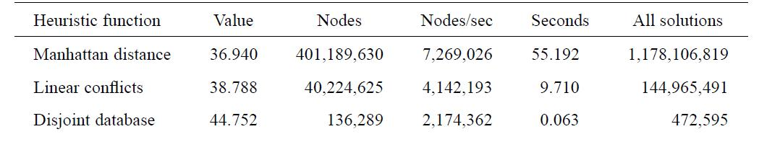
Disjoint Pattern Databases
Experimental results on the Fifteen Puzzle

Slide 23
References
Culberson, Joseph C., and Schaeffer, J., "Pattern databases."Computational Intelligence 14.3 (1998): 318-334.
Korf, Richard E. "Finding optimal solutions to Rubik's Cube using pattern databases." AAAI/IAAI. 1997.
Korf, Richard E., and Ariel F.. "Disjoint pattern database heuristics."Artificial intelligence 134.1 (2002): 9-22.
Felner, Ariel, Korf, Richard E. and Hanan, S. "Additive pattern database heuristics." J. Artif. Intell. Res.(JAIR) 22 (2004): 279-318.
Holte, R. C., Newton, J., Felner, A., Meshulam, R., & Furcy, D. “Multiple Pattern Databases.” In ICAPS (2004): 122-131.

Slide 24
State of Art on PDB
Maximizing over Multiple Pattern Databases Speeds up Heuristic Search
Using Instance Dependent Pattern Databases
Combining Partial Pattern Databases and Bloom Filters

