Slide 1
Abstraction Transformation & Heuristics
Md Modasshir
Sharmin Rahman

Slide 2
What we will cover
Abstraction Transformation
Valtorta's Theorem
Hierarchical A*

Slide 3
Review
Admissibility
Consistency
Solution Preserving
Relaxed Problem
Embedding
Homomorphism

Slide 4
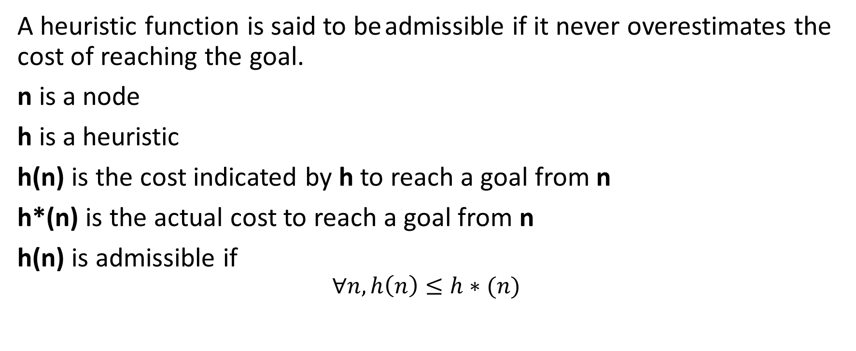
Admissibility
A heuristic function is said to be admissible if it never overestimates the cost of reaching the goal.
n is a node
h is a heuristic
h(n) is the cost indicated by h to reach a goal from n
h*(n) is the actual cost to reach a goal from n
h(n) is admissible if
$$∀n, h\left(n\right)≤h∗(n)$$

Slide 5
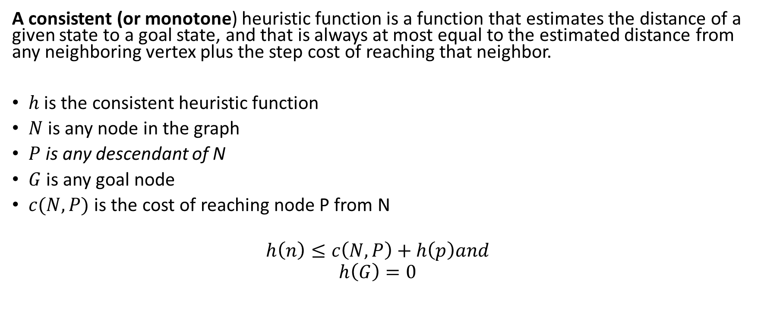
Consistency
A consistent (or monotone) heuristic function is a function that estimates the distance of a given state to a goal state, and that is always at most equal to the estimated distance from any neighboring vertex plus the step cost of reaching that neighbor.
$h$ is the consistent heuristic function
$N$ is any node in the graph
$P$ is any descendant of N
$G$ is any goal node
$c(N,P)$ is the cost of reaching node P from N
$$h\left(n\right)≤c\left(N,P\right)+h\left(p\right)and$$
$$h\left(G\right)=0$$

Slide 6
Solution Preserving
While transforming, keeping the existing solution path in the concrete problem is solution preserving

Slide 7
Relaxed problem
A problem where constraints are dropped (e.g. removing constraints on puzzle problem)
It means we can add new edges or merge existing nodes or both.

Slide 8
Embedding
Embedding: Drop some preconditions from the operators (creates “supergraph”)
– Preserves nodes, but creates extra edges

Slide 9
Homomorphism
Homomorphism: Drop distinctions between objects
– Reduces set of nodes, preserves edges

Slide 10
Abstraction Transformation

Slide 11

Definition: Abstraction Transformation
An abstraction transformation $∅ :S →S′$ maps states u in the concrete problem space to abstract states $∅\left(u\right)$ and concrete actions a to abstract actions $∅\left(a\right).$

Slide 12

Heuristics Defined By Abstraction
An abstraction of state space S is any state space such that :
  for every state $s ∈S$there is a corresponding state $∅ \left(s\right) ∈ ∅\left(S\right).$
  distance $(∅\left(s_{1}\right), ∅ \left(s_{2}\right)≤$distance $\left(s_{1},s_{2}\right)$.
Exact distances in $∅\left(S\right)$are admissible and consistent heuristics for searching in S.

Slide 13

Definition: Embedding and Homomorphism
An abstraction transformation $∅$ is an embedding transformation if it adds edges to S such that the concrete and abstract state sets are the same; That is, $∅\left(u\right)=u$ for all $u ∈S$. Homomorphism requires that for all edges$\left(u,v\right)$ in S, there must also be an edge $\left(∅\left(u\right), ∅\left(v\right)\right)$ in S’.

Slide 14

Use of Abstract Spaces
The solution in the abstract space can be used in 2 ways:
  The length of the abstract solution as a heuristic function $h\left(n\right)$
  The actual abstract plan as constraints for the concrete plan

Slide 15
Spurious Paths
Introduces new path which does not exist in the concrete problem.

Slide 16

Theorem: Admissibility and Consistency of Abstraction Heuristics
Let S be a state space and $S′= ∅\left(S\right)$ be any homomorphic abstraction transformation of S. Let heuristic function $h_{∅}\left(u\right)$ for state u and goal t be defined as the length of the shortest path from $∅\left(u\right)$ and $∅\left(t\right)$ in S’. Then $h_{∅}$ is an admissible consistent heuristic function.

Slide 17
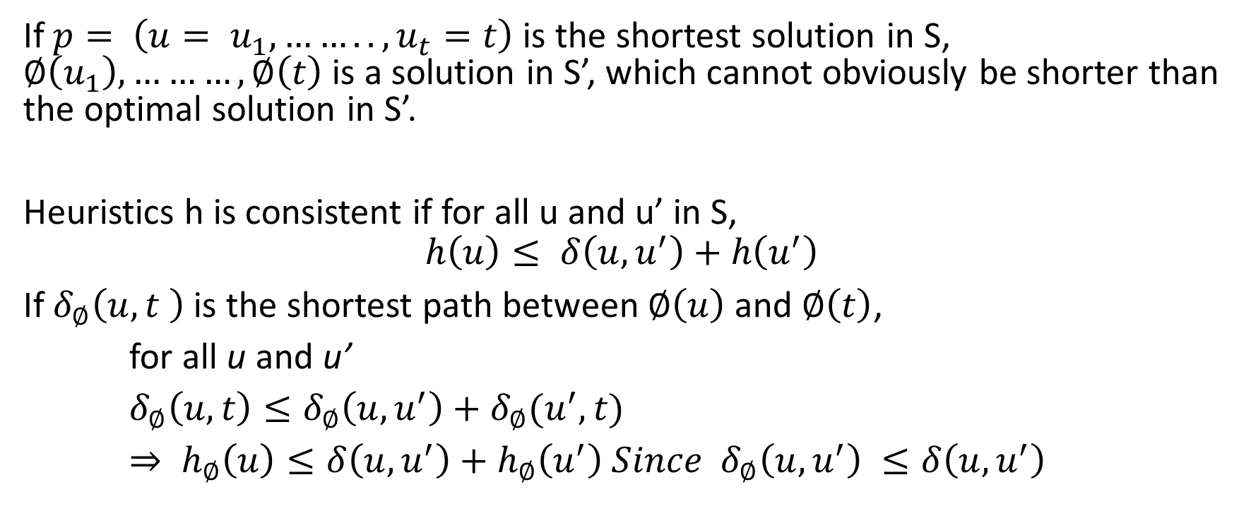
Proof
If $p= \left(u= u_{1},…….., u_{t}=t\right)$ is the shortest solution in S, $∅\left(u_{1}\right),………,∅\left(t\right)$ is a solution in S’, which cannot obviously be shorter than the optimal solution in S’.
Heuristics h is consistent if for all u and u’ in S,
$$h\left(u\right)≤ δ\left(u,u^{′}\right)+h\left(u^{′}\right)$$
If $δ_{∅}\left(u,t \right)$ is the shortest path between $∅\left(u\right)$ and $∅\left(t\right)$,
for all u and u’
$δ_{∅}\left(u,t\right)≤δ_{∅}\left(u,u^{′}\right)+δ_{∅}(u^{′},t)$
$⇒ h_{∅}\left(u\right)≤δ\left(u,u^{′}\right)+h_{∅}\left(u^{′}\right) Since$ $δ_{∅}\left(u,u^{′}\right) ≤δ\left(u,u^{′}\right)$

Slide 18
Types of Abstraction based on State Representation
Star Abstraction
Domain Abstraction

Slide 19
Star Abstraction
A method of grouping states together
  The state u with the largest degree is grouped together with its neighbors within a certain distance (the “abstraction radius”) to form a single abstract state.
  The range of an abstract state consists of all states reachable from u within the abstract radius.

Slide 20

Domain Abstraction
Mapping of labels $∅:L→L′$
  Relabels all constants in both concrete states and actions
  Abstract space consists of all states reachable from $∅\left(s\right)$ by applying sequence of abstract action.

Slide 21
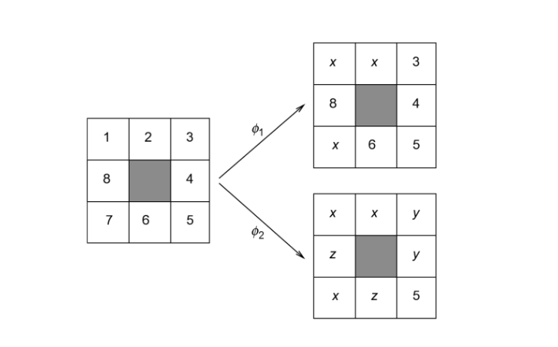
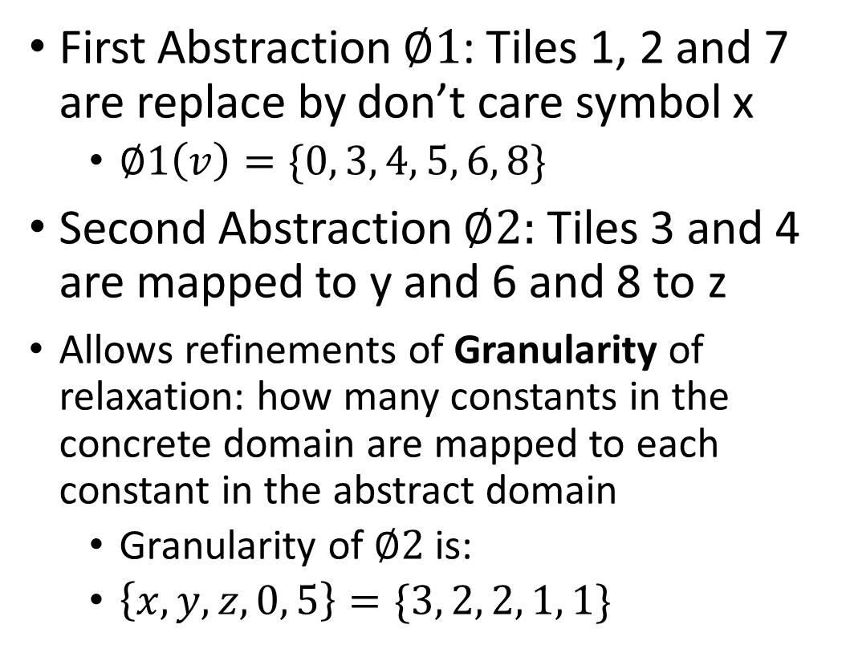
Example of Domain Abstraction
First Abstraction $∅1$: Tiles 1, 2 and 7 are replace by don’t care symbol x
  $∅1\left(v\right)=\{0, 3, 4, 5, 6, 8\}$
Second Abstraction $∅2:$ Tiles 3 and 4 are mapped to y and 6 and 8 to z
  Allows refinements of Granularity of relaxation: how many constants in the concrete domain are mapped to each constant in the abstract domain
  Granularity of $∅2$is:
  $\left\{x, y, z,0, 5\right\}=\{3, 2, 2, 1, 1\}$

Slide 22
Valtorta’s Theorem

Slide 23

Theorem
Let u be any state necessarily expanded, when the problem $\left(s,t\right)$ is solved in S with BFS: $∅ :S →S′$ be any abstraction mapping; and the heuristic estimate $h\left(u\right)$ be computed by blindly searching from $∅\left(u\right)$ to $∅\left(t\right)$. If the problem is solved by the A* algorithm using h then either u itself will be expanded or $∅\left(u\right)$ will be expanded.

Slide 24
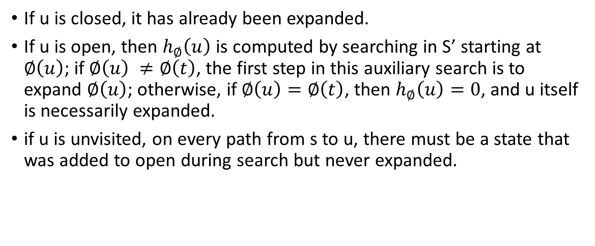
Proof
If u is closed, it has already been expanded.
If u is open, then $h_{∅}\left(u\right)$ is computed by searching in S’ starting at $∅\left(u\right)$; if $∅\left(u\right) ≠∅\left(t\right)$, the first step in this auxiliary search is to expand $∅\left(u\right)$; otherwise, if $∅\left(u\right)=∅\left(t\right)$, then $h_{∅}\left(u\right)=0$, and u itself is necessarily expanded.
if u is unvisited, on every path from s to u, there must be a state that was added to open during search but never expanded.

Slide 25
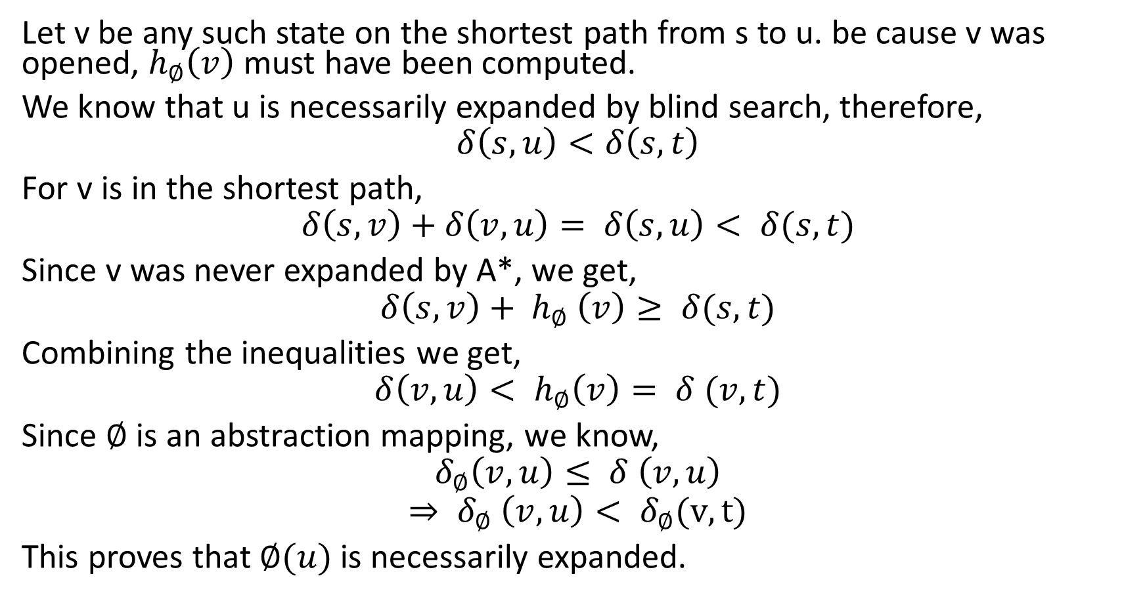
Proof (continued)
Let v be any such state on the shortest path from s to u. be cause v was opened, $h_{∅}\left(v\right)$ must have been computed.
We know that u is necessarily expanded by blind search, therefore,
$$δ\left(s,u\right)<δ\left(s,t\right)$$
For v is in the shortest path,
$$δ\left(s,v\right)+δ\left(v,u\right)= δ\left(s,u\right)< δ(s,t)$$
Since v was never expanded by A*, we get,
$$δ\left(s,v\right)+ h_{∅} \left(v\right)≥ δ(s,t)$$
Combining the inequalities we get,
$$δ\left(v,u\right)< h_{∅}\left(v\right)= δ (v,t)$$
Since $∅$ is an abstraction mapping, we know,
$$δ_{∅}\left(v,u\right)≤ δ \left(v,u\right)$$
$$⇒ δ_{∅} \left(v,u\right)< δ_{∅}(v,t)$$
This proves that $∅(u)$ is necessarily expanded.

Slide 26
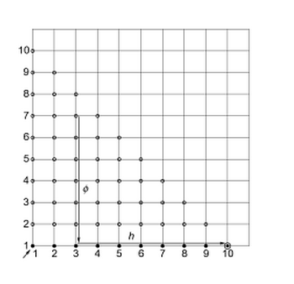
Example of Valtorta’s Theorem

Slide 27
Hierarchical A*

Slide 28
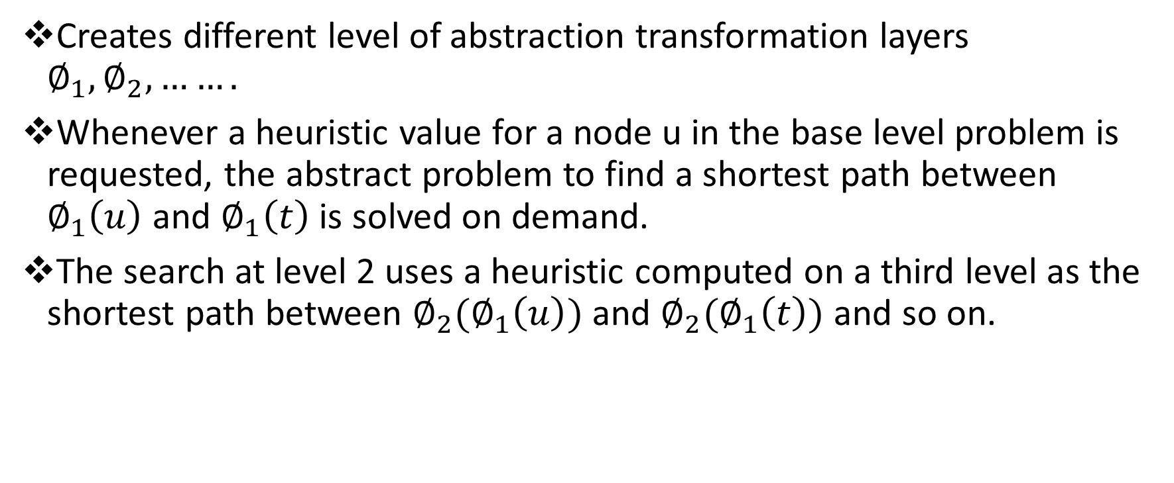
Same Method, but applied differently
Creates different level of abstraction transformation layers $∅_{1},∅_{2}, …….$
Whenever a heuristic value for a node u in the base level problem is requested, the abstract problem to find a shortest path between $∅_{1}\left(u\right)$ and $∅_{1}\left(t\right)$ is solved on demand.
The search at level 2 uses a heuristic computed on a third level as the shortest path between $∅_{2}(∅_{1}\left(u\right))$ and $∅_{2}(∅_{1}\left(t\right))$ and so on.

Slide 29
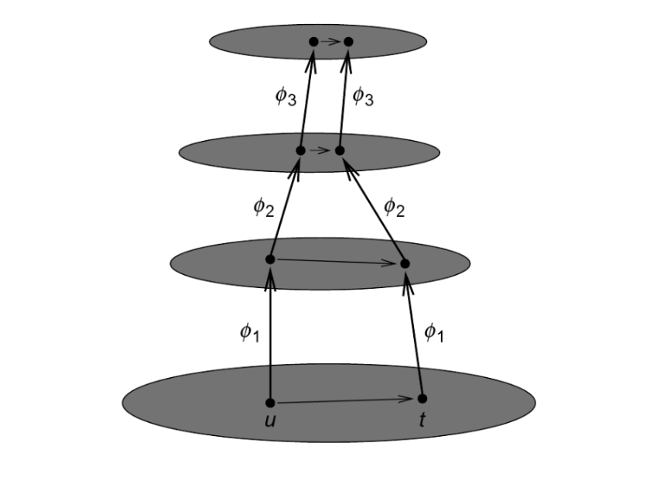
Layered abstraction in hierarchical A* with regard to current state u and goal state t

Slide 30
Pitfalls and Remedy
There are overheads for repeatedly solving the same instances in the higher levels.
Immediate solution is to cache the heuristic values of all the nodes in a shortest path computed at an abstract level.

Slide 31
Pitfalls and Remedy (Continued)
The resulting heuristic will no longer be monotone. This leads to reopening nodes, they can be closed even if no shortest path is found.
However, a node u can only be prematurely closed if every shortest path passes through same node v for which a shortest path is known.
All nodes on the shortest path from v to t have already cached the exact estimate and hence will only be expanded once.

Slide 32
References
Edelkamp, Stefan, and Stefan Schroedl. Heuristic search: theory and applications.
Holte, Robert C., et al. "Hierarchical A*: Searching abstraction hierarchies efficiently." AAAI/IAAI, Vol. 1. 1996.
Yang, Fan, et al. "A general theory of additive state space abstractions."Journal of Artificial Intelligence Research (2008): 631-662.

Slide 33


