Slide 1
Speech Recognition with CMU Sphinx
Srikar Nadipally
Hareesh Lingareddy

Slide 2
What is Speech Recognition
A Speech Recognition System converts a speech signal in to textual representation

Slide 3
Types of speech recognition
Isolated words
Connected words
Continuous speech
Spontaneous speech (automatic speech recognition)
Voice verification and identification (used in Bio-Metrics)
Fundamentals of Speech Recognition". L. Rabiner & B. Juang. 1993

Slide 4
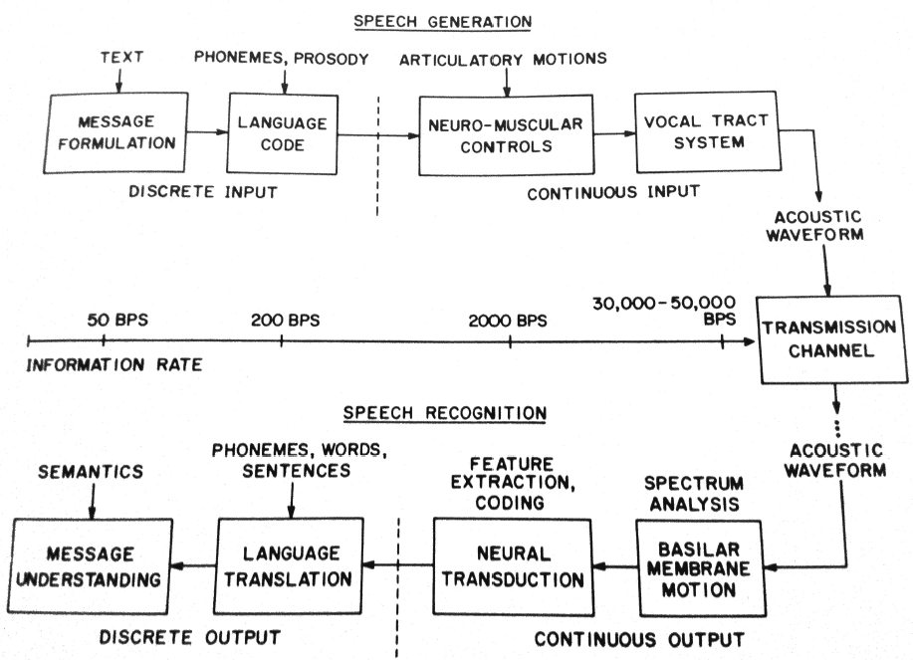
Speech Production and Perception Process
Fundamentals of Speech Recognition". L. Rabiner & B. Juang. 1993

Slide 5
Speech recognition – uses and applications
Dictation
Command and control
Telephony
Medical/disabilities
Fundamentals of Speech Recognition". L. Rabiner & B. Juang. 1993

Slide 6
Project at a Glance - Sphinx 4
Description
  Speech recognition written entirely in the JavaTM
  programming language
  Based upon Sphinx developed at CMU:
    www.speech.cs.cmu.edu/sphinx/
Goals
  Highly flexible recognizer
  Performance equal to or exceeding Sphinx 3
  Collaborate with researchers at CMU and MERL, Sun Microsystems and others
Notes:
MERL – Mitsubishi Electric Research Labs

Slide 7
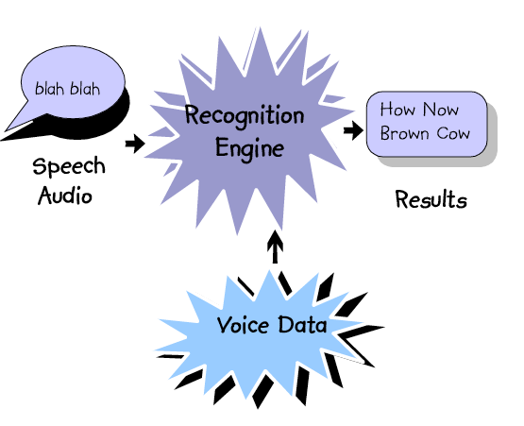
How does a Recognizer Work?

Slide 8
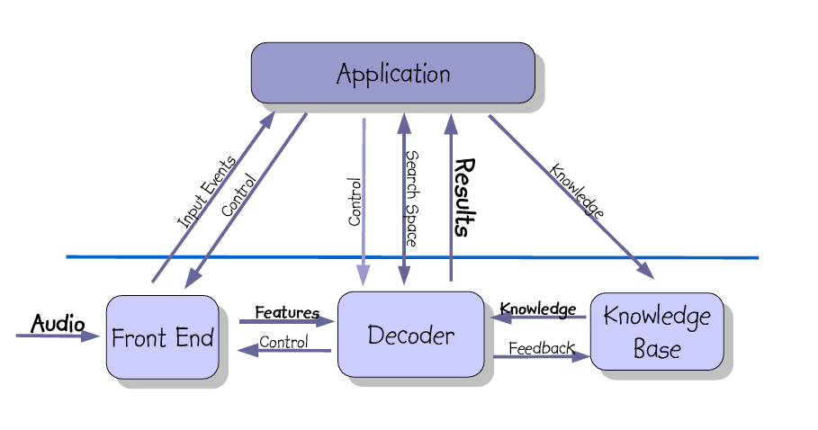
Sphinx 4 Architecture

Slide 9
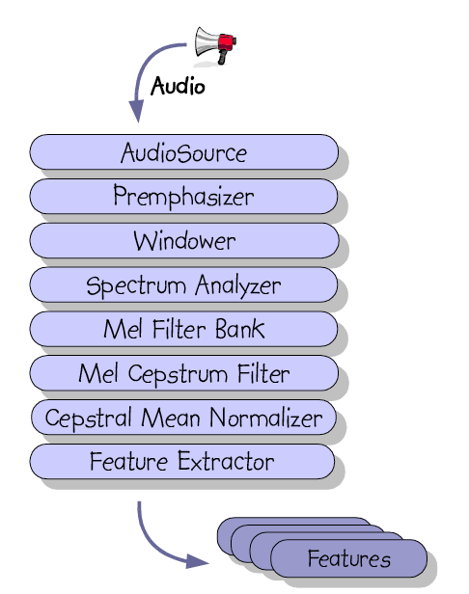
Front-End
Transforms speech
waveform into features
used by recognition
Features are sets of mel-
frequency cepstrum
coefficients (MFCC)
MFCC model human
auditory system
Front-End is a set of signal
processing filters
Pluggable architecture
Notes:
It is a high-pass filter because it allows the high frequency components to "pass through", while weakening or filtering out the low frequency components.

Slide 10
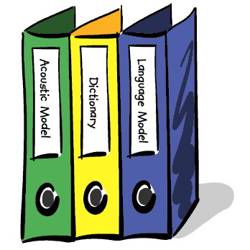
Knowledge Base
The data that drives the decoder
Consists of three sets of data:
    Dictionary
    Acoustic Model
    Language Model
Needs to scale between the three application types

Slide 11

Dictionary
Maps words to pronunciations
Provides word classification information (such as part-of- speech)
Single word may have multiple pronunciations
Pronunciations represented as phones or other units
Can vary in size from a dozen words to >100,000 words

Slide 12
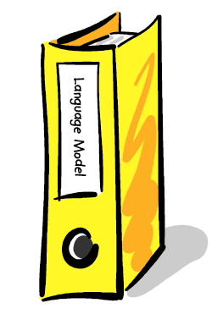
Language Model
Describes what is likely to be spoken in a particular context
Uses stochastic approach. Word transitions are defined in terms of transition probabilities
Helps to constrain the search space

Slide 13
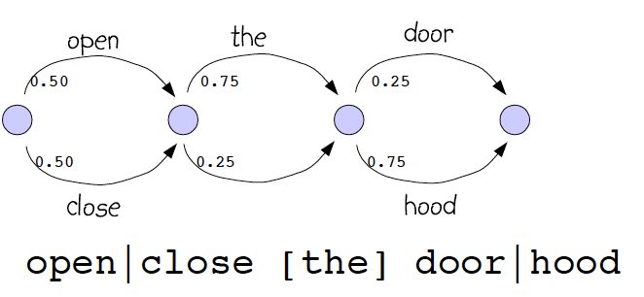
Command Grammars
Probabilistic context-free grammar
Relatively small number of states
Appropriate for command and control applications

Slide 14
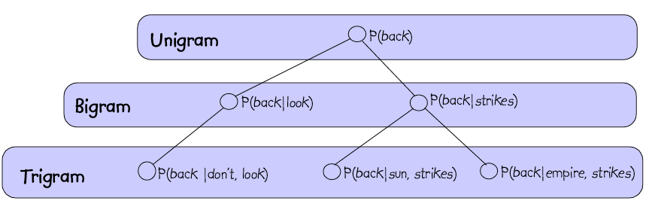
N-gram Language Models
Probability of word N dependent on word N-1, N-2, ...
Bigrams and trigrams most commonly used
Used for large vocabulary applications such as dictation
Typically trained by very large (millions of words) corpus

Slide 15
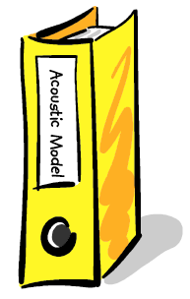
Acoustic Models
Database of statistical models
Each statistical model represents a single unit of speech such as a word or phoneme
Acoustic Models are created/trained by analyzing large corpora of labeled speech
Acoustic Models can be speaker dependent
or speaker independent

Slide 16
What is a Markov Model?
A Markov Model (Markov Chain) is:
similar to a finite-state automata, with probabilities of
transitioning from one state to another:
0.5
0.1
1.0
S₁
S₂
S₃
S₄
S₅
0.5
0.3
0.9
0.8
0.7
0.2
transition from state to state at discrete time intervals
can only be in 1 state at any given time
http://www.cslu.ogi.edu/people/hosom/cs552/

Slide 17
Hidden Markov Model
Hidden Markov Models represent each unit of speech in the Acoustic Model
HMMs are used by a scorer to calculate the acoustic probability for a particular unit of speech
A Typical HMM uses 3 states to model a single context dependent phoneme
Each state of an HMM is represented by a set of Gaussian mixture density functions

Slide 18
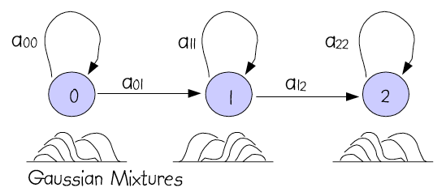
Gaussian Mixtures
Gaussian mixture density functions represent each state in an HMM
Each set of Gaussian mixtures is called a senone
HMMs can share senones

Slide 19
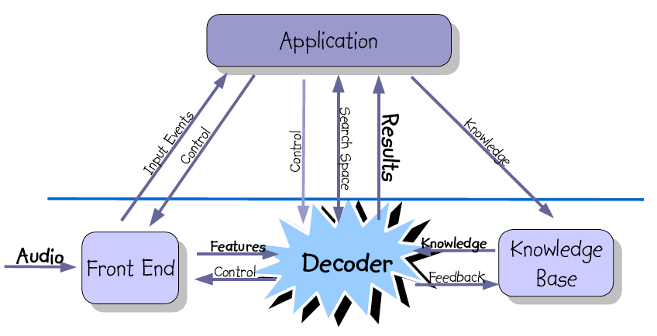
The Decoder

Slide 20
Decoder - heart of the recognizer
Selects next set of likely states
Scores incoming features against these states
Prunes low scoring states
Generates results

Slide 21
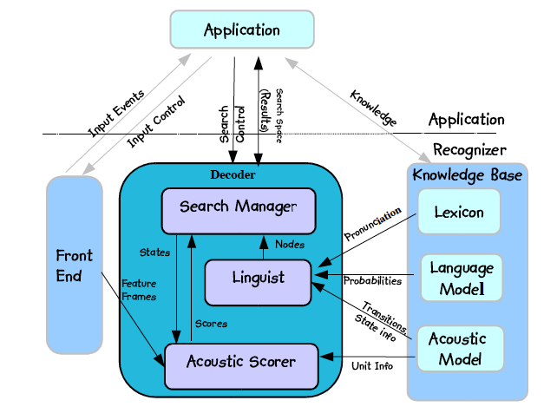
Decoder Overview

Slide 22
Selecting next set of states
Uses Grammar to select next set of possible words
Uses dictionary to collect pronunciations for words
Uses Acoustic Model to collect HMMs for each pronunciation
Uses transition probabilities in HMMs to select next set of states

Slide 23
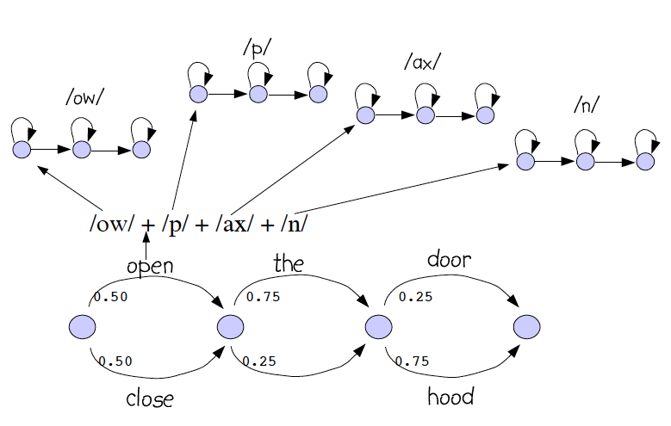
Sentence HMMS

Slide 24
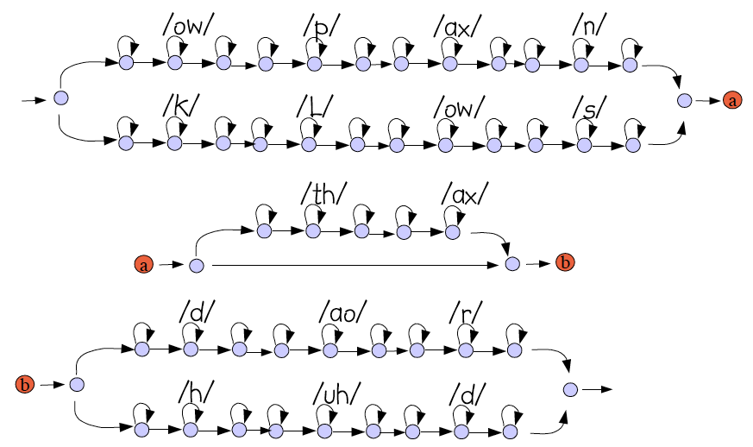
Sentence HMMS

Slide 25
Search Strategies: Tree Search
Can reduce number of connections by taking advantage of
redundancy in beginnings of words (with large enough vocabulary):
f
t
er (after)
l
ih
s (alice)
ae
ae
n (dan)
d
ih
sh
ih
z (dishes)
dh
n
er (dinner)
k
ax (the)
l
aa
r (car)
w
ah
n
ch (lunch)
aa
sh
t (washed)
http://www.cslu.ogi.edu/people/hosom/cs552/

Slide 26
??
Questions

Slide 27
References
CMU Sphinx Project,
http://cmusphinx.sourceforge.net
Vox Forge Project,
http://www.voxforge.org

