Slide 1
Computer Vision
Machine Learning
Features
Presented By
Dr. Keith Haynes

Slide 2
Outline
Introduction
Appearance-Based Approach
Features
Classifiers
Face Detection Walkthrough
Questions

Slide 3
Computer Vision
Computer vision is a field that includes methods for acquiring, processing, analyzing, and understanding images.
What does that mean?
What are some computer vision task?

Slide 4

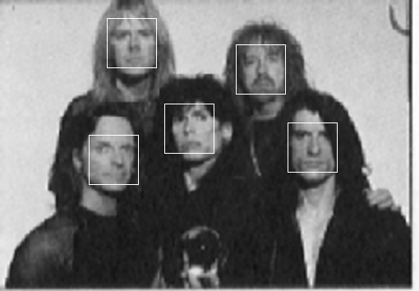
Detection
Are there any faces in this image?

Slide 5
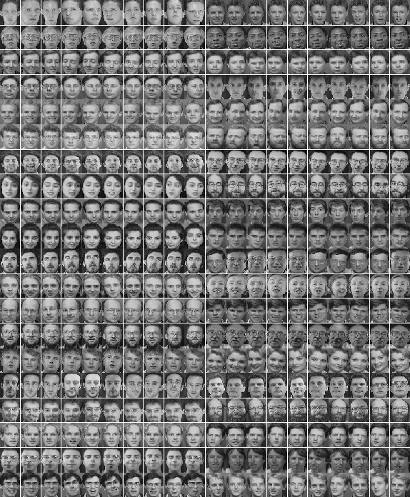
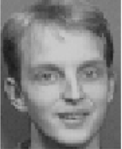
Recognition
+
Class
Label
Test
Subject
Database of Classes

Slide 6
Pattern Recognition System

Slide 7
Computer Vision a difficult problem

Slide 8
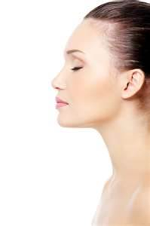
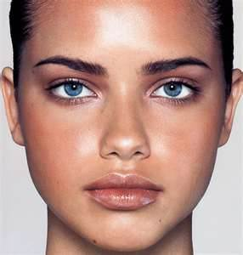
Pose
Images vary due to the relative camera-object pose
Frontal, profile, etc.

Slide 9
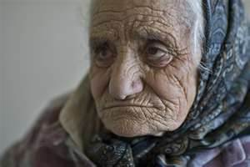



Structural Components
Components may vary in:
  Size
  Shape
  Color
  texture

Slide 10

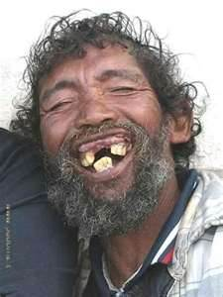

Deformability
Some objects have the ability to change shape

Slide 11
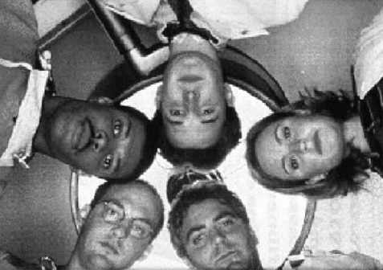

Computational Complexity
There are many possible objects
Scale
Orientation

Slide 12
Crux of the Problem

Slide 13


Slide 14
Curse of Dimensionality
As the dimensions increase, the volume of the space increases exponentially
The data points occupy a volume that is mainly empty.
Under these conditions, tasks such as estimating a probability distribution function become very difficult.
In high dimensions the training sets may not provide adequate coverage of the space.

Slide 15
Machine Learning
Machine learning is the science of getting computers to act without being explicitly programmed.
Applications
  self-driving cars
  speech recognition
  effective web search
  understanding of the human genome

Slide 16
Humans Don’t Understand

Slide 17
Computer Vision Approaches
Model-Based
  Uses 3D models to generate images
  Original and rendered images compared for classification
Appearance-Based
  Learns how to classify image via training examples

Slide 18
The Concept

Slide 19
Appearance-Based Approach
Features are learned through example images, usually known as a training set
3D Models are not needed
Utilizes machine learning and statistical analysis

Slide 20
Training Sets

Slide 21

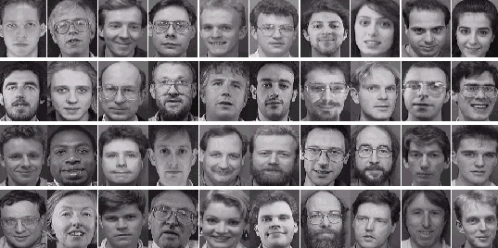
ORL (Face recognition)

Slide 22
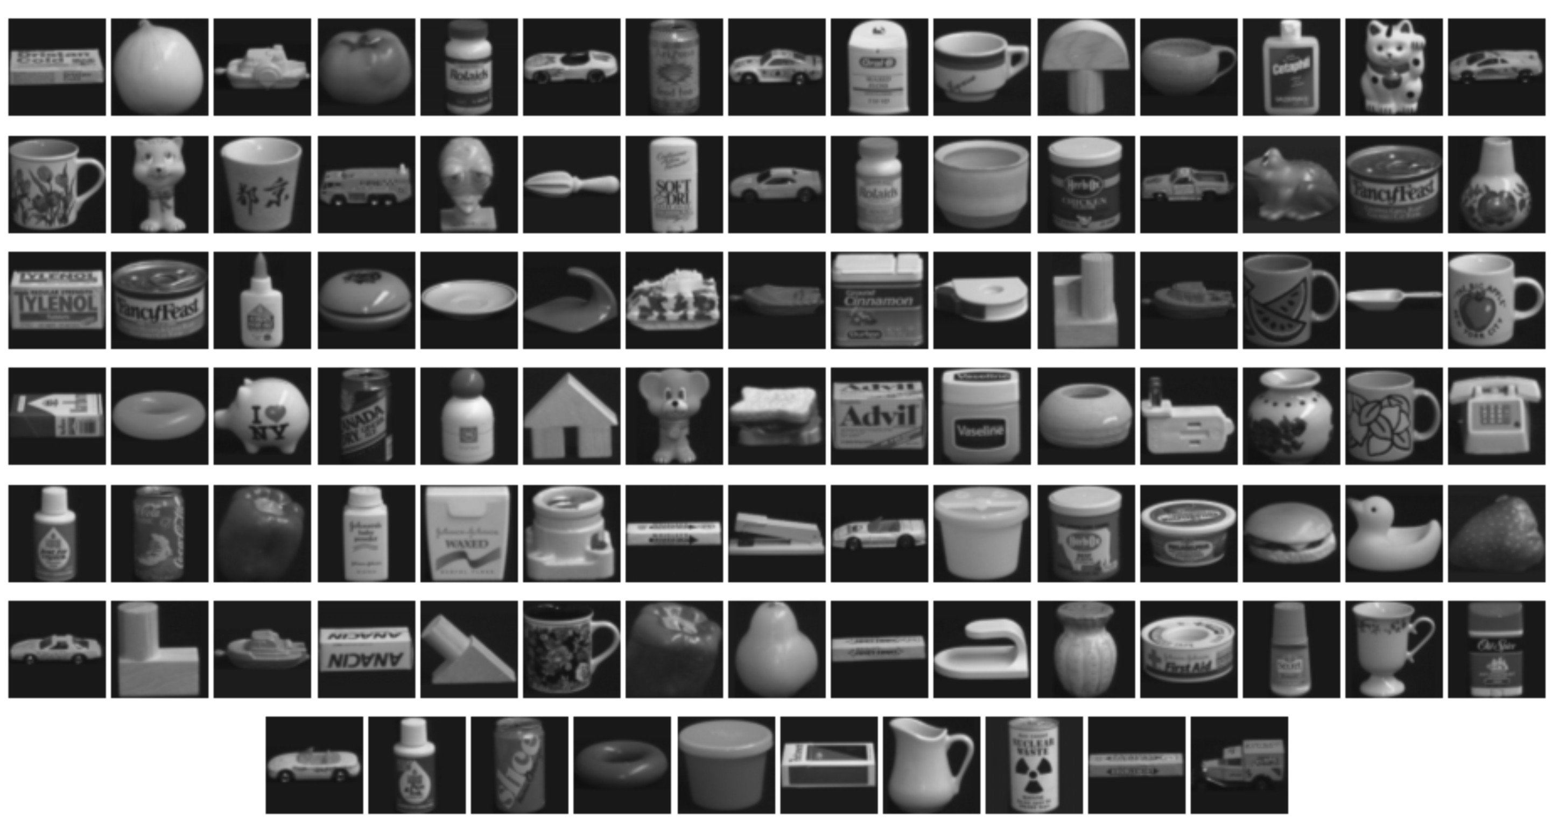
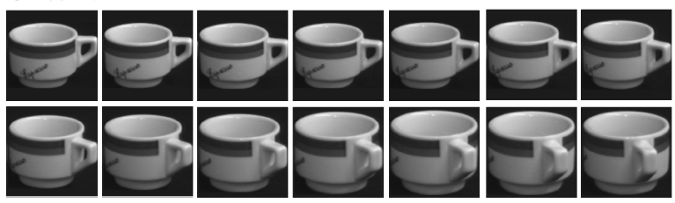
COIL-100 (Object Recognition)

Slide 23
Image Features
A feature is a calculation performed on a portion of an image that yields a number
Features are used to represent the entity being analyzed.

Slide 24
Image

Slide 25
Haar Features
Computes the difference between sums of two or more areas
Edge detector

Slide 26
Image
-328
199
527
262
414
152
+
-

Slide 27
Image Features
Feature representation is determined by:
  the task being performed
  performance constraints such as accuracy and calculation time.
Two Groups
  Global – feature uses the entire image
  Local – feature uses parts of the image

Slide 28
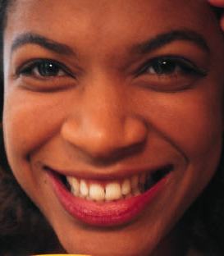
Local Features
Attempts to identify the critical areas from a set of images for class discrimination
How are critical areas identified?
Requires an exhaustive search of possible sub-windows

Slide 29
Rectangular Features
2MP image has 922,944,480,000 possible features and took 16.45 min

Slide 30
Features and Classification
A single Haar feature is a weak classifier
A set of features can form a strong classifier

Slide 31
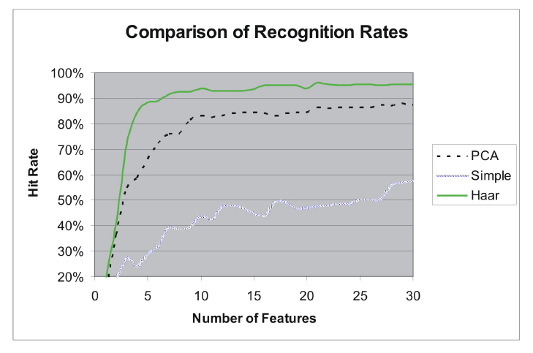
Haar Feature Effectiveness

Slide 32
Sets of Features

Slide 33
Search Method
Exhaustive Search
  For 5 features 5.9x10²⁴ unique sets
Find best features one at a time.
  Find the first best feature
  Find the feature that works best with the first feature, and so on
  For 5 features 449,990 sets searched
Increase step size

Slide 34











Example Features
Together they form a strong classifier

Slide 35
Feature Extraction
Feature
Set
Original Image

Slide 36
Summary
Feature selection is important, is application dependent
Statistical methods very useful with high dimensionality
Local identify discriminating areas or features images
No universal solution
Features can be combined

Slide 37
The Classifier

Slide 38
Types of Classifiers
Linear Discriminant Analysis
Fisher Discriminant Analysis
Bayesian Classifier
Neural Networks
K-Nearest Neighbor Classifier

Slide 39
Nearest Neighbor Classification
Features can used to form a coordinate space called the feature space.
Euclidean distance is used as the metric

Slide 40
Feature Selection
The distance is not used directly for feature selection
The higher the ratio, the better the filter
In order to prevent one class from dominating, an exponential function was used
The sum of function for all test images was used for selection
[Liu, Srivastava, Gallivan]

Slide 41
Feature Space Examples
Separation and grouping
Better Classification
Low Classification Rates

Slide 42
Rapid Classification Tree

Slide 43
Rapid Classification Tree
“Divide and Conquer”
Instead of trying to solve a difficult problem all at once, divide it into several parts
Each of the resulting parts should be easier to solve than the original problem
Perform classifications fast

Slide 44
Example RCT

Slide 45
Principal Component Analysis
Classical technique that is widely used for image compression and recognition
Produces features with a dimensionality significantly less than that of the original images
Reduction is performed without a substantial loss of the data contained in the image
Analysis is based on the variance of dataset
  Variance implies a distinction in class

Slide 46

PCA
Feature
Set
Feature
Set
PCA
Matrix
$$×$$
Lower
Dimensional
Space

Slide 47
3. Reduction Optimization
In many cases, the PCA reduction was not sufficient
Improving the performance of the reduction matrix is necessary
Four methods were implemented
  Gradient Search
  Random or Vibration Search
    Variation of the Metropolis Algorithm
  Neighborhood Component Analysis
  Stochastic Gradient Search

Slide 48
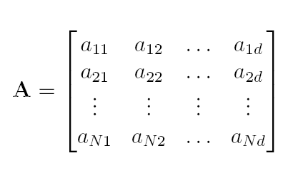
Optimization Search
Data reduction occurs via a matrix multiplication
  x′ = xA
Optimization is achieved by
  defining F as a function A, F(A)
  Changing A

Slide 49


Slide 50
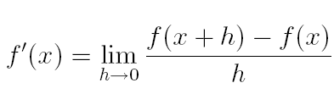
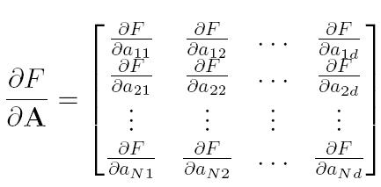
Gradient Search

Slide 51
Gradient Search
Can be computationally expensive
Does not provide a means to escape a local maximum

Slide 52
Stochastic Search
Makes a guess
Guesses are fast
There is a possibility of escaping a local maximum

Slide 53
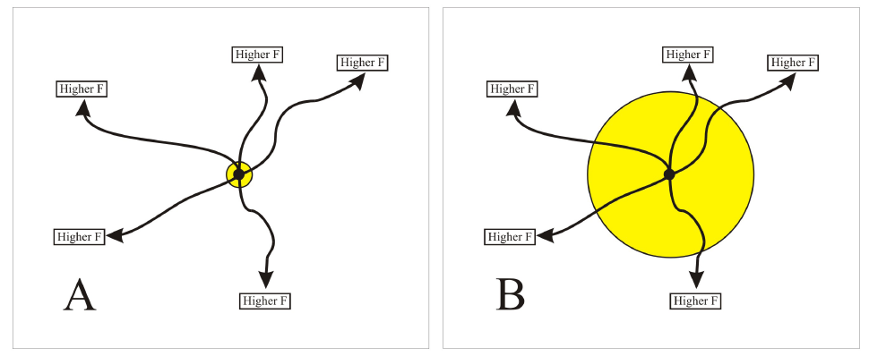
Stochastic Search
Restricting the search area increases the probability of finding an increasing path

Slide 54
Clustering
If all data at the node can be classified accurately
  The classification decision is stored as leaf nodes
  No further processing occurs down this branch of the tree.
If data cannot be classified accurately
  The problem then becomes a clustering one.
  Accuracy is now defined in terms of clusters, not classes.
The accuracy achieved through class level clustering will always be no worse than that of individual classes and in most cases, will be higher.

Slide 55
Clustering Process

Slide 56
Decomposition

Slide 57
Generated RCT

Slide 58
Decomposition

Slide 59
Decomposition

Slide 60
Decomposition

Slide 61
Classifier Comparisons

Slide 62
References
X. Liu, A. Srivastava, K. Gallivan, Optimal linear representations of images for object recognition, IEEE Transactions on Pattern Analysis and Machine Intelligence, May 2004, pp. 662-666.
Haynes, K., Liu, X., Mio, W., (2006). Object Recognition Using Rapid Classification Trees. 2006 International Conference on Image Processing
Haynes, K. (2011). Using Image Steganography to Establish Covert Communication Channels. International Journal of Computer Science and Information Security, Vol. 9, No. 9
Duda, R., Hart, P., Stork, D. (2001). Pattern Classification. Wiley-Interscience Publications, NY

Slide 63
Questions?

