Slide 1
Finding Heuristics Using Abstraction
Kenny Denmark
Jason Isenhower
Ross Roessler
Notes:
so did we decide who is presenting what slides?

Slide 2
Background
A* uses heuristics for efficient searching
Initially, heuristics provided by "expert"
Challenge is to have program create heuristics

Slide 3
Valtorta's Theorem
Every node expanded by blind search (BFS, Dijkstra's) in the original graph will be expanded either when generating the heuristic using blind search, or in the actual A* search.
You can never win, you always expand as many or more nodes.

Slide 4
Valtorta's Barrier
Number of nodes expanded when blindly searching a space
Cannot be broken using an embedded transformation for heuristics

Slide 5
Abstractions
Embedded
adds more transitions (edges) to the system
ex. constraint relaxation in Towers of Hanoi
Homomorphic
merges groups of states and transitions into one state
can possibly break Valtorta's barrier!

Slide 6
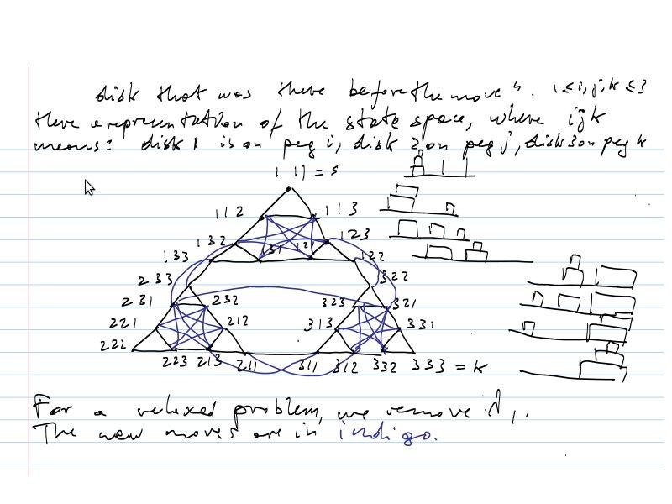
Embedded Heuristic Example

Slide 7
Homomorphic Example
N x N grid
Get from bottom left (1,1) to bottom right (N,1)
Required N² expansions for blind search
Homomorphic mapping- ignore 2nd coordinate
Requires N expansions

Slide 8
Admissible vs Monotone
Admissible: gives a cost for reaching the goal from the current node that is that is less or equal to the actual cost
Monotone: same as admissible but also never requires backtracking. The cost takes into account both the distance travelled and the distance remaining.
Notes:
mention trivial vs non-trivial. every problem has a trivial/useless solution such as h(n) = 1 for all n

Slide 9
Absolver II
Find heuristics for a given problem
Uses abstracting transformations
reduce cost
expand goals
Reduces tree size using speedups
removes redundant and irrelevant nodes
Found admissible heuristics for 6 of the 13 problems
Found 8 new ones, 5 of which were effective
Creates hierarchies of abstraction to find heuristics
Notes:
an abstracting transformation might be allowing tiles to overlap each other in the 8 puzzle
reduce cost = adding a shortcut so the heuristic's found path is guaranteed to be <= to the actual path
expand goals = ?? adding more goal states so they are easier to find?
redundant nodes: after the problem is abstracted/relaxed nodes, some nodes become redundant and can be removed
irrelevant nodes: if the goal node is simplified, then nodes leading to it may only alter values not specified in the node, in which case these nodes can be dropped. EX: a simplified goal node for the 8 puzzle only specifies where tile 1 should be, so any node that doesn't deal with moving tile 1 can be dropped because it is irrelevant to that goal.
effective: 1 or more orders of magnitude improvement over exhaustive search
if a solution can't be found in the abstracted layer, then it can't be found in the original version as the abstraction is a simplified/easier version of the problem

Slide 10
Rubik's Cube
First non-trivial heuristic
Explored only 10^-15 % of the abstracted space
8 orders of magnitude faster than breadth-first search
Center-Corner
Notes:
center corner: calculates the minimum number of moves to get the center positions in place and adds the minumum number of moves to get the corners in place

Slide 11
Fool's Disk
Explored 2.4% of the abstracted space
45 times fewer states than exhaustive search
Diameters

Slide 12
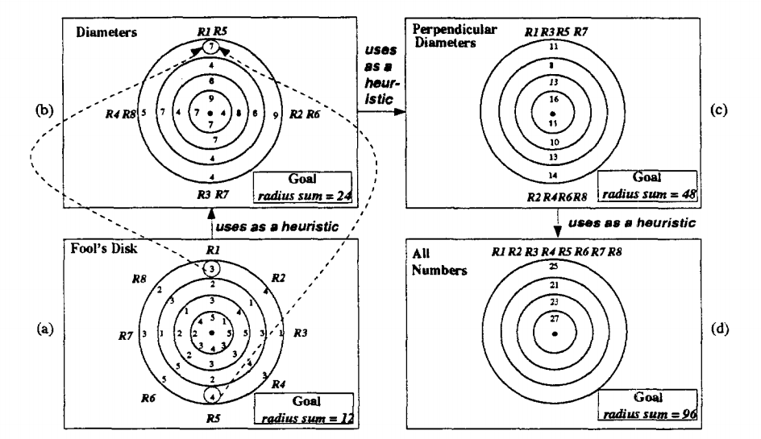
Fool's Disk
Notes:
want each column to add to a specific number
rotate each disk to change the values of the column
so opposite columns can be combined to greatly reduce the size of the search tree
if the total for "all numbers" doesn't add up, then it is impossible for the problem to be solved
fools disk has many solutions with the same value, so the heuristic simply removes arrangements that can't work

Slide 13
Hierarchical Search Using A*

Slide 14
Max-degree STAR Abstraction Technique
state with the largest degree (most adjacent nodes) is grouped together with its neighbors within a certain distance to form a single abstract state
repeated until all states have been assigned to some abstract state
not suitable for search spaces in which different operators have different costs
Notes:
the certain distance is called the "abstraction radius"

Slide 15
Building the Abstraction Hierarchy
Base level is original problem
To generate abstraction hierarchy, max-degree abstraction technique is used first on the base level, and then recursively on each level of abstraction
the highest level will be trivial (only one state)

Slide 16
Combining Sources of Heuristic Information
to combine multiple sources of heuristic information, take their maximum.
This is guaranteed to be admissible if the individual heuristics are admissible
may not be monotone even if individual heuristics are monotone

Slide 17
Naive Hierarchical A*
At each step of algorithm, a state is removed from OPEN list and "expanded"
for a state S to be added to the OPEN list, h(S) must be known
h(S) is computed by searching the next higher level of abstraction and combining that information with other estimates
Notes:
Problem with this version: to solve a single base level problem, this technique must solve other problems at each level of abstraction

Slide 18
Testing Method
the various hierarchical A* techniques were evaluated empirically on 8 state spaces
Test problems for each state space were generated by choosing 100 pairs of states at random (S1 and S2)
These states define 2 problems to be solved: <start=S1,goal=S2>,<start=S2,goal=S1>
Average number of nodes expanded over these 200 tests is used as a metric for comparison
Notes:
the 8 state spaces = appendix C of main paper

Slide 19
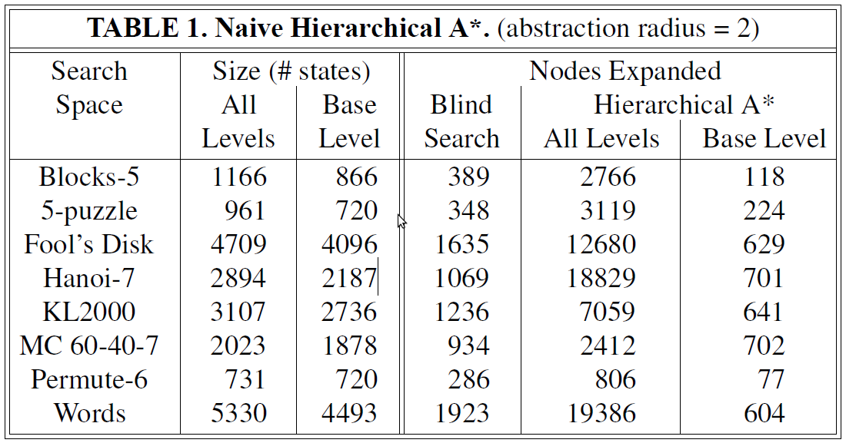
Blind Search vs. Naive Hierarchical A*

Slide 20
Caching
h*-caching
optimal-path caching
P-g caching

Slide 21
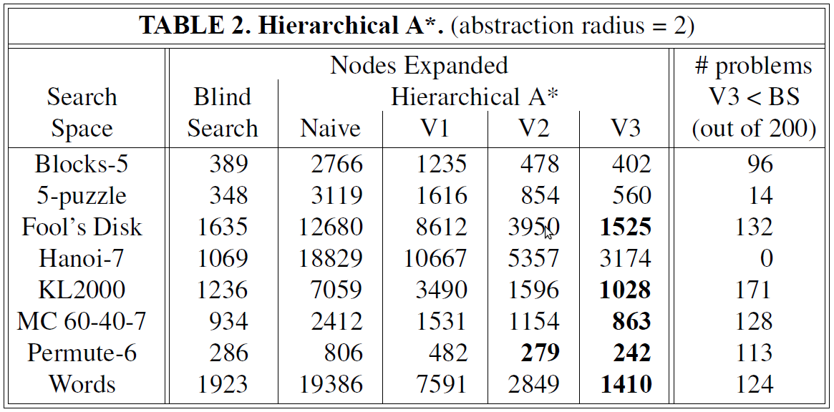
Table 2

Slide 22
Abstraction Granularity
In the previous table, the abstraction radius was 2 (state is grouped with its immediate neighbors)
Positive effects of increasing radius:
abstract spaces contain fewer states
single abstract search produces heuristic values for more states
Negative effects of increasing radius:
heuristic is less discriminating (less useful)
Notes:
Method in paper: run hierarchical A* with abstractions set to 2-5 (or larger values for larger search spaces). This eventually caused the number of nodes expanded to reach a minimum, after which increasing the radius after this point would increase the number of nodes expanded

Slide 23
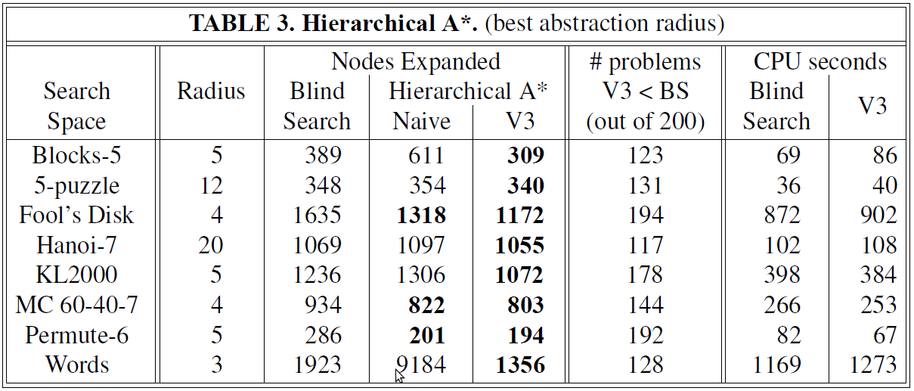
Table 3

Slide 24
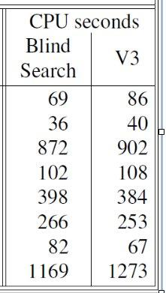
Key Point- CPU Seconds
Node expansions generally less
CPU seconds generally more
Node expansions not necessarily best measurement of efficiency?
Notes:
just wanted to add this in because they mentioned it in the paper, even though i think they said they could make their code more efficient to make the CPU time go down.

Slide 25
Questions?

