Slide 1
Emotional Representation in A.I.
Bridgette Parsons and Dhaval Salvi

Slide 2
Introduction
Terminology for Non-Gamers

Slide 3
Introduction
Terminology for Non-Gamers
PC – Player Character: The character played by the gamer or user of the simulation

Slide 4
Introduction
Terminology for Non-Gamers
PC – Player Character: The character played by the gamer or user of the simulation
NPC – Non-player Character: Any character controlled by the computer

Slide 5
Introduction
Video Game Examples

Slide 6
Introduction
Video Game Examples
Everquest – broken scripting

Slide 7
Introduction
Video Game Examples
Everquest – broken scripting
The Sims Online – griefing

Slide 8
Introduction
Simulation Examples

Slide 9
Introduction
Simulation Examples
Virtual Patient – psychiatric training

Slide 10
Introduction
Simulation Examples
Virtual Patient – psychiatric training
“Steve” – multicultural gesture interpretation

Slide 11
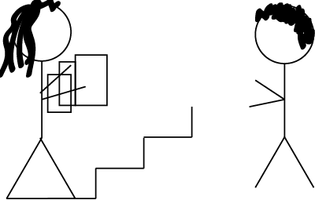
Model Overview
Emotional modeling example – Julie

Slide 12
Model Overview

Slide 13
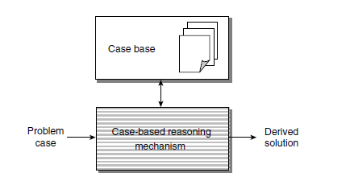
Case-Based Reasoning
Components and Features of Case-Based Reasoning

Slide 14
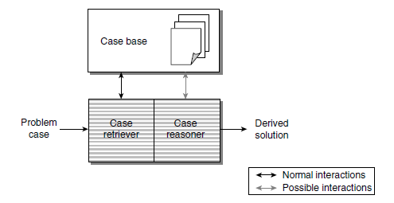
Case-Based Reasoning
Components and Features of Case-Based Reasoning

Slide 15
Case-Based Reasoning
CBR System versus Rule-Based System
Knowledge acquisition task is a time-consuming aspect of Rule-Based system
Acquiring domain specific information and converting it into some formal representation can be a huge task .
In some situations with less well understood domains , formalization of the knowledge cannot be done at all
Case-Based systems require significantly less knowledge acquisition
It does not have the necessity of extracting a formal domain model from set of past cases.
CBR is applicable in domains with insufficient cases to extract a domain model

Slide 16
Case-Based Reasoning
CBR versus Human Reasoning
CBR can be seen as a reflection of particular type of human reasoning
CBR can be used in arguing a point of view similar to human reasoning
Partial use of past cases to support a current case
CBR is similar to human problem solving behavior

Slide 17
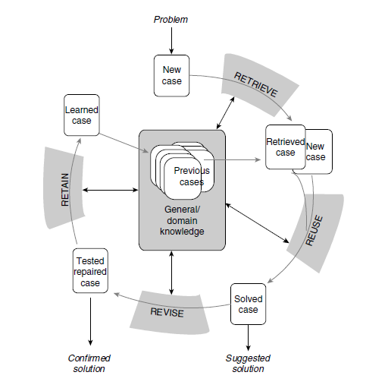
Case-Based Reasoning
CBR Life Cycle

Slide 18
Case-Based Reasoning
Guidelines for use of Case-Based Reasoning
Does the domain have an underlying model?
Are there exceptions and novel cases?
Do cases recur?
Is there significant benefit in adapting past solutions?
Are relevant previous cases obtainable?

Slide 19
Case-Based Reasoning
Advantages of using Case-Based Reasoning
Reducing the Knowledge acquisition task
Avoiding repeating mistakes made in the past
Providing flexibility in knowledge modeling
Reasoning in domains that have not been fully understood, defined or modeled
Making predictions of the probable success of a preferred solution
Learning over time

Slide 20
Case-Based Reasoning
Advantages of using Case-Based Reasoning
Reasoning in a domain with a small body of knowledge
Reasoning with incomplete or imprecise data and concepts
Avoiding repeating all the steps that need to be taken to arrive at a solution
Reflecting human reasoning
Extending to many different purposes

Slide 21
Modeling Personality
OCEAN Model

Slide 22
Modeling Personality
OCEAN Model
Openness – open to new experiences

Slide 23
Modeling Personality
OCEAN Model
Openness – open to new experiences
Conscientiousness – disciplined, organized

Slide 24
Modeling Personality
OCEAN Model
Openness – open to new experiences
Conscientiousness – disciplined, organized
Extraversion – seek company of others

Slide 25
Modeling Personality
OCEAN Model
Openness – open to new experiences
Conscientiousness – disciplined, organized
Extraversion – seek company of others
Agreeableness – cooperation, compassion

Slide 26
Modeling Personality
OCEAN Model
Openness – open to new experiences
Conscientiousness – disciplined, organized
Extraversion – seek company of others
Agreeableness – cooperation, compassion
Neuroticism – anxiety, emotional imbalance

Slide 27
Modeling Personality
Personality is generally static.

Slide 28
Modeling Personality
Personality is generally static.
When using the OCEAN model, it is encoded as a 5-tuple, with each factor expressed as a decimal between 0 and 1 to indicate a percentage.

Slide 29
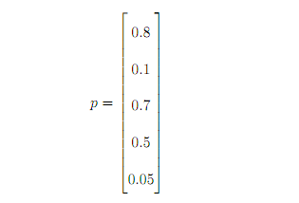
Modeling Personality
Personality is generally static.
When using the OCEAN model, it is encoded as a 5-tuple, with each factor expressed as a decimal between 0 and 1 to indicate a percentage.

Slide 30
Modeling Personality
Personality affects emotions by changing the interpretation of events.

Slide 31
Modeling Personality
Personality affects emotions by changing the interpretation of events.
Personality affects which goals are important.

Slide 32
Modeling Personality
Personality affects emotions by changing the interpretation of events.
Personality affects which goals are important.
Personality directly affects the probability of certain behaviors.

Slide 33
Modeling Emotion
OCC model (Ortony, Clore, and Collins)

Slide 34
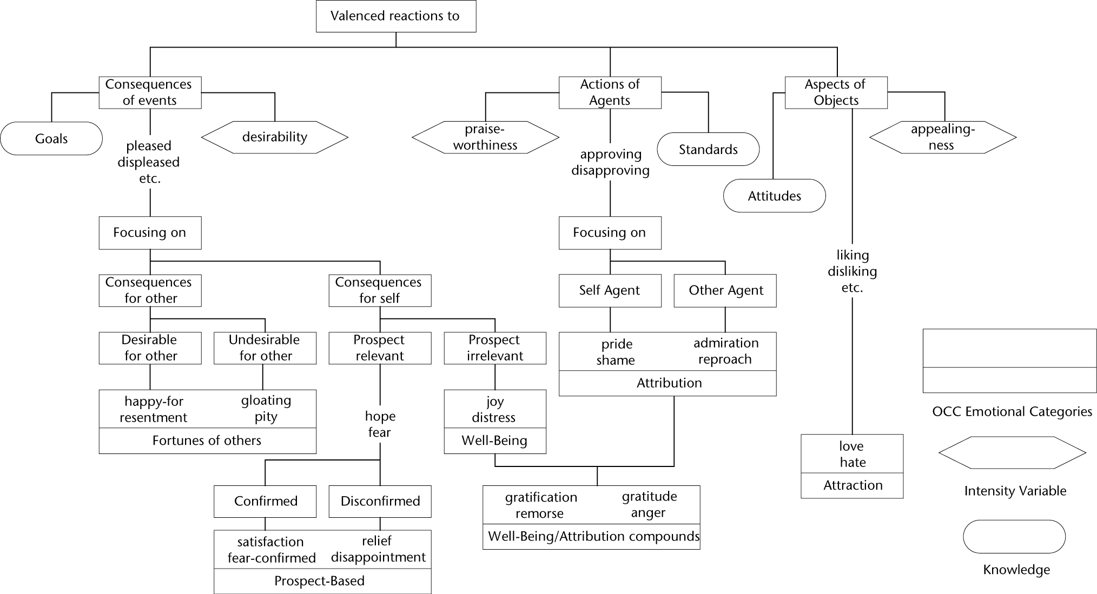
Modeling Emotion
OCC model (Ortony, Clore, and Collins)

Slide 35
Modeling Emotion
Alternatives to the OCC model

Slide 36
Modeling Emotion
Alternatives to the OCC model
Basic emotional model – model of 5 or 6 basic emotions, either as states or with scales from 0 to 1

Slide 37
Modeling Emotion
Alternatives to the OCC model
Basic emotional model – model of 5 or 6 basic emotions, either as states or with scales from 0 to 1
Families of emotions – Anger, Sadness, Fear, Enjoyment, Love, Surprise, Disgust, Shame

Slide 38
Modeling Emotion
Alternatives to the OCC model
Basic emotional model – model of 5 or 6 basic emotions, either as states or with scales from 0 to 1
Families of emotions – Anger, Sadness, Fear, Enjoyment, Love, Surprise, Disgust, Shame
Blended emotions – model of more than one emotion at once

Slide 39
Modeling Emotion
Emotions are affected by:

Slide 40
Modeling Emotion
Emotions are affected by:
Goal achievement or failure

Slide 41
Modeling Emotion
Emotions are affected by:
Goal achievement or failure
Current experiences

Slide 42
Modeling Emotion
Emotions are affected by:
Goal achievement or failure
Current experiences
Neurochemicals

Slide 43
Modeling Emotion
Emotions are affected by:
Goal achievement or failure
Current experiences
Neurochemicals
Current mood

Slide 44
Modeling Emotion
Emotions affect behavior and mood.

Slide 45
Modeling Emotion
Emotions affect behavior and mood.
They are generally expressed as a k-tuple, where k is the number of emotions represented.

Slide 46
Modeling Emotion
Emotions affect behavior and mood.
They are generally expressed as a k-tuple, where k is the number of emotions represented.
Emotions decay over time.

Slide 47
Mood vs. Emotion
Mood is more simple to represent than emotion.

Slide 48
Mood vs. Emotion
Mood is more simple to represent than emotion.
It is frequently represented simply in terms of “good mood” vs. “bad mood.”

Slide 49
Mood vs. Emotion
Mood is more simple to represent than emotion.
It is frequently represented simply in terms of “good mood” vs. “bad mood.”
Mood decays more slowly than emotion.

Slide 50
Mood vs. Emotion
Mood is more simple to represent than emotion.
It is frequently represented simply in terms of “good mood” vs. “bad mood.”
Mood decays more slowly than emotion.
Some emotional models ignore mood.

Slide 51
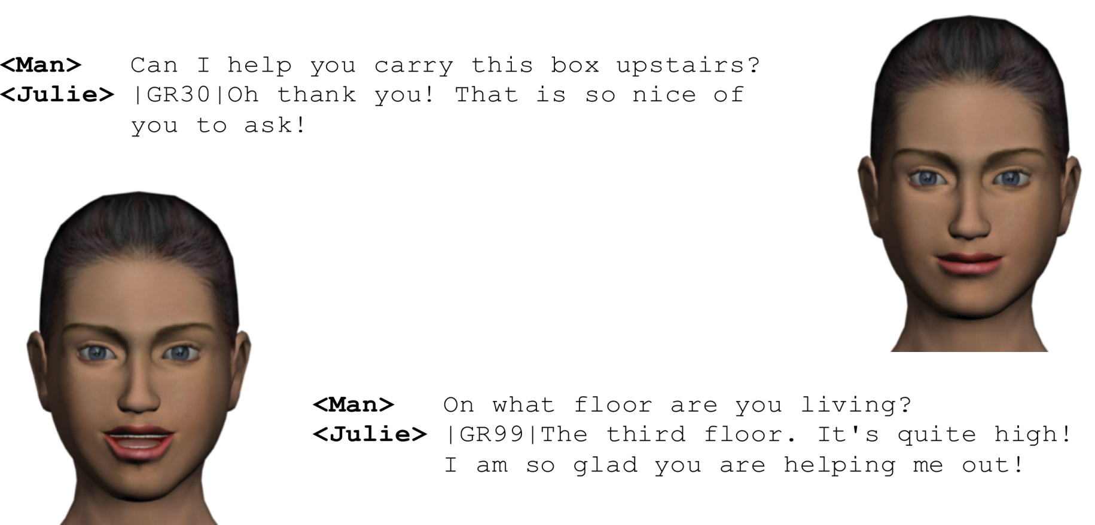
Example of Emotional Model
Julie with extraversion at 90%:
From “Generic Personality and Emotion Simulation for Conversational Agents” by Egges, Kshirsagar, and Magnenat-Thalmann

Slide 52
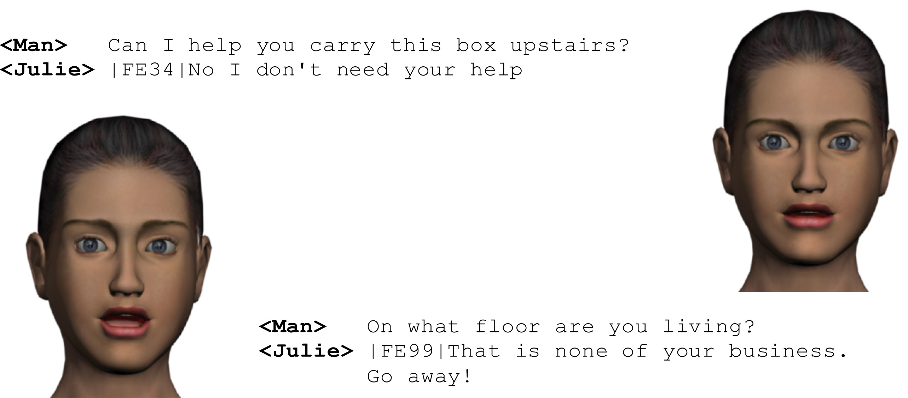
Example of Emotional Model
Julie with Neuroticism at 90%:
From “Generic Personality and Emotion Simulation for Conversational Agents” by Egges, Kshirsagar, and Magnenat-Thalmann

Slide 53
References
Bartneck, Christoph, “Integrating the OCC Model of Emotions in Embodied Characters”, Workshop on Conversational Characters (2002).
Bhandari, Shruti, “Conversational Case-Based Reasoning”, Lehigh University, PowerPoint Presentation.
Eckman, Paul, “An Argument for Basic Emotions”, Cognition and Emotion 6.3(1992): 169-200.
Egges, Arjan; Kshirsagar, Sumedha; and Magnenat-Thalmann, Nadia, “Generic Personality and Emotion Simulation for Conversational Agents”, Wiley Online Library (2004): 1-39.
Pal, Sankar K., and Shiu, Simon C. K. Foundations of Soft Cased-Based Reasoning. Hoboken, New Jersey: Wiley-Interscience, 2004.
Parunak, H. Van Dyke; Bisson, Robert; Brueckner, Sven; Matthews, Robert ; and Sauter, John “A Model of Emotions for Situated Agents”, Proceedings of AAMAS (2006).
Stanfill, Craig, and Waltz, David, “Toward Memory-Based Reasoning”, Communications of the ACM 29.12 (1986): 1213-1228.
Velásquez, Juan D., “Modeling Emotions and Other Motivations in Synthetic Agents”, Proceedings of the National Conference on Artificial Intelligence (1997).

