Slide 1
Model-based Automatic Detection of the Anterior and Posterior Commissures on MRI Scans
Babak A. Ardekani and Alvin H. Bachman
Presented by Dazhou Guo

Slide 2
Introduction
The anterior and posterior commissures are bundles of transverse white matter fibers that connect the two cerebral hemispheres of the brain.
Intersection points of these fibers (AC/PC) with the mid-sagittal plane (MSP) are important landmarks in neuroimaging.

Slide 3
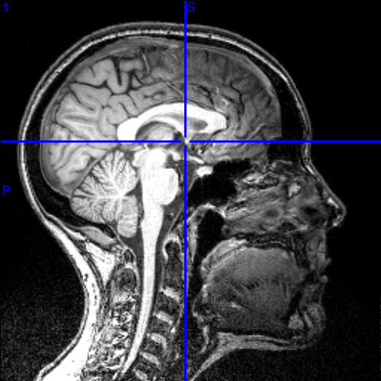
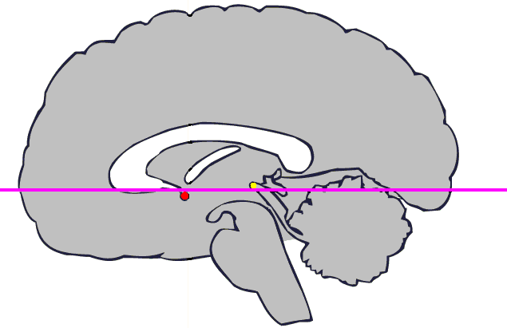
Background
Where?
Y+
Y-
■ PC
Z+
Z-
■ AC

Slide 4
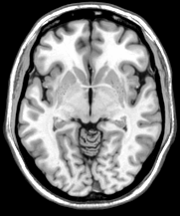
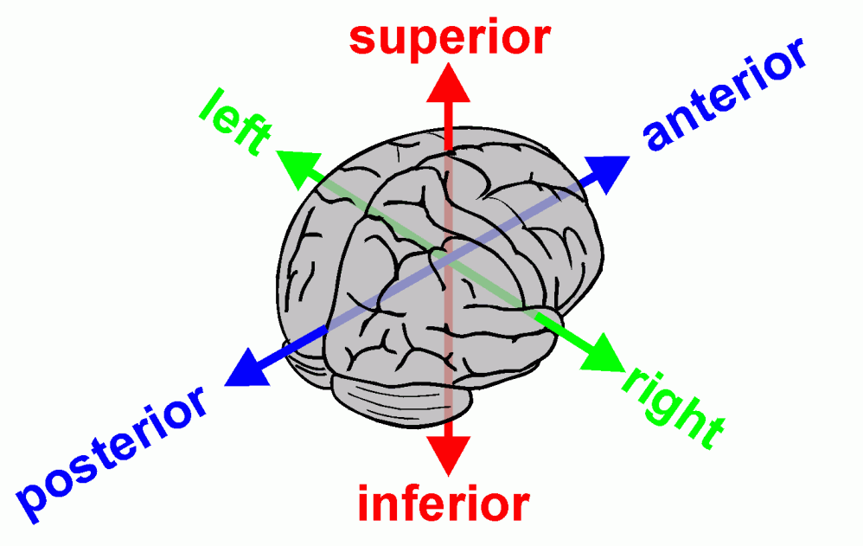
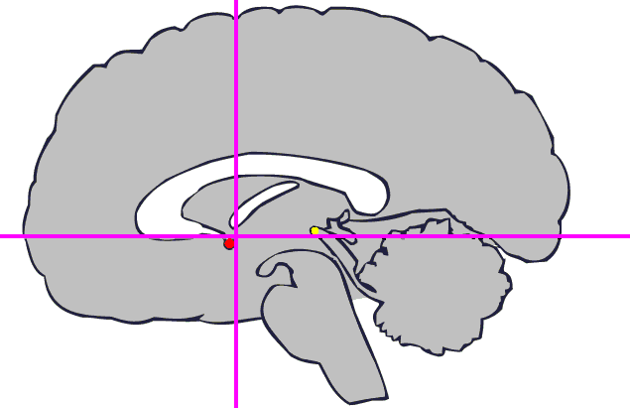

Background
Where?

Slide 5
Introduction
They find a highly prominent landmark MPJ on the midbrain-pons junction, located at the vertex of the superior pontine sulcus, and then proceed to search for the AC/PC based on their relative locations with respect to the MPJ as obtained from the training data set.

Slide 6
Datasets
For Training
(1) Nathan Kline Institute (NKI) set:
      33 healthy subjects and 15 patients with chronic schizophrenia
  (2) Publically available IXI database:
      42 standard anatomical 3D T1W MPRAGE scans
  For Evaluating
  (3) Publically available IXI database:
      42 T₂-weighted (T2W) fast spin echo scans

Slide 7
Training Phase
The MSP (middle sagittal plane) is automatically located on each model image using the algorithm described by Ardekani et al. (1997). The MSP is defined by equation: Ax+By+Cz = 1. The three parameters (A, B, C) are determined using an optimization procedure that maximizes the symmetry between image halves on either side of the plane.
[1] Ardekani BA, Kershaw J, Braun M, Kanno I. Automatic detection of the mid-sagittal plane in 3-D brain images. IEEE Trans Med Imaging. 1997;16:947–952.

Slide 8
Training Phase
Let P_{ai}, P_{pi}, and P_{mi} respectively correspond to the position vectors of AC, PC, and MPJ of the i^{th} model image after undergoing this transformation.
The mean MPJ position vector, P_{m}, and two mean displacement vectors, P_{ma} and P_{mp}, are computed as follows:

Slide 9
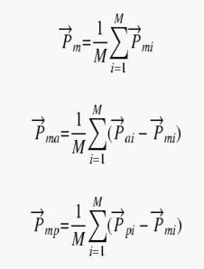
Training Phase

Slide 10
Training Phase
For each rotation, the voxel values that fall in the cylindrical region are organized as vectors, denoted by: T_{aiα}, T_{piα}, and T_{miα} corresponding to the cylinders centered around the AC, PC, and MPJ, respectively. Thus, for example, the elements of vector T_{piα} are voxel values inside the cylinder centered around the PC in model i after undergoing a rotation of α degrees about the axis of the cylinder.
M is the Number input model images.

Slide 11
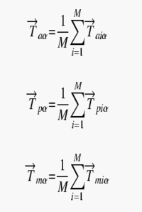
Training Phase

Slide 12
Training Phase
The results of the training procedure are the mean position vector of the MPJ: P_{m} the mean displacement vector between the MPJ and the AC: T_{ma}, the mean displacement vector between the MPJ and PC: T_{mp}, and N average template vectors for different pitch angles α for the AC, PC, and the MPJ: T_{aα}, T_{pα}, and T_{mα}. This information is saved in a “model file” that is recalled during automatic AC/PC detection.

Slide 13
Detection Phase
The mean position vector P_{m} and the set of templates T_{mα} are read from the model file. A cylindrical region, centered around P_{m} whose axis parallel is to the z-axis, is searched on the PIL oriented test image for the MPJ. The search is based on template matching by normalized cross-correlation (NCC).
For each supra-threshold voxel v in the search cylinder, a vector F_{v} is formed whose element are the voxel values on the test image inside a cylindrical region centered around v and parallel with the z-axis, exactly similar in shape and size to the one that was used in defining the template T_{mα} during the training phase.
The maximum NCC (over all angles α {α₁, α₂, ···, α_{N}}) is computed for all voxels v in the search region. The voxel with the largest maximum NCC is taken provisionally to be the location of the MPJ, denoted by v_{m}. The operations described here can be written in a concise mathematical form as follows:

Slide 14

Detection Phase

Slide 15
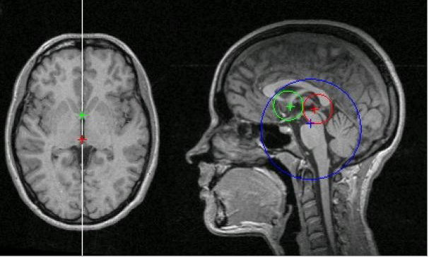
Results

Slide 16
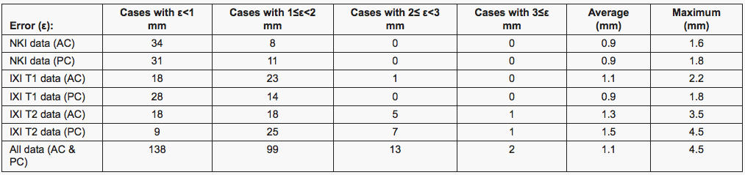
Results

Slide 17
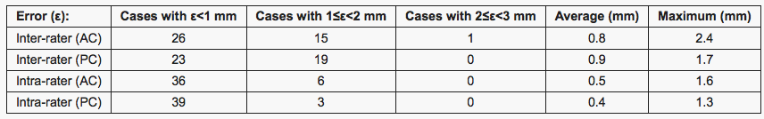
Results

Slide 18
Key References
[1] Ardekani BA, Kershaw J, Braun M, Kanno I. Automatic detection of the mid-sagittal plane in 3-D brain images. IEEE Trans Med Imaging. 1997;16:947–952.
[2] Hu Q, Nowinski WL. A rapid algorithm for robust and automatic extraction of the midsagittal plane of the human cerebrum from neuroimages based on local symmetry and outlier removal. Neuroimage. 2003;20:2153–2165
[3] Vérard L, Allain P, Travère JM, Baron JC, Bloyet D. Fully automatic identification of the AC and PC landmarks on brain MRI using scene analysis. IEEE Trans Med Imaging. 1997;16:610–616.

