Slide 1
Inconsistent Heuristics
Mounica Atluri
Sruthi Vemulapalli
CSCE 580

Slide 2
Introduction
It is assumed that admissible heuristics are consistent
Issue of inconsistent heuristics was never fully investigated after the invention of IDA*
Perceptions about inconsistent heuristics are wrong
Notes:
In the field of heuristic search it is usually assumed that admissible heuristics are consistent, implying that consistency is a desirable attribute. The term “inconsistent heuristic” has, been portrayed negatively, as something to be avoided. Issue of inconsistent heuristics was never fully investigated after the invention of IDA*. This paper shows that these . . . .

Slide 3
Consistent and Inconsistent heuristics
Admissibility is a desirable property
Consistency:
An admissible heuristic h is consistent if, for every two states x and y, if there is a path from x to y, then
h(x) ≤ c(x, y) + h(y)
Notes:
Admissibility is a desirable property for a heuristic since it guarantees that the solution returned by A* and IDA* will be optimal.
Another attribute for a heuristic is that it can be consistent ..

Slide 4
Inconsistent heuristics
An admissible heuristic h is inconsistent if for at least one pair of states x and y,
h(x) > c(x, y) + h(y)
Two types of inconsistencies
h decreases from parent to child
h increases from parent to child

Slide 5
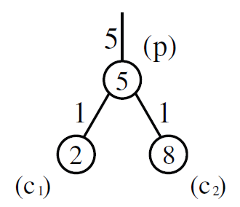
Inconsistent heuristics
h decreases from parent to child
f(p)=5+5=10
f(c1) = 6+2 = 8
lower bound on the total cost of reaching the goal through c1
information provided by evaluating c1 is “inconsistent”
Notes:
Since the heuristic is admissible, any path from the start node to the goal node
that passes through p has a cost of at least 10.

Slide 6
Inconsistent heuristics
h increases from parent to child
Inconsistent only if undirected
heuristic increased from 5 to 8
f is still monotonic increasing from p to c2
edge from c2 to p
Then, f decreases
Notes:
Since the graph is undirected there is also an edge from c2 to p. Hence, logically p is also one of the children of c2. In
this second occurrence of p, the f-value will decrease from 14 to 12 and is non-monotonic

Slide 7
Inconsistent heuristics in A*
If a consistent heuristic is used then, the first time a node n is expanded by A*, it always has the optimal g-value
When a node is expanded and moved to CLOSED it will never be chosen for expansion again
With inconsistent heuristics, A* may re-expand nodes
Risk of more node expansions
Notes:
Whenever a node is generated by A*, it is first matched against OPEN and CLOSED and if a duplicate is found, the copy with the larger g-value is ignored
when they are reached via a lower cost path

Slide 8
Inconsistent heuristics in IDA*
IDA* does not perform duplicate detection
Problem of re-expanding nodes already exists

Slide 9
Worst case behavior of A*with inconsistent heuristics
heuristic - admissible and consistent,
A* is optimal in terms of node expansions.
heuristic – admissible and not consistent
A* does O(2^N) node expansions
N is number of distinct expanded states.
Proved by Martelli
Notes:
We will look at the worst-case time complexity of A* when inconsistent heuristics are used

Slide 10
The Gi family of state spaces
Gi – family of state spaces, i>=3 and contains i+1 states.
Requires A* to do O(2^i) node expansions for the
solution.
Notes:
Numbers inside the nodes – heuristic value
Numbers beside the edges – cost of the edge

Slide 11
Inconsistencies in the graph
Optimal path from the start (n5) to the goal (n0) has the states in decreasing order of their index.
n4 has a large enough heuristic value (f(n4) = 14).
n5 (23), n1(11), n2(12), n1(10), n3(13), n1(9), n2(10), n1(8), n4(14), n1 (7), n2(8), n1(6), n3(9), n1(5), n2(6), n1(4).
Edge weights and heuristic values grow exponentially with the number of states
Notes:
existence of n4 in G5 essentially doubles the search effort required for G4.
This property holds for each ni so the total amount of work is O(2i).

Slide 12
Variants of A*
New algorithm B – improves A*’s worst case complexity while being admissible.
Global variable F – track of max(f-value) of nodes expanded.
Choice for next node:
If fm, min f-value in OPEN >= F, then it is chosen.
Else among all f< F, node with least g-value chosen.
Value of F changes only once (when node is expanded), worst case complexity O(N^2) node expansions. This is poor.
Bagchi and Mahanti’s alg C has the same worst case complexity after changing to fm <=F and altering the condition.
Notes:
Since value of F changes only once and a node can be expanded only once for a given F value.
C is a variant of B.

Slide 13
New analysis
Martelli’s proof of increase in the number of node expansions has never been proved.
New Result: Exponential growth in solution costs and heuristic values are necessary conditions for A*’s worst-case behavior to occur.
Edge weights – non-negative.
Δ – gcd of edge weights.
Cost of a path from start to node n or diff in costs between two nodes is a multiple of Δ.
Reopening of n causes g(n) to reduce by a factor of Δ.
Notes:
His family of worst case state spaces have solution costs and heuristic values that grow exponentially with the number of states.

Slide 14
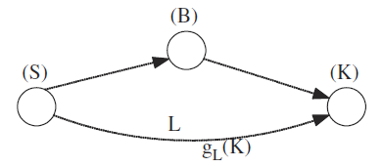
Theorem
Theorem 1: If A* performs M >N node expansions then there must be a node with heuristic value of at least LB = Δ∗ T(M − N)/NT.
Notes:
Explain the figure

Slide 15
Contradictions
Nodes distinct from S and K must exist along upper half because if there were a direct edge from S to K, then K would be opened as soon as S was expanded with a g-value < gL(K). Hence K would not be expanded via L, leading to a contradiction.
Node B must be one of these intermediate nodes — it cannot be S and it cannot be K because if flast(K) was the largest flast value, the entire upper path would be expanded before K would be expanded via L, again a contradiction.

Slide 17
Pathmax
f-values can be forced to be monotonic by propagating the f-value of a parent to a child if it is larger
Heuristic values can be dynamically updated by adding two rules that propagate heuristic values during the search between a parent node p and its child node c_{i} :
Pathmax Rule 1: h(c_{i}) ← max(h(c_{i}), h(p) − c(p, c_{i}))
Pathmax Rule 2: h(p) ← max(h(p), min_{ci∈Successors[p]}(h(c_{i}) + c(p, c_{i})))

Slide 18
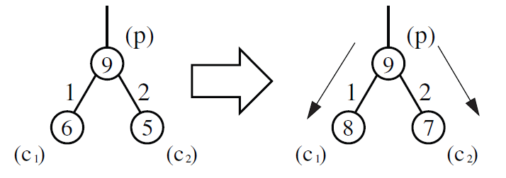
Pathmax Rule 1
f(c₁) := max(6, 9-1)
f(c₂) := max(5, 9-2)
Causes the f-value to be monotonic non-decreasing
Heuristic can still be inconsistent if the graph is undirected

Slide 19
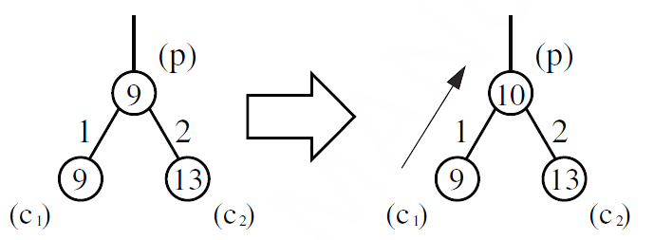
Pathmax Rule 2
Rule 2 corrects h(p) so that h*(p) is at least as large as min_{ci∈Successors[p]}(h(c_{i}) + c(p, c_{i}))
c₁ has the minimal f-value and its value is propagated to the parent
There is an edge from state p to its parent a and shortest path from p to goal might pass through a, Rule 2 is relevant only if a is listed as a child of p
Possible only if the parent pruning optimization is not used

Slide 20
Monotonicity after applying Pathmax
After applying pathmax the f-values never decrease along the path that was just traversed
However, the f-values can still be non-monotonic for paths that were not traversed yet
Closed nodes are never re-opened by A*
Key advantage of a consistent heuristic over an inconsistent heuristic
Pathmax does not correct this deficiency of inconsistent heuristics
Notes:
With a consistent heuristic where the cost function is monotonic, closed nodes are never re-opened by A*,

Slide 21
Bidirectional Pathmax – BPMX
Mero’s Rule 1 for value propagation is beneficial in application domains where the search graph is undirected.
Assume an admissible heuristic h where h(x) > h(y) + c(x, y).
Now, h*(x) ≤ c(x, y) + h*(y).
From above, h∗(y) ≥ h∗(x)−c(x, y) ≥ h(x) −c(x, y)
Generalized as,
h(y) ← max (h(y), h(x) − c(x, y))
This rule is applied to a parent and child in a search tree.
Notes:
Propagation of f-values from parent to child to make them monotonic non-decreasing is called pathmax.
because a possible path from x to the goal passes through y.

Slide 22
Pathmax Rule 3: h(p) ← max(h(p), h(c) − c(c, p)) – New pathmax rule if there is an edge from child(c) to its parent(p).
Notes:
updating a node’s value can have a cascading effect, as the propagation that started from child c1 continues from the parent to the other children

Slide 23
BPMX FOR IDA*
Observation: What is important for IDA* is not the exact f-value of a node but whether or not the f-value causes a cutoff.
Explanation: IDA* expands a node if its f-value is less than or equal to the current threshold T and backtracks if it is larger than T. Thus, only a cutoff reduces the work performed.

Slide 24
Using Rule 3 with IDA*
Notes:
using Rule 1 with IDA* does not have any benefit. This is because propagating the heuristic of the parent p (with Rule 1) to the child c will cause
f(c) = f(p). It will not increase its f-value above the threshold T (as the f-value of p was already less than or equal to T) and therefore will not result in additional pruning.

Slide 25
Notes:
Alternative exhaustive implementation:
The drawback of this implementation is that parent p is fully expanded.

Slide 26
Pathmax Rule 2 when IDA* is used
No benefit for using Rule 2 on top of IDA* in undirected state spaces as no pruning will be caused by it

Slide 27
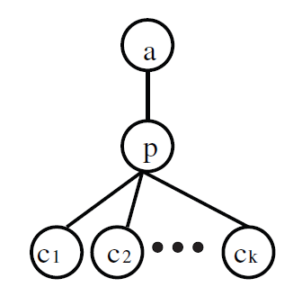
Pathmax Rule 2 when IDA* is used
p cannot benefit from Rule 2:
if minimum child (c_{m}) causes a cutoff, all the children are generated in order to find the one with minimum cost
Either way, all children are generated
Notes:
cm produced the minimal f-value among all
the children

Slide 28
Pathmax Rule 2 when IDA* is used
a cannot benefit from Rule 2:
Assume Rule 2 is activated, f_{new}(p)=f(c_{m})
f_{new}(p) ≥ f(p) as f is monotonic
a must be listed as a child of p
If (c_{m} = a) and Rule 3 is activated, h_{new}(a) = h(p)−c(a, p)=h(c_{m}) + c(p, a) − c(a, p) = h(a)
If (c_{m} != a) and Rule 3 is activated, h_{new}(a) = h(p)−c(a, p) < h(c_{m}) + c(p, a) − c(a, p) = h(a)
Notes:
applying Rule 3 can only decrease the h-value of a and it is again unchanged.

Slide 29
Pathmax Rule 2 when A* is used
Assume that p is expanded, its children are added to OPEN while p goes to CLOSED
If f-value increases after applying Rule 2, it will go to CLOSED with a higher f-value
This might affect duplicate pruning if node p is reached via a different path later

Slide 30
Creating Inconsistent heuristics
Introducing inconsistency results in a strictly less informed heuristic
Random selection of heuristics:
When a single heuristic is used the search may enter a region with low estimation values
One solution is to consult a number of heuristics and select the maximum
If a heuristic is selected randomly from a number of heuristics, only one heuristic will be consulted at each node
Random selection produces inconsistent values
Notes:
There is a perception that inconsistent admissible heuristics are hard to create
This has an over head of computing h-value

Slide 31
Creating Inconsistent heuristics
Compressed pattern databases
Trade-off between heuristic table-size and search performance
Large PDBs can be compressed by replacing multiple entries by a single entry
If the values in PDBs are locally correlated, then most of the heuristic accuracy will be preserved
The compression process may introduce inconsistency into the heuristic

Slide 32
Conclusion
Effective inconsistent heuristics are:
easy to create,
can be integrated into IDA* and A*,
substantially reduces the search effort.
IDA* re-expands nodes whether the heuristic is consistent or not.
Generalized the known pathmax propagation rules to bidirectional pathmax (BPMX).
Large reduction in the number of generated nodes when a single inconsistent heuristic is used.
Increase in the diversity of values and improved performance.

Slide 33
References
Inconsistent Heuristics and IDA*. Uzi Zahavi, Ariel Felner, Jonathan Schaeffer, and Nathan Sturtevant. "Inconsistent Heuristics." In Association for the Advancement of Artificial Intelligence (AAAI) National Conference, pages 1211-1216, 2007.
Ariel Felner, Uzi Zahavi, Robert Holte, Jonathan Schaeffer, and Nathan Sturtevant. "Inconsistent Heuristics in Theory and Practice," Artificial Intelligence, 2011. To appear.

