Slide 1
Criticizing solutions to Relaxed Models Yields Powerful Admissible Heuristics
Sean Doherty
Mingxiang Zhu

Slide 2
First Off…
Branch-and-bound
  Necessity: No applicable/discovered exact polynomial time solution
Admissibility
  Heuristic function underestimates actual costs
Monotonicity
  Heuristic function does not decrease through successors

Slide 3
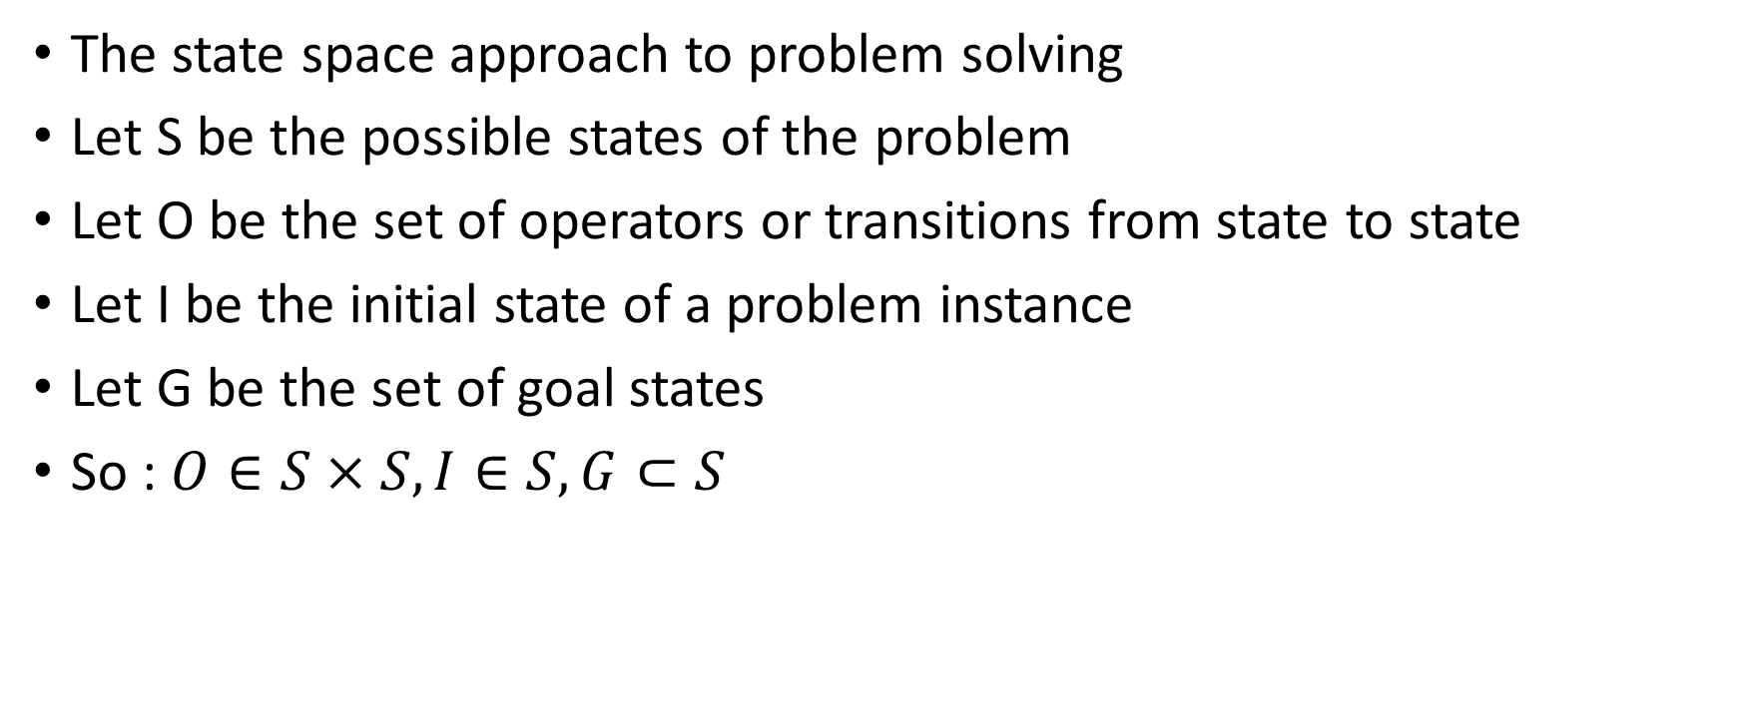
Overview of Heuristic Search
The state space approach to problem solving
Let S be the possible states of the problem
Let O be the set of operators or transitions from state to state
Let I be the initial state of a problem instance
Let G be the set of goal states
So : $O∈S×S, I∈S, G⊂S$

Slide 4
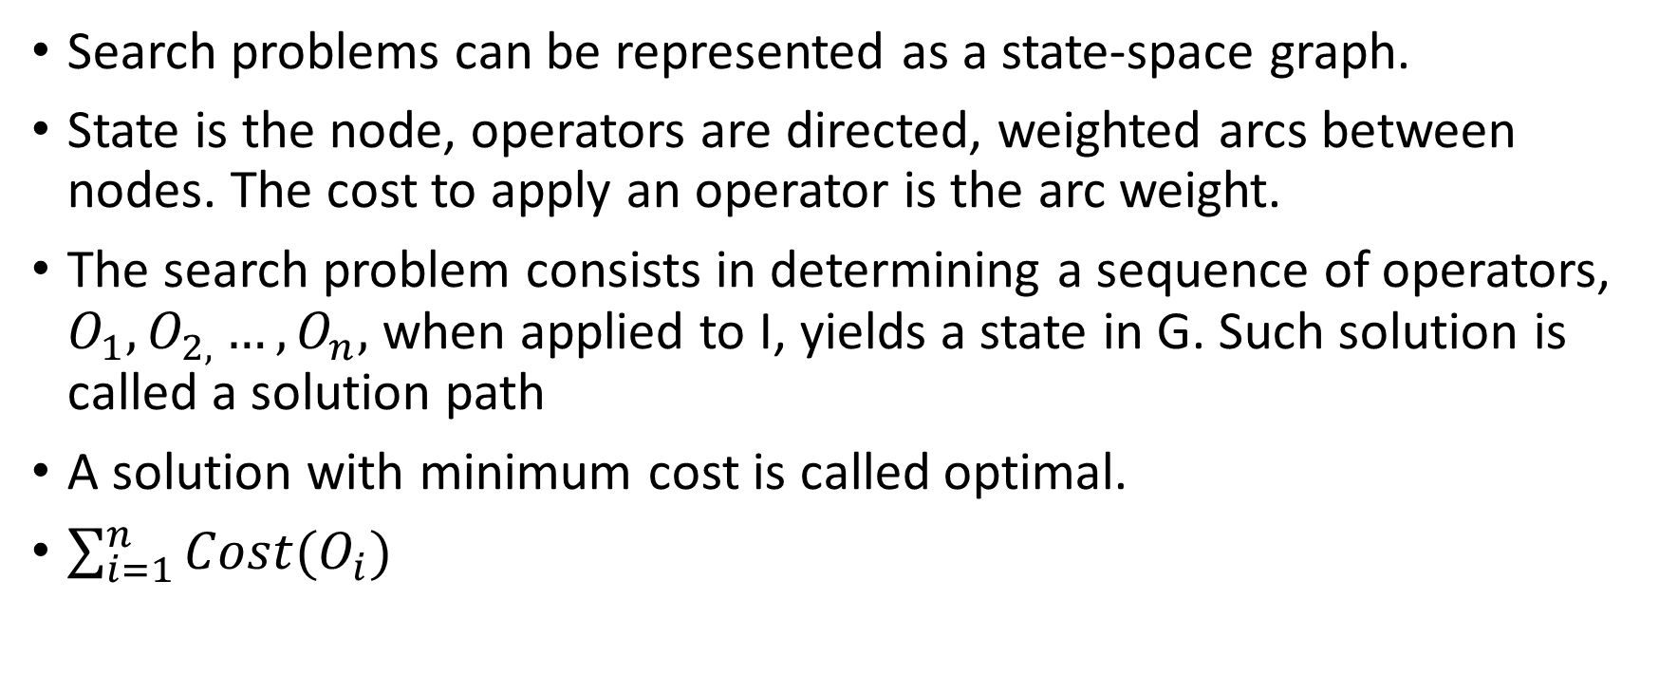
Overview of Heuristic Search(continued)
Search problems can be represented as a state-space graph.
State is the node, operators are directed, weighted arcs between nodes. The cost to apply an operator is the arc weight.
The search problem consists in determining a sequence of operators, $O_{1},O_{2,}…,O_{n},$when applied to I, yields a state in G. Such solution is called a solution path
A solution with minimum cost is called optimal.
$\sum_{i=1}^{n}{Cost(O_{i})}$

Slide 5
A* algorithm
A* algorithm orders the search by associating each state s with two values:
g(s): the length of the shortest path from the initial state to s.
h’(s): an estimate of the length of the shortest path from s to any goal state[the actual length is h(s)].
A* is an ordered best-first search algorithm, which always examines the successors of the most promising state based on the evaluation function f’(s) = g(s) + h’(s)

Slide 6
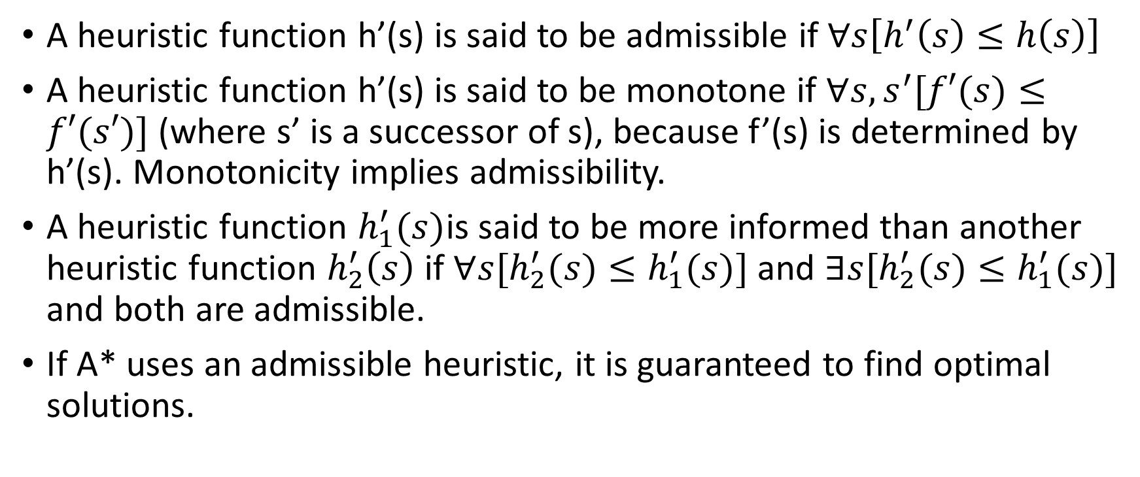
A* algorithm(continued)
A heuristic function h’(s) is said to be admissible if $∀s\left[h^{′}\left(s\right)≤h\left(s\right)\right]$
A heuristic function h’(s) is said to be monotone if $∀s, s^{′}[f′(s)≤f′(s′)]$ (where s’ is a successor of s), because f’(s) is determined by h’(s). Monotonicity implies admissibility.
A heuristic function $h_{1}^{′}(s)$is said to be more informed than another heuristic function $h_{2}^{′}\left(s\right)$if $∀s[h_{2}^{′}(s)≤h_{1}^{′}(s)]$ and $∃s[h_{2}^{′}(s)≤h_{1}^{′}(s)]$ and both are admissible.
If A* uses an admissible heuristic, it is guaranteed to find optimal solutions.

Slide 7
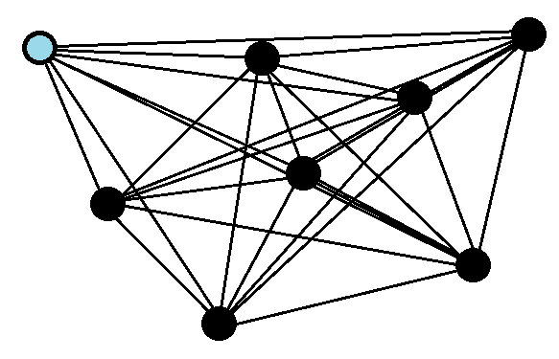
Traveling-Salesman Problem
Combinatorial optimization
NP-hard (Exhaustive search would be (n-1)!)
Perfect way to express the need of
branch-and-bound solutions
Hamiltonian circuit
n=8
(8-1)! = 5040
.
.
.
(100-1)! = 9.33 e155

Slide 8
TSP & Problem Relaxation
Relaxation by constraint deletion
  What is it?
Require a well defined set of states and operators
Different relaxations create different models
Lets see an example

Slide 9
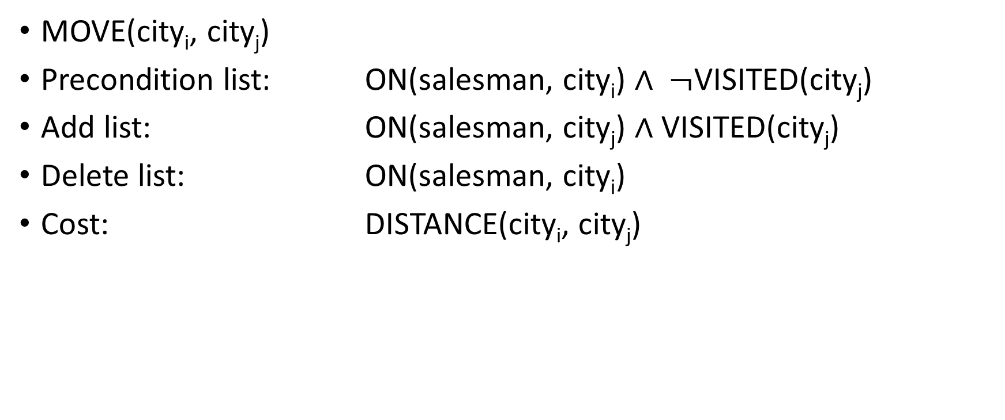
Operator on state space
MOVE(city_{i}, city_{j})
Precondition list: ON(salesman, city_{i}) $∧ ¬$VISITED(city_{j})
Add list: ON(salesman, city_{j}) $∧$ VISITED(city_{j})
Delete list: ON(salesman, city_{i})
Cost: DISTANCE(city_{i}, city_{j})

Slide 10
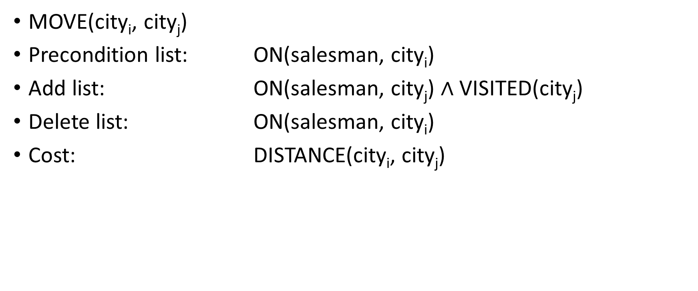
Bad Relaxation
MOVE(city_{i}, city_{j})
Precondition list: ON(salesman, city_{i})
Add list: ON(salesman, city_{j}) $∧$ VISITED(city_{j})
Delete list: ON(salesman, city_{i})
Cost: DISTANCE(city_{i}, city_{j})

Slide 11
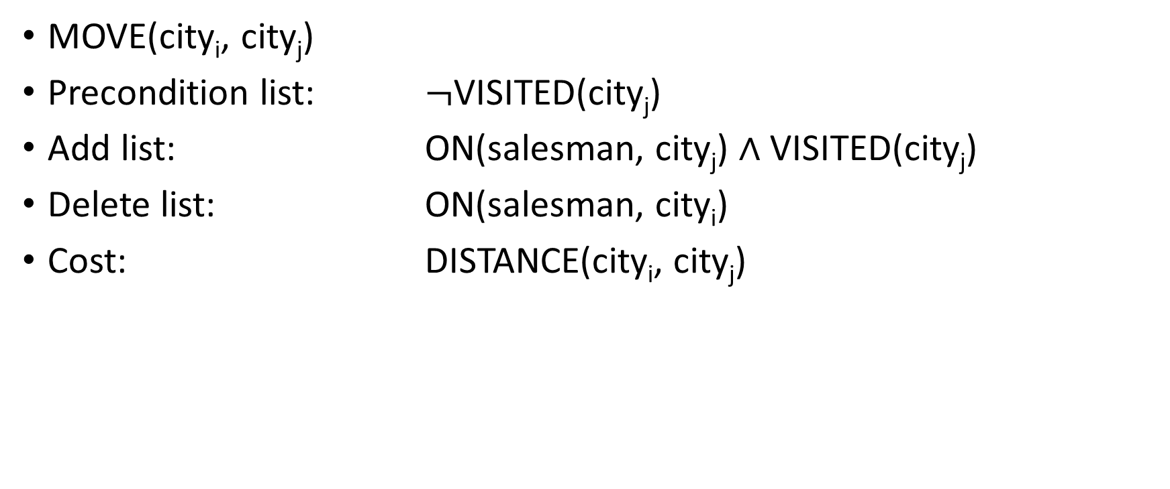
Better choice
MOVE(city_{i}, city_{j})
Precondition list: $¬$VISITED(city_{j})
Add list: ON(salesman, city_{j}) $∧$ VISITED(city_{j})
Delete list: ON(salesman, city_{i})
Cost: DISTANCE(city_{i}, city_{j})

Slide 12
Analyzing the Nearest-Neighbor Heuristic
Heuristic that can be used that…
  Is easily computable
  Admissible
  Conceptually simple
But what are the issues?

Slide 13
Criticizing the Nearest-Neighbor Heuristic
Disconnection
Multiple cycles
Starting city/node omitted
Result: Held and Karp’s minimum-weight 1-tree

Slide 14
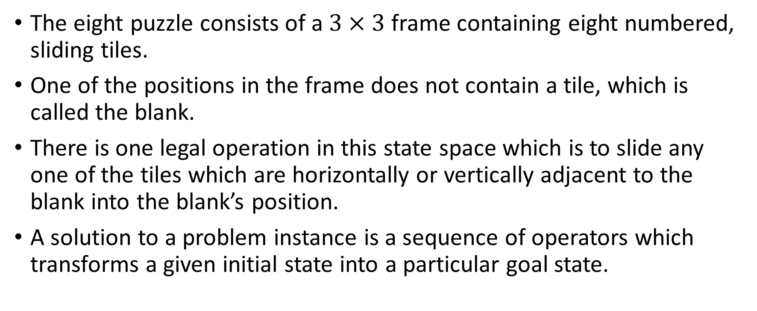
Eight puzzle
The eight puzzle consists of a $3×3$ frame containing eight numbered, sliding tiles.
One of the positions in the frame does not contain a tile, which is called the blank.
There is one legal operation in this state space which is to slide any one of the tiles which are horizontally or vertically adjacent to the blank into the blank’s position.
A solution to a problem instance is a sequence of operators which transforms a given initial state into a particular goal state.

Slide 15
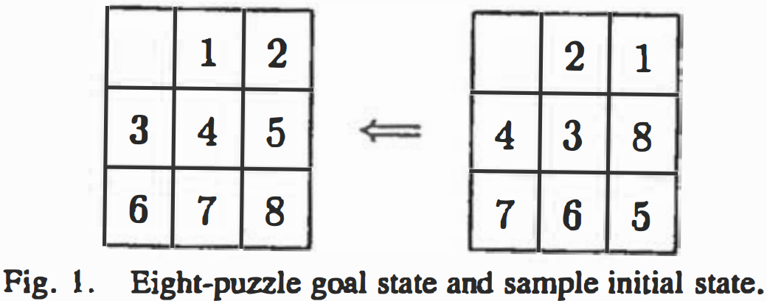
Eight puzzle (continued)

Slide 16
Formalization of the problem
We use three predicates to describe the problem state of the eight puzzle:
ON(x, y): tile x is on the cell y
CLEAR(y): cell y is clear of tiles
ADJ(y, z): cell y is horizontally or vertically adjacent to cell z

Slide 17
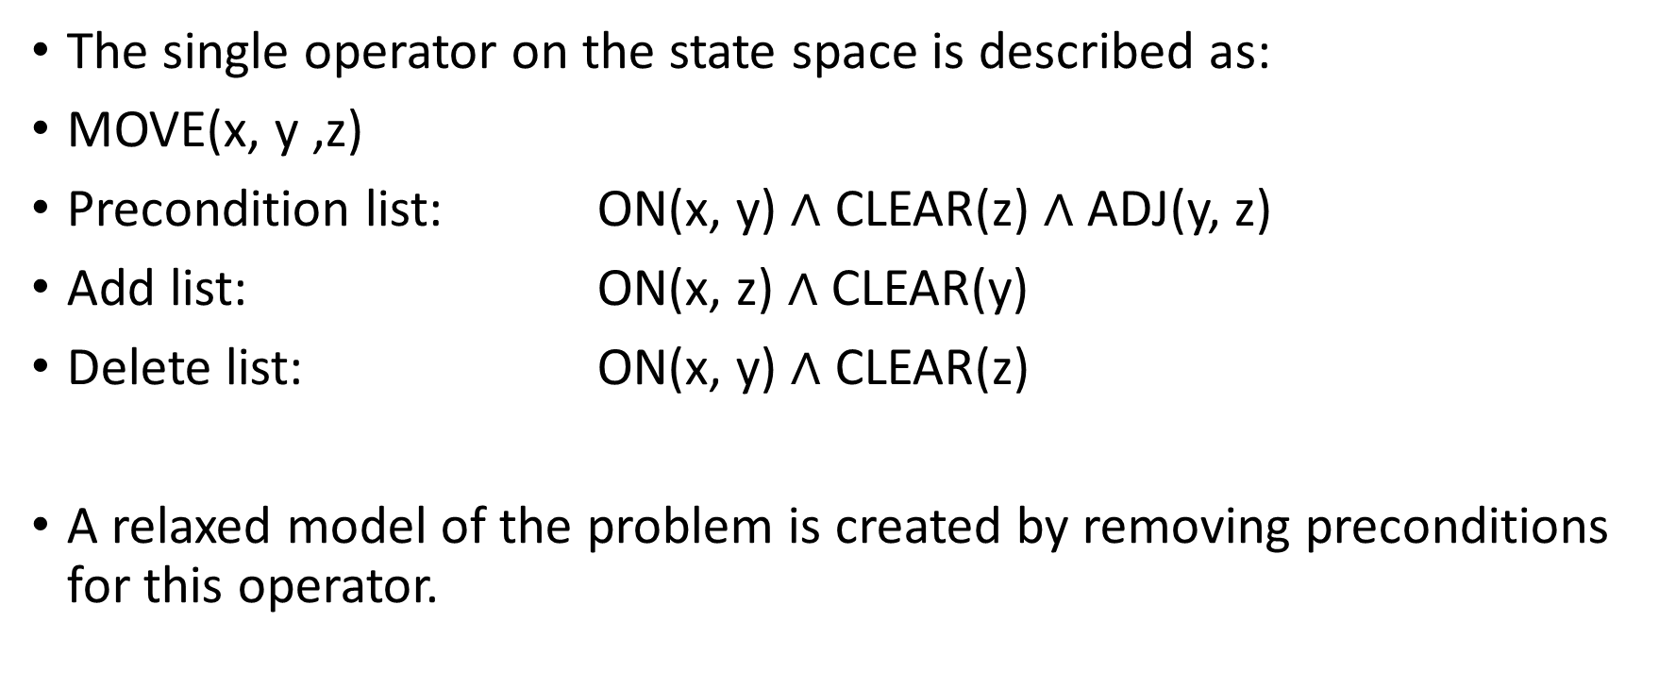
Operator on state space
The single operator on the state space is described as:
MOVE(x, y ,z)
Precondition list: ON(x, y) $∧$ CLEAR(z) $∧$ ADJ(y, z)
Add list: ON(x, z) $∧$ CLEAR(y)
Delete list: ON(x, y) $∧$ CLEAR(z)
A relaxed model of the problem is created by removing preconditions for this operator.

Slide 18
Heuristics developed via constraint deletion
Misplaced tiles
Relaxed adjacency
Manhattan distance

Slide 19
Misplaced tiles
The most severe relaxation is to delete both ADJ(y, z) and CLEAR(z).
In this model, any tile in any position may be moved into any other position, with stacking allowed.
The obvious solution is to move each tile from its current position into its goal position.
Thus, the length of the optimal solution is merely the number of tiles which are not currently in their goal positions—the misplaced tiles.

Slide 20
Relaxed Adjacency
If we delete only the ADJ(y, z) from the list of preconditions.
In which, any tile, anywhere may swap positions with the blank.
In this relaxed-adjacency model, optimal solution is as following:
While any tile is out of its goal position do:
if the blank is in its own goal position:
then swap with any misplaced tile
else
swap with the tile that belongs in the blank’s position

Slide 21
Manhattan distance
If CLEAR(z) is deleted, the optimal solution length is given by the familiar Manhattan-distance heuristic.
In which, a tile may be moved into any horizontally or vertically adjacent position, with stacking allowed.
The optimal solution to this problem is found by moving each tile along a shortest path between its initial and goal positions.
For any one tile, the length of this shortest path is the grid distance(horizontal plus vertical distance) between its current and goal positions.

Slide 22
Refining relaxed models by solution criticism
We have seen how constraint deletion can generate a number of admissible heuristics for the eight puzzle.
The different relaxations discussed above are weighted heavily towards certain properties:
“the shortest path” and “the role of blank in moving the tiles”
Intuitively, Manhattan distance is the best of the heuristics discussed above.

Slide 23
Analyzing Manhattan distance solution
Manhattan distance proposes that the puzzle can be solved by moving each tile along a shortest path to its goal position.
More specifically, the optimal solution in the model is a set of subgoal solutions, one for each tile.
In many cases, the tile is already in its correct row or column and need only move within that row or column
In other cases, the path is not unique.

Slide 24
continued
Lemma 1:
If there exists one path from position X to position Y in the eight puzzle that is of even (odd) length, then all paths from X to Y are of even (odd) length
Corollary to lemma 1:
If there is a unique shortest path p between position X and position Y in the eight puzzle, then any alternate path will be at least 2 moves longer than p.

Slide 25
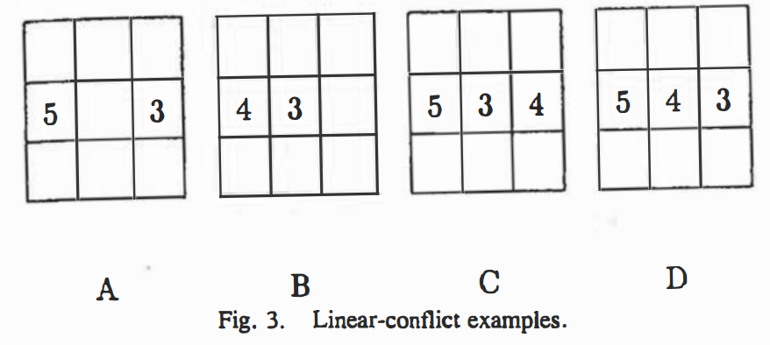
Example of conflicting shortest paths

Slide 26
Example of conflicting shortest paths(continued)
A: either 5 or the 3 must move outside the middle row, two more steps will be added
B: either 4 or 3 will have to follow a non-shortest path. Adding at least 2 moves to the Manhattan distance estimate.
C: the tile 5 is in conflict with the 3 and the 4, either the 5 has to move out of the way adding 2 steps, or both the 3 and the 4 have to move adding 4 steps
D: each tile in the middle row is in conflict with the other two, so two tiles have to be move out the middle row adding 4 steps.

Slide 27
Linear Conflict Heuristic
Intuitively, one can estimate the puzzle state, row by row, column by column, and adds to the Manhattan distance the minimum number of additional moves necessary to resolve the conflicts within each row and column.
Linear conflict estimate is still a lower bound on the actual optimal solution length.

Slide 28
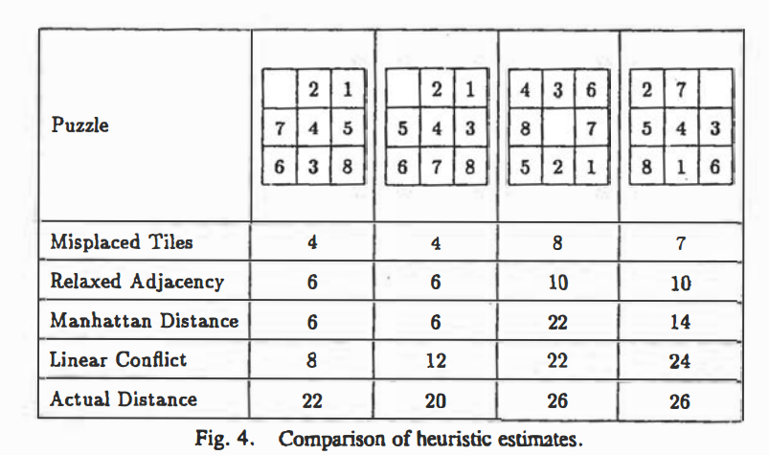
Comparison of heuristics

Slide 29
Questions?

Slide 30
References
Othar Hansson, Andrew Mayer, Moti Yung. "Criticizing Solutions to Relaxed Models Yields Powerful Admissible Heuristics." Information Sciences, 63 (September 15, 1992), 207- 227

