Slide 1
Normality and Faults in Logic-Based Diagnosis
Presented by
Kelly Benson
Mouiad Al-Wahah

Slide 2
Definitions we agreed upon..
Def 1. Diagnosis is the problem of trying to find what is wrong with some system based on knowledge about the design/structure of the system, possible malfunctions that can occur in the system and observations made of the behavior of the system.
Def 2. An abductive diagnosis is finding a set of causes which can imply the observations.
Def 3. Observation is the set of observations made of the actual artifacts we are diagnosing.

Slide 3
Definitions we agreed upon..
Def 4. Normality assumptions are hypotheses that some component is working properly.
Def 5. Abnormality assumptions, the negation of def. 4 above.
Def 6. Fault assumptions are assumptions of some fault or disease.

Slide 4
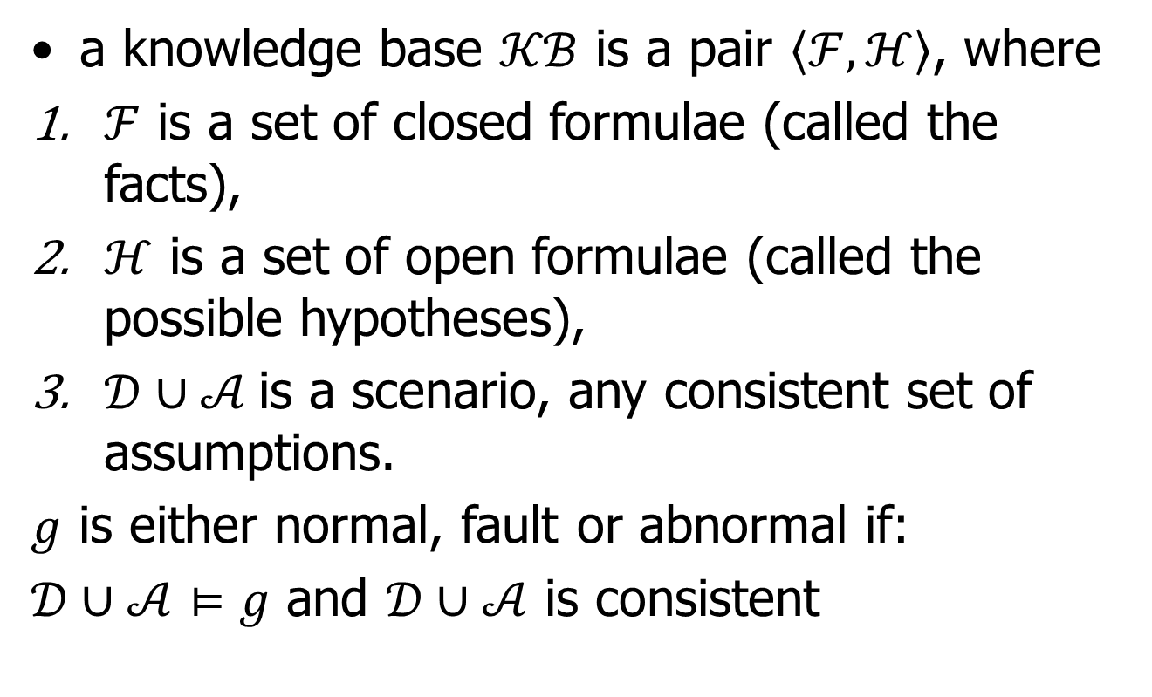
Knowledge base for Diagnosis

Slide 5


Slide 6
Normality in Abduction Diagnosis
A component is normal if it is being produced in a particular case.
Battery example:
  Hypothesis: battOK(B, V), battAB(B, V)
Ex: diagnoses entails observations

Slide 7
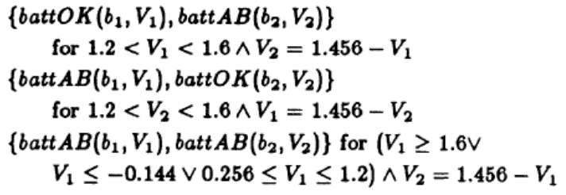
Normality in Abduction Diagnosis
Battery example:
Observation: volt(series(b1,b2), 1.456)

Slide 8
Faults in Abduction Diagnosis
Replace abnormalities with fault assumptions
  Flat battery:
    0.3 > V > 1.2
  Shorted battery:
    V = 0
  Observation : volt(series(b₁,b₂), 1.517)

Slide 9
Faults in Abduction Diagnosis, cont..
Diagnoses:
Overcharged battery
(1.6 < V < 2.0)
Both batteries are OK, or one is overcharged and one is flat.

Slide 10
Faults evolution in Abduction Diagnosis
  No fault information
    Deals with abnormality (vagueness) as a fault.

Slide 11
Issues
Representing observations
Example:
Argument 1: the input 4 and the output 16 are what we observed.
Argument 2: we just observed the output 16.

Slide 12
Issues
Noise
We allow the hypothesis of error,
Include the fact as observation
Will get the fact:

Slide 13
Issues
Hierarchical Reasoning
If batteries were complex power stations, then abductive diagnosis can handle this by modeling the levels of abstraction.

Slide 14
Issues
Efficiency
Use backward chaining starting from observations.
Prove negation of faults.
Undecidable.

Slide 15
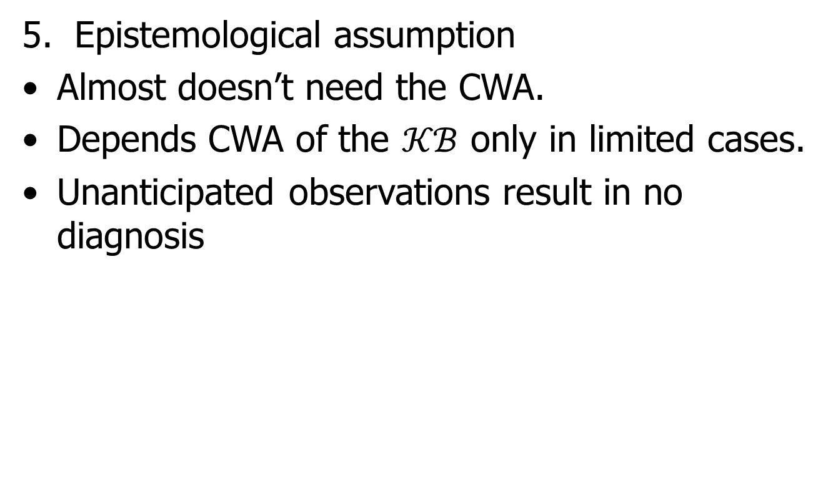
Issues

Slide 16
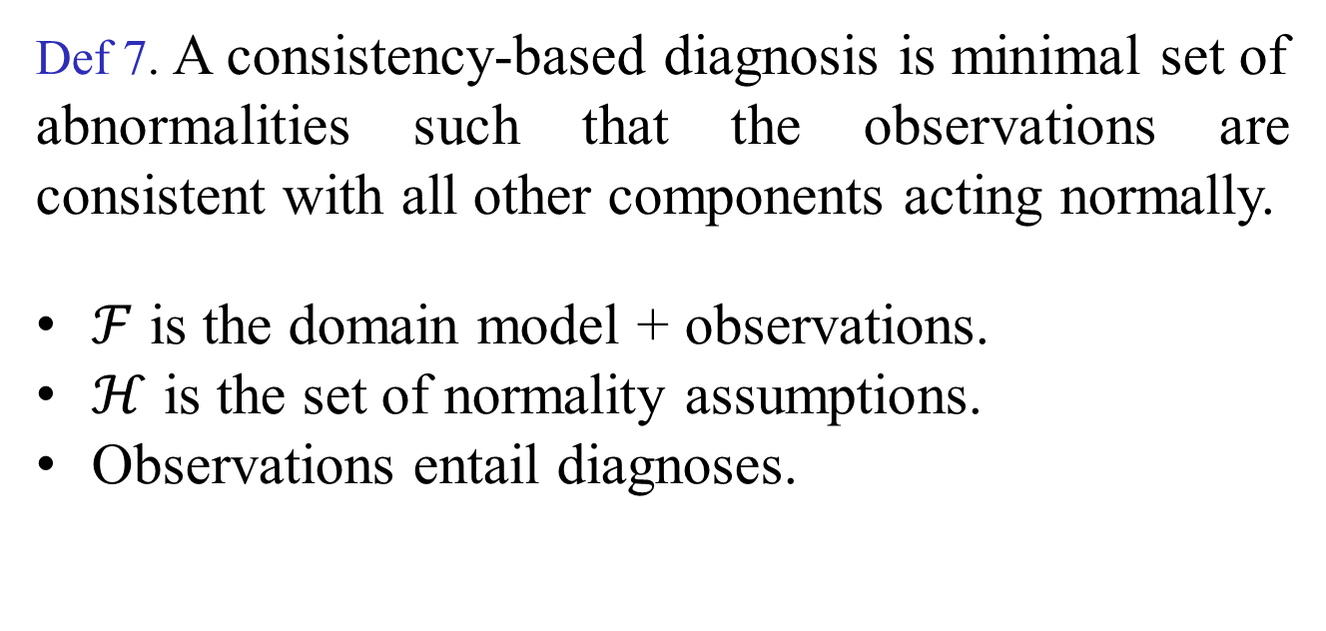
Consistency-Based (CB) Diagnosis

Slide 17


Slide 18
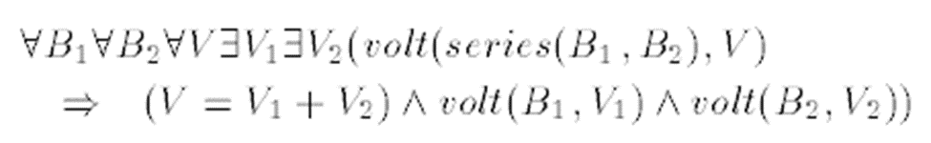
Normality in Consistency-Based Diagnosis
A component is normal if it works correctly all the time.
Battery example:
-
-
-
  - Observations: volt(series(b₁,b₂), 1.456)
  - Hypotheses:

Slide 19
Normality in Consistency-Based Diagnosis
    ~ab(b₁) and ~ab(b₂)
  -We have two diagnoses:
    {ab(b₁)}, {ab(b₂)}

Slide 20
Faults in CB Diagnosis
Assume normality and let faults be concluded as a side effect
Assume the absence of faults and let normality be concluded as a side effect.
Assume both normality and the absence of faults.

Slide 21
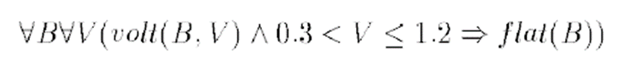
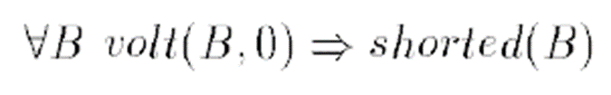

Faults in CB Diagnosis..cont
  Flat battery:
    0.3 > V > 1.2
  Shorted battery:
    V = 0
Assuming b₁ is ok and observing volt(series(b₁,b₂))

Slide 22
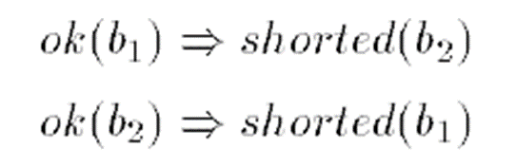
Faults in CB Diagnosis..cont
Assuming both batteries are ok rules out the possibility of both being flat:
Must treat abnormality as a fault!

Slide 23
Faults in CB Diagnosis..cont
Overcharged battery
(1.6 < V < 2.0)
Both batteries are OK, or one is overcharged and one is flat.
The interpretation here is different than AD.

Slide 24
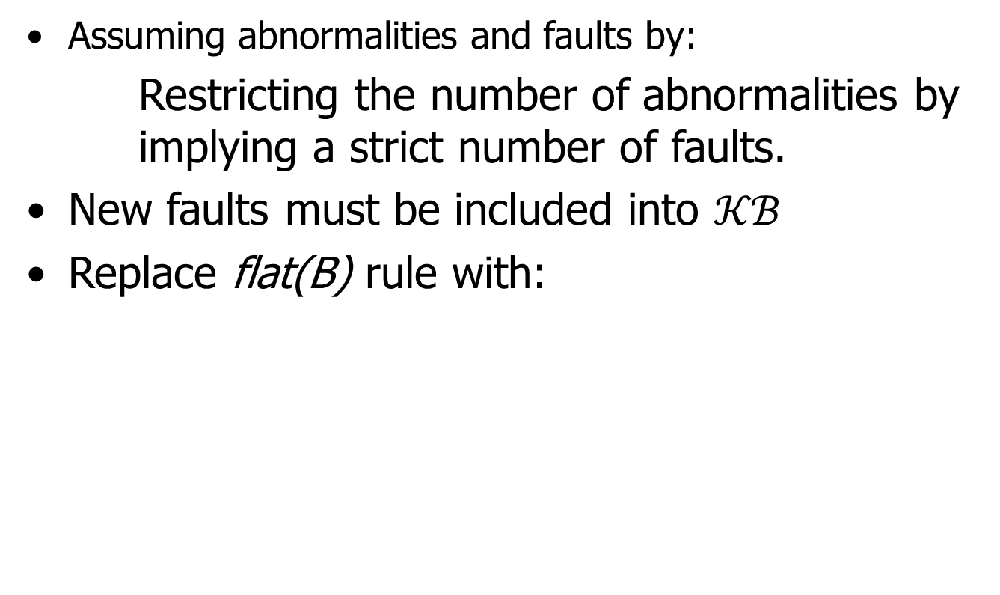
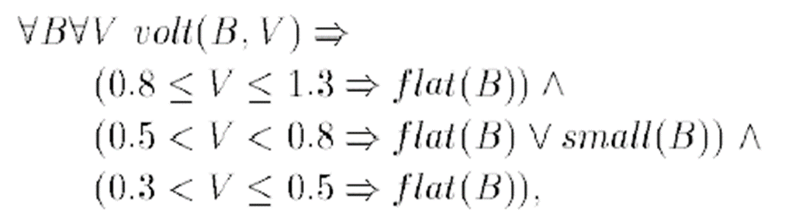
Faults evolution in CB diagnosis

Slide 25
Faults evolution in CB diagnosis..cont
Replace the complete knowledge assumption with:

Slide 26
Issues
Representing observations
Example:
Argument 1: the input 4 and the output 16 are what we observed.
Argument 2: we just observed the output 16.
CB diagnosis requires the first form.

Slide 27

Issues
Noise
We allow the hypothesis of error,
Include the fact as facts
Will get the fact:

Slide 28
Issues
Hierarchical Reasoning
If batteries were complex power stations, then CB diagnosis can handle this by modeling the levels of abstraction.

Slide 29
Issues
Efficiency
Use forward chaining starting from observations.
Continue until contradictions occur.
Undecidable.

Slide 30
Issues
Epistemological assumption
CWA is strongly assumed.
Unanticipated observations are ignored.

Slide 31
Conclusions
No one true logical definition of diagnosis
Both AB and CB diagnosis approaches need different KR.
Both AB and CB diagnosis approaches can work in real-valued domains.

Slide 32
Bibliography
David Poole, Representing Knowledge for Logic-Based Diagnosis
David Poole, Normality and Faults in Logic-Based Diagnosis
Andrew Smith, Jhih-Rong Lin, Jeremy Lewis, Slides titled Consistency-Based vs. Explanation-Based (Abduction) Diagnosis

