Slide 1
Artificial Intelligence in Video Games
By: Renaldo Doe
Kevin Lam

Slide 2
What is AI in Video Games?
Definition: techniques used in computers and video games to produce the illusion of intelligence in the behavior of non-player characters (NPCs).

Slide 3
First Examples
Checkers – Christopher Strachey
Chess – Dietrick Prinz

Slide 4
Types of AI Algorithms (Older Games)
Tracking AI
Path-finding
Pattern Finding

Slide 5
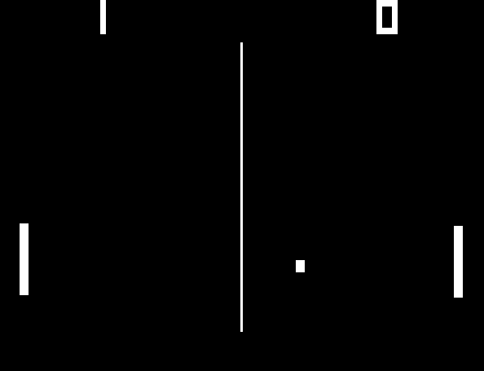
Pong
Paddle movement is determined by simple equations (where the ball will go)
Difficulty determines the speed of the computer’s paddle.
Uses tracking AI.

Slide 6
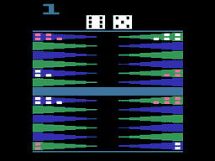
Board Games - Backgammon
Uses Path Finding to find the best next move.
The computer makes its move based on the current state of the board. The search algorithm used is A*.

Slide 7
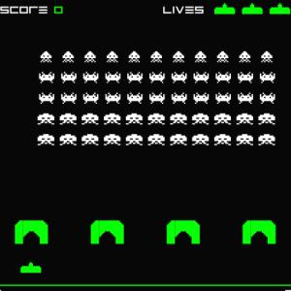
Space Invaders
Utilized “pattern AI” - follows a preset path or pattern
The directions or path followed is usually random.

Slide 8
Simulation - Chess
Many different moves at any given turn.
Utilizes a search tree of possible moves.
Many different moves available at any time.
Large search trees

Slide 9
Limit the Search Tree
More manageable state
Depth limited
A*
Programmer provides heuristics to the computer to determine which path is best
Heuristic could be giving a value to the current state of the board
The computer keeps its pieces and removes some of your pieces = desirable move.

Slide 10
“God” Game
NPC creatures can “learn”
Player can award or punish after the completion of a task
Creature’s belief in how good of an idea that action was will be altered
Player repeatedly tells creature to attack a specific type of enemy

Slide 11
Lionhead’s Black and White
Creature dynamically builds a decision tree for “Anger”:
What creature attacked | Feedback from player
Friendly town, weak defense, Celtic tribe | -1.0
Enemy town, weak defense, tribe Celtic | +0.4
Friendly town, strong defense, tribe Norse | -1.0
Enemy town, strong defense, tribe Norse | -0.2
Friendly town, medium defense, tribe Greek | -1.0
Enemy town, medium defense, tribe Greek | +0.2
Enemy town, strong defense, tribe Greek | -0.4
Enemy town, medium defense, tribe Aztec | 0.0
Friendly town, weak defense, tribe Aztec | -1.0

Slide 12
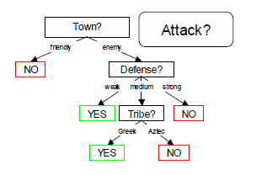
“Anger” decision tree

Slide 13
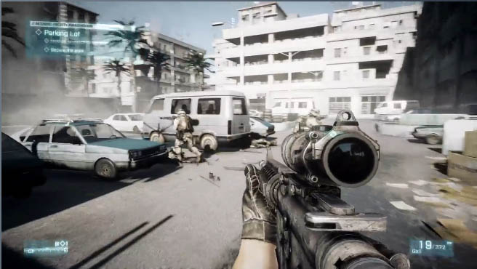
Path Planning for NPCs
Grid based approach
Complex game environments require navigation algorithms to consider complex level geometry for path finding

Slide 14
Example – Static Scene
3D level is converted into a 2D grid
Path-finding is accomplished between two cells of the grid
“flood-fill” or “bushfire” algorithms used in filling closed regions with irregular and non-polygonal boundaries
Cells have at most 8 neighbors

Slide 15
2D Grid
First, a seed cell is selected
Neighboring cells are enumerated IF they are not marked as obstacles
Enumerated cells expand like a wavefront in a breadth-first manner

Slide 16
3D Grid
Each cell in a 3D grid has at most 26 neighbors
Extension of basic 2D flood-fill algorithm inefficient
Human agent only walks on the surface

Slide 17
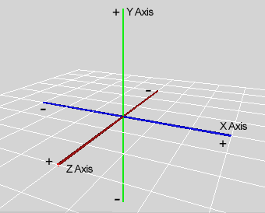
3D Grid cont.
If (x, y, z) is a surface cell, then (x, y+1, z) is empty.

Slide 18
3D Grid cont.
Effective cell neighbors are reduced from 26 to 8
Performance of path-finding in 3D levels runs close to 2D levels

Slide 19
First Person Shooters
Uses waypoints placed on maps to determine what the NPC’s will do.
Calculates: tactical advantage, cover from fire, and safety of a NPC.
Uses a look up tables to see if player is in “line of sight”
Weakness:
Needs to recalculate when players move.

Slide 20
Moving Target Search Algorithms
Computer generated bots
Must satisfy stringent requirements
Computation
Execution efficiency
Search algorithms can take up as much as 70% of CPU time
Graphics consume a significant portion of computational resources, leaving a limited amount for game AI.
Basic moving target search, weighted moving target search, commitment and deliberation moving target search

Slide 21
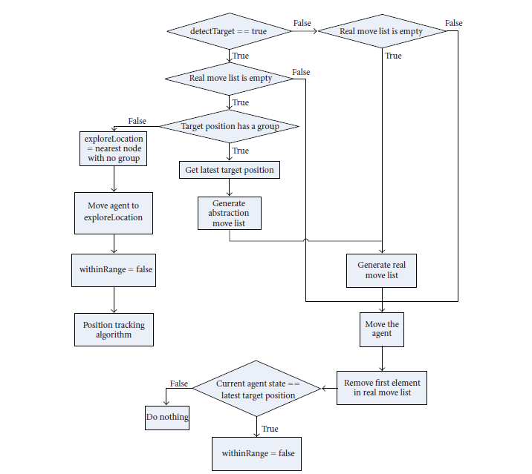
Abstract View

Slide 22
Basic Moving Target Search (BMTS)
Generalisation of the A* algorithm.
A matrix of heuristic values is maintained during the search process to improve an agent’s accuracy.
Suffers from heuristic depression
Agent repeatedly traverses the same subset of neighboring states without visiting the rest
Agent may continue to look for a shorter path even though a fairly good path to the target has been found
Additional computational overheads and reduce bot performance

Slide 23
Weighted Moving Target Search
Reduces explore time in MTS and accelerates convergence by producing a suboptimal solution
Heuristic values are brought as close as possible to, but not reaching, the actual values

Slide 24
Commitment and Deliberation MTS
Agent may ignore some of the target’s moves
The commitment to the current target state increases if the agent moves in a direction where the heuristic value is reducing
During deliberation, real-time search is performed when heuristic difference decreases

Slide 25
Computer Abilities vs. Human Abilities
Humans can:
Cheat (passcodes and hacks)
Outsmart Computer (Based on Computer Limitations)
Computers are faster than humans by:
Aiming (first person shooter)
Calculation
Reconnaissance

Slide 26
Future
Challenges
Enemies begin in “guard state”. They won’t do anything until the player would walk into their area. (Repetitive)
Characters behave and move in a more lifelike manner.

Slide 27
Works Cited
Cavazza, Marc, Srikanth Bandi, and Ian Palmer. "“Situated AI” in Video Games: Integrating NLP, Path Planning and 3D Animation." Web. 23 Nov. 2011. <http://www.qrg.northwestern.edu/resources/aigames.org/1999/cavazza.pdf>.
Loh, Peter K., and Edmond C. Prakash. "Performance Simulations Of Moving Target Search Algorithms." International Journal of Computer Game Technology (2008): 12-17. Print.
Mott, Ken. "Evolution of Artificial Intelligence In Video Games: A Survey." Web. 25 Nov. 2011. <http://www.cs.uni.edu/~schafer/courses/previous/161/spring2009/proceedings/papers/paperG.pdf>.
Wexler, James. "Artificial Intelligence in Games: A Look at the Smarts behind Lionhead Studio’s “Black and White” and Where It Can and Will Go in the Future." Web. 25 Nov. 2011. <http://www.cs.rochester.edu/~brown/242/assts/termprojs/games.pdf>.

Slide 28

Questions?

