Slide 1
CSCE 531
Compiler Construction
Introduction
Spring 2024
Marco Valtorta
mgv@cse.sc.edu

Slide 2
Catalog Description and Textbook
531—Compiler Construction. (3) (Prereq: CSCE 240) Techniques for design and implementation of compilers, including lexical analysis, parsing, syntax-directed translation, and symbol table management.
Aarne Ranta [R]. Implementing Programming Languages: An Introduction to Compilers and Interpreters. College Publications, 2012. ISBN: 978-1-84890-064-6. (required text).
Torben Aegidius Mogensen [M]. Introduction to Compiler Design, second edition. Springer, 2017. ISBN: 978-3-319-66965-6. (required text).
Notes:
Watt, David A. and Deryck F. Brown. Programming Language Processors in Java. Prentice-Hall, 2000 (required text)
Supplementary materials from the authors, including an errata list, are available

Slide 3
Course Objectives
Formally define the grammar and semantics of a language
Design and implement finite state machines appropriate for use asa lexical scanner
Given the definition of an appropriate context-free grammar, design either a bottom-up or a top-doen parser for the grammar
Given the semantic definitions for an appropriate language, implement the semantic routines for a top-down or a bottom-up parser
Perform code generation.

Slide 4
Acknowledgment
The slides are based on the textbooks and other sources
Other compiler textbooks I considered are:
  Aho, Alfred V., Monica S. Lam, Ravi Sethi, and Jeffrey D. Ullman. Compilers: Principles, Techniques, & Tools, 2nd ed. Addison-Welsey, 2007. (The “dragon book”)
  Appel, Andrew W. Modern Compiler Implementation in Java, 2nd ed. Cambridge, 2002. (Editions in ML and C also available; the “tiger books”)
  Grune, Dick, Henri E. Bal, Ceriel J.H. Jacobs, and Koen G. Langendoen. Modern Compiler Design. Wiley, 2000. (New edition available)
  Watt, David A. and Deryck F. Brown. Programming Language Processors in Java. Prentice-Hall, 2000. (Used in my previous offerings of this course.)

Slide 5
Why Study Compiler Construction?
Better understanding of the significance of implementation
Improved background for choosing appropriate languages
Improved appreciation for the trade-offs in programming language design
Improved background for efficient programming
Increased ability to learn new languages
Increased ability to design new languages
Improved appreciation for the power of theory
Example of good software engineering principles

Slide 6
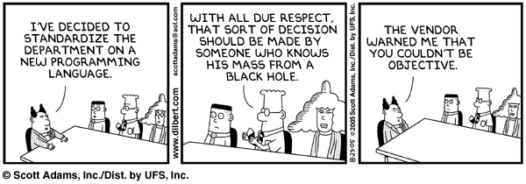
Improved background for choosing appropriate languages
Source: http://www.dilbert.com/comics/dilbert/archive/dilbert-20050823.html

Slide 7
Language Families
Imperative (or Procedural, or Assignment-Based)
Functional (or Applicative)
Logic (or Declarative)
In this course, we concentrate on the first family
[R] and [Grune et al] has good coverage of compilation of functional and logic languages

Slide 8
Imperative Languages
Mostly influenced by the von Neumann computer architecture
Variables model memory cells, can be assigned to, and act differently from mathematical variables
Destructive assignment, which mimics the movement of data from memory to CPU and back
Iteration as a means of repetition is faster than the more natural recursion, because instructions to be repeated are stored in adjacent memory cells

Slide 9
GCD (Euclid’s Algorithm) in C
To compute the gcd of a and b, check to see if a and b are equal. If so, print one of them and stop. Otherwise, replace the larger one by their difference and repeat.
#include <stdio.h>
int gcd(int a, int b) {
while (a != b) {
if (a > b) a = a - b;
else b = b - a;
}
return a;
}
Notes:
[S] Also:
int main()
{
int i, j;
scanf("%d %d", &i, &j);
printf("%d\n", gcd(i, j));
}

Slide 10
Functional Languages
Model of computation is the lambda calculus (of function application)
No variables or write-once variables
No destructive assignment
Program computes by applying a functional form to an argument
Program are built by composing simple functions into progressively more complicated ones
Recursion is the preferred means of repetition

Slide 11
GCD (Euclid’s Algorithm) in Scheme
The gcd of a and b is defined to be (1) a when a and b are equal, (2) the gcd of b and a-b when a > b and (3) the gcd of a and b-a when b > a. To compute the gcd of a given pair of numbers, expand and simplify this definition until it terminates
(define gcd2 ; 'gcd' is built-in to R5RS
(lambda (a b)
(cond ((= a b) a)
((> a b) (gcd2 (- a b) b))
(else (gcd2 (- b a) a)))))

Slide 12
GCD (Euclid’s Algorithm) in OCaml
The gcd of a and b is defined to be (1) a when a and b are equal, (2) the gcd of b and a-b when a > b and (3) the gcd of a and b-a when b > a. To compute the gcd of a given pair of numbers, expand and simplify this definition until it terminates
let rec gcd a b =
if a = b then a
else if a > b then gcd b (a – b)
else gcd a (b – a)
Notes:
[S], Fourth Edition (2016)

Slide 13
GCD (Euclid’s Algorithm) in Haskell
The gcd of a and b is defined to be (1) a when a and b are equal, (2) the gcd of b and a-b when a > b and (3) the gcd of a and b-a when b > a. To compute the gcd of a given pair of numbers, expand and simplify this definition until it terminates
-- GCD (Euclid's Algorithm) in Haskell; requires non-negative
-- arguments.
gcd' :: Integral a => a -> a -> a
gcd' m n | m == n = m
| otherwise = if m > n then gcd' (m - n) n
else gcd' m (n - m)
Notes:
Show the algorithm in Haskell too (20151124_190.hs in csce330f09/hutton/chapterPrograms); also in the csce190f17 directory. May also show the binary string transmitter (transmit.hs) in C:\Users\mgv\courses_D_Fujitsu161013\csce330f09\hutton\huttonPrograms2016\Code

Slide 14
New Interest in Functional Programming
Microsoft recently announced that it would release a commercial version of its F# functional programming language, designed specifically for developers dealing with concurrency. Functional programming treats computation as the evaluation of mathematical functions while avoiding state and mutable data.
Microsoft's S. "Soma" Somasegar says that many ideas from functional languages are helping solve some of the biggest challenges in the industry, such as impedance mismatches between data and objects and the challenges of multi-core and parallel computing space.
Java creator and Sun Microsystems Fellow James Gosling says the main problem with functional programming is that only a small portion of the community is interested in or able to learn functional programming.
Mads Torgersen, the program manager for Microsoft's C# and a instrumental part of the F# project, says that functional languages are very much in their own world and tend not to interoperate well. F#, however, is designed to run on Microsoft's Common Language Runtime. "F# stems from the functional programming tradition and has strong roots in the ML family of languages, though also draws from C#, LINQ, and Haskell," Somasegar says. "F# runs on the CLR, embraces object-oriented programming, and has features to ensure a smooth integration with the .Net Framework."
Torgersen says that F# is a very pragmatic adoption of functional programming and will serve the needs of people doing numerical, scientific, technical, and financial programming that have been forgotten about in the "traveling circus" of object-oriented programming.
See: http://www.eweek.com/article2/0,1759,2212215,00.asp (November 2007)

Slide 15
Logic Languages
Model of computation is the Post production system
Write-once variables
Rule-based programming
Related to Horn logic, a subset of first-order logic
AND and OR non-determinism can be exploited in parallel execution
Almost unbelievably simple semantics
Prolog is a compromise language: not a pure logic language

Slide 16
GCD (Euclid’s Algorithm) in Prolog
The proposition gcd(a,b,g) is true if (a) a,b, and g are equal; (2) a is greater than b and there exists a number c such that c is a-b and gcd(c,g,b) is true; or (3) a is less than b and there exists a number c such that c is b-a and gcd(c,a,g) is true. To compute the gcd of a given pair of numbers, search for a number g (and various numbers c) for which these rules allow one to prove that gcd(a,b,g) is true
gcd(A,B,G) :- A = B, G = A.
gcd(A,B,G) :- A > B, C is A-B, gcd(C,B,G).
gcd(A,B,G) :- B > A, C is B-A, gcd(C,A,G).

Slide 17
PLs as Components of a Software Development Environment
Goal: software productivity
Need: support for all phases of SD
Computer-aided tools (“Software Tools”)
  Text and program editors, compilers, linkers, libraries, formatters, pre-processors
  E.g., Unix (shell, pipe, redirection)
Software development environments
  E.g., Interlisp, JBuilder
Intermediate approach:
  Emacs (customizable editor to lightweight SDE)

Slide 18
Programming Languages as Algorithm Description Languages
“Most people consider a programming language merely as code with the sole purpose of constructing software for computers to run. However, a language is a computational model, and programs are formal texts amenable to mathematical reasoning. The model must be defined so that its semantics are delineated without reference to an underlying mechanism, be it physical or abstract.” Niklaus Wirth, “Good Ideas, through the Looking Glass,” Computer, January 2006, pp.28-39
Analyses of complexity, correctness (including termination)

Slide 19
Axiomatic, Denotational, and Operational Semantics
Axiomatic semantics formalizes language commands by describing how their execution causes a state change. The state is formalized by a first-order logic sentence. The change is formalized by an inference rule
Denotational semantics associates each language command with a function from the state of the program before execution to the state after execution
Operational semantics associates each language command to a sequence of commands in a simple abstract processor

Slide 20
Loop Invariants
Loop invariants are used in axiomatic semantics
A loop invariant for the while loop
while B do SL od with precondition P and postcondition Q is a sentence I s.t.:
P => I
I & ~B => Q
{I & B} SL {I}, i.e., if the loop invariant holds before executing the body of the loop and the condition of the loop holds, then the loop invariant holds after executing the body of the loop

Slide 21
Programming Languages as Machine Command Languages
Practicing programmers are not only concerning with expressing and analyzing algorithms, but also with constructing software that is executed on actual machines and that performs useful tasks
This requires programming language processors, such as translators (assemblers and compilers) and interpreters, as well as other components of a software programming environment (editors, browsers, debuggers, etc.)

Slide 22
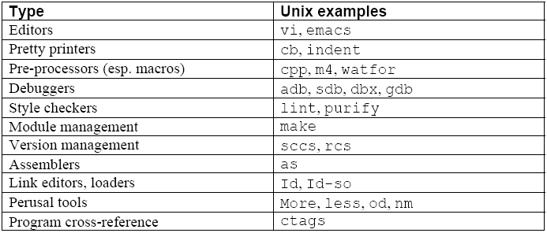
Programming Environment Tools
Copyright © 2009 Elsevier

Slide 23
Influences on PL Design
Software design methodology (“People”)
  Need to reduce the cost of software development
Computer architecture (“Machines”)
  Efficiency in execution
A continuing tension
The machines are winning
Programmer’s
needs
requirements
Programming
language
higher level of abstraction
constraints
von Neumann
architecture

Slide 24
Software Design Methodology and PLs
Example of convergence of software design methodology and PLs:
  Separation of concerns (a cognitive principle)
  Divide and conquer (an algorithm design technique)
  Information hiding (a software development method)
  Data abstraction facilities, embodied in PL constructs such as:
    SIMULA 67 class, Modula 2 module, Ada package, Smalltalk class, CLU cluster, C++ class, Java class

Slide 25
Abstraction
Abstraction is the process of identifying the important qualities or properties of a phenomenon being modeled
Programming languages are abstractions from the underlying physical processor: they implement “virtual machines”
Programming languages are also the tools with which the programmer can implement the abstract models
Symbolic naming per se is a powerful abstracting mechanism: the programmer is freed from concerns of a bookkeeping nature

Slide 26
Data Abstraction
In early languages, fixed sets of data abstractions, application-type specific (FORTRAN, COBOL, ALGOL 60), or generic (PL/1)
In ALGOL 68, Pascal, and SIMULA 67 Programmer can define new abstractions
Procedures (concrete operations) related to data types: the SIMULA 67 class
In Abstract Data Types (ADTs),
  representation is associated to concrete operations
  the representation of the new type is hidden from the units that use the new type
Protecting the representation from attempt to manipulating it directly allows for ease of modification.

Slide 27
Control Abstraction
Control refers to the order in which statements or groups of statements (program units) are executed
From sequencing and branching (jump, jumpt) to structured control statements (if…then…else, while)
Subprograms and unnamed blocks
  methods are subprograms with an implicit argument (this)
  unnamed blocks cannot be called
Exception handling

Slide 28
Computer Architecture and PLs
Von Neumann architecture
  a memory with data and instructions, a control unit, and a CPU
  fetch-decode-execute cycle
  the Von Neumann bottleneck
Von Neumann architecture influenced early programming languages
  sequential step-by-step execution
  the assignment statement
  variables as named memory locations
  iteration as the mode of repetition

Slide 29
The Von Neumann Architecture
I/O
Memory
CPU
fetch instr.
execute
store result
BUS
Notes:
[W]

Slide 30
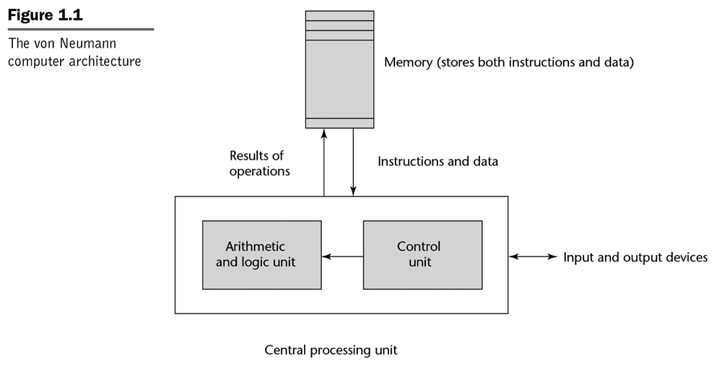
The Von Neumann Computer Architecture
Notes:
[Sebesta]; an alternative conceptual diagram.

Slide 31
Other Computer Architectures
Harvard
  separate data and program memories
Functional architectures
  Symbolics, Lambda machine, Mago’s reduction machine
Logic architectures
  Fifth generation computer project (1982-1992) and the PIM
Overall, alternate computer architectures have failed commercially
  von Neumann machines get faster too quickly!

Slide 32
Language Design Goals
Reliability
  writability
  readability
  simplicity
  safety
  robustness
Maintainability
  factoring
  locality
Efficiency
  execution efficiency
  referential transparency and optimization
    optimizability: “the preoccupation with optimization should be removed from the early stages of programming… a series of [correctness-preserving and] efficiency-improving transformations should be supported by the language” [Ghezzi and Jazayeri]
  software development process efficiency
    effectiveness in the production of software

Slide 33
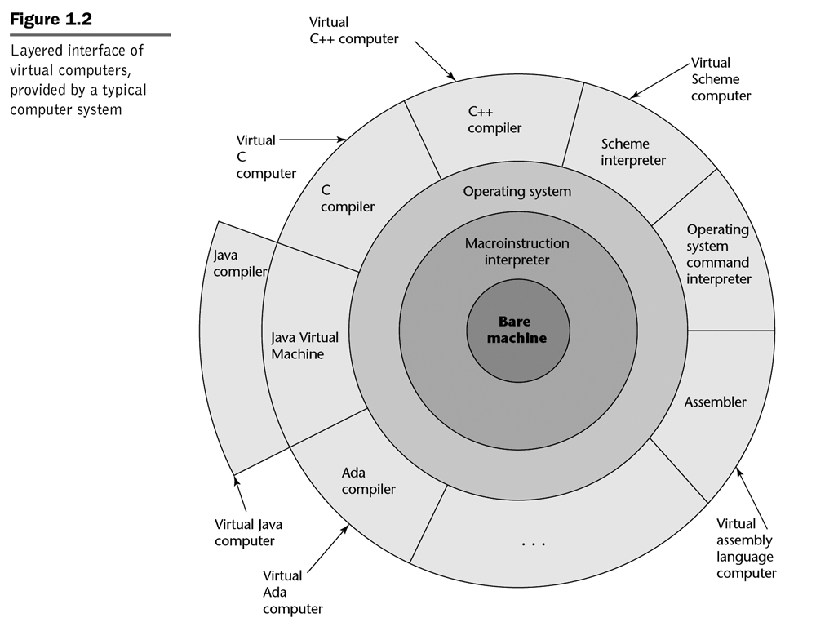
The Onion Model of Computers
Notes:
[Sebesta]

Slide 34
Language Translation
A source program in some source language is translated into an object program in some target language
An assembler translates from assembly language to machine language
A compiler translates from a high-level language into a low-level language
  the compiler is written in its implementation language
An interpreter is a program that accepts a source program and runs it immediately
An interpretive compiler translates a source program into an intermediate language, and the resulting object program is then executed by an interpreter

Slide 35
Translation and Interpretation of Natural Languages
For 2007, the cost of translation in the EU Commission (EC) is estimated to be around EUR 302 million. In 2006, the overall cost of translation in all EU institutions is estimated at EUR 800 million. The total cost of interpretation in the EU institutions was almost EUR 190 million in 2005
  With a permanent staff of around 1750 linguists and 600 support staff, EC Translation is one of the largest translation services in the world
  EC Interpretation provides interpreters for some 11000 meetings every year and is the largest interpreting service in the world
Twenty-three official languages: български (Bălgarski) - BG – Bulgarian, Čeština - CS – Czech, Dansk - DA – Danish, Deutsch - DE – German, Eesti - ET – Estonian, Elinika - EL – Greek, English – EN, Español - ES – Spanish, Français - FR – French, Gaeilge - GA – Irish, Italiano - IT – Italian, Latviesu valoda - LV – Latvian, Lietuviu kalba - LT – Lithuanian, Magyar - HU – Hungarian, Malti - MT – Maltese, Nederlands - NL – Dutch, Polski - PL – Polish, Português - PT – Portuguese, Română - RO – Romanian, Slovenčina - SK – Slovak, Slovenščina - SL – Slovene, Suomi - FI – Finnish, Svenska - SV - Swedish
Notes:
See http://ec.europa.eu/dgs/translation/whoweare/index_en.htm, accessed 2010-01-11 and 2020-01-16, for some related information on interpretation at the EC.
See http://scic.ec.europa.eu/europa/jcms/c_5204/what-we-do-faq, accessed 2010-01-11, for some related information on interpretation at the EC.

Slide 36
Example of Language Translators
Compilers for Fortran, COBOL, C
Interpretive compilers for Pascal (P-Code) and Java (Java Virtual Machine)
Interpreters for APL and (early) LISP

Slide 37
Some Historical Perspective
“Every programmer knows there is one true programming language. A new one every week.”
  Brian Hayes, “The Semicolon Wars.” American Scientist, July-August 2006, pp.299-303
  http://www.americanscientist.org/template/AssetDetail/assetid/51982#52116
Language families
Evolution and Design
The Triangle language is an imperative language with some features resembling (syntactically) the functional language ML. Triangle is not object-oriented

Slide 38
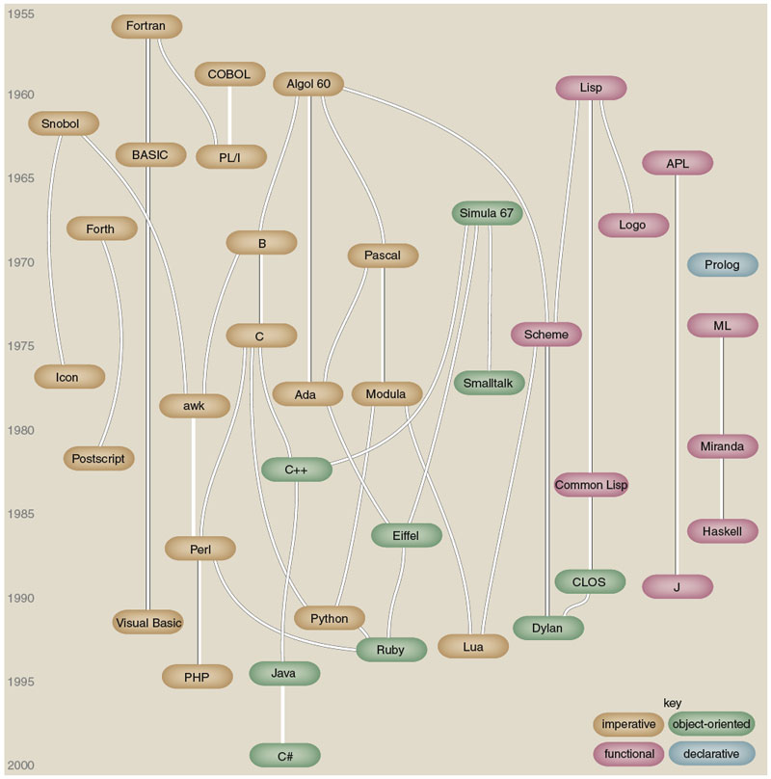
Figure by Brian Hayes
(who credits, in part, Éric Lévénez and Pascal Rigaux):
Brian Hayes, “The Semicolon Wars.” American Scientist, July-August 2006, pp.299-303

Slide 39
Some Historical Perspective
Plankalkül (Konrad Zuse, 1943-1945)
FORTRAN (John Backus, 1956)
LISP (John McCarthy, 1960)
ALGOL 60 (Transatlantic Committee, 1960)
COBOL (US DoD Committee, 1960)
APL (Iverson, 1962)
BASIC (Kemeny and Kurz, 1964)
PL/I (IBM, 1964)
SIMULA 67 (Nygaard and Dahl, 1967)
ALGOL 68 (Committee, 1968)
Pascal (Niklaus Wirth, 1971)
C (Dennis Ritchie, 1972)
Prolog (Alain Colmerauer, 1972)
Smalltalk (Alan Kay, 1972)
FP (Backus, 1978)
Ada (UD DoD and Jean Ichbiah, 1983)
C++ (Stroustrup, 1983)
Modula-2 (Wirth, 1985)
Delphi (Borland, 1988?)
Modula-3 (Cardelli, 1989)
ML (Robin Milner, 1978)
Haskell (Committee, 1990)
Eiffel (Bertrand Meyer, 1992)
Java (Sun and James Gosling, 1993?)
C# (Microsoft, 2001?)
Scripting languages such as Perl, etc.
Etc.

Slide 40
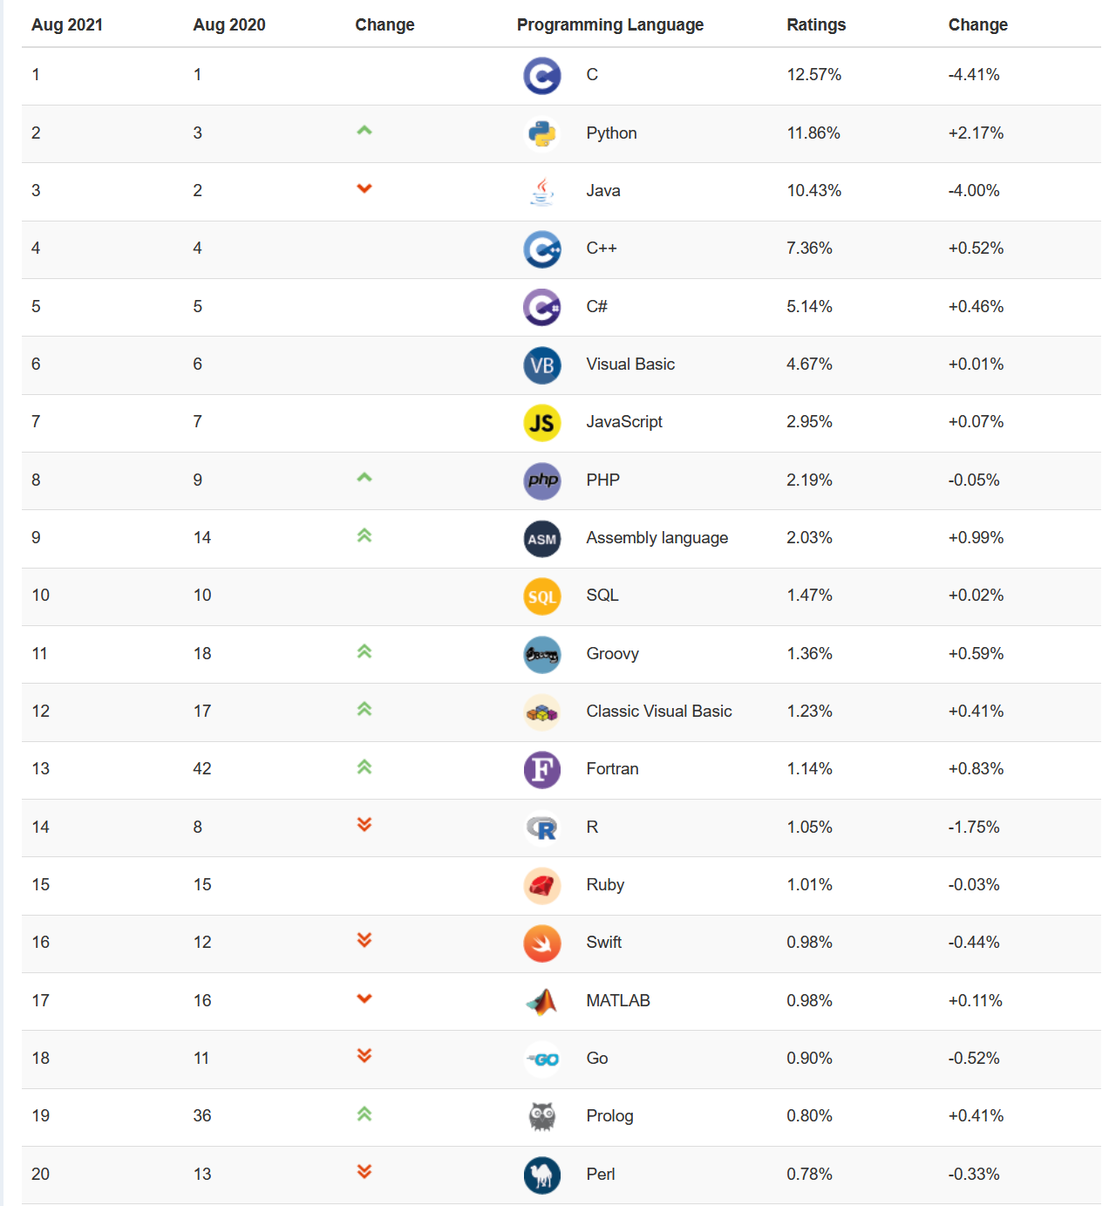
August 2021Tiobe PL Index
Notes:
Accessed 2021-08-24. Haskell is in the 51-100 range (was #47 in December 2017, #39 in August 2016, #41 in August 2015, #40 in August 2014, #34 in August 2013 and 2012), Prolog was #30 in December 2017, #33 in August 2016, #32 in August 2015, #46 in August 2014, #36 in August 2013, #31 in August 2012), Fortran was #27 in December 2017, #35 in August 2017, #28 in August 2016, #24 in August 2015, #34 in August 2014), and ML is in the 51-100 range (Ocaml and Standard ML are both in this range; was in that range in August 2017, August 2016, #46 in August 2015).

Slide 41
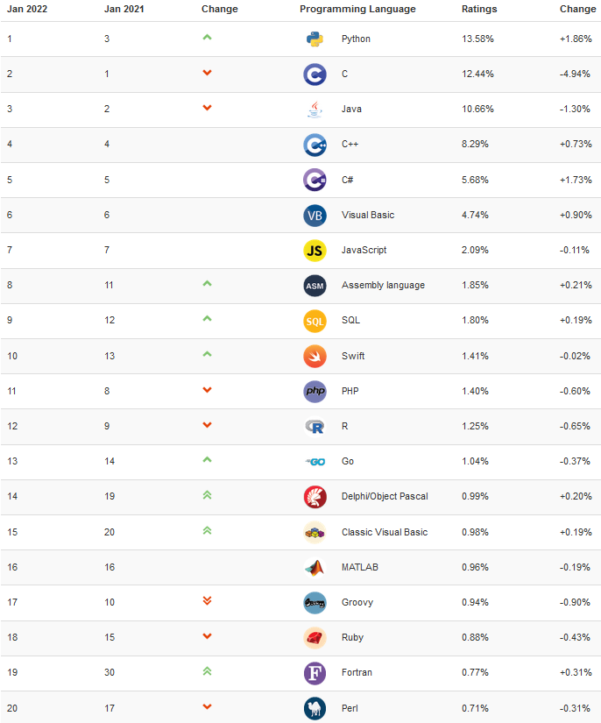
August 2021Tiobe PL Index
Notes:
Accessed 2022-01-27. Haskell is #47 (was in the 51-100 range in August 2021, #47 in December 2017, #39 in August 2016, #41 in August 2015, #40 in August 2014, #34 in August 2013 and 2012), Prolog was #19 in August 2021, #30 in December 2017, #33 in August 2016, #32 in August 2015, #46 in August 2014, #36 in August 2013, #31 in August 2012), Fortran was #27 in December 2017, #35 in August 2017, #28 in August 2016, #24 in August 2015, #34 in August 2014), and ML is #48 ( (Ocaml and Standard ML are both in the 51-100 range ; was in that range in August 2017, August 2016, #46 in August 2015).

Slide 42
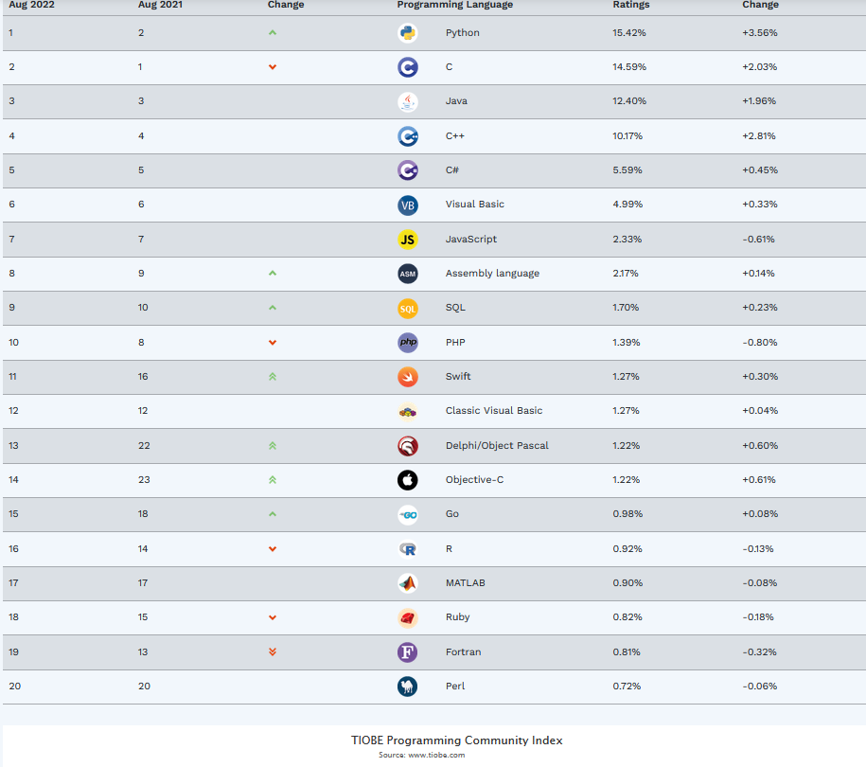
August 2022 Tiobe PL Index
Notes:
Accessed 2022-08-18. Haskell is #47 (was in the 51-100 range, #47 in December 2017, #39 in August 2016, #41 in August 2015, #40 in August 2014, #34 in August 2013 and 2012), Prolog is #27 (was #30 in December 2017, #33 in August 2016, #32 in August 2015, #46 in August 2014, #36 in August 2013, #31 in August 2012), Fortran was #27 in December 2017, #35 in August 2017, #28 in August 2016, #24 in August 2015, #34 in August 2014), and ML is #50 ( Ocaml and Standard ML were both in the 50-100 range in December 2017; ML was in that range in August 2017, August 2016, #46 in August 2015).

Slide 43
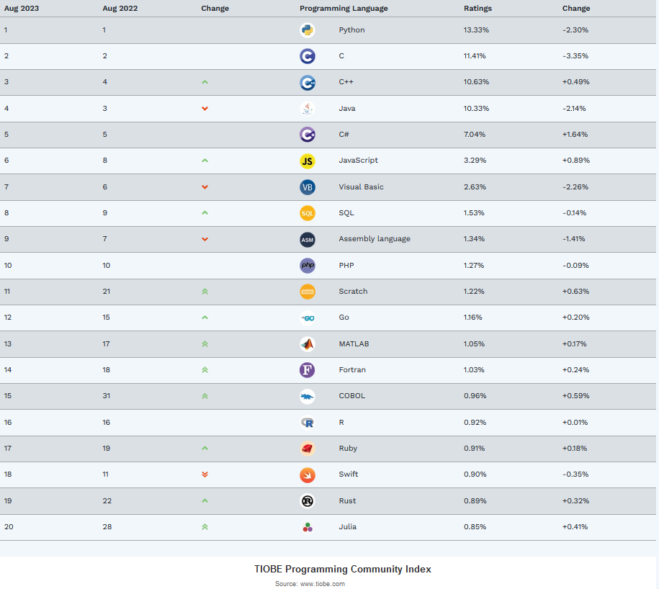
August 2023 Tiobe PL Index
Notes:
Accessed 2023-08-23. Haskell is #32 (was #47 in August 2022, in the 51-100 range in 2021 (?), #47 in December 2017, #39 in August 2016, #41 in August 2015, #40 in August 2014, #34 in August 2013 and 2012), Prolog is #25 (was #27 in August 2022, #30 in December 2017, #33 in August 2016, #32 in August 2015, #46 in August 2014, #36 in August 2013, #31 in August 2012), Fortran is #14 (was #27 in December 2017, #35 in August 2017, #28 in August 2016, #24 in August 2015, #34 in August 2014), and ML is in the 50-100 range (was #50 in August 2022; Ocaml and Standard ML were both in the 50-100 range in December 2017; ML was in that range in August 2017, August 2016, #46 in August 2015).

Slide 44
Tiobe Index Language of the Year for 2021
Programming Language Python awarded Programming Language of the Year 2021
Python has won the prestigious TIOBE Programming Language of the Year award. Congratulations! This is the second time in a row. The award is given to the programming language that has gained the highest increase in ratings in one year. C# was on its way to get the title for the first time in history, but Python surpassed C# in the last month. [C was the PLOTY for 2019.]
Python started at position #3 of the TIOBE index at the beginning of 2021 and left both Java and C behind to become the number one of the TIOBE index. But Python's popularity didn't stop there. It is currently more than 1 percent ahead of the rest. Java's all time record of 26.49% ratings in 2001 is still far away, but Python has it all to become the de facto standard programming language for many domains. There are no signs that Python's triumphal march will stop soon.
Are there any serious contenders for Python? Any new and shiny languages that might compete in the future? If we look at the promising languages of the last few years, we see the following changes in 2021: Swift from #13 to #10, Go from #14 to #13, Rust from #26 to #26, Julia from #23 to #28, Kotlin from #40 to #29, Dart from #25 to #37, and TypeScript from #42 to #49. So, except may be for Swift and Go, we don't expect any new languages entering the top 5 or even the top 3 any time soon.
Notes:
https://www.tiobe.com/tiobe-index/ Accessed 2022-01-27.
(Note: Programming Language C awarded Programming Language of the Year 2019)
The TIOBE Programming Community index is an indicator of the popularity of programming languages. The index is updated once a month. The ratings are based on the number of skilled engineers world-wide, courses and third party vendors. Popular search engines such as Google, Bing, Yahoo!, Wikipedia, Amazon, YouTube and Baidu are used to calculate the ratings. It is important to note that the TIOBE index is not about the best programming language or the language in which most lines of code have been written.
The index can be used to check whether your programming skills are still up to date or to make a strategic decision about what programming language should be adopted when starting to build a new software system. The definition of the TIOBE index can be found here.

Slide 45
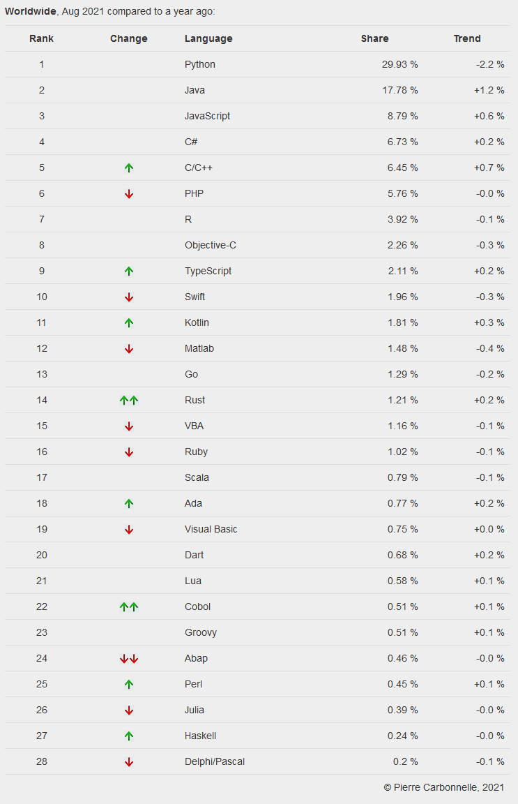
August 2021 PYPL Index
Notes:
PYPL is a competing (with respect to Tiobe) PL popularity index. This chart and the commentary below were downloaded on 2021-08-24 from http://pypl.github.io/PYPL.html. The site includes a custom search engine to construct charts and graphs for specific languages and geographic regions. The PYPL PopularitY of Programming Language index is created by analyzing how often language tutorials are searched on Google : the more a specific language tutorial is searched, the more popular the language is assumed to be. It is a leading indicator. The raw data comes from Google Trends, so that anyone can verify it, or make the analysis for his own country.

Slide 46
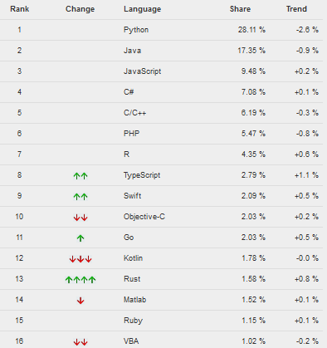
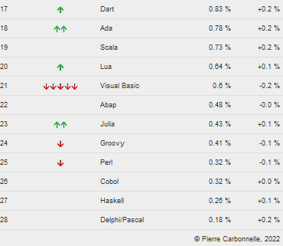
August 2022 PYPL Index
Notes:
PYPL is a competing (with respect to Tiobe) PL popularity index. This chart and the commentary below were downloaded on 2022-08-18 (chart only) and 2017-08-23 from http://pypl.github.io/PYPL.html. The site includes a custom search engine to construct charts and graphs for specific languages and geographic regions. The PYPL PopularitY of Programming Language index is created by analyzing how often language tutorials are searched on Google : the more a specific language tutorial is searched, the more popular the language is assumed to be. It is a leading indicator. The raw data comes from Google Trends, so that anyone can verify it, or make the analysis for his own country.

Slide 47
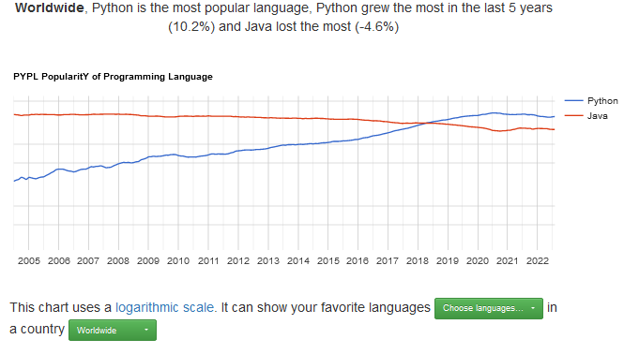
August 2022 PYPL Index
Notes:
PYPL is a competing (with respect to Tiobe) PL popularity index. This chart wasdownloaded on 2022-08-23 from http://pypl.github.io/PYPL.html.

Slide 48
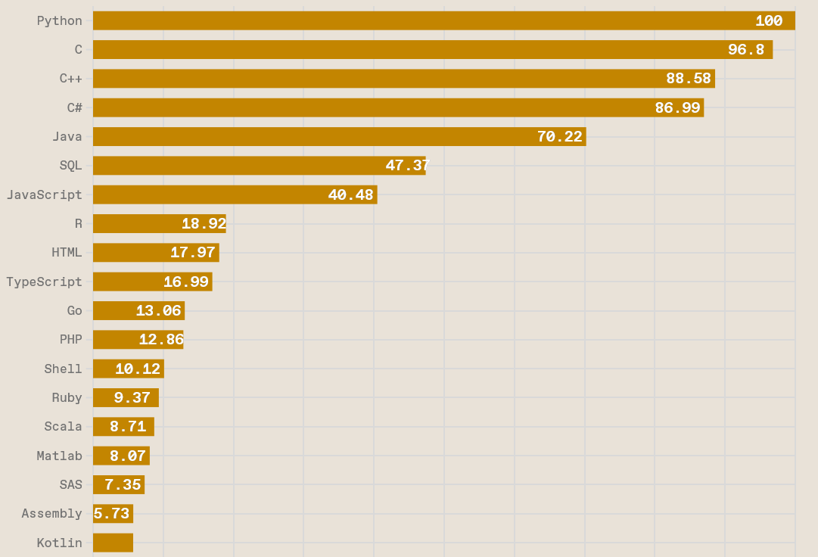
IEEE Spectrum Top Programming Languages 2022
Notes:
https://spectrum.ieee.org/top-programming-languages-2022, accessed 2022-08-24. Methodology described on site. “Jobs” and “Trending” rankings also provided.

Slide 49
January 2020 Tiobe PL Index
Jan 2020 | Jan 2019 | Change | Programming Language | Ratings | Change
1 | 1 |  | Java | 16.896% | -0.01%
2 | 2 |  | C | 15.773% | +2.44%
3 | 3 |  | Python | 9.704% | +1.41%
4 | 4 |  | C++ | 5.574% | -2.58%
5 | 7 |  | C# | 5.349% | +2.07%
6 | 5 |  | Visual Basic .NET | 5.287% | -1.17%
7 | 6 |  | JavaScript | 2.451% | -0.85%
8 | 8 |  | PHP | 2.405% | -0.28%
9 | 15 |  | Swift | 1.795% | +0.61%
10 | 9 |  | SQL | 1.504% | -0.77%
11 | 18 |  | Ruby | 1.063% | -0.03%
12 | 17 |  | Delphi/Object Pascal | 0.997% | -0.10%
13 | 10 |  | Objective-C | 0.929% | -0.85%
14 | 16 |  | Go | 0.900% | -0.22%
15 | 14 |  | Assembly language | 0.877% | -0.32%
16 | 20 |  | Visual Basic | 0.831% | -0.20%
17 | 25 |  | D | 0.825% | +0.25%
18 | 12 |  | R | 0.808% | -0.52%
19 | 13 |  | Perl | 0.746% | -0.48%
20 | 11 |  | MATLAB | 0.737% | -0.76%
Notes:
http://www.tiobe.com/index.php/content/paperinfo/tpci/index.html, accessed 2020-01-14.
Note that C is the language of the year!

Slide 50
Tiobe Index Language of the Year for 2019
Programming Language C awarded Programming Language of the Year 2019
Everybody thought that Python would become TIOBE's programming language of the year for the second consecutive time. But it is good old language C that wins the award this time with an yearly increase of 2.4%. Runners up are C# (+2.1%), Python (+1.4%) and Swift (+0.6%). Why is the programming language C still hot? The major drivers behind this trend are the Internet of Things (IoT) and the vast amount of small intelligent devices that are released nowadays. C excels when it is applied to small devices that are performance-critical. It is easy to learn and there is a C compiler available for every processor. Congratulations to C!
Notes:
Accessed 2020-01-14.
Quoting:
Other interesting winners of 2019 are Swift (from #15 to #9) and Ruby (from #18 to #11). Swift is a permanent top 10 player now and Ruby seems to become one soon. Some languages that were supposed to break through in 2019 didn't: Rust won only 3 positions (from #33 to #30), Kotlin lost 3 positions (from #31 to #35), Julia lost even 10 positions (from #37 to #47) and TypeScript won just one position (from #49 to #48). Let's see what 2020 has in store for us!
The TIOBE Programming Community index is an indicator of the popularity of programming languages. The index is updated once a month. The ratings are based on the number of skilled engineers world-wide, courses and third party vendors. Popular search engines such as Google, Bing, Yahoo!, Wikipedia, Amazon, YouTube and Baidu are used to calculate the ratings. It is important to note that the TIOBE index is not about the best programming language or the language in which most lines of code have been written.

Slide 51
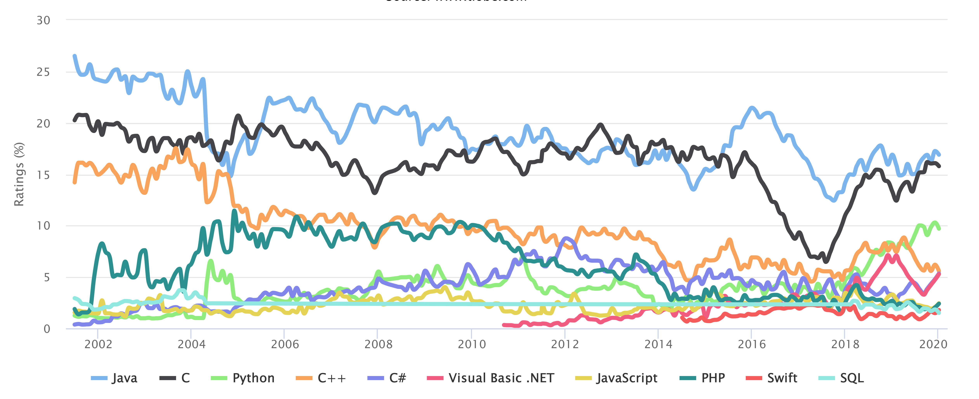
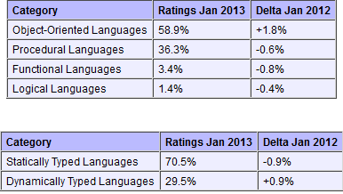
Tiobe Index Long Term Trends, January 2020
Notes:
http://www.tiobe.com/index.php/content/paperinfo/tpci/index.html, accessed 2013-01-17. The end of 2004 drop for Java is due to a change in Google. See http://www.tiobe.com/index.htm?tiobe_index, accessed on 2007-08-23.
Static vs. Dynamic Typing will be explained in a later lecture.

Slide 52
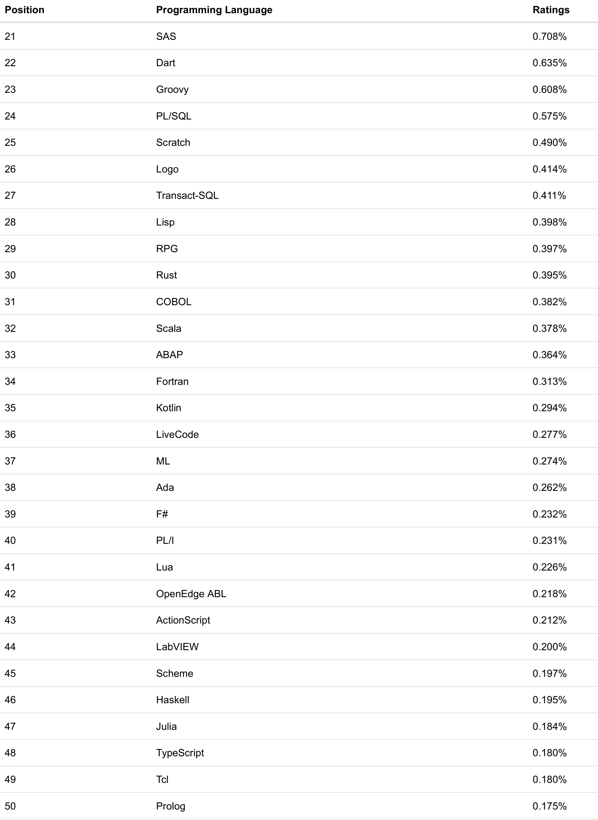
Tiobe
2020:
21-50
Notes:
Accessed 2020-01-14. Note Haskell at place 46 and Prolog at place 50.

Slide 53
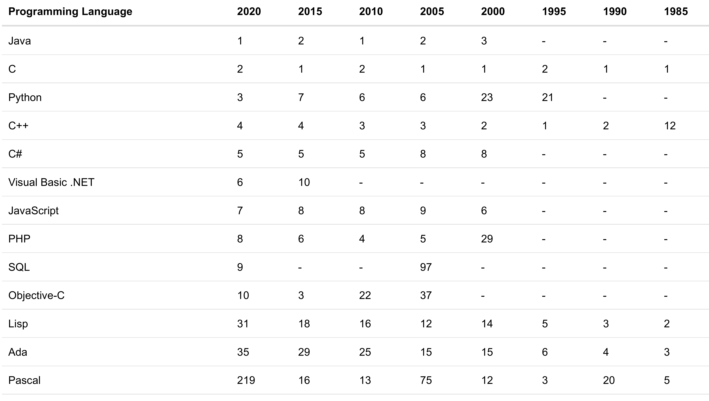
Tiobe Index Long Term Trends, January 2020
Notes:
http://www.tiobe.com/index.php/content/paperinfo/tpci/index.html, accessed 2013-01-17. The end of 2004 drop for Java is due to a change in Google. See http://www.tiobe.com/index.htm?tiobe_index, accessed on 2007-08-23.
Static vs. Dynamic Typing will be explained in a later lecture.

Slide 54
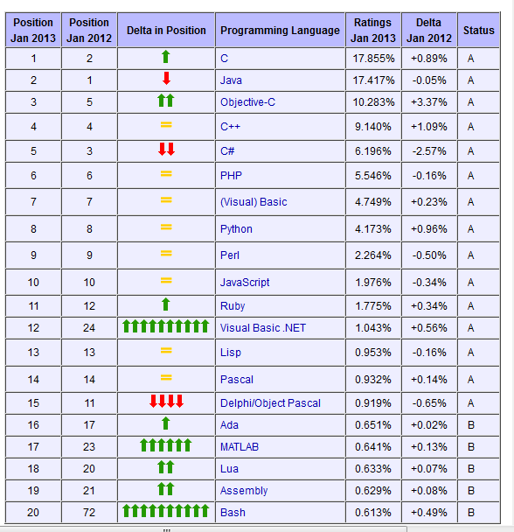
January 2013 Tiobe PL Index
Notes:
http://www.tiobe.com/index.php/content/paperinfo/tpci/index.html, accessed 2013-01-17.

Slide 55
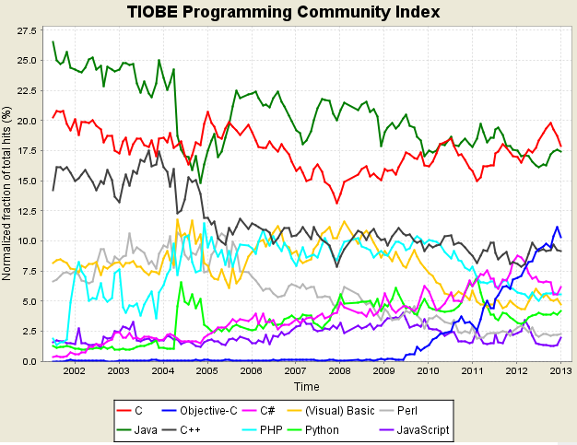
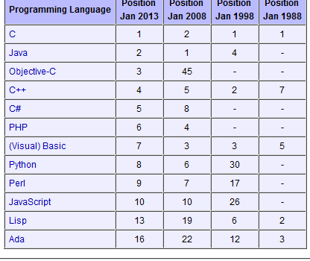
Tiobe Index Long Term Trends, January 2013
Notes:
http://www.tiobe.com/index.php/content/paperinfo/tpci/index.html, accessed 2013-01-17. The end of 2004 drop for Java is due to a change in Google. See http://www.tiobe.com/index.htm?tiobe_index, accessed on 2007-08-23.
Static vs. Dynamic Typing will be explained in a later lecture.

