Slide 1
Attribute Grammars
Slides by Robert Sebesta, from support materials from different editions of his textbook on Programming Languages (see presenter notes for detailed bibliographical entry)
CSCE 531, Spring 2023
Notes:
Slides 7-11 are from: Robert W. Sebesta. Concepts of Programming Languages, 3rd edition. Addison-Wesley, 1996. ISBN 0-8053-7133-8. Slides 1-6 are from later editions.

Slide 2
Attribute Grammars: Definition
Let X₀ → X₁ ... X_{n} be a rule
Functions of the form S(X₀) = f(A(X₁), ... , A(X_{n})) define synthesized attributes
Functions of the form I(X_{j}) = f(A(X₀), ... , A(X_{n})), for i <= j <= n, define inherited attributes
Initially, there are intrinsic attributes on the leaves
Notes:
Slides 7-11 are from: Robert W. Sebesta. Concepts of Programming Languages, 3rd edition. Addison-Wesley, 1996. ISBN 0-8053-7133-8. Slides 1-6 are from later editions.

Slide 3
Attribute Grammars: An Example
Syntax
  <assign> -> <var> = <expr>
  <expr> -> <var> + <var> | <var>
  <var> A | B | C
actual_type: synthesized for <var> and <expr>
expected_type: inherited for <expr>
Notes:
Slides 7-11 are from: Robert W. Sebesta. Concepts of Programming Languages, 3rd edition. Addison-Wesley, 1996. ISBN 0-8053-7133-8. Slides 1-6 are from later editions.

Slide 4
Attribute Grammar (continued)
Syntax rule: <expr> → <var>[1] + <var>[2]
Semantic rules:
<expr>.actual_type ← <var>[1].actual_type
Predicate:
<var>[1].actual_type == <var>[2].actual_type
<expr>.expected_type == <expr>.actual_type
Syntax rule: <var> → id
Semantic rule:
<var>.actual_type ← lookup (<var>.string)
Notes:
Slides 7-11 are from: Robert W. Sebesta. Concepts of Programming Languages, 3rd edition. Addison-Wesley, 1996. ISBN 0-8053-7133-8. Slides 1-6 are from later editions.

Slide 5
Attribute Grammars (continued)
How are attribute values computed?
  If all attributes were inherited, the tree could be decorated in top-down order.
  If all attributes were synthesized, the tree could be decorated in bottom-up order.
  In many cases, both kinds of attributes are used, and it is some combination of top-down and bottom-up that must be used.
Notes:
Slides 7-11 are from: Robert W. Sebesta. Concepts of Programming Languages, 3rd edition. Addison-Wesley, 1996. ISBN 0-8053-7133-8. Slides 1-6 are from later editions.

Slide 6
Attribute Grammars (continued)
<expr>.expected_type ← inherited from parent
<var>[1].actual_type ← lookup (A)
<var>[2].actual_type ← lookup (B)
<var>[1].actual_type =? <var>[2].actual_type
<expr>.actual_type ← <var>[1].actual_type
<expr>.actual_type =? <expr>.expected_type
Notes:
Slides 7-11 are from: Robert W. Sebesta. Concepts of Programming Languages, 3rd edition. Addison-Wesley, 1996. ISBN 0-8053-7133-8. Slides 1-6 are from later editions.

Slide 7
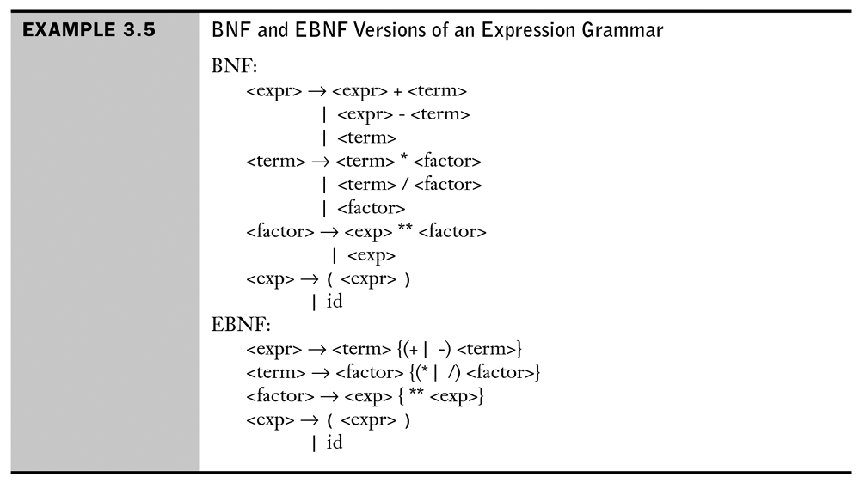
Notes:
Slides 7-11 are from: Robert W. Sebesta. Concepts of Programming Languages, 3rd edition. Addison-Wesley, 1996. ISBN 0-8053-7133-8. Slides 1-6 are from later editions.

Slide 8
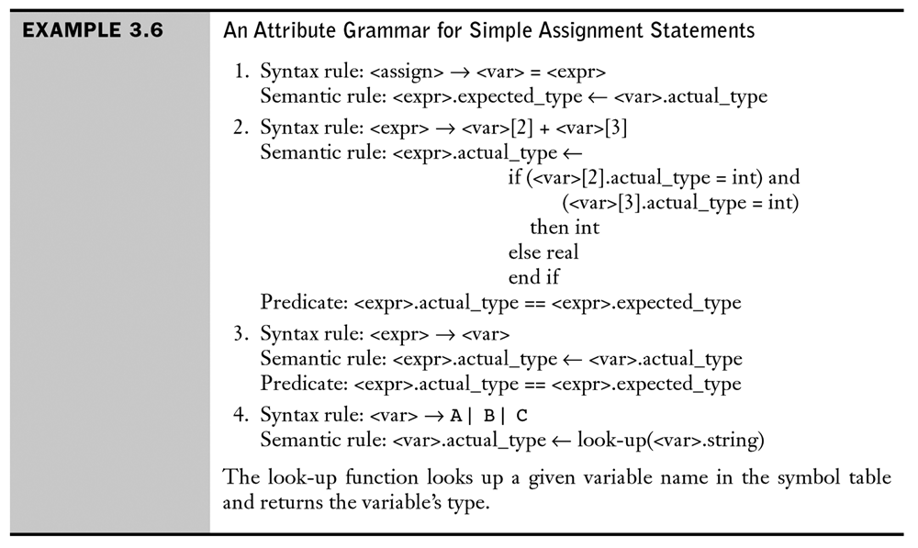
Notes:
Slides 7-11 are from: Robert W. Sebesta. Concepts of Programming Languages, 3rd edition. Addison-Wesley, 1996. ISBN 0-8053-7133-8. Slides 1-6 are from later editions.

Slide 9
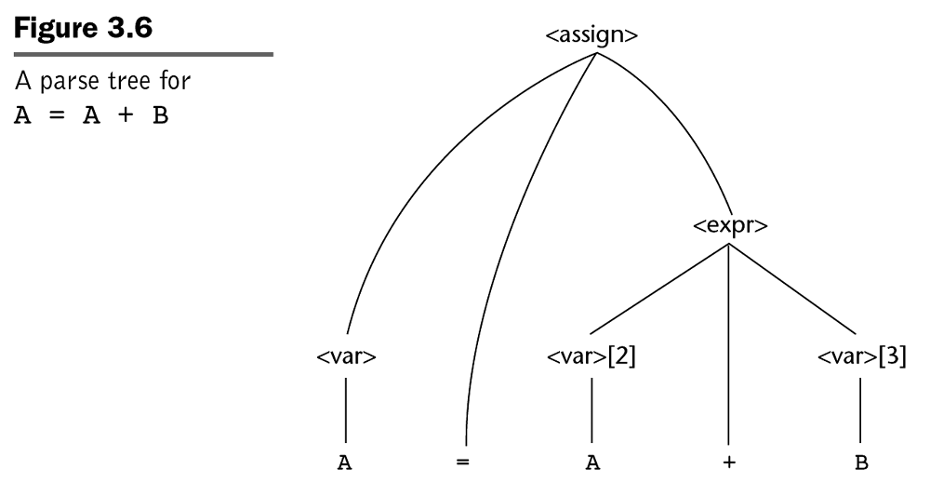
Notes:
Slides 7-11 are from: Robert W. Sebesta. Concepts of Programming Languages, 3rd edition. Addison-Wesley, 1996. ISBN 0-8053-7133-8. Slides 1-6 are from later editions.

Slide 10
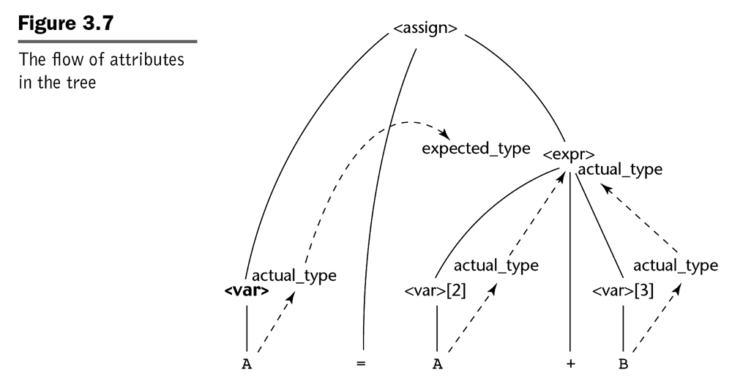
Notes:
Slides 7-11 are from: Robert W. Sebesta. Concepts of Programming Languages, 3rd edition. Addison-Wesley, 1996. ISBN 0-8053-7133-8. Slides 1-6 are from later editions.

Slide 11
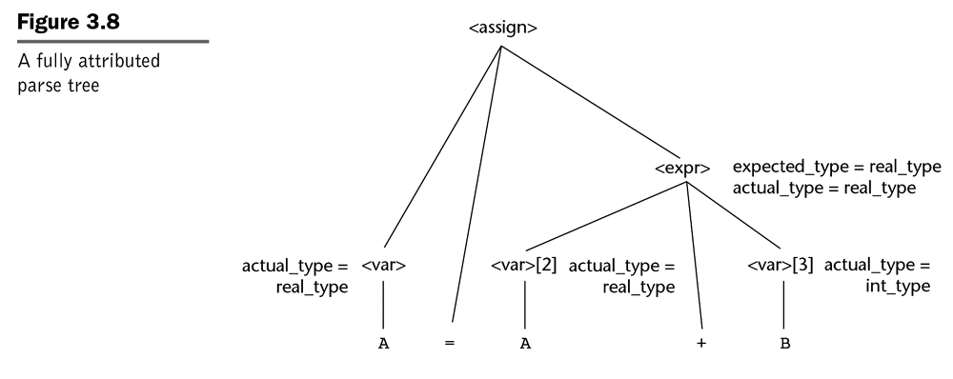
Notes:
Slides 7-11 are from: Robert W. Sebesta. Concepts of Programming Languages, 3rd edition. Addison-Wesley, 1996. ISBN 0-8053-7133-8. Slides 1-6 are from later editions.

