Slide 1
CSCE 531
Compiler Construction
Ch. 3: Compilation
Spring 2020
Marco Valtorta
mgv@cse.sc.edu

Slide 2
Acknowledgment
These slides are based mainly on [W].

Slide 3
Review of Bootstrapping
To write a good compiler you may be writing several simpler ones first
You have to think about the source language, the target language and the implementation language.
Strategies for implementing a compiler
  Write it in machine code
  Write it in a lower level language and compile it using an existing compiler
  Write it in the same language that it compiles and bootstrap
The work of a compiler writer is never finished, there is always version 1.x and version 2.0 and …

Slide 4
Compilation
So far we have treated language processors (including compilers) as “black boxes”
Now we take a first look "inside the box": how are compilers built.
And we take a look at the different “phases” and their relationships

Slide 5
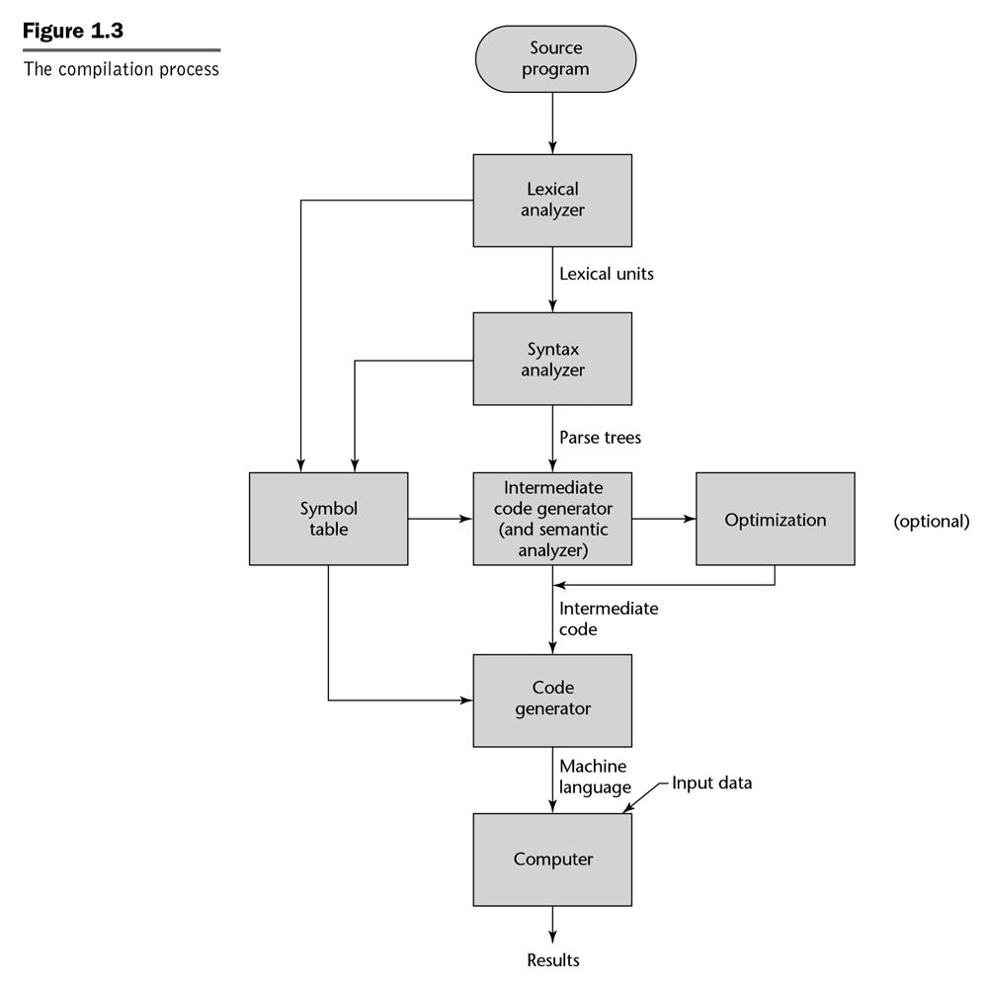
Phases of Compilation
Different authors divide the compilation process into different phases
Here: [Sebesta, 2007]

Slide 6
The “Phases” of a Compiler
Source Program
Syntax Analysis
Error Reports
Abstract Syntax Tree
Contextual Analysis
Error Reports
Decorated Abstract Syntax Tree
Code Generation
Object Code

Slide 7
Different Phases of a Compiler
The different phases can be seen as different transformation steps to transform source code into object code.
The different phases correspond roughly to the different parts of the language specification:
Syntax analysis <-> Syntax
Contextual analysis <-> Contextual constraints
Code generation <-> Semantics

Slide 8
Chomsky’s Hierarchy
Type (notes) | Name | Recognizers | Production Rules
0 | Recursively enumerable | Turing machines | unrestricted
1 (attribute grammars) | Contextual | Limited linear automata | Fewer symbols on left hand side
2 (BNF) | Context-free | Stack automata | Only one non-terminal symbol on left-hand side
3 (Mealy machines and Moore machines) | Regular | Finite-state automata | A ::= aB and A ::= b or A ::= Ba and A ::= b, where a, b are terminal symbols, and A, B are non-terminal symbols

Slide 9
Notes:
Sebesta, 2007

Slide 10
Example: Syntax of Mini Triangle
Mini triangle is a very simple Pascal-like programming language.
An example program:
Declarations
!This is a comment.
let const m ~ 7;
var n
in
begin
n := 2 * m * m ;
putint(n)
end
Expression
Command

Slide 11
Block Command, Let Expression, and Function Body in Triangle
The block command (“let command”) consists of a declaration and a command:
let <Declaration> in <single-Command>
  The scope of the <Declaration> is the <single-Command> (see p.388 of text)
The let expression consists of a declaration and an expression:
let <Declaration> in <Expression>
  The scope of the <Declaration> is the <Expression> (see pp.389-390)
The function declaration consists of a name, a list of formal parameters, and an expression (see pp.393-394), e.g.:
func power(a: Integer, n: Integer): Integer ~
if n = 0 then 1 else a * power(a, n-1)

Slide 12
Example: Syntax of Mini Triangle
Program ::= single-Command
single-Command
::= V-name := Expression
| Identifier ( Expression )
| if Expression then single-Command
else single-Command
| while Expression do single-Command
| let Declaration in single-Command
| begin Command end
Command ::= single-Command
| Command ; single-Command
...

Slide 13
Example: Syntax of “Mini Triangle” (continued)
Expression
::= primary-Expression
| Expression Operator primary-Expression
primary-Expression
::= Integer-Literal
| V-name
| Operator primary-Expression
| ( Expression )
V-name ::= Identifier
Identifier ::= Letter
| Identifier Letter
| Identifier Digit
Integer-Literal ::= Digit
| Integer-Literal Digit
Operator ::= + | - | * | / | < | > | =

Slide 14
Example: Syntax of “Mini Triangle” (continued)
Declaration
::= single-Declaration
| Declaration ; single-Declaration
single-Declaration
::= const Identifier ~ Expression
| var Identifier : Type-denoter
Type-denoter ::= Identifier
Comment ::= ! CommentLine eol
CommentLine ::= Graphic CommentLine
Graphic ::= any printable character or space

Slide 15
Syntax Trees
A syntax tree is an ordered labeled tree such that:
  a) terminal nodes (leaf nodes) are labeled by terminal symbols
  b) non-terminal nodes (internal nodes) are labeled by non terminal symbols.
  c) each non-terminal node labeled by N has children X₁,X₂,...X_{n} (in this order) such that N := X₁,X₂,...X_{n} is a production.

Slide 16
Syntax Trees
Example:
1
2
3
Expression ::= Expression Op primary-Exp
Expression
Expression
1
Expression
3
primary-Exp.
primary-Exp
primary-Exp.
V-name
V-name
2
Ident
Op
Int-Lit
Op
Ident
d
+
10
*
d

Slide 17
Concrete and Abstract Syntax
The previous grammar specified the concrete syntax of mini triangle.
The concrete syntax is important for the programmer who needs to know exactly how to write syntactically well-formed programs.
The abstract syntax omits irrelevant syntactic details and only specifies the essential structure of programs.
Example: different concrete syntaxes for an assignment
v := e
(set! v e)
e -> v
v = e

Slide 18
Example: Concrete/Abstract Syntax of Commands
Concrete Syntax
single-Command
::= V-name := Expression
| Identifier ( Expression )
| if Expression then single-Command
else single-Command
| while Expression do single-Command
| let Declaration in single-Command
| begin Command end
Command ::= single-Command
| Command ; single-Command

Slide 19
Example: Concrete/Abstract Syntax of Commands
Abstract Syntax
Command
::= V-name := Expression AssignCmd
| Identifier ( Expression ) CallCmd
| if Expression then Command
else Command IfCmd
| while Expression do Command WhileCmd
| let Declaration in Command LetCmd
| Command ; Command SequentialCmd

Slide 20
Example: Concrete Syntax of Expressions (recap)
Expression
::= primary-Expression
| Expression Operator primary-Expression
primary-Expression
::= Integer-Literal
| V-name
| Operator primary-Expression
| ( Expression )
V-name
::= Identifier

Slide 21
Example: Abstract Syntax of Expressions
Expression
::= Integer-Literal IntegerExp
| V-name VnameExp
| Operator Expression UnaryExp
| Expression Op Expression BinaryExp
V-name::= Identifier SimpleVName

Slide 22
Abstract Syntax Trees
Abstract Syntax Tree for: d:=d+10*n
AssignmentCmd
BinaryExpression
BinaryExpression
VName
VNameExp
IntegerExp
VNameExp
SimpleVName
SimpleVName
SimpleVName
Ident
Ident
Op
Int-Lit
Op
Ident
d
d
+
10
n
*

Slide 23
Example Program
We now look at each of the three different phases in a little more detail. We look at each of the steps in transforming an example Triangle program into TAM code.
! This program is useless except for
! illustration
let var n: integer;
var c: char
in begin
c := ‘&’;
n := n+1
end

Slide 24
1) Syntax Analysis
Source Program
Syntax Analysis
Error Reports
Abstract Syntax Tree
Note: Not all compilers construct an
explicit representation of an AST. (e.g. on a “single pass compiler” there is generally no need to construct an AST)

Slide 25
1) Syntax Analysis -> AST
Program
LetCommand
SequentialCommand
SequentialDeclaration
AssignCommand
AssignCommand
BinaryExpr
VarDecl
VarDecl
Char.Expr
VNameExp
Int.Expr
SimpleT
SimpleT
SimpleV
SimpleV
Ident
Ident
Ident
Ident
Ident
Char.Lit
Ident
Ident
Op
Int.Lit
n Integer c Char c ‘&’ n n + 1

Slide 26
2) Contextual Analysis -> Decorated AST
Abstract Syntax Tree
Contextual Analysis
Error Reports
Decorated Abstract Syntax Tree
Contextual analysis:
  Scope checking: verify that all applied occurrences of identifiers are declared
  Type checking: verify that all operations in the program are used according to their type rules.
Annotate AST:
  Applied identifier occurrences => declaration
  Expressions => Type

Slide 27
2) Contextual Analysis -> Decorated AST
Program
LetCommand
SequentialCommand
SequentialDeclaration
AssignCommand
AssignCommand
BinaryExpr
:int
VarDecl
VarDecl
Char.Expr
VNameExp
Int.Expr
:char
:int
:int
SimpleT
SimpleT
SimpleV
SimpleV
:char
:int
Ident
Ident
Ident
Ident
Ident
Char.Lit
Ident
Ident
Op
Int.Lit
n
Integer
c
Char
c
‘&’
n
n
+
1

Slide 28
Contextual Analysis
Finds scope and type errors.
Example 1:
AssignCommand
***TYPE ERROR (incompatible types in
assigncommand)
:int
:char
Example 2:
foo not found
SimpleV
***SCOPE ERROR: undeclared variable foo
Ident
foo

Slide 29
3) Code Generation
Decorated Abstract Syntax Tree
Code Generation
Object Code
Assumes that program has been thoroughly checked and is well formed (scope & type rules)
Takes into account semantics of the source language as well as the target language.
Transforms source program into target code.

Slide 30
3) Code Generation
Space for n
0, SB
let var n: integer;
var c: char
in begin
c := ‘&’;
n := n+1
end
PUSH 2
LOADL 38
STORE 1[SB]
LOAD 0 [SB]
LOADL 1
CALL add
STORE 0[SB]
POP 2
HALT
Space for c
1
&
2
Space for n
0, SB
&
1
VarDecl
address = 0[SB]
SimpleT
TAM is a stack machine---the values to be evaluated are on the stack top; they are popped, and the result is left on the stack top; stack grows downwards in the figure!
STORE pops from the top of the stack to the address that is the argument to STORE
LOAD pushes to the top of the stack from the address that is the argument to LOAD
Ident
Ident
n
Integer
Notes:
From [W]: The code generator (2) allocates an address for the variable n, say 0 [SB]. It stores the address in the decorated AST tree (not shown) at node (2) for later retrieval. (3) It similarly allocates an address for the variable c, say 1[SB]. It stores that address at node (3), for later retrieval.
The code generator processes the second assignment command as follows: (8) by following the link to the declaration of n, it retrieves this variable’s address, namely 0[SB]. Then it generates the instruction LOAD 0[SB]. (When executed, this instruction will fetch the current value of that variable.) (9) It generates the instruction LOADL 1. (When executed, this instruction will fetchb the literal value 1. (7) It generates the instruction CALL add. (When executed, this instruction will add the two previously-fetched values.) (5) By following the link to the declaration of n, it retrieves this variable (n)’s address, namely 0[SB]. Then it generates the instruction STORE 0[SB]. (When executed, this instruction will store the previously-computed value in that variable.)
In a similar way, the code generator translates the whole program into object code.

Slide 31
Compiler Passes
A pass is a complete traversal of the source program, or a complete traversal of some internal representation of the source program.
A pass can correspond to a “phase” but it does not have to!
Sometimes a single “pass” corresponds to several phases that are interleaved in time.
What and how many passes a compiler does over the source program is an important design decision.

Slide 32
Single Pass Compiler
A single pass compiler makes a single pass over the source text, parsing, analyzing and generating code all at once.
Dependency diagram of a typical Single Pass Compiler:
Compiler Driver
calls
Syntactic Analyzer
calls
calls
Contextual Analyzer
Code Generator

Slide 33
Multi Pass Compiler
A multi pass compiler makes several passes over the program. The output of a preceding phase is stored in a data structure and used by subsequent phases.
Dependency diagram of a typical Multi Pass Compiler:
Compiler Driver
calls
calls
calls
Syntactic Analyzer
Contextual Analyzer
Code Generator
input
input
input
output
output
output
Source Text
AST
Decorated AST
Object Code

Slide 34
Example: The Triangle Compiler Driver
public class Compiler {
public static void compileProgram(...) {
Parser parser = new Parser(...);
Checker checker = new Checker(...);
Encoder generator = new Encoder(...);
Program theAST = parser.parse();
checker.check(theAST);
generator.encode(theAST);
}
public void main(String[] args) {
... compileProgram(...) ...
}
}

Slide 35
Compiler Design Issues
Single Pass
Multi Pass
Speed
Memory
Modularity
Flexibility
“Global” optimization
Source Language
better
worse
better for
large programs
(potentially) better for small programs
worse
better
worse
better
impossible
possible
single pass compilers are not possible for many programming languages

Slide 36
Language Issues
Example Pascal:
Pascal was explicitly designed to be easy to implement with a single pass compiler:
  Every identifier must be declared before it is first used
  C requires the same
?
var n:integer;
procedure inc;
begin
n:=n+1
end
procedure inc;
begin
n:=n+1
end;
var n:integer;
Undeclared Variable!

Slide 37
Language Issues
Example Pascal:
  Every identifier must be declared before it is used.
  How to handle mutual recursion then?
procedure ping(x:integer)
begin
... pong(x-1); ...
end;
procedure pong(x:integer)
begin
... ping(x); ...
end;

Slide 38
Language Issues
Example Pascal:
  Every identifier must be declared before it is used.
  How to handle mutual recursion then?
forward procedure pong(x:integer)
procedure ping(x:integer)
begin
... pong(x-1); ...
end;
procedure pong(x:integer)
begin
... ping(x); ...
end;
OK!

Slide 39
Language Issues
Example Java:
  identifiers can be used before they are declared
    True for member variables (declared inside classes), not for variables: the scope of a variable is from its declaration to the end of innermost enclosing block
  thus a Java compiler need at least two passes
Class Example {
void inc() { n = n + 1; }
int n;
void use() { n = 0 ; inc(); }
}

Slide 40
Scope of Variable
Range of program statements that can reference that variable (i.e. access the corresponding data object by the variable’s name)
Variable is local to program or block if it is declared there
Variable is nonlocal to program unit if it is visible there but not declared there

Slide 41
Static vs. Dynamic Scope
Under static, sometimes called lexical, scope, sub1 will always reference the x defined in big
Under dynamic scope, the x it references depends on the dynamic state of execution
procedure big;
var x: integer;
procedure sub1;
begin {sub1}
... x ...
end; {sub1}
procedure sub2;
var x: integer;
begin {sub2}
...
sub1;
...
end; {sub2}
begin {big}
...
sub1;
sub2;
...
end; {big}

Slide 42
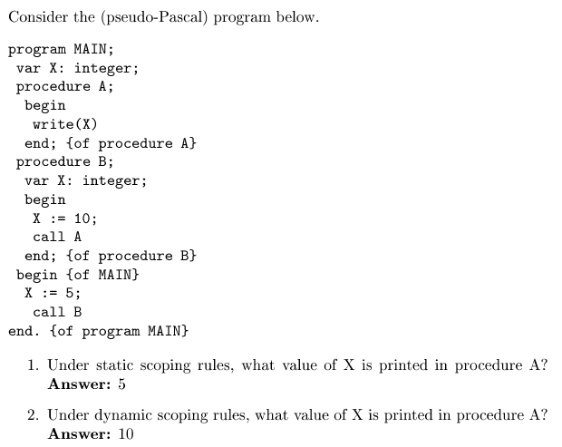
Static vs. Dynamic Scoping

Slide 43
Static Scoping
Scope computed at compile time, based on program text
To determine the name of a used variable we must find statement declaring variable
Subprograms and blocks generate hierarchy of scopes
  Subprogram or block that declares current subprogram or contains current block is its static parent
General procedure to find declaration:
  First see if variable is local; if yes, done
  If non-local to current subprogram or block recursively search static parent until declaration is found
  If no declaration is found this way, undeclared variable error detected

Slide 44
Example
program main;
var x : integer;
procedure sub1;
var x : integer;
begin { sub1 }
… x …
end; { sub1 }
begin { main }
… x …
end; { main }

Slide 45
Dynamic Scope
Now generally thought to have been a mistake
Main example of use: original versions of LISP
  Scheme uses static scope
  Perl allows variables to be declared to have dynamic scope
Determined by the calling sequence of program units, not static layout
Name bound to corresponding variable most recently declared among still active subprograms and blocks

Slide 46
Example
program main;
var x : integer;
procedure sub1;
begin { sub1 }
… x …
end; { sub1 }
procedure sub2;
var x : integer;
begin { sub2 }
… call sub1 …
end; { sub2 }
… call sub2…
end; { main }

Slide 47
Binding
Binding: an association between an attribute and its entity
Binding Time: when does it happen?
… and, when can it happen?

Slide 48
Binding of Data Objects and Variables
Attributes of data objects and variables have different binding times
If a binding is made before run time and remains fixed through execution, it is called static
If the binding first occurs or can change during execution, it is called dynamic

Slide 49
Binding Time
Static
Language definition time
Language implementation time
Program writing time
Compile time
Link time
Load time
Dynamic
Run time
  At the start of execution (program)
  On entry to a subprogram or block
  When the expression is evaluated
  When the data is accessed

Slide 50
X = X + 10
Set of types for variable X
Type of variable X
Set of possible values for variable X
Value of variable X
Scope of X
  lexical or dynamic scope
Representation of constant 10
  Value (10)
  Value representation (1010₂)
    big-endian vs. little-endian
  Type (int)
  Storage (4 bytes)
    stack or global allocation
Properties of the operator +
  Overloaded or not

Slide 51
Little- vs. Big-Endians
Big-endian
  A computer architecture in which, within a given multi-byte numeric representation, the most significant byte has the lowest address (the word is stored `big-end-first').
  Motorola and Sun processors
Little-endian
  a computer architecture in which, within a given 16- or 32-bit word, bytes at lower addresses have lower significance (the word is stored `little-end-first').
  Intel processors
from The Jargon Dictionary - http://info.astrian.net/jargon

Slide 52
Binding Times summary
Language definition time:
  language syntax and semantics, scope discipline
Language implementation time:
  interpreter versus compiler,
  aspects left flexible in definition,
  set of available libraries
Compile time:
  some initial data layout, internal data structures
Link time (load time):
  binding of values to identifiers across program modules
Run time (execution time):
  actual values assigned to non-constant identifiers
The Programming language designer and compiler implementer
have to make decisions about binding times

