Slide 1
CSCE 531 Compiler Construction Ch.5: Contextual Analysis
Spring 2020
Marco Valtorta
mgv@cse.sc.edu

Slide 2
Acknowledgment
The slides are based on the required textbooks: [M] and [R] and other sources
[W] and slides from Bent Thomsen’s course at the University of Aalborg in Denmark, based on [W]
[M10]: the online version of the edition of Torben Mogensen’s online textbook, Basics of Compiler Design
The three main other compiler textbooks I considered are:
Aho, Alfred V., Monica S. Lam, Ravi Sethi, and Jeffrey D. Ullman. Compilers: Principles, Techniques, & Tools, 2nd ed. Addison-Welsey, 2007. (The “dragon book”)
Appel, Andrew W. Modern Compiler Implementation in Java, 2nd ed. Cambridge, 2002. (Editions in ML and C also available; the “tiger books”)
Grune, Dick, Henri E. Bal, Ceriel J.H. Jacobs, and Koen G. Langendoen. Modern Compiler Design. Wiley, 2000; second edition 2012 [G]
Notes:
The textbooks are:
Aarne Ranta [R]. Implementing Programming Languages: An Introduction to Compilers and Interpreters. College Publications, 2012. ISBN: 978-1-84890-064-6. (required text).
Torben Aegidius Mogensen [M]. Introduction to Compiler Design, second edition. Springer, 2017. ISBN: 978-3-319-66965-6. (required text).
We will use parts of this free online textbook from 2010 by Torben Mogensen of the Department of Computer Science at the University of Copenhagen [M10] (local copy).
Watt, David A. and Deryck F. Brown [W]. Programming Language Processors in Java. Prentice-Hall, 2000 (not required; we will use parts of it). Supplementary materials from the author, including an errata list, are available.
[G] can easily be found online in pdf.

Slide 3
Contextual Analysis Phase
Purposes:
Finish syntax analysis by deriving context-sensitive information
Associate semantic routines with individual productions of the context free grammar or subtrees of the AST
Start to interpret meaning of program based on its syntactic structure
Prepare for the final stage of compilation: Code generation

Slide 4
Programming Language specification
A Language specification has (at least) three parts:
Syntax of the language: usually formal: EBNF
Contextual constraints:
scope rules (often written in English, but can be formal)
type rules (formal or informal)
Semantics:
defined by the implementation
informal descriptions in English
formal using operational, denotational, or axiomatic semantics

Slide 5
The “Phases” of a Compiler
Source Program
Syntax Analysis
Error Reports
Today’s lecture
Abstract Syntax Tree
Contextual Analysis
Error Reports
Decorated Abstract Syntax Tree
Code Generation
Object Code

Slide 6
Recap: Contextual Constraints
Syntax rules alone are not enough to specify the format of well-formed programs.
Example 1:
let const m~2;
in m + x
Undefined!
Scope Rules
Example 2:
let const m~2 ;
var n:Boolean
in begin
n := m<4;
n := n+1
end
Type error!
Type Rules

Slide 7
Scope Rules
Scope rules regulate visibility of identifiers. They relate every applied occurrence of an identifier to a binding occurrence
Example 1
let const m~2;
var r:Integer
in
r := 10*m
?
Binding occurrence
Example 2:
let const m~2
in m + x
Applied occurrence
Terminology:
Static binding vs. dynamic binding

Slide 8
Type Rules
In order to "tame" the behaviour of programs we can make more or less restrictive type rules
The validity of these rules is controlled by type checking
Details depend upon the type system
Type systems can be very complicated

Slide 9
Type Rules
Type rules regulate the expected types of arguments and types of returned values for the operations of a language.
Examples
Type rule of < :
E1 < E2 is type correct and of type Boolean if E1 and E2 are type correct and of type Integer
Type rule of while:
while E do C is type correct
if E of type Boolean and C type correct
Terminology:
Static typing vs. dynamic typing

Slide 10
Type Checking
Static type checking
All type errors are detected at compile-time
Triangle is statically typed
Most modern languages have a large emphasis on static type checking
Dynamic type checking
Scripting languages such as JavaScript, PhP, Perl and Python do run-time type checking
Mix of Static and Dynamic
object-oriented programming requires some runtime type checking: e.g. Java has a lot of compile-time type checking but it is still necessary for some potential runtime type errors to be detected by the runtime system
Static type checking involves calculating or inferring the types of expressions (by using information about the types of their components) and checking that these types are what they should be (e.g. the condition in an if statement must have type Boolean).

Slide 11
Action Routines and Attribute Grammars
Automatic tools can construct lexer and parser for a given context-free grammar
E.g. JavaCC and JLex/CUP (and Lex/Yacc)
CFGs cannot describe all of the syntax of programming languages
An ad hoc techniques is to annotate the grammar with executable rules
These rules are known as action routines
Action routines can be formalized Attribute Grammars
Primary value of AGs:
Static semantics specification
Compiler design (static semantics checking)

Slide 12
Attribute Grammars
Example: expressions of the form id + id
id's can be either int_type or real_type
types of the two id's must be the same
type of the expression must match its expected type
BNF:
<expr> → <var> + <var>
<var> → id
Attributes:
actual_type - synthesized for <var> and <expr>
expected_type - inherited for <expr>
Copyright © 2004 Pearson Addison-Wesley. All rights reserved.

Slide 13
The Attribute Grammar
Syntax rule: <expr> → <var>[1] + <var>[2]
Semantic rules:
<expr>.actual_type ← <var>[1].actual_type
Predicate:
<var>[1].actual_type == <var>[2].actual_type
<expr>.expected_type == <expr>.actual_type
Syntax rule: <var> → id
Semantic rule:
<var>.actual_type ← lookup (<var>.string)
Copyright © 2004 Pearson Addison-Wesley. All rights reserved.

Slide 14
Attribute Grammars
<expr>.expected_type ← inherited from parent
<var>[1].actual_type ← lookup (A)
<var>[2].actual_type ← lookup (B)
<var>[1].actual_type =? <var>[2].actual_type
<expr>.actual_type ← <var>[1].actual_type
<expr>.actual_type =? <expr>.expected_type
Copyright © 2004 Pearson Addison-Wesley. All rights reserved.

Slide 15
Attribute Grammars
Def: An attribute grammar is a CFG G = (S, N, T, P) with the following additions:
For each grammar symbol x there is a set A(x) of attribute values
Each rule has a set of functions that define certain attributes of the nonterminals in the rule
Each rule has a (possibly empty) set of predicates to check for attribute consistency
Copyright © 2004 Pearson Addison-Wesley. All rights reserved.

Slide 16
Attribute Grammars
Let X₀ → X₁ ... X_{n} be a rule
Functions of the form S(X₀) = f(A(X₁), ... , A(X_{n})) define synthesized attributes
Functions of the form I(X_{j}) = f(A(X₀), ... , A(X_{n})), for i <= j <= n, define inherited attributes
Initially, there are intrinsic attributes on the leaves
Copyright © 2004 Pearson Addison-Wesley. All rights reserved.

Slide 17
Attribute Grammars
How are attribute values computed?
If all attributes were inherited, the tree could be decorated in top-down order.
If all attributes were synthesized, the tree could be decorated in bottom-up order.
In many cases, both kinds of attributes are used, and it is some combination of top-down and bottom-up that must be used.
Top-down grammars (LL(k)) generally require inherited flows
Copyright © 2004 Pearson Addison-Wesley. All rights reserved.

Slide 18
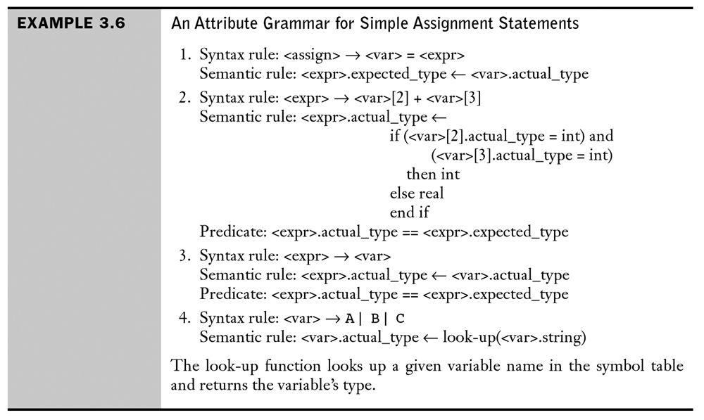
Attribute Grammar: Example
[Sebesta, 2008]

Slide 19
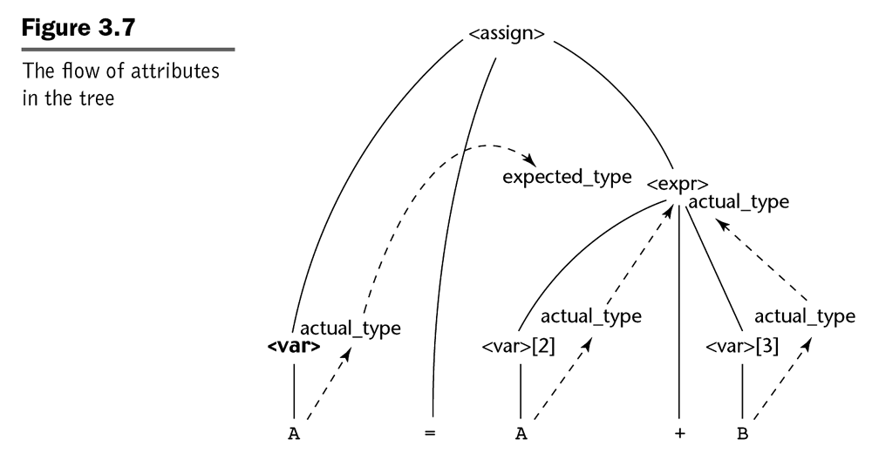
Attribute Flow: Example
[Sebesta, 2008]

Slide 20
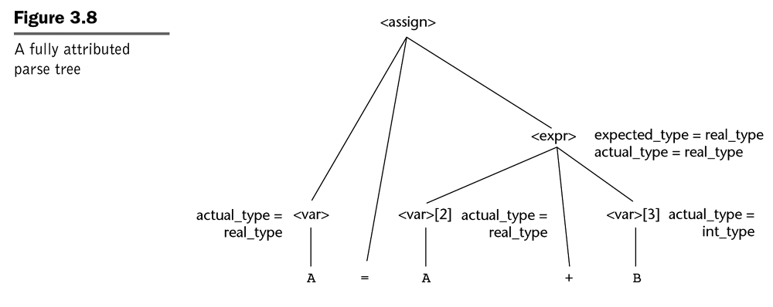
Attributed Parse Tree: Example
To compute all attributes, one may require acyclicity of the attribute dependency graph. Less restrictive conditions are sometimes used [Paaki, J. (1995) “Attribute Grammar Paradigms – A High-Level Methodology in Language Implementation.” ACM Computing Surveys, Vol 27, No 2.
Example from [Sebesta, 2008]

Slide 21
Attribute Grammars and Practice
The attribute grammar formalism is important
Succinctly makes many points clear
Sets the stage for actual, ad-hoc practice
The problems with attribute grammars motivate practice
Non-local computation
Need for centralized information (globals)
Advantages
Addresses the shortcomings of the AG paradigm
Efficient, flexible
Disadvantages
Must write the code with little assistance
Programmer deals directly with the details

Slide 22
The Realist’s Alternative
Ad-hoc syntax-directed translation
Associate a snippet of code with each production
At each reduction, the corresponding snippet runs
Allowing arbitrary code provides complete flexibility
Includes ability to do tasteless & bad things
To make this work
Need names for attributes of each symbol on lhs & rhs
Typically, one attribute passed through parser + arbitrary code (structures, globals, statics, …)
Yacc/CUP introduces $$, $1, $2, … $n, left to right
Need an evaluation scheme
Fits nicely into LR(1) parsing algorithm

Slide 23
Contextual Analysis Phase
Purposes:
Finish syntax analysis by deriving context-sensitive information
Scoping
(static) type checking
Start to interpret meaning of program based on its syntactic structure
Prepare for the final stage of compilation: Code generation

Slide 24
Contextual Analyzer
Which contextual constraints might the compiler add?
Is identifier x declared before it is used?
Which declaration of x does an occurrence of x refer to?
Is x an integer, Boolean, array or a function?
Is an expression type-consistent?
Are any names declared but not used?
Has x been initialized before it is being accessed?
Is an array reference out of bounds?
Does a function bar produce a constant value?
Where can x be stored? (heap, stack, …)

Slide 25
Why contextual analysis can be hard
Questions and answers involve non-local information
Answers mostly depend on values, not syntax
Answers may involve computations
Solution alternatives:
Abstract syntax tree
specify non-local computations by walking the tree
Identification tables (sometimes called symbol tables)
central store for facts + checking code
Language design
simplify language

Slide 26
To simplify the language design or not?
Syntax vs. types
Bool expressions and Int expressions as syntactic categories
One syntactic category of Expressions with types
Psychology of syntax errors vs. type errors
Most C programmers accept syntax errors as their fault, but regard typing errors as annoying constraints imposed on them
Bexp := true
| false
| Bexp Bop Bexp
Bop := & | or | …
IntExp := Literal
| IntExp Iop IntExp
Iop := + | - | * | / | …
vs
Exp := Literal
| Exp op Exp
Op := & | or | + | - | * | / | …

Slide 27
Language Issues
Example Pascal:
Pascal was explicitly designed to be easy to implement with a single pass compiler:
Every identifier must be declared before its first use.
?
var n:integer;
procedure inc; begin n:=n+1 end
procedure inc; begin n:=n+1 end;
var n:integer;
Undeclared Variable!

Slide 28
Language Issues
Example Pascal:
Every identifier must be declared before it is used.
How to handle mutual recursion then?
procedure ping(x:integer) begin ... pong(x-1); ... end;
procedure pong(x:integer) begin ... ping(x); ... end;

Slide 29
Language Issues
Example Pascal:
Every identifier must be declared before it is used.
How to handle mutual recursion then?
forward procedure pong(x:integer)
procedure ping(x:integer) begin ... pong(x-1); ... end;
procedure pong(x:integer) begin ... ping(x); ... end;
OK!

Slide 30
Language Issues
Example SML:
Every identifier must be declared before it is used.
How to handle mutual recursion then?
fun ping(x:int)= ... pong(x-1) ...
fun pong(x:int)= ... ping(x) ... ;
and
OK!

Slide 31
Language Issues
Example Java:
identifiers can be used before they are declared.
thus a Java compiler needs at least two passes
Class Example {
void inc() { n = n + 1; }
int n;
void use() { n = 0 ; inc(); }
}

Slide 32
Contextual Analysis -> Decorated AST
Abstract Syntax Tree
Contextual Analysis
Error Reports
Decorated Abstract Syntax Tree
Contextual analysis:
Scope checking: verify that all applied occurrences of identifiers are declared
Type checking: verify that all operations in the program are used according to their type rules.
Annotate AST:
Applied identifier occurrences => declaration
Expressions => Type

Slide 33
Multi Pass Compiler
A multi pass compiler makes several passes over the program. The output of a preceding phase is stored in a data structure and used by subsequent phases.
Dependency diagram of a typical Multi Pass Compiler:
Compiler Driver
calls
calls
calls
Syntactic Analyzer
Contextual Analyzer
Code Generator
input
input
input
output
output
output
Source Text
AST
Decorated AST
Object Code

Slide 34
Contextual Analysis -> Decorated AST
Annotations:
Program
result of identification
LetCommand
:type result of type checking
SequentialCommand
SequentialDeclaration
AssignCommand
AssignCommand
BinaryExpr
:int
VarDecl
VarDecl
Char.Expr
VNameExp
Int.Expr
:char
:int
:int
SimpleT
SimpleT
SimpleV
SimpleV
:char
:int
Ident
Ident
Ident
Ident
Ident
Char.Lit
Ident
Ident
Op
Int.Lit
n
Integer
c
Char
c
‘&’
n
n
+
1

Slide 35
Recursive Identification
The program is represented by an AST
Possibility:
For every identification: traverse tree and find the right declaration and perform typechecking accordingly
Inefficient solution. . .

Slide 36
Identification Table
The identification table (also often called symbol table) is a dictionary-style data structure in which we somehow store identifier names and relate each identifier to its corresponding attributes.
Typical operations:
Empty the table
Add an entry (Identifier -> Attribute)
Find an entry for an identifier
(open and close scope)

Slide 37
Identification Table
The organization of the identification table depends on the programming language.
Different kinds of “block structure” in languages:
Monolithic block structure: e.g. BASIC, COBOL
Flat block structure: e.g. Fortran
Nested block structure => Modern “block-structured” programming languages (e.g. Algol, Pascal, C, C++, Scheme, Java,…)
a block = an area of text in the program that corresponds to some kind of boundary for the visibility of identifiers.
In Triangle C is a block in let D in C end and proc I (FPS) ~ C
block structure = the textual relationship between blocks in a program.

Slide 38
Different kinds of Block Structure
Monolithic
Flat
Nested

Slide 39
Monolithic Block Structure
Monolithic
A language exhibits monolithic block structure if the only block is the entire program.
=> Every identifier is visible throughout the entire program
Very simple scope rules:
No identifier may be declared more than once
For every applied occurrence of an identifier I there must be a corresponding declaration.

Slide 40
Flat Block Structure
A language exhibits flat block structure if the program can be subdivided into several disjoint blocks
Flat
There are two scope levels: global or local.
Typical scope rules:
a globally defined identifier may be redefined locally
several local definitions of a single identifier may occur in different blocks (but not in the same block)
For every applied occurrence of an identifier there must be either a local declaration within the same block or a global declaration.

Slide 41
Nested Block Structure
A language exhibits nested block structure if blocks may be nested one within another (typically with no upper bound on the level of nesting that is allowed).
Nested
There can be any number of scope levels (depending on the level of nesting of blocks):
Typical scope rules:
no identifier may be declared more than once within the same block (at the same level).
for any applied occurrence there must be a corresponding declaration, either within the same block or in a block in which it is nested.

Slide 42
Identification Table
For a typical programming language, i.e. statically scoped language and with nested block structure we can visualize the structure of all scopes within a program as a kind of tree.
Global
Global
A
A1
A
B
A2
Lookup path for an applied occurrence in A3
A1
A2
A3
A3
= “direction” of identifier lookup
At any one time (in analyzing the program) only a single path on the tree is accessible.
=> We don’t necessarily need to keep the whole “scope” tree in memory all the time.
B

Slide 43
Identification Table: Example
let var a: Integer;
var b: Boolean
in begin
...
let var b: Integer;
var c: Boolean
in begin
...
end
...
let var d: Boolean;
var e: Integer
in begin
let const x:3
in ...
end
end
Level Ident Attr
1 a (1)
1 b (2)
Level Ident Attr
1 a (1)
1 b (2)
2 b (3)
2 c (4)
Level Ident Attr
1 a (1)
1 b (2)
2 d (5)
2 e (6)
Level Ident Attr
1 a (1)
1 b (2)
2 d (5)
2 e (6)
3 x (7)

Slide 44
Identification Table Implementation
public class IdentificationTable {
/** Adds a new entry */
public void enter(String id, Attribute attr) { ... }
/** Retrieve a previously added entry. Returns null
when no entry for this identifier is found */
public Attribute retrieve(String id) { ... }
/** Add a new deepest nesting level to the
identification table */
public void openScope() { ... }
/** Remove the deepest scope level from the table.
Deletes all entries associated with it */
public void closeScope() { ... }
...

Slide 45
Identification Table Implementation
We can use our favorite implementation of a look-up table.
linked list and linear search (easy but slow)
hash table (more efficient)
stack of hash tables
It’s essential that an identifier can appear in the table many times, with different levels, and that look-up returns the entry with the highest level.
(Linked list makes this easy; hash table - perhaps make the entries
linked lists; more complicated possibilities exist.)

Slide 46
Attributes
public void enter(String id, Attribute attr) { ... }
public Attribute retrieve(String id) { ... }
What are these attributes? (Or in other words: What information do we need to store about identifiers)
To understand what information needs to be stored… you first have to understand what the information will be used for!
Checking Scope Rules
Checking Type Rules
Q: So… what information is required by each of these two subphases and where does it come from?

Slide 47
Attributes
The ID table needs to provide information needed for
Checking Scope Rules
Checking Type Rules
Example 1:
let const m~2;
in m + x
Undefined!
Scope Rules
Example 2:
let const m~2 ;
var n:Boolean
in begin
n := m<4;
n := n+1
end
Type error!
Type Rules

Slide 48
Attributes
The ID table needs to provide information needed for
Checking Scope Rules
Checking Type Rules
To check scope rules, all we need to know is whether or not a corresponding declaration exists.
To check type rules we need to be able to find the type of an applied occurrence.
=> One possible solution is to enter type information into the identification (ID) table.
=> Attribute = type information.

Slide 49
Attributes: Example 1: Mini-Triangle attributes
Mini Triangle is very simple: there are only two kinds of declarations
single-Declaration
::= const Identifier ~ Expression
| var Identifier : Type-denoter
... and only two types of values: INT or BOOL
public class Attribute {
public static final byte
CONST = 0, VAR = 1; // two kinds of declaration
BOOL = 0, INT = 1; // two types
byte kind; // either CONST or VAR
byte type; // either BOOL or INT
}

Slide 50
Attributes: Example 2: Triangle attributes
Triangle is more complex => more kinds of declarations and types.
public abstract class Attribute { ... }
public class ConstAttribute extends Attribute {...}
public class VarAttribute extends Attribute {...}
public class ProcAttribute extends Attribute {...}
public class FuncAttribute extends Attribute {
FormalList formals; //a list of (identifier, attribute) pairs
Type resultType;
}
public class TypeAttribute extends Attribute {...}
public abstract class Type {...}
public class BoolType extends Type {...}
public class CharType extends Type {...}
public class IntType extends Type {...}
public class ArrayType extends Type {
int elementCount;
Type elementType;
}
public class RecordType extends Type {
FieldList fields; // a list of (identifier, type) pairs
}

Slide 51
Attributes: Pointers to Declaration AST’s
Mini Triangle is very simple, but in a more realistic language the attributes can be quite complicated (many different kinds of identifiers and many different types of values)
=> The implementation of “attributes” becomes much more complex and tedious.
Observation: The declarations of identifiers provide the necessary information for attributes.
=> For some languages, a practical way to represent attributes is simply as pointers to the AST-subtree of the actual declaration of an identifier.

Slide 52
Attributes as pointers to Declaration ASTs
Program
LetCommand
SequentialDecl
LetCommand
VarDecl
VarDecl
VarDecl
Ident
Ident
Ident
Ident
Id table
Ident
Ident
Level Ident Attr
1 x •
1 a •
2 y •
x
int
a
bool
y
int
Figure 5.4 (p.148) in text shows how the table changes during contextual analysis of each of two blocks. enter and retrieve are used.

Slide 53
The Standard Environment
Most programming languages have a set of predefined functions, operators etc.
We call this the standard environment
top-level environment in ML: http://www.standardml.org/Basis/top-level-chapter.html
standard environment in Triangle (p.401)
standard environment in Mini-Triangle (p.149)
standard prelude in Haskell: “The Prelude: a standard module imported by default into all Haskell modules.” See Chapter 9 *”Standard Prelude” at: https://www.haskell.org/definition/haskell2010.pdf
java.lang in Java: “Provides classes that are fundamental to the design of the Java programming language” (java.sun.com)
The package Standard in Ada: http://www.ida.liu.se/edu/ugrad/progkon/Ada/ada-doc/LRM95/rm95html/rm9x-A-01.html
At the start of identification the ID table is not empty but... needs to be initialized with entries representing the standard environment.

Slide 54
The Standard Environment
Example: Mini triangle standard environment
type Boolean ~ ...;
const false ~ ...;
const true ~ ...;
type Integer ~ ...;
const maxint ~ ...;
func \ (b:Boolean) : Boolean ~ ...;
func + (i1:Integer, i2:Integer) : Integer ~ ...;
func - (i1:Integer, i2:Integer) : Integer ~ ...;
func * (i1:Integer, i2:Integer) : Integer ~ ...;
func / (i1:Integer, i2:Integer) : Integer ~ ...;
func > (i1:Integer, i2:Integer) : Boolean ~ ...;
func < (i1:Integer, i2:Integer) : Boolean ~ ...;
proc putint(i: Integer) ~ ...;
And for each type T:
func = (v1:T, v2:T) : Boolean ~ ...;

Slide 55
Scope for Standard Environment
Should the scope level for the standard environment be the same as the global declarations (level 1) or outside the global declarations (level 0)?
C: level 1
Mini-Triangle: level 0
Consequence:
1 let
2 var false : Integer
3 in
4 begin
5 false := 3;
6 putint ( false )
7 end
is a perfectly correct Mini-Triangle program
Similar with Integer or putint. . .

Slide 56
Type Checking
RECAP: The contextual analyzer performs two tasks:
identification
(static) type checking
In a statically typed language every expression E either:
Is ill-typed
Or has a static type that can be computed without actually evaluating E
When an expression E has static type T this means that when E is evaluated then the returned value will always have type T
=> This makes static type checking possible!

Slide 57
Type Checking: How Does It Work
For most statically typed programming languages, a bottom up algorithm over the AST:
Types of expression AST leaves are known immediately:
literals => obvious
variables => from the ID table
named constants => from the ID table
Types of internal nodes are inferred from the type of the children and the type rule for that kind of expression

Slide 58
Type Checking: How Does It Work
Example: Type of a variable (applied occurrence)
VarDecl
SimpleVName
type
Ident
Ident
type
x
x

Slide 59
Type Checking: How Does It Work
Example: the type of a binary operation expressions
Type rule:
If op is an operation of type T1xT2->R then E1 op E2 is type correct and of type R if E1 and E2 are type correct and have type compatible with T1 and T2 respectively
BinOp
bool
Int.Expr
Operator
Int.Expr
int
intxint->bool
int
3
<
4

Slide 60
Type checking
Commands which contain expressions:
Type rule of ifCommand:
if E do C1 else C2 is type correct
if E of type Boolean and C1 and C2 are type correct
deduce that this command is correctly typed
IfCommand
Expression
Command
Command
check that this
has type Boolean
typecheck
typecheck
WhileCommand is similar.

Slide 61
Type checking
Function applications:
deduce that this has type Boolean,
and record the type in the AST
FunctionApp
Name
Expression
after identification,
we know the type of
this function: e.g.
f : Integer → Boolean
check that this
has type Integer

Slide 62
Type checking
Function definitions:
func f(x : ParamType) : ResultType ~ Expression
Typecheck the function body and
calculate its type.
Check that the type is ResultType.
Then deduce
f : ParamType → ResultType
e.g.
f : Integer → Boolean

Slide 63
Type checking
Operators in expressions (again):
For each operator we know that the operands must have certain
types, and that the result has a certain type. This information can
be represented by giving the operators function types:
+ : Integer × Integer → Integer
< : Integer × Integer → Boolean
deduce that this has type Boolean,
and record the type in the AST
<
check that this
has type Integer
check that this
has type Integer

Slide 64
Contextual Analysis
Identification and type checking are combined into a depth-first traversal
of the abstract syntax tree.
Program
LetCommand
SequentialDeclaration
SequentialCommand
AssignCommand
AssignCommand
BinaryExpression
VarDec
VarDec
CharExpr
VnameExpr
IntExpr
SimpleT
SimpleT
SimpleV
SimpleV
SimpleV
Ident
Ident
Ident
Ident
Ident
CharLit
Ident
Ident
Op
IntLit
n
Integer
c
Char
c
‘&’
n
n
+
1

Slide 65
Contextual Analysis: an Algorithm
Identification and Type checking could be done as separate passes over the AST but …
In practice the two are often done (interleaved) in a single pass.
Every applied occurrence of an identifier must be identified before type checking can proceed.
A possible implementation:
One depth-first traversal over the AST to do both identification and type checking.
Results of the analysis recorded in the AST by decorating it.
note: For Java the contextual analysis is somewhat more complicated.
=> Contextual analysis for Java: several passes.

Slide 66
Depth-First Traversal
Depth-first traversal depends on the structure of the AST - it depends
on the number and kind of descendants of each node. Organize it as a
collection of functions: analyzeNodeType
analyzeProgram(Program P) {
… analyzeCommand(P.C) … }
analyzeIfCommand(IfCommand C) {
… analyzeExpression(C.E) …
… analyzeCommand(C.C1)… analyzeCommand(C.C2)… }

Slide 67
Depth-First Traversal
It turns out (later in the course) that code generation also requires a
traversal of the AST. So we expect the code generator to be
organized similarly:
generateProgram(Program P) {
… generateCommand(P.C) … }
generateIfCommand(IfCommand C) {
… generateExpression(C.E) …
… generateCommand(C.C1)… generateCommand(C.C2)… }

Slide 68
Implementing Tree Traversal
“Traditional” OO approach
“Functional” approach
Visitor approach
(Aspect oriented approach)

Slide 69
Implementing Tree Traversal: Traditional
“Traditional” OO approach would be to add a method to each class, so for each node in the AST we would have a method that knows how to traverse its children.
Scatters code over a large number of classes
Requires recompilation of AST classes each time a method needs changing

Slide 70
Implementing Tree Traversal: instanceof
Another possibility is to use a “functional” approach and
implement a case-analysis on the class of an object.
Type check(Expr e) {
if (e instanceof IntLitExpr)
return representation of type int
else if (e instanceof BoolLitExpr)
return representation of type bool
else if (e instanceof EqExpr) {
Type t = check(((EqExpr)e).left);
Type u = check(((EqExpr)e).right);
if (t == representation of type int &&
u == representation of type int)
return representation of type bool
...

Slide 71
Implementing Tree Traversal: instanceof
This approach leads to a messy nested if, which can’t be
converted into a switch because Java has no mechanism for switching on the class of an object.
Also this technique is not very object-oriented: instead of
explicitly using instanceof, we prefer to arrange for analysis of an object’s class to be done via the built-in mechanisms of overloading and dynamic method dispatch.

Slide 72
Patterns
Eric Gamma, Richard Helm, Ralph Johnson, and John Vlissides. Design Patterns: Elements of Reusable Object-Oriented Software. Addison-Wesley, 1995.
O-O “design patterns are descriptions of communicating objects and classes that are customized to solve a general design problem in a particular context.”
ADTs are not considered design patterns.

Slide 73
How Does a Visitor Work?
The compiler creates a TypeChecking Visitor Object---see p.155.
The compiler calls the visit operation on the AST with that AST object as an argument.
Each of the nodes implement visit by calling back on the visitor, e.g., an assignment node calls visitAssignCommand (p.159).

Slide 74
Trade-Offs
The contextual analyzer is all together in a single class, rather than spread out with one method per AST subclass.
If the AST changes, one has to redefine the interface to all visitors, which is costly: in this case, it is better to define the operations in the AST classes themselves.

Slide 75
Implementing Tree Traversal: Visitor
Solution using Visitor:
Visitor is an abstract class that has a different method for each type of object on which it operates
Each operation is a subclass of Visitor and overloads the type-specific methods
Objects that are operated on accept a Visitor and call back their type-specific method passing themselves as operands
Object types are independent of the operations that apply to them
New operations can be added without modifying the object types

Slide 76
Visitor Solution
Node
Accept( NodeVisitor v )
Nodes accept visitors and call appropriate method of the visitor
Visitors implement the operations and have one method for each type of node they visit
VariableRefNode
AssignmentNode
Accept(NodeVisitor v)
{v->VisitVariableRef(this)}
Accept(NodeVisitor v)
{v->VisitAssignment(this)}
NodeVisitor
VisitAssignment( AssignmentNode )
VisitVariableRef( VariableRefNode )
TypeCheckingVisitor
CodeGeneratingVisitor
VisitAssignment( AssignmentNode )
VisitVariableRef( VariableRefNode )
VisitAssignment( AssignmentNode )
VisitVariableRef( VariableRefNode )

Slide 77
The Visitor Design Pattern
Abstracting the common structure of the contextual analyzer and the code generator, we can make use of the visitor design pattern. The Visitor interface specifies a collection of visitor methods which must be implemented by any particular tree traversal.
interface Visitor {
public Object visitProgram(Program prog, Object arg);
public Object visitAssignCommand(AssignCommand com, Object arg);
… }
to allow a result to be returned:
e.g. the type of an expression,
during type checking
to allow additional information to be
supplied: e.g. during code generation
this parameter holds information about
the size of the object code

Slide 78
The Visitor Design Pattern
The contextual analyzer and the code generator are implemented as classes that implement the Visitor interface. For example:
class Checker implements Visitor {
…
public Object checkIfCommand(IfCommand com, Object arg) {
… checkExpression(com.E) …
… checkCommand(com.C1)… checkCommand(com.C2)…
… }
…
}

Slide 79
The Visitor Design Pattern
There is one further complication. How would we implement
Object checkCommand(Command com, Object arg)
?
com is an instance of one of the classes IfCommand, WhileCommand
etc. Within checkCommand we should call the appropriate check
method, but which one? We would need a messy series of tests using
instanceof:
if (com instanceof IfCommand) checkIfCommand(com, arg)
else if (com instanceof WhileCommand) checkWhileCommand(com, arg)
else …

Slide 80
The Visitor Design Pattern
Instead of a long sequence of instanceof tests, we define a visit method in every AST class. It is given a visitor object (for example, an object of class Checker) and simply applies the correct visitor method to itself.
class IfCommand extends Command {
…
public Object visit(Visitor v, Object arg) {
return v.visitIfCommand(this, arg);
}
}
Instead of calling checkCommand(com.C1,arg) we just call
com.C1.visit(this, arg) (this refers to the current Visitor object).
We exploit the fact that com “knows” which class it is an instance of.
This approach is more in the spirit of OO programming.

Slide 81
The Visitor Design Pattern
The class Checker defines checkIfCommand etc., but there is no checkCommand method.
To do contextual analysis, we create an object of class Checker:
Checker theChecker = new Checker( );
and apply the top-level checking function to the AST:
theChecker.visitProgram(theAST,null);
this parameter is
only used by the
code generator
within visitProgram we get the call
theAST.C.visit(this,null)
because Program contains
Command C;
refers to theChecker because visitProgram
is defined within Checker

Slide 82
The Visitor Design Pattern
If the Command C within theAST is an IfCommand then the call
theAST.C.visit(theChecker,null)
will execute
theChecker.visitIfCommand(C,null)
which is what we want.
In summary, the visitor design pattern consists of
classes such as Checker and CodeGenerator which implement the interface Visitor
the visit methods within the AST node classes.

Slide 83
Example: Implementation of Mini-Triangle Contextual Analyzer
RECAP: Mini Triangle Abstract Syntax
Program ::= Command Program
Command
::= V-name := Expression AssignCmd
| Identifier ( Expression ) CallCmd
| if Expression then Command
else Command IfCmd
| while Expression do Command WhileCmd
| let Declaration in Command LetCmd
| Command ; Command SequentialCmd
V-name ::= Identifier SimpleVName
…
Expression: Compute its type, make annotation, return type.
Commands: Check. Returns void.
Declaration: Check and enter into id-table, returns void.
Identifier: (applied occurrence) make annotation, return corresponding declaration.

Slide 84
RECAP: Mini Triangle Abstract Syntax (ctd)
Declaration
::= const Identifier ~ Expression ConstDecl
| var Identifier : TypeDenoter VarDecl
| Declaration ; Declaration SequentialDecl
TypeDenoter ::= Identifier SimpleTypeDenoter
Expression
::= Integer-Literal IntegerExpression
| V-name VnameExpression
| Operator Expression UnaryExpression
| Expression Op Expression BinaryExpression

Slide 85
RECAP: AST representation (ctd)
Declaration
::= const Identifier ~ Expression ConstDecl
| var Identifier : TypeDenoter VarDecl
| Declaration ; Declaration SequentialDecl
AST
Declaration
Expression
ConstDecl
VarDecl
SequentialDecl

Slide 86
RECAP: AST representation (ctd)
Declaration
::= const Identifier ~ Expression ConstDecl
| var Identifier : TypeDenoter VarDecl
| Declaration ; Declaration SequentialDecl
public class ConstDecl extends Declaration {
public Identifier I; // constant name
public Expression E; // constant value
...
}
public class VarDecl extends Declaration {
...
...

Slide 87
Representing the Decorated AST (in Java)
1) We add some instance variables to some of the AST node classes.
public abstract class Expression extends AST {
// Every type-correct expression has a static type
public Type type;
...
}
public class Identifier extends Token {
// For applied occurrences only: where was this id
// declared?
public Declaration decl;
...
}
...

Slide 88
Representing the Decorated AST (in Java)
...
public abstract class VName extends AST {
// The type of this variable or constant name
public Type type;
// Is it a variable? (otherwise it is a constant)
public boolean variable;
}

Slide 89
Traversal over the AST: Visitor Design Pattern
public interface Visitor {
// Programs
public Object visitProgram(Program p,Object arg);
// Commands
public Object visitAssignCommand
(AssignCommand c,Object arg);
public Object visitCallCommand
(CallCommand c,Object arg);
...
// Expressions
public Object visitVnameExpression
(VnameExpression e,Object arg);
public Object visitUnaryExpression
(UnaryExpression e,Object arg);
...
For passing extra
arguments/infoto a traversal
Traversal may compute a value

Slide 90
Traversal over the AST: Visitor Design Pattern
public abstract class AST {
...
public abstract Object visit(Visitor v,Object arg);
}
In every concrete AST class add:
public class AssignCommand extends AST {
...
public Object visit(Visitor v,Object arg) {
return v.visitAssignCommand(this,arg);
}
}
public class IfCommand extends AST {
...
public Object visit(Visitor v,Object arg) {
return v.visitIfCommand(this,arg);
}
}

Slide 91
Example: Implementation of Mini-Triangle Contextual Analyzer
Mini Triangle Types
public class Type {
private byte kind; // INT, BOOL or ERROR
public static final byte
BOOL=0, INT=1, ERROR=-1;
private Type(byte kind) { ... }
public boolean equals(Object other) { ... }
public static Type boolT = new Type(BOOL);
public static Type intT = new Type(INT);
public static Type errorT = new Type(ERROR);
}

Slide 92
Example: Implementation of Mini-Triangle Contextual Analyzer
Contextual Analyzer as an AST visitor
public class Checker implements Visitor {
private IdentificationTable idTable;
public void check(Program prog) {
idTable = new IdentificationTable();
// initialize with standard environment
idTable.enter(“false”,...);
...
idTable.enter(“putint”,...);
prog.visit(this,null);
}
...
Checker is a traversal of AST
Start AST traversal with this checker

Slide 93
What the Checker Visitor Does
visitProgram Check whether program is well-formed and return null.
visit…Command Check whether the command is well-formed and return null.
visit…Expression Check expression, decorate it with its type and return the type.
visitSimpleVName Check whether name is declared. Decorate it with its type and a flag whether it is a variable. Return its type.
visit…Declaration Check that declaration is well-formed. Enter declared identifier into ID table. Return null.
visitSimpleTypeDen Check that type denoter is well-formed. Decorate with its type. Return the type.
visitIdentifier Check whether identifier is declared. Decorate with link to its declaration. Return declaration.

Slide 94
Example: Implementation of Mini-Triangle Contextual Analyzer
public class Checker implements Visitor {
...
//Checking commands
public Object visitAssignCommand (AssignCommand com,Object arg)
{
Type vType = (Type) com.V.visit(this,null);
Type eType = (Type) com.E.visit(this,null);
if (! com.V.variable)
report error: v is not a variable
if (! eType.equals(vType) )
report error incompatible types in assignCommand
return null;
}
...

Slide 95
Example: Implementation of Mini-Triangle Contextual Analyzer
...
public Object visitIfCommand (IfCommand com,Object arg)
{
Type eType = (Type)com.E.visit(this,null);
if (! eType.equals(Type.boolT) )
report error: expression in if not boolean
com.C1.visit(this,null);
com.C2.visit(this,null);
return null;
}
...

Slide 96
Example: Implementation of Mini-Triangle Contextual Analyzer
...
public Object visitSequentialCommand
(SequentialCommand com,Object arg)
{
com.C1.visit(this,null);
com.C2.visit(this,null);
}
public Object visitLetCommand (LetCommand com,Object arg)
{
idTable.openScope();
com.D.visit(this,null); // enters declarations into idTable
com.C.visit(this,null);
idTable.closeScope();
return null;
}
...

Slide 97
Example: Implementation of Mini-Triangle Contextual Analyzer
// Expression Checking
public Object visitIntegerExpression
(IntegerExpression expr,Object arg)
{
expr.type = Type.intT; // decoration
return expr.type;
}
public Object visitVnameExpression
(VnameExpression expr,Object arg)
{
Type vType = (Type) expr.V.visit(this,null);
expr.type = vType; // decoration
return expr.type;
}

Slide 98
Example: Implementation of Mini-Triangle Contextual Analyzer
public Object visitBinaryExpression
(BinaryExpression expr,Object arg) {
Type e1Type = expr.E1.visit(this,null);
Type e2Type = expr.E2.visit(this,null);
OperatorDeclaration opdecl =
(OperatorDeclaration) expr.O.visit(this,null);
if (opdecl==null) {
// error: operator not defined
expr.type = Type.error;
} else if (opdecl instanceof BinaryOperatorDecl) {
// check binary operator
} else {
// error: operator not binary
expr.type = Type.errorT;
}
return expr.type;
}

Slide 99
Example: Implementation of Mini-Triangle Contextual Analyzer
public Object visitBinaryExpression
(BinaryExpression expr,Object arg) {
...
} else if (opdecl instanceof BinaryOperatorDecl) {
BinaryOperatorDecl bopdecl =
(BinaryOperatorDecl) opdecl;
if (! e1Type.equals(bopdecl.operand1Type) )
// error: first argument wrong type
if (! e2Type.equals(bopdecl.operand2Type) )
// error: second argument wrong type
expr.type = bopdecl.resultType;
} else {
// error: operator not binary
...
}
return expr.type;
}

Slide 100
Example: Implementation of Mini-Triangle Contextual Analyzer
// Declaration checking
public Object visitVarDeclaration
(VarDeclaration decl,Object arg) {
decl.T.visit(this,null);
idTable.enter(decl.I.spelling,decl);
return null;
}
public Object visitConstDeclaration
(ConstDeclaration decl,Object arg) {
decl.E.visit(this,null);
idTable.enter(decl.I.spelling,decl);
return null;
}
...

Slide 101
Example: Implementation of Mini-Triangle Contextual Analyzer
// Type denoter checking
public Object visitSimpleTypeDenoter
(SimpleTypeDenoter den,Object arg) {
if (den.I.spelling.equals(“Integer”)
den.type = Type.intT;
else if (den.I.spelling.equals(“Boolean”)
den.type = Type.boolT;
else {
// error: unknown type denoter
den.type = Type.errorT;
}
return den.type;
}
...

Slide 102
Example: Implementation of Mini-Triangle Contextual Analyzer
// VName checking
public Object visitSimpleVName
(SimpleVname vname, Object arg) {
Declaration decl = vname.I.visit(this,null);
if (decl==null) {
// error: VName not declared
vname = Type.errorT;
vname.variable = true;
} else if (decl instanceof ConstDeclaration) {
vname.type = ((ConstDeclaration) decl).E.type);
vname.variable = false;
} else if (decl instanceof VarDeclaration) {
vname.type = ((VarDeclaration) decl).T.type);
vname.variable = true;
}
return vname.type;
}

Slide 103
Example: Implementation of Mini-Triangle Contextual Analyzer
...
// Checking applied occurrence of Id.
public Object visitIdentifier
(Identifier id,Object arg) {
id.decl = idTable.retrieve(id.spelling);
return id.decl;
}
}

Slide 104
Consequences of using Visitor
Addition of new operations is easy
New operations can be created by simply adding a new visitor
Gathers related operations together
All operation related code is in the visitor
Code for different operations are in different sub-classes of visitor
Unrelated operations are not mixed together in the object classes
Adding a new concrete type in the object structure is hard
Each Visitor has to be recompiled with an appropriate method for the new type

Slide 105
Summary
Contextual constraints
Scoping rules
Typing rules
Both part of programming language definition
Design choices:
static vs. dynamic scope
nesting of scopes
scope level of standard environment
static vs. dynamic typing
type checking: syntax vs. checking
Implementations
Identification table (symbol table)
Attributes (record/objects or references to AST)
Algorithm to walk the AST and produce DAST
Traditional
Functional
Visitors pattern
(aspect oriented)

