Slide 1
CSCE 531
Compiler Construction
Ch.2 [W]: Language Processors
Spring 2022
Marco Valtorta
mgv@cse.sc.edu
Notes:
Based on Watt and Brown ([W]) and on Mogensen 2010 [M10]. See course website for full references.

Slide 2
Today’s lecture
Treating compilers and interpreters as black-boxes
Tombstone diagrams (T-diagrams)
Key reference: Jay Earley and Howard Sturgis. “A Formalism for Translator Interactions.” Communications of the ACM, 607-617, 13, 10 (October 1970).
Chapter 2 of [W] (“Language Processors”)
Alternative presentation in Ch.13 [M10].
T-diagrams are also called Bratman diagrams.
Notes:
As explained on p.288 [M10], Bratman wrote a paper in which he introduced T-shaped diagrams: H. Bratman. An alternative form of the ‘UNCOL’ diagram. Communications
of the ACM, 4(3):142, 1961. “The notation for interpreters, machines, and unspecified programs was introduced” by Earley and Sturgis in: J. Earley and H. Sturgis. A formalism for translator interactions. Communications of the ACM, 13:607–617, 1970.

Slide 3
Language Translation
A programming language processor is any system that manipulates programs expressed in a programming language (PL)
A source program in some source language is translated into an object program in some target language
Translators are assemblers or compilers
An assembler translates from assembly language to machine language
A compiler translates from a high-level language into a low-level language
  the compiler is written in its implementation language
An interpreter is a program that accepts a source program and runs it (almost) immediately
An interpretive compiler translates a source program into an intermediate language, and the resulting object program is then executed by an interpreter

Slide 4
Example of Language Translators
Compilers for Fortran, COBOL, C, C++
Interpretive compilers for Pascal (P-Code), Prolog (Warren Abstract Machine) and Java (Java Virtual Machine)
Interpreters for APL, Scheme, Haskell, Python, and (early) LISP

Slide 5
Terminology
Q: Which programming languages play a role in this picture?
input
Translator
output
source program
object program
is expressed in the
source language
is expressed in the
target language
is expressed in the
implementation language
A: All of them!

Slide 6
Tombstone Diagrams
What are they?
diagrams consisting out of a set of “puzzle pieces” we can use to reason about language processors and programs
different kinds of pieces
  the base of the piece always contains the implementation language
combination rules (not all diagrams are “well formed”)
Program P implemented in L
Translator implemented in L
P
S -> T
L
L
Machine implemented in hardware
Language interpreter in L
M
M
L

Slide 7
Tombstone diagrams: Combination rules
P
P
P
M
S
S -> T
T
OK!
M
M
OK!
OK!
M
OK!
P
P
L
WRONG!
L
S -> T
M
M
WRONG!

Slide 8
Compilation
Example: Compilation of C programs on an x86 machine
Tetris
Tetris
Tetris
C
C -> x86
x86
x86
x86
x86
x86

Slide 9
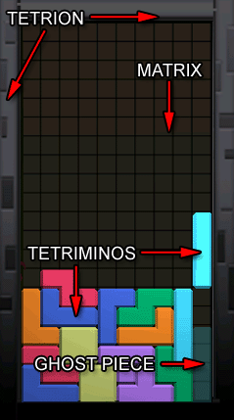
What is Tetris?
The game Tetris® was commercially introduced in 1987.

Slide 10
Cross compilation
Example: A C “cross compiler” from x86 to PPC
A cross compiler is a compiler that runs on one machine (the host machine) but emits code for another machine (the target machine).
Tetris
Tetris
Tetris
C
C -> PPC
PPC
download
PPC
x86
PPC
x86
Host ≠ Target
Q: Are cross compilers useful? Why would/could we use them?
Notes:
Example: The cross-compiler for the TMS C30 Texas Instrument Digital Signal Processor runs under DOS on PCs

Slide 11
Two Stage Compilation
A two-stage translator is a composition of two translators. The output of the first translator is provided as input to the second translator.
Tetris
Tetris
Tetris
Java
Java->JVM
JVM
JVM->x86
x86
x86
x86
x86
x86

Slide 12
Compiling a Compiler
Observation: A compiler is a program!
Therefore it can be provided as input to a language processor.
Example: compiling a compiler.
Java->x86
Java->x86
C
C -> x86
x86
x86
x86

Slide 13
Half Bootstrapping
Suppose we have a compiler from ML (a functional high-level language) to ARM (a machine language) whose implementation language is ARM, and we want a compiler from ML to x86 (a machine language) whose implementation language is x86, as shown below. We will use a technique called half bootstrapping.
[M10, p.284]
ML -> ARM
ARM
ARM
Notes:
This is called “half bootstrap” on slides 34-35. It is described in section 2.6.3 [W].

Slide 14
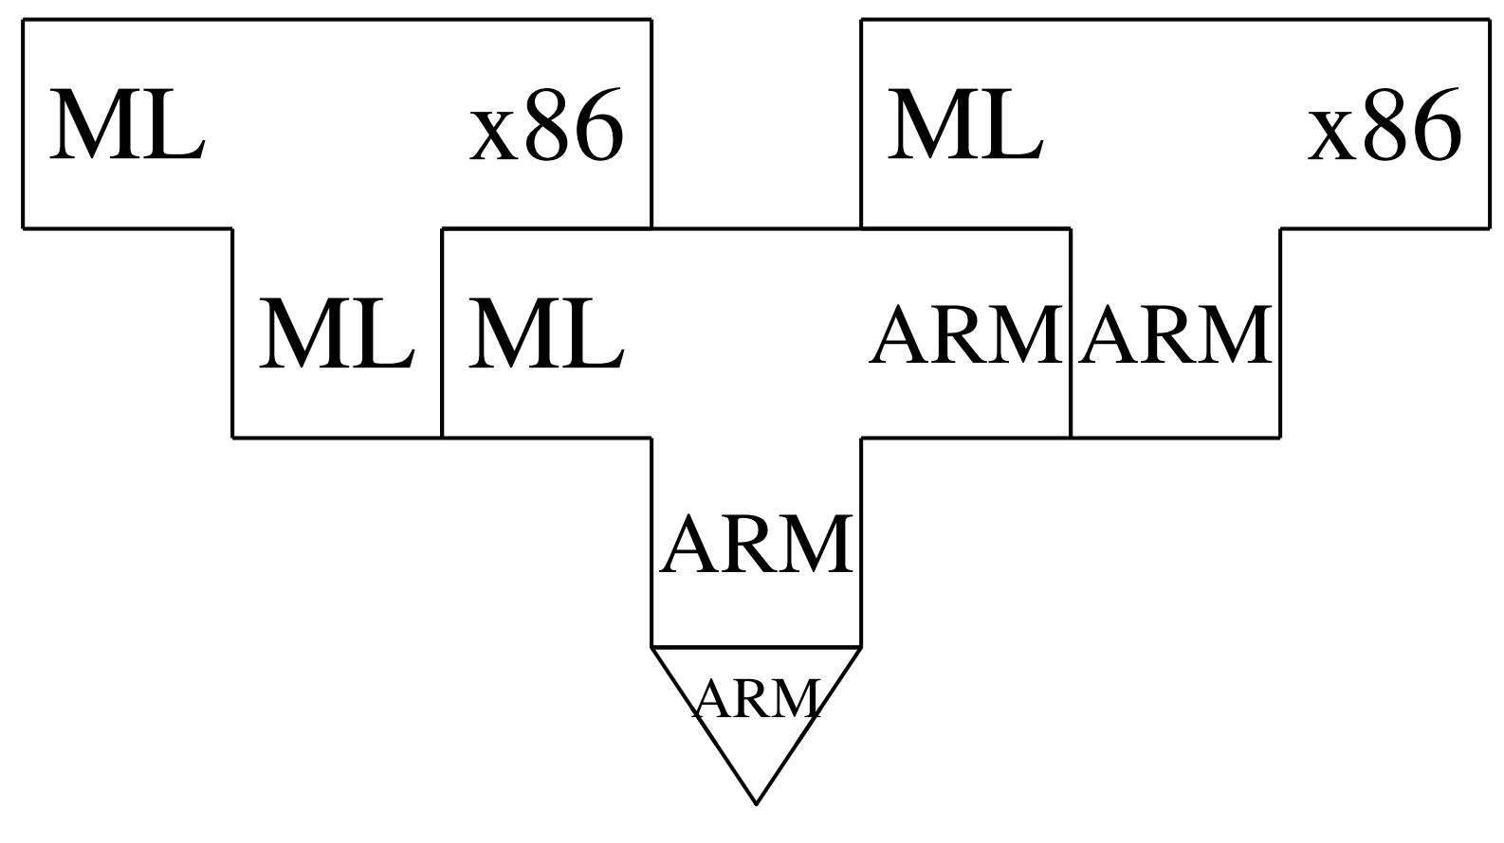
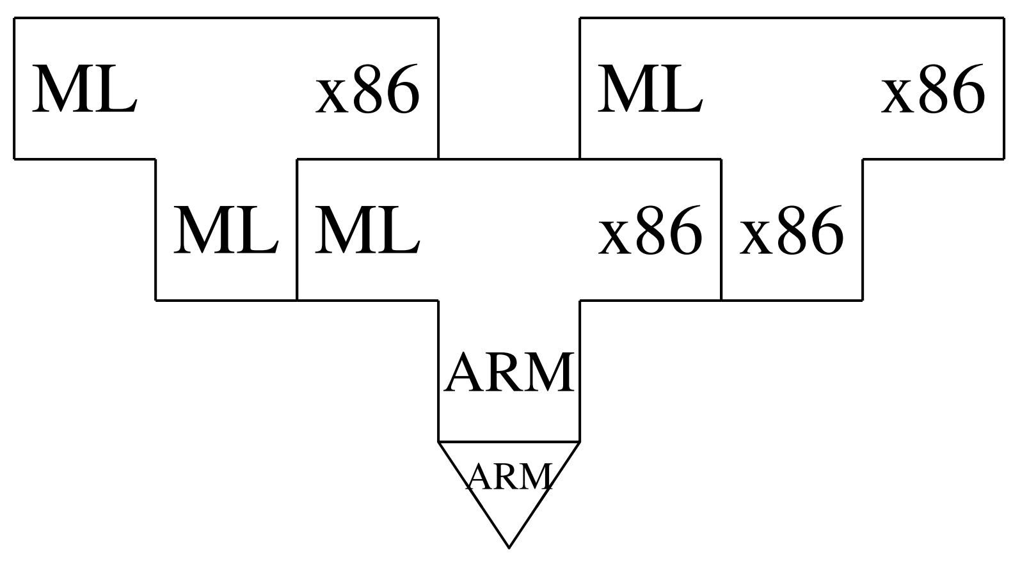
Compiling a Compiler
A better solution than binary translation (writing a compiler from ARM to x86 machine code) is to write an ML-to-x86 compiler in ML and compile it using the ML compiler on the ARM:
We can now run the ML to x86 compiler on the ARM and let it compile itself:
(This is the actual bootstrap.)
This process is called half bootstrapping. The x86 machine language is both the target and the implementation language of the compiler we have obtained, but all the new code we wrote is in a high-level language (ML).

Slide 15
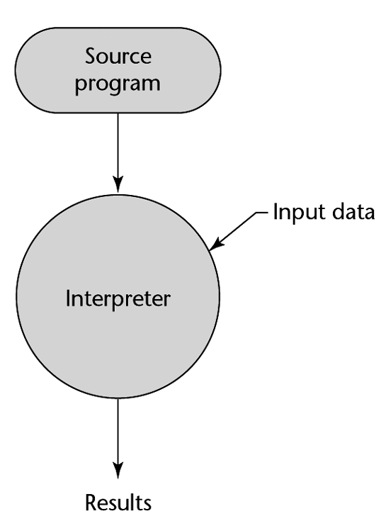
Interpreters
An interpreter is a language processor implemented in software, which accepts any program (the source program) expressed in a particular language (the source language) and runs that source program immediately.
An interpreter works by fetching, analyzing, and executing the source program instructions, one at a time. The source program starts to run and produce results as soon as the first instruction has been analyzed. The interpreter does not translate the source program into object code prior to execution. However,
  the analysis phase may involve local translation into a suitable intermediate representation
  recursive interpreters may analyze the whole program before executing any instruction
Notes:
The two bullets are important!

Slide 16
Interpreters versus Compilers
Q: What are the tradeoffs between compilation and interpretation?
Compilers typically offer more advantages when
  programs are deployed in a production setting
  programs are “repetitive”
  the instructions of the programming language are complex
Interpreters typically are a better choice when
  we are in a development/testing/debugging stage
  programs are run once and then discarded
  the instructions of the language are simple
  the execution speed is overshadowed by other factors
    e.g. on a web server where communications costs are much higher than execution speed

Slide 17
Interpreters
Terminology: abstract (or virtual) machine versus real machine
Example: The Java Virtual Machine
Tetris
JVM
JVM
x86
x86
Q: Why are abstract machines useful?

Slide 18
Interpreters
Q: Why are abstract machines useful?
1) Abstract machines provide better platform independence
Tetris
Tetris
JVM
JVM
JVM
x86
JVM
PPC
x86
PPC

Slide 19
Interpreters
Q: Why are abstract machines useful?
2) Abstract machines are useful for testing and debugging.
Example: Testing the “Ultima” processor using hardware emulation
P
P
Ultima
≡
Ultima
Ultima
x86
Ultima
x86
Functional equivalence
Note: we don’t have to implement Ultima emulator in x86; we can use a high-level language and compile it.

Slide 20
Interpretive Compilers
Why?
A tradeoff between fast(er) compilation and a reasonable runtime performance.
How?
Use an “intermediate language”
  more high-level than machine code => easier to compile to
  more low-level than source language => easy to implement as an interpreter
Example: A “Java Development Kit” for machine M
Java->JVM
JVM
M
M

Slide 21
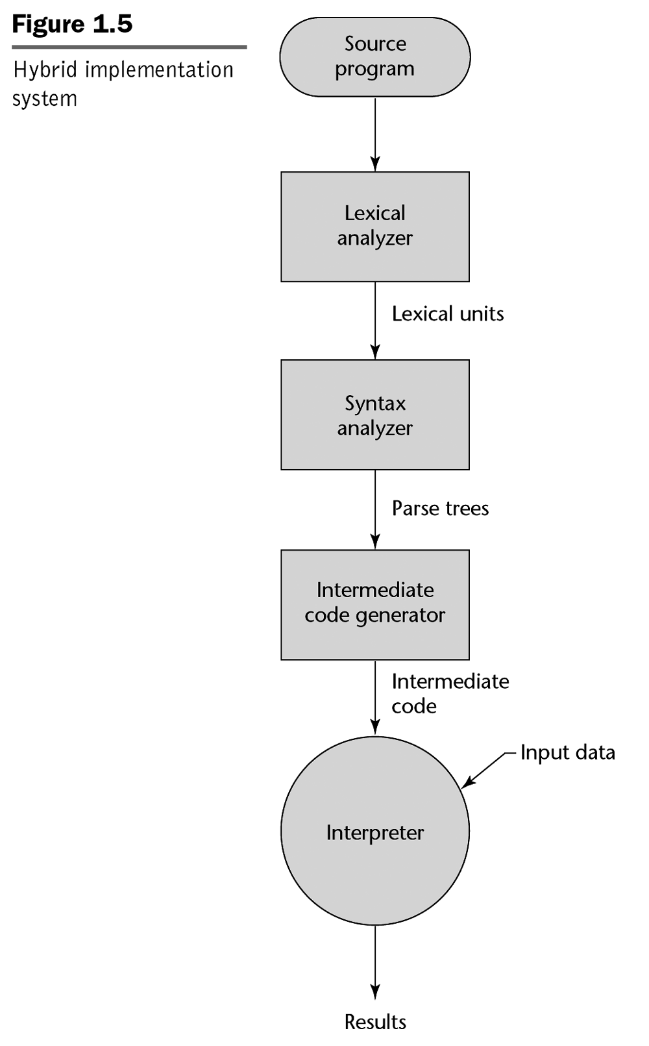
Hybrid Compilation and Interpretation
Notes:
[Sebesta]

Slide 22
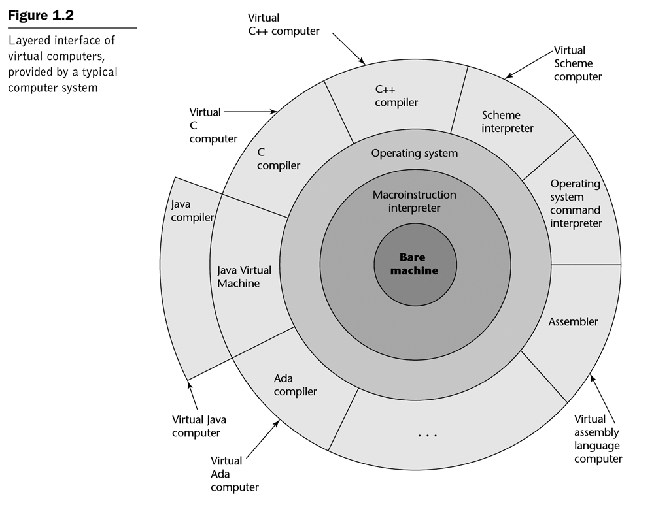
Notes:
Sebesta, 2007

Slide 23
Interpretive Compilers
Example: Here is how we use our “Java Development Kit” to run a Java program P
P
P
P
Java
Java->JVM
JVM
JVM
M
JVM
M
M
javac
java
M

Slide 24
Portable Compilers
Example: Two different “Java Development Kits”
Kit 1:
Java->JVM
JVM
M
M
Kit 2:
Java->JVM
JVM
M
JVM
Q: Which one is “more portable”?

Slide 25
Portable Compilers
Portability is not an “all or nothing” kind of deal.
It is useful to talk about a “degree of portability” as the percentage of code that needs to be re-written when moving to a dissimilar machine.
A program written in assembly language is around 0% portable.
A program written in a high language may be close to 100% portable.
A compiler written in a high-level language is around 50% portable: the “front end” (analysis part, including lexical analysis, syntactic analysis, and contextual analysis) is (almost) fully portable; the “back end” (synthesis part, including code generation) is not portable.

Slide 26
Example: a “portable” compiler kit
Portable Compiler Kit:
Java->JVM
Java->JVM
JVM
Java
Java
JVM
Q: Suppose we want to run this kit on some machine M. How could we go about realizing that goal? (with the least amount of effort)
Assume we already have a compiler for a high-level language, such as C, for machine M:
C->M
M
Notes:
Example 2.16 [M].

Slide 27
Example: a “portable” compiler kit
Java->JVM
Java->JVM
JVM
Java
Java
JVM
Q: Suppose we want to run this kit on some machine M. How could we go about realizing that goal? (with the least amount of effort)
reimplement
JVM
Java
JVM
C
JVM
M
C->M
M
M

Slide 28
Example: a “portable” compiler kit
This is what we have now:
Java->JVM
Java->JVM
JVM
Java
JVM
M
Java
JVM
Now, how do we run our Tetris program?
Tetris
Tetris
Tetris
Java
Java->JVM
JVM
JVM
JVM
JVM
M
JVM
M
M
M

Slide 29
Bootstrapping
Remember our “portable compiler kit”:
Java->JVM
Java->JVM
JVM
Java
JVM
M
Java
JVM
We haven’t used this yet!
Java->JVM
Java
Same language!
Q: What can we do with a compiler written in itself? Is that useful at all?

Slide 30
Bootstrapping
Java->JVM
Java
Q: What can we do with a compiler written in itself? Is that useful at all?
Same language!
By implementing the compiler in (a subset of) its own language, we become less dependent on the target platform => more portable implementation.
But… “chicken and egg problem”? How do to get around that?
=> BOOTSTRAPPING: requires some work to make the first “egg”.
There are many possible variations on how to bootstrap a compiler written in its own language.

Slide 31
Bootstrapping an Interpretive Compiler to Generate M code
Our “portable compiler kit”:
Java->JVM
Java->JVM
JVM
Java
JVM
M
Java
JVM
Goal: we want to get a “completely native”
Java compiler on machine M:
P
P
Java
Java->M
M
M
M

Slide 32
Bootstrapping an Interpretive Compiler to Generate M code (first approach)
Step 1: implement
Java ->M
by rewriting
Java ->JVM
Java
Java
Step 2: compile it
Java->M
Java ->M
Java
Java->JVM
JVM
JVM
JVM
M
M
Step 3: Use this to compile again

Slide 33
Bootstrapping an Interpretive Compiler to Generate M code (first approach)
Step 3: “Self compile” the Java (in Java) compiler
Java->M
Java->M
This is our desired compiler!
Java
Java->M
M
JVM
JVM
M
M
Step 4: use this to compile the P program
P
P
Java
Java->M
M
M

Slide 34
Bootstrapping an Interpretive Compiler to Generate M code (second approach)
Idea: we will build a two-stage Java -> M compiler.
P
P
P
P
Java
Java->JVM
M
JVM->M
JVM
M
M
M
M
M
We will make this by
compiling
To get this we implement
JVM->M
Java->JVM
Java
JVM
and compile it
Notes:
This second approach is the one described in section 2.17 of [Watt and Brown]

Slide 35
Bootstrapping an Interpretive Compiler to Generate M code (second approach)
Step 1: implement
JVM->M
Java
Step 2: compile it
JVM->M
JVM->M
Java
Java->JVM
JVM
JVM
JVM
M
M
Step 3: compile this

Slide 36
Bootstrapping an Interpretive Compiler to Generate M code (second approach)
Step 3: “Self compile” the JVM (in JVM) compiler
JVM->M
JVM->M
This is the second stage of our compiler!
JVM
JVM->M
M
JVM
JVM
M
M
Step 4: use this to compile the Java compiler

Slide 37
Bootstrapping an Interpretive Compiler to Generate M code
Step 4: Compile the Java->JVM compiler into machine code
Java->JVM
Java->JVM
The first stage of our compiler!
JVM
JVM->M
M
M
M
We are DONE!
P
P
P
P
Java
Java->JVM
M
JVM->M
JVM
M
M
M
M
M

Slide 38
Comparison of approaches to bootstrapping an interpretive compiler (portable compiler kit)
In approach one, we implement
Java ->M
Java ->JVM
Java
by rewriting
Java
In approach two, we implement
JVM ->M
Java ->JVM
Java
by rewriting
Java
In approach one, we obtain a one-stage compiler
Java->M
M
P
P
P
In approach two, we obtain a two-stage compiler
Java->JVM
JVM->M
Java
JVM
M
M
M
M
M

Slide 39
Full Bootstrap
A full bootstrap is necessary when we are building a new compiler from scratch. One goal is to remove the dependence on a compiler for a different high-level language, even though such a compiler is very useful to start building the new compiler.
Example:
We want to implement an Ada compiler for machine M. We don’t currently have access to any Ada compiler (not on M, nor on any other machine).
Idea: Ada is very large, so we will implement the compiler in a subset of Ada and bootstrap it from a compiler for a subset of Ada implemented in another language. (e.g. C)

Slide 40
Full Bootstrap
Step 1a: build a compiler (v1) for Ada-S in another language
v1
Ada-S ->M
C
Step 1b: Compile v1 compiler on M
This compiler can be used for bootstrapping on machine M but we do not want to rely on it permanently, since it is written in C, and we do not want to depend on the existence of C compilers.
v1
v1
Ada-S ->M
Ada-S->M
C
C->M
M
M
M

Slide 41
Full Bootstrap
Step 2a: Implement v2 of Ada-S compiler in Ada-S
v2
Ada-S ->M
Q: Is it hard to rewrite the compiler in Ada-S?
Ada-S
Step 2b: Compile v2 compiler with v1 compiler
v2
v2
Ada-S ->M
v1
Ada-S->M
Ada-S
Ada-S ->M
M
M
M
We are now no longer dependent on the availability of a C compiler!

Slide 42
Full Bootstrap
Step 3a: Build a full Ada compiler in Ada-S
v3
Ada->M
Ada-S
Step 3b: Compile with v2 compiler
v3
v3
Ada->M
v2
Ada->M
Ada-S
Ada-S ->M
M
M
M
From this point on we can maintain the compiler in Ada.
Subsequent versions v4,v5,... of the compiler are written in the previous version of Ada

Slide 43
Half Bootstrap
We discussed full bootstrap which is required when we have no access to a compiler for our language at all.
Q: What if we have access to an compiler for our language on a different host machine HM but want to develop one for target machine TM ?
We have:
We want:
Ada->HM
Ada->HM
Ada->TM
HM
Ada
TM
Idea: We can use cross compilation from HM to TM to bootstrap the TM compiler.
Notes:
See also slides 13-14.

Slide 44
Half Bootstrap
Idea: We can use cross compilation from HM to M to bootstrap the M compiler.
Step 1: Implement Ada->TM compiler in Ada
Ada->TM
Ada
Step 2: Compile on HM
Ada->TM
Ada->TM
Cross compiler: running on HM but emits TM code
Ada
Ada->HM
HM
HM
HM
Notes:
This is the example from 13.3 [M] on slides 13-14.

Slide 45
Half Bootstrap
Step 3: Cross compile our TM compiler.
Ada->TM
Ada->TM
DONE!
Ada
Ada->TM
TM
HM
HM
From now on we can develop subsequent versions of the compiler completely on TM

Slide 46
Bootstrapping to Improve Efficiency
The efficiency of programs and compilers:
  Efficiency of programs:
    - memory usage
    - runtime
  Efficiency of compilers:
    - Efficiency of the compiler itself
    - Efficiency of the emitted code
Idea: We start from a simple compiler (generating inefficient code) and develop more sophisticated version of it. We can then use bootstrapping to improve performance of the compiler.

Slide 47
Bootstrapping to Improve Efficiency
We have:
We implement:
Ada->M_{slow}
Ada-> M_{slow}
Ada->M_{fast}
Ada
M_{slow}
Ada
Step 1
Ada->M_{fast}
Ada->M_{fast}
Ada
Ada-> M_{slow}
M_{slow}
M_{slow}
M
Step 2
Ada->M_{fast}
Ada->M_{fast}
Fast compiler that emits fast code!
Ada
Ada-> M_{fast}
M_{fast}
M_{slow}
M

Slide 48
The Triangle Language Processor
The Triangle language processor includes a compiler, an interpreter, and a disassembler
The compiler and interpreter together constitute an interpretive compiler
TAM is an abstract machine
TAL (Triangle Assembly Language) is an abstract version of the machine language of the TAM
Triangle->TAM
TAM
Java
TAM->TAL
Java
Java

Slide 49
Conclusion
To write a good compiler you may be writing several simpler ones first
You have to think about the source language, the target language and the implementation language.
Strategies for implementing a compiler
  Write it in machine code
  Write it in a lower level language and compile it using an existing compiler
  Write it in the same language that it compiles and bootstrap
The work of a compiler writer is never finished, there is always version 1.x and version 2.0 and …

