Slide 1
CSCE 531
Compiler Construction
Ch.4 [M]: Interpretation
Spring 2020
Marco Valtorta
mgv@cse.sc.edu

Slide 2
Acknowledgment
The slides use the required textbooks: [M] and [R] and other sources
In this presentation, slides 3-18 follow [M], ch.4 very closely. We use text from there without quoting
The other slides are based mainly on: Watt, David A. and Deryck F. Brown. Programming Language Processors in Java. Prentice-Hall, 2000 [W] and related slides from Bent Thomsen’s course at the University of Aalborg in Denmark
[M10]: the online version of the edition of Torben Mogensen’s textbook, Basics of Compiler Design
Notes:
The textbooks are:
Aarne Ranta [R]. Implementing Programming Languages: An Introduction to Compilers and Interpreters. College Publications, 2012. ISBN: 978-1-84890-064-6. (required text).
Torben Aegidius Mogensen [M]. Introduction to Compiler Design, second edition. Springer, 2017. ISBN: 978-3-319-66965-6. (required text).
We will use parts of this free online textbook from 2010 by Torben Mogensen of the Department of Computer Science at the University of Copenhagen [M10] (local copy).
Watt, David A. and Deryck F. Brown [W]. Programming Language Processors in Java. Prentice-Hall, 2000 (not required; we will use parts of it). Supplementary materials from the author, including an errata list, are available.
The three main other compiler textbooks I considered are:
-Aho, Alfred V., Monica S. Lam, Ravi Sethi, and Jeffrey D. Ullman. Compilers: Principles, Techniques, & Tools, 2nd ed. Addison-Welsey, 2007. (The “dragon book”)
-Appel, Andrew W. Modern Compiler Implementation in Java, 2nd ed. Cambridge, 2002. (Editions in ML and C also available; the “tiger books”)
-Grune, Dick, Henri E. Bal, Ceriel J.H. Jacobs, and Koen G. Langendoen. Modern Compiler Design. Wiley, 2000; second edition 2012 [G], which can easily be found online in pdf.

Slide 3
The Interpretation Process
After lexing and parsing, we have an abstract syntax tree (AST)
The easiest way to execute a program is interpretation
Interpretation takes the abstract syntax tree of a program and executes it by inspecting the syntax tree to see what needs to be done
In this sense it is similar to human interpretation of, say, a mathematical formula: We insert the values of variables in the expression and evaluate it bit by bit, starting with the innermost parentheses and moving out until we have the result of the expression

Slide 4
Recursive Interpretation
The interpreter is a function that takes an abstract syntax tree and a symbol table as arguments and returns the value of the expression represented by the AST.
The function can call itself recursively on parts of the abstract syntax tree to find the values of subexpressions, and when it evaluates a variable, it can look its value up in the symbol table

Slide 5
Contexts for Declarations and Commands
This process can be extended to also handle statements and declarations, but the basic idea is the same:
A function takes the abstract syntax tree of the program and, possibly, some extra information about the context (such as a symbol table or the input to the program) and returns the output of the program. Some input and output may be done as side effects by the interpreter
We assume that the symbol tables are persistent

Slide 6
The Structure of an Interpreter
An intepreter will typically consist of one function per syntactic category
Each function will take as arguments an abstract syntax tree from the syntactic category and, possibly, extra arguments such as symbol tables
Each function will return one or more results, which may be the value of an expression or an updated symbol table.
We will use a concrete syntax notation, e.g.: Exp1 + Exp2, rather than Eadd, because we do not commit to a specific abstract syntax representation, such as the one in [R].

Slide 7
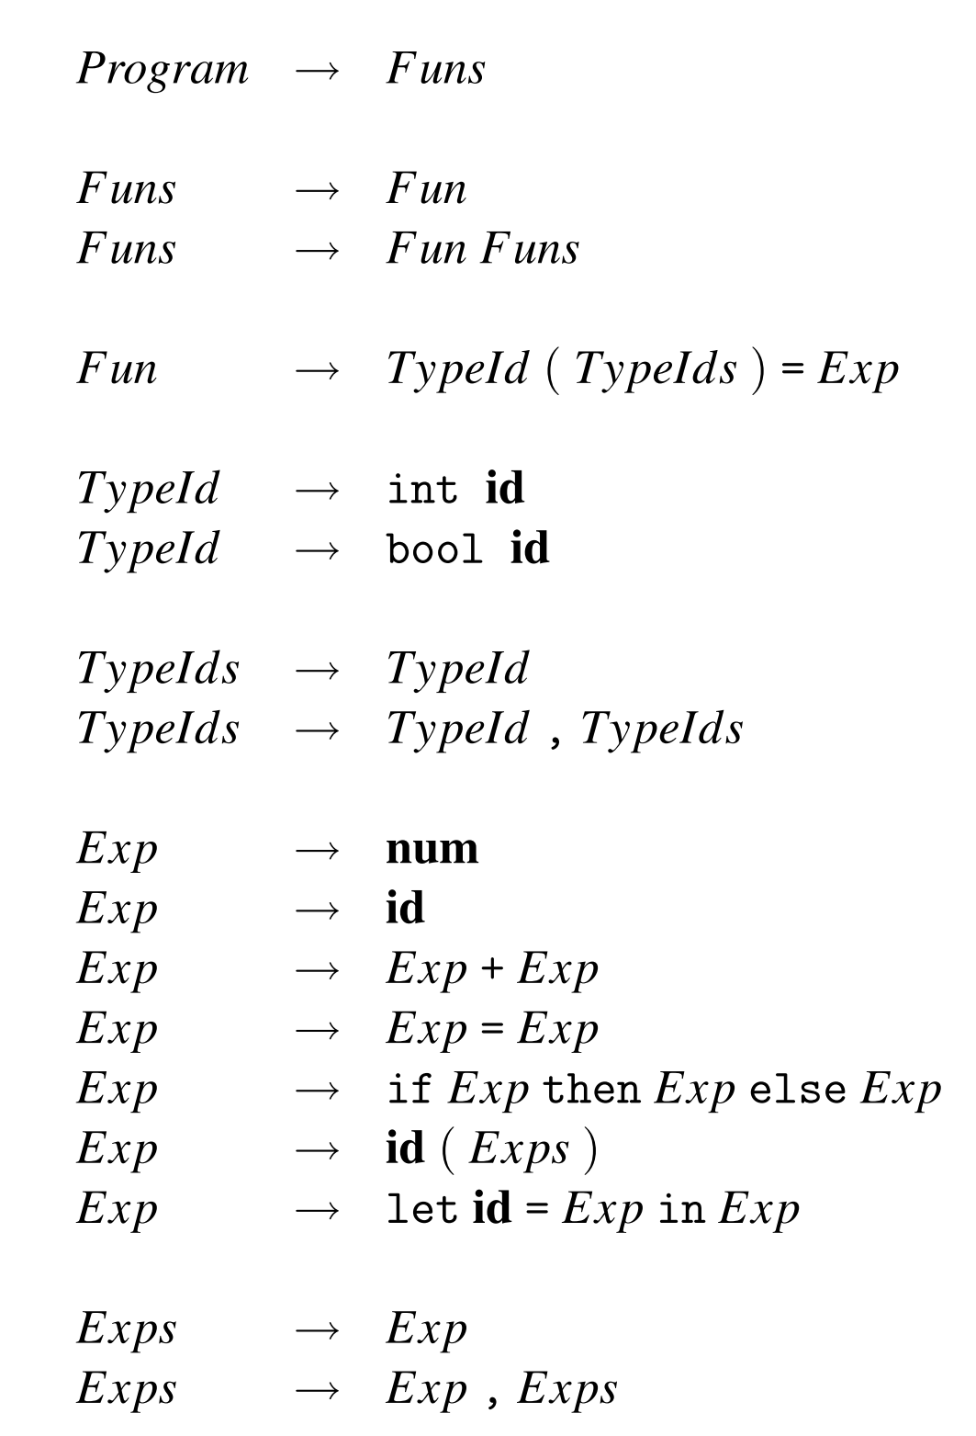
A Small Example Language
This is a first-order functional language with recursive definitions
The grammar is ambiguous; for the purpose of parsing, changes would have to be made, but the AST would be based on this grammar (cf. Section 2.16.3 [M])
Notes:
I recommend careful reading of Section 2.16.3 [M]. We did not spend much time on that section.

Slide 8
A Small Example Language
A program is a list of function declarations
Execution of the program is by calling the main function (which must be present) with the input (which must be an integer). The result of this function call is the result of the program

Slide 9
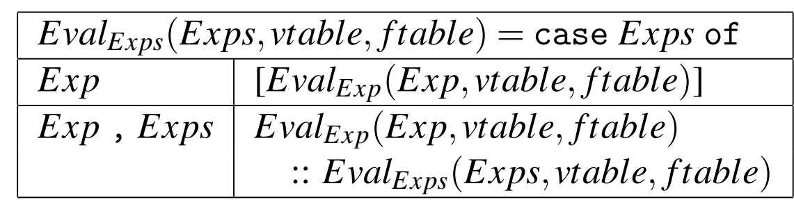
Evaluating Expressions
In addition to the AST, we need a symbol table for variables (vtable) and a symbol table for functions (ftable)
Terminals are looked up. For id we have getname, and for num, getvalue
Eval_Exps evaluates a list of expressions to a list of values. (“::” (read: cons) is the list constructor)

Slide 10
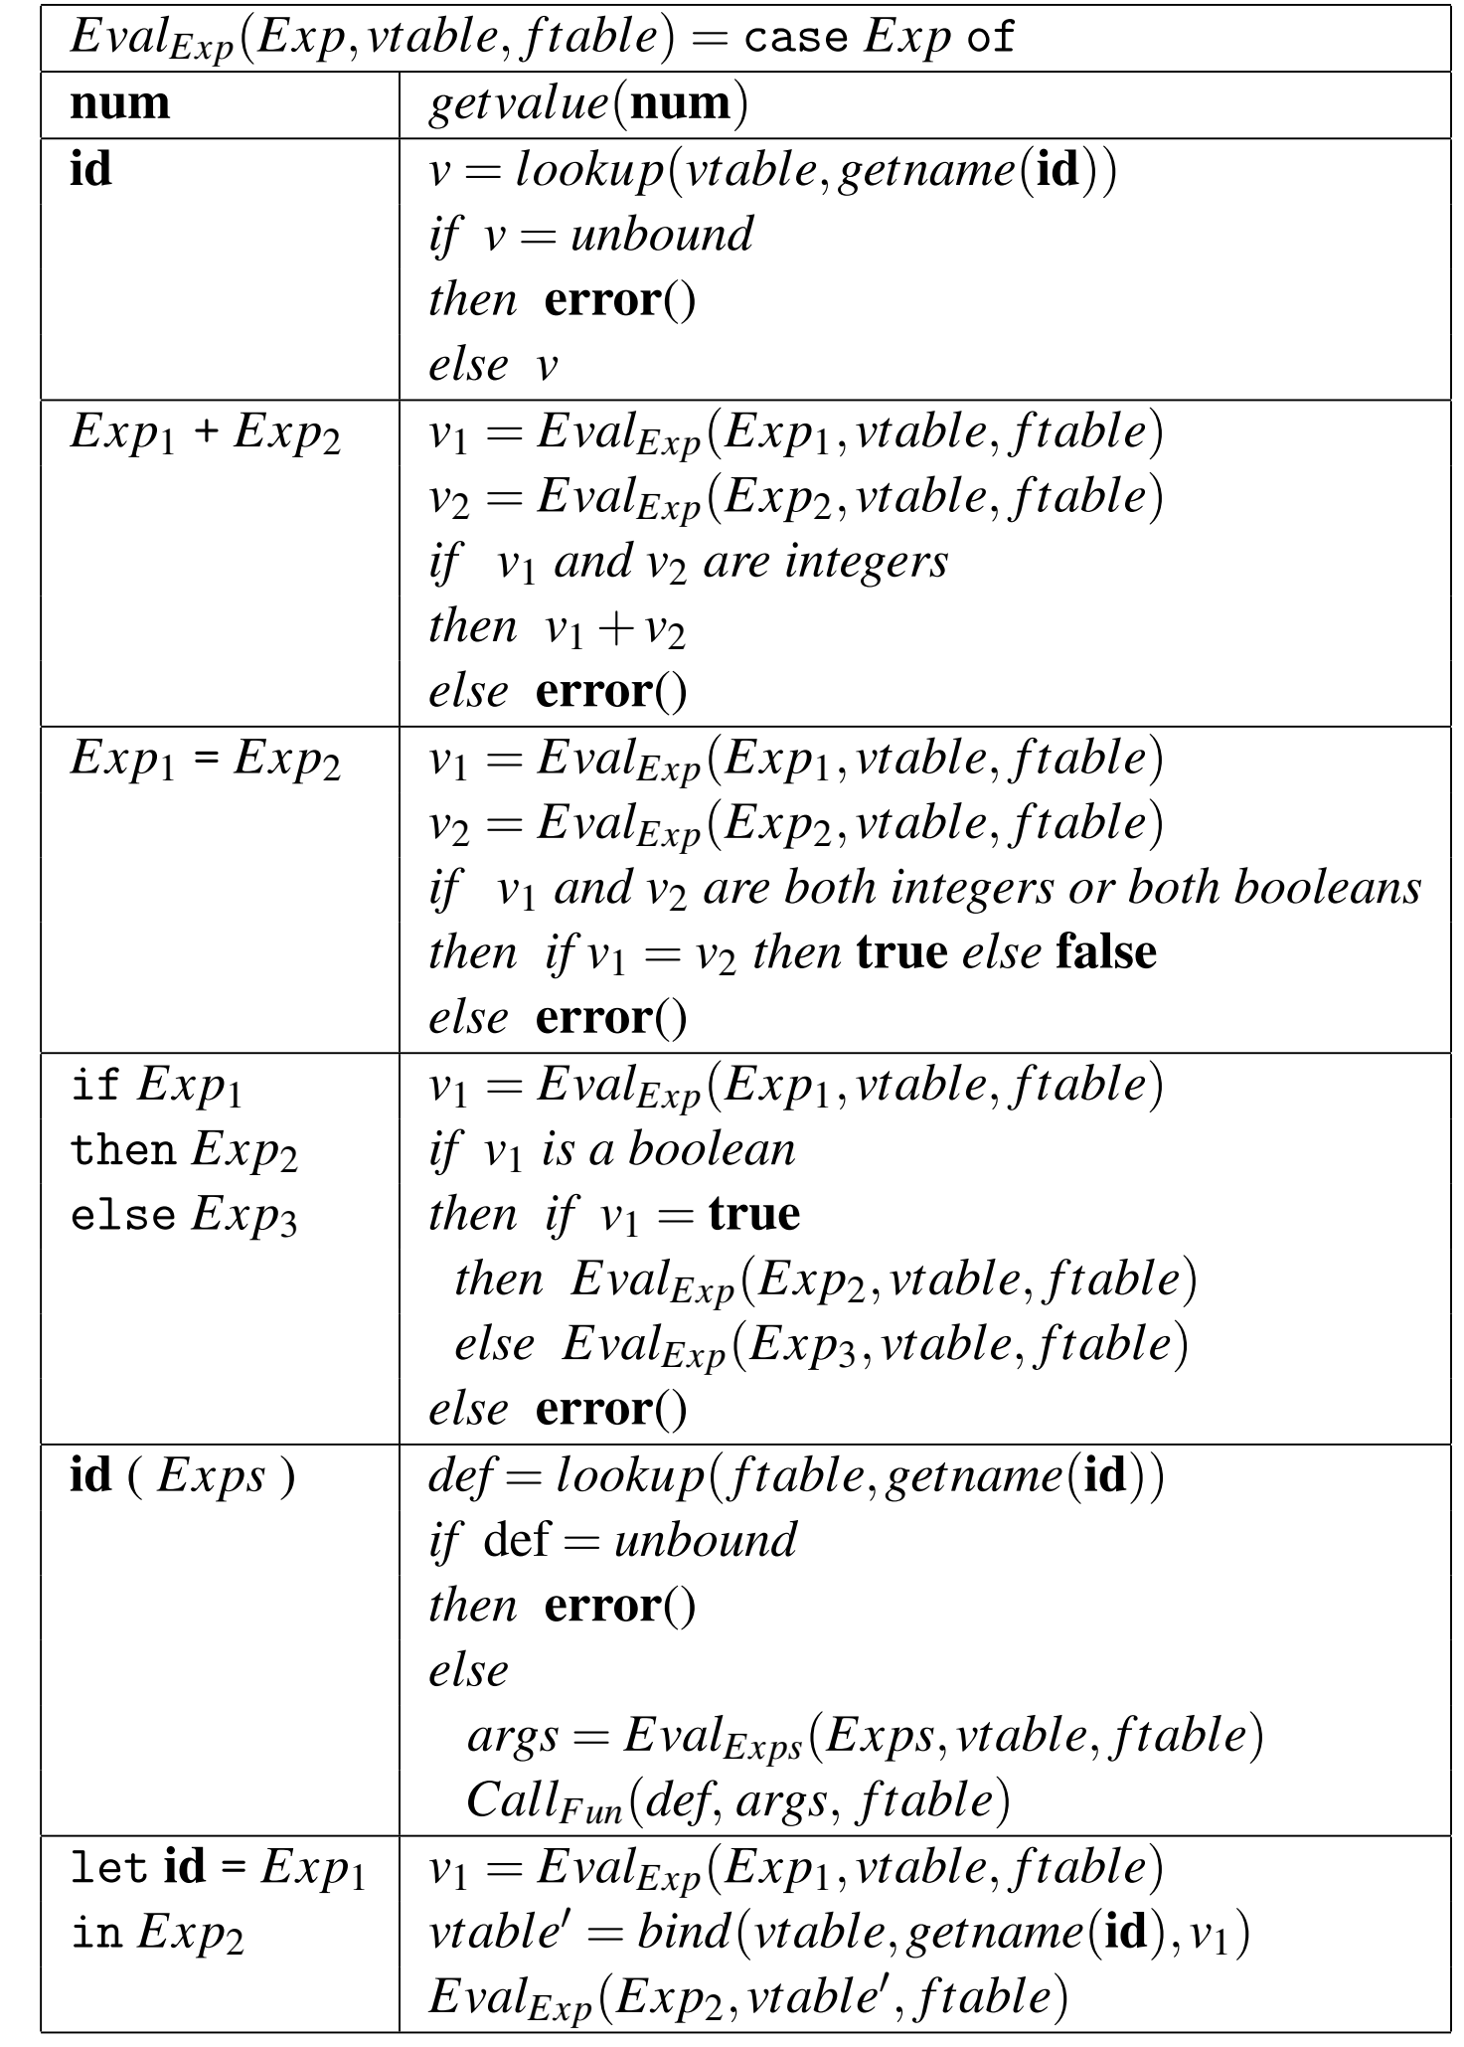
Evaluating an Expression
The main part of EvalExp is a case-expression that identifies which kind of expression the top node of the abstract syntax tree represents. The patterns are shown as concrete syntax, but you should think of it as pattern matching on the abstract syntax.
The box to the right of a pattern shows the actions needed to evaluate the expression. These actions can refer to parts of the pattern on the left. An action is a sequence of definitions of local variables followed by an expression (in the interpreter) that evaluates to the result of the expression that was given (in abstract syntax) as argument to EvalExp.
Notes:
Fig. 4.2 p.107 [M]

Slide 11
Evaluating an Expression
At a function call, the function name is looked up in the function environment to find its definition. If the function is not found in the environment, we report an error. Otherwise, we evaluate the arguments by calling Eval_{Exps} and call Call_{Fun} to find the result of the call
A let-expression declares a new variable with an initial value defined by an expression. The expression is evaluated and the symbol table for variables is extended using the function bind to bind the variable to the value. The extended table is used when evaluating the body-expression, which defines the value of the whole expression. Since we use a permanent symbol table, no explicit work is needed to restore it to its previous state
Notes:
Fig. 4.2 p.107 [M]

Slide 12
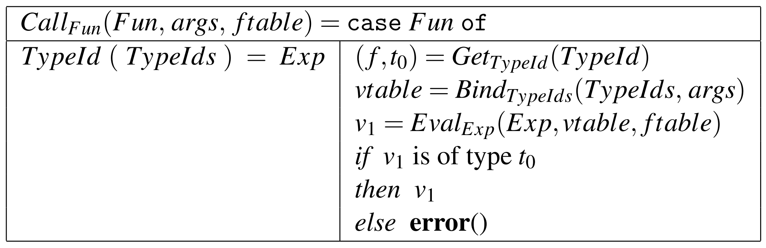
Interpreting Function Calls
Call_{Fun} builds a symbol
table that binds the
parameter variables
to the values of the arguments and use this in evaluating the body of the function. The value of the body must match the declared result type of the function.
Call_{Fun} is also passed a symbol table for functions, which is passed to Eval_{Exps} when evaluating the body of the function.

Slide 13
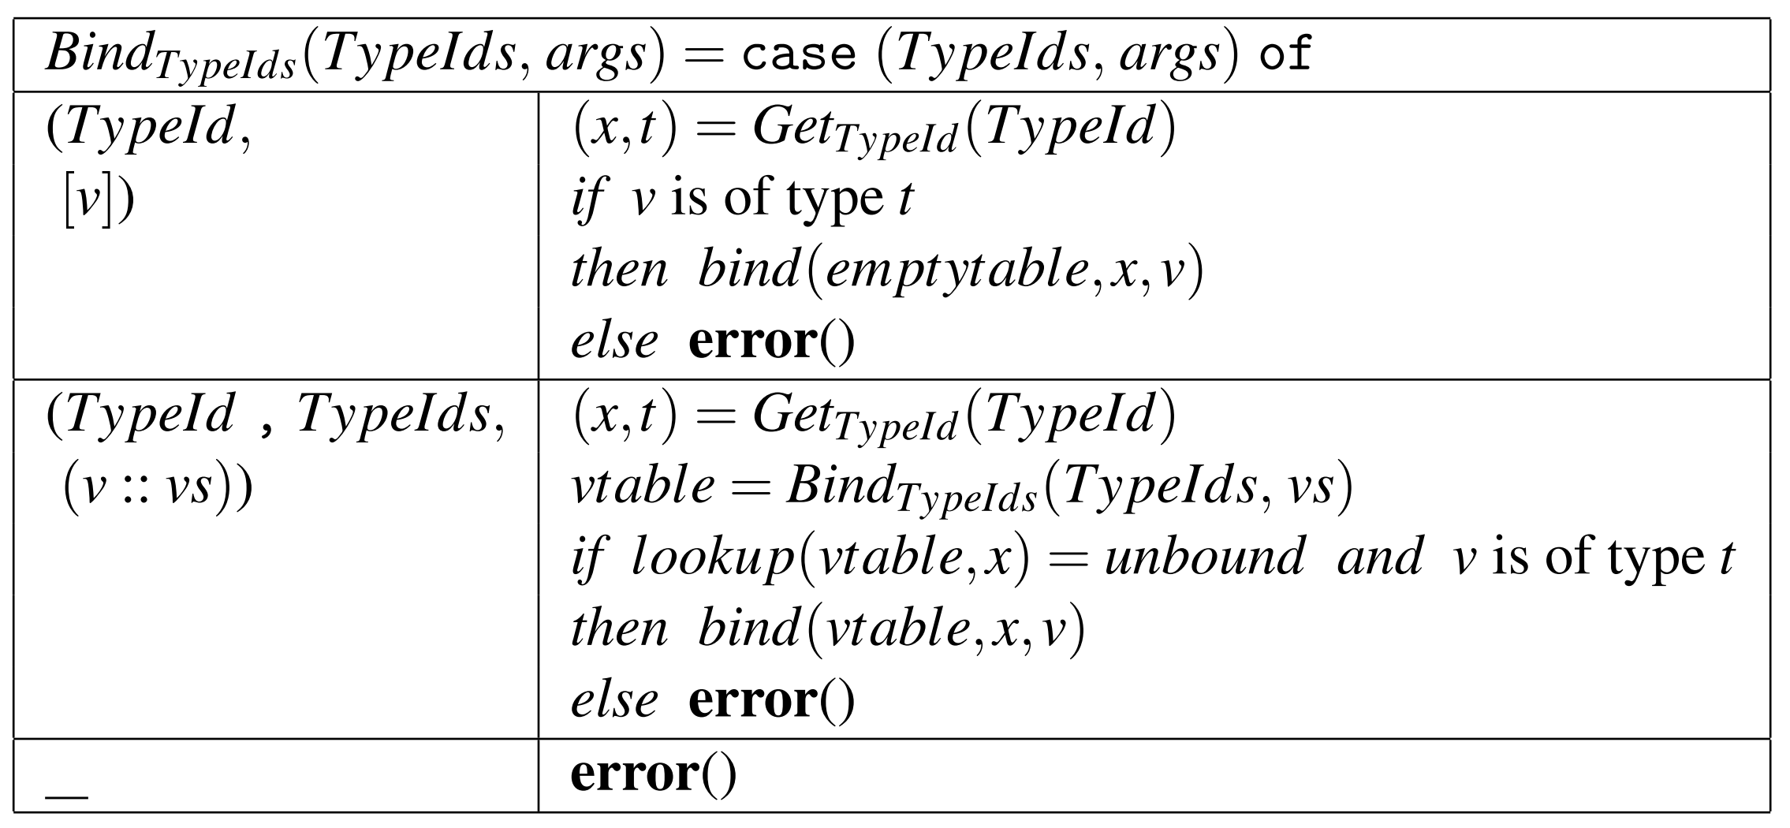
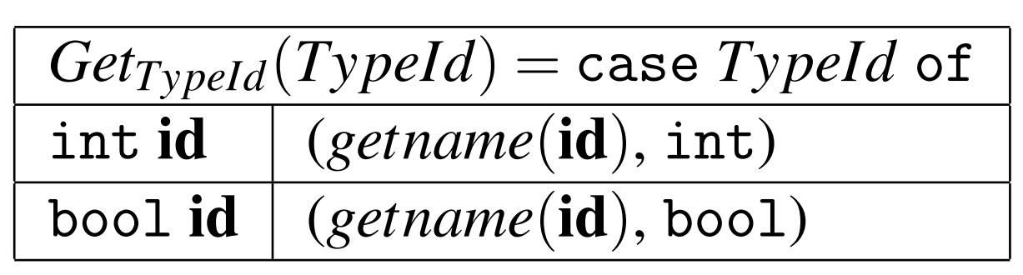
Interpreting Function Calls
GetTypeId just returns a pair of
the declared name and type,
and BindTypeIds checks the
declared type against a value
and builds a symbol table that
binds the name to the value if
they match (and report an error if they
do not). BindsTypeIds also checks if all
parameters have different names by
seeing if the current name is already
bound. emptytable is an empty symbol table. Looking any name up in the empty symbol table returns unbound. The underscore used in the last rule for BindTypeIds is a wildcard pattern that matches anything, so this rule is used when the number of arguments do not match the number of declared parameters.

Slide 14
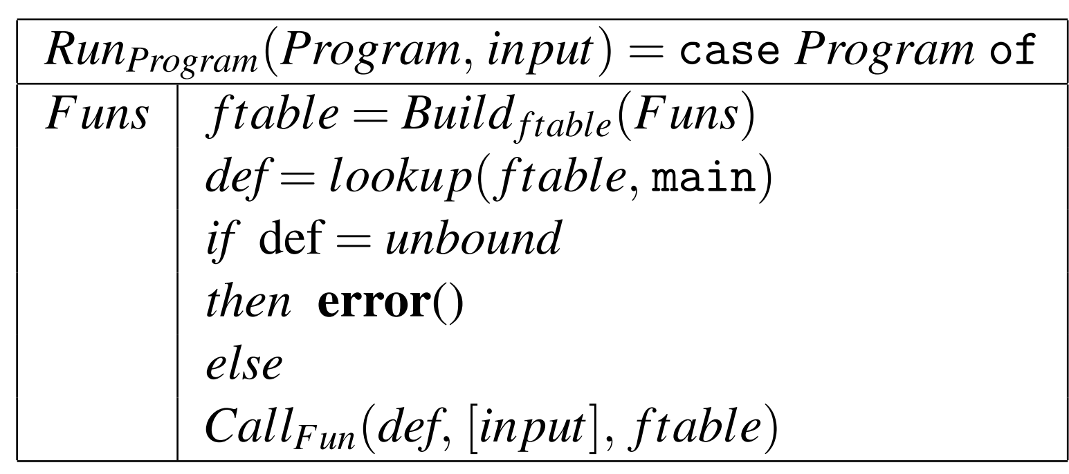
Interpreting a Program
Running a program is done by calling the main function with a single argument that is the input to the program. So we build the symbol table for functions, look up main in this and call Call_{Fun} with the resulting definition and an argument list containing just the input.

Slide 15
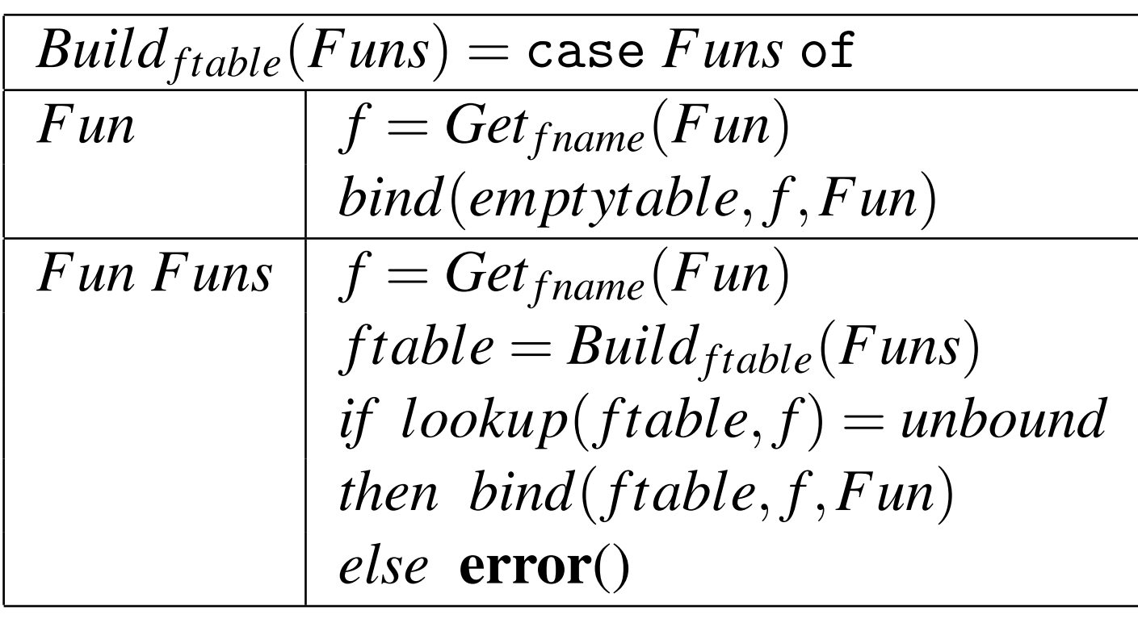
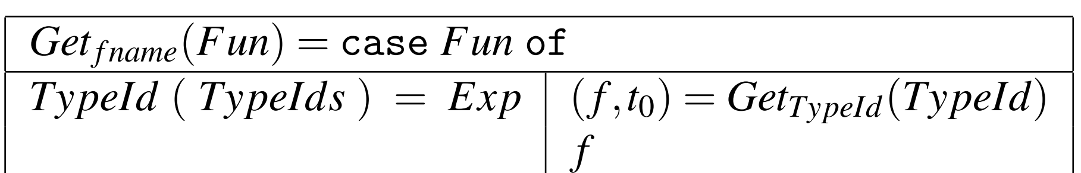
Interpreting a Program
Hence, Run_{Program}, which runs the whole program, calls a function Build_{ftable} that builds the symbol table for functions. This, in turn, uses a function Get_{fname} that finds the name of a function.
The methods carry over to other languages: We build one or more functions for each syntactic category. These may, in addition to the AST, also take other parameters, such as symbol tables, and return values that are used in other parts of the interpreter (or represent part of the output).

Slide 16
Advantages and Disadvantages of Interpretation
Interpretation is often the simplest way of executing a program once you have its abstract syntax tree. However, it is also a relatively slow way to do so. When we perform an operation in the interpreted program, the interpreter must first inspect the abstract syntax tree to see what operation it needs to perform, then it must check that the types of the arguments to the operation match the requirements of the operation, and only then can it perform the operation. Additionally, each value must include sufficient information to identify its type, so after doing, say, an addition, we must add type information to the resulting number.
It should be clear from this that we spend much more time on figuring out what to do and if it is O.K. to do it than on actually doing it!

Slide 17
Advantages and Disadvantages of Interpretation
To get faster execution, we use the observation that a program that only executes each part of the program once will finish quite quickly. In other words, any time consuming program will contain parts that are executed many times. The idea is that we can do the inspection of the abstract syntax tree and the type checking once for each part and only repeat the actual operations that are performed in this part.
Since performing the operations is a small fraction of the total time, we can get a substantial speedup by doing this.
This is the basic idea behind static type checking and compilation.

Slide 18
Advantages and Disadvantages of Interpretation
Some implementations combine interpretation and compilation: The first few times a function is called, it is interpreted, but if it is called sufficiently often, it is compiled and all subsequent calls to the function will execute the compiled code.
This is often called just-in-time compilation, though this term was originally used for just postponing comilation of a function until the first time it is called, hence reducing the delay from editing a program to its execution but at the cost of adding smaller delays during execution.

Slide 19
Different Kinds of Interpretation
recursive interpretation (seen so far)
  operates directly on the AST
  simple to write
  thorough error checks
  very slow: 100x speed of compiled code
iterative interpretation
  operates on intermediate code
  good error checking
  slow: 10x

Slide 20
What’s next?
interpretation
code generation
  code selection
  register allocation
  instruction ordering
Source program
front-end
annotated AST
interpreter
Code generation
Object code
Notes:
Q: do you know an interpreter?
A: Java

Slide 21
What’s next?
intermediate code
interpretation
code generation
  code selection
  register allocation
  instruction ordering
Source program
front-end
annotated AST
intermediate
code generation
interpreter
Code generation
Object code
Notes:
Q: does anybody know what java byte code is?

Slide 22
Intermediate code
language independent
  no structured types,
  only basic types (char, int, float)
  no structured control flow,
  only (un)conditional jumps
linear format
  Java byte code

Slide 23
The usefulness of Interpreters
Quick implementation of new language
  Remember bootstrapping
Testing and debugging
Portability via Abstract Machine
Hardware emulation

Slide 24
Interpretation
recursive interpretation
  operates directly on the AST
  simple to write
  thorough error checks
  very slow: 100x speed of compiled code
iterative interpretation
  operates on intermediate code
  good error checking
  slow: 10x

Slide 25
Iterative interpretation
Follows a very simple scheme:
Typical source language will have several instructions
Execution then is just a big case statement
  one for each instruction
Initialize
Do {
fetch next instruction
analyze instruction
execute instruction
} while (still running)

Slide 26
Iterative Interpreters
Command languages
Query languages
  SQL
Simple programming languages
  Basic
Virtual Machines

Slide 27
Mini-shell
Script ::= Command*
Command ::= Command-Name Argument* end-of-line
Argument ::= Filename
| Literal
Command-Name ::= create
| delete
| edit
| list
| print
| quit
| Filename

Slide 28
Mini-Shell Interpreter
Public class MiniShellCommand {
public String name;
public String[] args;
}
Public class MiniShellState {
//File store…
public …
//Registers
public byte status; //Running or Halted or Failed
public static final byte // status values
RUNNING = 0, HALTED = 1, FAILED = 2;
}

Slide 29
Mini-Shell Interpreter
Public class MiniShell extends MiniShellState {
public void Interpret () {
… // Execute the commands entered by the user
// terminating with a quit command
}
public MiniShellCommand readAnalyze () {
… //Read, analyze, and return
//the next command entered by the user
}
public void create (String fname) {
… // Create empty file with the given name
}
public void delete (String[] fnames) {
… // Delete all the named files
}
…
public void exec (String fname, String[] args) {
… //Run the executable program contained in the
… //named files, with the given arguments
}
}

Slide 30
Mini-Shell Interpreter
Public void interpret () {
//Initialize
status = RUNNING;
do {
//Fetch and analyze the next instruction
MiniShellCommand com = readAnalyze();
// Execute this instruction
if (com.name.equals(“create”))
create(com.args[0]);
else if (com.name.equals(“delete”))
delete(com.args)
else if …
else if (com.name.equals(“quit”))
status = HALTED;
else status = FAILED;
} while (status == RUNNING);
}

Slide 31
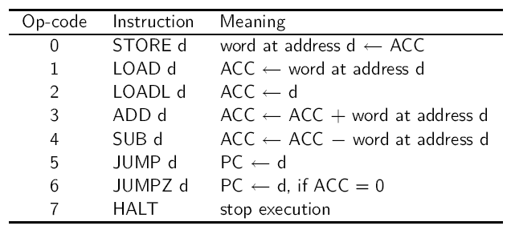
Hypo: a Hypothetic Abstract Machine
4096 word code store
4096 word data store
PC: program counter, starts at 0
ACC: general purpose register
4-bit op-code
12-bit operand
Instruction set:

Slide 32
Hypo Code Store and Data Store

Slide 33
Hypo: State Changes

Slide 34
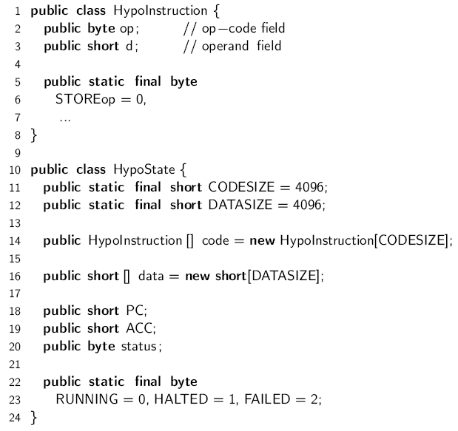
Hypo Interpreter Implementation (1)

Slide 35
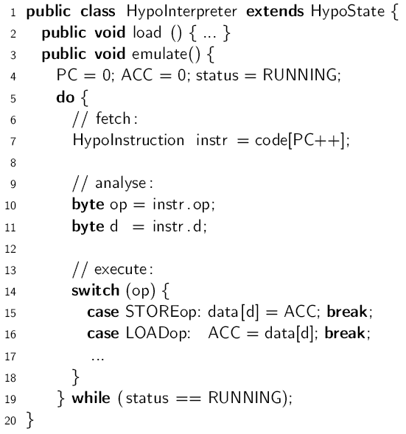
Hypo Interpreter Implementation (2)

Slide 36
Mini-Basic Interpreter
The Mini-Basic Abstract Machine is similar to the Hypo emulator. The interpreter is also an iterative one.
Three choices for representing Mini-Basic commands:
Source text (as in Mini-Shell): Each command is scanned and parsed every time the command is fetched from the code store
Token sequence: each command is scanned ay load time and parsed at run time
AST: All commands are scanned and parsed at load time.
The second choice is followed in [W]. ASTs are built at execution time.

Slide 37
The Mini-Basic Interpreter (Core)

Slide 38
TAM
The Triangle Abstract Machine (TAM) is implemented as an iterative interpreter
The file Interpreter.java
..\Triangle\tools-2.1\TAM\Interpreter.java
Implements an interpreter for the Triangle Assembly Language (TAL), viz. the Triangle Abstract Machine (TAM).

Slide 39
TAM machine architecture
TAM is a stack machine
  There are no data registers as in register machines.
  The temporary data are stored in the stack.
    But, there are special registers (Table C.1 of page 407)
TAM Instruction Set
  Instruction Format (Figure C.5 of page 408)
  op: opcode (4 bits)
    r: special register number (4 bits)
    n: size of the operand (8 bits)
    d: displacement (16 bits)
Instruction Set
  Table C.2 of page 409

Slide 40
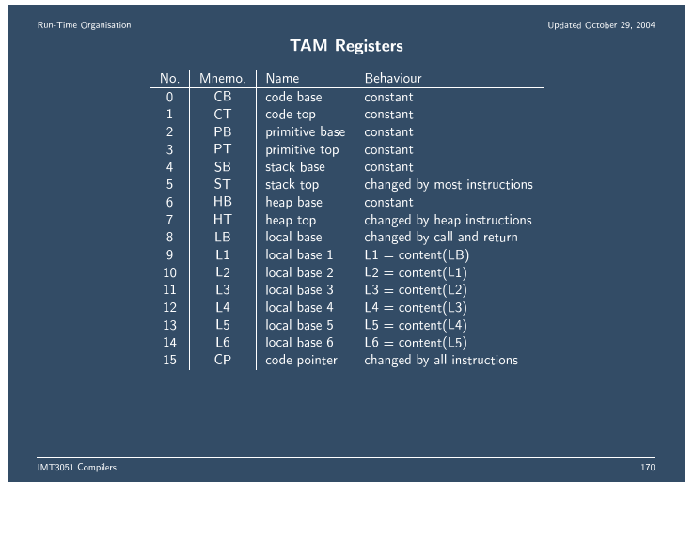
TAM Registers

Slide 41
TAM Machine code
Machine code consists of 32-bit instructions in the code store
  op (4 bits), type of instruction
  r (4 bits), register
  n (8 bits), size
  d (16 bits), displacement
Example: LOAD (1) 3[LB]:
  op = 0 (0000)
  r = 8 (1000)
  n = 1 (00000001)
  d = 3 (0000000000000011)
0000 1000 0000 0001 0000 0000 0000 0011

Slide 42
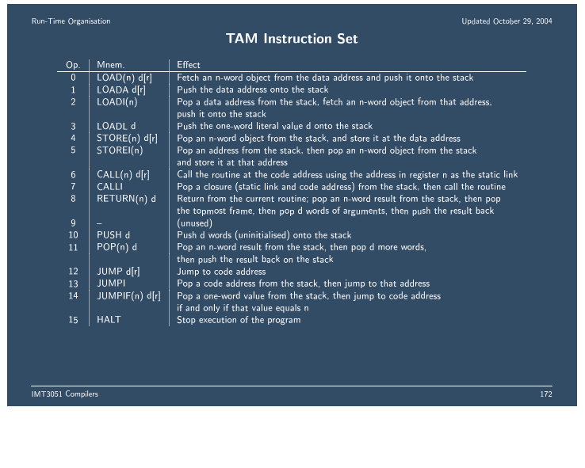
TAM Instruction set

Slide 43
TAM machine architecture
Two Storage Areas
  Code Store (32 bits words)
    Code Segment: to store the code of the program to run
      Pointed to by CB and CT
    Primitive Segment: to store the code for primitive operations
      Pointed to by PB and PT
  Data Store (16 bits words)
    Stack
      global segment at the base of the stack
        Pointed to by SB
      stack area for stack frames of procedure and function calls
        Pointed to by LB and ST
    Heap
      heap area for the dynamic allocation of variables
        Pointed to by HB and HT

Slide 44
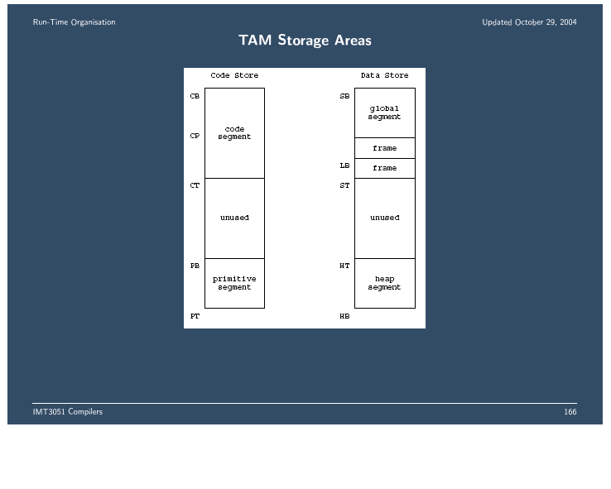
TAM machine architecture

Slide 45
Global Variable and Assignment Command
Triangle source code
  ! simple expression and assignment
  let
  var n: Integer
  in
    begin
    n := 5;
    n := n + 1
    end
TAM assembler code
  0: PUSH 1
  1: LOADL 5
  2: STORE (1) 0[SB]
  3: LOAD (1) 0[SB]
  4: LOADL 1
  5: CALL add
  6: STORE (1) 0[SB]
  7: POP (0) 1
  8: HALT

Slide 46
Recursive interpretation
Two phased strategy
  Fetch and analyze program
    Recursively analyzing the phrase structure of source
    Generating AST
    Performing contextual analysis
      Recursively via visitor
  Execute program
    Recursively by walking the decorated AST

Slide 47
Recursive Interpreter for MiniTriangle
Representing MiniTriangle values in Java:
public abstract class Value { }
public class IntValue extends Value {
public short i;
}
public class BoolValue extends Value {
public boolean b;
}
public class UndefinedValue extends Value { }

Slide 48
Recursive Interpreter for MiniTriangle
A Java class to represent the state of the interpreter:
public class MiniTriangleState {
public static final short DATASIZE = …;
//Code Store
Program program; //decorated AST
//Data store
Value[] data = new Value[DATASIZE];
//Register …
byte status;
public static final byte //status value
RUNNING = 0, HALTED = 1, FAILED = 2;
}
The class AST and its subclasses Program, Command,
Expression, Declaration, as described in Example 4.19 are assumed.

Slide 49
AST Construction: Review (Sec. 4.4.2)
Here is how Watt and Brown’s recursive descent parser actually constructs an AST.
N ::= X
private N parseN() {
N itsAST;
parse X at the same time constructing itsAST
return itsAST;
}

Slide 50
Recursive Interpreter for MiniTriangle
public class MiniTriangleProcessor
extends MiniTriangleState implements Visitor {
public void fetchAnalyze () {
//load the program into the code store after
//performing syntactic and contextual analysis
//requires -a parser (Example 4.12),
// -a contextual analyzer (Example 5.11),
// -a static storage allocator (Example 7.13)
}
public void run () {
… // run the program
public Object visit…Command
(…Command com, Object arg) {
//execute com, returning null (ignoring arg)
}
public Object visit…Expression
(…Expression expr, Object arg) {
//Evaluate expr, returning its result
}
public Object visit…
}

Slide 51
Recursive Interpreter for MiniTriangle
public Object visitAssignCommand
(AssignCommand com, Object arg) {
Value val = (Value) com.E.visit(this, null);
assign(com.V, val);
return null;
}
public Objects visitCallCommand
(CallCommand com, Object arg) {
Value val = (Value) com.E.visit(this, null);
CallStandardProc(com.I, val);
return null;
}
public Object visitSequentialCommand
(SequentialCommand com, Object arg) {
com.C1.visit(this, null);
com.C2.visit(this, null);
return null;
}

Slide 52
Recursive Interpreter for MiniTriangle
public Object visitIfCommand
(IfCommand com, Object arg) {
BoolValue val = (BoolValue) com.E.visit(this, null);
if (val.b) com.C1.visit(this, null);
else com.C2.visit(this, null);
return null;
}
public Object visitWhileCommand
(WhileCommand com, Object arg) {
for (;;) {
BoolValue val = (BoolValue) com.E.visit(this, null)
if (! Val.b) break;
com.C.visit(this, null);
}
return null;
}

Slide 53
Recursive Interpreter for MiniTriangle
public Object visitIntegerExpression
(IntegerExpression expr, Object arg){
return new IntValue(Valuation(expr.IL));
}
public Object visitVnameExpression
(VnameExpression expr, Object arg) {
return fetch(expr.V);
}
…
public Object visitBinaryExpression
(BinaryExpression expr, Object arg){
Value val1 = (Value) expr.E1.visit(this, null);
Value val2 = (Value) expr.E2.visit(this, null);
return applyBinary(expr.O, val1, val2);
}

Slide 54
Recursive Interpreter for MiniTriangle
public Object visitConstDeclaration
(ConstDeclaration decl, Object arg){
KnownAddress entity = (KnownAddress) decl.entity;
Value val = (Value) decl.E.visit(this, null);
data[entity.address] = val;
return null;
}
public Object visitVarDeclaration
(VarDeclaration decl, Object arg){
KnownAddress entity = (KnownAddress) decl.entity;
data[entity.address] = new UndefinedValue();
return null;
}
public Object visitSequentialDeclaration
(SequentialDeclaration decl, Object arg){
decl.D1.visit(this, null);
decl.D2.visit(this, null);
return null;
}

Slide 55
Recursive Interpreter for MiniTriangle
Public Value fetch (Vname vname) {
KnownAddress entity =
(KnownAddress) vname.visit(this, null);
return data[entity.address];
}
Public void assign (Vname vname, Value val) {
KnownAddress entity =
(KnownAddress) vname.visit(this, null);
data[entity.address] = val;
}
Public void fetchAnalyze () {
Parser parse = new Parse(…);
Checker checker = new Checker(…);
StorageAllocator allocator = new StorageAllocator();
program = parser.parse();
checker.check(program);
allocator.allocateAddresses(program);
}
Public void run () {
program.C.visit(this, null);
}

Slide 56
Alternative Design for the Mini-Triangle Recursive Interpreter
Design similar to the one for mini-Basic (Example 8.3):
  Equip each Command subclass with an execute method
  Equip each Expression subclass with an evaluate method
  Equip each Declaration subclass with an elaborate method
Each of these interpreting states would be passed the abstract machine state as argument.

Slide 57
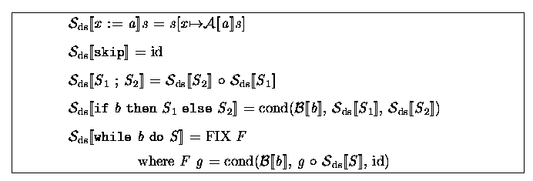
Recursive Interpreter and Semantics
Code for Recursive Interpreter is very close to denotational semantics

Slide 58
Recursive interpreters
Usage
  Quick implementation of high-level language
    LISP, SML, Prolog, … , all started out as interpreted languages
  Scripting languages
    If the language is more complex than a simple command structure we need to do all the front-end and static semantics work anyway.
    Web languages
      JavaScript, PhP, ASP where scripts are mixed with HTML or XML tags

Slide 59



Interpreters are everywhere on the web
Web-Client
Database
Server
Web-Server
HTML-Form
(+JavaScript)
Submit
Data
WWW
Call PHP
interpreter
DBMS
LAN
Web-Browser
PHP
Script
SQL
commands
Response
Response
Database
Output
Reply

Slide 60
Interpreters versus Compilers
Q: What are the tradeoffs between compilation and interpretation?
Compilers typically offer more advantages when
  programs are deployed in a production setting
  programs are “repetitive”
  the instructions of the programming language are complex
Interpreters typically are a better choice when
  we are in a development/testing/debugging stage
  programs are run once and then discarded
  the instructions of the language are simple
  the execution speed is overshadowed by other factors
    e.g. on a web server where communications costs are much higher than execution speed

